Slide 1
Modelling contingency experiments
Francesco Mannella
.
Laboratory of Compuational Embodied Neuroscience (LOCEN)
Institute of Cognitive Sciences and Technologies (ISTC)
Italian National Research Council (CNR)
Rome, Italy

Slide 2
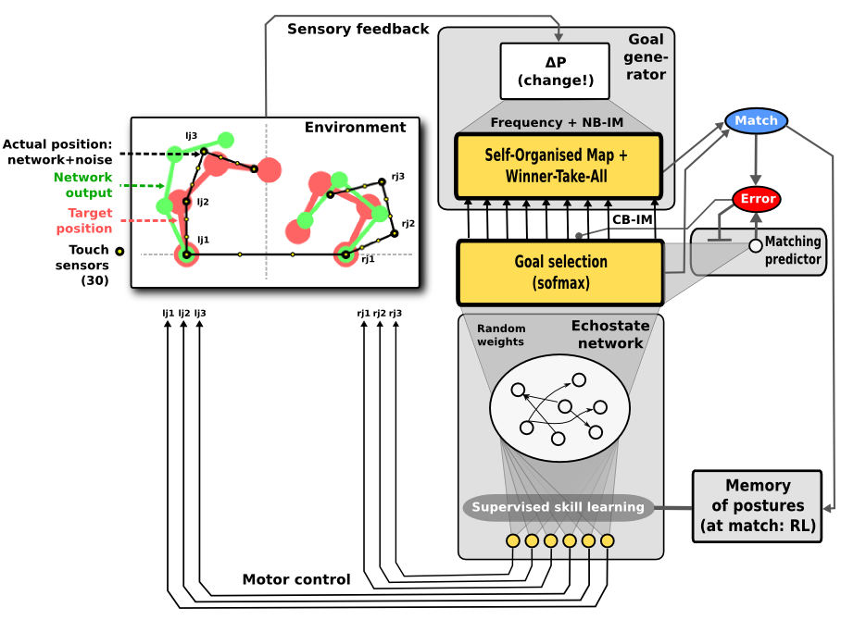
The previous model
sensory modality: touch
Goal generation:
  Cluster formation based on SOM (k-means + topology)
  Near-to-prototipe event detection based on SOM output + threshold
Motor skills:
  fixed-point attractors to the goal joint positions.

Slide 3
The contingency setting
Current:
  The agent moves randomly
  Occasionally it touches itself.
  The touch positions are focused on to reproduce the touch events (goals).
More realistic case:
  The agent randomly produces movements (trajectories)
  Some of those movements produce an interesting sensory event (goal)
  The goal can be anything involving all combinations of sensory modalities (touch, proprioception, vision)
  These movements are focused on and refined to reproduce the goal.

Slide 4
Needs for the upgrade of the model
Goal generation issue:
  Multiple sensory modalities
    Changes can affect a single sensory modality, but more often they affect a subset or even all the sensory space.
  Online clustering issue
    The environment of an embodied agent is non-static. The streaming of sensory patterns is not a finite set of randomly-shuffled patterns. Instead the sequence of sensory events depends on the sequence of agent's movements.
Movement reproduction issue:
  Learning and recall trajectories (instead of target positions)
    the agent must be able to learn not only the final postures to reach but also the more appropriate trajectories to perform in between (movements). Moreover it must be able to generalize them to the whole space of goal postures.

Slide 5
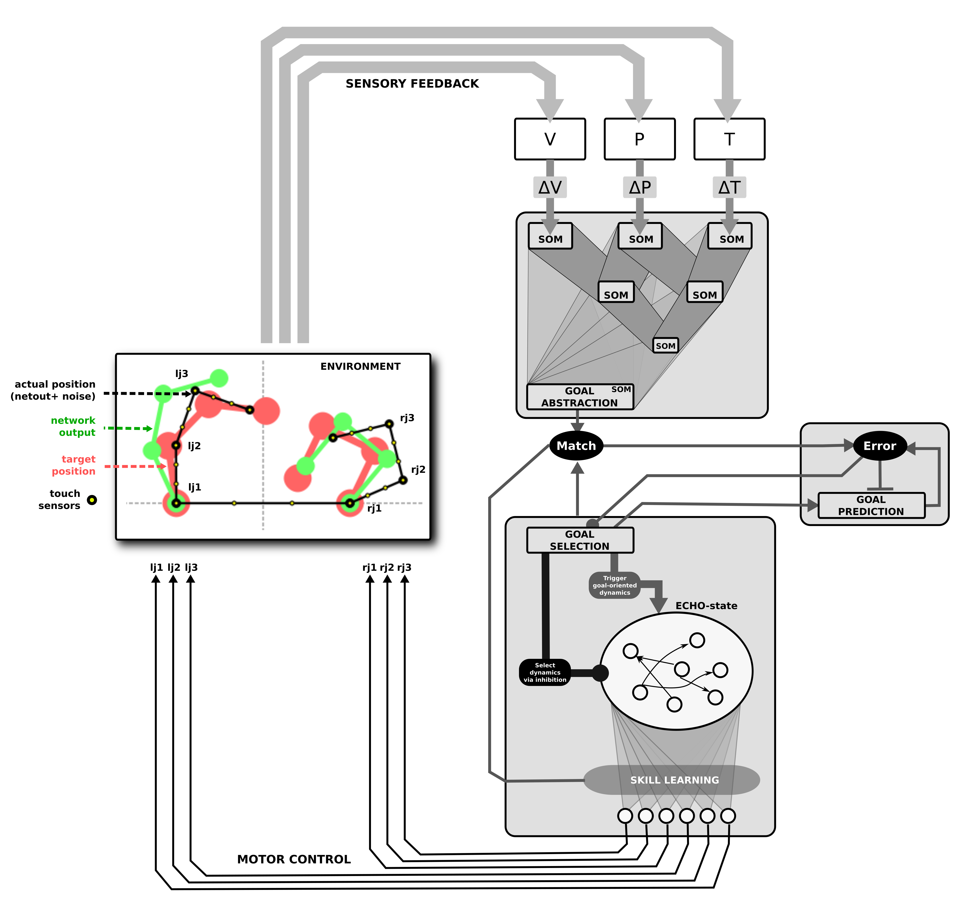
How to solve the goal generation issue
Using a stack of SOMs
  Allows to learn clusters of various combinations of modalities
  Allows to learn clusters at various levels of abstraction
  Does not solve the online clustering issue

Slide 6
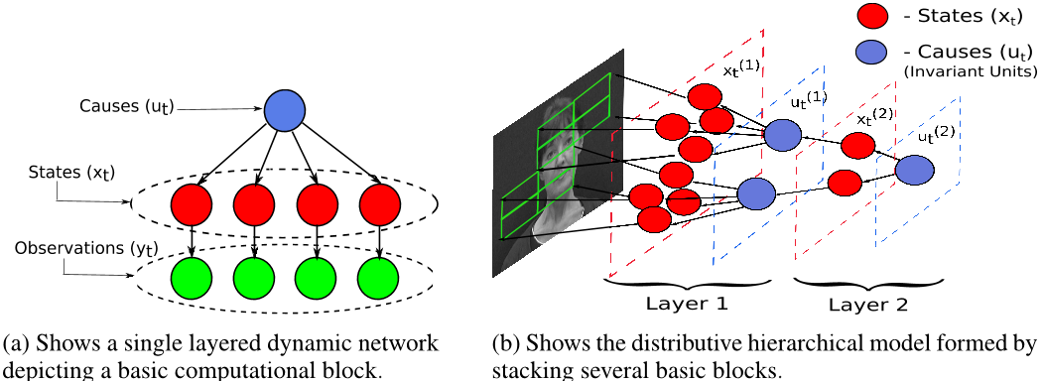
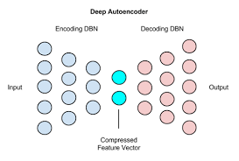
How to solve the goal generation issue
Possible alternatives to the stack of SOMs:
  Deep predictive coding
  Deep auto-encoders
  Solve the online clustering issue?

Slide 7
How to solve the goal generation issue
Solving the online clustering issue with intrinsic motivations (temptative)
  Coupling the step of online clustering to a measure of the acquired competence for the current skill.
  For instance multiplying the learning rate parameter of the SOM by r = (1-m), where m is the moving average of the proportion of successful reproductions of the interesting events by the agent.

Slide 8
How to solve the movement reproduction ssue
What we have now
  The agent acquires a fixed-point attractor dynamics for each new goal.
What we need
  The agent should acquire a parametrized trajectory for each new goal (where parameters could be the initial position or other context-based information).
  The agent should be also able to generalize trajectories with respect to the space of goals

