Slide 1
Modelling contingency experiments
Francesco Mannella
.
Laboratory of Compuational Embodied Neuroscience (LOCEN)
Institute of Cognitive Sciences and Technologies (ISTC)
Italian National Research Council (CNR)
Rome, Italy

Slide 2
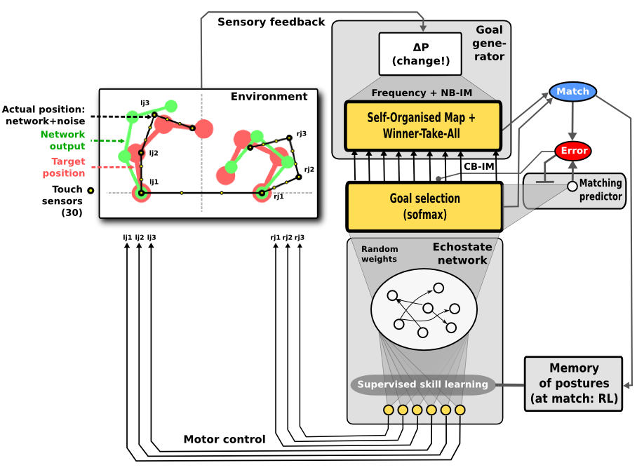
The previous model
sensory modality: touch
Goal generation:
  Cluster formation based on SOM learning (k-means + topology)
  Near-to-prototipe event detection based on SOM output + threshold
Motor skills:
  fixed-point attractors to the goal joint positions.

Slide 3
The contingency setting
Current:
  The agent moves randomly
  Occasionally it touches itself.
  The touch positions are focused on to reproduce the touch events (goals).
More realistic case:
  The agent randomly produces movements (trajectories)
  Some of those movements produce an interesting sensory event (goal)
  The goal can be anything involving all combinations of sensory modalities (touch, proprioception, vision)
  These movements are focused on and refined to reproduce the goal.

Slide 4
Needs for the upgrade of the model
Goal generation issue:
  Multiple sensory modalities
  Online clustering issue
Movement reproduction issue:
  Learning and recall trajectories (instead of target positions)

Slide 5
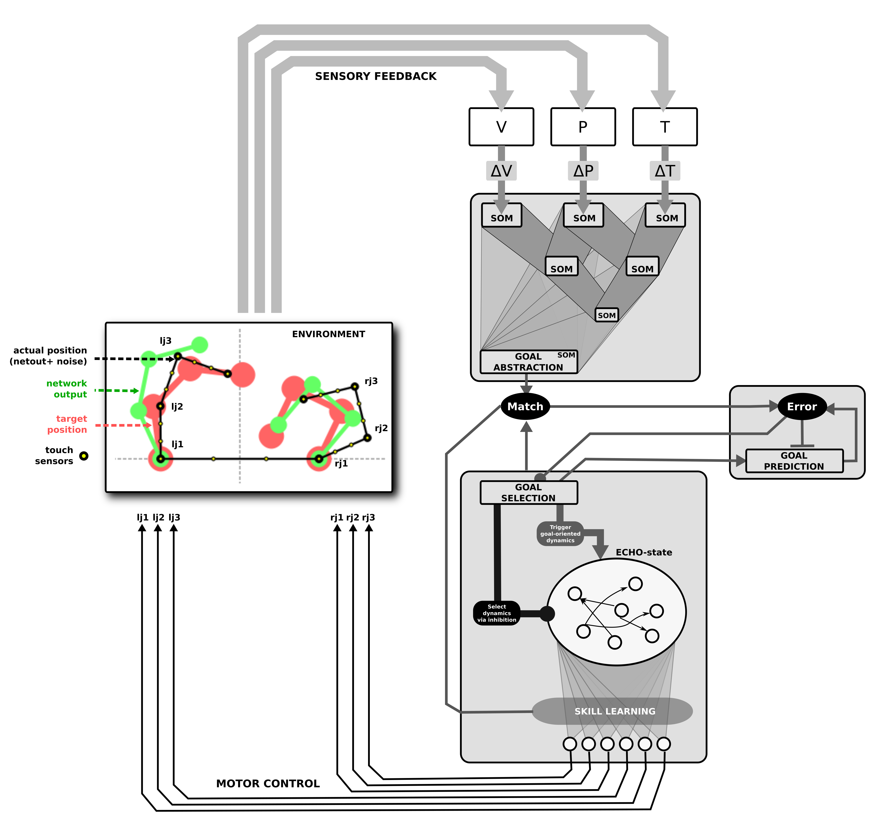
Trying to solve the goal generation issue
Using a stack of SOMs
  Allows to learn clusters of various combinations of modalities
  Allows to learn clusters at various levels of abstraction
  Does not solve the online clustering issue

Slide 6
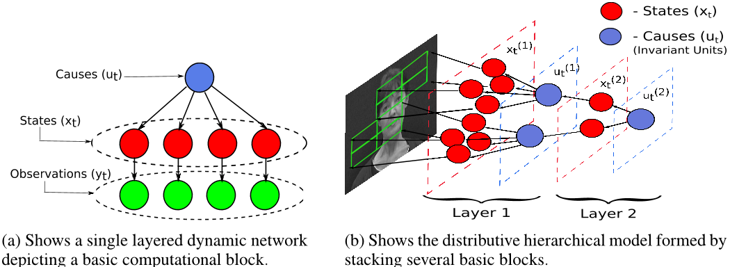
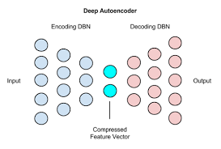
Trying to solve the goal generation issue
Possible alternatives to the stack of SOMs:
  Deep predictive coding
  Deep auto-encoders

Slide 7
Trying to solve the goal generation issue

