Slide 1
The buzzer experiment
Subjects (3-6 months)
Stimulus: costantly vibrating buzzer attached to one of the 4 limbs.
behavioral responses:
  moving limbs
  moving stimulated limb
  touching stimulated limb
  looking stimulated limb
  rubbing limbs together
  touching the buzzer

Slide 2
The buzzer experiment
3-months children respond with patterns that involve the whole body
Starting from 4 mounts children develop differentiated movement patterns associated to stimulus location after few months.

Slide 3
The development of sensorimotor body maps
Learning is categorizing the multimodal perceptual information
Learning is Acquiring the motor skills to reproduce a given perceptual category
intrinsic motivations (novelty-based, learning-based, agency-based) lead learning.
The acquisition of a more and more complex perceptual categorization leads to more a more refined motor skills.

Slide 4
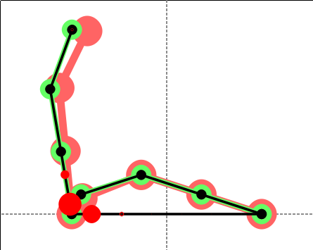
Modelling

