Slide 1
Indian Credit Card Brand Intelligence
Proof of Work | Published credit-card review dataset | 21 October 2026
Illustrative PoW — not for external publication without approved data

Slide 2
Objective and research questions
How does issuer visibility compare?
Which topics drive positive and negative conversation?
Where can Marketing prioritize deeper investigation?
Illustrative PoW — not for external publication without approved data

Slide 3
Data and methodology
1771 deduplicated pure credit-card review records from the published GitHub source.
Only records labelled credit_card_review are included; app reviews and bank commentary are excluded.
Source sentiment scores are mapped to positive, neutral and negative labels; topics use source labels where available.
Illustrative PoW — not for external publication without approved data

Slide 4
Dataset profile and quality
1771 deduplicated records | 3 issuers | 5 topics
All unique SBI credit-card records are retained. Issuer volume is unbalanced, so percentages and sample sizes accompany raw counts. Axis is excluded.
Illustrative PoW — not for external publication without approved data

Slide 5
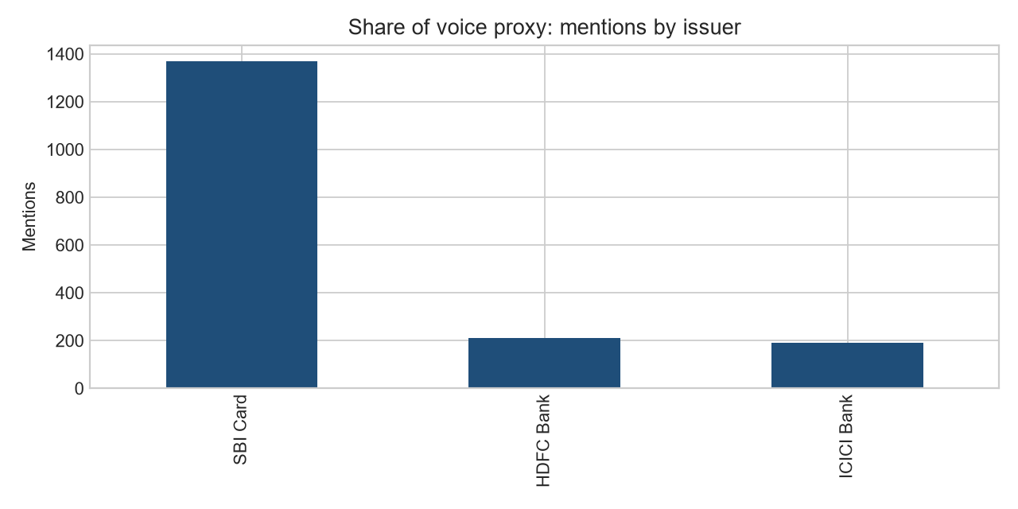
Share of voice proxy
SBI Card: 1368 (77.2%), HDFC Bank: 212 (12.0%), ICICI Bank: 191 (10.8%)
This is source-volume share, not market share or brand preference. SBI has more source records and therefore higher raw volume.
Illustrative PoW — not for external publication without approved data

Slide 6
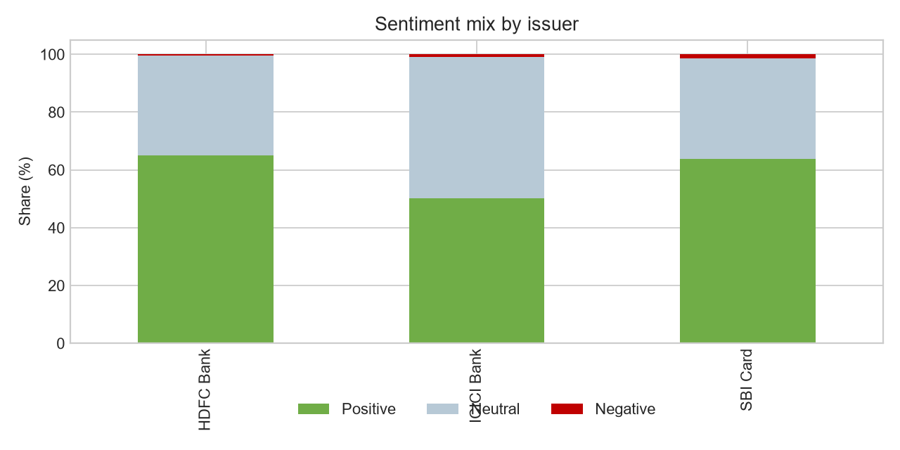
Sentiment comparison
SBI Card: 63.7% positive | 34.8% neutral | 1.5% negative
HDFC Bank: 65.1% positive | 34.4% neutral | 0.5% negative
ICICI Bank: 50.3% positive | 48.7% neutral | 1.0% negative
Only 24 reviews are negative, so differences are directional rather than statistically conclusive.
Illustrative PoW — not for external publication without approved data

Slide 7
Topic-level competitor comparison
Benefits is the dominant topic, followed by fees and rewards. SBI contributes most pure credit-card records; use within-issuer percentages rather than raw counts, while retaining all SBI records.
Illustrative PoW — not for external publication without approved data

Slide 8
Key findings and recommendations
1. SBI Card dominates source volume; do not interpret raw counts as performance.
2. HDFC and SBI show higher positive shares than ICICI in this sample.
3. Negative reviews are too sparse for strong complaint rankings.
4. Add Axis data and a permitted current source before making market claims.
Illustrative PoW — not for external publication without approved data

Slide 9
Limitations and next steps
The analysis is pure credit-card review data but remains issuer-imbalanced, lacks Axis coverage, and has no reliable dates or engagement values. Reuse rights need confirmation.
Next: obtain additional comparable card-level HDFC, ICICI and Axis reviews, QA labels, and refresh the dashboard.
Illustrative PoW — not for external publication without approved data

