Slide 1
Indian Credit Card Brand Intelligence
Proof of Work | Customer reviews + historical Twitter listening
Marketing Strategy analyst workflow | 21 October 2026
Indian Credit Card Brand Intelligence PoW | Directional analysis | Verify reuse rights before distribution

Slide 2
Executive summary
Review module: 1,771 pure credit-card reviews across HDFC Bank, SBI Card and ICICI Bank.
Twitter module: 2,084 filtered historical mentions across four issuers.
Indian Credit Card Brand Intelligence PoW | Directional analysis | Verify reuse rights before distribution

Slide 3
Business questions
Which issuers receive the most source visibility?
What topics and sentiment patterns appear in customer reviews?
How can dated social mentions and engagement support recurring marketing reporting?
Indian Credit Card Brand Intelligence PoW | Directional analysis | Verify reuse rights before distribution

Slide 4
Data and methodology
1,771 deduplicated pure customer reviews from the published GitHub dataset.
Source scores are mapped to Positive, Neutral and Negative; topics use source labels where available.
Twitter mentions are filtered and deduplicated separately because they are social-listening evidence, not necessarily customer reviews.
Indian Credit Card Brand Intelligence PoW | Directional analysis | Verify reuse rights before distribution

Slide 5
Customer-review dataset profile
1,771 records | 3 issuers | 5 topics
SBI records are retained in full; issuer volume is unbalanced.
All review dates and engagement values are missing or unreliable, so this module is cross-sectional.
Indian Credit Card Brand Intelligence PoW | Directional analysis | Verify reuse rights before distribution

Slide 6
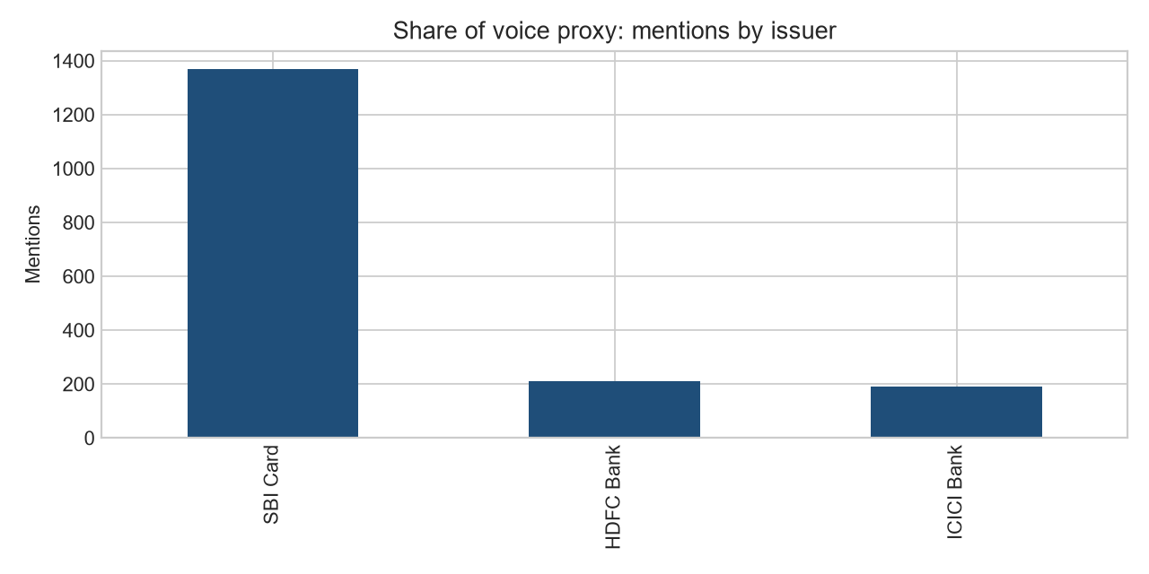
Customer-review volume
The chart shows source-volume composition, not market share or brand preference.
Use the counts to understand the dataset and use sentiment percentages with sample sizes for directional comparison.
Indian Credit Card Brand Intelligence PoW | Directional analysis | Verify reuse rights before distribution

Slide 7
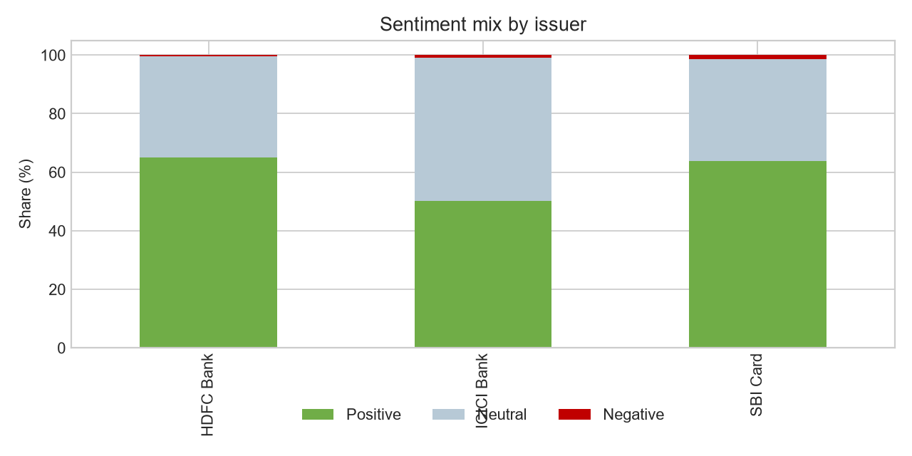
Customer-review sentiment
SBI Card: 63.7% positive | 34.8% neutral | 1.5% negative
HDFC Bank: 65.1% positive | 34.4% neutral | 0.5% negative
ICICI Bank: 50.3% positive | 48.7% neutral | 1.0% negative
Negative reviews are sparse in this source, so differences should not be treated as statistically conclusive.
Indian Credit Card Brand Intelligence PoW | Directional analysis | Verify reuse rights before distribution

Slide 8
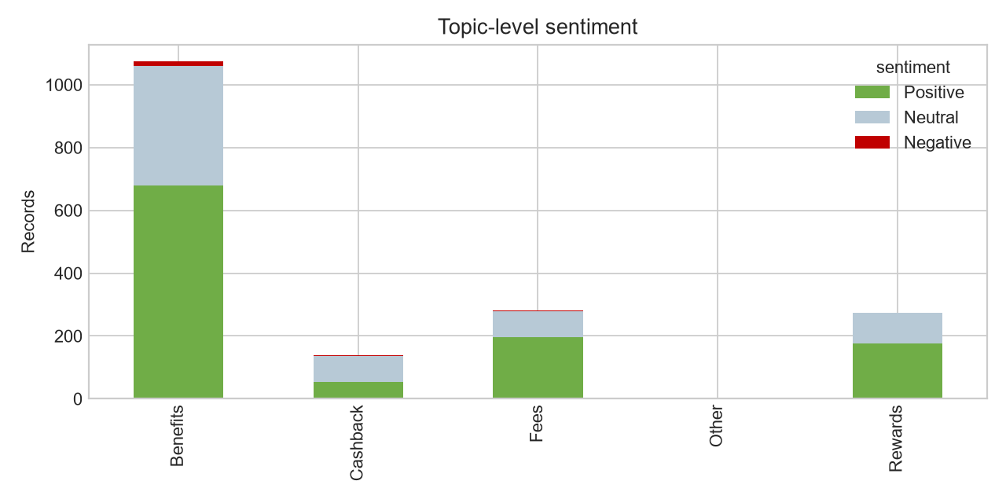
Customer-review topics
Benefits is the dominant topic, followed by fees and rewards.
Use topic patterns to identify questions for deeper investigation, not as a definitive ranking of customer priorities.
Indian Credit Card Brand Intelligence PoW | Directional analysis | Verify reuse rights before distribution

Slide 9
Twitter social-listening module
2,084 filtered unique mentions from 19 January to 19 March 2022.
Issuer coverage: HDFC Bank: 700, SBI Card: 566, Axis Bank: 506, ICICI Bank: 312
The Twitter workbook adds dates, retweets, favourites and calculated engagement.
Indian Credit Card Brand Intelligence PoW | Directional analysis | Verify reuse rights before distribution

Slide 10
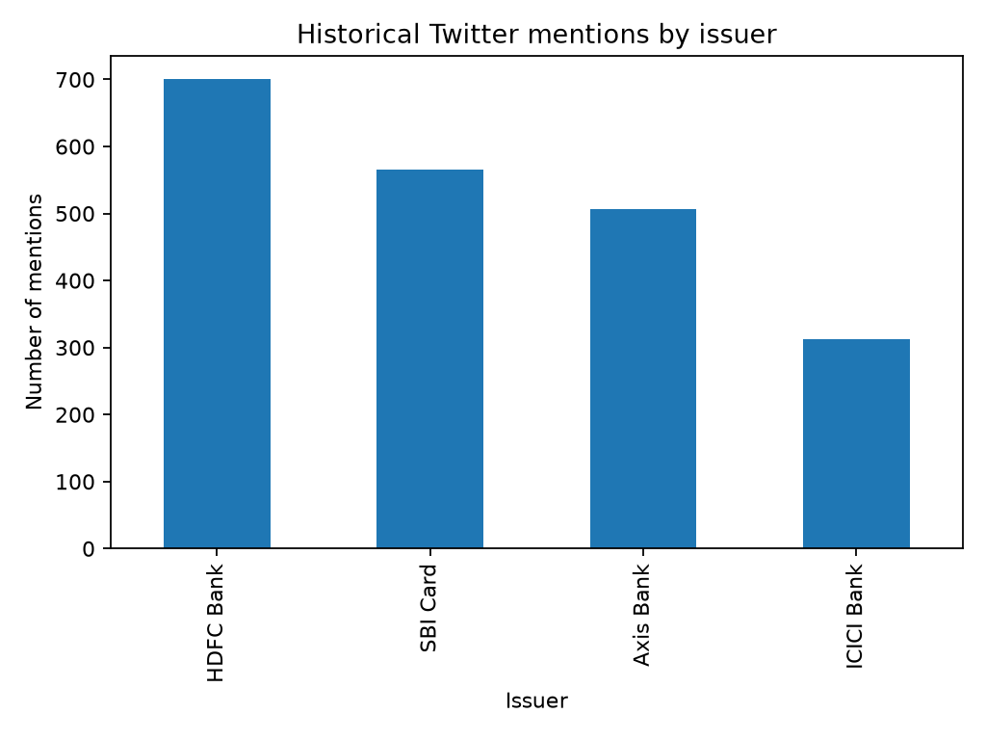
Twitter volume and trend
The social-listening charts show historical mention volume by issuer and the monthly trend.
This is a dated source-volume view, not current market share.
Indian Credit Card Brand Intelligence PoW | Directional analysis | Verify reuse rights before distribution

Slide 11
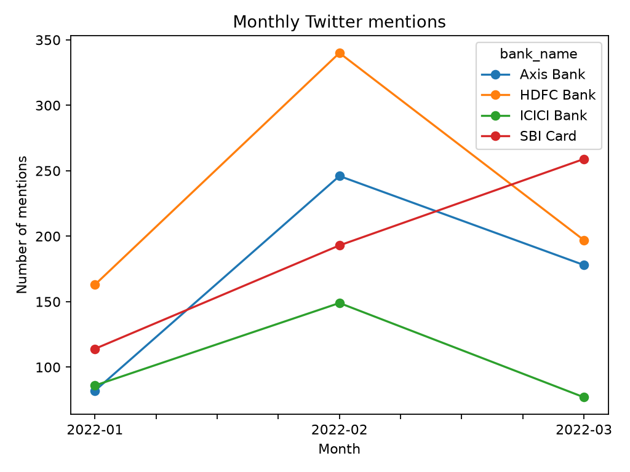
Twitter monthly trend
The monthly view shows how mention volume changed during the historical collection window.
Use it to identify spikes for follow-up, then inspect the underlying posts.
Indian Credit Card Brand Intelligence PoW | Directional analysis | Verify reuse rights before distribution

Slide 12
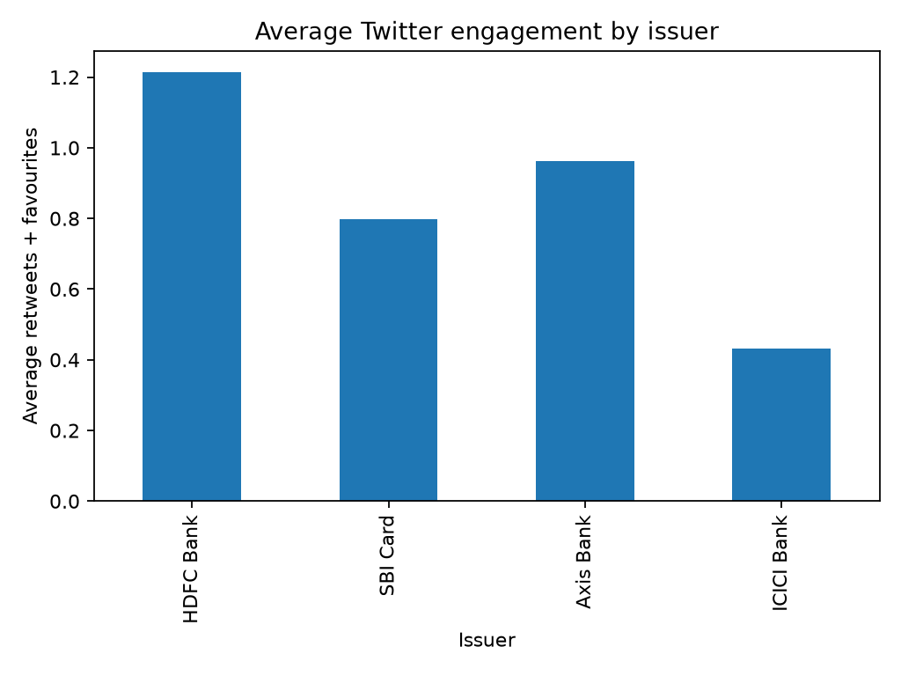
Twitter engagement
Average engagement is calculated as retweets plus favourites.
Use it to prioritize high-visibility conversations, then review the underlying posts before making a recommendation.
Indian Credit Card Brand Intelligence PoW | Directional analysis | Verify reuse rights before distribution

Slide 13
Recommendations and limitations
1. Use the review workbook for customer-topic and sentiment discussion.
2. Use the Twitter workbook for dated listening and engagement monitoring.
3. Do not combine denominators across modules.
4. Confirm reuse rights, add a current approved source and manually QA labels before external publication.
Indian Credit Card Brand Intelligence PoW | Directional analysis | Verify reuse rights before distribution

