Slide 1

CGMB113
MULTIMEDIA TECHNOLOGY
T.J.ISKANDAR ABD AZIZ
ADAPTED FROM NOTES PREPARED BY:
NOOR FARDELA ZAINAL ABIDIN
REVISED ON SEPT 2012

Slide 2
Objectives
At the end of this chapter, students should be able to:
identify the terms and concept related to video
state the advantages and disadvantages of analog and digital video
describe the color models used in video
describe how video can be used in multimedia systems

Slide 3
Basics of Video
Video is an excellent tool for delivering multimedia.
Video places the highest performance demand on computer and its memory and storage.
Digital video has replaced analog as the method of choice for making and delivering video for multimedia.

Slide 4
ANALOG VS. DIGITAL VIDEO
Digital video is beginning to replace analog in both professional (production house and broadcast station) and consumer video markets.
Digital video offer superior quality at a given cost.
Why?
  Digital video reduces generational losses suffered by analog video.
  Digital mastering means that quality will never be an issue

Slide 5
ANALOG VS. DIGITAL VIDEO
Analog video is represented as a continuous (time varying) signal.
Digital video is represented as a sequence of digital images.
Analog is linear, must rewind/forward to go to frame
Digital offers superior quality
Digital does not experience generational loss

Slide 6
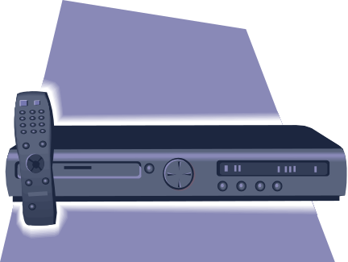
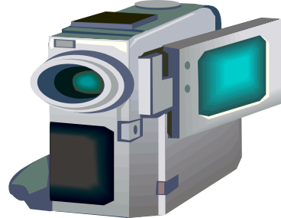
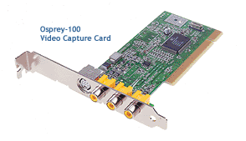
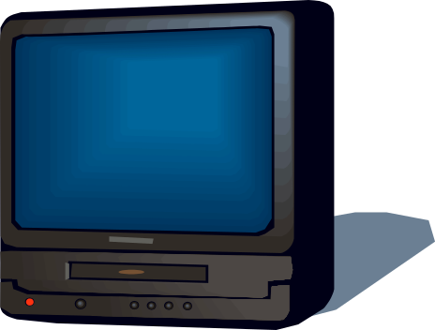

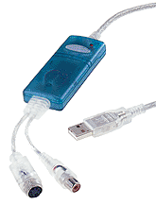
Camcorder
VCR
PCI Video capture card
Television
With a video-capture card, you can capture analog video from a VCR or camcorder and convert the analog video into a digital format
USB Video capture card

Slide 7
HOW VIDEO WORKS
Video basics
  Light passes through the camera lens and is converted to an electronic signal by a Charge Coupled Device (CCD)
  Most consumer-grade cameras have a single CCD.
  Professional–grade cameras have three CCDs, one for each Red, Green and Blue color information.

Slide 8
HOW VIDEO WORKS
Video basics
  The output of the CCD is processed by the camera into a signal containing three channels of color information and synchronization pulse (sync).
  If each channel of color information is transmitted as a separate signal on its own conductor, the signal output is called RGB, which is the preferred method for higher-quality and professional video work.

Slide 9
HOW VIDEO WORKS
Transmission mode
  Composite video transmits the whole signal in a single cable (all three color information and the sync signals are mixed together).
    Yield less precise color definition
    Colors cannot be manipulated or corrected
    A coaxial cable or RCA connector are usually used.
  S-Video (separate video)separates color and brightness information over two wires.
    S-Video cables use a unique S-Video connector.

Slide 10
HOW VIDEO WORKS
Transmission mode
  Component video separates color (chrominance) and brightness (luminance) information over three wires.
    Two chrominance and one luminance signals
    Chrominance = information on colors
    Luminance = information on brightness
  Luminance and chrominance are used to encode color during transmission.

Slide 11
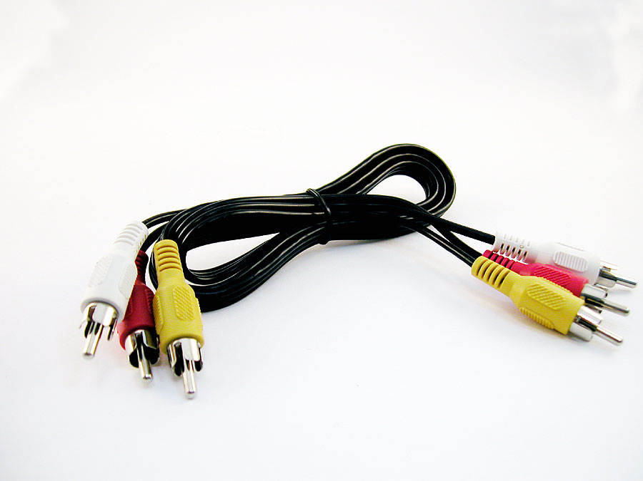
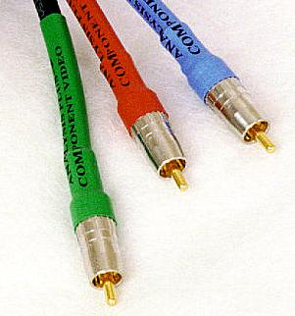
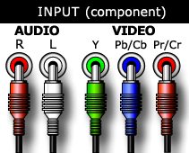
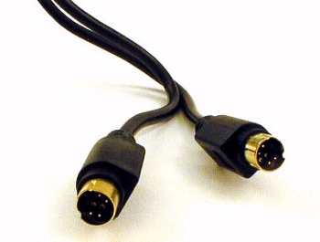
VIDEO CABLES
Composite Video (RCA)
S-Video
Component Video

Slide 12
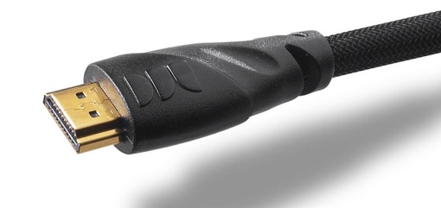
HDMI CABLE
The High-Definition Multimedia Interface (HDMI) is a licensable compact audio/video connector interface for transmitting uncompressed digital streams.
HDMI connects DRM (digital right management)-enforcing digital audio/video sources such as a set-top box, an HD DVD disc player, a Blu-ray Disc player, a personal computer, a video game console, or an AV receiver to a compatible digital audio device and/or video monitor such as a digital television (DTV).
HDMI began to appear in 2006 on consumer HDTV camcorders and high-end digital still cameras

Slide 13
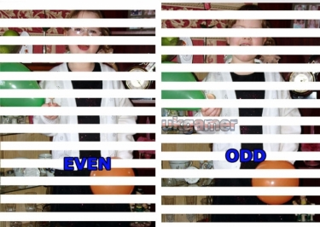

HOW VIDEO WORKS
Video frames for television are interlaced
  Each frame consist of two separate fields : odd and even fields.
  The technique of mixing the two fields together to create one image is called interlacing.
http://www.ocmodshop.com/images/articles/faq/playstation_3_faq/interlaced.jpg
interlaced video

Slide 14
HOW VIDEO WORKS
Video is recorded onto magnetic tapes (analog)
Audio is recorded on a separate straight-line track at the top of the videotape.
At the bottom of the tape is a control track containing the pulses used to regulate speed.

Slide 15
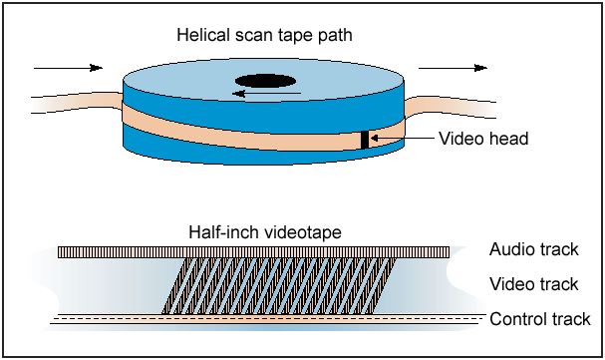
Diagram of tape path across the video head for analog recording

Slide 16
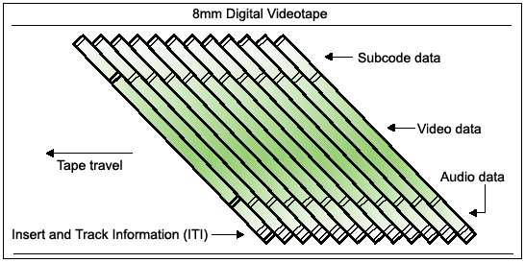
DIAGRAM OF TAPE PATH ACROSS THE VIDEO HEAD FOR DIGITAL RECORDING

Slide 17
COLOR ENCODING FOR VIDEO TRANSMISSION
1. RGB signal
  Consist of separate signals for red, green and blue
  Other colors can be coded as a combination of these primary colors
    e.g. white = R + G + B

Slide 18
COLOR ENCODING FOR VIDEO TRANSMISSION
2. YUV signal
  Separate brightness (luminance) component Y
  Color information (2 chrominance signals U and V)
    Y = 0.3R + 0.59G + 0.11B
    U = (B-Y) * 0.493
    V = (R-Y) * 0.877
3. Composite signal
  Individual component (RGB, YUV) must be combine into one signal.

Slide 19
BROADCAST VIDEO STANDARDS
NTSC
  North America, South America, Japan
  525 interlaced resolution lines
  30 frames per second (fps)
PAL
  Australia, South Africa, Europe
  625 interlaced resolution lines
  25 frames per second (fps)

Slide 20
BROADCAST VIDEO STANDARD
SECAM (Sequential Color and Memory)
  This standard is used in France, Russia and a few other countries.
  SECAM video has 625 interlaced lines of resolution.

Slide 21
BROADCAST VIDEO STANDARDS
HDTV (High Definition Television)
  Six HDTV formats exist
    Resolution vary from 720 to 1080 lines
    Frame rates vary from 24 to 60 fps.
    Format can either be interlaced or progressively scanned.
  The aspect ratio of HDTV is 16:9
    Aspect ratio for NTSC, PAL, SECAM and computer monitor is 4:3
  The aspect ration of 16:9 is sometimes called “widescreen”

Slide 22
BROADCAST VIDEO STANDARD
4:3 aspect ratio
16:9 aspect ratio
(1280 x 720)

Slide 23
INTEGRATING COMPUTERS AND TELEVISIONS FOR VIDEO
We will look at:
  Differences between computer and television video
    Overscan and safe title area
    Video color
    Interlaced and progressive scanning
    Interlacing effect
  Working with text and titles

Slide 24
DIFFERENCES BETWEEN COMPUTER AND TELEVISION VIDEO
Overscan and the safe title area
  Every analog TV displays the picture differently
  Common practice for the television industry to broadcast an image larger than the the standard TV screen so that the “edge” seen by viewer is always bounded by the TV’s physical frame, or bezel.
  This is called overscan

Slide 25
DIFFERENCES BETWEEN COMPUTER AND TELEVISION VIDEO
  In contrast, Computer monitor displays a smaller image (underscan), leaving a black border inside the bezel.
  When a digitized video image is displayed on the RGB screen, there is a border around the image, and when computer screen is converted to video, the outer edges of the images will not fit on a TV screen.

Slide 26
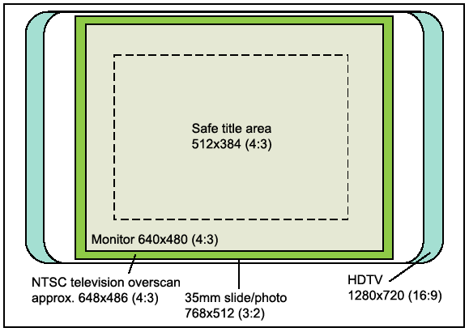
DIFFERENCES BETWEEN COMPUTER AND TELEVISION VIDEO
  It is advisable to scale the video within the “safe title area” as shown below so that the image will not be affected by over scanning.

Slide 27
DIFFERENCES BETWEEN COMPUTER AND TELEVISION VIDEO
2. Video color
  Computer monitors uses RGB color.
  Video uses YUV color.
    A YUV signal includes separate red, blue and luminance (brightness) information.
  Many RGB colors will not display in the YUV color space.
  High-end video editing applications offer filters to help you identify and correct ‘illegal’ RGB colors in the YUV color space.

Slide 28
DIFFERENCES BETWEEN COMPUTER AND TELEVISION VIDEO
3. Interlaced and progressive scanning
  Television uses interlaced scanning
  Computer employs progressive scanning

Slide 29
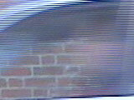
DIFFERENCES BETWEEN COMPUTER AND TELEVISION VIDEO
4. Interlacing effect
  Interlacing divides these into odd and even lines and then alternately refreshes them at 30 frames per second. The slight delay between odd and even line refreshes creates some distortion or 'jaggedness'.
  Lines that are one pixel thick will flicker on a TV due to interlacing.

Slide 30

DIFFERENCES BETWEEN COMPUTER AND TELEVISION VIDEO
Progressive scanning
  Progressive scanning, as opposed to interlaced, scans the entire picture line by line every sixteenth of a second. In other words, captured images are not split into separate fields like in interlaced scanning.

Slide 31
WORKING WITH TEXT AND TITLES.
  Use plain, sans serif fonts
  Use light text over a dark background
  Do not kern the letters too tight
  Remember to avoid single-pixel-thick lines.
  Avoid parallel lines, boxes, and tight concentric lines
  Keep the graphics and title within the title safe area
  Leave titles on screen long enough to be read

Slide 32
SHOOTING AND EDITING VIDEO
1. Shooting platform
  Use steady shooting platform to avoid shaky camera work.
  Use a tripod or place the camera on a stable platform
  If must shoot handheld, use a camera that has an electronic image stabilization feature for static shoot such as “steady-cam” balancing attachment.

Slide 33
SHOOTING AND EDITING VIDEO
2. Lighting
  Lighting can make a major different between amateur and professional shooting
  Always strive for adequate lighting
  A standard studio lighting arrangement includes
    Fill
    Key
    Rim
    background

Slide 34
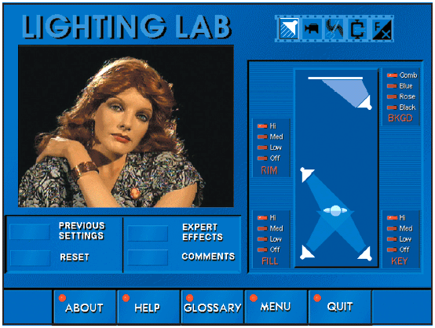
SHOOTING AND EDITING VIDEO
The “Lighting Lab” software
http://www.tayvaughan.com/multimedia/stuff/lightinglab.html

Slide 35
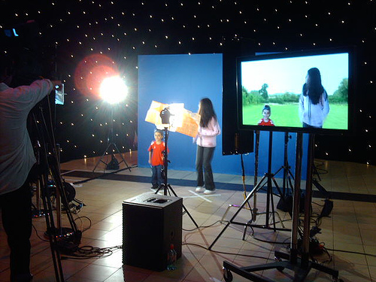
SHOOTING AND EDITING VIDEO
3. Blue Screen
  Blue screen key editing is used to superimposed subjects over different backgrounds.
  Blue screen is popular because expensive sets are not required.
  The blue background color will be replaced by the background image, frame by frame.
  e.g. Star Trek movie.
http://videoskin.net/system/files/editor/bluescreen.jpg

Slide 36
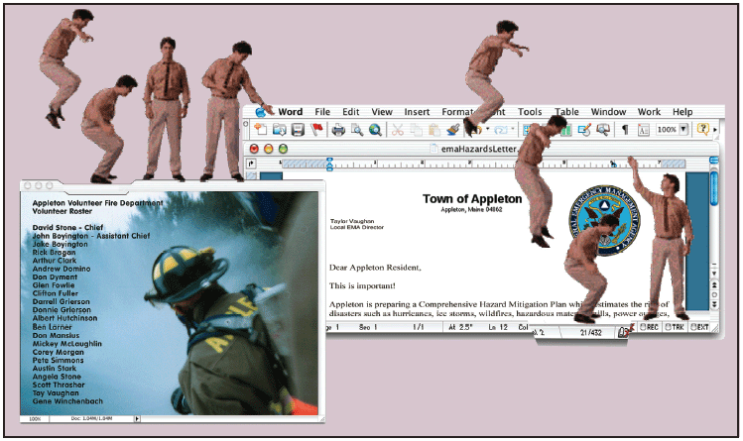
SHOOTING AND EDITING VIDEO
The following figure shows frames taken from a video of an actor shot against blue screen on a commercial stage. The blue background was removed from each frame, and the actor himself was turn into a photo-realistic animation that walked and jumped over the computer desktop.

Slide 37
SHOOTING AND EDITING VIDEO
4. Composition
  Consider the delivery medium when composing shots
    For playback from CD-ROM or the web in small computer window, avoid wide panoramic shots.
    Use close-up or head-and-shoulder shooting.
  Consider the amount of motion in shot
    The more scene changes from frame to frame, the more “information” need to be transferred from the computer memory to the screen, unless you have a very good compression algorithm to handle this.
  Keep the camera still, let the subject move, not the camera.

Slide 38
VIDEO COMPRESSION
Compression is necessary when working with video on computers.
Compression is performed by a compression/decompression scheme called a codec.
Uncompressed digital video has a data rate of approximately 20 MBps.
  Many computer hard drives cannot handle this data rate.

Slide 39

USING VIDEO
Video places the highest performance demand on the computer and it’s memory compared to all other multimedia elements
Video
Conferencing
USAGES
Video
Surveillance
Video Streaming
For Web Sites
Video
Presentation

Slide 40


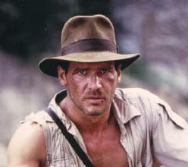

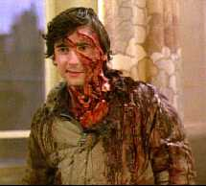
Applying Video In MM Systems
Video is used for practically everything people wish (and would pay) to see, including sci-fi, fantasy, adventure, horror and sex.

Slide 41
REFERENCE
Vaughan Tay, Multimedia: Making It work. 7th Edition. McGraw Hill
S. McGloughlin, “Multimedia: Concept and Practice”, Prentice Hall, 2001

