Slide 1
EgoLife Two-User QA Pipeline
01

Slide 2
PIPELINE OVERVIEW
The loop accepts a QA only after every gate agrees
One evidence packet is processed through generation, review, answerability testing, and strict validation. Rejections become feedback for another attempt.
1
Evidence
2
Generate
Schema
Judger
Answerability
Acceptance
2
3
4
5
6
packet with users, clips, paths, gaze summaries
one MCQ JSON with evidence fields
basic structure and answer consistency
nine structured checks must pass
Should ideally
be answerable only by combining evidence
review, trace, audit, gates present
Retry rule
If JSON parsing, schema, reviewer, answerability, or strict validation fails, the attempt is recorded and feedback is injected into the next attempt.
EgoLife two-user QA pipeline
02

Slide 3
INPUT SETUP
Each packet is converted into media plus metadata context
The loop reads JSONL evidence rows, chooses a question type, gathers media paths, and starts a per-packet attempt trace.
Evidence packet
Video stream fields
Context passed
Question type
- evidence_id
- required_users
- videos
- source_urls
- agent_name
- day/time
- local_video
- video_url
- source metadata
- gaze-summary (inactive for now)
- CLIP guidance/hints
- commonality
- Difference
…
EgoLife two-user QA pipeline
03

Slide 4
MODE FORK
The generation mode changes only the generator branch
All modes share the same downstream reviewer, answerability gate, strict validation, retry bookkeeping, and output files.
baseline
clip_guided
discovery
One VLM call writes the MCQ directly from videos and metadata.
Same direct generator path, but with CLIP retrieval hints.
Planner VLM call selects a relation, then generator writes the MCQ.
Fastest path; relation discovery and question writing are bundled.
Useful when candidate distinctive moments are pre-mined.
More traceable; lets retries choose a different relation.
EgoLife two-user QA pipeline
04

Slide 5
Baseline
Baseline pipeline flow chart
Schema
OK?
YES
YES
YES
Raw video
evidence packet
Generate
candidate QA
Judger
PASS?
Needs
both?
Accepted
QA row
Book-keeping
NO
NO
NO
Reject wrapper
+ intermediate log
Loop for 3 iterations until rejection
EgoLife two-user QA pipeline
05

Slide 6
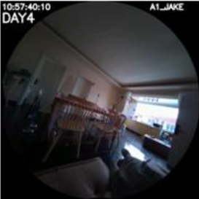
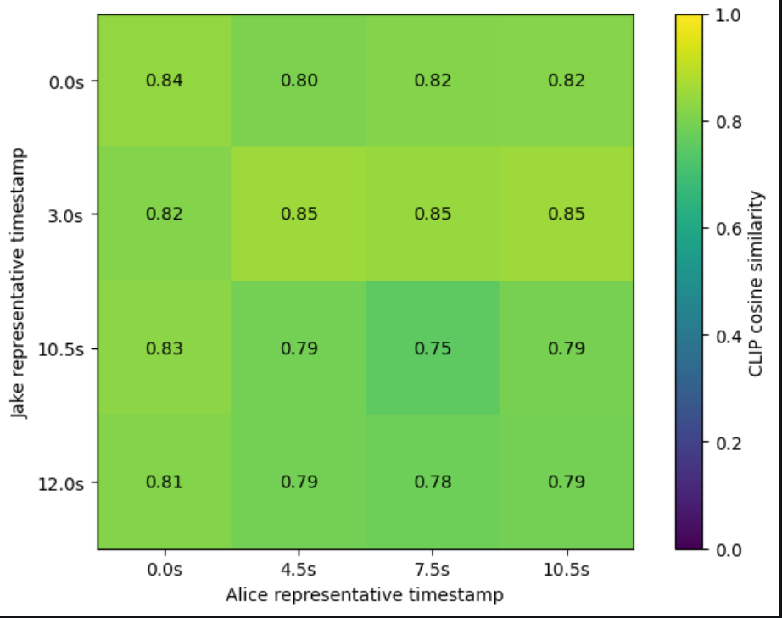
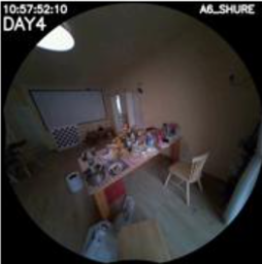
CLIP-guided
CLIP embeddings as a generation heuristic
1
Frame sampling
2
Embed
Compression
Similarity calculation
Novelty
Guidance
2
3
4
5
6
Embed each sampled frame with CLIP
K-means clustering of sampled frames
Find out how “novel” a frame from A is to B’s entire video
Inject CLIP information to generator as hints
Uniform sampling from videos
Calculate pairwise cosine sim between A video and B
novelty for A at frame i =
1 - max_j cos(A_i, B_j)
A’s stream:
CLIP retrieval hints:
- Jake has a visually distinctive moment around frame 10.
- Alice has a visually distinctive moment around frame 12.
- These may be useful candidate moments where the two users saw different things.
- Do not mention CLIP or frame scores. Verify from the videos.
B’s stream:
Ideally, high novelty means that at frame i, A sees different things than B
EgoLife two-user QA pipeline
05

Slide 7
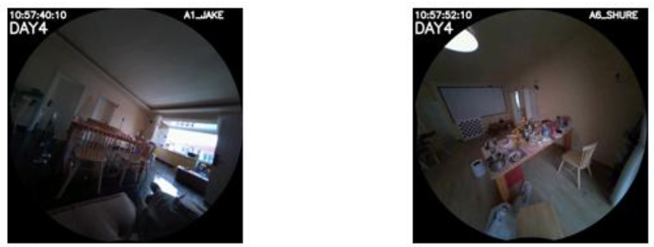
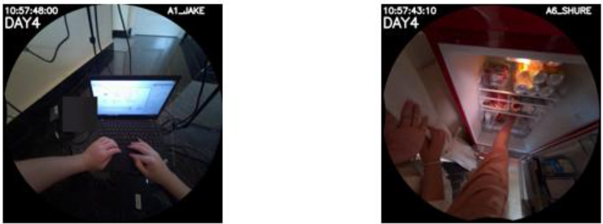
CLIP-guided
CLIP-guidance rationale
Similar embeddings→same context and information→bad questions
Low novelty: hard to find questions that can’t be answered by a single user
High novelty: can ask questions such as Jake: “how many cans of sodas are left in my fridge?”
EgoLife two-user QA pipeline
06

Slide 8
Baseline
CLIP-guidance pipeline flow chart
Schema
OK?
YES
YES
YES
Raw video
evidence packet
Generate
candidate QA
Judger
PASS?
Needs
both?
Accepted
QA row
Book-keeping
NO
NO
NO
edit evidence packet with CLIP-based guidance
Reject wrapper
+ intermediate log
EgoLife two-user QA pipeline
05

Slide 9
DISCOVERY PATH – TOWARDS TEMPLATE FREE GENERATION
Discovery mode splits generation into planning first
This is the current discovery-mode difference: an intermediate selected_relation exists before the MCQ generator runs.
1. Relation planner
selected_relation
2. MCQ generator
- Do not write the MCQ yet
- List 3-5 cross-user needs
- Select one relation
- Explain why it is natural and not single-user-answerable
- speaker_user
- other_required_users
- what_speaker_knows_sees
- what_others_know_see
- only_clear_when_combining
- Use selected relation
- Write natural first-person MCQ
- Return VIDEO_GENERATION_SCHEMA
- Satisfy two-user necessity
Why it matters: let the generator reason explicitly before drafting answer. Also, if a gate fails, the next attempt can search for a different relation rather than only rephrasing the same flawed question.
EgoLife two-user QA pipeline
06

Slide 10
SCHEMA AND METADATA
After generation, the loop normalizes and checks the QA structure
The generator may omit or weaken some metadata. complete_generator_metadata(...) fills safe defaults before basic validation.
Backfilled or normalized
Basic schema gate
- qa_id if missing
- question_type from loop target
- required_users from packet
- category default: environmental_interaction
- answer text from options[correct] when possible
- trace, human_audit, source URLs, video_evidence
- Required fields exist
- Exactly five non-empty options
- correct is A-E
- answer equals options[correct]
- at least two unique required users
- single-user and combined answerability text exists
EgoLife two-user QA pipeline
07

Slide 11
JUDGER GATE
The judger is a VLM check, and the gate is deterministic
Function: build_judger_prompt(...) asks for nine structured checks. judge_gate(...) then requires every blocking check to be PASS.
Core semantics
Wording and source
Format and safety
- multi_video_necessity
- visual_grounding
- question_type_semantics
- first_person_naturalness
- agent_perspective
- source_scope
- mcq_option_quality
- gaze_safety
- human_auditability
All 9 checks have to PASS for generator acceptance
EgoLife two-user QA pipeline
08

Slide 12
JUDGER GATE
Judger gate specifics
Check | Prompt snippet | General idea
1. first_person_naturalness | “natural first-person memory/AR-assistant wording” | The question should sound like something a wearer/user would naturally ask from memory, using an involved first-person perspective rather than a detached benchmark style.
2. agent_perspective | “no dataset-observer wording, and no video/footage/recording/frame/camera/clip/timestamp language” | Blocks questions/options that mention the data collection artifact. The user should not be asked “in the video/frame/camera...”
3. source_scope | “answerable from provided raw videos and metadata only” | Ensures the QA does not depend on captions, transcripts, outside knowledge, hidden intent, or facts not visible in the provided evidence packet.
4. question_type_semantics | “commonality means shared or jointly verified; difference means meaningful contrast, asymmetry, or complementary detail” | Checks that question_type matches the actual reasoning. A commonality question must be truly joint/shared; a difference question must involve a real contrast or complementary detail.
EgoLife two-user QA pipeline
08

Slide 13
JUDGER GATE
Judger gate specifics
Check | Prompt snippet | General idea
multi_video_necessity | “PASS only if one required user's video provides a speaker-side anchor event and another required user's video provides a missing visual detail...” | The QA must have a real cross-video dependency. It rejects timestamp-only stitching, generic comparisons, “what did both users see,” and cases where one video alone gives the answer.
visual_grounding | “correct option and evidence claims are visually grounded in concrete moments” | Verifies that the correct answer and per-user evidence claims are actually visible in the videos at concrete moments, not merely plausible.
EgoLife two-user QA pipeline
08

Slide 14
JUDGER GATE
Judger gate specifics
Check | Prompt snippet | General idea
mcq_option_quality | “exactly five plausible options and exactly one correct answer” | Checks MCQ mechanics: five options, plausible distractors, no duplicate/ambiguous correct choices, and one uniquely correct answer.
gaze_safety | “do not invent exact gaze-to-object claims when 2D gaze is unavailable” | Prevents overclaiming eye gaze. If gaze projection/calibration is missing, the QA should not pretend to know exact pixel/object fixation.
human_auditability | “enough user/video/time evidence exists for a human to inspect later” | Ensures the row has enough traceable evidence, such as users, videos, timestamps, and claims, so a human reviewer can verify why it passed or failed.
(currently disabled)
EgoLife two-user QA pipeline
08

Slide 15
BEHAVIORAL GATE
Answerability tests whether the MCQ truly needs multiple users
The same QA is answered under restricted media conditions. A valid two-user QA should be answerable only when all required users' videos are available.
A
single_user A
B
single_user B
C
combined_all_users
Condition ID: single_user::<user>. If any one user selects the correct answer, the QA leaks.
Condition ID: single_user::<user>. If any one user selects the correct answer, the QA leaks.
The combined condition must select the correct answer. Otherwise the QA is not actually answerable.
Pass condition
combined_all_users selects correct AND every single/proper-subset condition is insufficient or incorrect.
EgoLife two-user QA pipeline
09

Slide 16
ATTEMPTS AND OUTPUTS
Retries are feedback-driven and fully traced
Each packet can retry up to max_attempts (3). Every stage writes prompt rows and attempt traces for later inspection.
Failure sources
Feedback injection
Outputs
- schema validation
- reviewer gate
- answerability gate
- strict validation
- baseline/CLIP-guided: next direct generator prompt
- discovery: next relation planner and MCQ prompt
- prevents repeating the rejected issue
- accepted QA JSONL
- rejected attempts JSONL
- prompts JSONL
- intermediate trace JSONL
EgoLife two-user QA pipeline
10

Slide 17
Actual testing
Experiment and results
Mode | Packets | Accepted | Attempts | Judger Rej. | Answerability Rej. | Single-video Leakage | Multi-video Necessity Blocks
Baseline | 5 | 0 | 15 | 2 | 13 | 12 | 2
CLIP-guided | 5 | 0 | 15 | 6 | 9 | 9 | 3
Discovery | 5 | 1 | 13 | 4 | 8 | 8 | 4
EgoLife two-user QA pipeline
10

Slide 18
Actual testing
Judger rejections
Category | Count
Total judger rejects | 12
Baseline | 2
CLIP-guided | 6
Discovery | 4
multi_video_necessity involved | 9
visual_grounding involved | 3
human_auditability involved | 1
Mode | Multi-video necessity rejects
Baseline | 2
CLIP-guided | 4
Discovery | 3
Total | 9
CLIP hints improve visual specificity, but visual novelty often becomes forced cross-video stitching.
EgoLife two-user QA pipeline
10

Slide 19
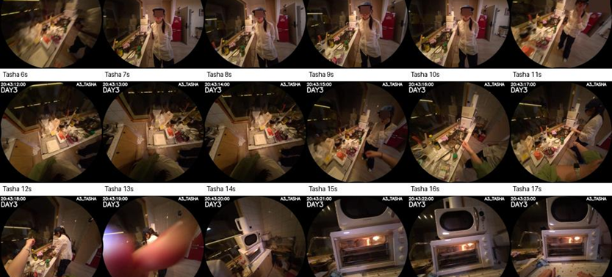
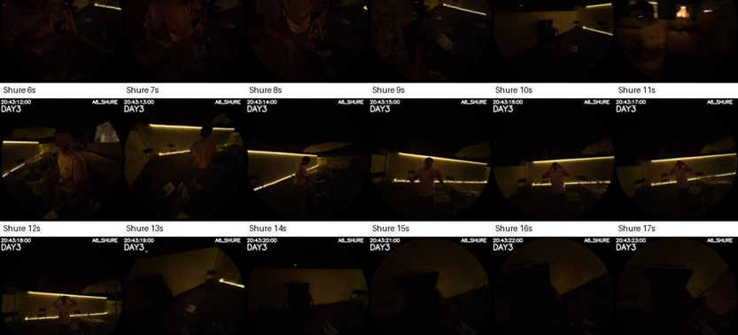
ISSUES
1. Random video-pair sampling is too stochastic
The video pairs used for generation are sampled randomly, and will force the generators to generate loosely related questions that fail multi_user_necessity / answerability checks
Generated question: “What was Shure doing while I was checking the oven?”
answer: “Handling a bag and moving around the area”
EgoLife two-user QA pipeline
09

Slide 20
ISSUES
1. Random video-pair sampling is too stochastic
Proposed Solution: Group Relative Embedding-Similarity Selection
A
Retrive videos
B
Embed with CLIP
A
Select middle pair
C
Instead of sampling video pairs, we retrive all 6 synchronized videos at the same time
We find how similar each video is relative to the batch of 6 videos
-maybe cos sim to group centroid
Select pairs in a middle similarity band for generation
We select pairs in a middle similarity band: not so similar that they show redundant evidence, and not so distant that they are likely unrelated.
EgoLife two-user QA pipeline
09

Slide 21
ISSUES
2. Hefty judger workload
The judger has to make decisions for all 9 gates in one inference—Often forget/hallucinate
Failed Judgements / Hallucinations
Redundant / ambiguous checks
Weak entity-recognition
- Incorrectly mark some checks as PASS or FAIL
- Especially obvious in discovery mode, where it passes the first_person_naturalness test constantly while the question was asked in third person
- multi_video_necessity largely overlaps with answerability
- question_type_semantics / agent_perspective / … are vague and unecessary
- Often fails to dismiss cases where the generator ambiguates between different people
EgoLife two-user QA pipeline
09

Slide 22
ISSUES
2. Hefty judger workload
Proposed Solution: Gate pruning, multi-judger loop, and possibly judger of judges
Specialized judges – delete unnecessary gates and group into multiple specialized judges
e.g. QA structure / co-reference, visual groundings / …
Also gives faster inference
Judger of Judger pass?
Schema
OK?
Multi- Judger
PASS?
Needs
both?
YES
Raw video
evidence packet
Generate
candidate QA
YES
YES
Accepted
QA row
Review
bundle
NO
NO
NO
Reject wrapper
+ intermediate log
EgoLife two-user QA pipeline
09

