Slide 1
Data Mining Project Display
Anomaly Detection in Server Machine Telemetry Data
Using
ConvBiGRU Autoencoder

Slide 2


The Significance of Anomaly Detection
Why did I choose ConvBiGRU Autoencoder
In modern data centers characterized by a vast number of servers and complex operating environments, anomaly detection is of paramount importance. By researching anomaly detection models based on the ConvBiGRU Autoencoder, we aim to enhance the intelligence of server operations and maintenance.
This model is capable of automatically learning normal server operating patterns and accurately identifying potential hardware failures, security threats, or performance bottlenecks, thereby achieving proactive prevention, significantly reducing service disruptions, lowering operating costs, and ultimately ensuring the overall stability and reliability of the data center.
This not only revolutionizes traditional manual monitoring but also represents a crucial step towards enhancing the intelligent management of data centers.
The ConvBiGRU Autoencoder model is well-suited for server anomaly detection due to its unique architecture's ability to effectively capture the complex characteristics of server data. Convolutional layers excel at extracting spatial correlations between various server performance metrics, such as the interrelationship between CPU utilization and memory consumption.
Meanwhile, the bidirectional GRU network can capture long-term dependencies in time series data, learning the patterns of server operating states over time. This effective fusion of spatiotemporal features enables the ConvBiGRU Autoencoder to accurately identify subtle anomalies in server operations, thereby significantly improving the accuracy and robustness of anomaly detection.

Slide 3
How to Quickly Understand This Project
In order to quickly grasp this project on server anomaly detection, I recommend the following reading order:
1.Dataset Analysis and Preprocessing: Start here to understand what data we used, and how we cleaned and prepared it for subsequent model training. This part is the foundation for understanding the entire project.
2.Technical Report: Next, dive into the details of the ConvBiGRU Autoencoder model we used. This report explains the model's principles, training process, and optimization methods, helping you understand how the model works.
3.Models Comparison: Finally, take a look at how our model compares to other anomaly detection methods. This section shows the strengths and limitations of our model, giving you a comprehensive understanding of its performance.
Through these three steps, you will be able to systematically understand our project, from data to model, and then to performance evaluation.

Slide 4
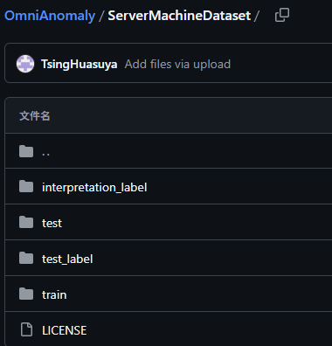
Understanding the Server Machine Dataset (SMD)
Name: Server Machine Dataset (SMD)
Source: NetMan (https://github.com/NetManAIOps/OmniAnomaly)
Purpose: Development and evaluation of anomaly detection algorithms
Data Characteristics:
Time-Series Data: Each row represents a 1-minute interval.
Multivariate: Contains 38 server performance metrics, such as CPU utilization, memory usage, disk I/O, etc.
Real Data: Derived from a real server monitoring system.
Mixed Data: Includes training sets (normal data only) and testing sets (containing both normal and anomalous data).
File Structure:
train: Training data (normal behavior only).
test: Testing data (normal and anomalous behavior).
test_label.txt: Anomaly labels (0 or 1).
interpretation_label.txt: Indicates the metrics contributing to each anomaly.

Slide 5
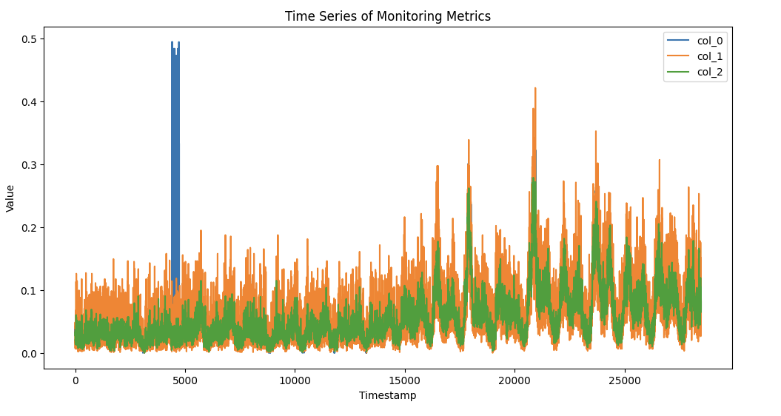
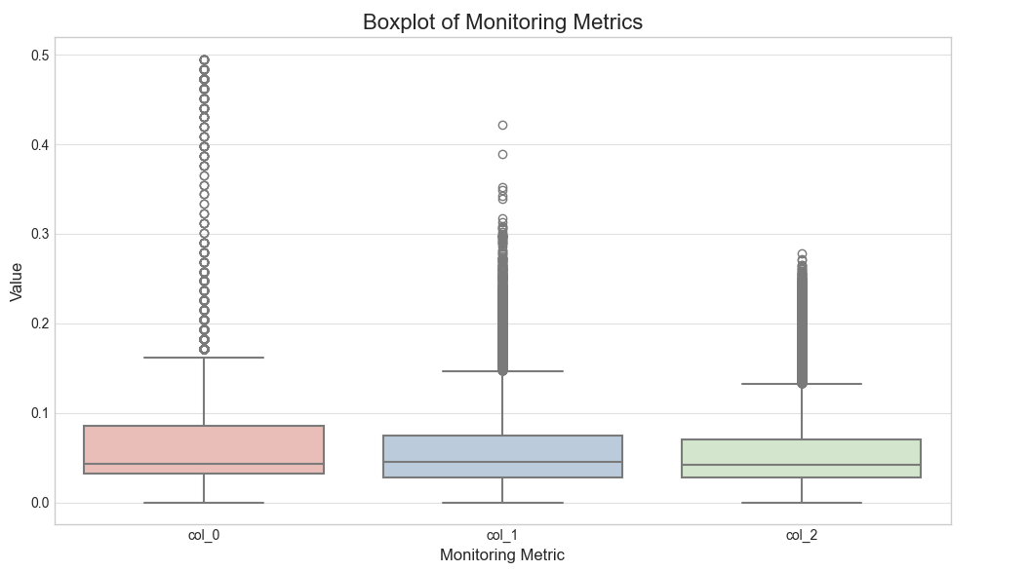
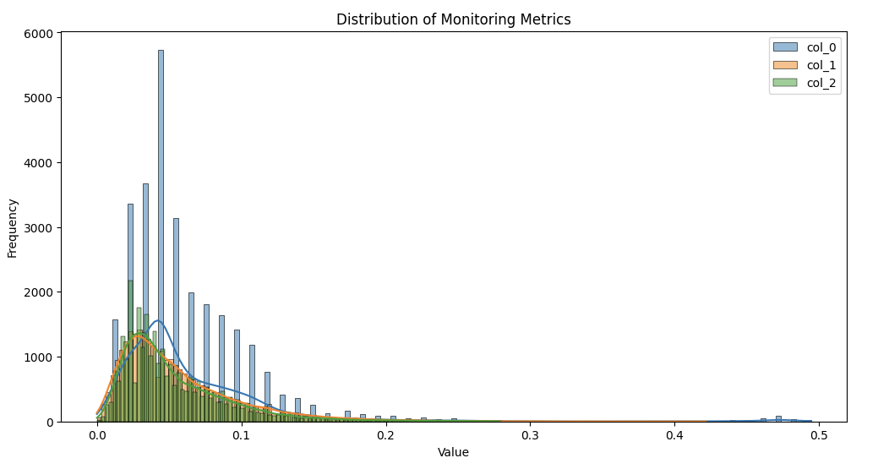
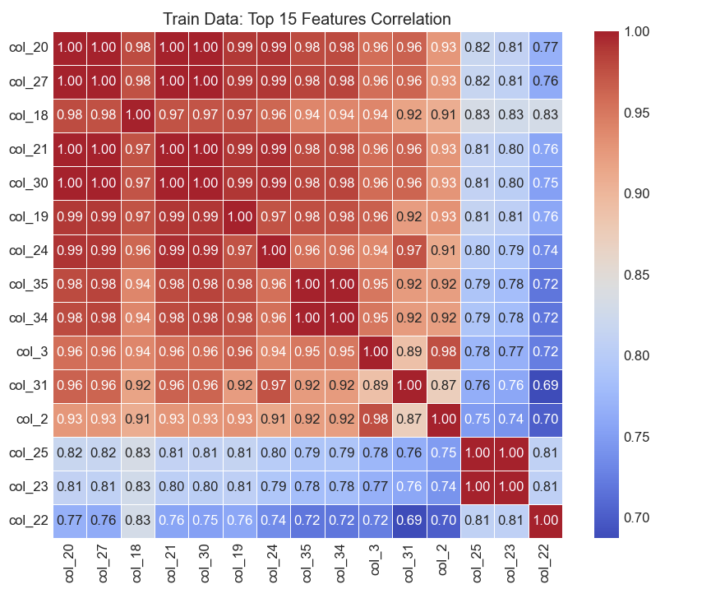
Data Insight

Slide 6
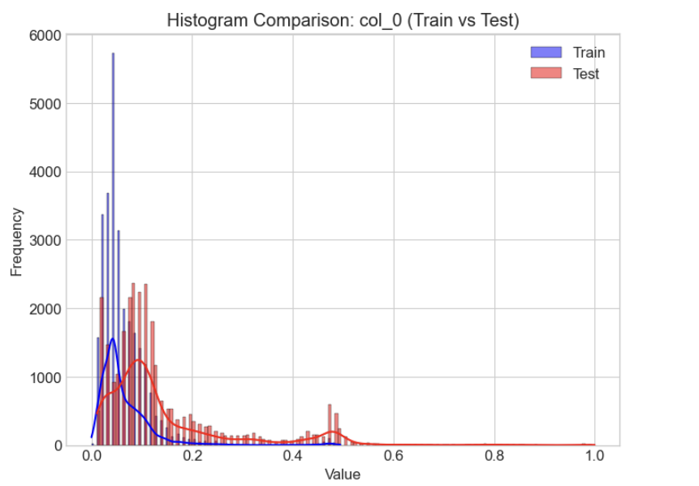
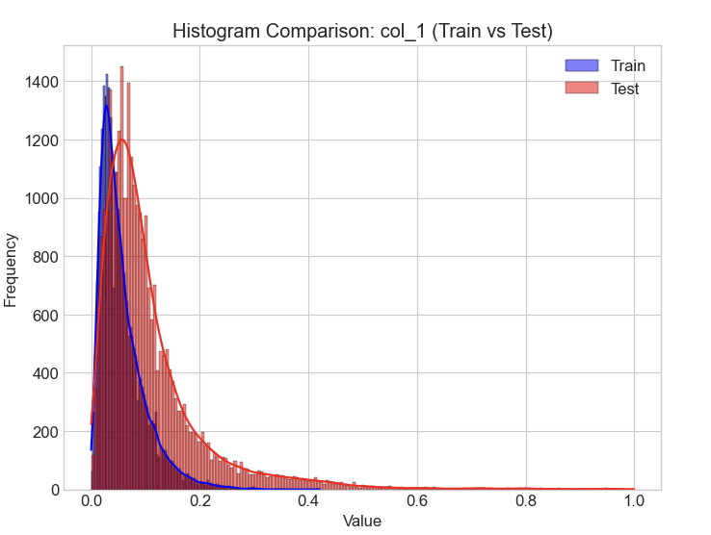
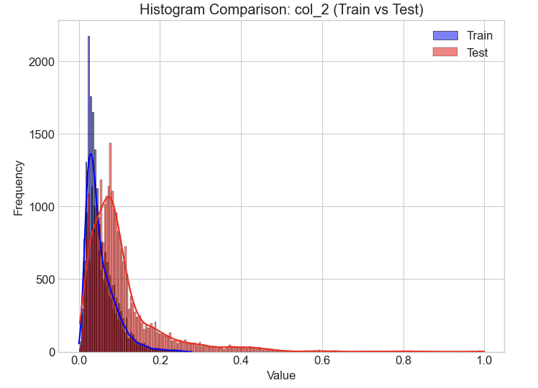
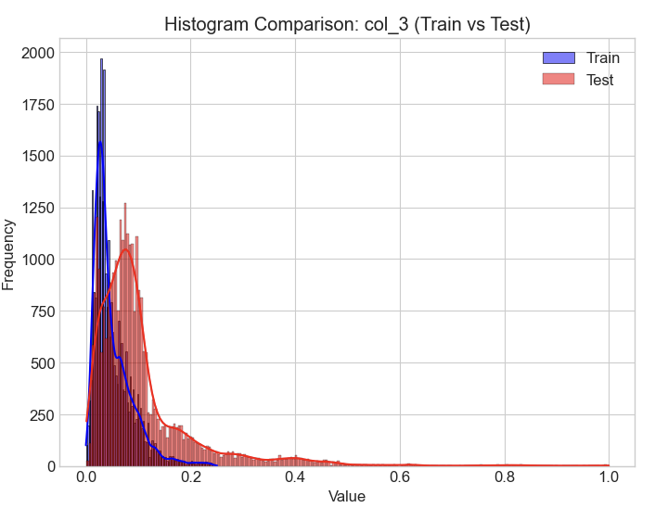
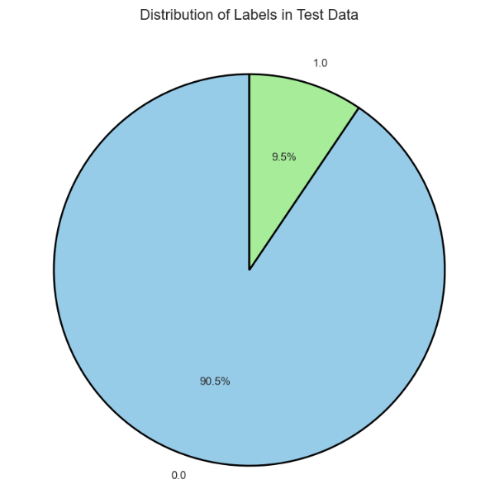
Data Insight
We can discover the characteristics of the data through visualization. For details, please refer to Dataset Analysis and Preprocessing.

Slide 7
Detailed Explanation of the ConvBiGRU Autoencoder Model
Model Overview:
Working Principle:
The ConvBiGRU Autoencoder is a deep learning model used for anomaly detection.
It combines the strengths of Convolutional Neural Networks (CNNs) and Bidirectional Gated Recurrent Units (BiGRUs).
The autoencoder structure enables it to learn the latent representation of normal data, thereby detecting anomalies.
The model first uses convolutional layers to extract spatial features from the input data.
The BiGRU layers then learn temporal dependencies in the time series.
The encoder compresses the extracted features into a low-dimensional latent representation.
The decoder attempts to reconstruct the original data from the latent representation.
For anomalous data, the reconstruction error will be high because the model has never seen similar patterns.
Model Architecture:
Convolutional Layers: Used to extract spatial features between server performance metrics, such as correlations between CPU and memory usage.
Bidirectional GRU (BiGRU): Used to capture long-term dependencies in time-series data, understanding how server states evolve over time.
Autoencoder: Consists of an encoder and a decoder. The encoder compresses the input data into a latent representation, and the decoder attempts to reconstruct the original data from the latent representation.

Slide 8
Performance Evaluation
Evaluation Metrics:
Evaluation Analysis
Accuracy: The proportion of correctly identified normal and anomalous data points.
Precision: The proportion of truly anomalous data points among all data points predicted as anomalous.
Recall: The proportion of truly anomalous data points that are correctly identified by the model.
F1-score: The harmonic mean of precision and recall, providing a balanced evaluation of model performance.
AUC (Area Under the ROC Curve): The area under the ROC curve, measuring the model's ability to distinguish between normal and anomalous data.
High Accuracy (0.941): This means that the model can correctly classify most data points (including both normal and anomalous ones), indicating good overall classification effectiveness.
High Precision (0.846): This indicates that among all data predicted as anomalous by the model, 84.6% are indeed anomalous, suggesting a relatively low false positive rate.
Relatively High Recall (0.805): This indicates that the model successfully detected 80.5% of all true anomalous data, keeping the false negative rate within a certain range.
Good F1-score (0.824): Combining precision and recall, this demonstrates that the model achieves a good balance between accuracy and completeness.
Excellent AUC (ROC-AUC: 0.965): With the area under the ROC curve very close to 1, this indicates that the model has a strong ability to distinguish between normal and anomalous data.
Evaluation of ConvBiGRU Autoencoder
 | Accuracy | Precision | Recall | F1-Score | ROC-AUC
ConvBiGRU-AE | 0.941 | 0.846 | 0.805 | 0.824 | 0.965

Slide 9
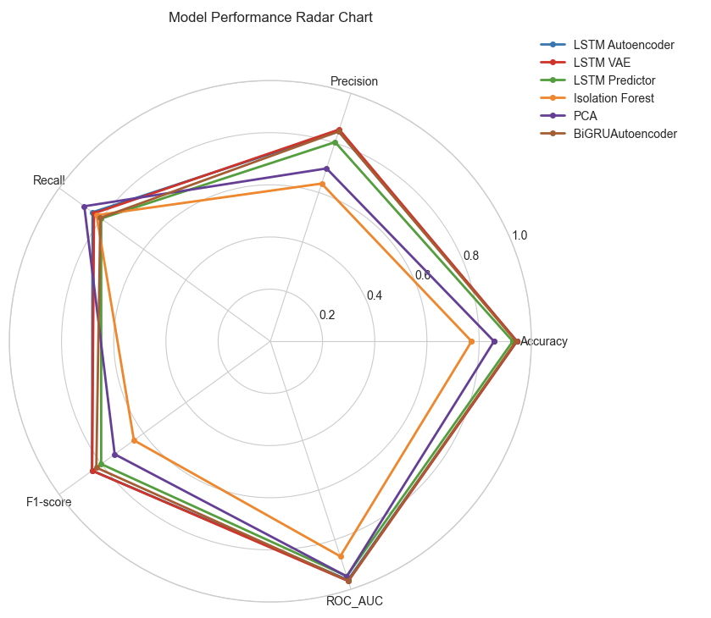
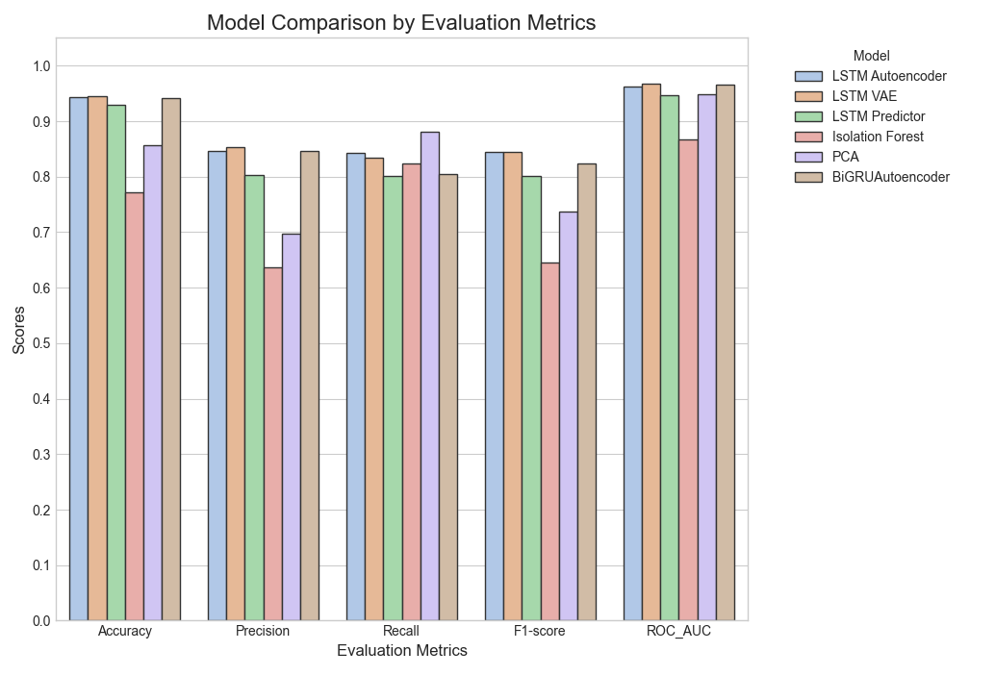
Performance Comparision
We used multiple models for anomaly detection and evaluated the results, as shown in the following table.
 | Accuracy | Precision | Recall | F1-score | ROC_AUC
LSTM Autoencoder | 0.944 | 0.846 | 0.842 | 0.844 | 0.962
LSTM VAE | 0.945 | 0.854 | 0.835 | 0.844 | 0.967
LSTM Predictor | 0.929 | 0.803 | 0.801 | 0.801 | 0.947
Isolation Forest | 0.771 | 0.636 | 0.823 | 0.646 | 0.867
PCA | 0.857 | 0.697 | 0.881 | 0.737 | 0.948
ConvBiGRU-AE | 0.941 | 0.846 | 0.805 | 0.824 | 0.965

Slide 10
Performance Comparision Analysis
 | Accuracy | Precision | Recall | F1-score | ROC_AUC
LSTM Autoencoder | 0.944 | 0.846 | 0.842 | 0.844 | 0.962
LSTM VAE | 0.945 | 0.854 | 0.835 | 0.844 | 0.967
LSTM Predictor | 0.929 | 0.803 | 0.801 | 0.801 | 0.947
Isolation Forest | 0.771 | 0.636 | 0.823 | 0.646 | 0.867
PCA | 0.857 | 0.697 | 0.881 | 0.737 | 0.948
ConvBiGRU-AE | 0.941 | 0.846 | 0.805 | 0.824 | 0.965
Based on the evaluation metrics presented, our BiGRU Autoencoder demonstrates highly competitive performance across the board. While its scores might be slightly lower than the absolute highest achieved by the LSTM Autoencoder or LSTM VAE on certain metrics like F1-score, its performance is remarkably close. Crucially, the BiGRU Autoencoder achieves this near state-of-the-art performance with a potentially simpler architecture compared to complex LSTM or VAE structures. This balance of strong effectiveness and relative structural simplicity makes the BiGRU Autoencoder a compelling and efficient alternative for tasks like anomaly detection, offering performance comparable to more complex models without necessarily incurring the same computational overhead or implementation complexity.

Slide 11

Conclusion
Based on the comparative evaluation across key performance metrics including Accuracy, Precision, Recall, F1-score, and ROC_AUC, it is evident that the sequence-based deep learning models significantly outperform traditional anomaly detection methods like Isolation Forest and PCA for this specific task. Among the deep learning architectures assessed – LSTM Autoencoder, LSTM VAE, LSTM Predictor, and BiGRU Autoencoder – the LSTM Autoencoder and LSTM VAE generally demonstrate the highest scores across several metrics, setting a benchmark for top-tier performance in this comparison. The LSTM Predictor also shows strong results, positioning these recurrent network variants as highly effective solutions for capturing the temporal patterns relevant to the problem.
Within this competitive landscape, our BiGRU Autoencoder emerges as a particularly compelling model. While its performance metrics are marginally lower than the absolute highest scores achieved by the most complex LSTM variants such as the LSTM Autoencoder or VAE, it consistently achieves results that are remarkably close and highly competitive across all evaluated metrics. Crucially, the BiGRU Autoencoder often accomplishes this near state-of-the-art performance with a less intricate structural design. This inherent simplicity brings practical advantages, including potentially faster training, lower computational resource requirements, and easier implementation and maintenance, presenting the BiGRU Autoencoder as an efficient and robust alternative that strikes an excellent balance between strong detection capabilities and operational practicality.

