Slide 1
< A method to solve the orienteering problem >
< Gaston Tejeda villaseñor >
< 1889295 >

Slide 2
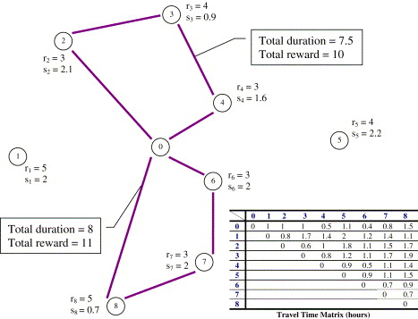
The orienteering problem
For this project we are going to work with the Orienteering Problem.
The Orienteering problem consists of giving you a set of nodes, with a cost for going from one to another, a benefit for each one, and a budget.
Its objective is to maximize the benefit without surpassing the budget.

Slide 3
TOOLS
GRASP
Search Procedure.
Visual Studio
IDE.
C#
Programming language.
Laptop
Core i7 8thG, 16 GB RAM.

Slide 4
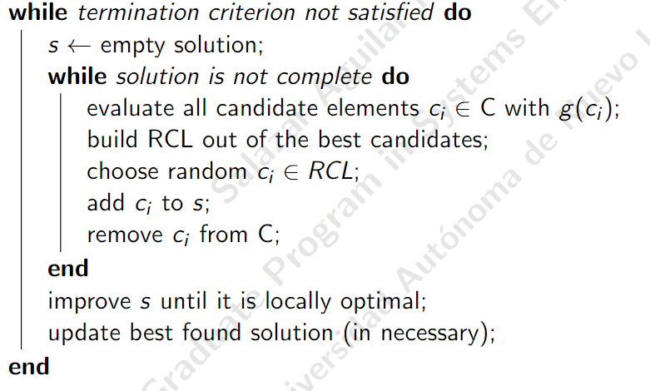
GRASP
GRASP as an acronym stands for:
G: Greedy.
R: Randomized.
A: Adaptative.
S: Search.
P: Procedure.

Slide 5
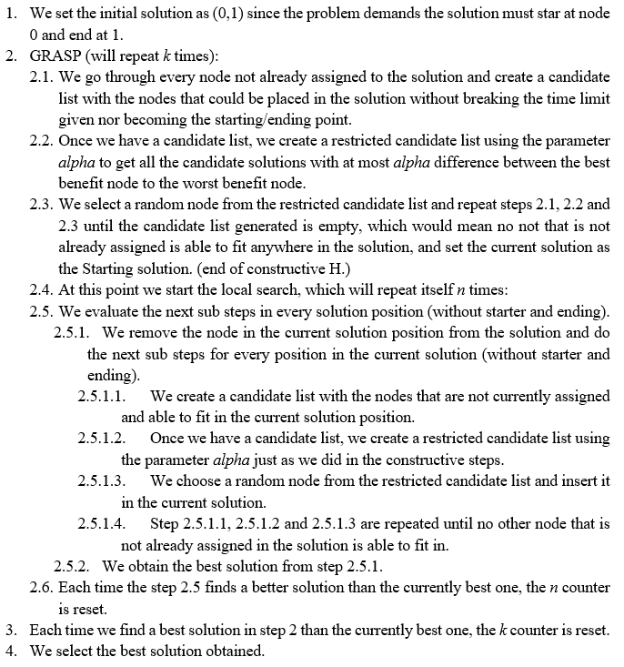
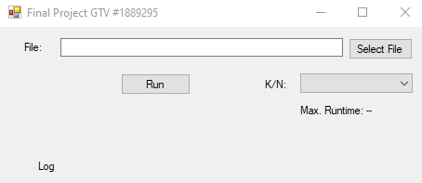
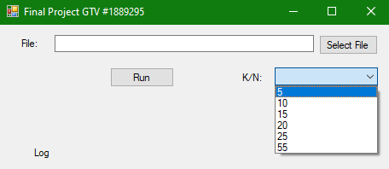
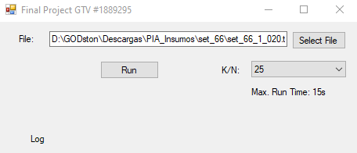
Method used

Slide 6
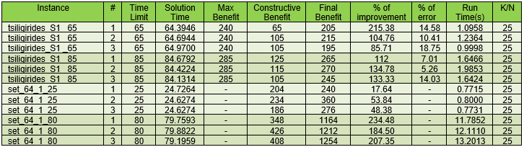
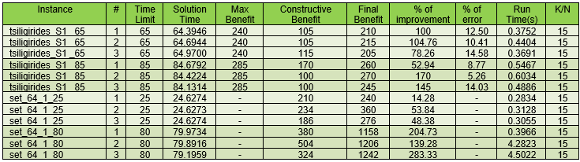
Experimental work

Slide 7
Conclusions

