Slide 1



Annotating the genome-wide cis-regulatory modules
in Drosophila via a deep channel-attention network
Speaker: Rui-Quan Hong
Author: Rui-Qian Hong, Teng Gao, Yu-Huai Yu, Tzu-Hsien Yang*
Department of Information Management,
National University of Kaohsiung, Taiwan

Slide 2
Outline
01
Introduction
02
Method
03
Results
04
Conclusion

Slide 3

Introduction
Background
CRMs (cis-regulatory module) in animal genomes, usually placed into one of three categories, are defined by their role in gene expression. Our goal is to automatically annotate CRM functions by deep learning models.
Known CRM Function
Promoter
Enhancer
Insulator
The DNA sequences that directs RNA polymerase to initiate transcription at the correct place.
The DNA sequences that cause increased expression of their target gene.
The DNA sequences that control the ability of an enhancer to regulate a promoter by an enhancer blocking activity.

Slide 4
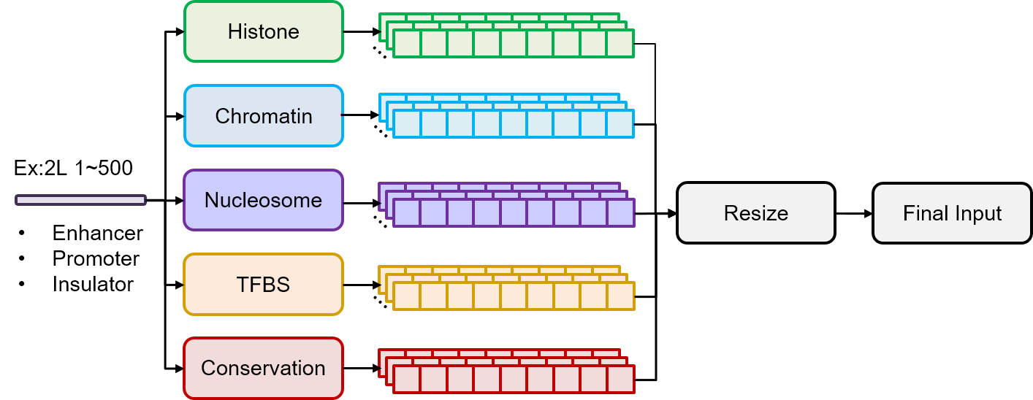
Method (generating CRM input)
[0.1, 0, 0.3, 0.8, 0.7, ……..]
Dataset number: 36
ATCGA….
Dataset number: 57
Dataset number: 7
(512, 259)
Dataset number: 158
...
Dataset number: 1

Slide 5
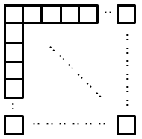
Method (Channel Attention)
Channel Attention
Pooling
(1)
259
259
259
(2)
(4)
Conv
Dense
Final
Probability
512
⊕
⊕
512
Input
259
Channel - attentive
512
(3)
512
Pooling

Slide 6
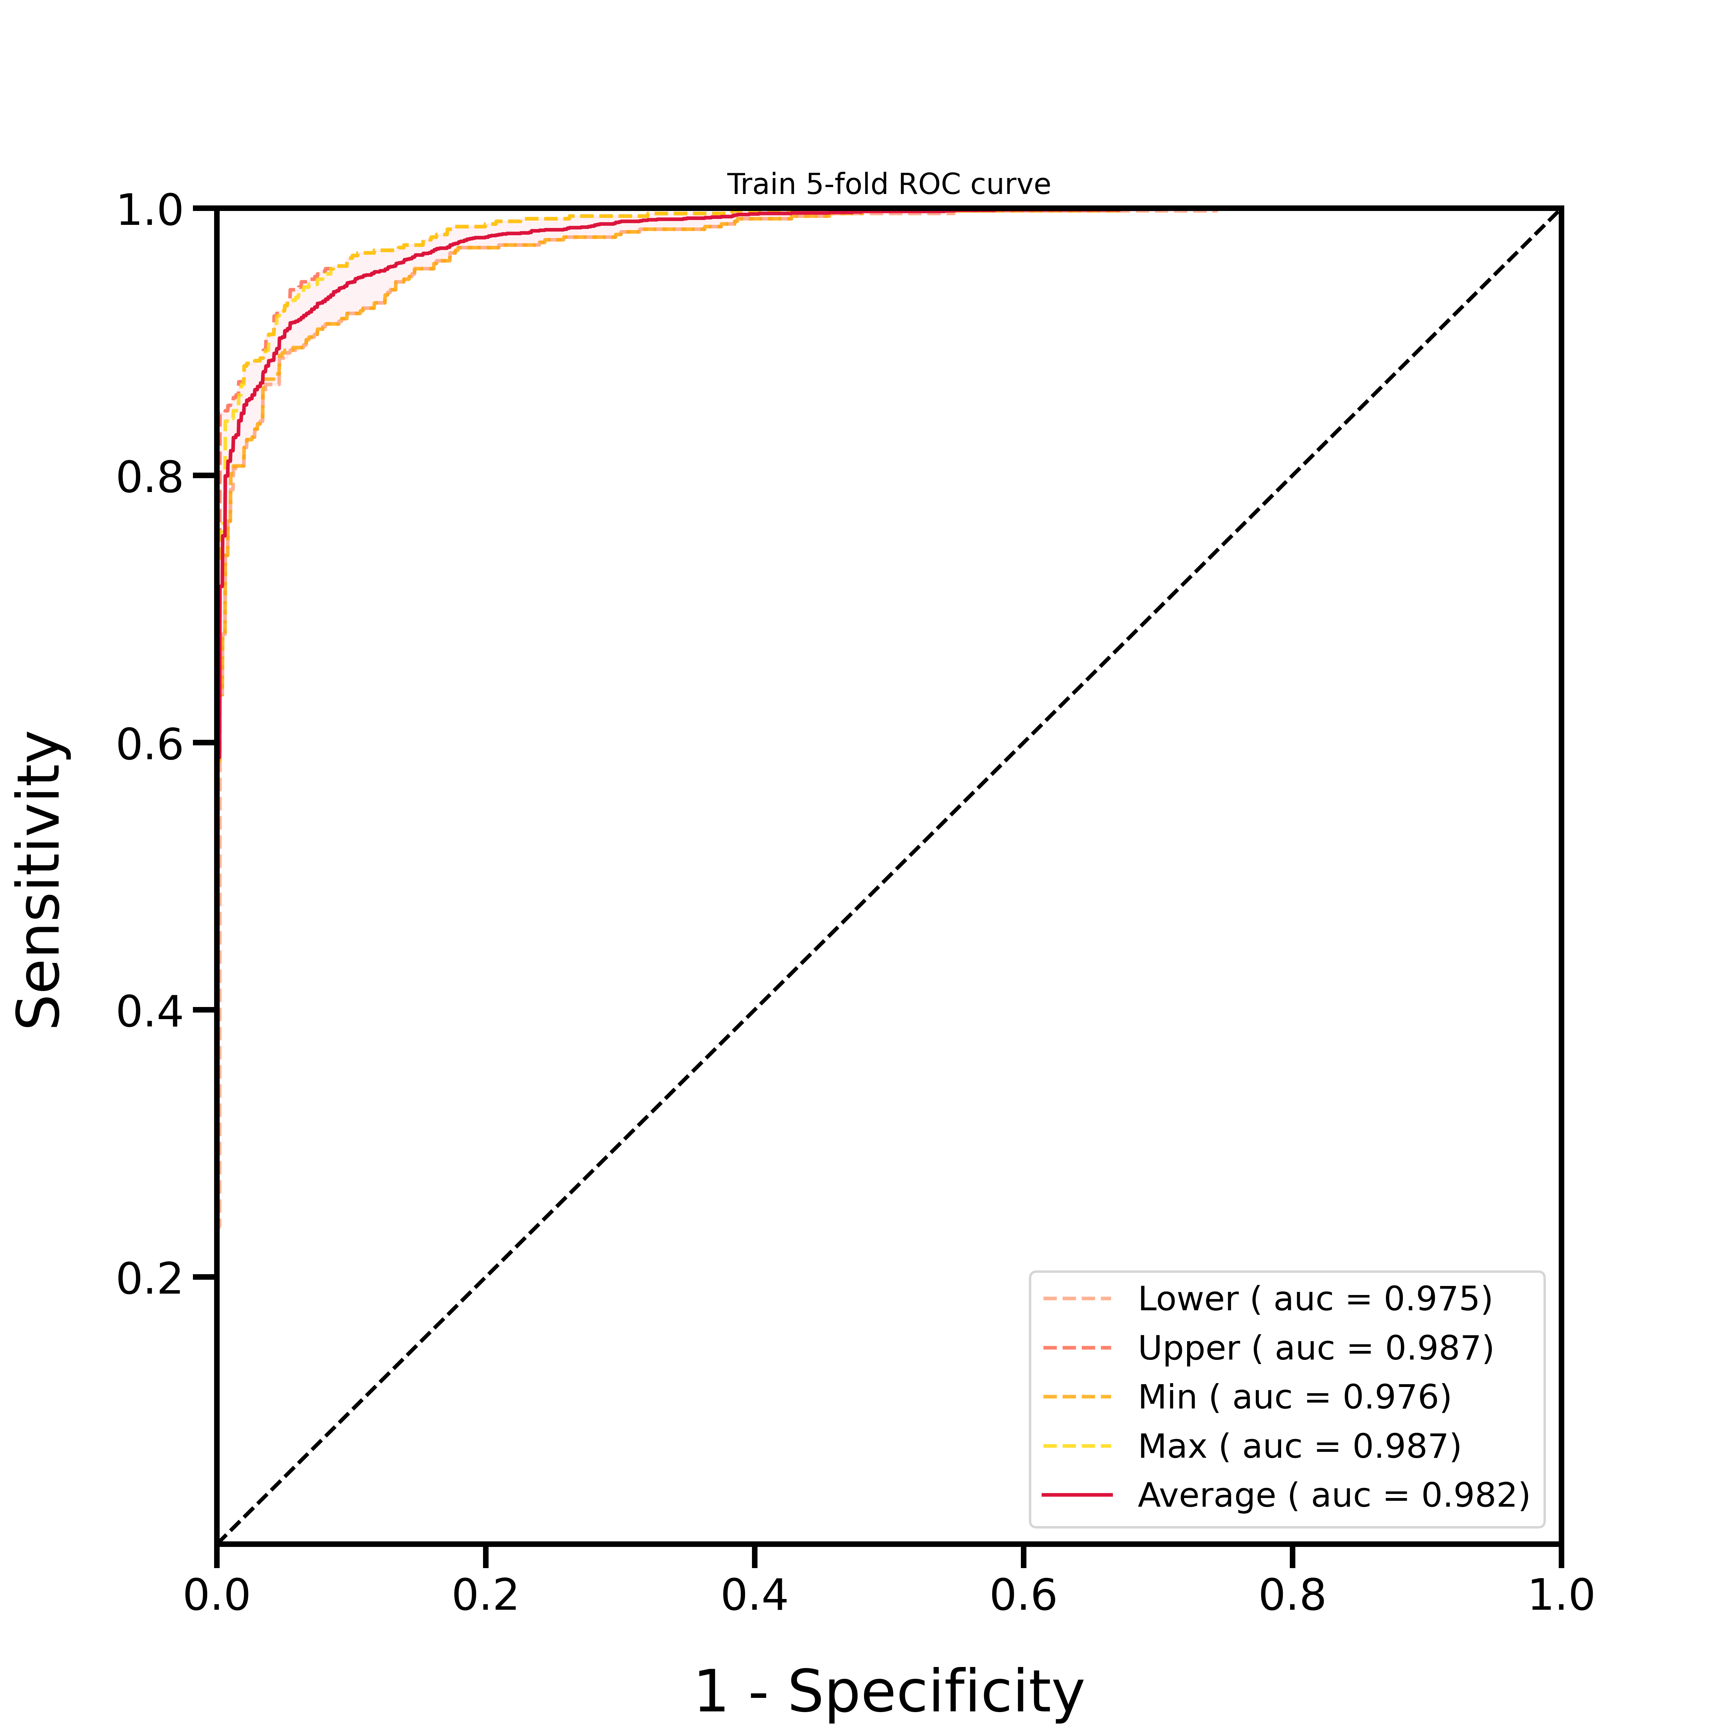
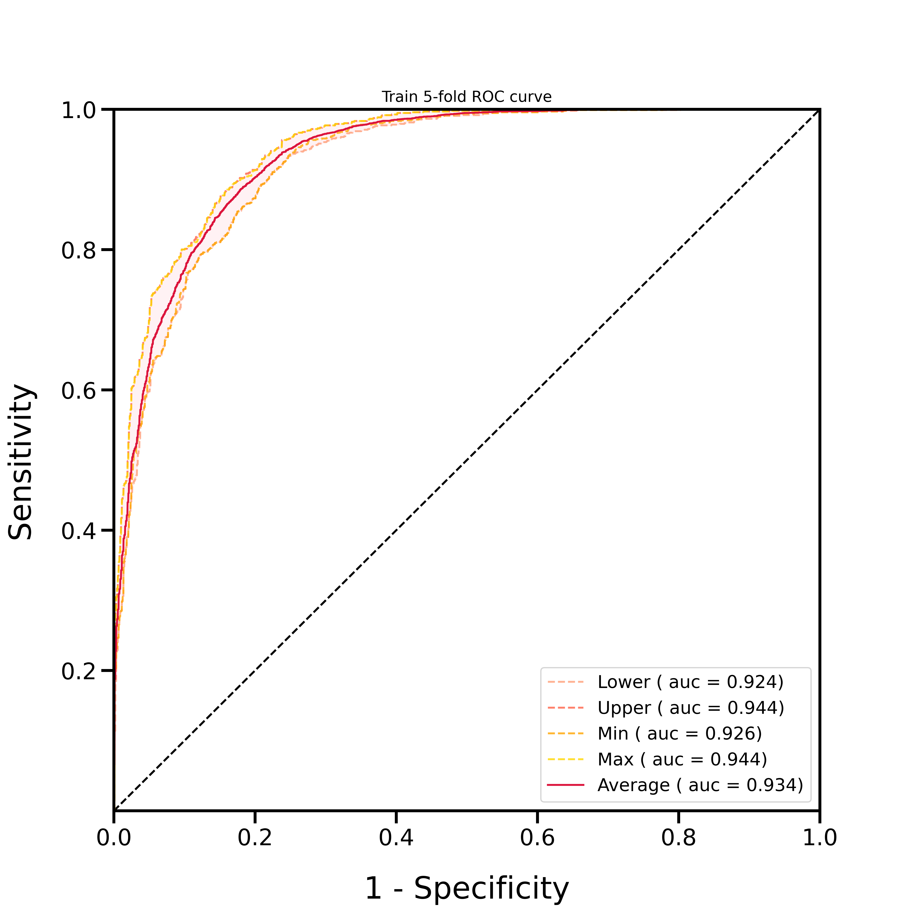
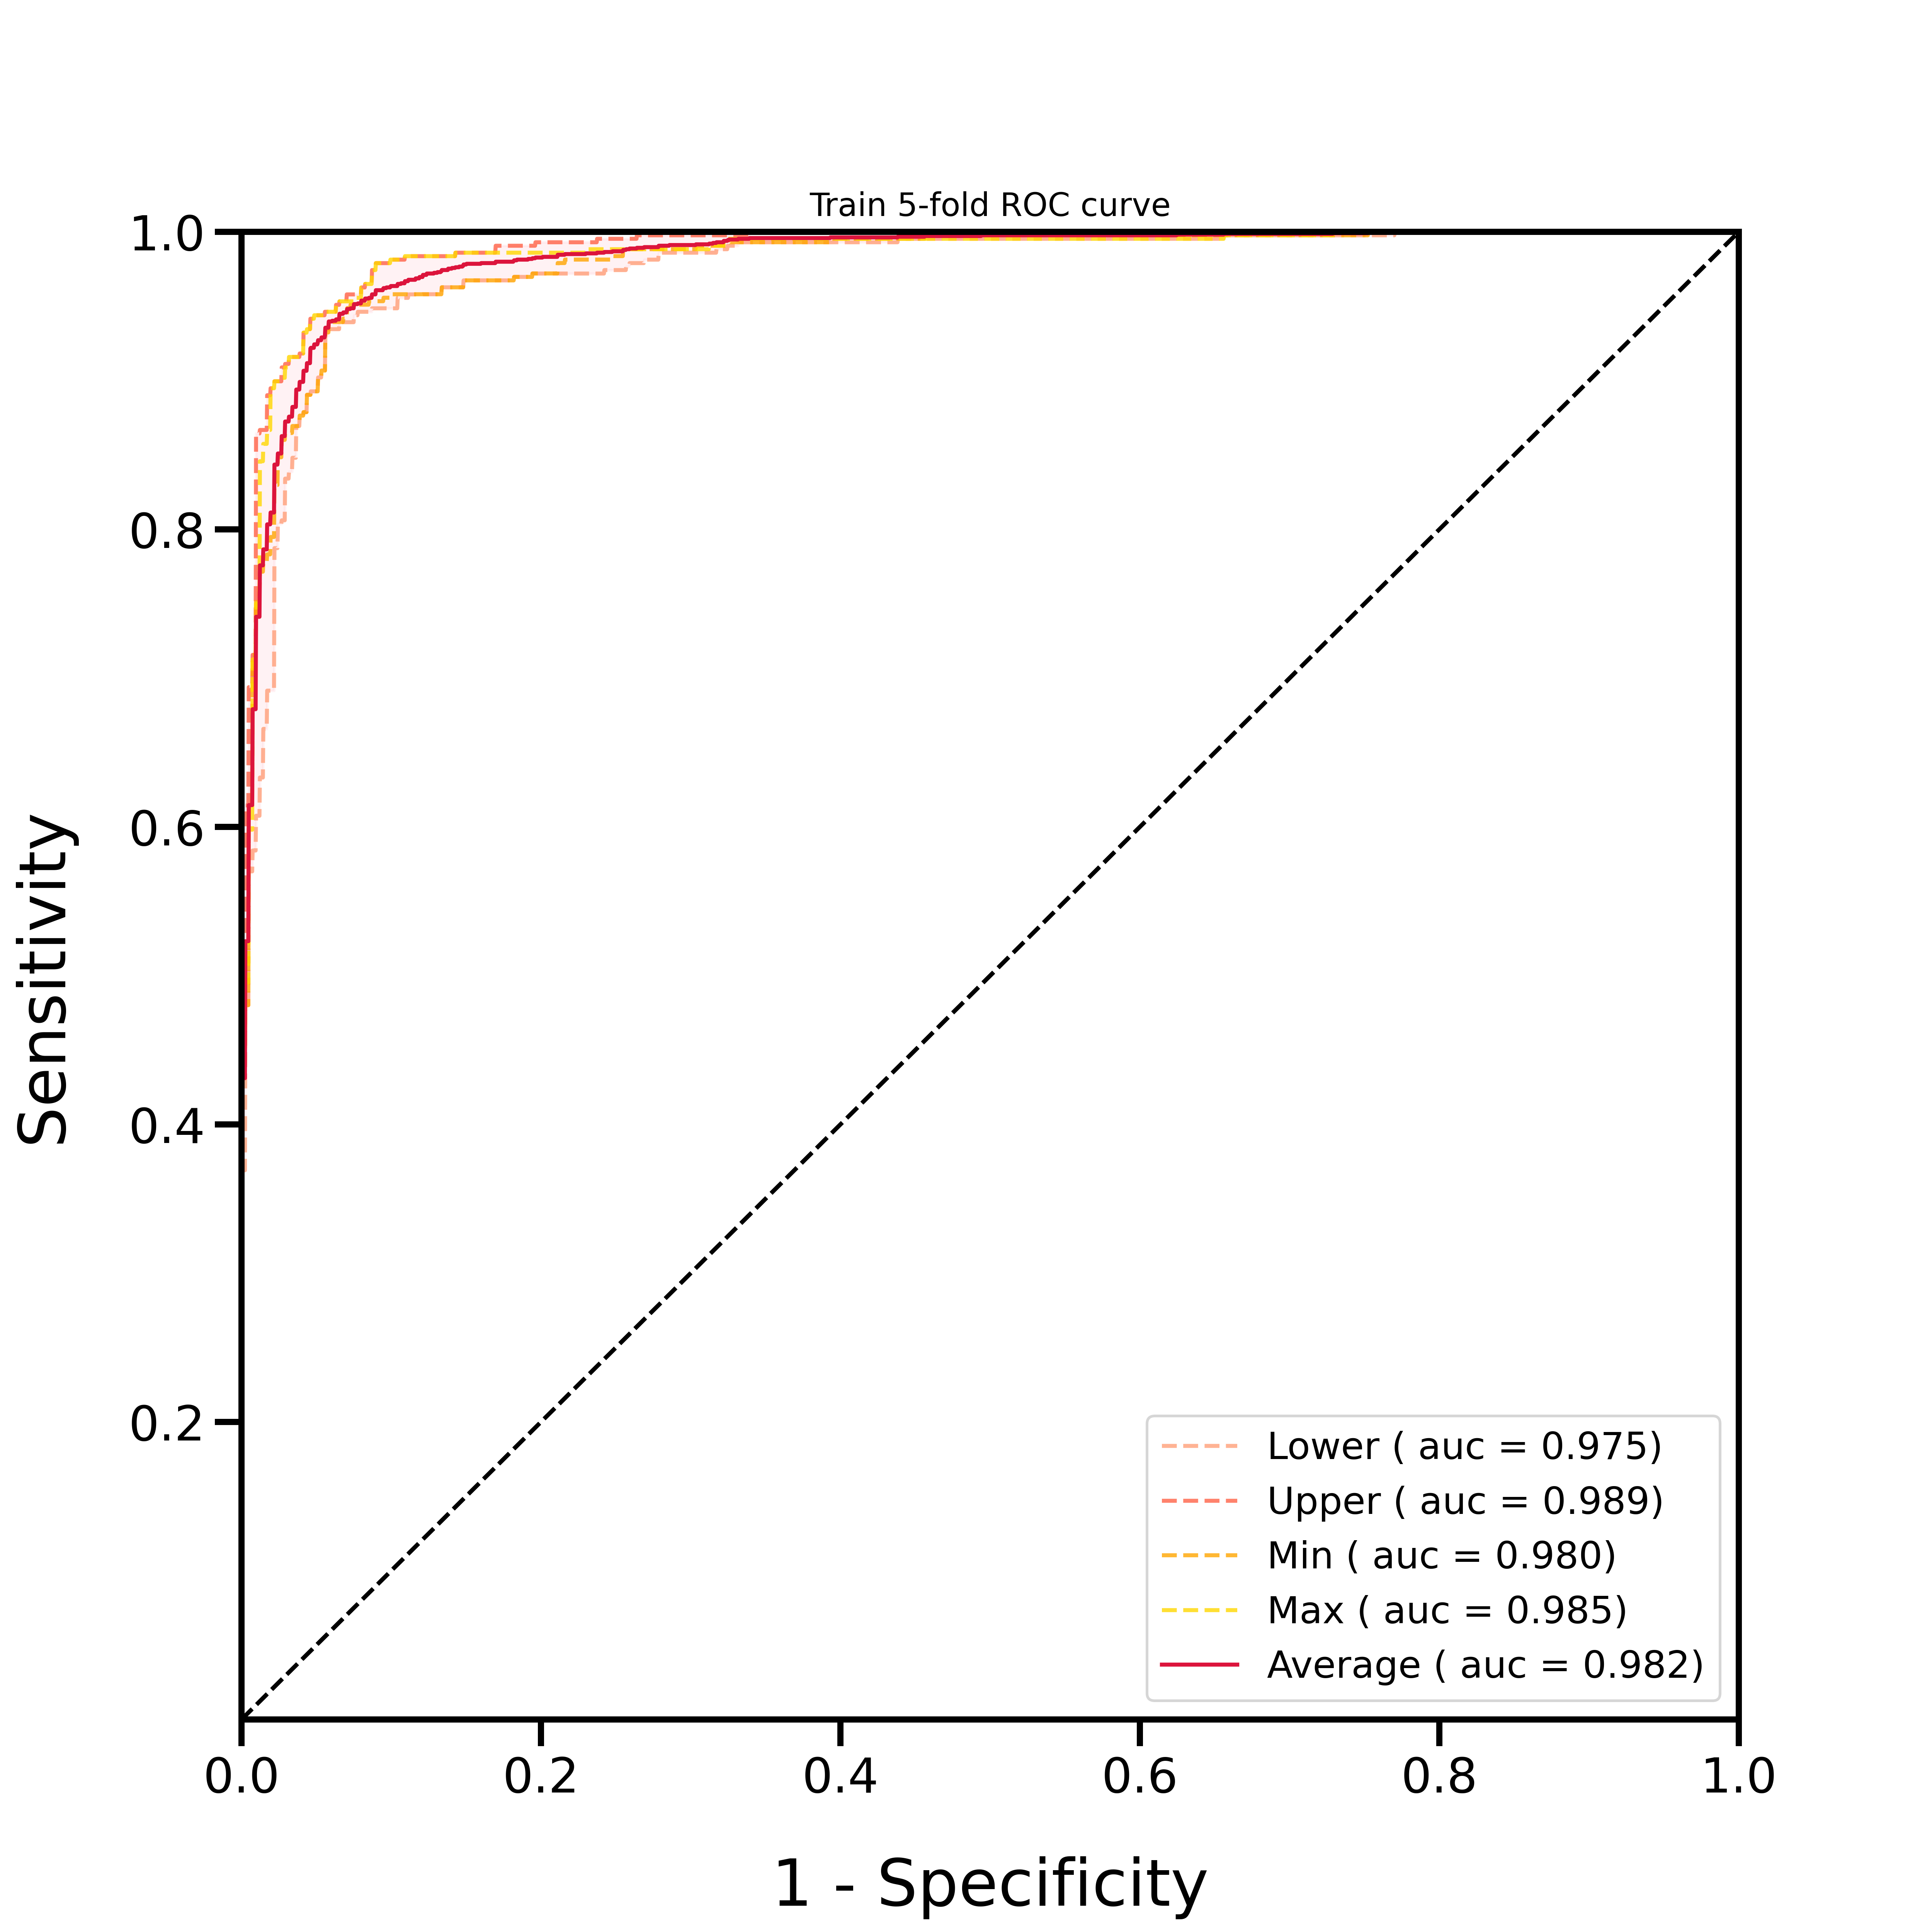
Results
Promoter
Enhancer
Insulator
Model | Accuracy | AUC | F1-score | Precision | recall
Promoter | 0.928 | 0.982 | 0.929 | 0.933 | 0.925
Enhancer | 0.855 | 0.934 | 0.865 | 0.842 | 0.889
Insulator | 0.939 | 0.982 | 0.941 | 0.938 | 0.943

Slide 7

Conclusion
Conclusion
We believe that the constructed model can help annotate genome-wide cis-regulatory elements.
This work can further help researchers understand the possible functional mechanisms of the hypothesized “histone code” in eukaryotes.

Slide 8
THANKS!

