Slide 1
Calibo AI Academy
Credit Pre-Screening Engine
Loan Intake Optimisation — Retail Personal Lending
PRESENTED BY
G. AKASH
R. DEVISREE
B. VARSHINI
D. SIVA DANESH
MUC02 • KLU BATCH • APRIL–SEPTEMBER 2026
Credit Pre-Screening Engine | Team presentation overview and business context.
01
Notes:
Cover slide — team names centered; Vattikuti Foundation and logos removed.

Slide 2
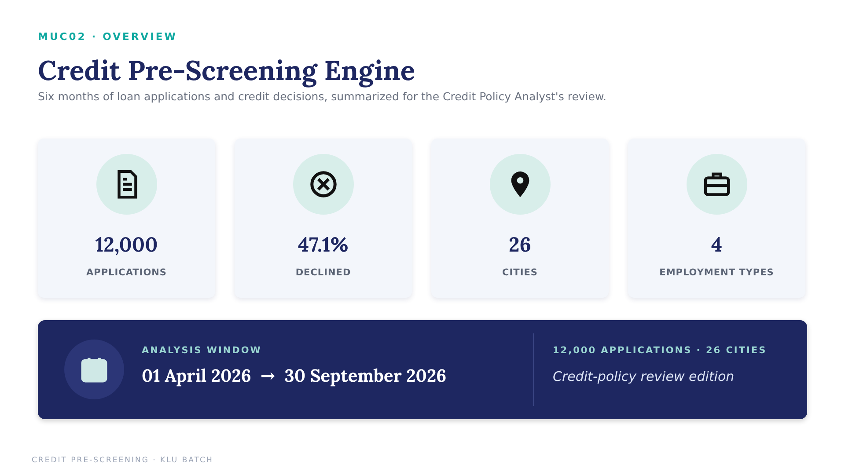
Project Overview | Scope, analysis workflow and credit pre-screening objective.
02

Slide 3
03 • BUSINESS PROBLEM
Why This Analysis Matters
Six months of past lending decisions are turned into a pre-screener the bank can defend.
SITUATION
COMPLICATION
A mid-size private bank receives about 3,000 personal loan applications a month. Every one gets a 25-minute manual credit review, and nearly half (47%) end up declined.
Many declines are visible in the first minute — a very low credit score or EMIs that already consume most of income. Analyst time goes on clear-cut declines while good applicants wait longer.
THE BUSINESS QUESTION
Can a model safely auto-decline clear-cut applications while ensuring that no more than 5% of applications placed in the auto-decline lane were historically approved?
DATA FOUNDATION
SUCCESS DEFINITION
PRIMARY STAKEHOLDER
Select a validation threshold where historically approved applicants are no more than 5% of all auto-declined applications; then evaluate once on the held-out test set.
MUC02 credit pre-screening dataset: 12,000 applications, Apr–Sep 2026, 19 columns.
Credit Policy Analyst — plus the analysts and applicants affected by the decision.
NEXT → LOAD → CLEAN → FLAG → DRIVERS
Problem Statement | Defines the stakeholder, business question, success criteria and path from cleaning to modelling.
03

Slide 4
04 • G. AKASH
04
Load, Inspect & Clean
Preparing 12,000 applications before any modelling begins.
SPEAKER CUE
Introduce cleaning as policy decisions.
ROLE SNAPSHOT
PRIMARY FOCUS
01
02
03
04
Analysis-ready loan application data, with every cleaning decision written down.
INSPECT
→
IMPUTE
→
FLAG
→
CORRECT
Shape, types, nulls
Fill 441 incomes
Keep 1,039 NTC
Fix 12 incomes
MY ROLE IN ONE LINE
Blank credit scores are new-to-credit customers, so I kept and flagged them instead of dropping them.
Akash | Cleaning: loaded, inspected and cleaned 12,000 applications with every decision logged.
04

Slide 5
05 • G. AKASH
CBIM Problem Canvas
The business context that drives the cleaning, modelling and threshold decision.
SITUATION (S)
COMPLICATION (C)
A mid-size private bank receives about 3,000 personal loan applications a month, each reviewed manually for about 25 minutes.
Analyst time is spent on clear-cut declines — very low scores or EMIs above affordable limits — while good applicants wait longer.
QUESTION (Q)
SSOT
Which applications can safely leave manual review (be auto-declined), and at what model threshold?
The MUC02 dataset (12,000 applications). The decision column is past analyst judgement, not repayment.
SUCCESS DEFINITION
PRIMARY STAKEHOLDER
A threshold within the 5% wrong-decline limit, plus the applications and analyst hours it frees up each month.
The Credit Policy Analyst — plus the analysts and applicants affected by the decision she makes.
BUSINESS PROBLEM → CLEANING & FEATURES → APPROVAL DRIVERS → MODEL & THRESHOLD → FAIRNESS & BRIEFING
Akash | CBIM canvas: framed the business problem before any code was written.
05

Slide 6
06 • G. AKASH
06
Key Contribution
Every cleaning choice is written down so a bank reviewer could agree with it.
“A blank credit score is not an error — it is a new-to-credit customer.”
APPROACH
IMPACT
LEARNING
Median income fill by employment type; 12 annual incomes divided by 12.
1,039 NTC applicants (8.7%) kept and flagged with is_ntc.
Income-imputation caveat: employment-type medians were calculated before the train/test split. Recalculate medians on training data only and rerun the model before final deployment claims.
Akash | Contribution: transparent data preparation supports every downstream analysis.
06

Slide 7
07 • B. VARSHINI
07
What Drives Approval Today
SPEAKER CUE
Introduce approval drivers.
Before any model, find out what the credit team actually does.
ROLE SNAPSHOT
PRIMARY FOCUS
2.0%
32.5%
85.2%
Approval rate by credit-score band and by FOIR band, to uncover the bank's unwritten credit policy.
BELOW 600
650–699
800+
Approval rate • weakest score band
Approval rate • just past the line
Approval rate • strongest score band
ANALYTICAL LENS
Credit-score cliff → Affordability (FOIR) → Policy rule
Approvals jump from 3.2% to 32.5% across the 650 line.
Key question: Is there a point where approvals collapse?
Varshini | Approval drivers: credit score and FOIR
07

Slide 8
08 • B. VARSHINI
08
Approval by Credit Score
SPEAKER CUE
Ask: Is there a score below which approvals almost stop?
Approval rates by score band reveal the bank's unwritten credit policy.
APPROVAL-RATE VIEW
Approval rate by credit-score band (%)
KEY OBSERVATIONS
01
A cliff at 650
Approval jumps from 3.2% (600–649) to 32.5% (650–699).
02
No score ≠ low score
New-to-credit applicants are approved 53.9% of the time — analyst judgement.
03
Job type matters
Gig / Contract approved 34.9% vs Salaried 58.4%.
Question: Is 650 an unwritten rule?
Varshini | Approval drivers: credit-score bands
08

Slide 9
09 • B. VARSHINI
09
Approval by FOIR Band
SPEAKER CUE
Ask: At what FOIR do approvals fall sharply?
FOIR = (existing EMI + proposed EMI) ÷ monthly income.
AFFORDABILITY VIEW
Approval rate by FOIR band (%)
≈ 50 pts ↓
Approval-rate fall from <30% to >55% FOIR
65.5% → 15.6%
Approval rate: lowest vs highest FOIR band
Approvals fall at every step. The decline becomes more pronounced above 50% FOIR; use this as a trigger for additional affordability review, not as a stand-alone rejection rule.
Applicants above 55% FOIR have a 15.6% historical approval rate. This pattern describes past decisions; it does not establish a safe lending limit.
Varshini | Affordability: approval falls as FOIR rises
09

Slide 10
10 • D. SIVA DANESH
Logistic Regression Pre-Screener
Held-out test set: 2,400 applications at the default 0.50 cut-off.
ACCURACY
ROC-AUC
WRONGLY DECLINED
78.0% | Correct on 1,871 of 2,400 test applications
0.867
Good separation of approvals and declines
232 | Historically approved applicants wrongly declined at 0.50
SUBGROUP METRICS
NTC REVIEW
Verify from held-out predictions
Keep NTC applicants in manual review
READING THE RESULT
At 0.50, 232 applicants historically approved by the credit team would be wrongly classified as Declined. Overall accuracy is 78.0%; subgroup accuracy should be reported only after reproducible calculations from held-out predictions. Keep NTC applicants in human review.
Siva Danesh | Model: precision 78.2% and recall 73.7% for the Declined class.
10

Slide 11
11 • D. SIVA DANESH
Threshold Table — What Stood Out
Raising the threshold auto-declines fewer applicants and reduces the share of historically approved applicants in that lane.
APPLICATIONS AUTO-DECLINED
0.50
41.00% of validation applications
0.95
9.88% of validation applications
HISTORICALLY APPROVED AS % OF AUTO-DECLINED APPLICATIONS
0.50
19.31% — validation wrong-decline share
0.95
2.53% — validation wrong-decline share; passes 5% limit
Wrong-decline share = historically approved applications among all auto-declined applications. Validation selects 0.95 (2.53%); held-out test at 0.95: 9.62% auto-declined and 1.30% wrong-decline share.
11

Slide 12
12 • D. SIVA DANESH
Features Associated with Predicted Decline
The fitted model associates higher FOIR and recent delinquencies with decline, and higher credit scores with lower decline likelihood.
FOIR (+1.269)
CREDIT SCORE (−1.003)
DELINQUENCIES (+0.982)
Largest positive coefficient; higher FOIR is associated with greater predicted decline likelihood.
Higher credit score is associated with lower predicted decline likelihood.
More recent delinquencies are associated with greater predicted decline likelihood.
POLICY FOUND
→
MODEL LEARNED
→
THRESHOLD SET
→
ANALYST DECIDES
READING THE COEFFICIENTS
Coefficients: FOIR +1.269; credit score −1.003; delinquencies +0.982; Gig / Contract +0.655; Salaried −0.425; NTC +0.390. Numeric variables were standardised; categorical indicators were one-hot encoded, so compare coefficient magnitudes cautiously.
Siva Danesh | Coefficients show model associations, not causal effects.
12

Slide 13
13 • D. SIVA DANESH
Threshold & Business Case
Three numbers Siva Danesh brings into the final briefing.
THRESHOLD
VOLUME
TIME
0.95 is the lowest validation cut-off within the 5% limit (2.53% wrong on validation; 1.30% on test).
9.62% of test applications auto-declined — about 289 of 3,000 a month.
About 120.3 analyst hours potentially freed monthly at 25 minutes per review. Test set catches 20.19% of historical declines.
DECISION LENS
RULE
5% validation risk limit
SCALE
~289 applications / month
VALUE
~120.3 analyst hours / month
Siva Danesh | Contribution: validation-selected threshold translated into held-out test results and estimated capacity.
13

Slide 14
14 • R. DEVISREE
Fairness Check — Gender Gap
Historical approval differs by gender; income and employment mix may be associated with the gap, but do not establish its cause.
OVERALL GAP
Full-dataset historical approval: Male 54.1% vs Female 50.4%. Within employment categories, the differences vary.
WHAT EXPLAINS IT
Held-out test set: median income ₹46K (F) vs ₹56.5K (M); Gig / Contract share 20.45% (F) vs 11.51% (M).
THE MODEL
At the selected 0.95 threshold, test auto-decline rates are 10.64% female vs 9.19% male.
Devisree | Fairness: monitor test-set outcomes and possible proxy effects; observed differences do not establish causation.
14

Slide 15
15 • R. DEVISREE
The model decides for some applicants;
a human must decide for others
Where the model can be trusted — and where it should not decide yet.
Applicant group
What the data shows
Recommended handling
Credit score below 650
Only 2.0–3.2% approved
Use validated model output plus human policy review
FOIR above 55%
Only 15.6% approved
Enhanced affordability review; not an automatic rule
New to credit (8.7%)
Model only 56.7% accurate
Always send to an analyst
Gig / Contract
34.9% approved vs 58.4% Salaried
Monitor outcomes for bias
Scored applicants
Model 81.2% accurate
Auto-decline only at ≥ 0.95 for eligible scored applicants
BUSINESS READ:
Historical approval patterns can guide review, but do not prove future repayment risk or justify automatic rejection by score or FOIR alone. NTC applicants remain in manual review.
Devisree | Who the model should decide for — and who it should not.
15

Slide 16
16 • R. DEVISREE
Credit Policy Briefing
A threshold, two drivers, one group to protect and one fairness safeguard.
RECOMMENDED THRESHOLD • 0.95
TWO KEY DRIVERS
Validation wrong-decline share: 2.53%. Held-out test: 9.62% auto-declined and 1.30% wrong-decline share. Estimated impact: ~289 applications and ~120.3 analyst hours per month.
FOIR: historical approval falls from 65.5% below 30% to 15.6% above 55%. Credit score: approval is 2.0–3.2% below 650.
CREDIT POLICY ANALYST BRIEFING
KEEP WITH HUMANS
FAIRNESS POSITION
New-to-credit applicants: the model is right only 56.7% of the time.
Always route them to an analyst.
At 0.95, test auto-decline is 10.64% female vs 9.19% male. Gender is excluded; income and employment may be proxies, so monitor subgroup outcomes.
BUSINESS DIRECTION
Auto-decline the clear cases, let analysts judge the rest — and get repayment data before go-live.
Devisree | Credit policy briefing: threshold, drivers, protected group and fairness.
16

Slide 17
17 • R. DEVISREE
Business Case & Go-Live Safeguards
A conservative pilot candidate requiring further validation; scale only with additional evidence.
THRESHOLD 0.95
MONTHLY IMPACT
ANALYST TIME
9.62% of test applications auto-declined; 1.30% of those were historically approved. 0.95 is the lowest threshold passing the validation 5% gate.
About 289 of 3,000 monthly applications are estimated to avoid manual review.
About 120.3 analyst hours potentially freed monthly (25 minutes per review). The test lane catches 20.19% of historical declines.
BEFORE GO-LIVE
1
Keep new-to-credit applicants with analysts.
2
Pilot the 0.95 lane on a controlled volume.
3
Compare model outcomes with analyst decisions monthly.
4
Report approval and auto-decline rates by gender.
Do not lower the threshold solely to save more time; the 5% validation risk limit is the governing constraint.
Devisree | Business case: hours freed vs risk of wrongly declining good customers.
17

Slide 18
18 • R. DEVISREE
Action Plan & Final Recommendation
Four actions to convert the analysis into decisions.
1
SET THE THRESHOLD AT 0.95
Use the validation-selected 0.95 threshold; test results estimate ~289 applications and ~120.3 analyst hours saved monthly.
2
PROTECT NEW-TO-CREDIT
Always route NTC applicants (8.7%) to an analyst; the model is only 56.7% accurate for them.
3
WRITE THE POLICY LIMITS
Use score and FOIR bands as review indicators, not stand-alone lending rules. Obtain formal credit-policy approval before setting limits.
4
MONITOR FAIRNESS
Track approval and auto-decline by gender monthly; watch income and job-type proxies.
DECISION BOUNDARY
OVERALL RECOMMENDATION
Before go-live: fit income imputation on training data only, conduct out-of-time validation, assess calibration and drift, and obtain repayment outcomes. The model predicts past analyst decisions, not repayment.
Pilot only after leakage-safe rerun and further validation. Keep human judgement for NTC and other cases requiring review. Monitor fairness, calibration and repayment outcomes.
Devisree | Final action plan and recommendation.
18

Slide 19


