Slide 1
09_ThreeJS_1
Computer Graphics

Slide 2
Reference (Not a Textbook)
Jos Dirksen, Learn Three.js, 3rd Edition, Packt Publishing, 2018.

Slide 3
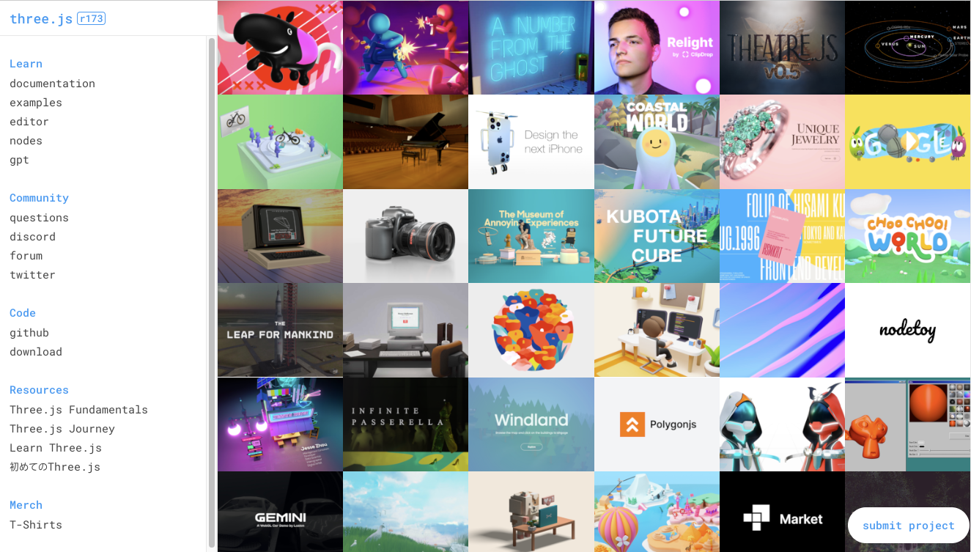
Three.js Home
https://threejs.org
Projects
Documentation
Examples
Community
Code
Resources - lectures

Slide 4
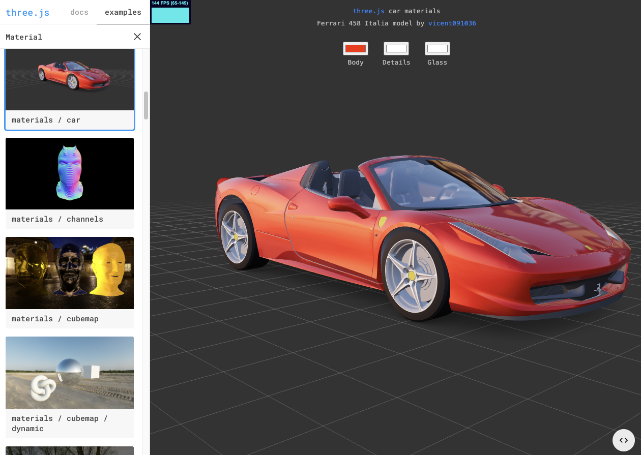
Three.js Examples
모든 example은 source code가 제공됨

Slide 5
Download the Example Code in Our Class
https://github.com/iklee99/ThreeJSSource

Slide 6
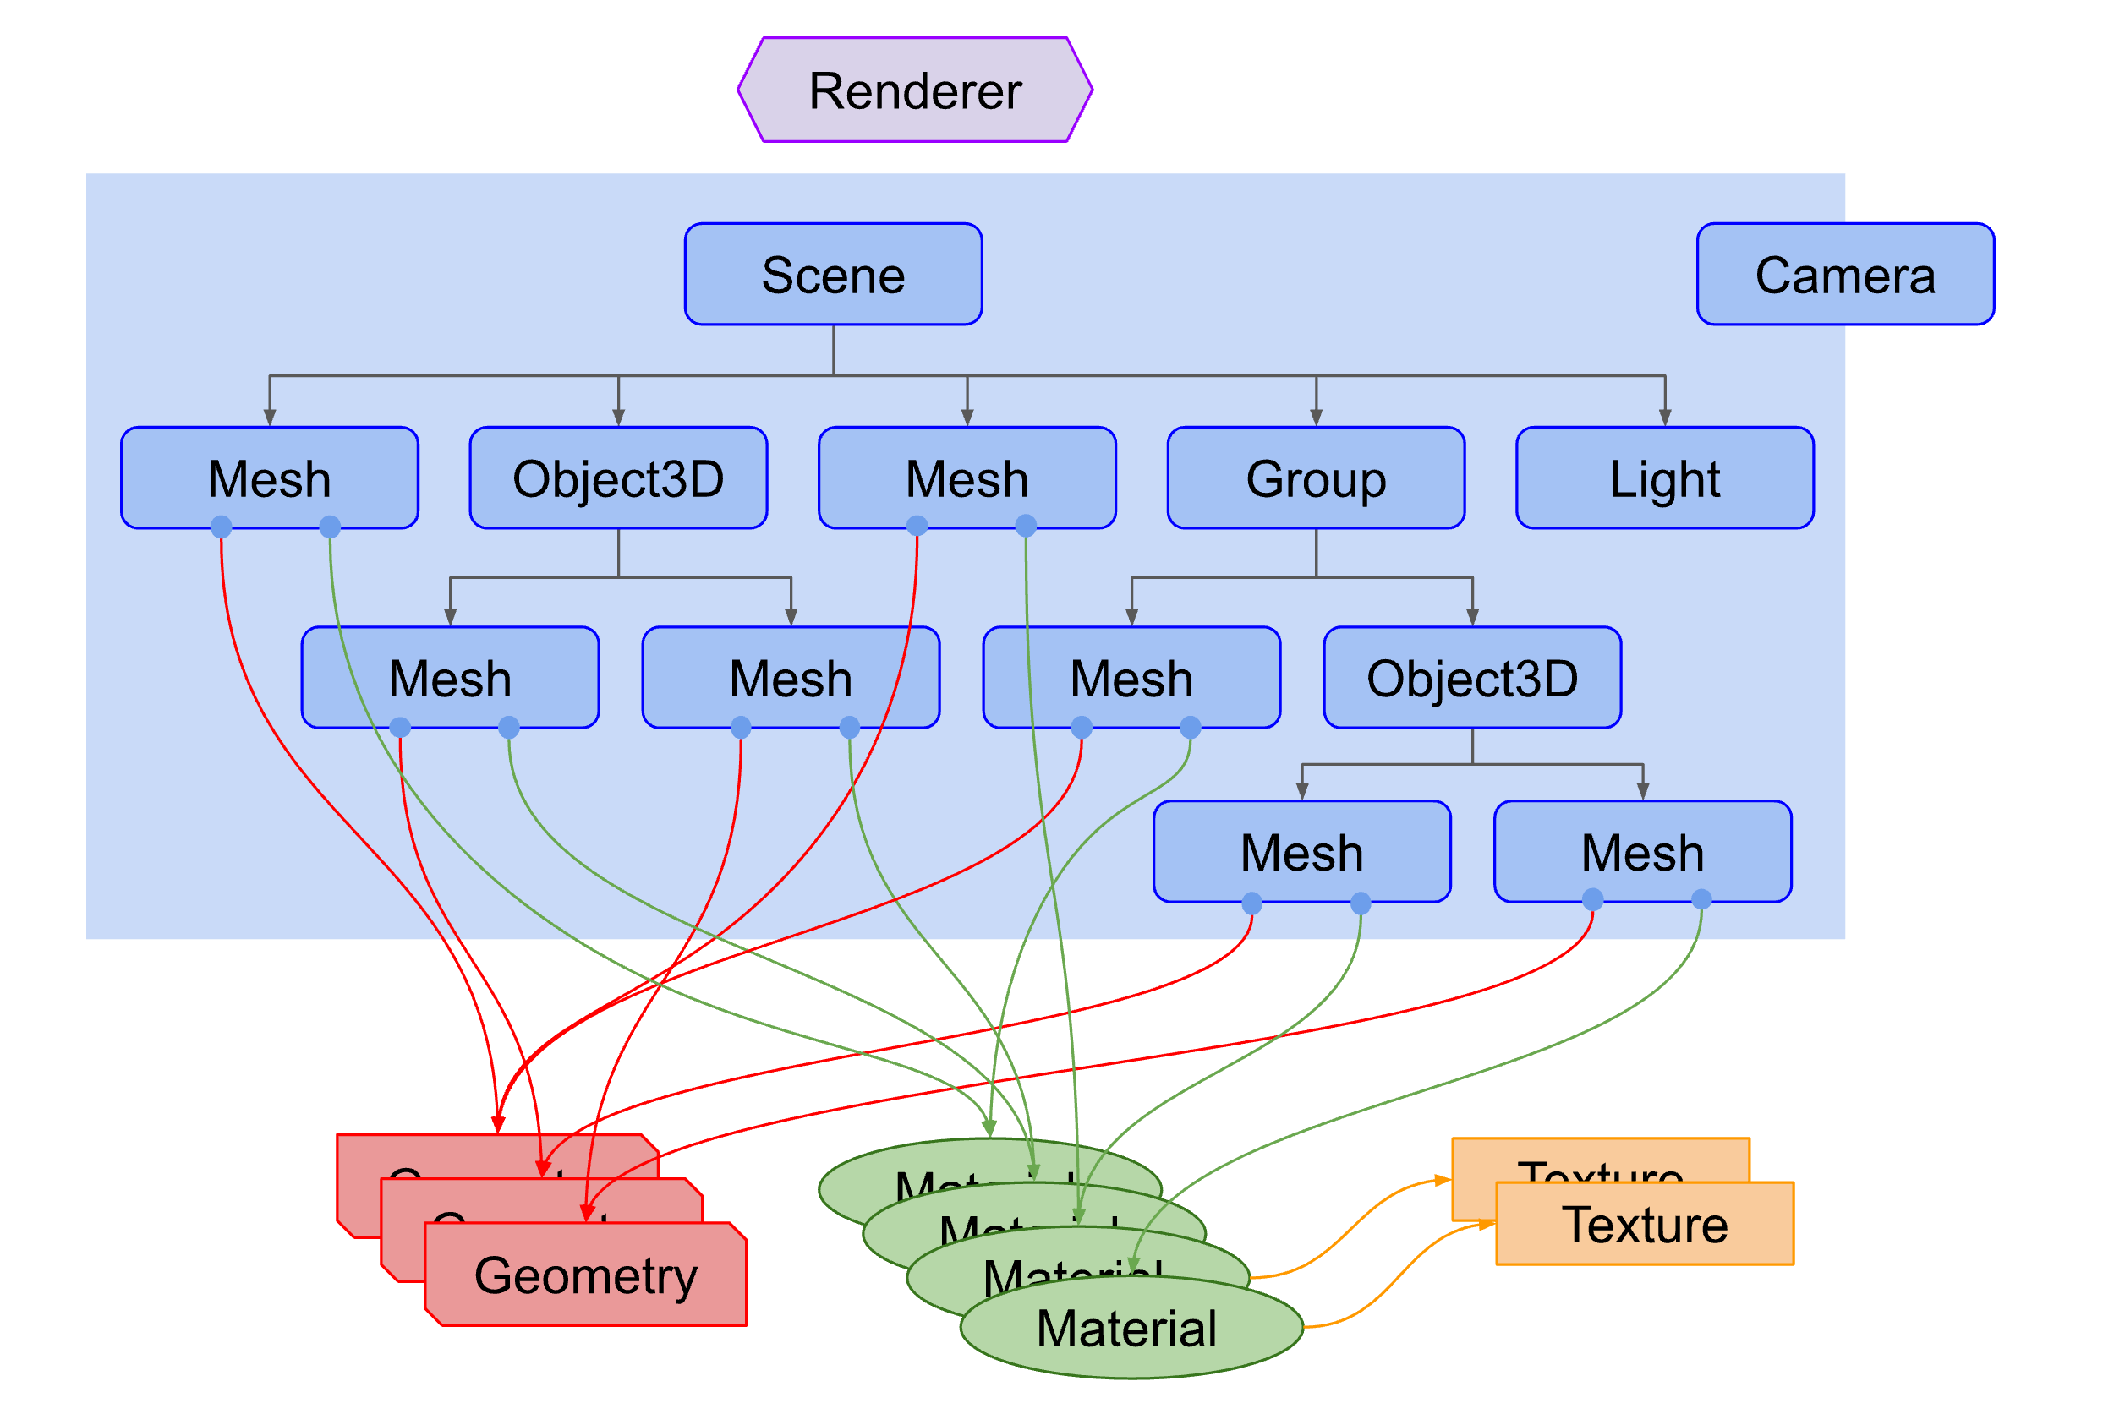
Object Hierarchy in Three.js
Mesh = Geometry + Material
Mesh, Object3D, Group, Light, Camera를 Scene에 add
Scene은 Tree 구조로 구성

Slide 7
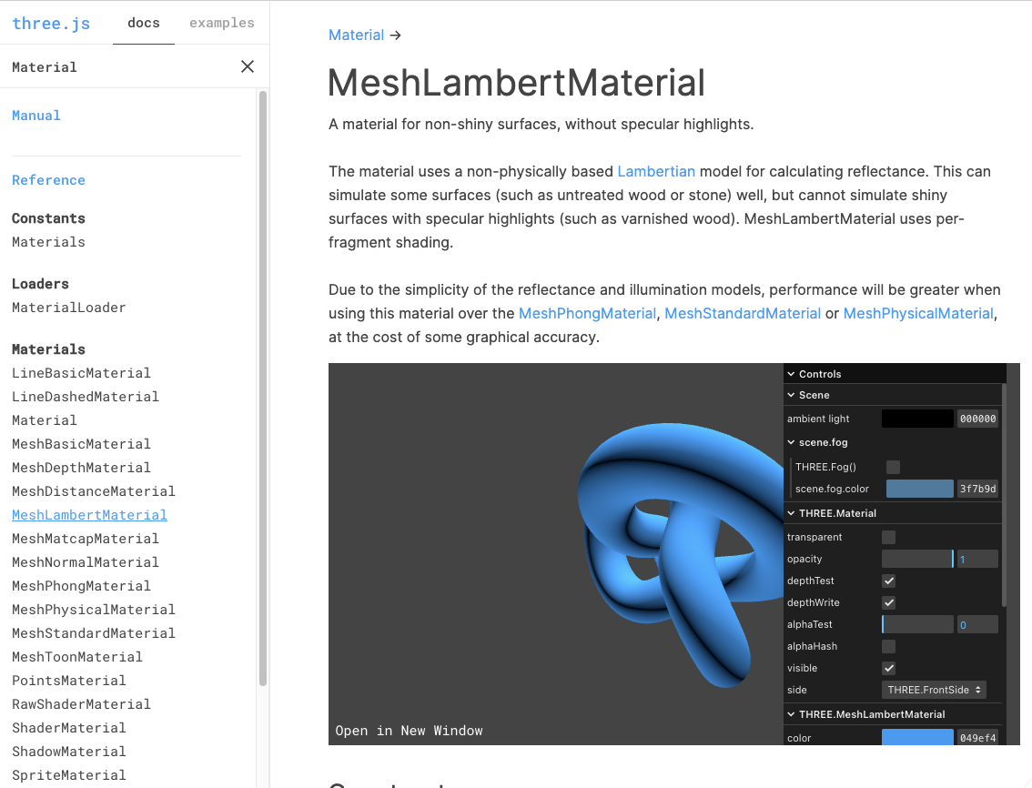
Three.js documentation
? 창에 class 이름 넣고 search
ex) “Material”
MeshPhongMaterial
diffuse + specular
MeshLambertMaterial
only diffuse
UI 이용하여 parameter 조절 해 볼 수 있음

Slide 8
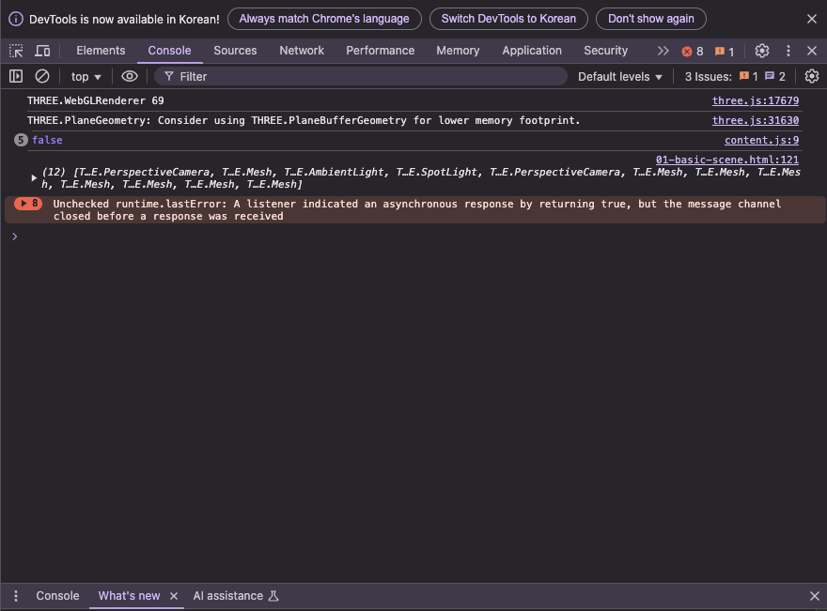
console.log(...)
Chrome의 개발자 모드 (Ctrl-Alt-i) 의 console에 value를 print
여기서는 scene의 모든 children을 print

Slide 9
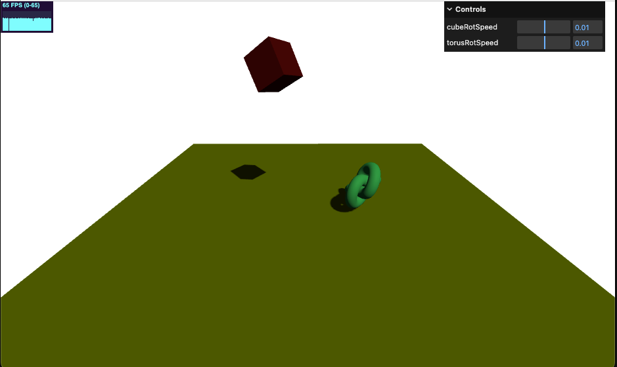
01-getting-started

Slide 10
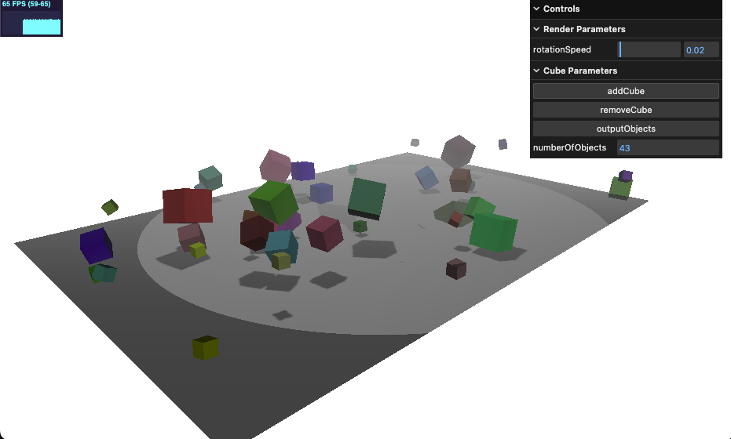
02-foggy-cubes.html
GUI
Stats
fog
scene.children

Slide 11
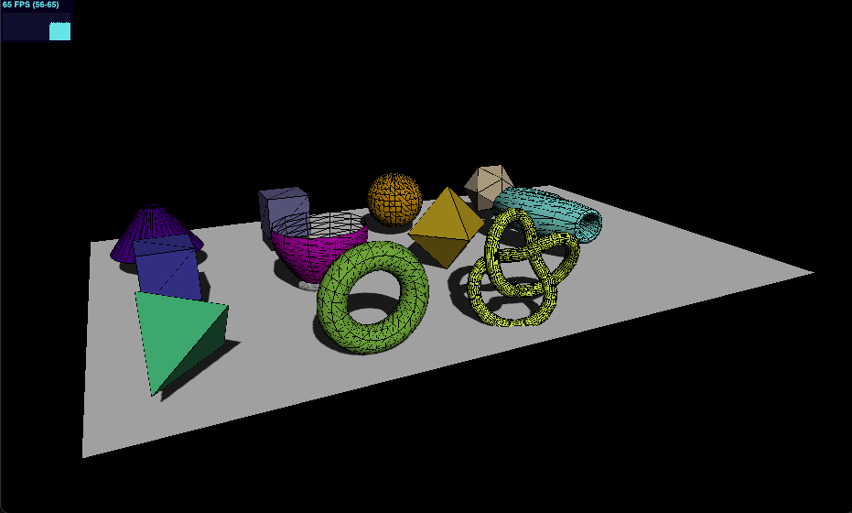
03-geometries
Geometries
Cylinder
Box
Sphere
Icosahedron
Convex
Lathe [lei♁]
Octahedron
Parametric
Tetrahedron
Torus
TorusKnot

Slide 12
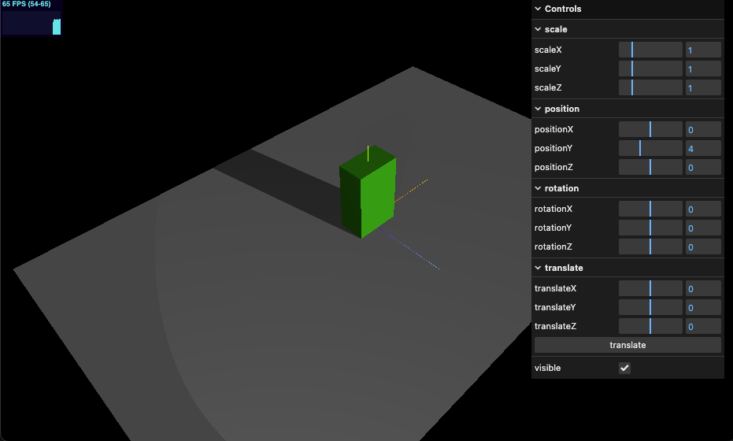
04-mesh-properties

Slide 13
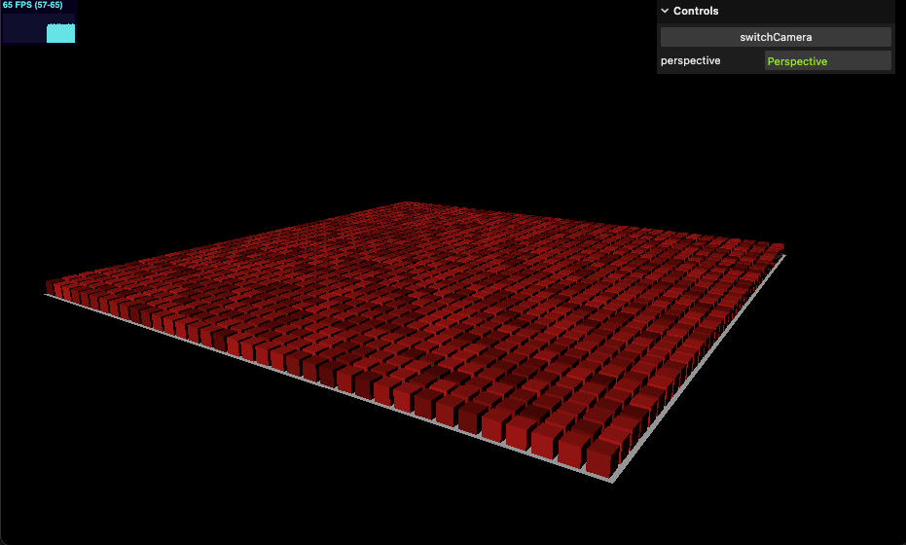
05-both-camera
Perspective vs
Orthographic Camera

Slide 14
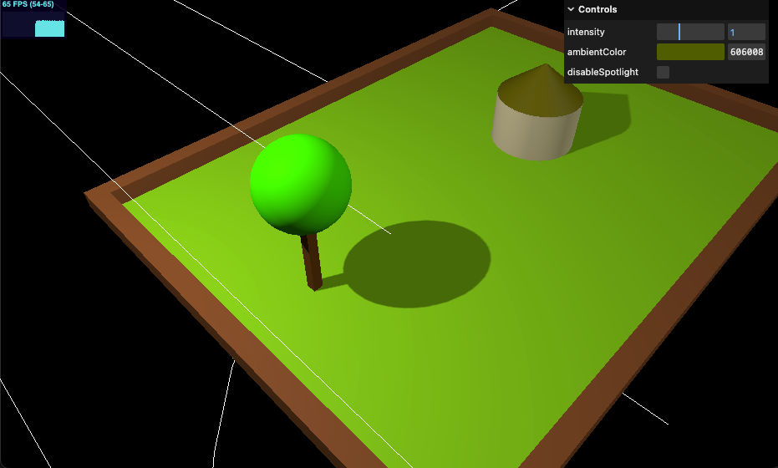
06-ambient-light

Slide 15
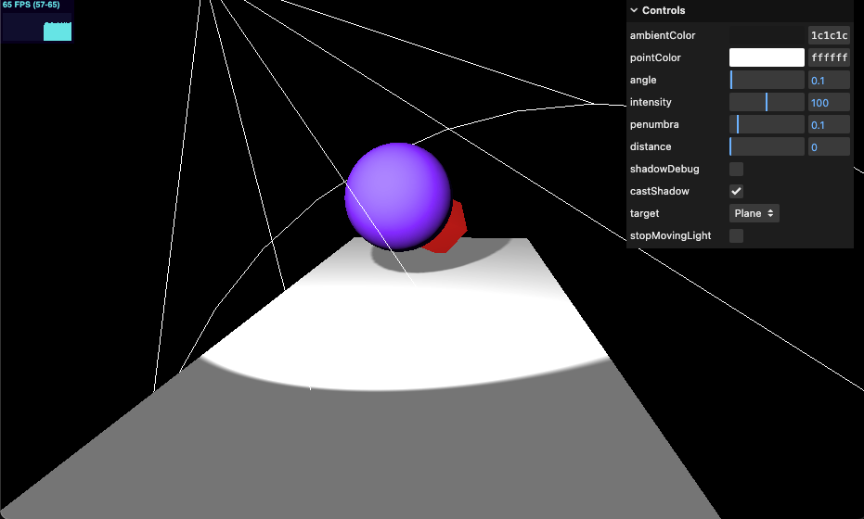
07-spot-light

