Slide 1
OpsTracker
Digital Attendance Management for SPF NS Reservists
For Approval
Ops Security, Ops Branch
NSPI Sun Jin
17 August 2026

Slide 2
Agenda
01
Executive Summary
10
Data Security and Privacy
02
The Problem
11
PDPA Compliance
03
Before vs After
12
Cost and Value
04
Introducing OpsTracker
13
Why Now
05
Reservist Experience
14
Challenges
06
Admin Capabilities and Features
15
Deployment Timeline
07
Reservist App Screens
16
Handover Plan
08
Admin Dashboard Screens
17
Future Plans and Recommendation
09
Expected Benefits and Impact

Slide 3
Executive Summary
The Challenge
The Solution
• Attendance tracked verbally with no system verification
• No real-time visibility for the team
• No consolidated records or audit trail
• GPS-verified check-in via mobile browser
• Live dashboard viewable by the team
• Digital leave and MC; full history; one-click export
Cost to the Unit
What We Are Asking For
• Built in-house at SGD 0 development cost
• Running cost: SGD 0 to SGD 15 per year
• Free tier supports years of use at this unit scale
• Approval to deploy at the next Ops Security cycle
• System is fully built, tested and ready to go
• Onboarding can begin within days of approval

Slide 4
The Problem
Verbal check-ins with no verification, visibility or records

Slide 5
The Problem
01 No Verification
• Reservists report verbally with no system check or confirmation
• No way to confirm physical presence at the reporting location
02 No Visibility
• The team has no real-time view without being physically present
• Leave and MC handled informally via chat with no formal record
03 No Records
• No consolidated attendance history exists for the unit
• Chronic absences go undetected until it is too late to act

Slide 6
Before vs After
Area | Before | OpsTracker
Attendance Check | Verbal, trust-based; no verification | GPS-verified check-in via mobile browser
Supervisor View | Must be on site to know who showed up | Live dashboard updated in real time
Leave and MC | WhatsApp or verbal; no formal record | Digital submission with full approval history
Record Keeping | Relies on memory and scattered chat logs | Permanent digital log with one-click export
Accountability | No mechanism to flag repeated no-shows | Auto-absent marking and trend tracking

Slide 7
The Solution
GPS-verified mobile check-in, live dashboards, and full digital records

Slide 8
Introducing OpsTracker
Mobile-first Progressive Web App replacing verbal check-ins with GPS-verified digital attendance records.
Progressive Web App
Supabase + Realtime
GPS Shift Verification
Mobile-First
Works on iOS, Android or desktop. No app store download required.
GPS Check-In
Confirms device location before recording. Supports AM, PM and Full Day shifts.
Real-Time Dashboard
Live view of present, absent and MC status as check-ins happen.
Attendance History
Full records and trends for any reservist or cycle, searchable anytime.
Automated Reporting
One-click export to Excel or a print-ready cycle report.

Slide 9
Reservist Experience
Step 1
Step 2
Step 3
Step 4
Register
Check In
Leave / MC
View History
• Submit form online
• Admin activates account
• Receive login credentials
• Open app in reporting window
• GPS confirms location
• One tap records attendance
• Submit request digitally
• Receive approval in-app
• History tracked automatically
• Access records anytime
• Check attendance trends
• See leave outcomes
▶
▶
▶
Reservists can install OpsTracker to their home screen as a PWA. No app store required.

Slide 10
Admin and Supervisor Capabilities
Attendance
Roster
• Live dashboard: present, absent and MC
• Manual attendance override with full audit log
• Mark all present or configure no-report days
• Auto-absent marking after check-in window closes
• Add, deactivate or reassign reservists
• CSV bulk upload and password resets
• Welfare notes and member activity log
• Assign reservists to batches and companies
Leave and MC
Reporting
• Approve or reject requests individually or in bulk
• Cancel approved leave if plans change
• Full leave history per reservist
• MC tracked separately from standard leave
• Export cycle report to Excel or print
• WhatsApp broadcast to the full unit
• Cycle picker and multi-day date range view
• Attendance trend snapshot per exercise cycle
Super Admins can also manage admin accounts, create cycles, and define GPS reporting boundaries.

Slide 11
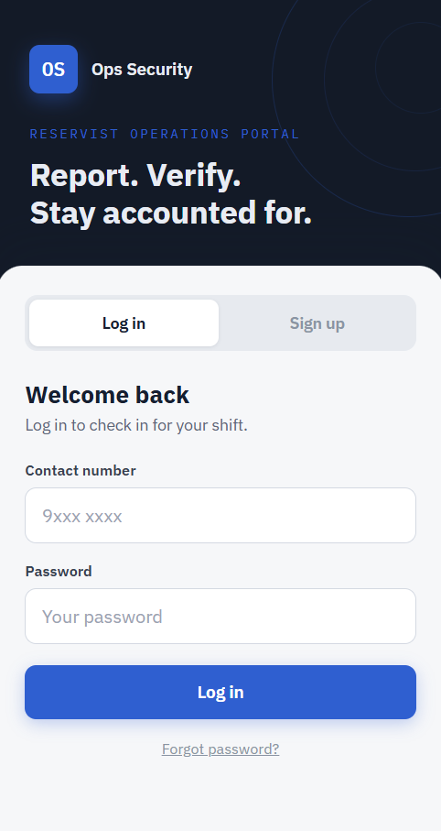
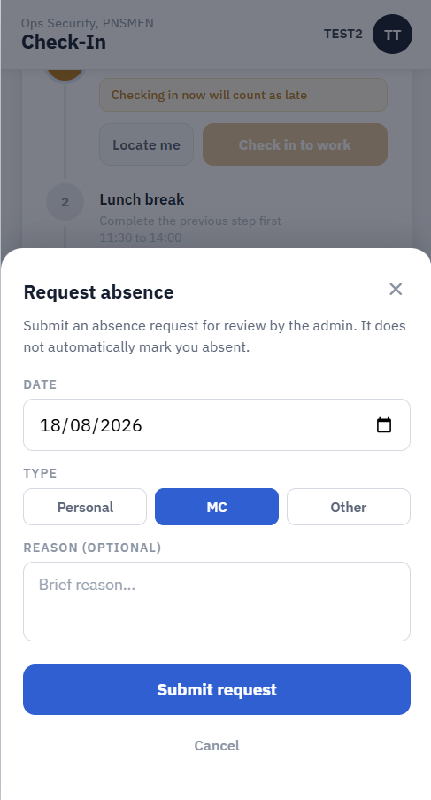
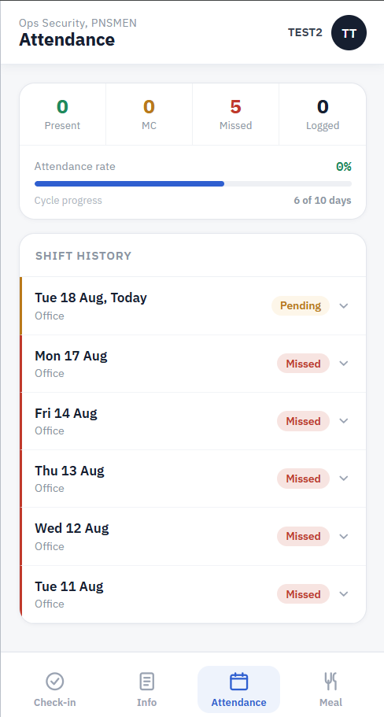
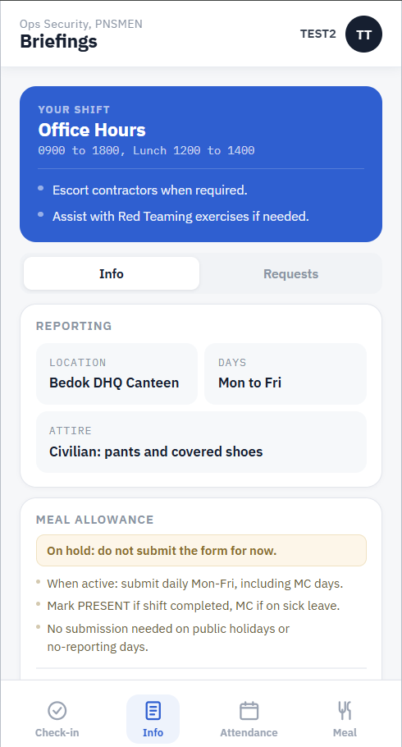
Reservist App Screens
[Login Screen]
[Check-In Screen]
[Leave / MC Form]
[My Attendance]
[Home / Briefings]
Login
Email and password sign-in; session persists on device
GPS Check-In
Shift selector, GPS confirmation, one-tap submission
Leave and MC
Date range, reason, and type; submitted digitally
Attendance
Personal record of all shifts, leaves, and MC
Home
Cycle notices and upcoming shift info

Slide 12
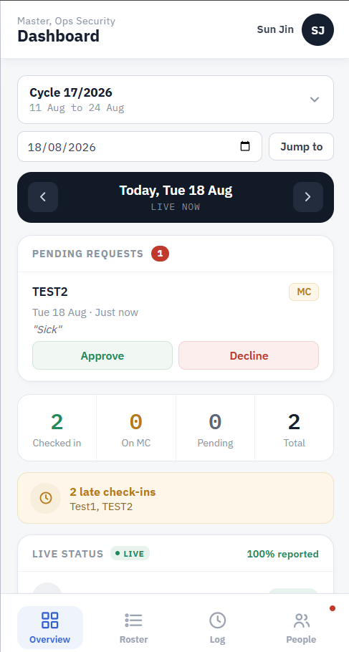
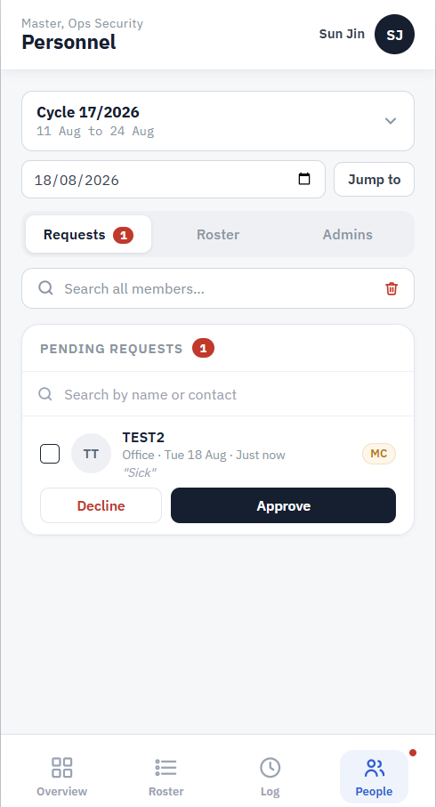
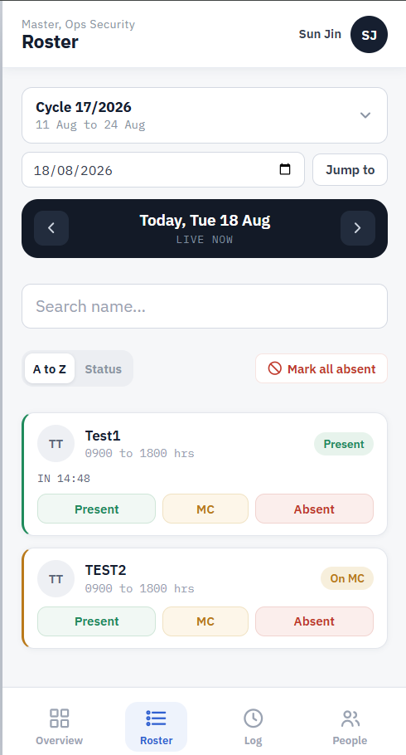
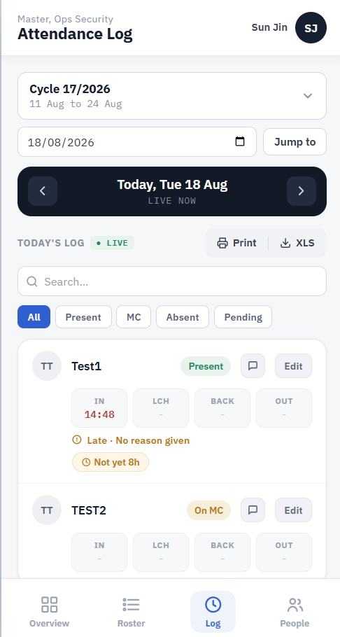
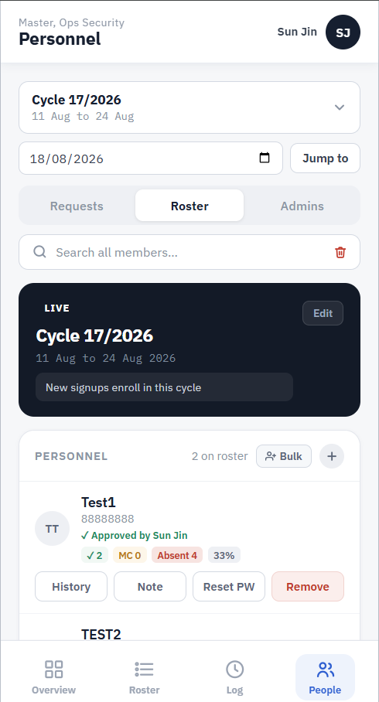
Admin Dashboard Screens
[Attendance Dashboard]
[Leave Approvals Queue]
[Roster Management]
[Cycle Report Export]
[Cycle Settings]
Live Dashboard
Real-time present, absent, and MC status per shift
Leave Approvals
Pending requests with one-tap approve or reject
Roster
Reservist list, status, welfare notes, and batch assignment
Reports & Export
One-click Excel export or print-ready cycle report
Cycle Setup
Create cycles, GPS zones, no-report days

Slide 13
Expected Benefits and Impact
Real-Time Visibility
See who is present, absent, or on MC without being physically on site
GPS Verification
Device location confirmed before each check-in is recorded
Full Attendance History
Complete attendance records and trends for every reservist and cycle
Early Accountability
Absent patterns identified automatically before they become critical
Digital Leave and MC
End-to-end digital handling with a full approval and rejection history
Permanent Records
Replaces memory and scattered chat logs with a verified digital trail
Reduced Admin Work
One-click exports and live dashboards cut manual coordination effort

Slide 14
Security and Compliance
Data protection, access control and PDPA alignment for Ops Security

Slide 15
Data Security and Privacy
Access Control
Data Protection
• Three-tier roles: Reservist, Admin, Super Admin
• Each role restricted to authorised data only
• Super Admin approval required for account changes
• All actions tied to authenticated identity
• PostgreSQL: encrypted at rest and in transit (TLS)
• Row-level security enforced at database layer
• No third-party data sharing
• ISO 27001 certified; SOC 2 Type II compliant
Session Security
Audit Trail
• Automatic logout after a period of inactivity
• Secure auth tokens managed by Supabase Auth
• No personal data stored on the device
• Login required on every new session
• Every edit logged with timestamp and user
• Leave decisions and admin actions recorded
• Full history available for compliance review
• Immutable log; edits cannot be silently deleted
Hosted externally on Supabase - comparable in approach to Google Forms, with stronger security controls. No SPF infrastructure required.

Slide 16
PDPA Compliance
Designed to align with the Personal Data Protection Act 2012 (PDPA) and government data governance principles.
Data Collected
Key Obligations Met
• Name and contact number (at registration)
• GPS location (at check-in only)
• Attendance and leave records
• No NRIC or financial data collected
• Consent obtained at sign-up before data collected
• Purpose limited to attendance management only
• Only necessary data collected (data minimisation)
• Encryption, access control, row-level security
Individual Rights
Recommended Actions
• Reservists may request their own records
• Corrections made by authorised admin
• Data deleted after NS liability ends
• Requests handled within a reasonable time
• Seek Data Protection Officer guidance before deployment
• Define data retention period per SPF policy
• Include a privacy notice at reservist sign-up
• Document the lawful basis for data collection

Slide 17
The Business Case
Zero licensing cost with measurable operational impact

Slide 18
Cost and Value
OpsTracker Cost
Commercial Equivalent
• Development: SGD 0 (built in-house)
• Hosting: SGD 0 (Netlify or GitHub Pages)
• Database: SGD 0 (Supabase free tier)
• Custom domain: ~SGD 15/year (optional)
• Off-the-shelf HR SaaS: SGD 5 to 15 per user per month
• 100 users: up to SGD 18,000 per year in licensing
• No commercial tool is built for NS exercise workflows
• OpsTracker: purpose-built at zero licensing cost
Scale for This Unit
Additional Value
• At 5 to 7 reservists per week, under 1,000 records per year
• Free tier (50,000 rows) supports decades at this scale
• Paid upgrade (SGD 25/month) unlikely to ever be needed
• Zero cost escalation risk for the foreseeable future
• Source code fully owned by the unit
• Purpose-built for SPF NS shift and leave workflows
• No developer knowledge needed to operate
• Fully transferable to successor at zero cost

Slide 19
Why Now
Next Cycle Is the Window
ORD Deadline: May 2027
Zero Cost to Approve
• The next Ops Security cycle is the optimal deployment window
• Delaying means another cycle without records or accountability
• Starting now ensures the system is ready when reservists report
• NSPI Sun Jin ORDs in May 2027
• System must be stable and handed over by March 2027
• A delayed start risks a rushed or incomplete handover
• OpsTracker is already built and tested; no further dev cost
• Running cost: SGD 0 to SGD 15 per year at this scale
• Every cycle without it is a cycle without accountability
• System is ready the moment approval is given

Slide 20
Challenges
Technical
Operational
• GPS accuracy can vary indoors or in covered spaces
• Some in-app browsers limit PWA features
• Service worker versioning needed for reliable updates
• Network reconnection handling in poor signal areas
• Encouraging reservists to check in via the app
• Admin training required for full dashboard use
• Sync reliability to be validated before field use
• Cross-device QA across iOS and Android

Slide 21
Deployment Timeline
Phase | Timing | Milestone
✓ Development | Complete | App fully built, tested, and ready for deployment
Approval | Aug 2026 | Committee approval received; system configuration begins
Admin Setup | Sep 2026 | GPS boundaries set; first cycle created; admins trained
Soft Launch | Oct 2026 | Deploy for the next Ops Security reservist cycle; validate in real conditions
Full Rollout | Nov 2026 | All Ops Security reservists onboarded; live for all subsequent cycles
Stabilise | Dec 2026 - Feb 2027 | Full operations; feedback collected; refinements applied
Handover Prep | Mar - Apr 2027 | Docs finalised; successor designated and trained
ORD | May 2027 | Ownership transferred; NSPI Sun Jin ORDs

Slide 22
Handover Plan
Role-Based Continuity
What Gets Transferred
• No designated successor required in advance
• Whoever takes the NS coordination role inherits the system
• Super Admin access transferred to incoming NSman or Regular
• Supabase project ownership
• Hosting account (Netlify or GitHub Pages)
• Domain registrar credentials if applicable
• Source code repository access
What Will Be Provided
Sustainability by Design
• Admin user manual for all day-to-day operations
• SOP: cycle creation, onboarding and report exports
• Troubleshooting guide for common issues
• NSPI Sun Jin will not provide post-ORD support - system designed for full independence
• All admin functions in-app; no command line needed
• Role-based access limits scope and risk
• System updates require no technical knowledge
• Free tier: no billing or renewal risk
Designed so any incoming NSman stepping into the role can be fully operational within half a day.

Slide 23
Future Plans and Recommendation
Near-Term
Mid-Term
Long-Term
• Push notifications for check-in windows
• Automated WhatsApp attendance reminders
• Attendance trend analytics and absence alerts
• Native mobile app with stronger offline support
• Auto-generate and send cycle reports on close
• SPF HR or NS portal integration
• Automated report submission to HQ
• Single sign-on with NS credentials
We Are Asking For Your Approval
• Deploy OpsTracker at the start of the next Ops Security reservist cycle
• Onboard all Ops Security reservists into the system
• Initiate IT security review for official and broader deployment
System is ready now. Onboarding can begin immediately.

Slide 24
Thank You
OpsTracker is ready for deployment. Awaiting your approval

