Slide 1
INSIDER THREAT
GOKULAVASAN

Slide 2
WHAT IS INSIDER THREAT?
An insider threat can happen when someone close to an organization with authorized access misuses that access to negatively impact the organization’s critical information or systems. This person does not necessarily need to be an employee – third party vendors, contractors, and partners could pose a threat as well.
Recent insider threat statistics reveal that 69% say their organizations have experienced an attempted or successful threat or corruption of data in the last 12 months. Discover more Insider Threat Statistics.

Slide 3
WHO ARE INSIDERS?
Employees
Privileged users, such as IT team members and superusers
Knowledge workers, such as analysts or developers
Resigned or terminated employees
Employees involved in a merger or acquisition
Third Parties
Vendors
Contractors
Partners

Slide 4
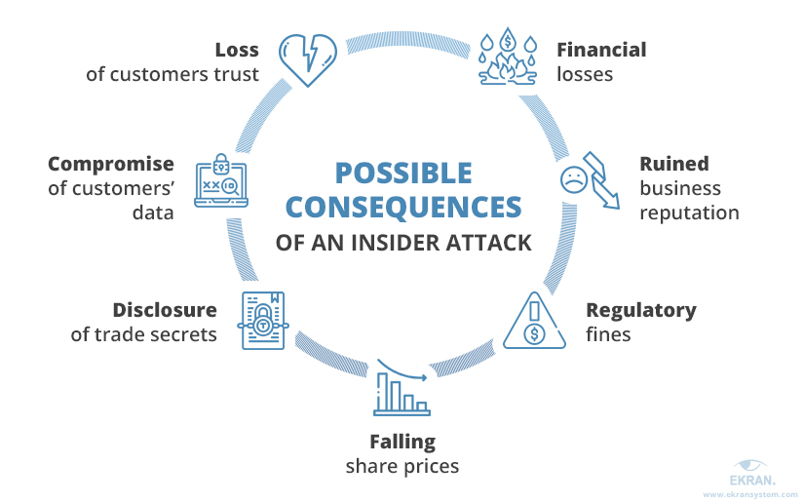
POSSIBLE CONSEQUENCES

Slide 5
TYPES OF IT
MALICIOUS
Sabotage
Intellectual property (IP) theft
Espionage
Fraud (financial gain)

Slide 6
TYPES OF IT
INADVERTENT
Human error
Bad judgment
Phishing
Malware
Unintentional aiding and abetting
Stolen credentials
Convenience

Slide 7
INSIDER THREAT STATISTICS
50% of incidents where private or sensitive information was unintentionally exposed
40% of incidents where employee records were compromised or stolen
33% of incidents where customer records were compromised or stolen
32% of incidents where confidential records (trade secrets or intellectual property) were compromised or stolen

Slide 8
Who is at Risk of Insider Threats?
Financial Services
Telecommunications
Technical Services
Healthcare
Government

Slide 9
How to Stop Insider Threats?
Detect Insider Threats
Uncover risky user activity by identifying anomalous behavior.
Investigate Incidents
Investigate suspicious user activity in minutes—not days.
Prevent Incidents
Reduce risk with real-time user notifications and blocking.

Slide 10
Protect User Privacy
Anonymize user data to protect employee and contractor privacy and meet regulations.
Satisfy Compliance
Meet key compliance requirements regarding insider threats in a streamlined manner.
Integrate Tools
Integrate insider threat management and detection with SIEMs and other security tools for greater insight.

Slide 11
CASE 1
Stephen Kellogg III
Born in the U.S.
Joined the U.S. Navy in 2014
From Buffalo, NY
Worked as a Nuclear Electrician in the Navy • Served aboard the nuclear powered warship USS Carl Vinson (CVN-70)

Slide 12
WHAT HAPPENED
Stephen Kellogg III was a U.S. Navy Petty Officer 2nd Class and worked as a Nuclear Electrician’s mate on the USS Carl Vinson. He had access to classified information relating to operations and capabilities of the Navy’s nuclear propulsion systems. According to news media accounts, Kellogg wanted to publish an exposé on waste in the U.S. military. Kellogg admitted in August 2018 that he tried to take a commercial flight from San Diego, California, to New York City to give confidential information about the U.S. Navy’s nuclear-powered warships to a news reporter who he believed would go public with it. According to court documents, Kellogg was in contact with Sevmash, Russia’s only nuclear submarine producer and largest shipbuilder. Authorities stated Kellogg admitted to photographing areas containing sensitive information about the Navy’s nuclear propulsion program on the ship and sent the photos to family and friends. In May 2019, Kellogg pled guilty to two counts of espionage. He was sentenced to three years confinement, reduced in rank from E-5 to E-1, and received a dishonorable discharge from the Navy.

Slide 13
IMPACT
Although Kellogg’s efforts were thwarted, disclosure of classified Navy nuclear propulsion information would pose a significant threat to national security and endanger the lives of American service members. Had the information became public, U.S. adversaries could potentially have learned the capabilities and limitations of the United States’ nuclear-powered warships. Special Agent in Charge Garrett Waugh of the Southwest Field Office said, “This sailor’s attempts to disclose classified Navy nuclear propulsion information posed a significant threat to national security and endangered the lives of American service members. NCIS will continue to prioritize counterintelligence efforts as well as investigate and disrupt espionage activity directed at the Navy and Marine Corps.”

Slide 14
CASE 2
Mozaffar Khazaee
Former contractor, who had worked for three different cleared companies.
Age at time of incident: 61
Sentenced to 97 months in prison and ordered to pay a $50,000 fine for violating the Arms Export Control Act.

Slide 15
WHAT HAPPENED
Around November 2013, Federal authorities intercepted a container packed with thousands of sensitive technical manuals, specification sheets, test results, technical data and other proprietary material relating to U.S. military jet engines, including the F-35 Joint Strike Fighter program and the F-22 Raptor he attempted to ship to Iran. • On Jan. 9, 2014, Khazaee was arrested at the Newark Liberty International Airport while carrying hard copy documents and computer media containing sensitive, proprietary, trade secret and export controlled documents relating to U.S. military jet engines and nearly $60,000 cash in his luggage.

Slide 16
IMPACT
Technical data could have helped Iran “leap forward” ten years or more in academic and military turbine engine research and development, reducing their investment in such technology by billions of dollars and potentially enhancing the effectiveness of their weapon systems.
Compromised highly sensitive information on the Joint Strike Fighter

Slide 17
CASE 3
Deepanshu Kher
Indian National
Age 32 at the time of the attack
Launched Cyber-attack from his home in Delhi, India

Slide 18
WHAT HAPPENED
Deepanshu Kher was employed by an information technology consulting firm from 2017 through May 2018. In 2017, the consulting firm was hired by the Carlsbad Company to assist with its migration to a Microsoft Office 365 (MSO365) environment. In response, the consulting firm sent its employee, Kher, to the company’s Carlsbad headquarters to assist with the migration. The company was dissatisfied with Kher’s work and relayed their dissatisfaction to the consulting firm soon after Kher’s arrival. In January 2018, the consulting firm pulled Kher from the company’s headquarters. A few months later, on May 4, 2018, the firm fired Kher, and a month after that, in June 2018, Kher returned to Delhi, India. On August 8, 2018, two months after his return to India, Kher hacked into the Carlsbad Company’s server and deleted over 1,200 of its 1,500 MSO365 user accounts. The attack affected the bulk of the company’s employees and completely shut down the company for two days. Unfortunately, even after those two days, the problems remained. Employees were not receiving meeting invites or cancellations, employees’ contacts lists could not be completely rebuilt, and affected employees could no longer access folders to which they previously had access. The Carlsbad Company repeatedly handled multitudes of IT problems for three months.

Slide 19
IMPACT
As the company’s Vice President of Information Technology (IT) explained, the impact was felt inside and outside the company. Employee accounts were deleted, and employees could not access their email, contacts lists, meeting calendars, documents, corporate directories, video and audio conferences, and the virtual teams environment necessary for them to perform their jobs. Outside the company, customers, vendors and consumers were unable to reach company employees (and the employees were unable to reach them). No one was able to inform these buyers what was going on or when the company would be operational again.
The Vice President of IT for the Carlsbad Company said, “In my 30-plus years as an IT professional, I have never been a part of a more difficult and trying work situation.”

Slide 20
CASE 4
Peter Zuccarelli
62-year-old owner of Texas company
August 3, 2017: Pled guilty to conspiring to smuggle and illegally export controlled technology
January 24, 2018: Sentenced to 46 months in U.S. prison, three years supervised release, and $50,000 fine for conspiracy to smuggle and illegally export radiation hardened integrated circuits (RHIC) to Russia and China, which is in violation of the International Emergency Economic Powers Act

Slide 21
WHAT HAPPENED
Between June 2015 and March 2016, Zuccarelli and co-conspirators agreed to illegally export RHICs to China and Russia
Zuccarelli and co-conspirator received purchase orders and payment of approximately $1.5 million to acquire RHICs for Chinese and Russian customers, while claiming his company as the end user
Zuccarelli repackaged RHICs and falsely relabeled shipping documents to disguise the true identity of technology in order to illegally ship the export controlled technology without required licenses

Slide 22
IMPACT
Russia and China have significantly closed the gap in space platform technology with the U.S. through their aggressive and successful attempts in obtaining U.S. technology
Billions of dollars’ worth of U.S. technology are stolen annually through economic espionage
Radiation Hardened Integrated Circuits continue to be one of the most highly targeted U.S. technology

Slide 23
What is a Critical Asset?
According to ISO 55000, An Asset Has a potential value for the organization & the org has a responsibility towards it
A Critical Asset - something valuable which if destroyed or altered would cause severe impact on organization’s business
Can be Physical as well as Logical
Key Steps to Ensure Protection of Critical Assets include
Identify critical assets
Know the current status
Define & Assign Business Importance to Critical Assets
Prioritize Critical Assets
Create a Monitoring Plan

Slide 24
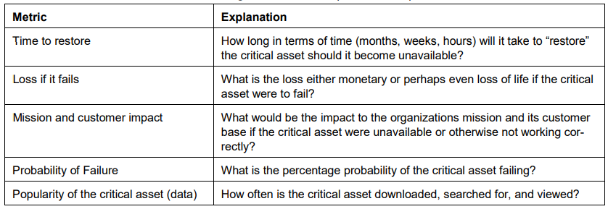
Consider Right Metrics
For Effective Measurement

Slide 25
Case Study
A hospital facility employed the insider, a contractor, as a security guard
The insider was actually leader of a hacking group
Insider worked during night and was mostly unsupervised
Insider worked on HVAC computer
Through HVAC computer, insider got access to Nurse computer and then many other systems
HVAC became unstable with 5 days of insider activities and went down for an hour
Later, it was found that insider was trying to use hospital computers to launch DDoS on another unknown target
Insider was jailed for 9+ years and fined 32,000 USD

Slide 26
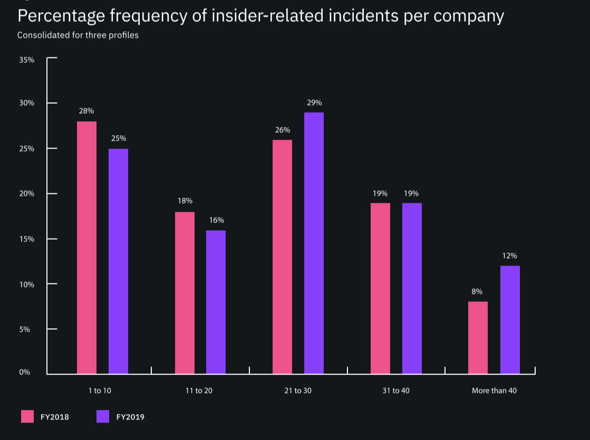
SOME STATISTICS

Slide 27
Above Figure provides a graph that shows a histogram of insider incidents for our sample of 204 companies over the past 12 months. As shown, 60 percent of companies experienced an average of more than 20 incidents per year.

Slide 28
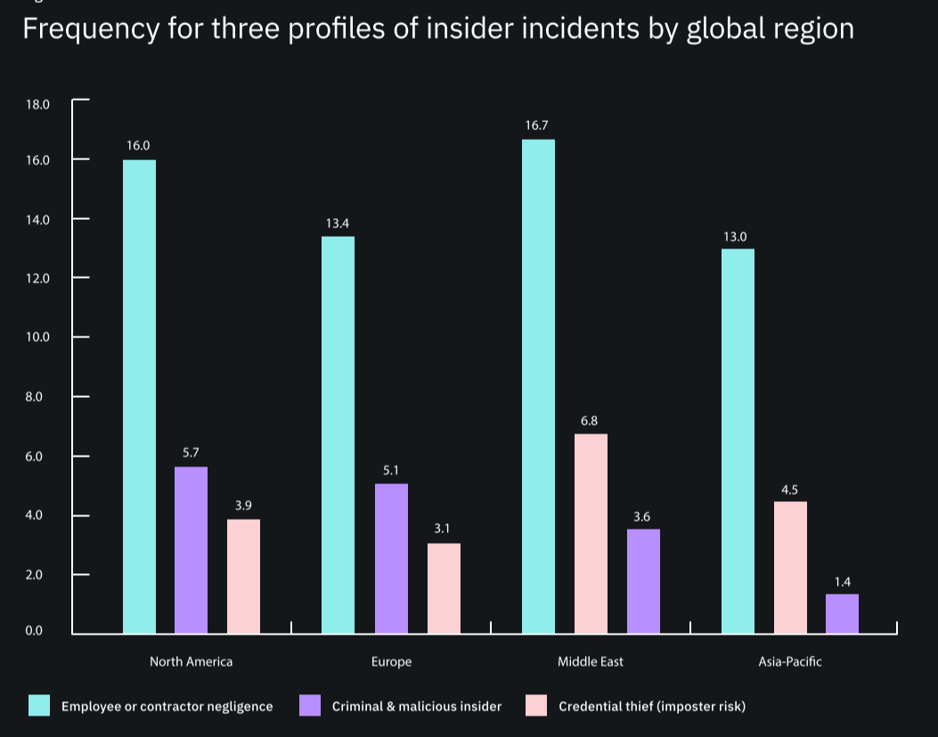

Slide 29
This Figure The frequency of insider threats varies across global regions. As shown in Figure, North American and Middle Eastern companies experienced the highest number of insider-related incidents over the past 12 months. In contrast, APAC companies had the lowest
number of insider-related incidents.

Slide 30
Thank You!

