Slide 1
On-Premise Data Pipeline: IoT & Weather Analytics
By
Gokularaja R

Slide 2
Introduction
Objective: Modern modular data pipeline for real-time and batch analytics, all on-premise.
Scenario: Weather analytics firm using live API data + simulated IoT sensor streams and Batches.

Slide 3
Architecture Overview
Data Ingestion:
Real weather via API
Synthetic sensor data (Python Faker)
Transport & Messaging:
Apache Kafka for event streaming
Processing Layers:
Spark Streaming for real-time
Spark Batch ETL for Batch

Slide 4
Architecture Overview
Data Storage:
MySQL (analytics tables)
Parquet (archive)
S3 (backups)
Snowflake
Orchestration:
Dockerized Airflow
Monitoring:
Grafana & Prometheus for System metrics
Streamlit : Live weather dashboard from Kafka

Slide 5
FLOW
Weather API → Kafka
Spark Streaming reads Kafka → Parquet
Sensor CSVs & MySQL → Spark Batch ETL → Final MySQL/Snowflake/S3
All flows orchestrated by Airflow in Docker

Slide 6
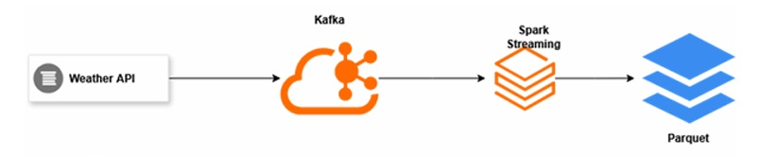
STREAM FLOW

Slide 7
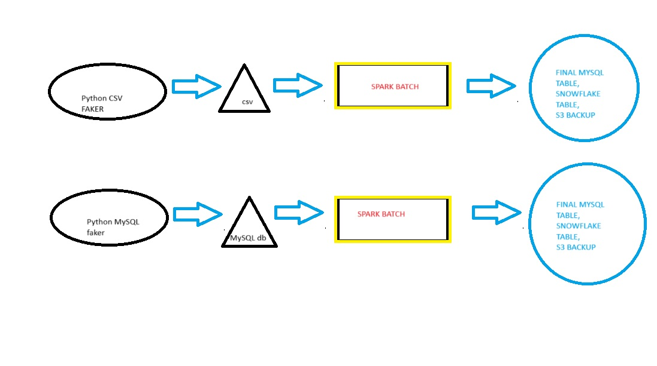
BATCH FLOW

Slide 8
Flow of each pipeline
REAL TIME STREAMING
Airflow triggers weather fetch (API → Kafka) every minute
Spark Streaming reads Kafka → periodic Parquet files
BATCH
Synthetic sensor data to CSV, inserts MySQL rows.
Synthetic CSV data using faker every minute.
Spark batch comes into action and the results are stored in the MySQL/Snowflake, CSVs archived to S3

Slide 9
Challenges and learnings
REAL TIME STREAMING
Faced challenges with kafka installation and after some learnings successfully installed the KAFKA in my local system and able to stream weather api messages.
Successfully Dockerized airflow and able to schedule my DAGs.
Streamlit realtime Visualiser for stream api pipeline.
BATCH
Facing problem with Hive integration in local system,Found a Cloud alternative Snowflake and able to backup there.
Implemented additional backup facility in S3 for Data availability.

Slide 10
REAL TIME APPLICATION
WEATHER FORECASTING COMPANY,
FOOD DELIVERY APPS PRICE VARIATION,
CAB DYNAMIC PRICING etc

Slide 11
Conclusion
Achieved modular real-time & batch analytics pipeline
On-premises deployment with future-proof, cloud-ready techniques
Adapted for flexibility, reliability, and modern observability
Ready for further scale or cloud native migration

Slide 12
THANK YOU
Comments and Suggestions are welcomed !!!

