Slide 1
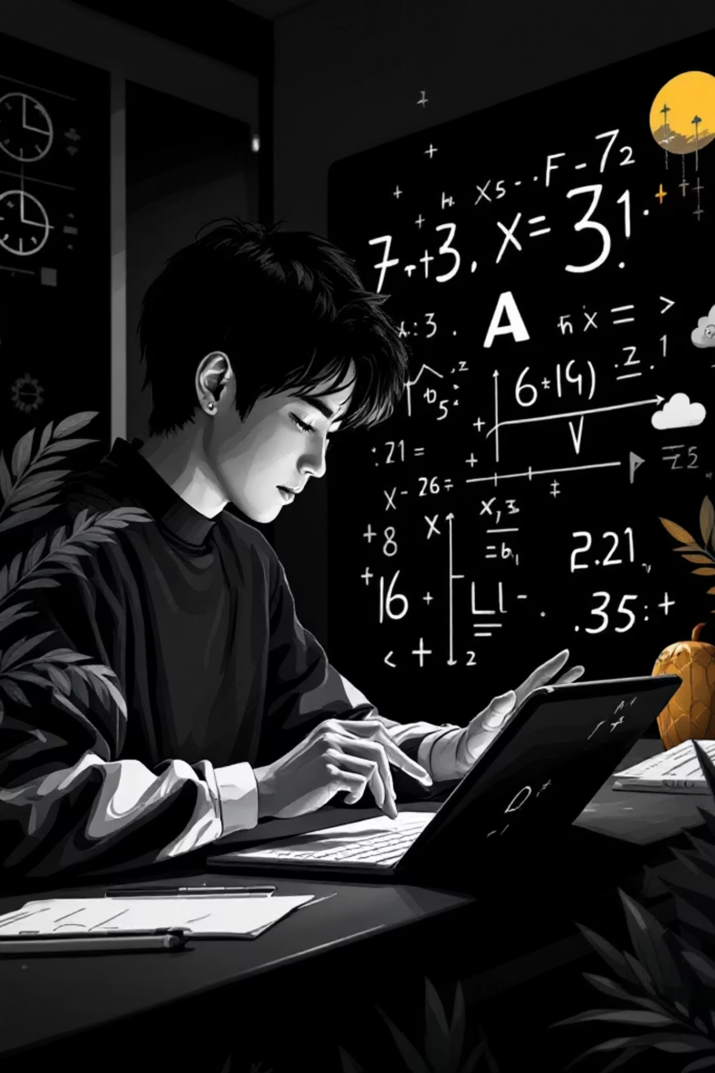

AI Mathematics Tutor
An intelligent digital learning assistant that transforms handwritten algebra problems into step-by-step solutions
Team: GOKUL K, ILAMUGILAN S, VIGNESHWARAN R | College: Hindu College (0110)
Notes:
1

Slide 2
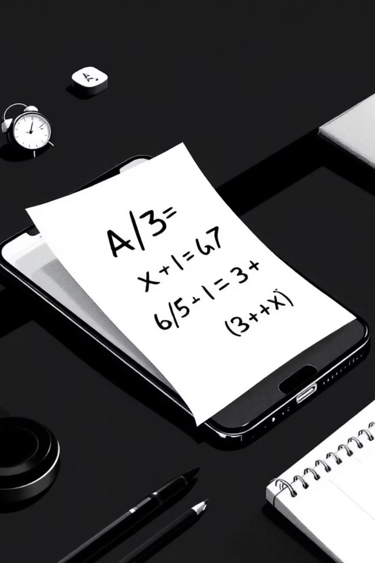
Transforming Algebra Learning
The Challenge
Our Solution
Students struggle with identifying mathematical symbols, interpreting equations, and applying correct solving sequences. Common mistakes include incorrect sign handling and algebraic transformations.
AI-powered system that interprets algebra problems from images, converts them to LaTeX format, and generates detailed step-by-step explanations with error detection.
Notes:
2

Slide 3




How It Works
Image Capture
OCR Processing
Student uploads photo of handwritten or printed equation
System detects and extracts mathematical symbols using vision AI
LaTeX Conversion
Solution Generation
Symbols transformed into structured mathematical expressions
Step-by-step explanations with error detection provided
Notes:
3

Slide 4

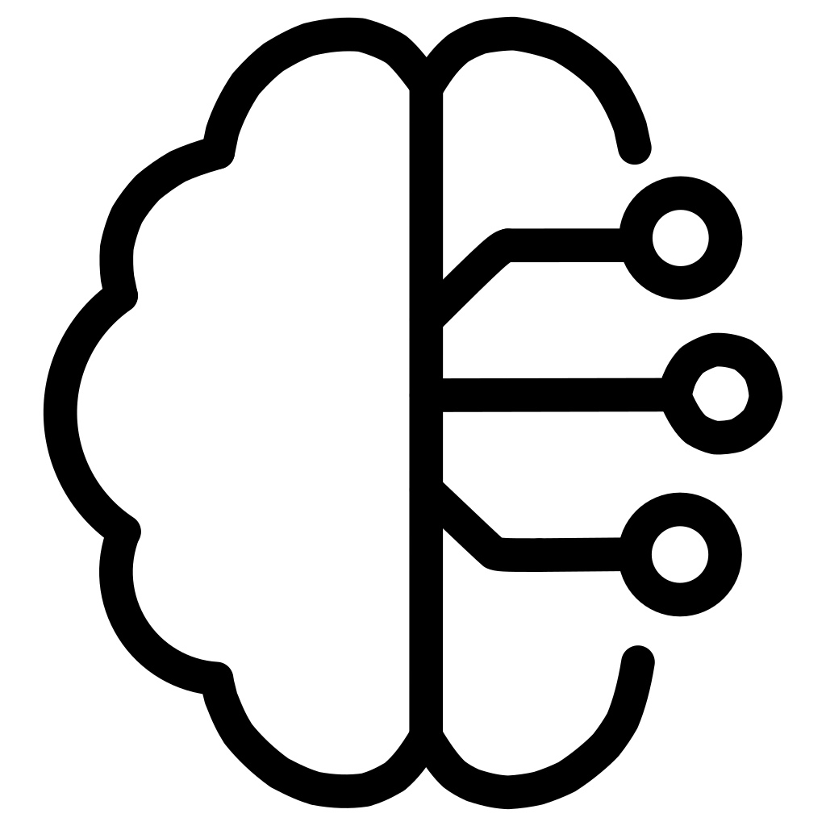


Key Features
Image-Based Recognition
Vision-Language AI
Processes handwritten and printed algebraic equations from photographs
Converts detected symbols into properly formatted LaTeX representations
Step-by-Step Solutions
Error Detection
Generates logical sequences explaining each transformation until final result
Identifies common mistakes like incorrect sign handling and arithmetic errors
Notes:
4

Slide 5






Technology Stack
Python Backend
Streamlit Framework
Core programming language implementing AI processing and mathematical computation
Interactive web interface for image uploads and dynamic result viewing
Vision AI Models
OCR Engines
Gemini/OpenAI Vision interprets symbols and converts to structured equations
EasyOCR and Tesseract extract textual and symbolic information from images
SymPy Library
OpenCV Processing
Symbolic mathematics engine for simplifying and solving algebraic expressions
Image preprocessing including resizing, noise removal, and contrast enhancement
Notes:
5

Slide 6
System Architecture
01
02
03
User Interface
Image Processing
Symbol Extraction
Streamlit frontend for image uploads and LaTeX rendering
OpenCV preprocessing optimizes images for OCR accuracy
OCR tools detect mathematical characters and symbols
04
05
06
Vision AI Interpretation
Equation Solving
Mistake Detection
Converts symbols to structured LaTeX expressions
SymPy library computes solutions and simplifies expressions
Analyzes solving process for common student errors
07
Solution Generation
Organizes steps with explanations for each transformation
Notes:
6

Slide 7
Development Workflow
Phase 1: AI Integration
Phase 3: Backend
Configured Gemini AI environment, generated API keys, tested multimodal processing with sample equations
Integrated SymPy for equation solving, implemented mistake detection and step explanations
1
2
3
4
Phase 2: Core System
Phase 4: Interface
Built Streamlit layout, implemented image upload features, developed processing pipeline with OCR
Designed student-friendly frontend with responsive layout, loading indicators, and clear instructions
Notes:
7

Slide 8
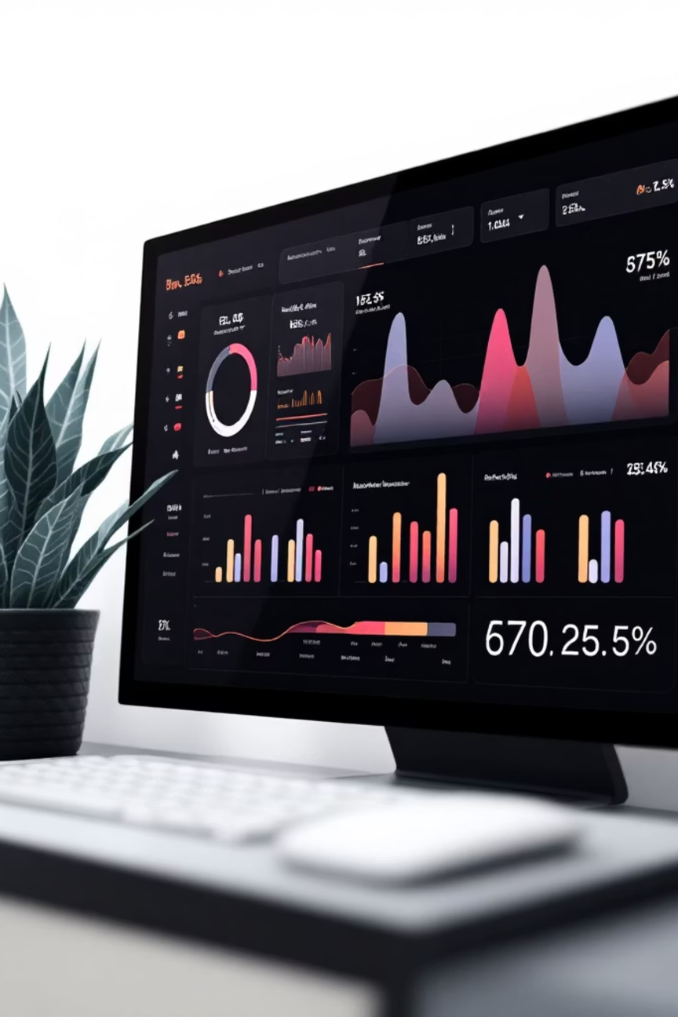
Testing & Performance
Testing Approach
Optimization Results
Functional testing with handwritten and printed equations
Edge case testing with blurry images and incomplete equations
Accuracy evaluation of solutions and explanations
LaTeX formatting verification
Optimized AI prompts for better accuracy
Reduced unnecessary API requests
Improved image preprocessing techniques
Stable performance across input types
Notes:
8

Slide 9
System Requirements
Software Requirements
Hardware Requirements
Python 3.9 or higher
Streamlit Framework
OpenCV Library
EasyOCR or Tesseract OCR
SymPy Library
NumPy and Pillow libraries
Gemini API or OpenAI Vision API access
Laptop or desktop computer
Mobile phone or camera for capturing equation images
Stable internet connection
Notes:
9

Slide 10

Future Vision
Expanded Domains
Personalized Analytics
Support for calculus, geometry, and statistics beyond algebra
Learning analytics to track progress and identify improvement areas
Enhanced AI
More sophisticated error detection and adaptive tutoring strategies
The AI Mathematics Tutor represents a significant step toward intelligent tutoring systems that support independent learning and modernize digital education through generative AI.
Notes:
10

