Slide 1
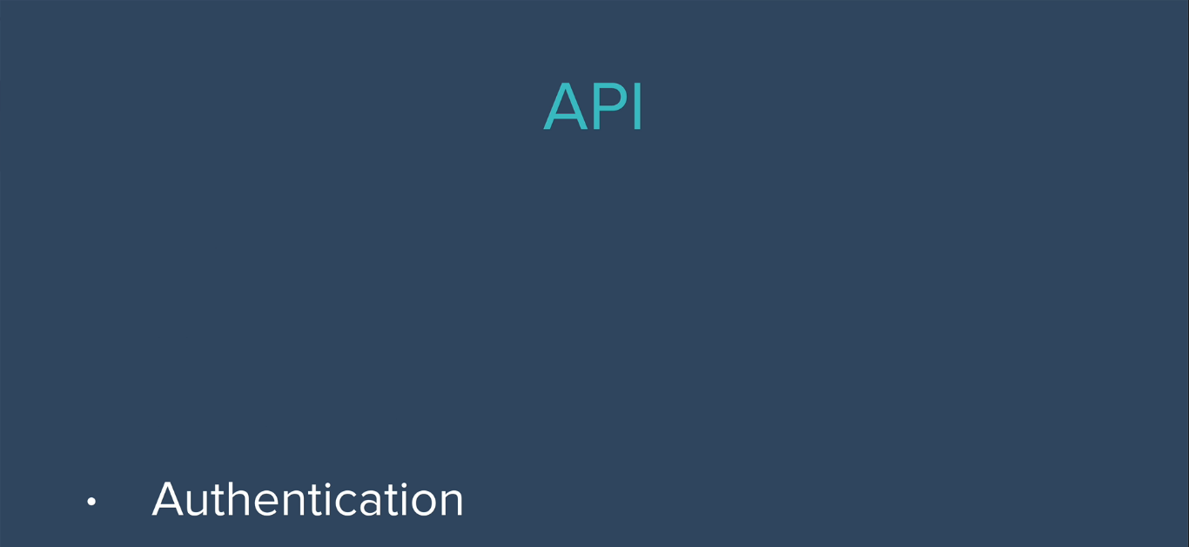

Slide 2
Every time we make a request through API, they have to be able to identify you as the developer and they have to keep track of how often we are using their server to get data, and then charge us, or limit you , accordingly.
In order to illustrate this concept of authentication,
we are going to use the openweathermap.org API.

Slide 3
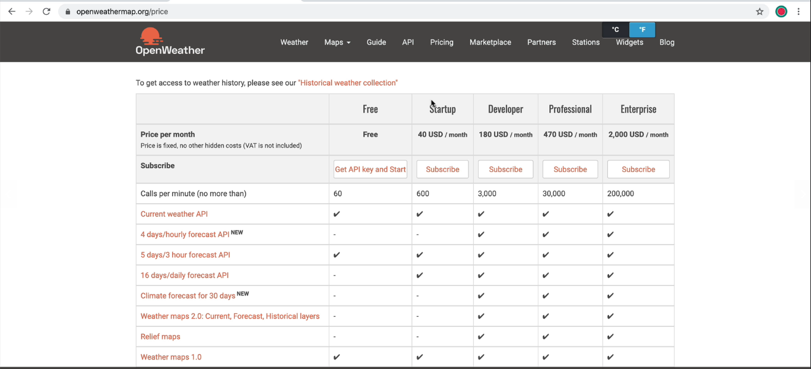

Slide 4
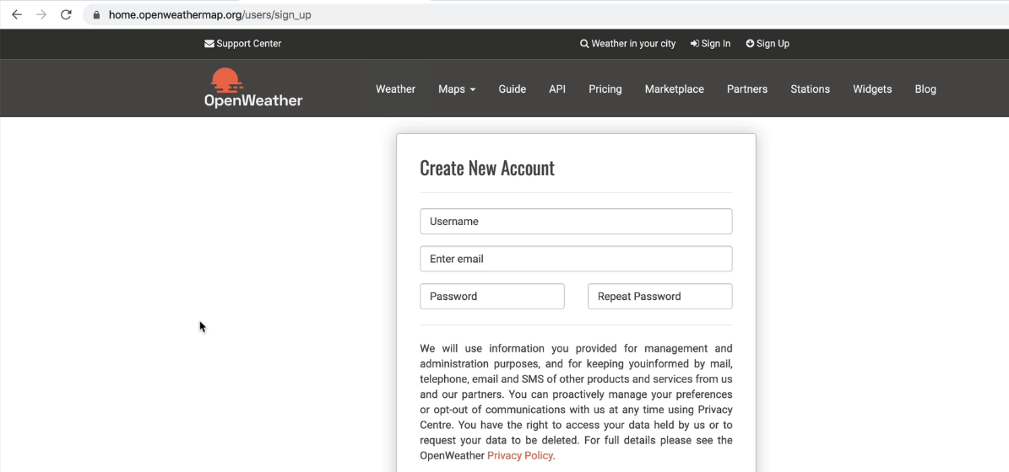
Sign Up to get free access

Slide 5
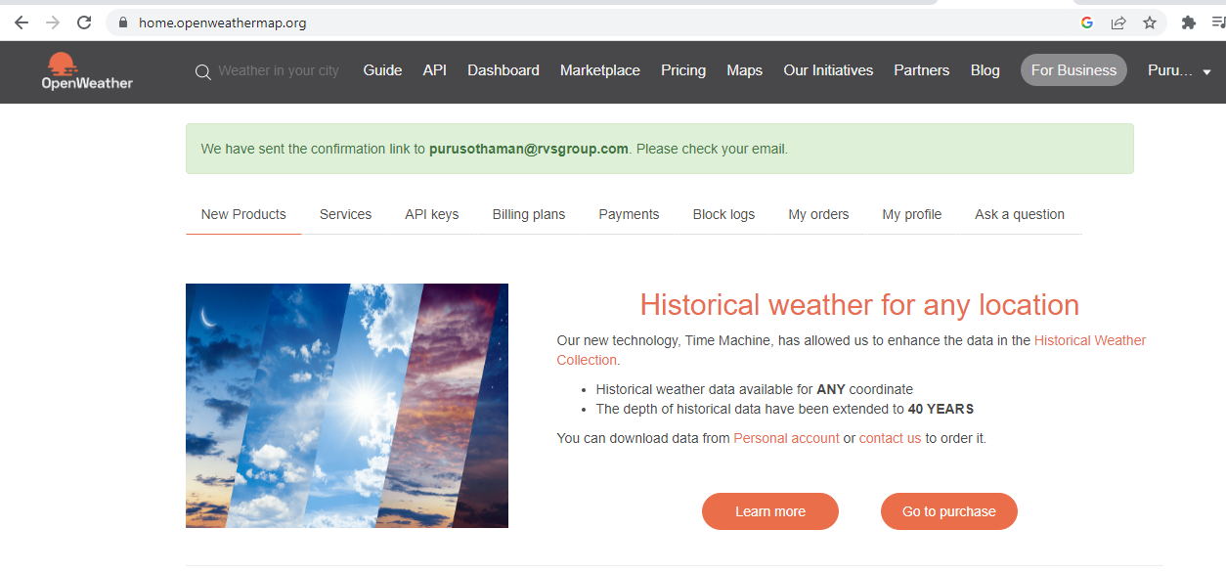
After Sign Up to verify email message

Slide 6
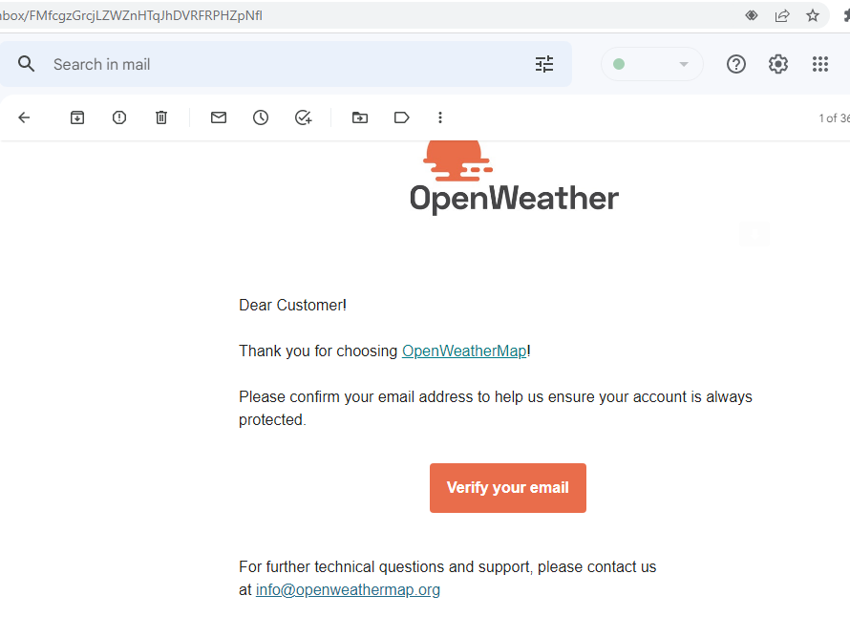
Confirm your mail address

Slide 7
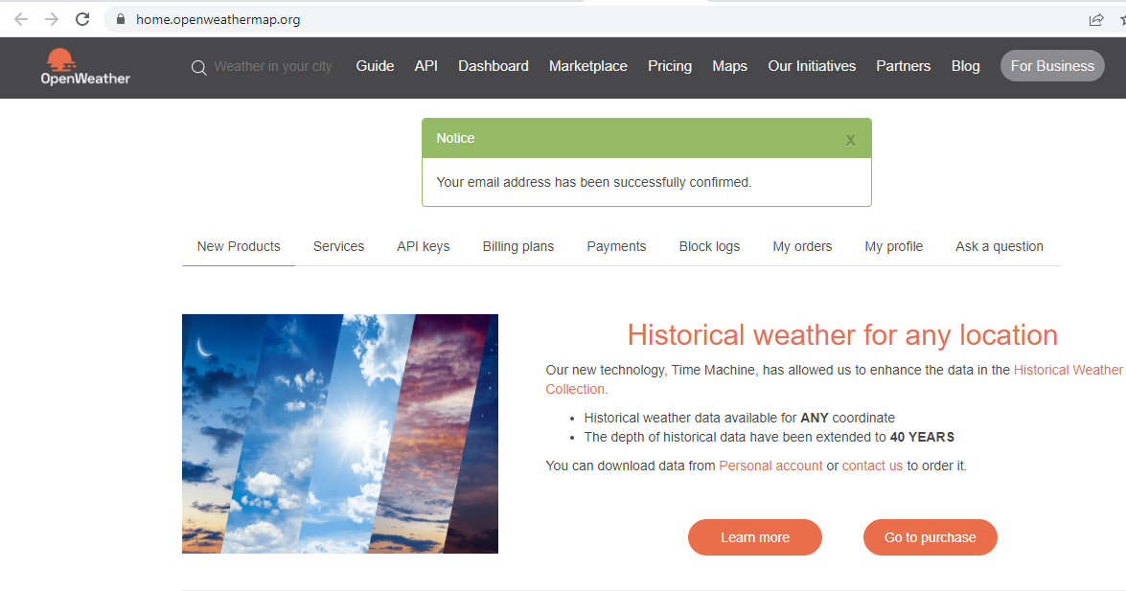
After Sign-in, click tab API Keys

Slide 8
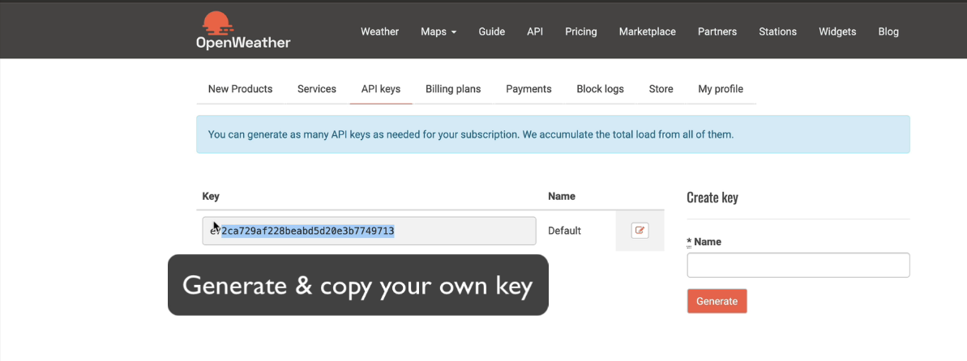
Copy the default one or generate a new one

Slide 9
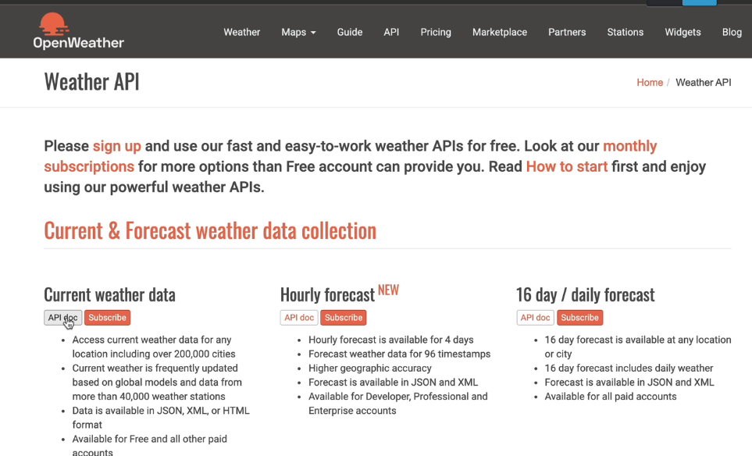
Read the API Docs

Slide 10
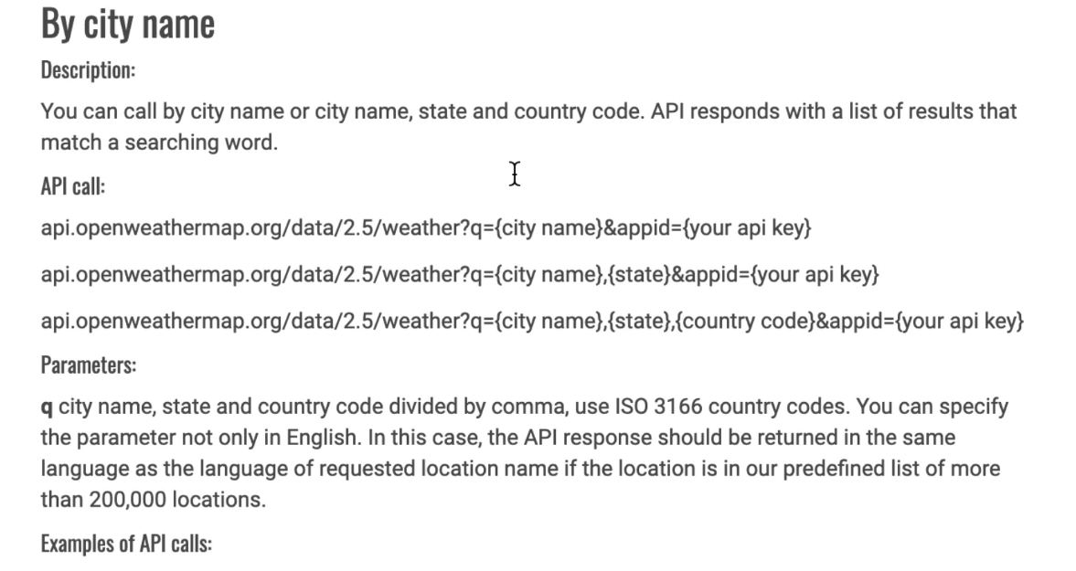
Refer the example city name API calls

Slide 11
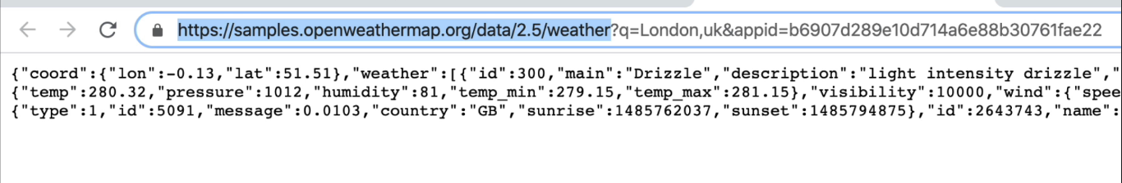

Slide 12
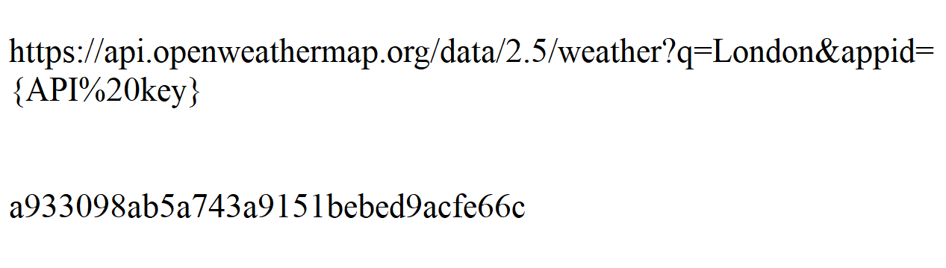
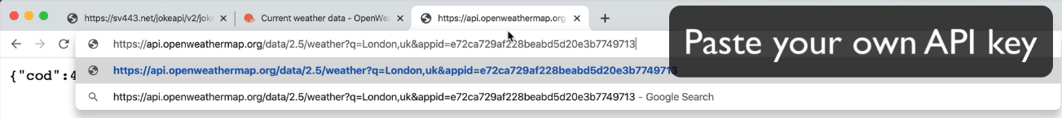

Slide 13
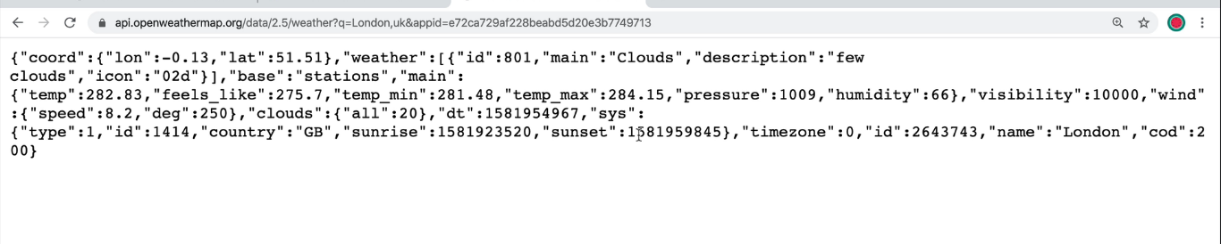
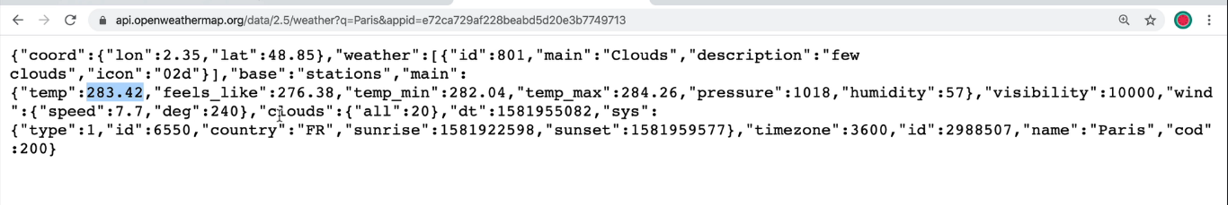

Slide 14
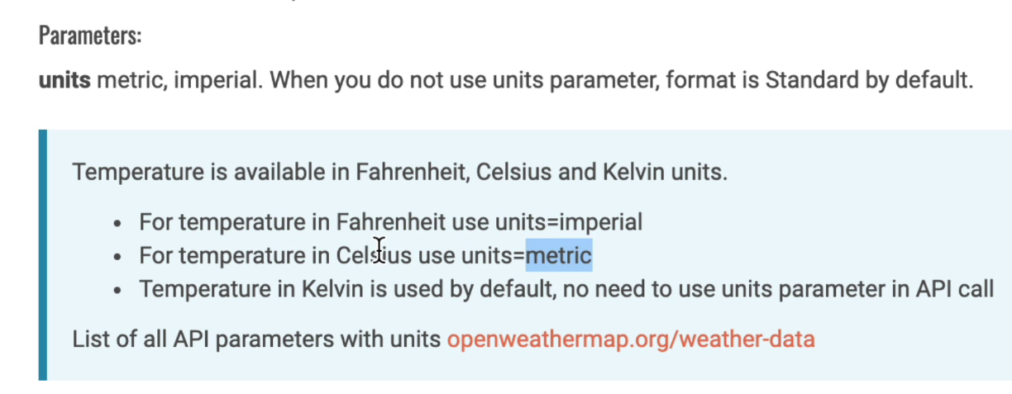

Slide 15
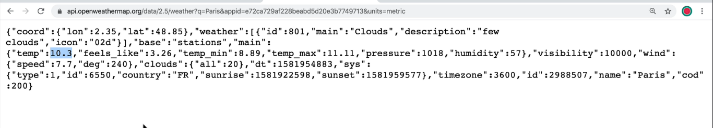

Slide 16
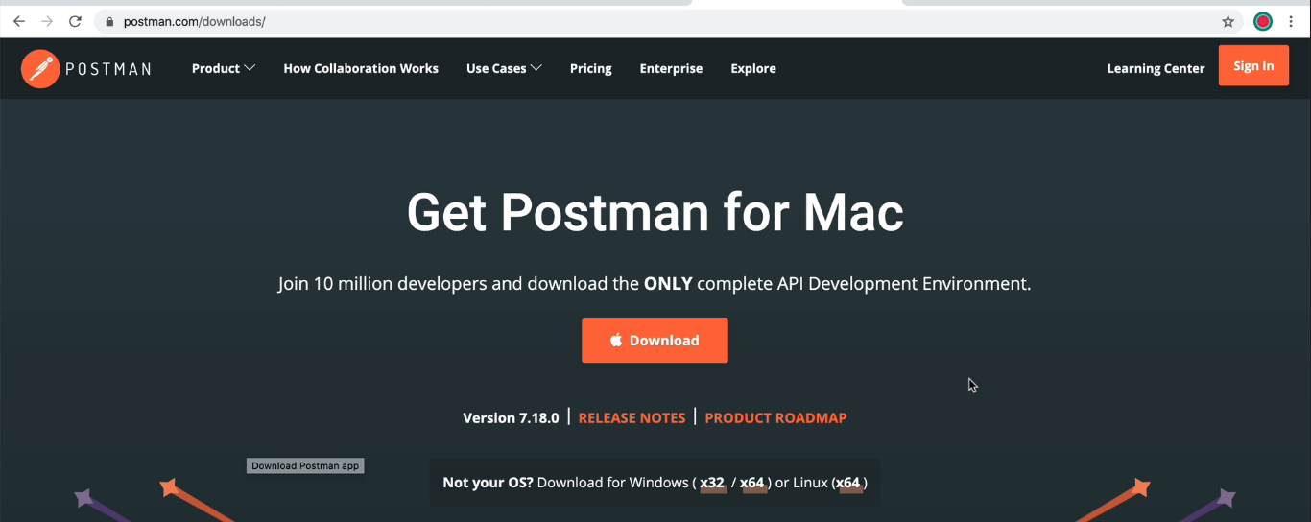

Slide 17
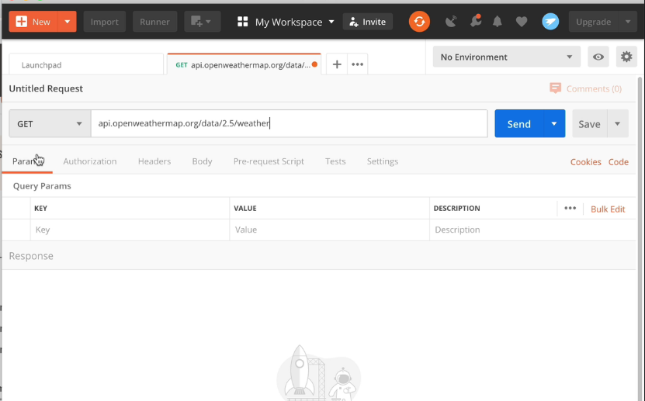

Slide 18
