Slide 1
REST stands for Representational State Transfer.

Slide 2
REST stands for Representational State Transfer. To follow it in our routes, we use a convention called RESTful Routing. RESTful routing is a set of standards used in many different languages to create efficient, reusable routes. It aims to map HTTP methods (GET, POST, PATCH, DELETE) and CRUD actions (Create, Read, Update, Destroy) together in a conventional pattern. This makes it easier for other developers to understand and navigate an application and results in clean, consistent URL paths for users.
Essentially, RESTful routing is a naming pattern. It asserts that routes completing certain common actions (like creating, updating, or deleting objects) have names and paths that accurately reflect what they're doing, with which CRUD and HTTP verbs, on what type of object.

Slide 3
Whenever you navigate through a site by clicking links, you’re making a state transition which brings you to the next page (the next state of application) and by following this simple model of clicking from page to page you’re following the REST principles and when something follows the rest principle it is known as RESTFUL.
So, Restful routes are just a conventional pattern to follow when structuring different routes for interacting with the server whenever an HTTP request is made by the client.

Slide 4
And for a route to be completely restful it must do the following:
Separate the client from the server
Not hold state between requests (i.e all information necessary to respond to a request is available in each request: no data or state, is held by the server from request to request)
Use HTTP and HTTP methods
Be reliable (for e.g most APIs follow the restful route pattern when specifying the process for authentication and important URLs)

Slide 5
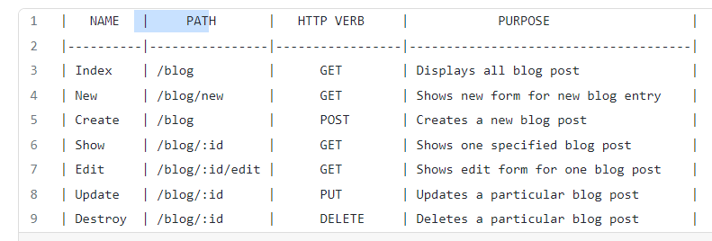
There are like 7 different restful routes pattern to follow when creating an application or web service that will interact with the server, for e.g let’s look at the 7 routes that can exist in a blog website:

Slide 6
The above table clearly shows the mapping between the HTTP verb and the CRUD actions which follows the above explained restful route patterns. You’d want to have an action to create a new post (new route), to display one post (show route), to display all posts (index route), to delete a post (delete route), and a page to edit a post (edit route).
These different route patterns just display a blueprint for us to follow when creating any restful web services or applications or even when building our APIs. It is a conventional and widely used pattern that you necessarily do not have to follow if you don’t want to.

Slide 7
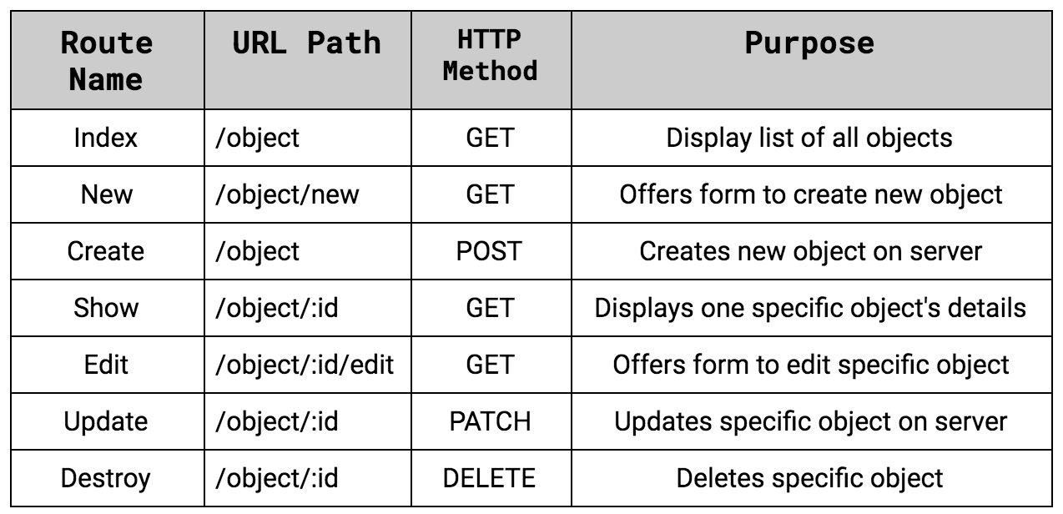
REST Conventions
What does this look like? Here's a table outlining standard RESTful routing conventions:

Slide 8
Everything that reads object refers to the model used in the application and its routes. For instance, our to do list works with Item objects. We would use the term items wherever we see object in the table above. A blog application might work with Post objects. It would use the term posts wherever we see object in the table above.
Route Name refers to the name of the route method in the controller.
URL Path refers to the path listed above the route in a route decorator. This will also be the URL a user sees when navigating to this area of the site.
HTTP Method refers to the HTTP method that route will respond to, or be invoked for.
Purpose details what each route is responsible for.
:id is a placeholder for where a specific object's unique ID will be placed. An example would be the _ids our Items now include. Don't worry about routes with :id yet. We'll discuss them more soon.

Slide 9
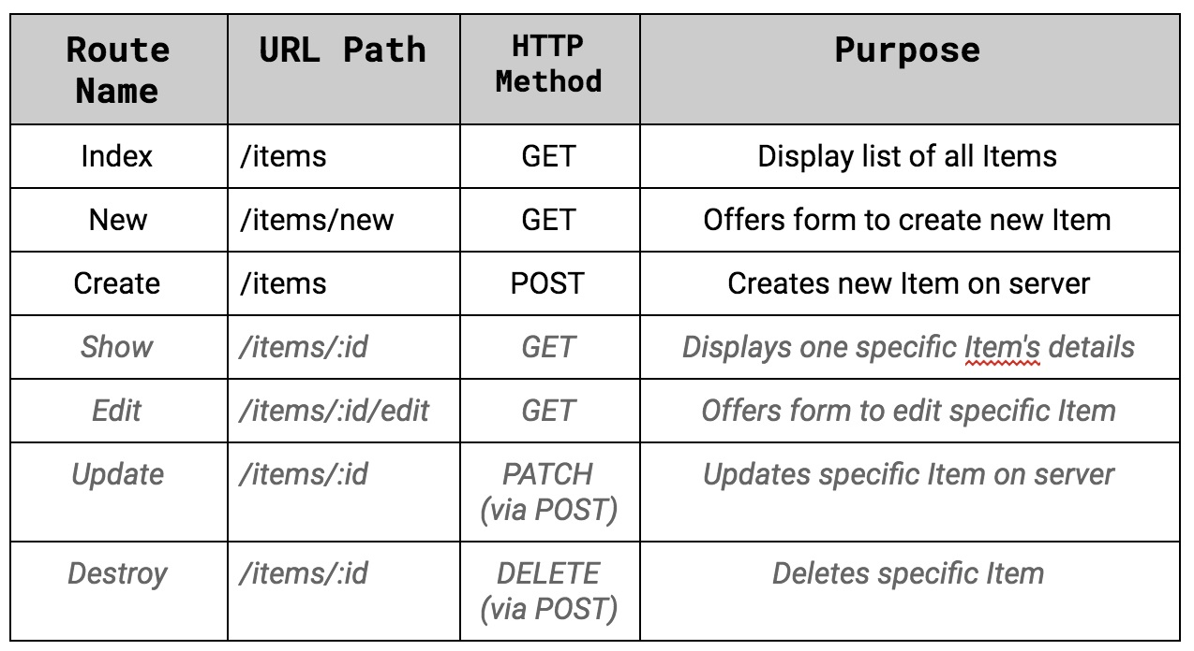
REST Conventions in To Do List
Here's how these same standards would look applied to our to do list. Routes we haven't created yet are in italics:

Slide 10
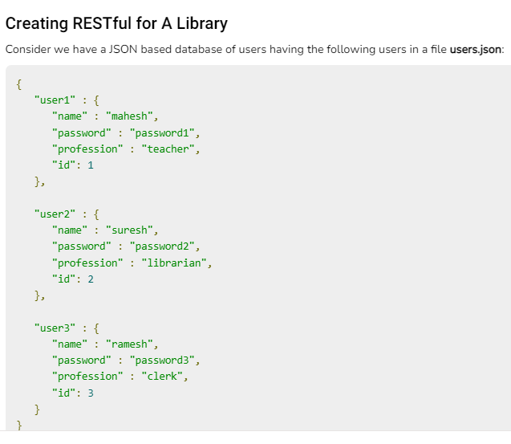

Slide 11
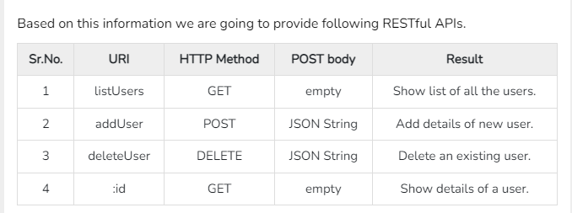

Slide 12
List Users
Let's implement our first RESTful API listUsers using the following code in a server.js file −
server.js
var express = require('express');
var app = express();
var fs = require("fs");
app.get('/listUsers', function (req, res) {
fs.readFile( __dirname + "/" + "users.json", 'utf8', function (err, data) {
console.log( data );
res.end( data );
});
})
var server = app.listen(8081, function () {
var host = server.address().address
var port = server.address().port
console.log("Example app listening at http://%s:%s", host, port)
})

Slide 13
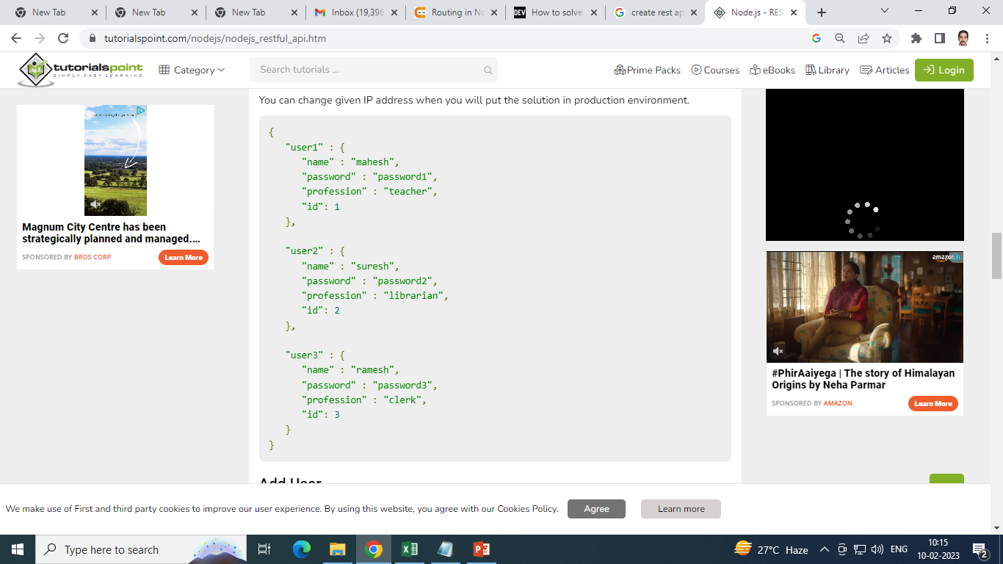
Now try to access defined API using
URL: http://127.0.0.1:8081/listUsers and HTTP Method : GET on local machine
using any REST client. This should produce following result −

Slide 14
Add User
Following API will show you how to add new user in the list. Following is the detail of the new user −
user = {
"user4" : {
"name" : "mohit",
"password" : "password4",
"profession" : "teacher",
"id": 4
}
}
You can accept the same input in the form of JSON using Ajax call but for teaching point of view, we are making it hard coded here. Following is the addUser API to a new user in the database −

Slide 15
server.js
var express = require('express');
var app = express();
var fs = require("fs");
var user = {
"user4" : {
"name" : "mohit",
"password" : "password4",
"profession" : "teacher",
"id": 4
}
}
app.post('/addUser', function (req, res) {
// First read existing users.
fs.readFile( __dirname + "/" + "users.json", 'utf8', function (err, data) {
data = JSON.parse( data );
data["user4"] = user["user4"];
console.log( data );
res.end( JSON.stringify(data));
});
})
var server = app.listen(8081, function () {
var host = server.address().address
var port = server.address().port
console.log("Example app listening at http://%s:%s", host, port)
})

Slide 16
Now try to access defined API using URL: http://127.0.0.1:8081/addUser and HTTP Method : POST on local machine using any REST client. This should produce following result −
{
"user1":{"name":"mahesh","password":"password1","profession":"teacher","id":1},
"user2":{"name":"suresh","password":"password2","profession":"librarian","id":2},
"user3":{"name":"ramesh","password":"password3","profession":"clerk","id":3},
"user4":{"name":"mohit","password":"password4","profession":"teacher","id":4}
}

Slide 17
Show Detail
Now we will implement an API which will be called using user ID and it will display the detail of the corresponding user.
server.js
var express = require('express');
var app = express();
var fs = require("fs");
app.get('/:id', function (req, res) {
// First read existing users.
fs.readFile( __dirname + "/" + "users.json", 'utf8', function (err, data) {
var users = JSON.parse( data );
var user = users["user" + req.params.id]
console.log( user );
res.end( JSON.stringify(user));
});
})
var server = app.listen(8081, function () {
var host = server.address().address
var port = server.address().port
console.log("Example app listening at http://%s:%s", host, port)
})

Slide 18
Now try to access defined API using URL: http://127.0.0.1:8081/2 and HTTP Method : GET on local machine using any REST client. This should produce following result −
{"name":"suresh","password":"password2","profession":"librarian","id":2}

Slide 19
Delete User
This API is very similar to addUser API where we receive input data through req.body and
then based on user ID we delete that user from the database.
To keep our program simple we assume we are going to delete user with ID 2.
server.js
var express = require('express');
var app = express();
var fs = require("fs");
var id = 2;
app.delete('/deleteUser', function (req, res) {
// First read existing users.
fs.readFile( __dirname + "/" + "users.json", 'utf8', function (err, data) {
data = JSON.parse( data );
delete data["user" + 2];
console.log( data );
res.end( JSON.stringify(data)); }); })
var server = app.listen(8081, function () {
var host = server.address().address
var port = server.address().port
console.log("Example app listening at http://%s:%s", host, port) })

Slide 20
Now try to access defined API using URL: http://127.0.0.1:8081/deleteUser and HTTP Method : DELETE on local machine using any REST client. This should produce following result −
{"user1":{"name":"mahesh","password":"password1","profession":"teacher","id":1},
"user3":{"name":"ramesh","password":"password3","profession":"clerk","id":3}}

