Slide 1
POST Method
Here is a simple example which passes two values using HTML FORM POST method. We are going to use process_get router inside server.js to handle this input.
<html>
<body>
<form action = "http://127.0.0.1:8081/process_post" method = "POST">
First Name: <input type = "text" name = "first_name"> <br>
Last Name: <input type = "text" name = "last_name">
<input type = "submit" value = "Submit">
</form>
</body>
</html>

Slide 2
Let's save the above code in index.htm and modify server.js to handle home page requests as well as the input sent by the HTML form.
var express = require('express');
var app = express();
var bodyParser = require('body-parser');
// Create application/x-www-form-urlencoded parser
var urlencodedParser = bodyParser.urlencoded({ extended: false })
app.use(express.static('public'));
app.get('/index.htm', function (req, res) {
res.sendFile( __dirname + "/" + "index.htm" );
})
app.post('/process_post', urlencodedParser, function (req, res) {
// Prepare output in JSON format
response = {
first_name:req.body.first_name,
last_name:req.body.last_name
};
console.log(response);
res.end(JSON.stringify(response));
})

Slide 3
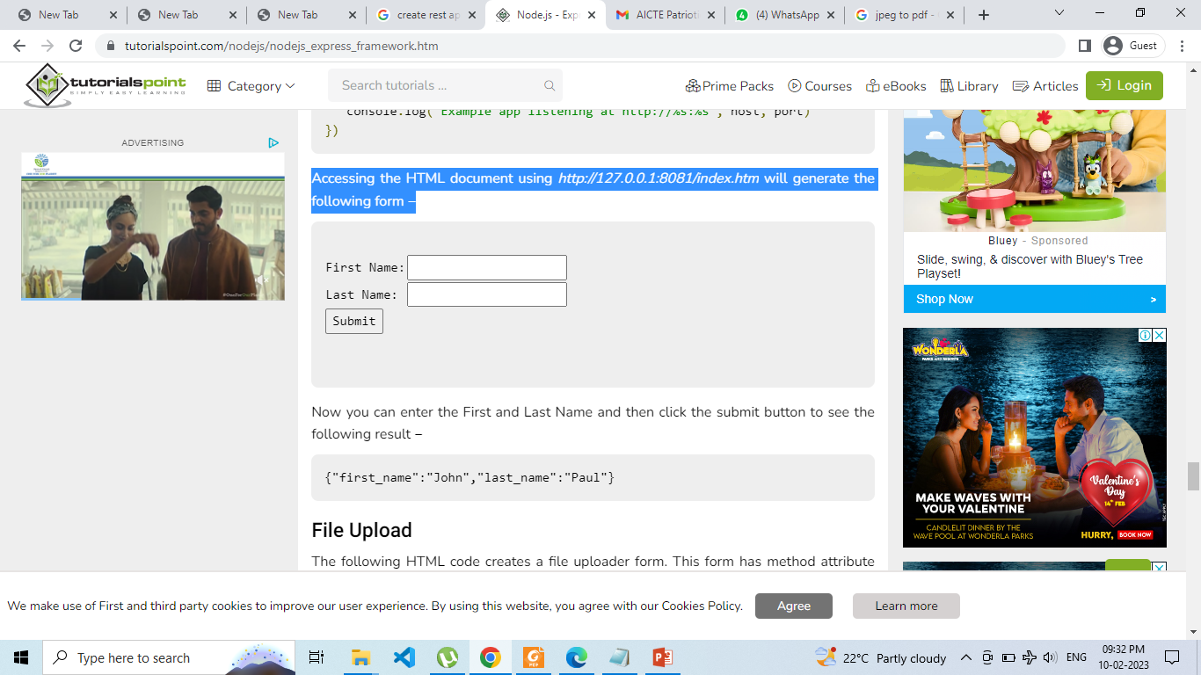
var server = app.listen(8081, function () {
var host = server.address().address
var port = server.address().port
console.log("Example app listening at http://%s:%s", host, port)
})
Accessing the HTML document using http://127.0.0.1:8081/index.htm will generate the following form −

Slide 4
File Upload
The following HTML code creates a file uploader form. This form has method attribute set to POST and enctype attribute is set to multipart/form-data
<html>
<head>
<title>File Uploading Form</title>
</head>
<body>
<h3>File Upload:</h3>
Select a file to upload: <br />
<form action = "http://127.0.0.1:8081/file_upload" method = "POST"
enctype = "multipart/form-data">
<input type="file" name="file" size="50" />
<br />
<input type = "submit" value = "Upload File" />
</form>
</body>
</html>

Slide 5
Let's save above code in index.htm and modify server.js to handle home page requests as well as file upload.
var express = require('express');
var app = express();
var fs = require("fs");
var bodyParser = require('body-parser');
var multer = require('multer');
app.use(express.static('public'));
app.use(bodyParser.urlencoded({ extended: false }));
app.use(multer({ dest: '/tmp/'}));
app.get('/index.htm', function (req, res) {
res.sendFile( __dirname + "/" + "index.htm" );
})

Slide 6
app.post('/file_upload', function (req, res) {
console.log(req.files.file.name);
console.log(req.files.file.path);
console.log(req.files.file.type);
var file = __dirname + "/" + req.files.file.name;
fs.readFile( req.files.file.path, function (err, data) {
fs.writeFile(file, data, function (err) {
if( err ) {
console.log( err );
} else {
response = {
message:'File uploaded successfully',
filename:req.files.file.name
};
}
console.log( response );
res.end( JSON.stringify( response ) );
});
});
})

Slide 7
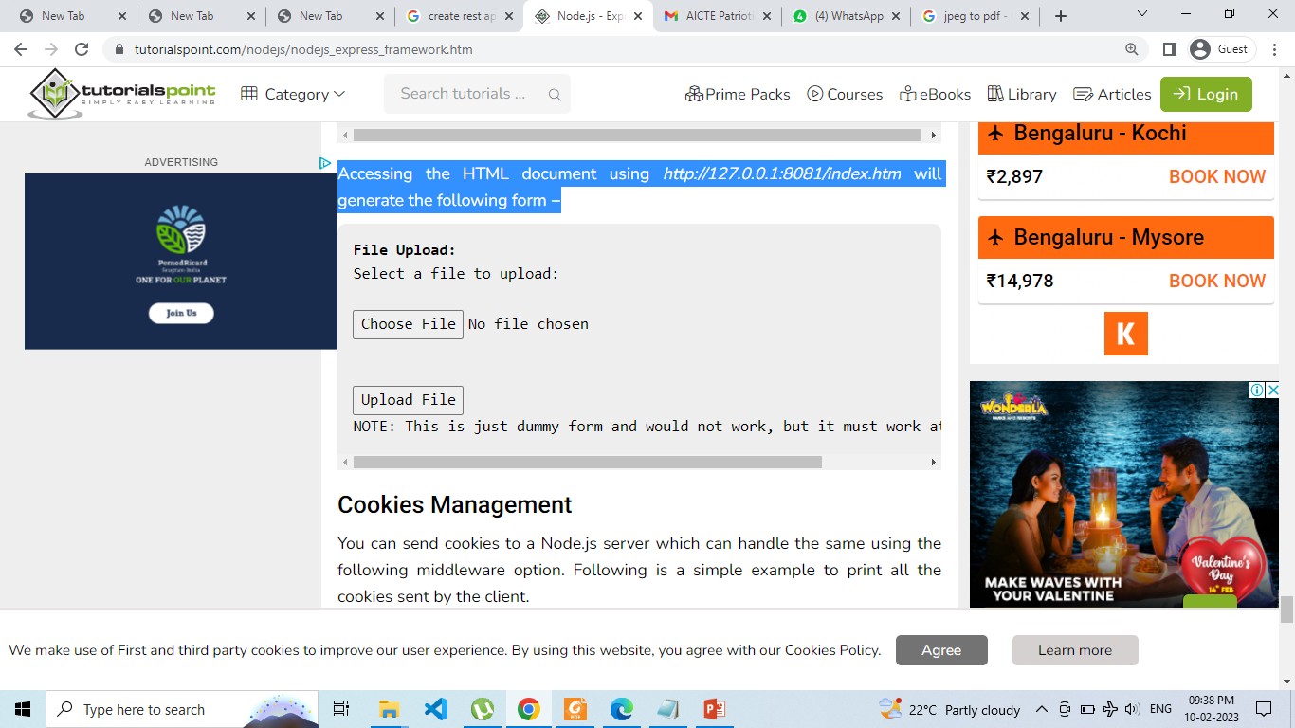
var server = app.listen(8081, function () {
var host = server.address().address
var port = server.address().port
console.log("Example app listening at http://%s:%s", host, port)
})
Accessing the HTML document using http://127.0.0.1:8081/index.htm will generate the following form −
NOTE: This is just dummy form and would not work, but it must work at your server.

Slide 8
Cookies Management
You can send cookies to a Node.js server which can handle the same using the following middleware option. Following is a simple example to print all the cookies sent by the client.
var express = require('express')
var cookieParser = require('cookie-parser')
var app = express()
app.use(cookieParser())
app.get('/', function(req, res) {
console.log("Cookies: ", req.cookies)
})
app.listen(8081)

Slide 9
What is REST architecture?
REST stands for REpresentational State Transfer. REST is web standards based architecture and uses HTTP Protocol.
It revolves around resource where every component is a resource and a resource is accessed by a common interface using HTTP standard methods. REST was first introduced by Roy Fielding in 2000.
A REST Server simply provides access to resources and REST client accesses and modifies the resources using HTTP protocol. Here each resource is identified by URIs/ global IDs.
REST uses various representation to represent a resource like text, JSON, XML but JSON is the most popular one.

Slide 10
HTTP methods
Following four HTTP methods are commonly used in REST based architecture.
GET − This is used to provide a read only access to a resource.
PUT − This is used to create a new resource.
DELETE − This is used to remove a resource.
POST − This is used to update a existing resource or create a new resource.

Slide 11
RESTful Web Services
A web service is a collection of open protocols and standards used for exchanging data between applications or systems. Software applications written in various programming languages and running on various platforms can use web services to exchange data over computer networks like the Internet in a manner similar to inter-process communication on a single computer. This interoperability (e.g., communication between Java and Python, or Windows and Linux applications) is due to the use of open standards.
Web services based on REST Architecture are known as RESTful web services. These webservices uses HTTP methods to implement the concept of REST architecture. A RESTful web service usually defines a URI, Uniform Resource Identifier a service, which provides resource representation such as JSON and set of HTTP Methods.

