Slide 1
Using Body-Parser-to-Parse-
POST Requests-to the server

Slide 2
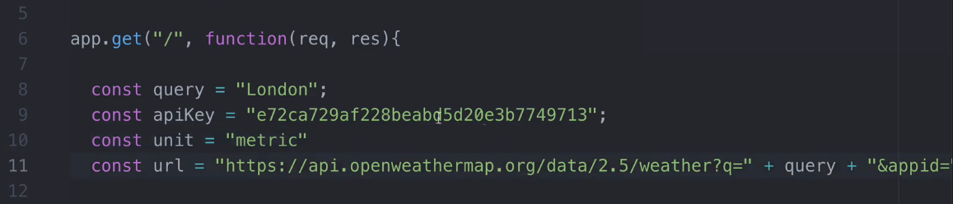
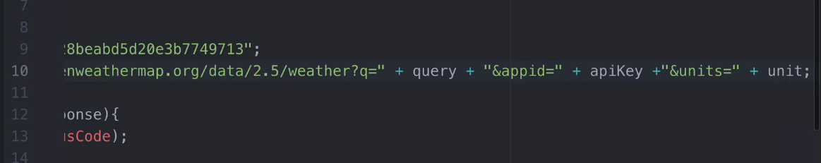
Creating separate variables to store values

Slide 3
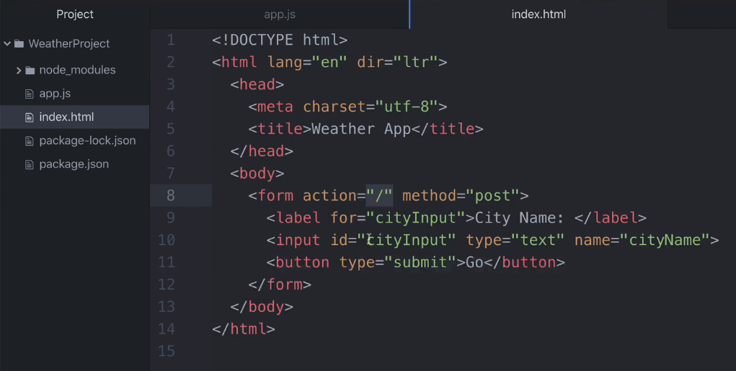
Getting inputs from user via html file

Slide 4
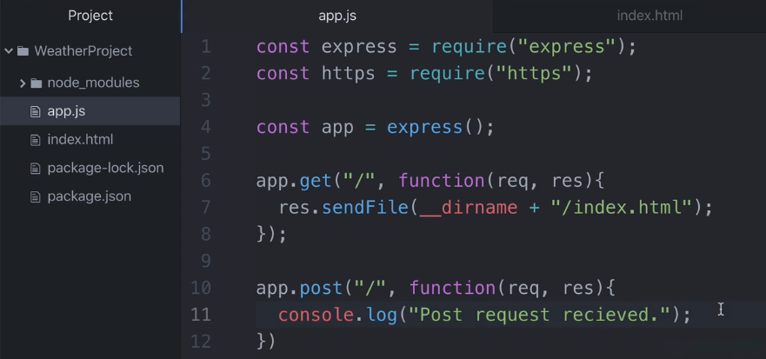
Adding post route and checking input/output

Slide 5
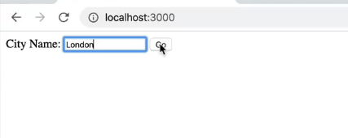
Sending input via HTML form

Slide 6
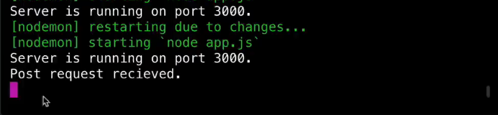
Receiving output at console.log

Slide 7
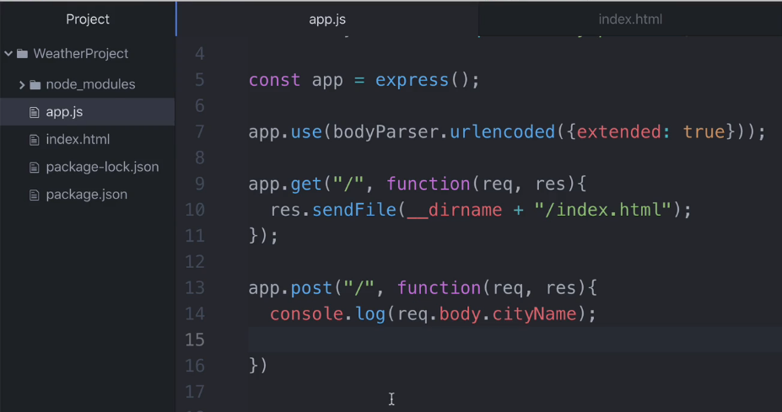
Getting city name and console it

Slide 8
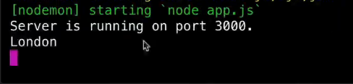

Slide 9
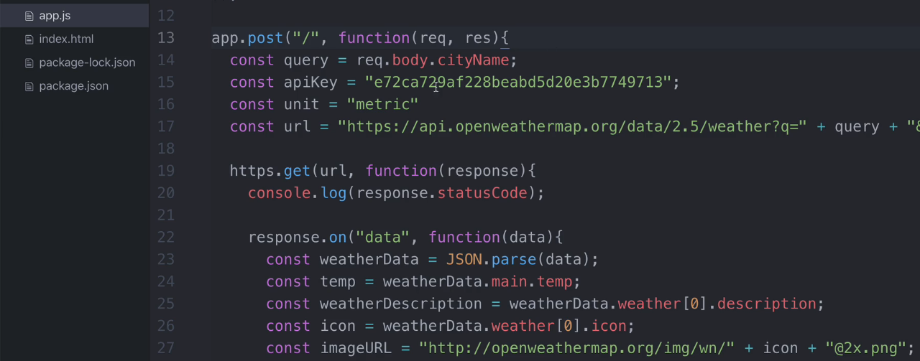
Adding make Get request to external server code
in post route

Slide 10
Challenge:
Get more inputs from user via
HTML form and update the result using POST route.

