Slide 1
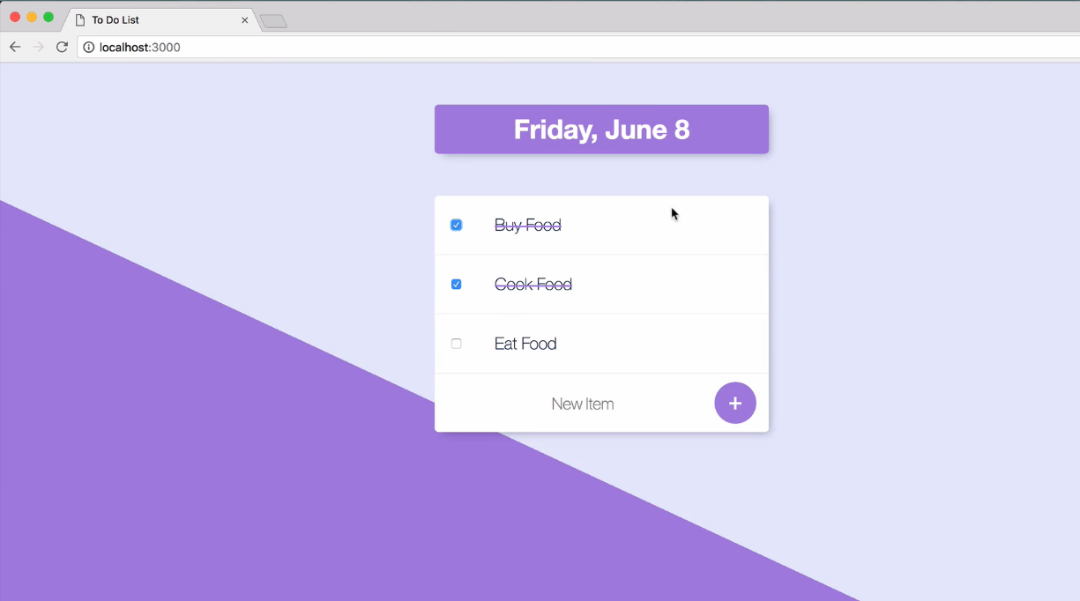
Expected Output

Slide 2
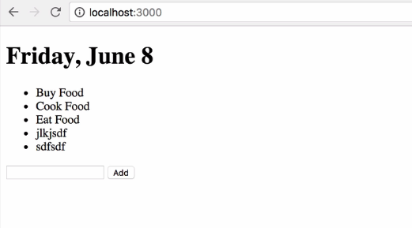
Current Output

Slide 3
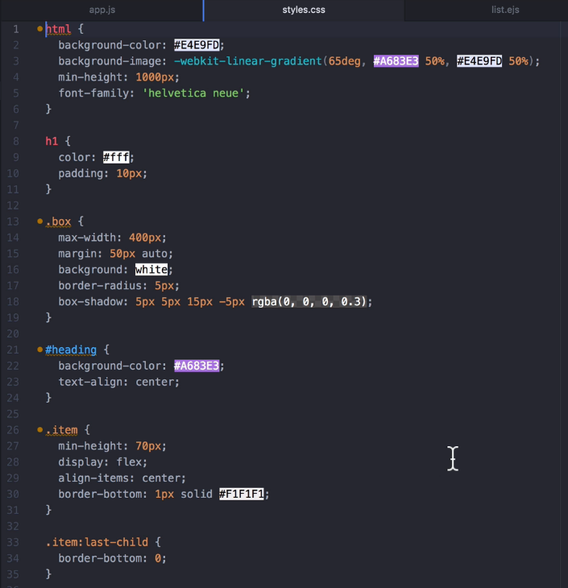
Download U3 Styles.css

Slide 4
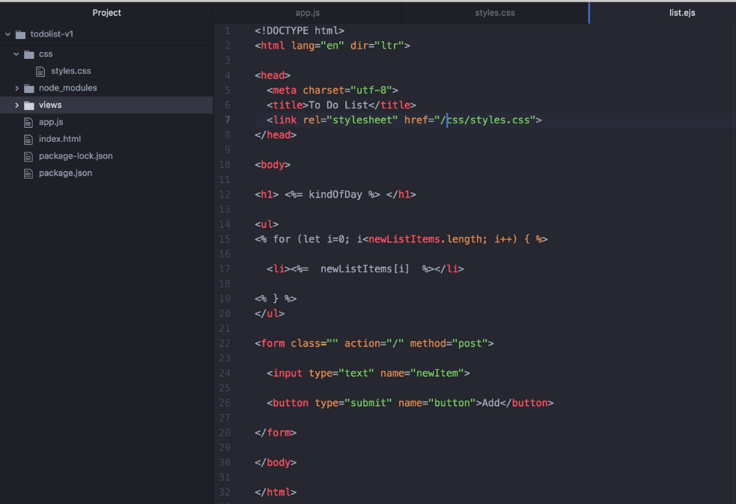
Linking Styles.css
inside list.ejs

Slide 5
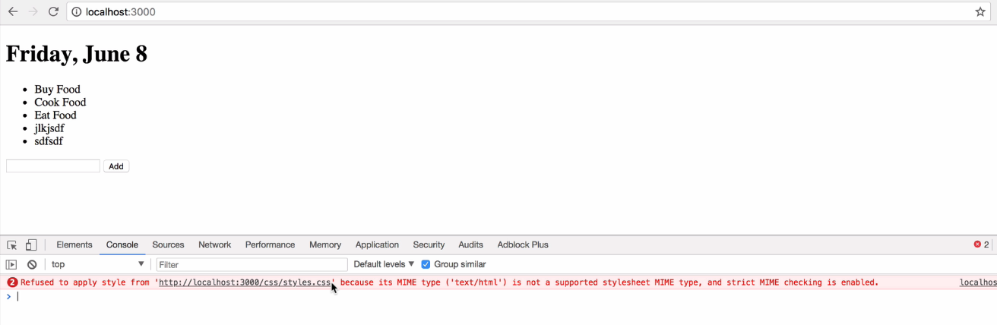
After linking styles.css file , but styles are not applied in
result page, getting warning message

Slide 6
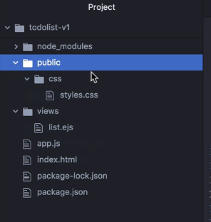
We have to inform express explicitly about the location
of css file

Slide 7
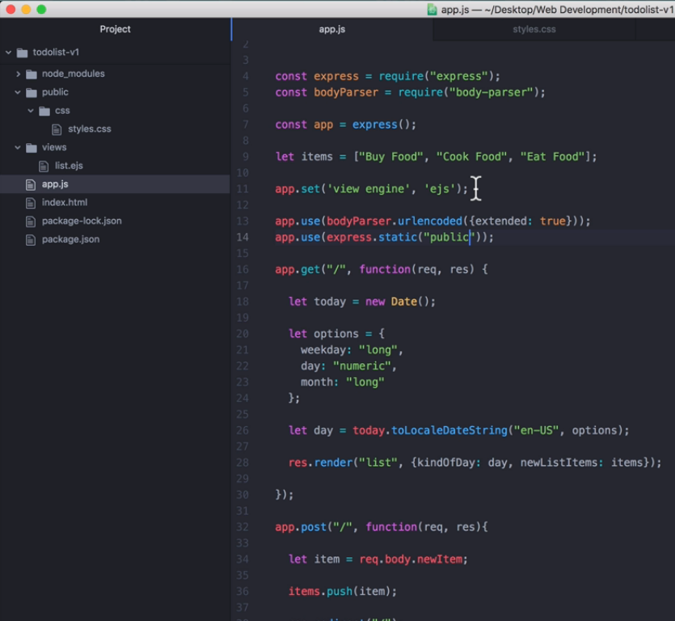
Adding public folder
at app.use() in app.js
file

Slide 8
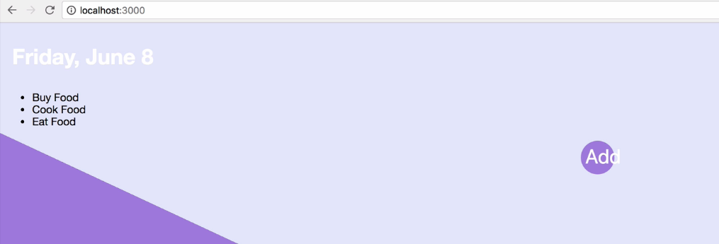
After adding css file, styles applied but we have to add style classes and ids inside list.ejs file

Slide 9
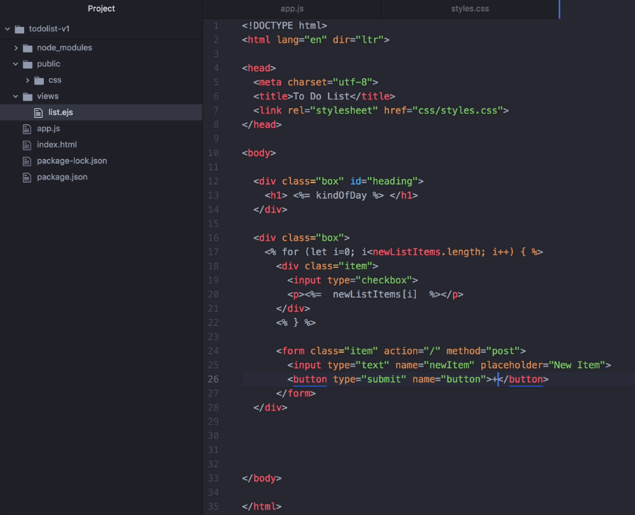
Changes at list.ejs file

Slide 10


Slide 11
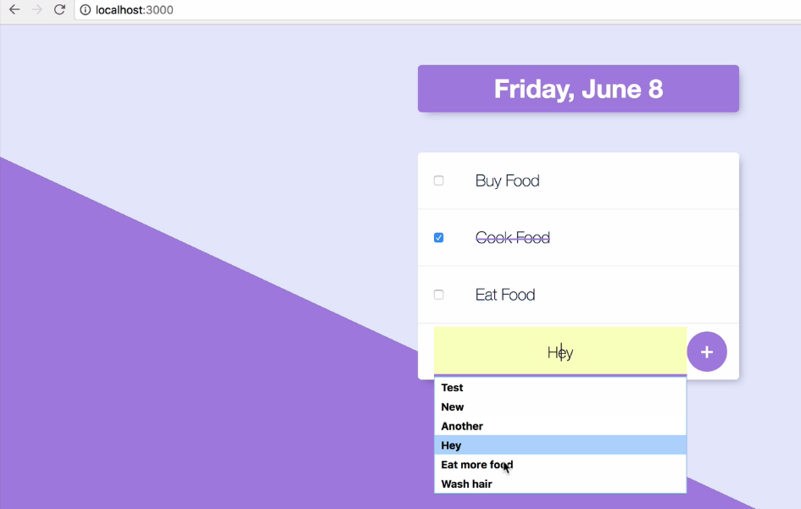
Removing auto
suggestion at list.ejs file

Slide 12
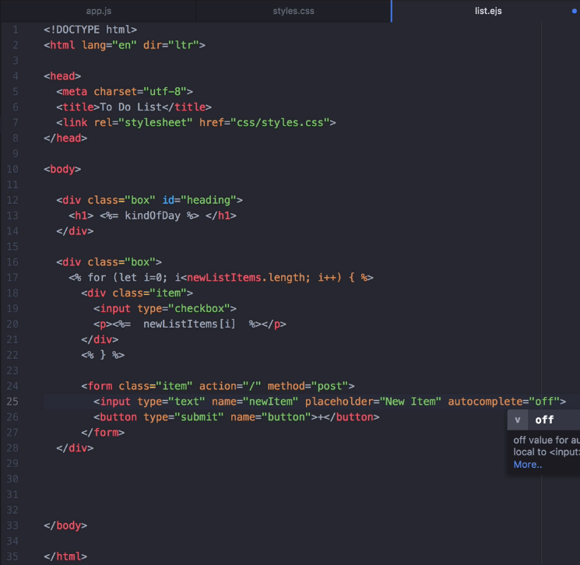
Removing auto
suggestion at list.ejs file

Slide 13
Go through styles.css file and learn any new selectors available or not, understand how these selectors are selecting element from web page.
In Internet there many websites provides reference about using selectors like mdn , w3schools, etc.,

Slide 14
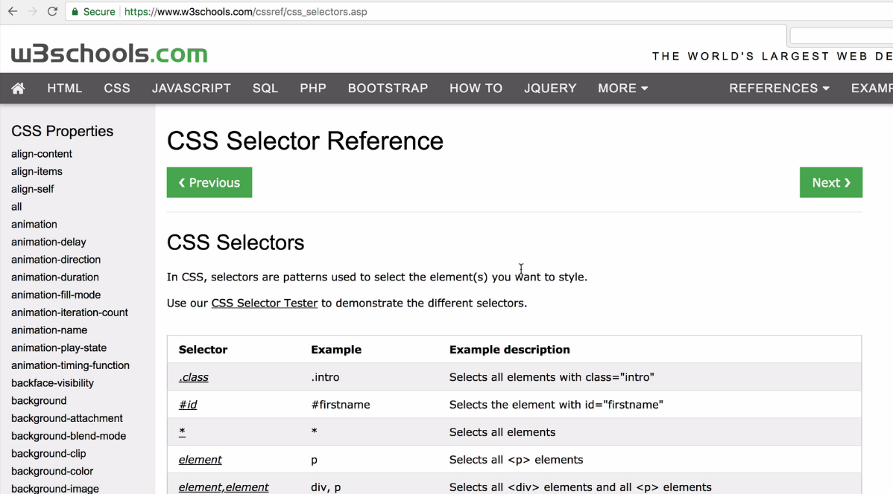

Slide 15
