Slide 1
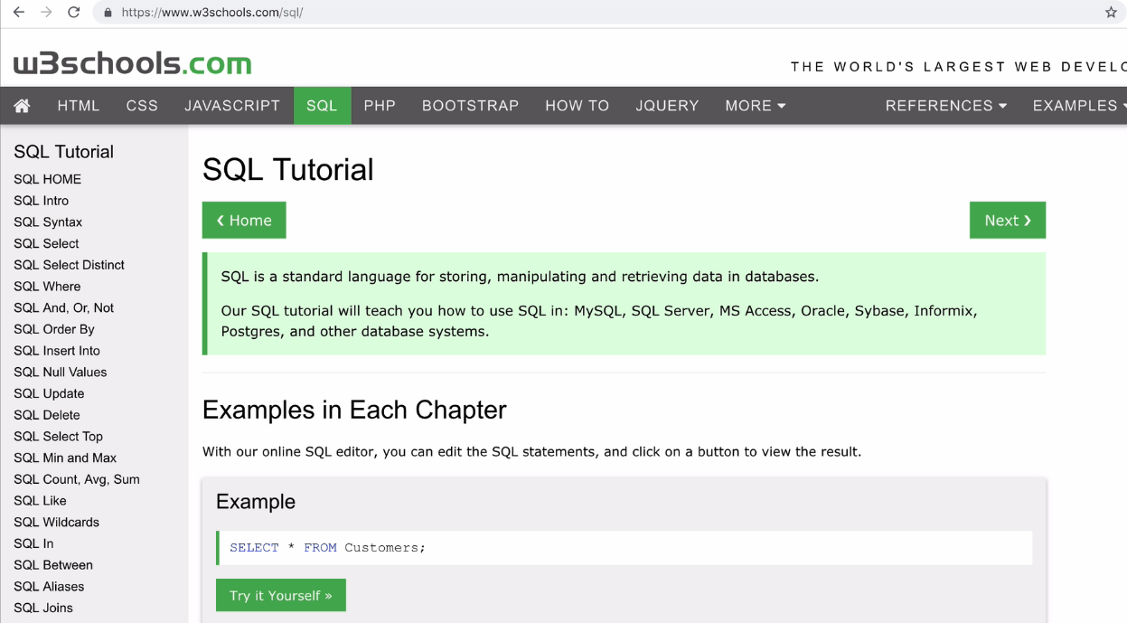
Reference SQL

Slide 2

CRUD
Operation

Slide 3
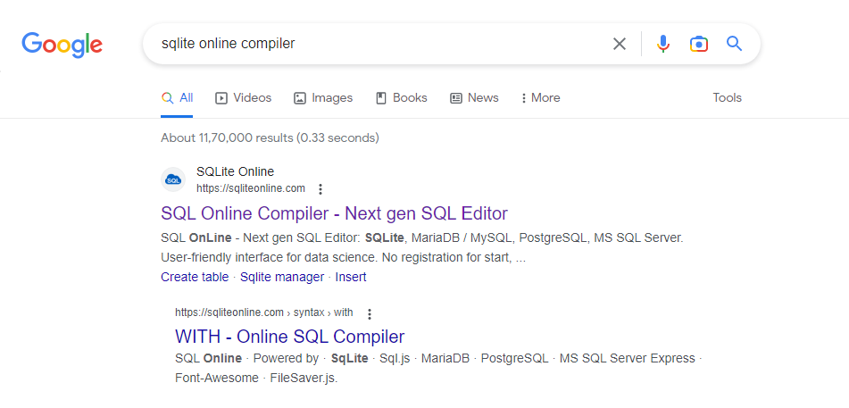
Reference SQL – online Compiler to practice

Slide 4
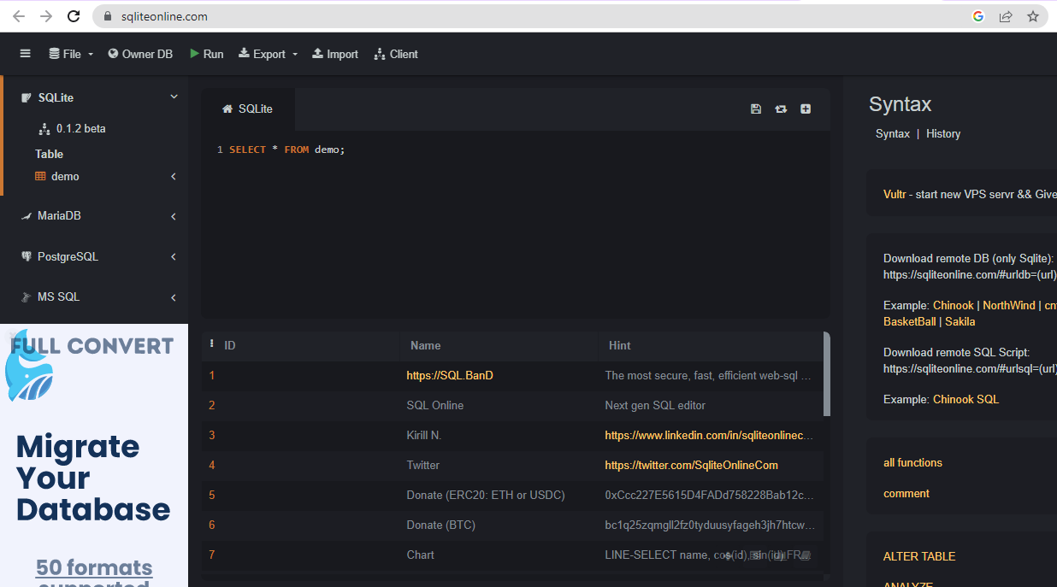
Reference sqliteonline.com

Slide 5
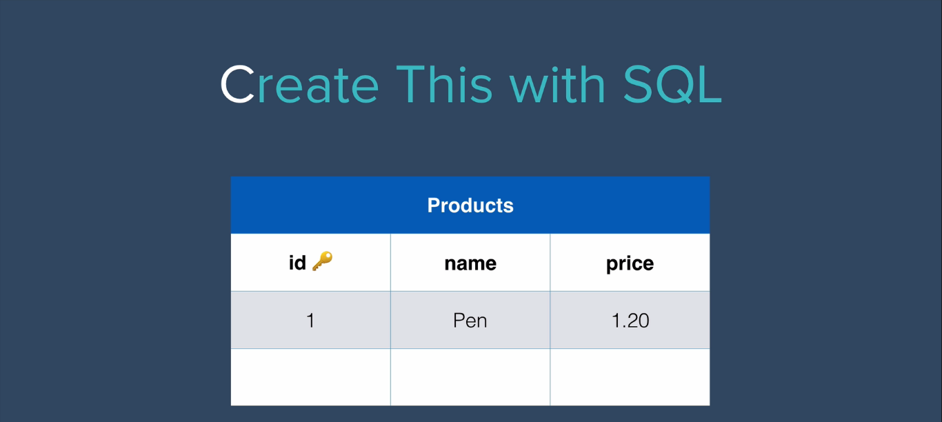
Table Structure: Table name-Products,
Field names –id, name, price

Slide 6
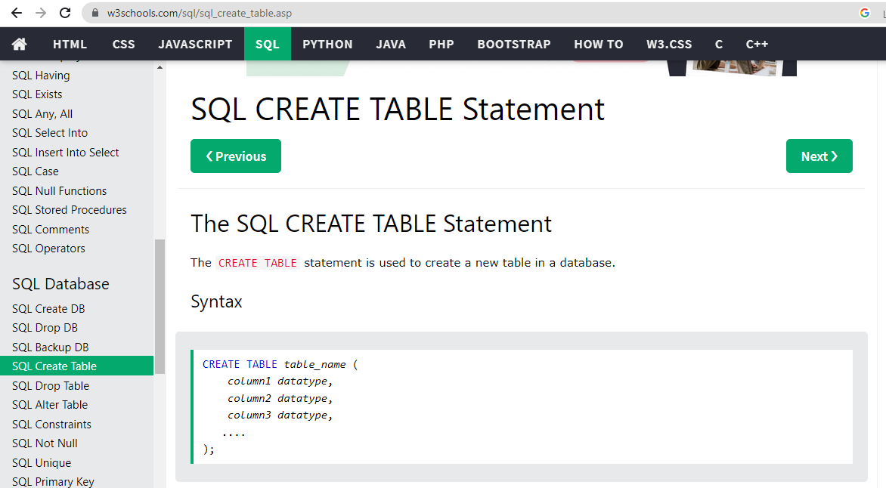
Reference SQL : Create Table Syntax

Slide 7
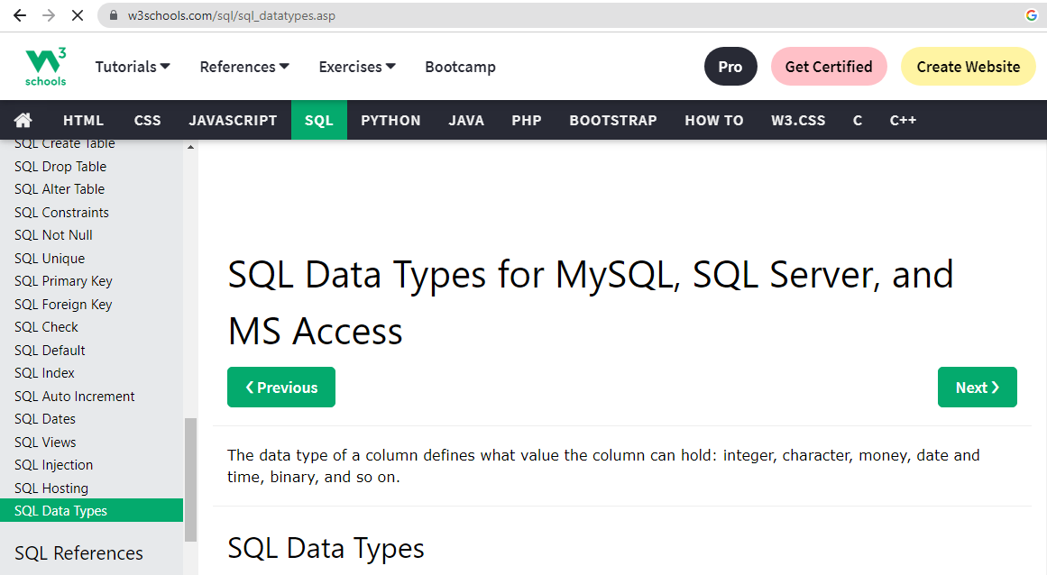
Reference SQL : SQL Data Types

Slide 8
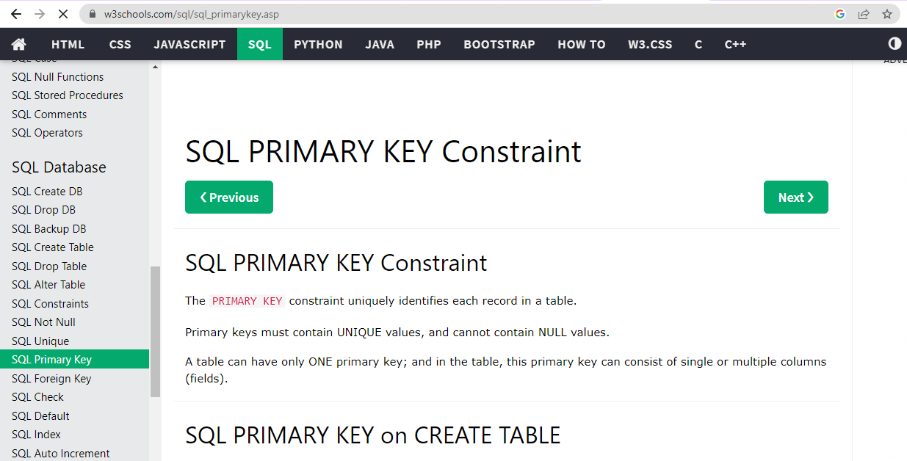
Reference SQL : Primary Key

Slide 9
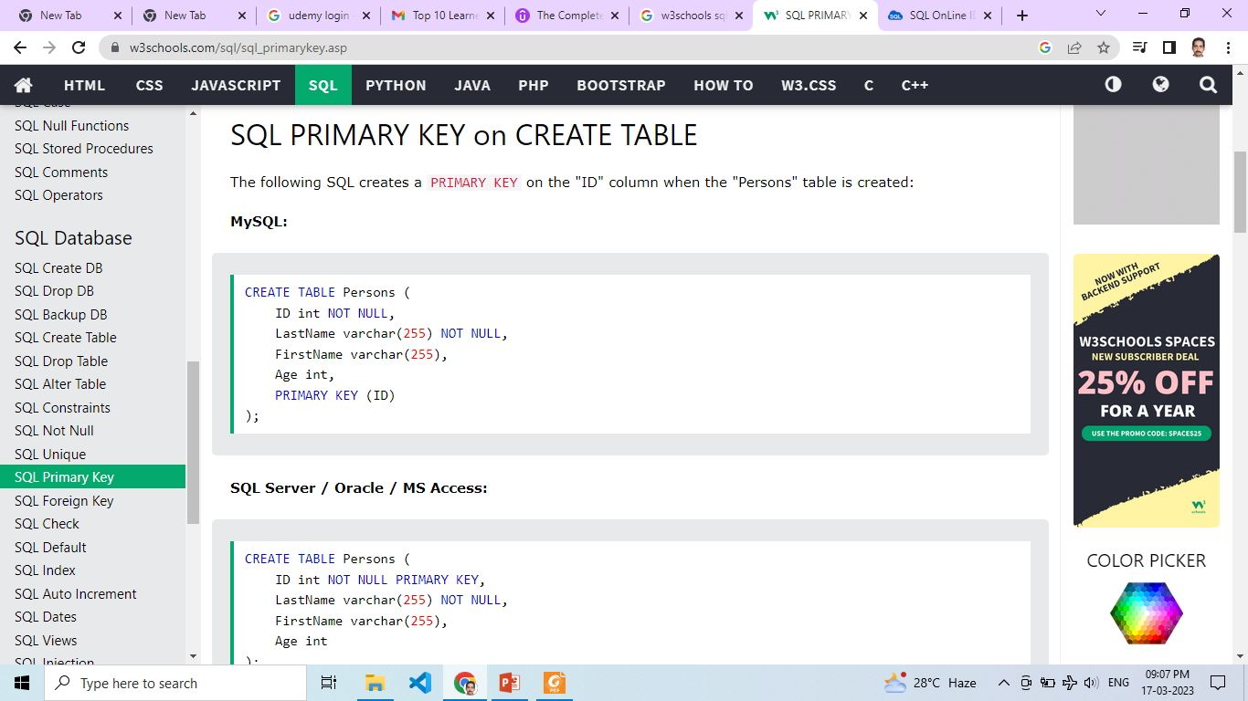
Reference SQL : Create table with primary key

Slide 10
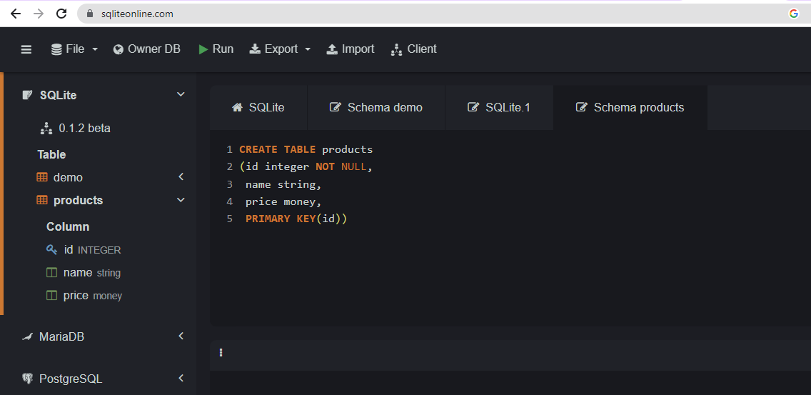
Create table with primary key at sqliteonline.com

Slide 11
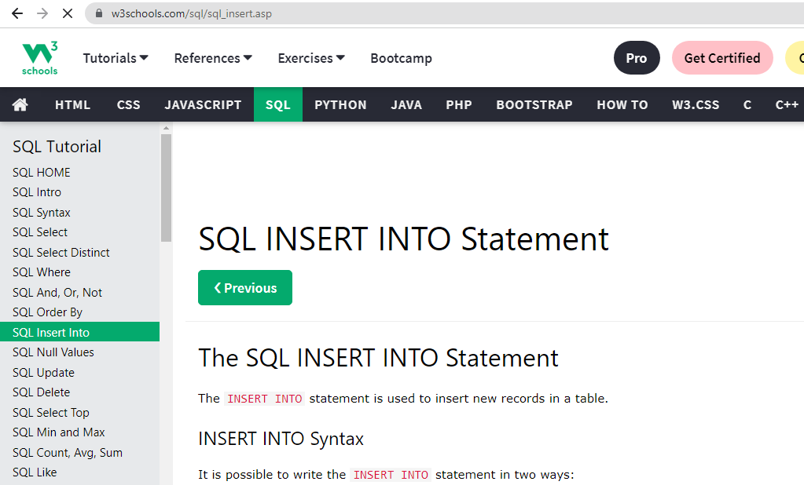
Reference SQL : Insert Syntax

Slide 12
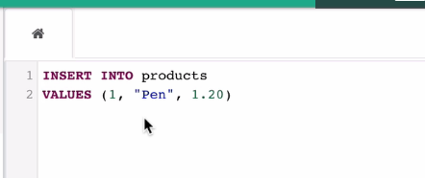
Inserting values into table products

Slide 13
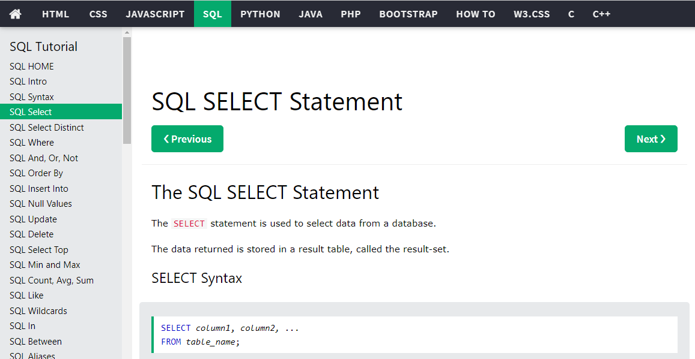
Reference SQL : Select Syntax

Slide 14
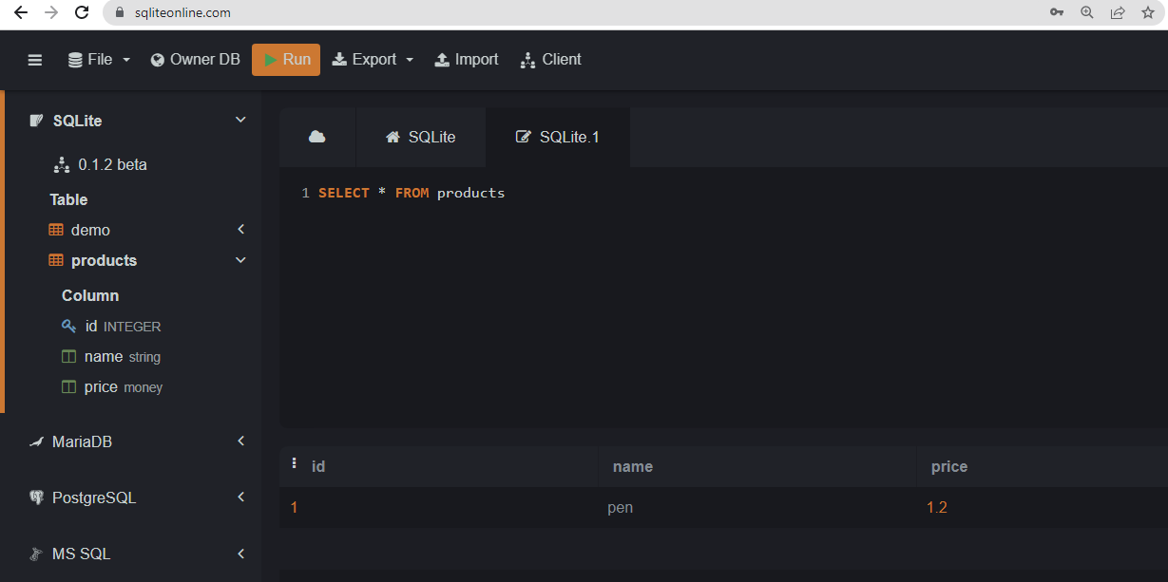
Select Syntax at sqliteonline.com

Slide 15
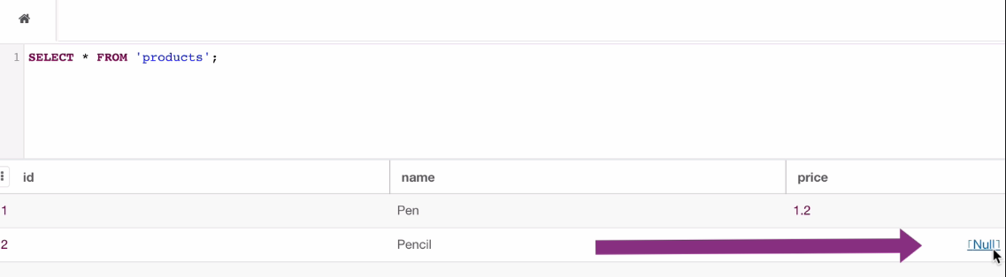
Seeing the result sqliteonline.com

Slide 16
Coding Activity 1:
Do following tasks on products table.
Insert 5 records, Update any two records,
Select all records and specific records, and Delete specific records.
Coding Activity 2:
Do following tasks on Persons table.
Insert 5 records, Update any two records,
Select all records and specific records, and Delete specific records.

