Slide 1
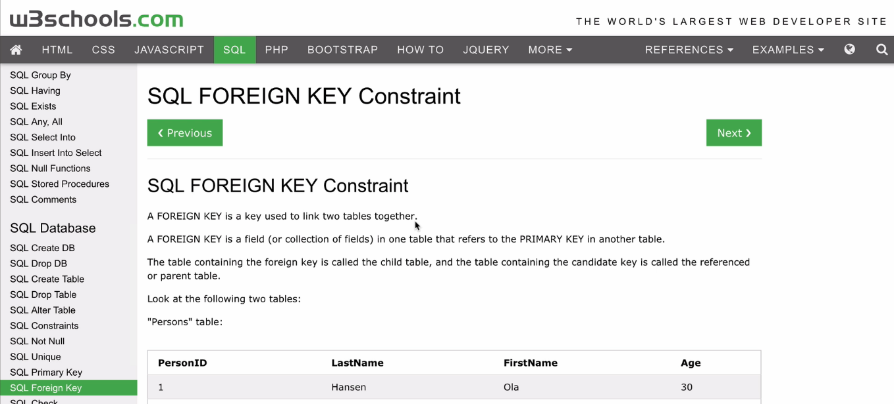
Connecting Two tables – Refer page at website w3schools

Slide 2
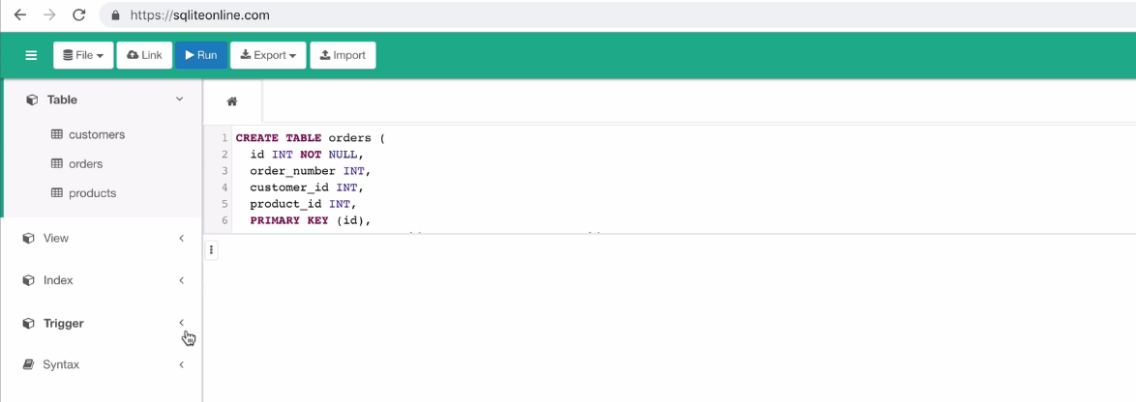
Connecting Two tables – adding primary key.
Assume we have two tables named customers and products.

Slide 3
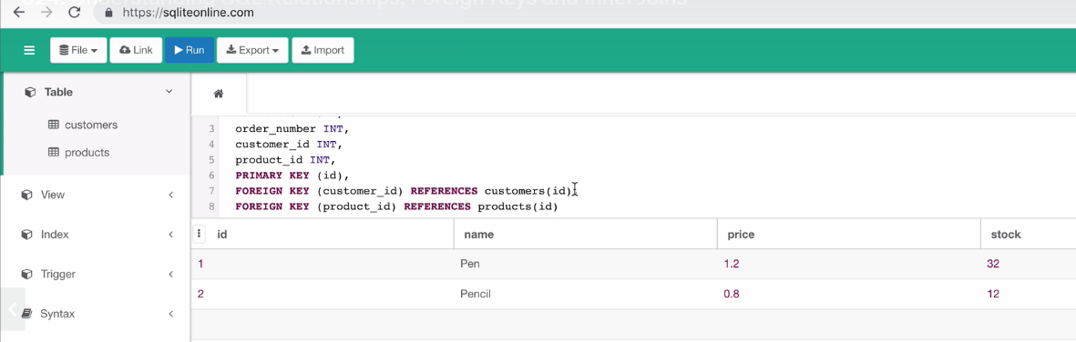
Connecting Two tables – adding primary key and foreign key at
orders table

Slide 4
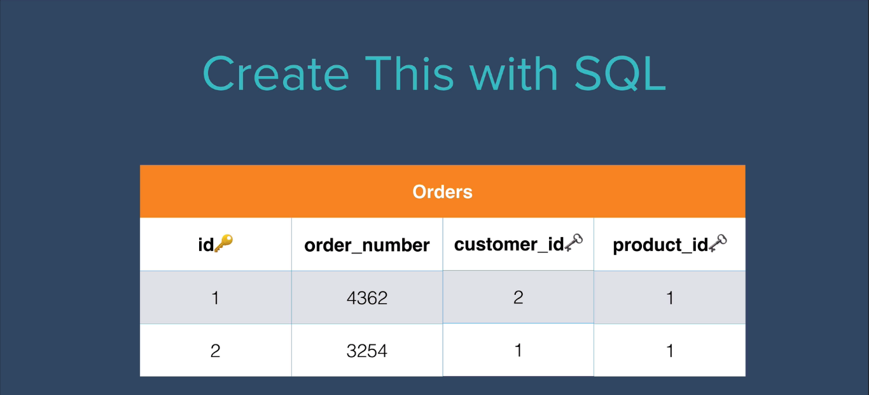
Actual orders Table

Slide 5
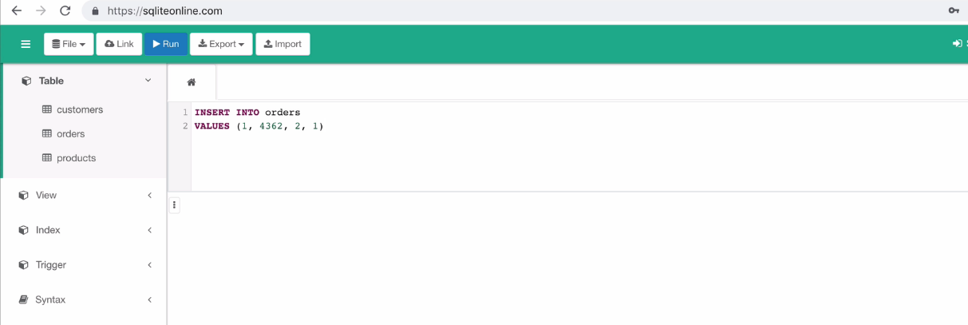
Insert values into particular table

Slide 6
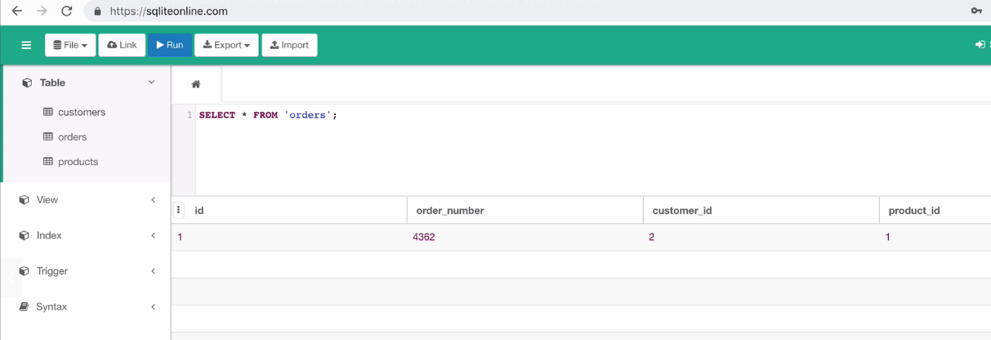
Read data from particular table using “select” query

Slide 7
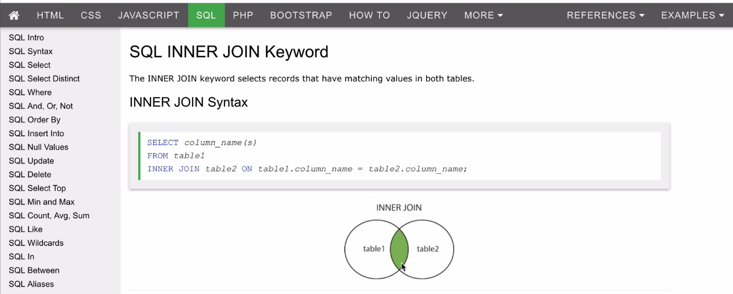
Getting data from connected tables using inner join query

Slide 8
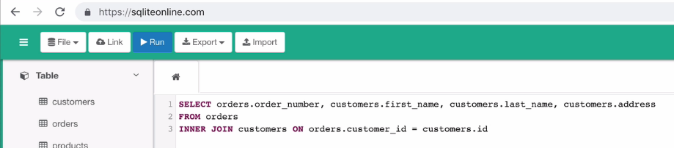
Getting data from connected tables using inner join query

Slide 9
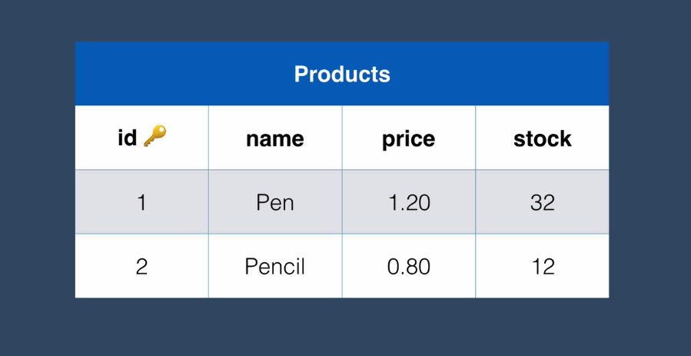
Actual Products Table

Slide 10
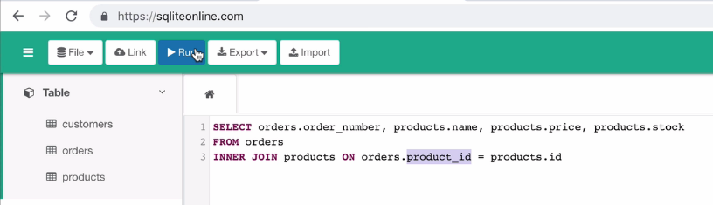
Getting data from connected tables using inner join query

Slide 11
Coding Activity: Apply inner join to the following two tables – students and mark tables.
Create both table with some columns , connect using primary and foreign keys.
Finally apply inner join and fetch following data.
Student name, average marks, percentage.

