Slide 1
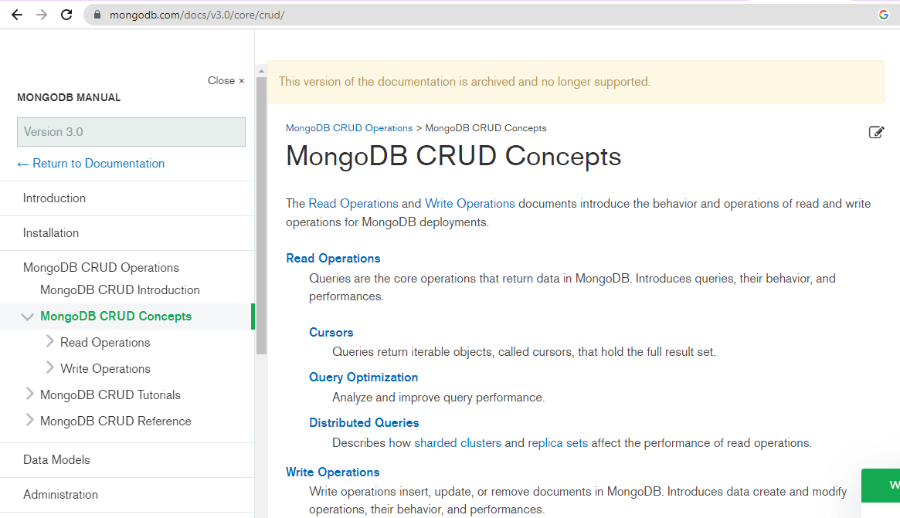
Unit-IV
Go to website: https://www.mongodb.com/docs/manual/crud/

Slide 2
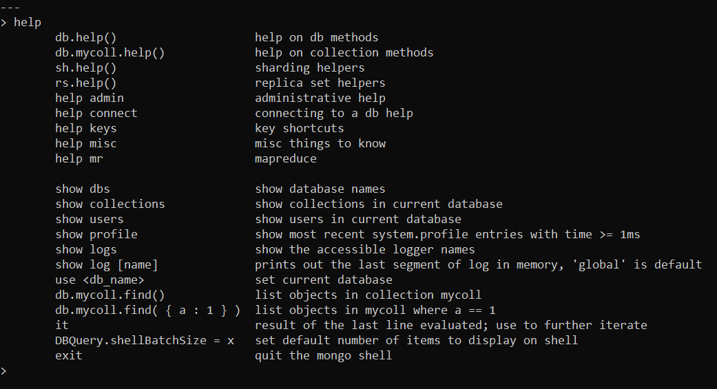
Applying shell command : help

Slide 3
To create database in MongoDB
Applying shell command : use <Database Name>
Example: Use shopDB

Slide 4
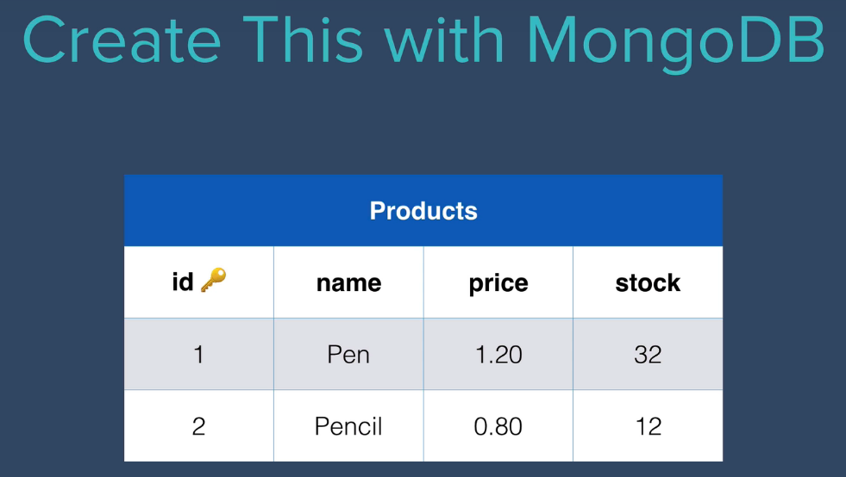
Creating collection named products

Slide 5
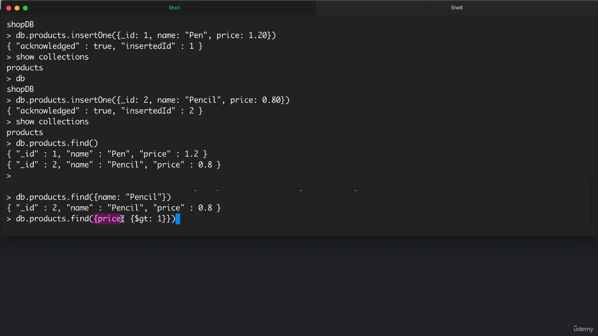
Applying shell command : insertOne

Slide 6
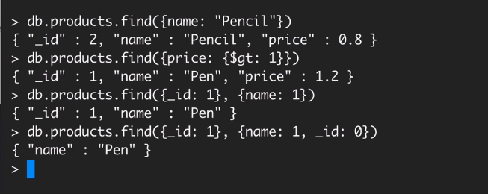
Applying shell command : find()

Slide 7
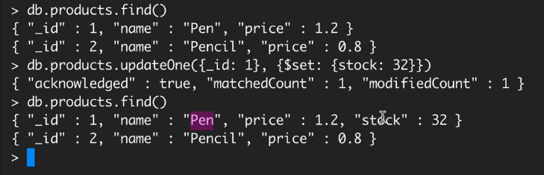
Applying shell command : Update

Slide 8
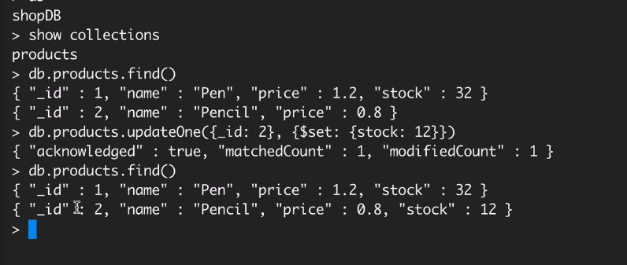
Applying shell command : Update

Slide 9
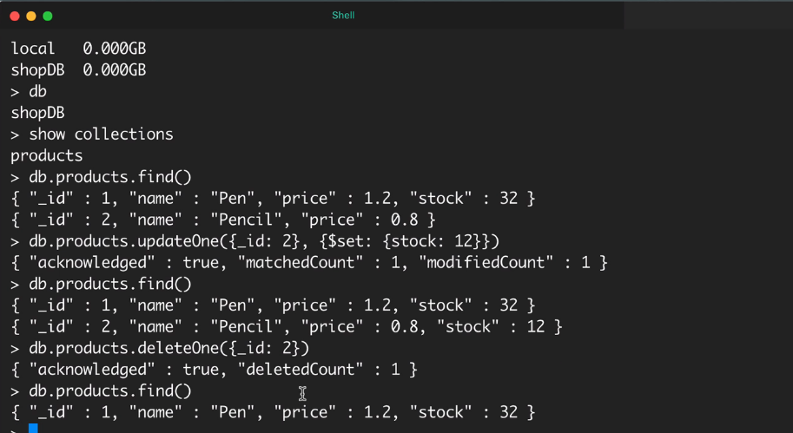
Applying shell command : delete

Slide 10
Refer MongoDB-Shell-CRUD-U4-Coding-Activity-1
CRUD Operations with MongoDB: Create Operations
o CRUD Operations with MongoDB: Read Operations
o CRUD Operations with MongoDB: Update Operations
o CRUD Operations with MongoDB: Delete Operations

