Slide 1
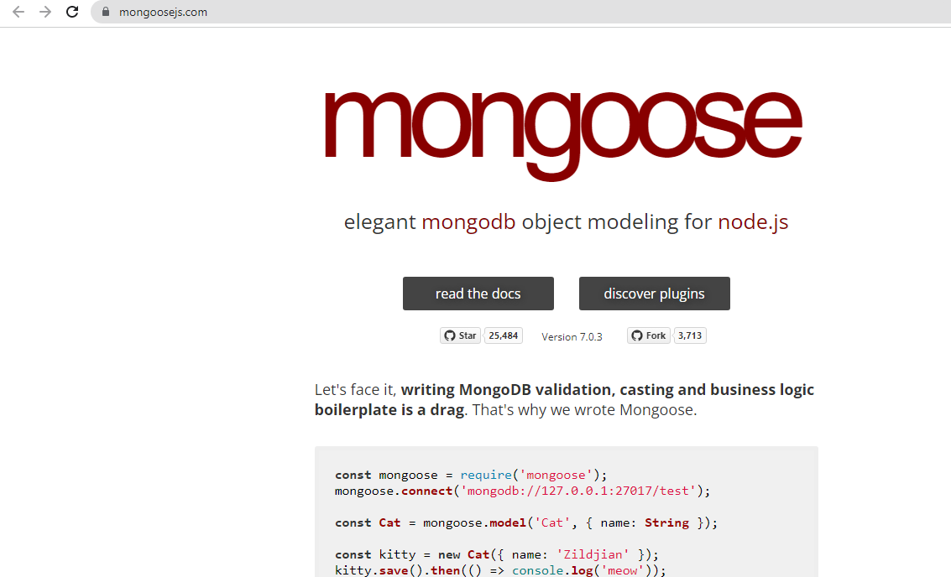
ODM –Object Document Mapper

Slide 2
Steps to use mongoose
Step 1: Create empty node js application with express and necessary packages
Step 2: Install mongoose package using npm command
npm install mongoose
Step 3: We can create new database named fruitsDB2
Or remove existing one to delete previous values / and use the same name again to add new values.

Slide 3
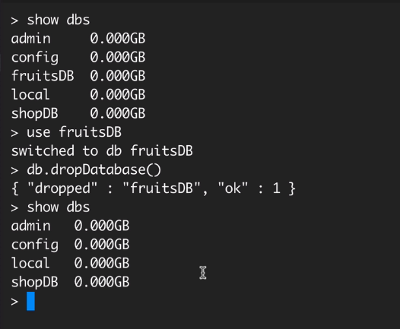
We can use different database name or
we can delete old one if it exists already.

Slide 4
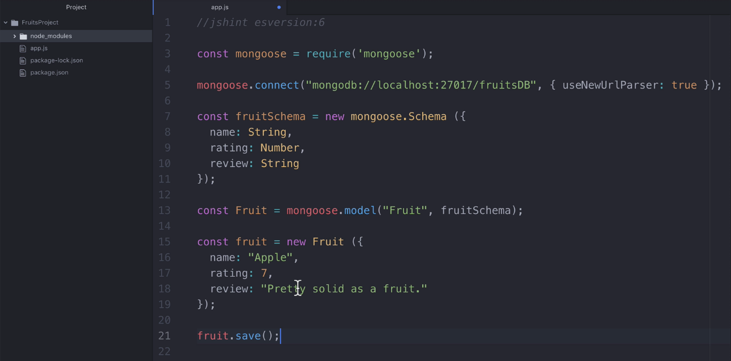
app.js code to create, connect database, create collection, and
insert document

Slide 5
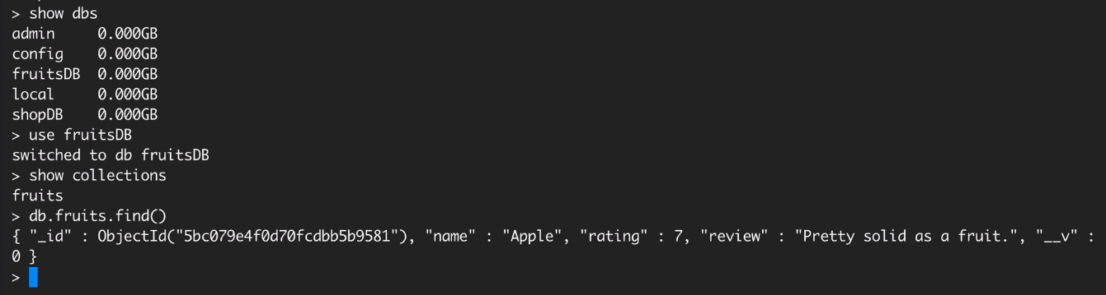
Run app.js and check whether database, collection and document added or not in Mongo DB Shell. Notice mongoose converts collection name into plural form.

Slide 6
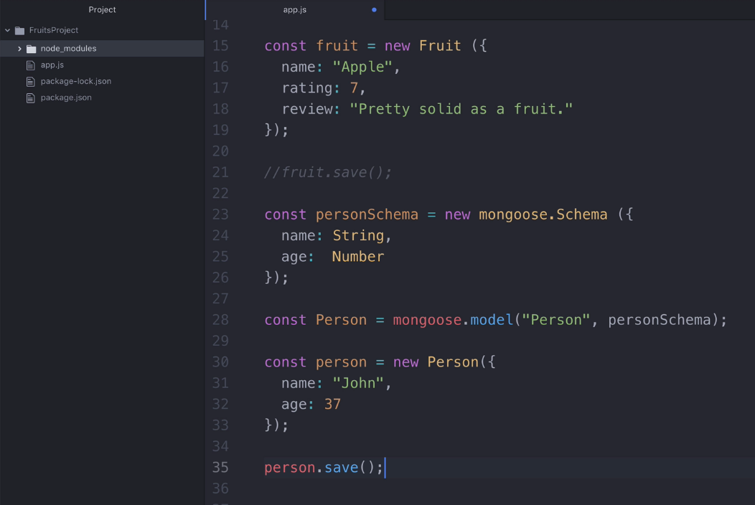
Creating another collection and inserting a document

Slide 7
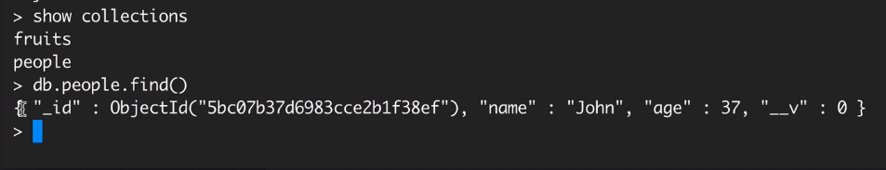
Run app.js and check whether database, collection and document added or not in Mongo DB Shell. Notice mongoose converts collection name into plural form. Example: Person into people.
In case if you want to insert many values
then we have to refer mongoose documentation page.

Slide 8
How to refer model’s methods in mongoose?
Go to the mongoose website, click read the docs button.

Slide 9
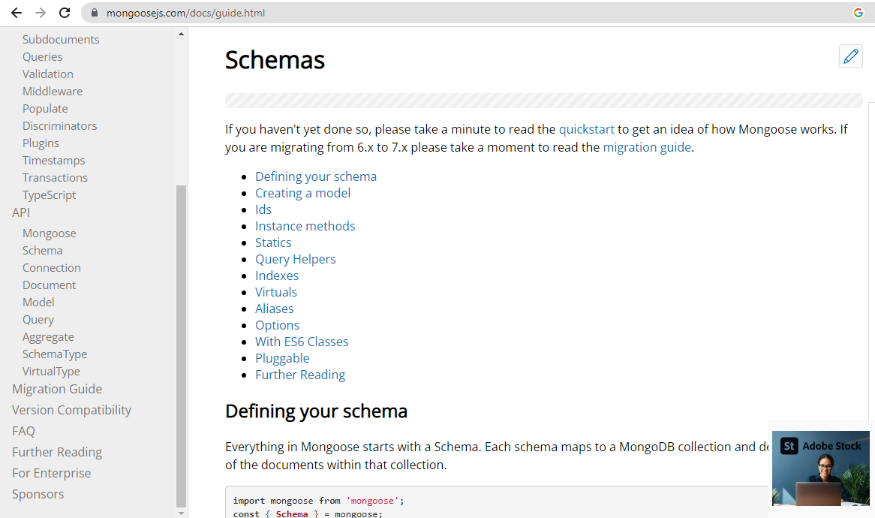
Choose Model tab left side under API Category in the given page.

Slide 10
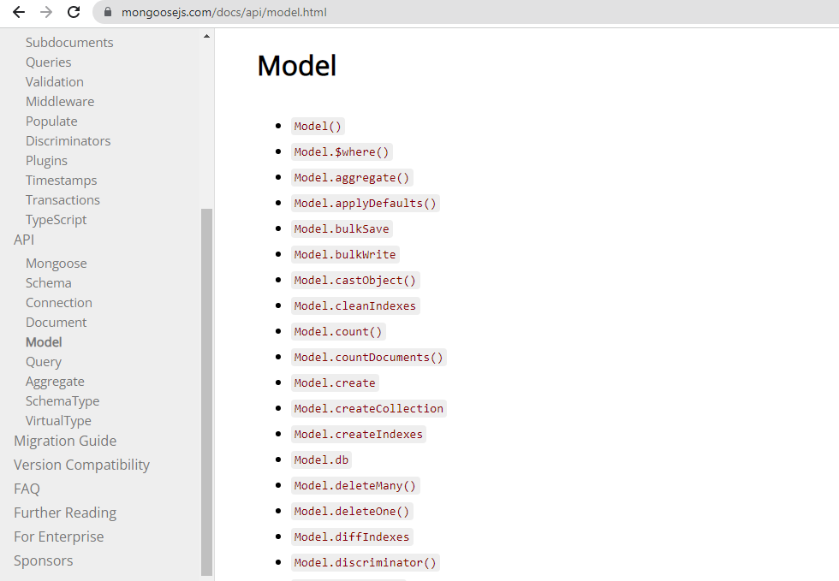
We can see many methods of Model – select insertMany()

Slide 11
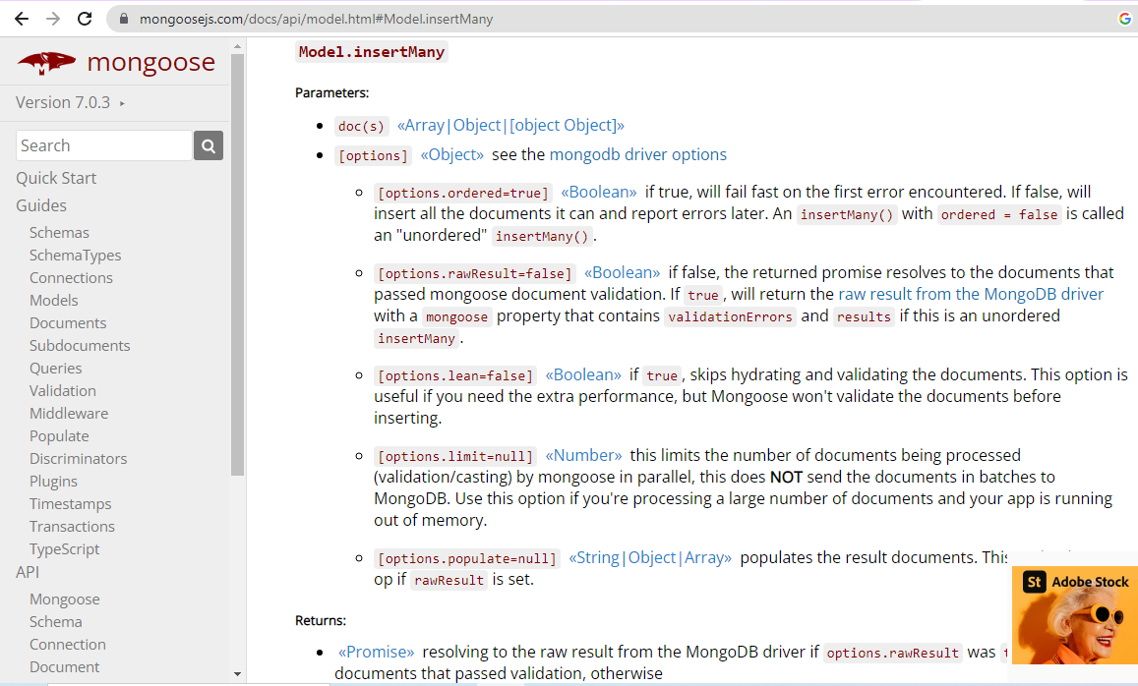
Read the documentation of insertMany()

Slide 12
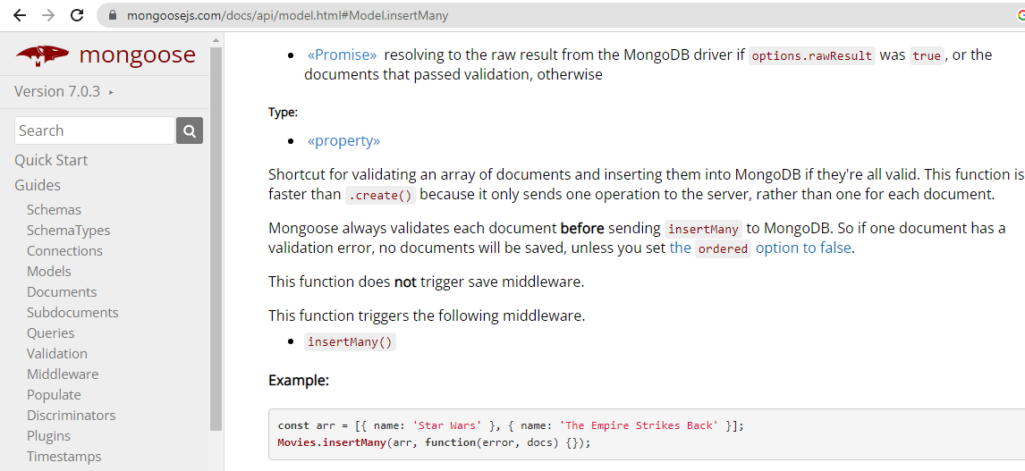
See the example of insertMany()

Slide 13
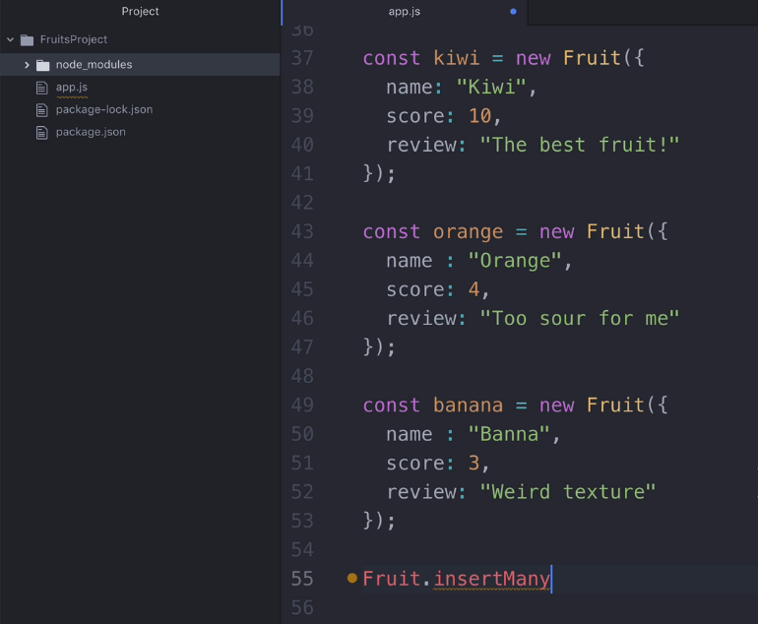
Creating many fruits at app.js file

Slide 14
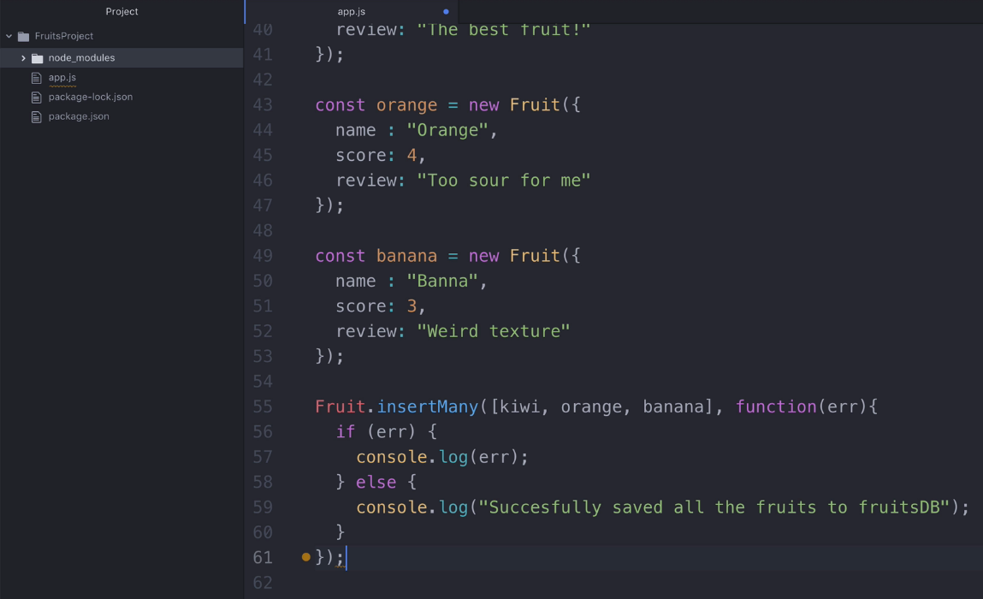
Creating many fruits at app.js file and adding at collection

Slide 15
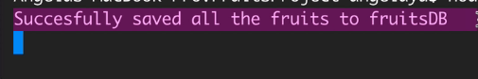
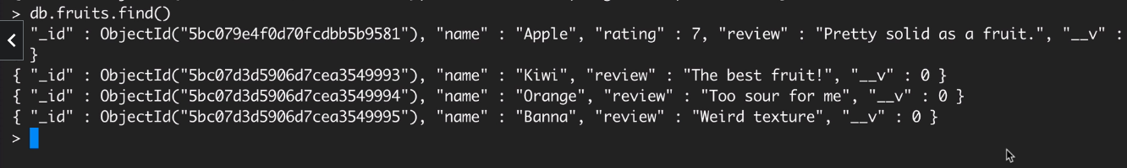
Run app.js file and see the output message at screen

Slide 16
Coding Activity: Complete Following tasks and upload your project folder with screen shots:
Connect node app using mongoose.
Create database fruitsDB.
Create collection fruits.
Insert many values.
Console success message after adding values
at collection.

