Slide 1
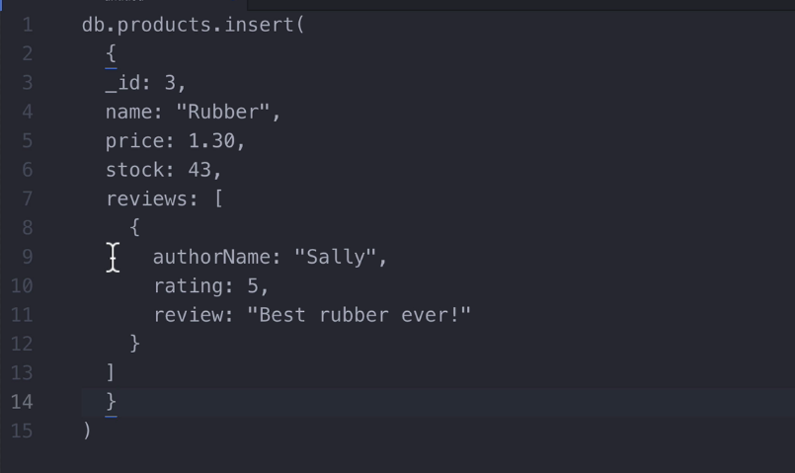
There are two kind of relationships in mongo DB,
First one is direct and simple method like below :
Representing a document inside another document.

Slide 2
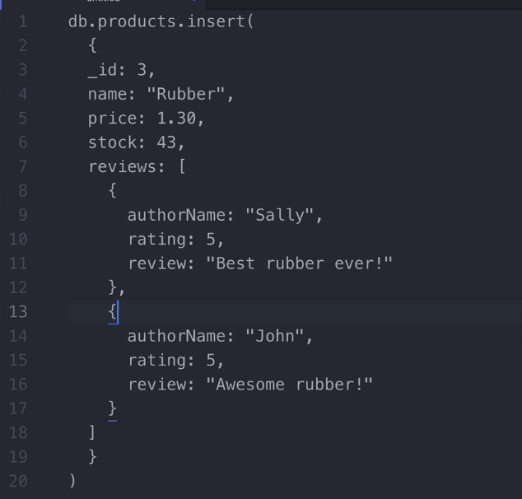
Here we have established a relationship between a single product
Document and a single review document. This style of embedding documents in each other is really well-suited to this kind of one to many realtionships.

Slide 3
One to many:
For example one product might have many reviews or
one user might have created many comments.
And this is a very natural way of expressing that
relationship using MongoDB.

Slide 4
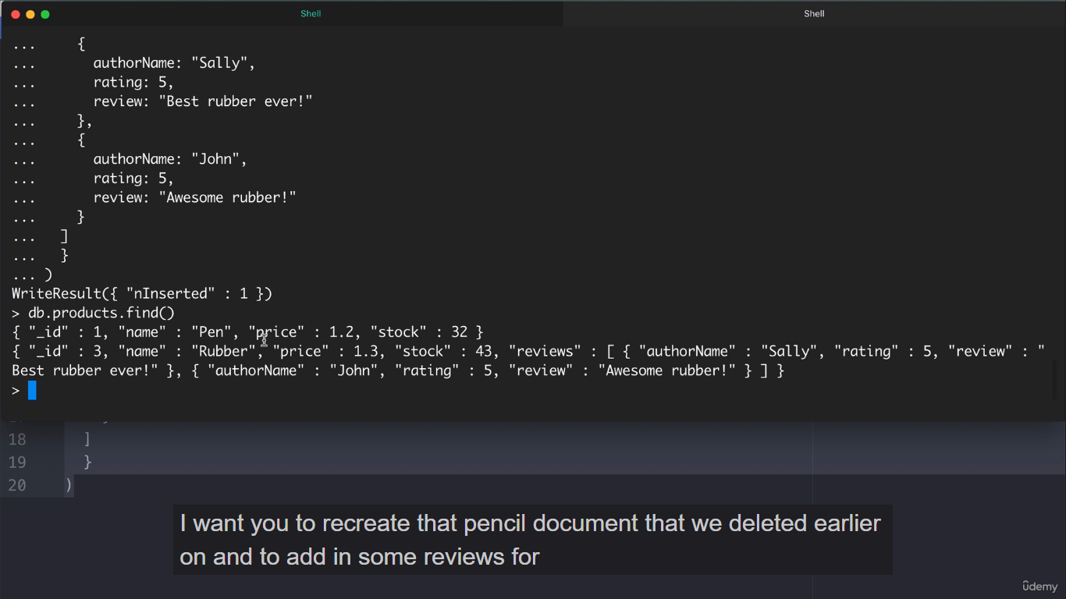
After adding a new products then seeing the result using find() method.

Slide 5
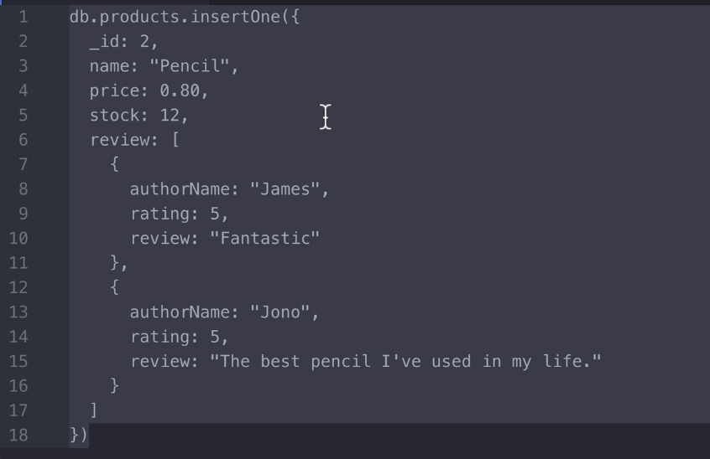
Like rubber product, add reviews to pencil product.

Slide 6
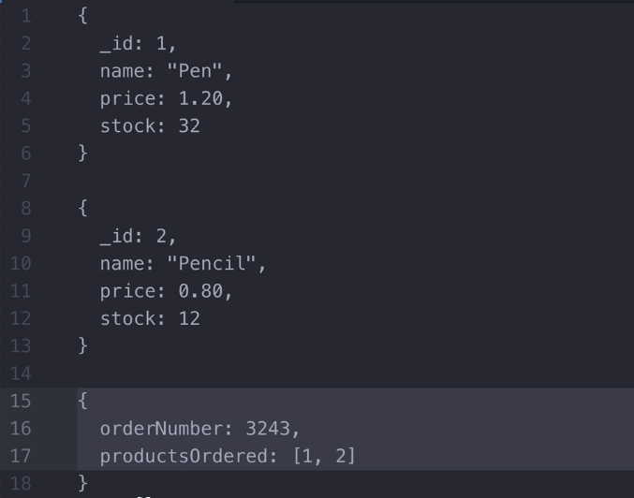

Slide 7
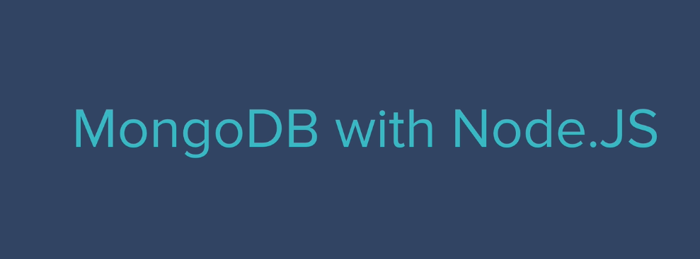

Slide 8
To connect our node application with Mongo DB using two way.
Native Driver
ODM- Mongoose

Slide 9
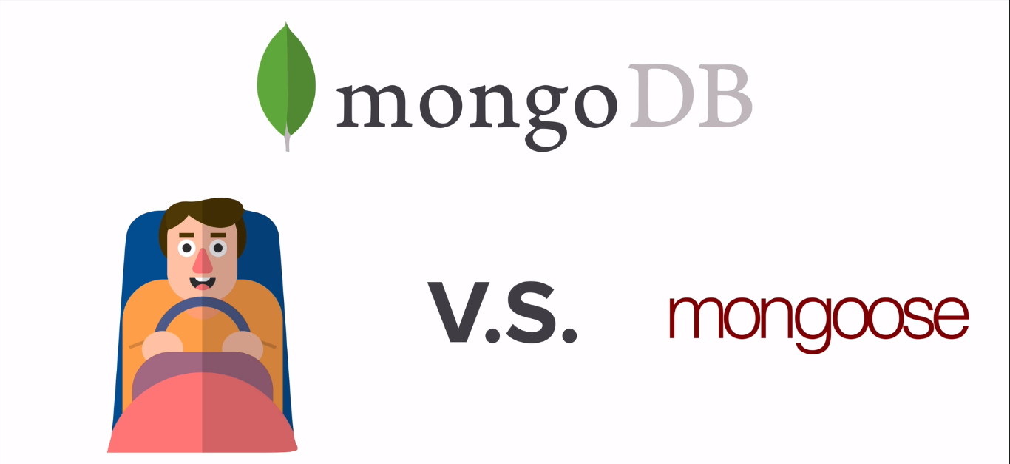

Slide 10
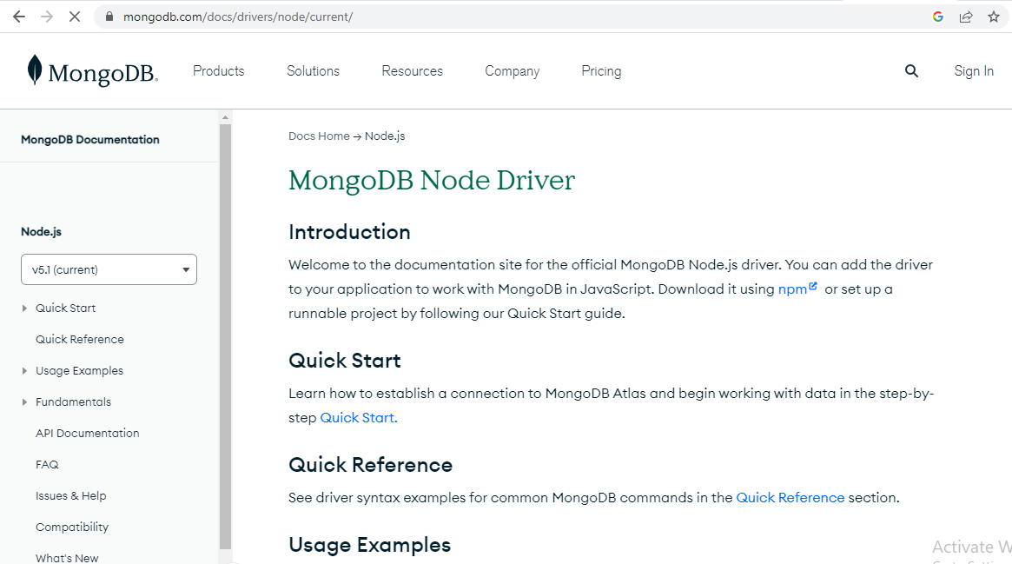

Slide 11
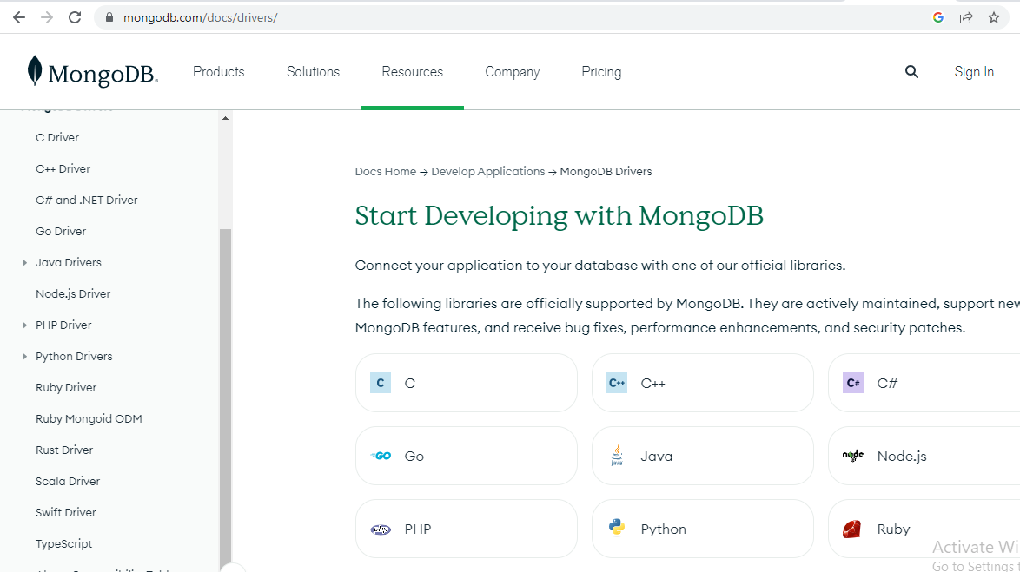

Slide 12
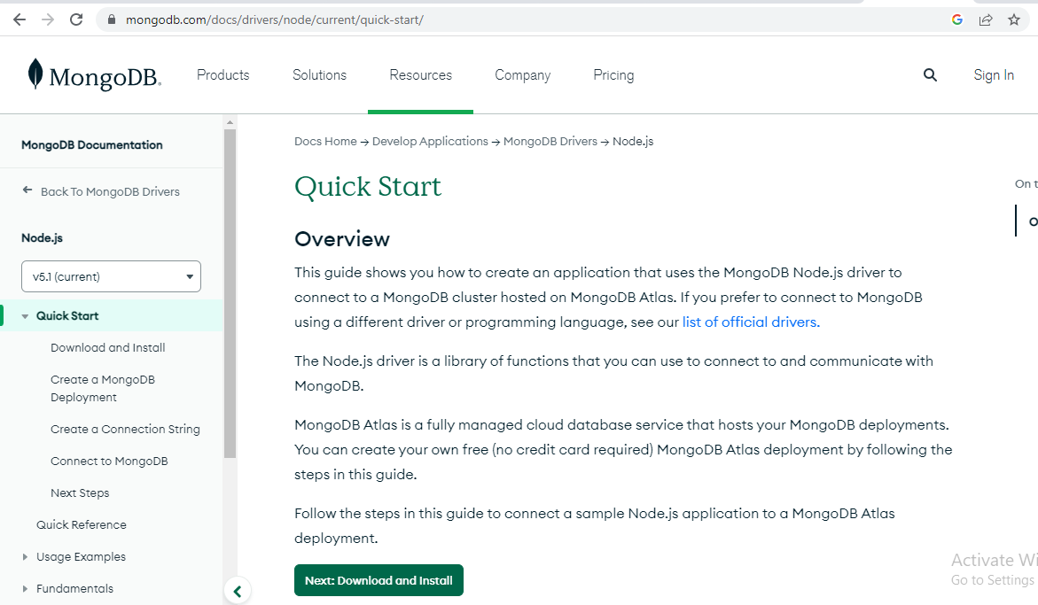

Slide 13
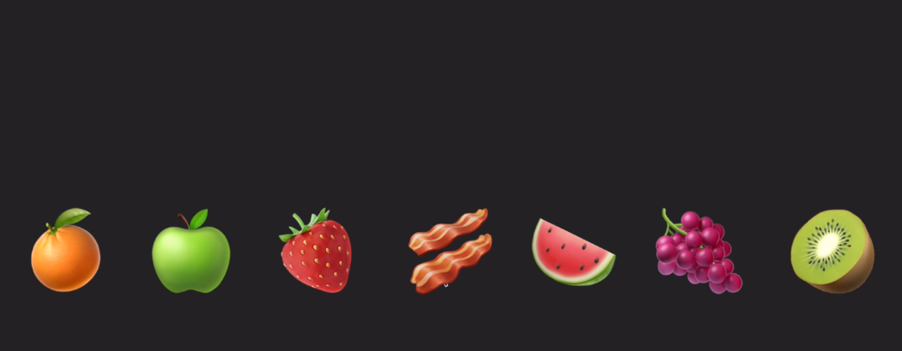
Create a Node Project called FruitsProject and fruits database

Slide 14
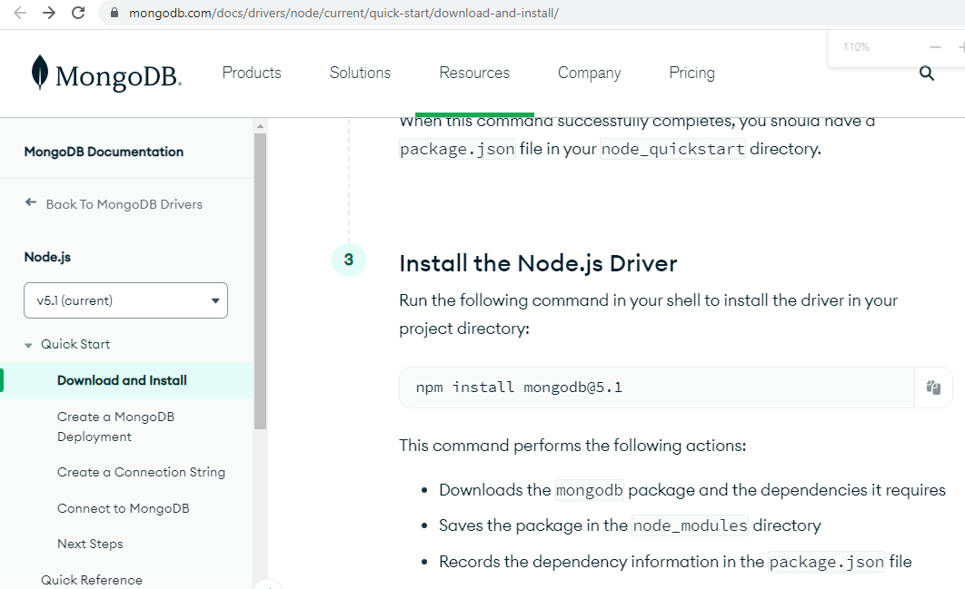
Add a package mongodb in your project FruitsProject using npm

Slide 15
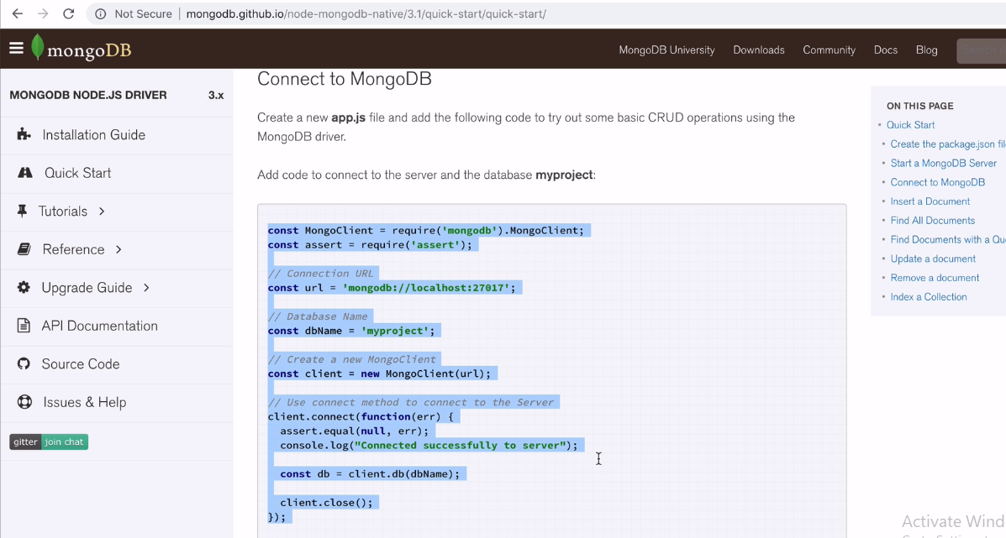

Slide 16
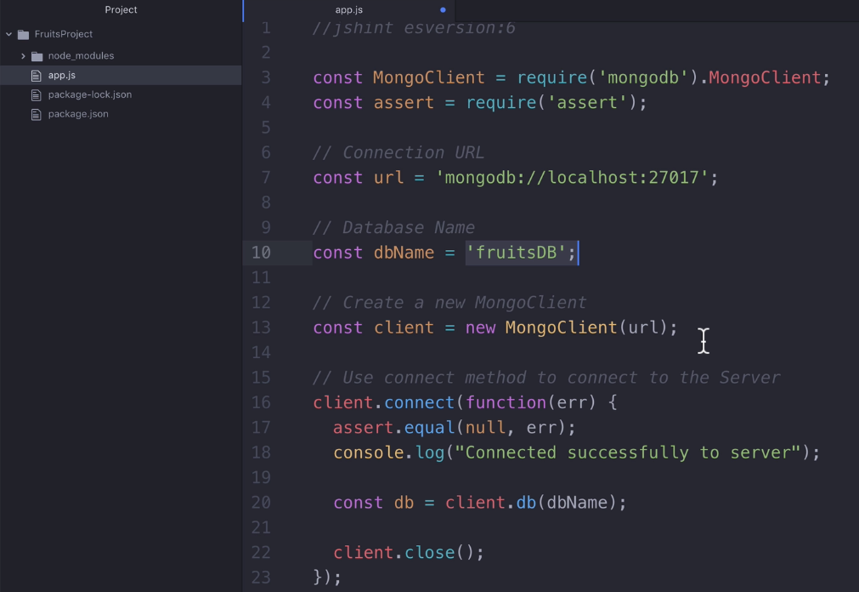
Create app.js file and run it – To connect mongoDB

Slide 17
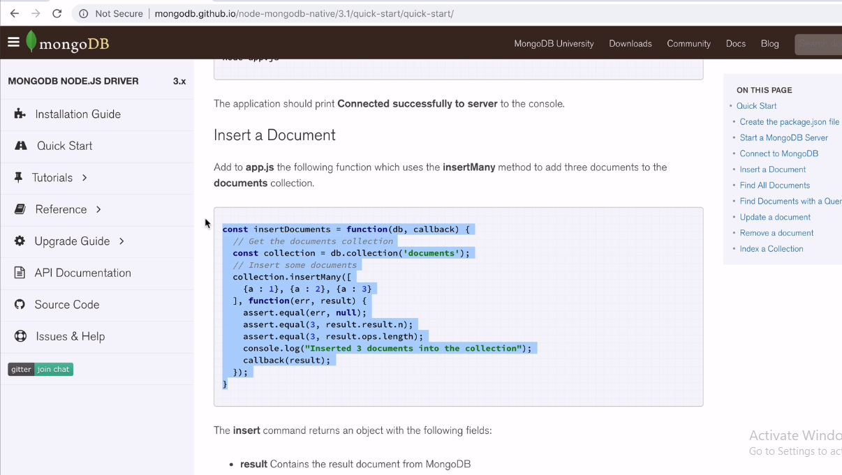

Slide 18
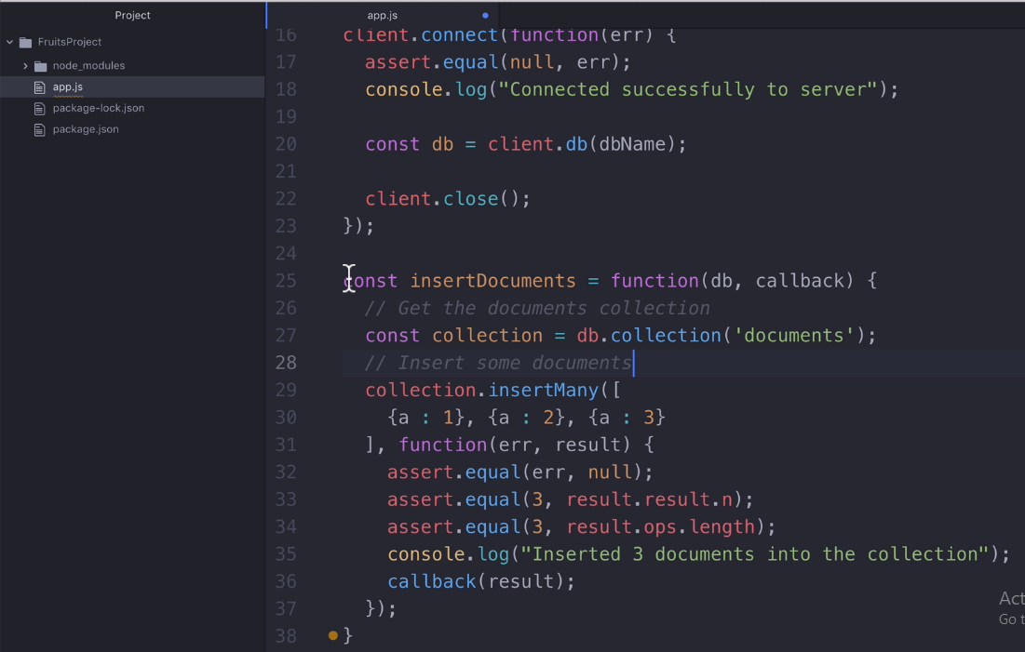
To insert a values in mongoDB

Slide 19
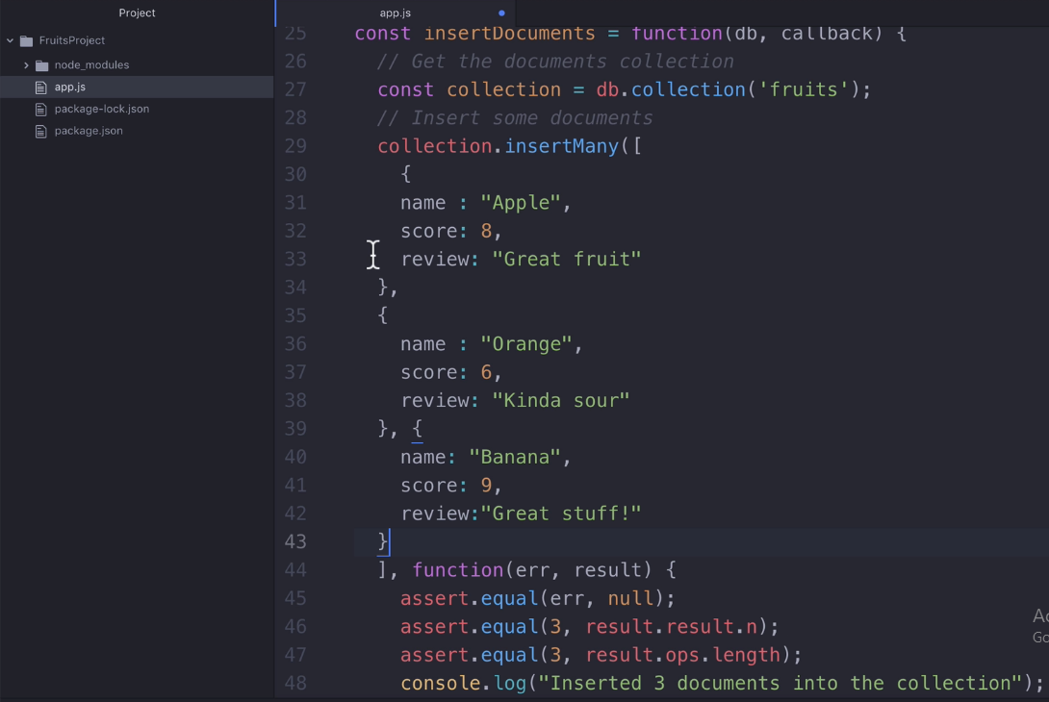
To insert a values of fruits at fruits collection in mongoDB

Slide 20
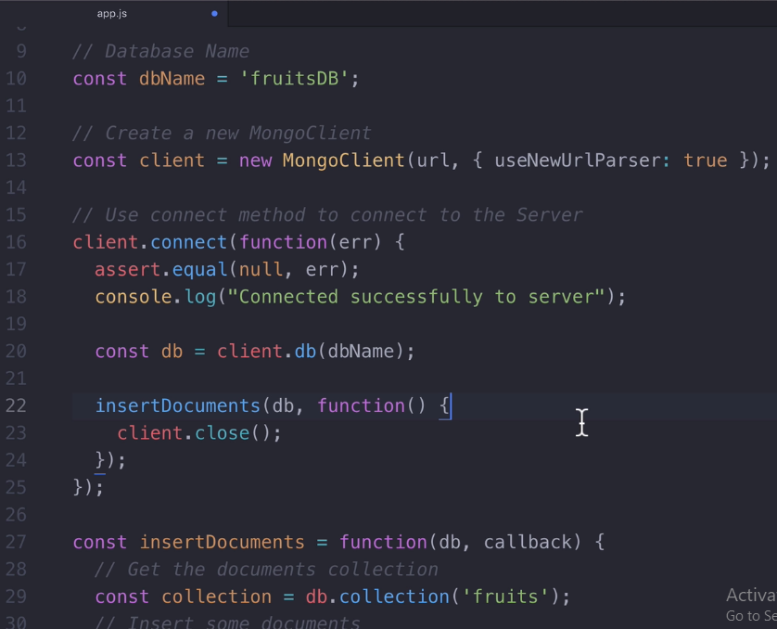
Do Wrap following code at line number 22

Slide 21
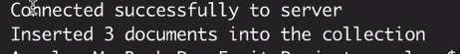
Output Message

Slide 22
Coding Activity- 2 MongoDB Native Driver -CRUD:
Complete and upload your project folder with output screen shots.
Refer https://www.geeksforgeeks.org/native-mongodb-driver-for-node-js/

