Slide 1
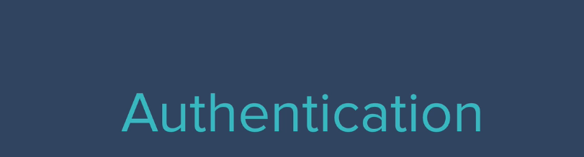

Slide 2

Using a key like password in E-Commerce
Application

Slide 3
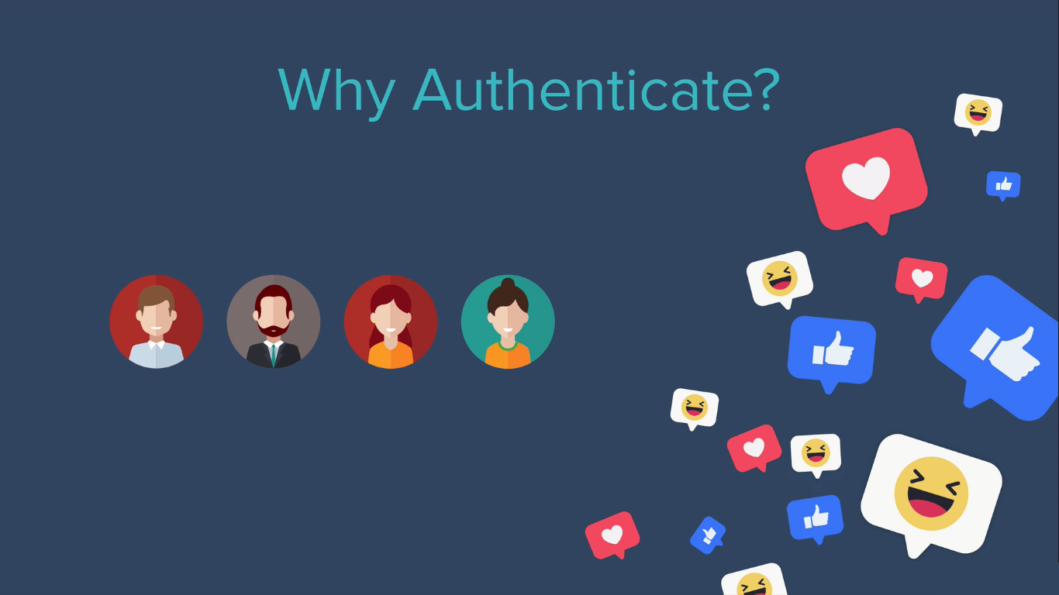

Slide 4
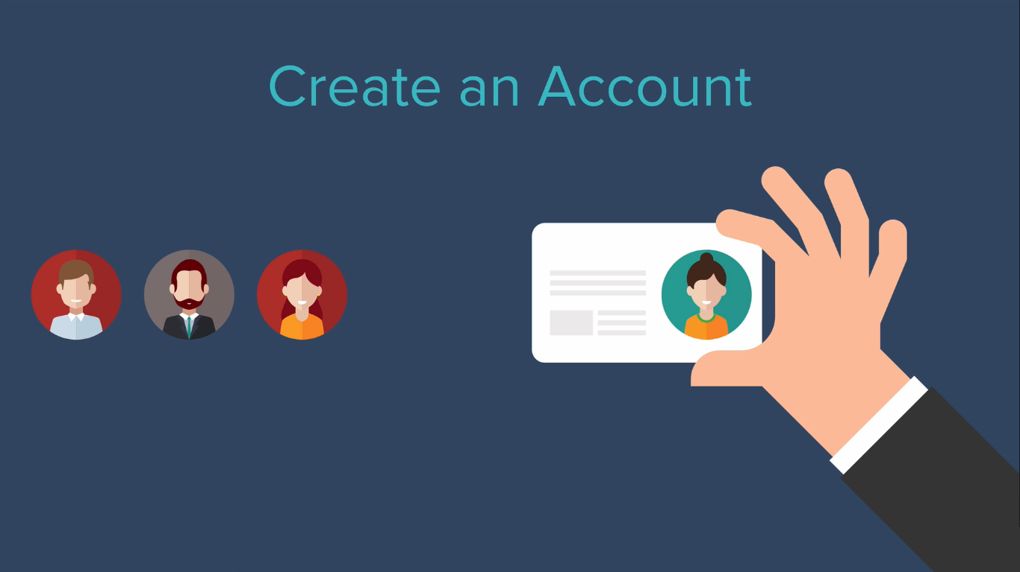

Slide 5


Slide 6


Slide 7
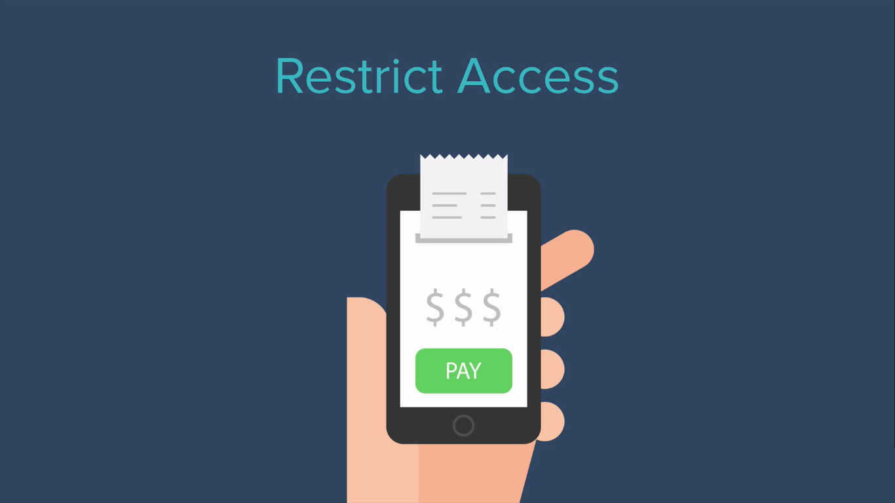
Example: Netflix Application, etc.,

Slide 8
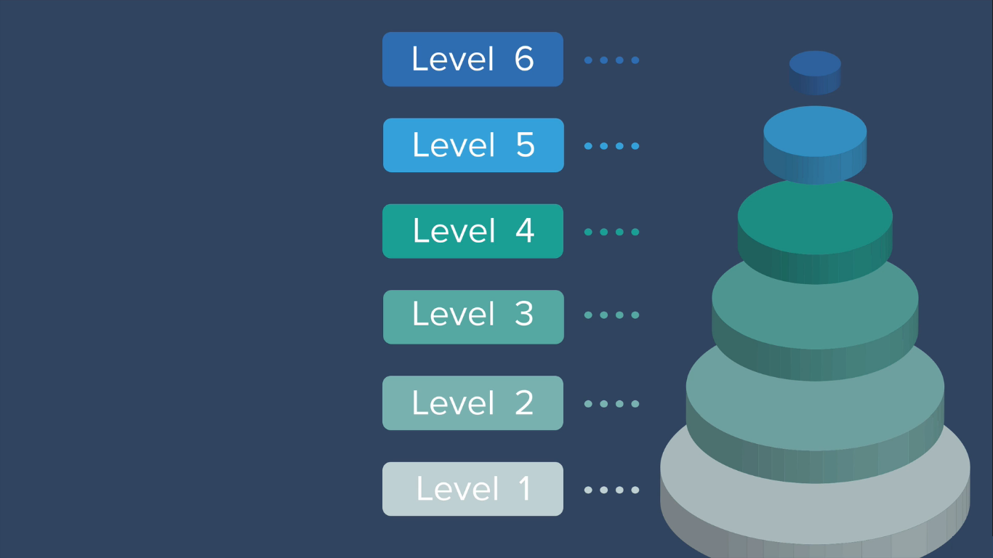
Different levels of Security

Slide 9
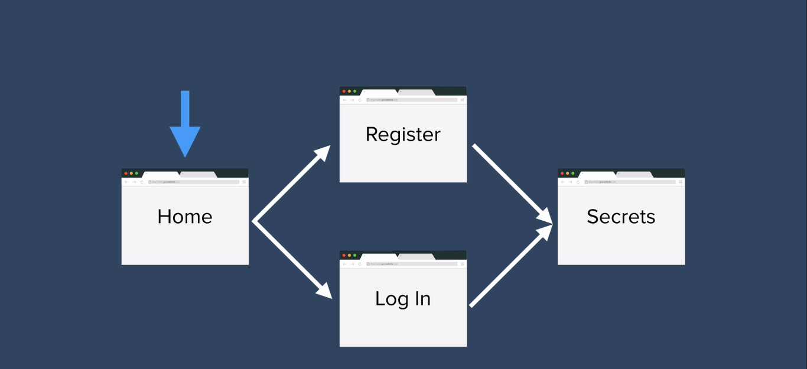
Example: Web Application Security Process Flow

Slide 10
Web Application Security Implementation

Slide 11
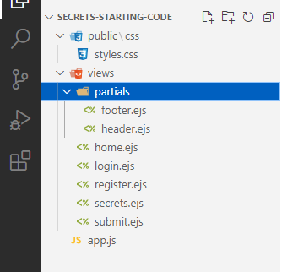
Download Example Application “Security-Starting-Code”

Slide 12
Execute Following Commands on your project at
Hyper terminal Window:
npm init –y → To create package.json
npm i express ejs body-parser → To install required packages

Slide 13
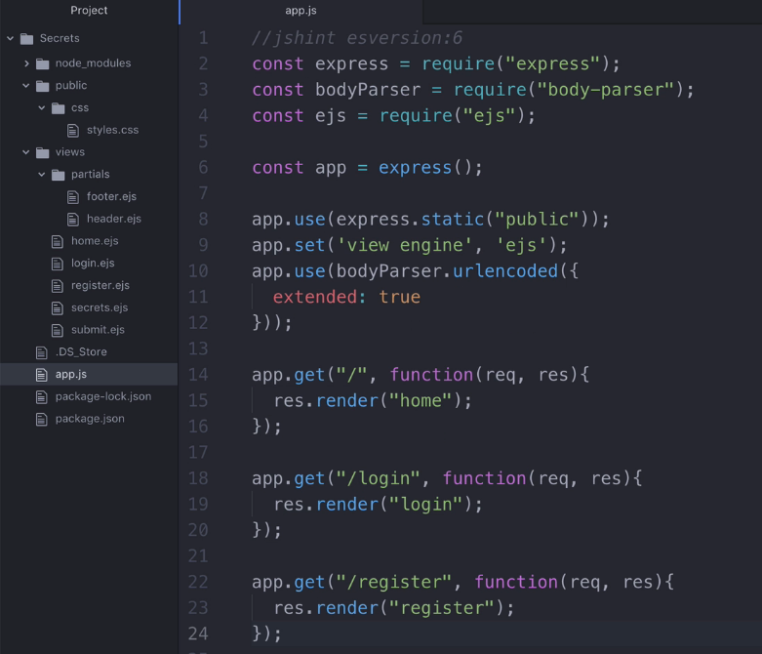
Adding following
Code at app.js to check routes
Default(Home),
Login
And
Register

Slide 14
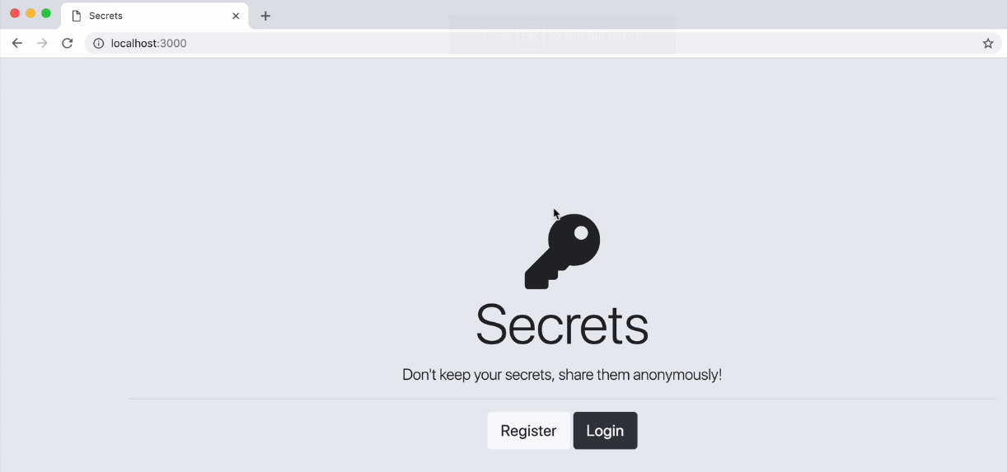
Accessing home route

Slide 15
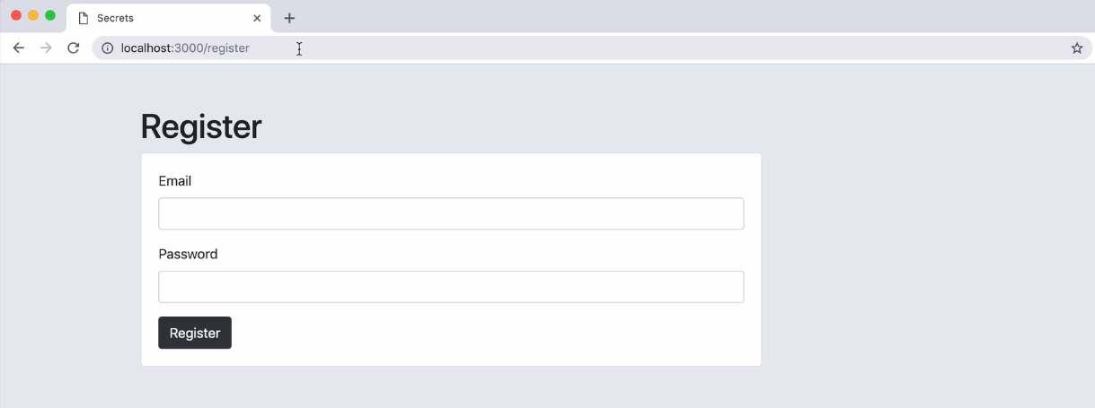
Accessing register route

Slide 16
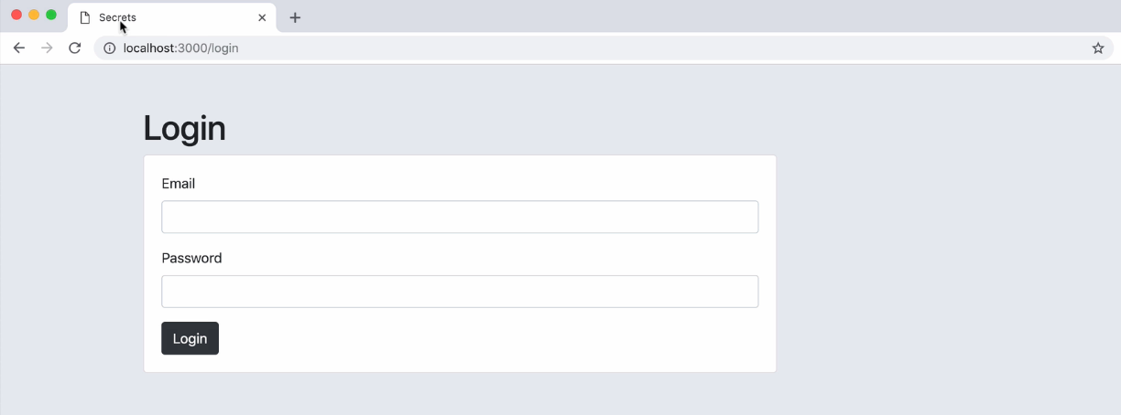
Accessing login route

Slide 17
Coding Activity: Setting up Secrets Projects with
All required routes like home, register, and login.
Checking whether all routes are working properly or not when
Specifying respective route name like
localhost:3000/ → Home Page
localhost:3000/register → Register Page
loginhost:3000/login → Login Page

