Slide 1
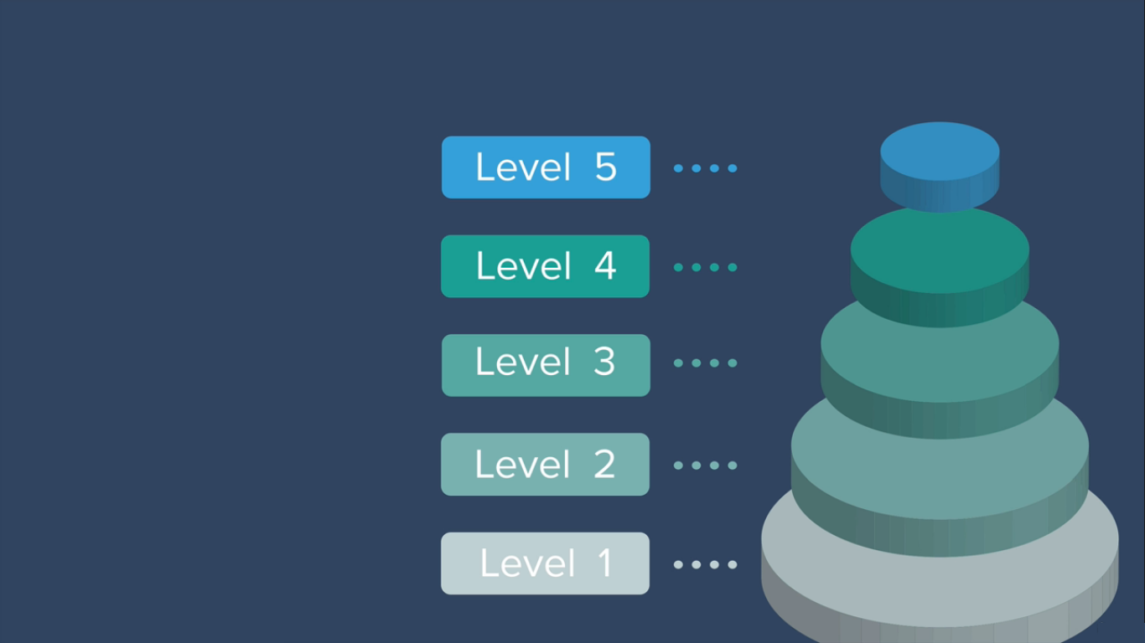
Level Up Security in Web Application

Slide 2

Cookies & Sessions

Slide 3

E-Commerce Application stores user information as cookie.

Slide 4
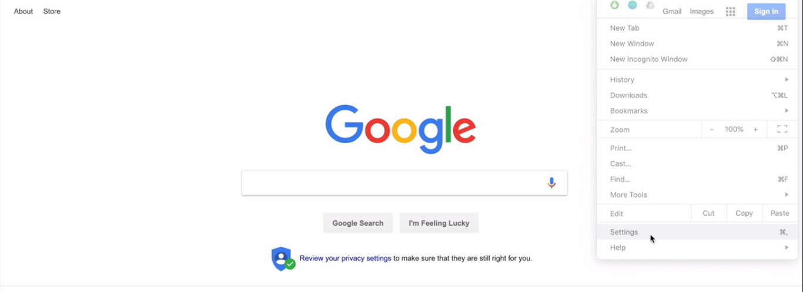
We can check it at browser settings page

Slide 5
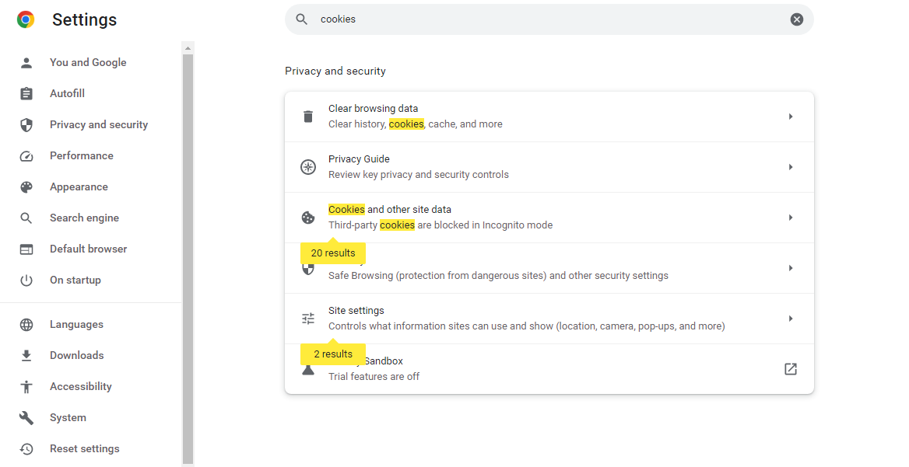
We can find cookies , Because many websites are creating
Cookies and storing user information at browser itself.

Slide 6
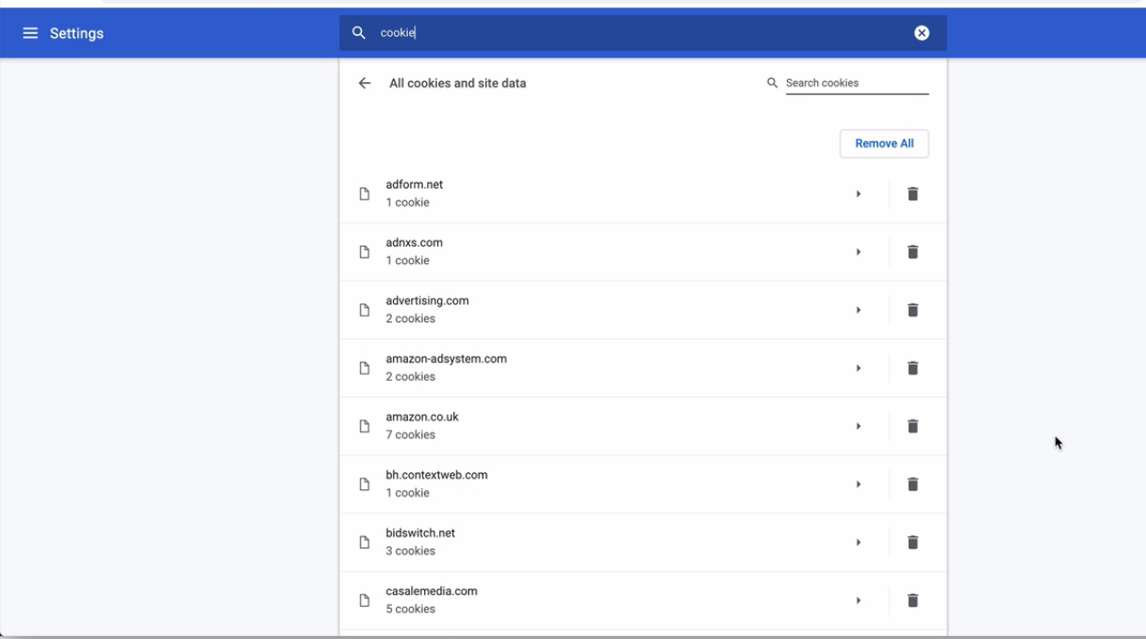

Slide 7
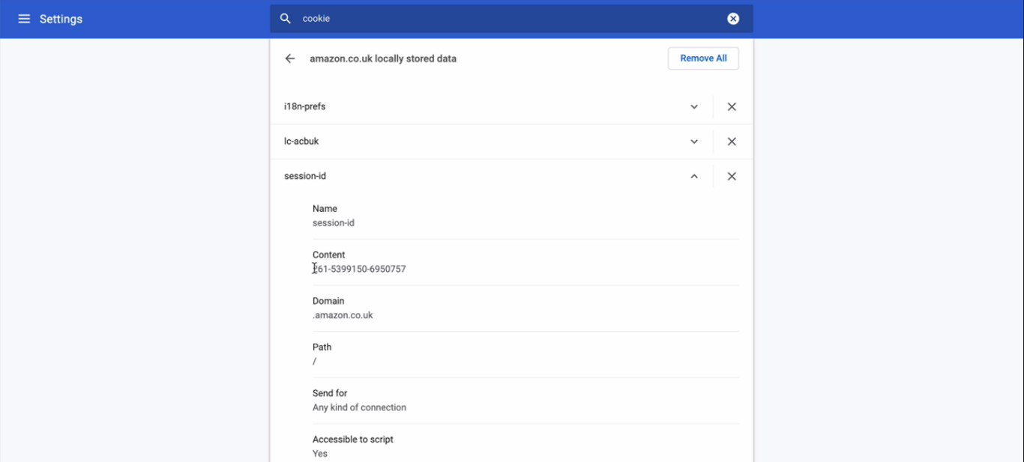

Slide 8
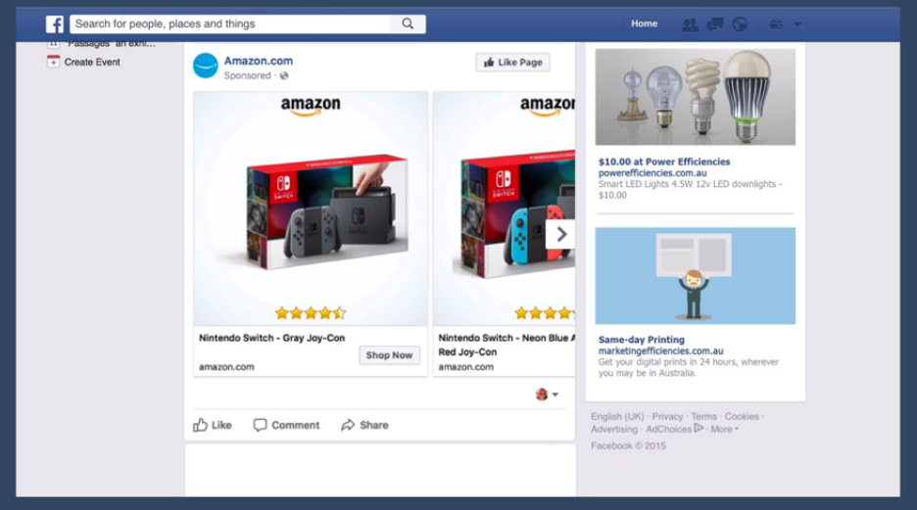
And E-Commerce Applications are using cookies to create Ads.

Slide 9
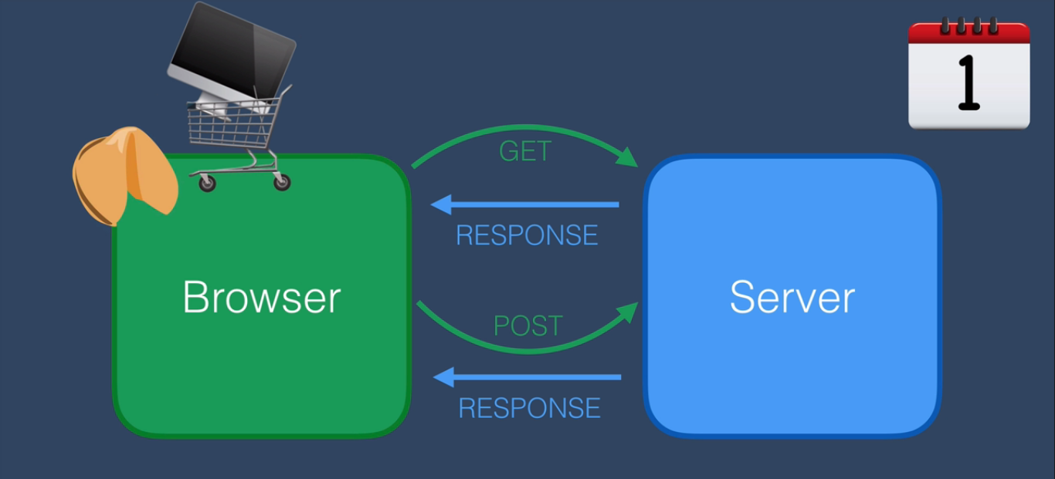
Cookies Working Principle in Web Applications.

Slide 10
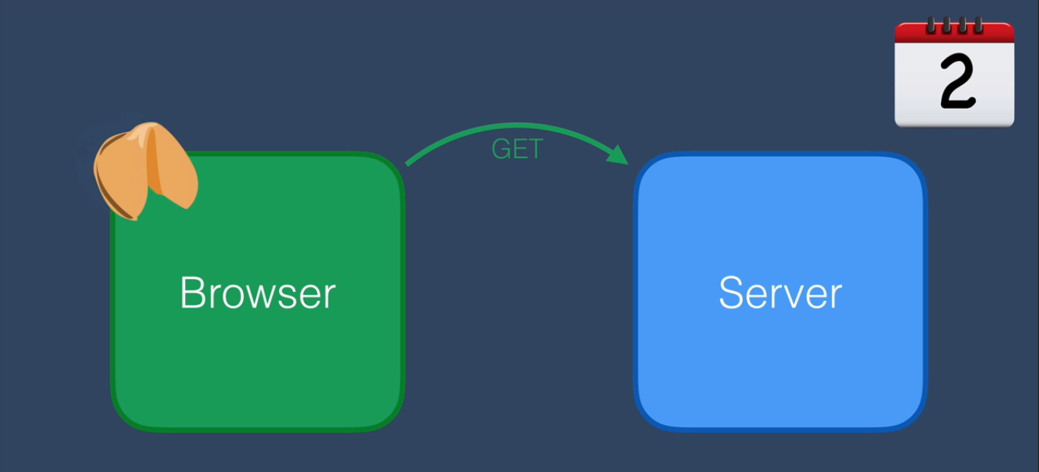
Cookies Working Principle in Web Applications.

Slide 11
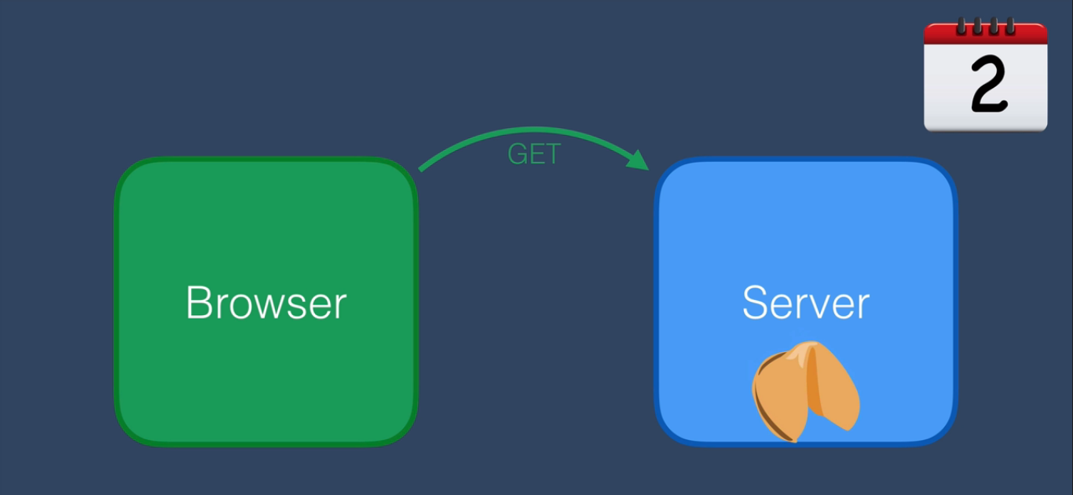
Cookies Working Principle in Web Applications.

Slide 12
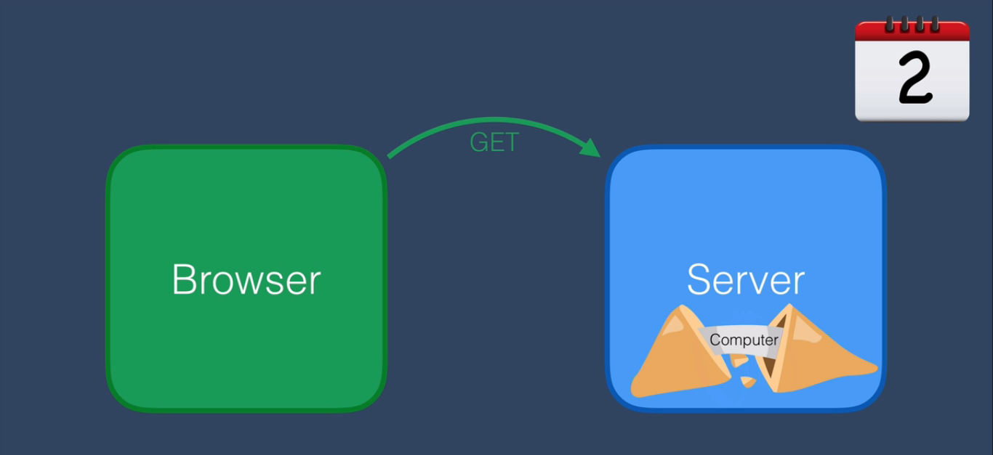
Cookies Working Principle in Web Applications.

Slide 13
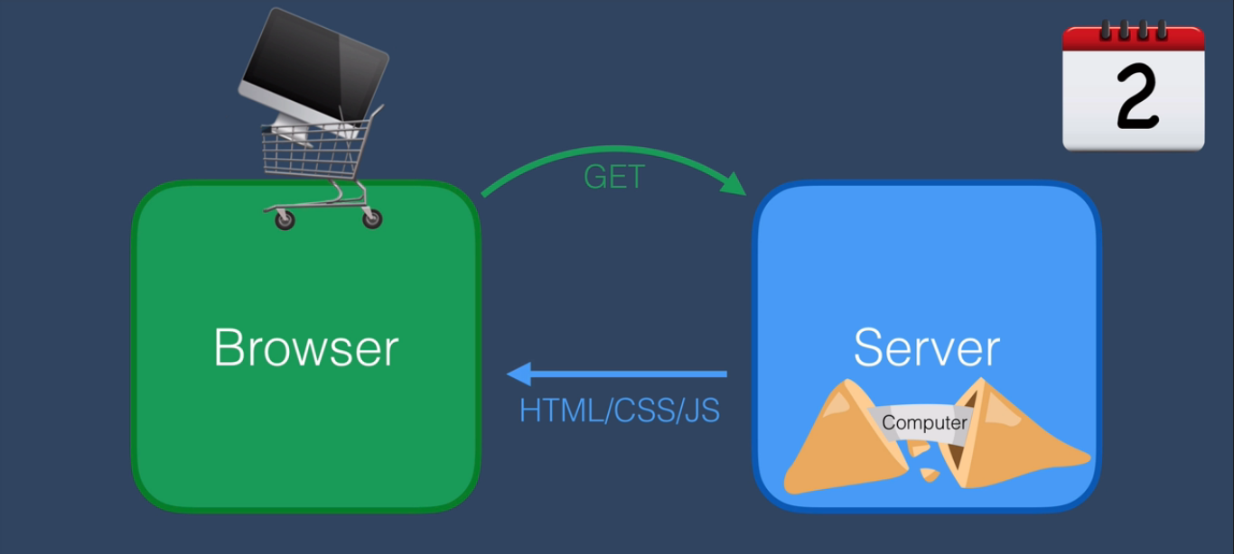
Cookies Working Principle in Web Applications.

Slide 14
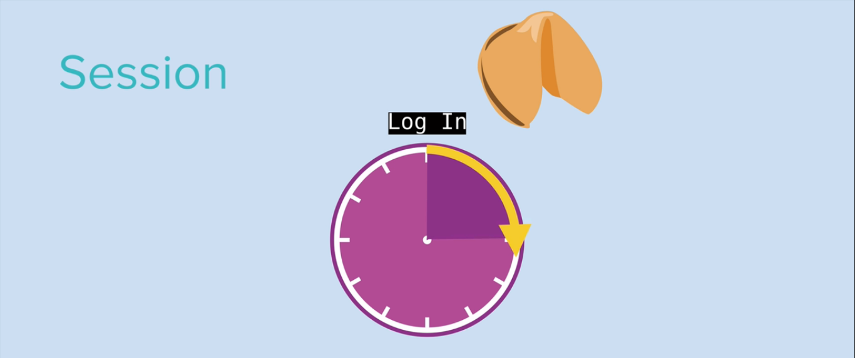
Session & Cookies Working Principle in Web Applications.

Slide 15
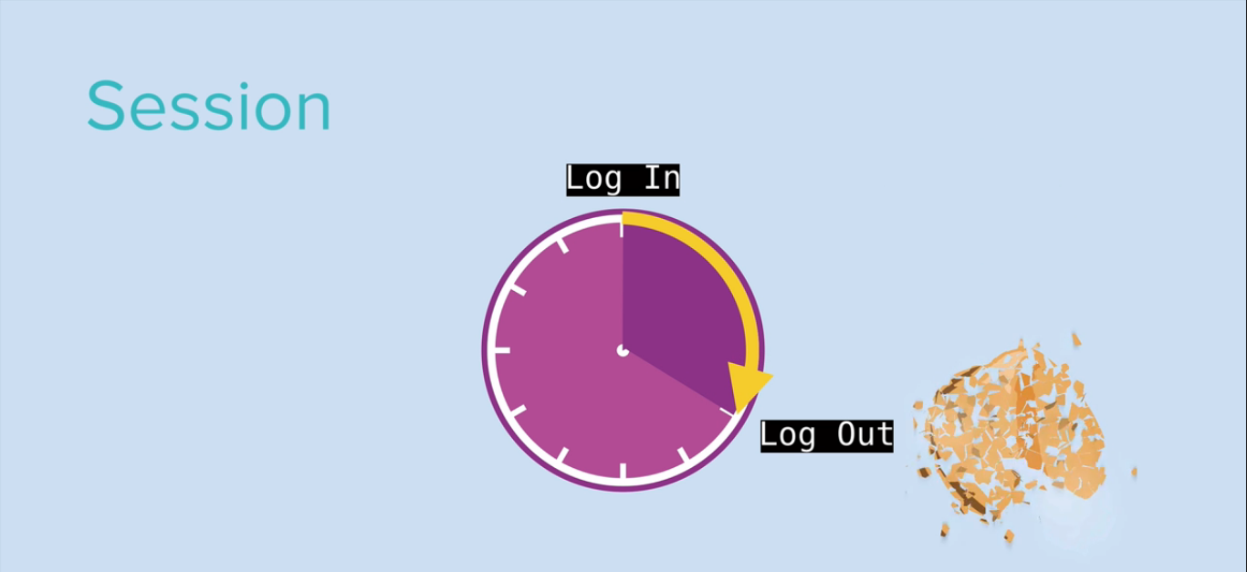
Session & Cookies Working Principle in Web Applications.

Slide 16
