Slide 1
When we store our codes either on GitHub or AWS or any cloud Platform then encryption key / secrets / API Keys
can be searchable / crawled by Google or any search engine.
An environment variables are basically a very simple file that we are going to keep certain sensitive variables such as encryption keys and API Keys.

Slide 2
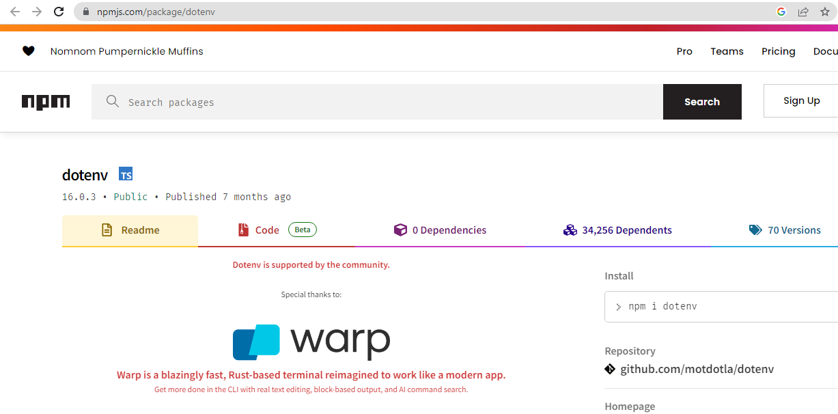
npm install dotenv --save

Slide 3
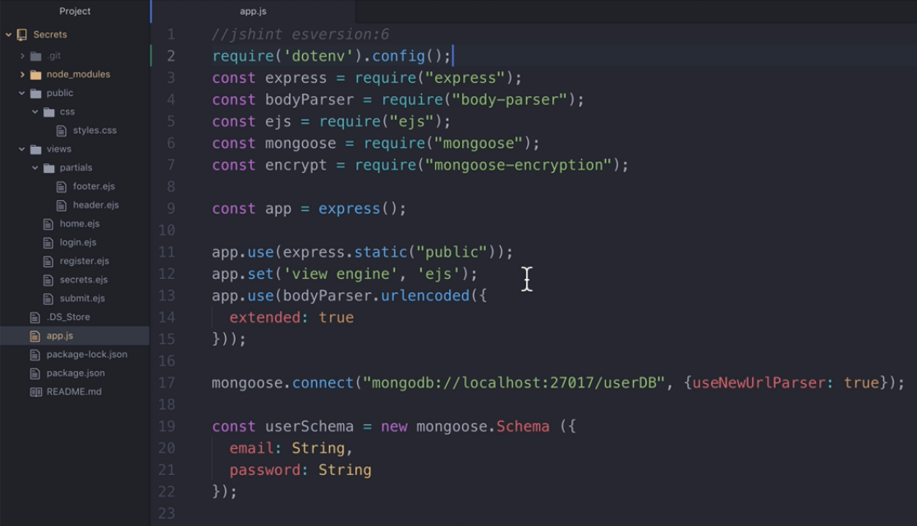
Adding dotenv package at top of all other package

Slide 4
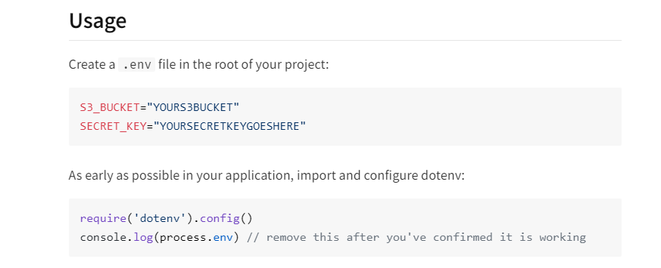

Slide 5
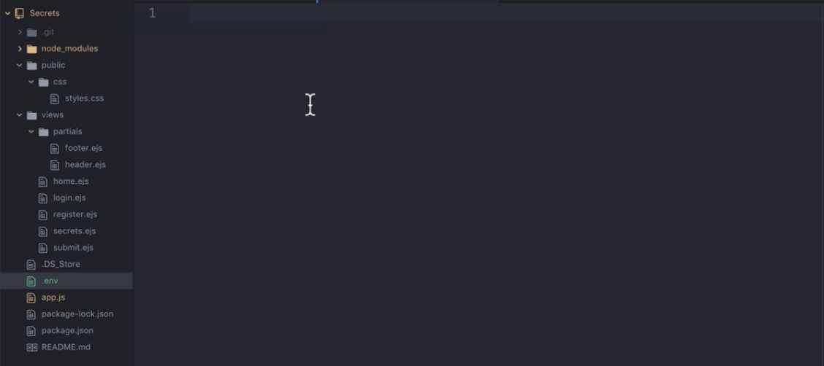
After Creating a dotenv file at the root directory, then
We have to add some secrets inside dotenv file.

Slide 6
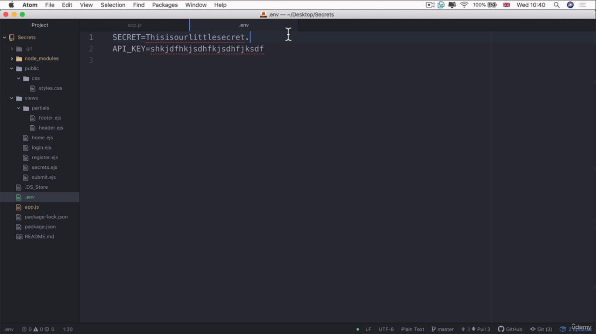
adding some secrets inside dotenv file in the format
NAME = VALUE , So no semicolon or comma at the end of each line.

Slide 7
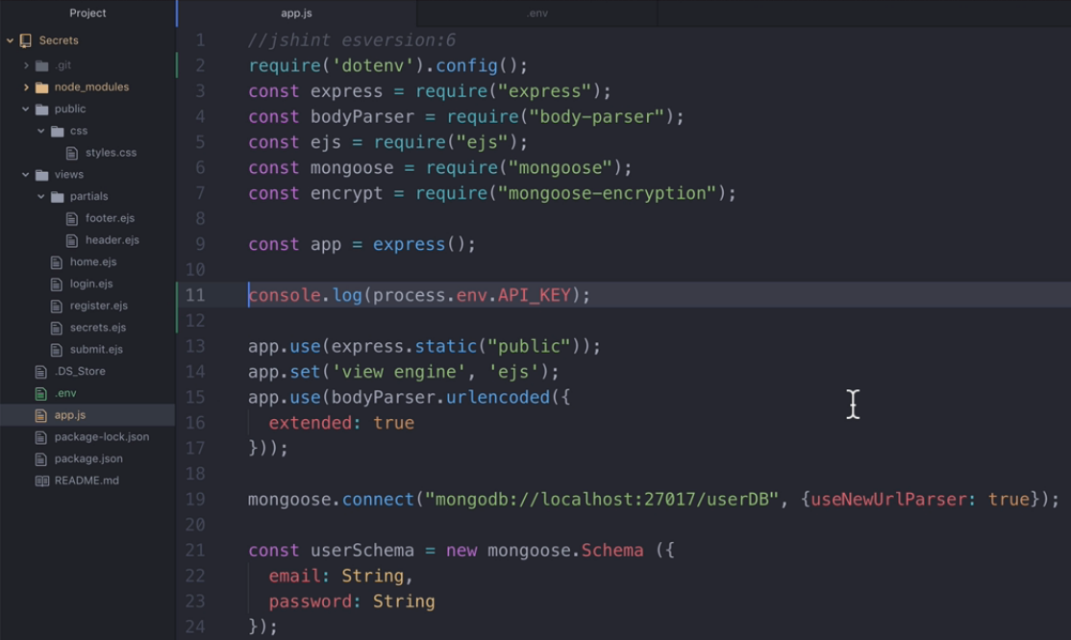
Getting values from dotenv file.

Slide 8
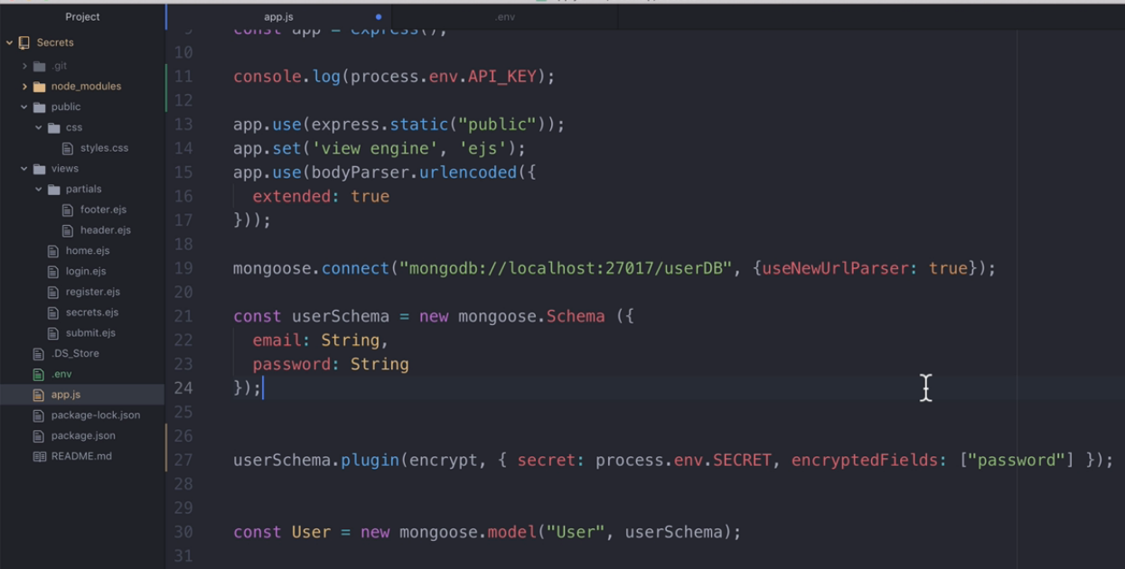
Getting values from dotenv file – assigning into secret key.

Slide 9
Important:
Dotenv file should not be committed when we do
Github commit command.

Slide 10
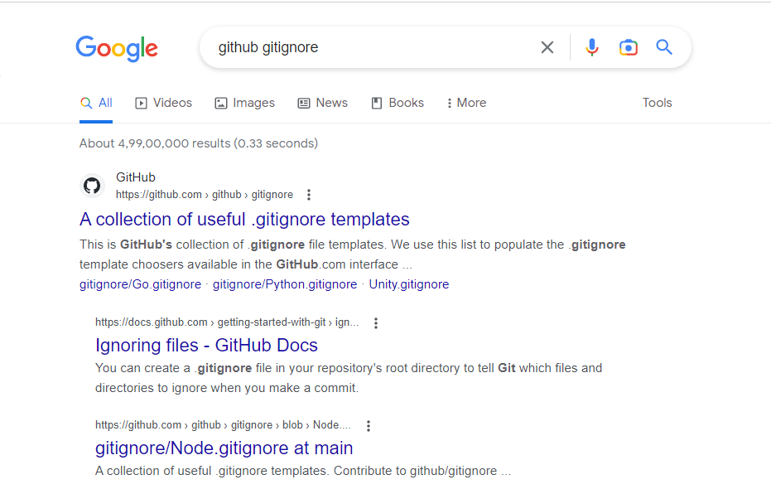
To know about dotenv file then search it in Google.

Slide 11
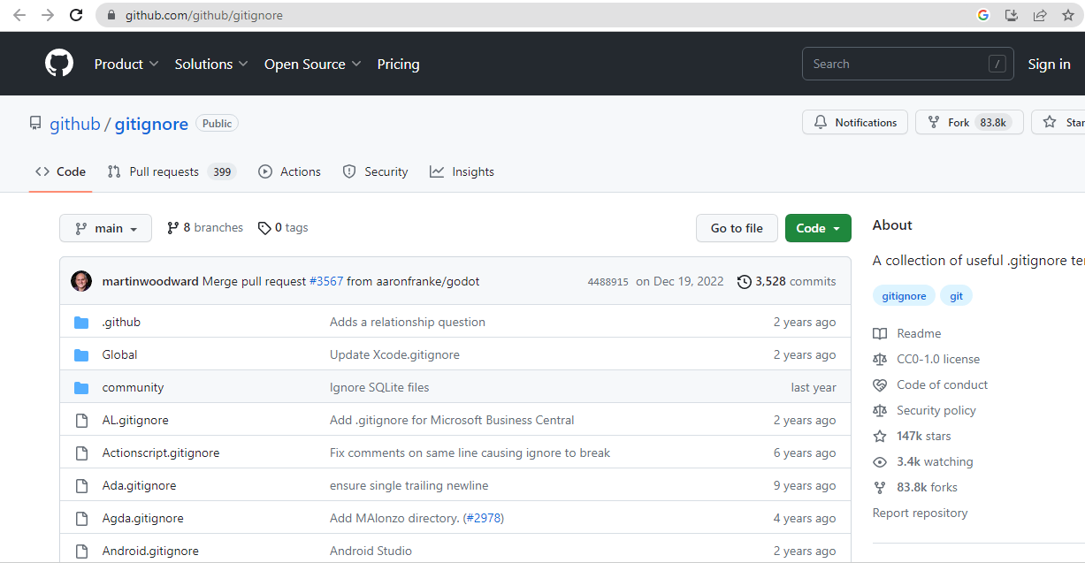
GitHub Page of dotenv file, here explore and find node .gitignore.

Slide 12
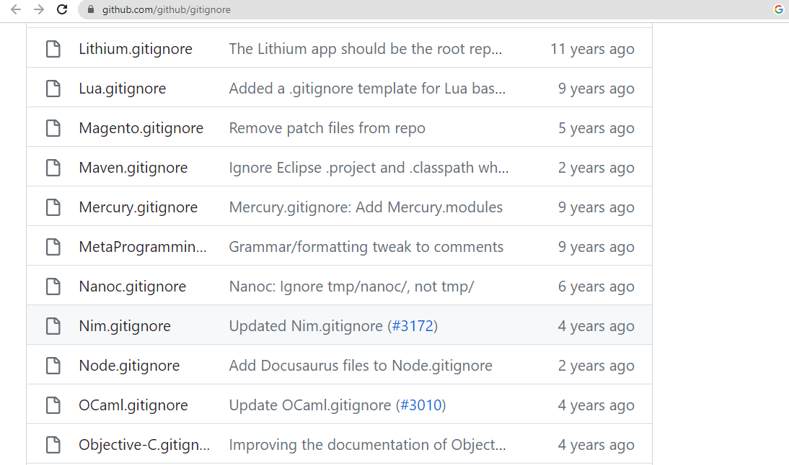
To know about Node.ignore then click the link.

Slide 13
Important:
Create .gitignore file at the top of the root directory like
Dotenv file.
Copy Node.gitignore file content and paste in
Local .gitignore file.

Slide 14
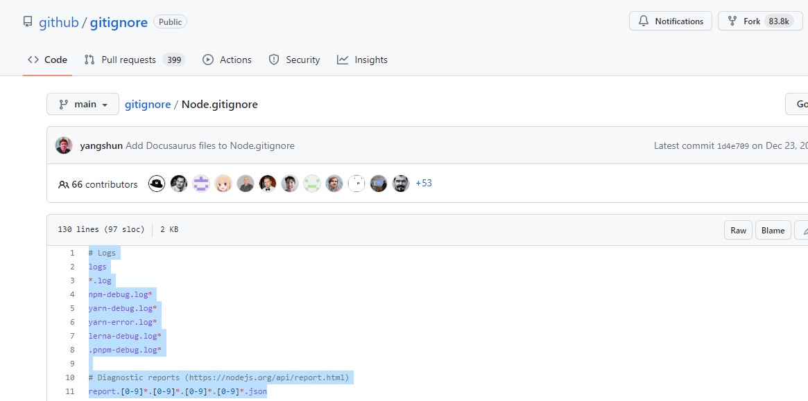
Copy Node.gitignore file content

Slide 15
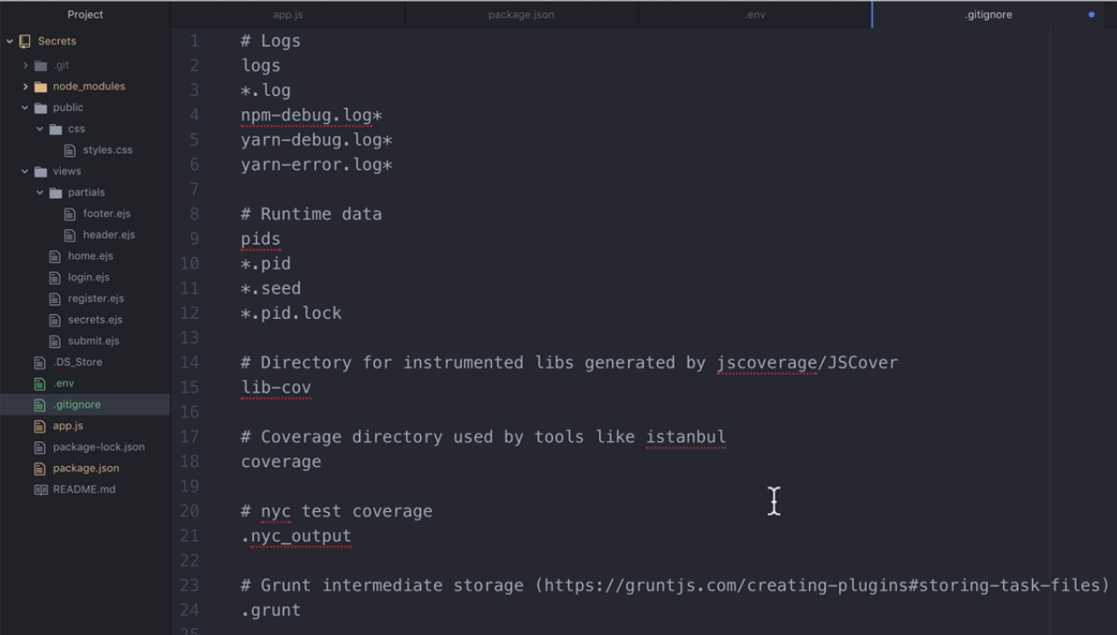
Paste at .gitignore file in our project folder.

Slide 16
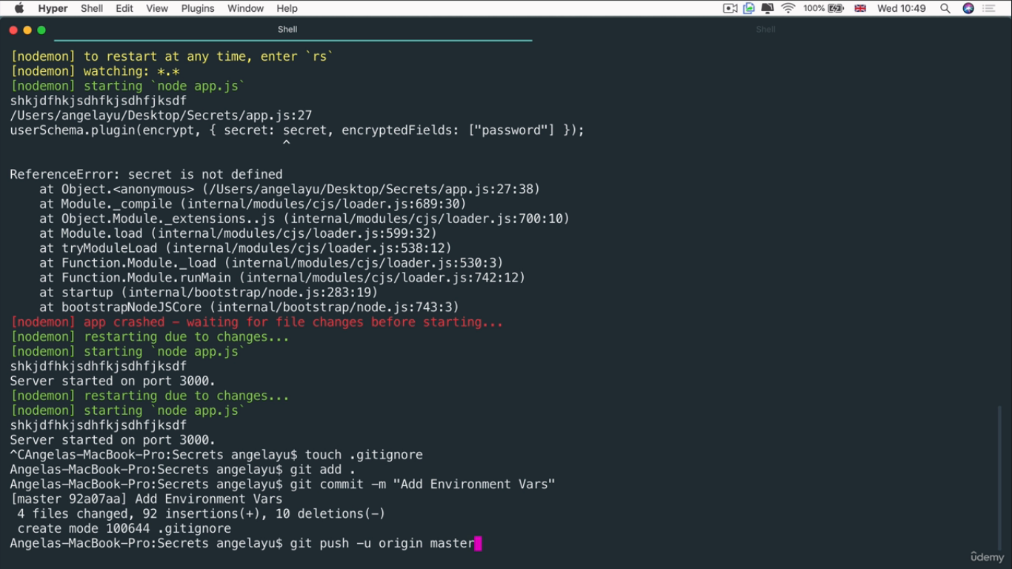
Open Command Prompt and go to your project folder.
Type following commands one by one to commit project.
(It means saving your recent code changes in GitHub.)

Slide 17
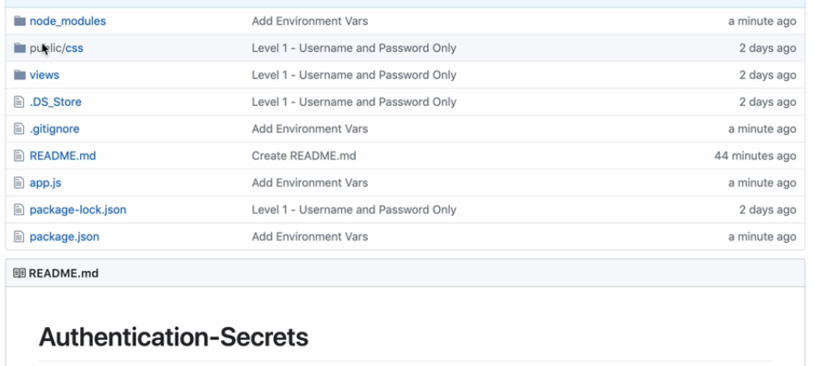
Checking at GitHub, whether dotenv & node modules are
added or not added.

Slide 18
Important:
We should use dotenv file in the beginning of project
Creation. Because if we create in between then earlier
Versions of our project commits may have visibility of secrets like encryption key / API Keys.

