Slide 1
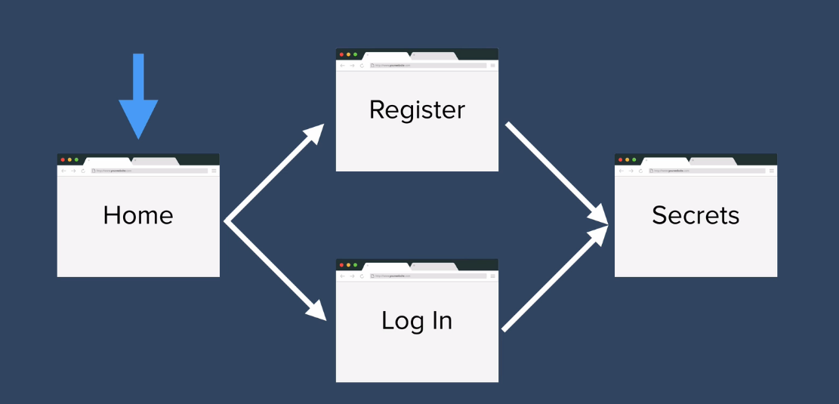
Implementing Level-1 Authentication by creating username and password.

Slide 2
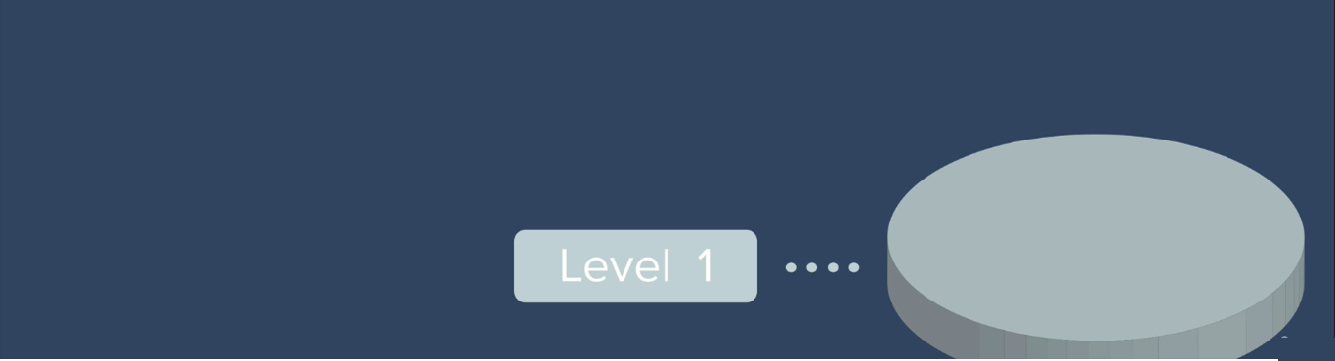

Slide 3
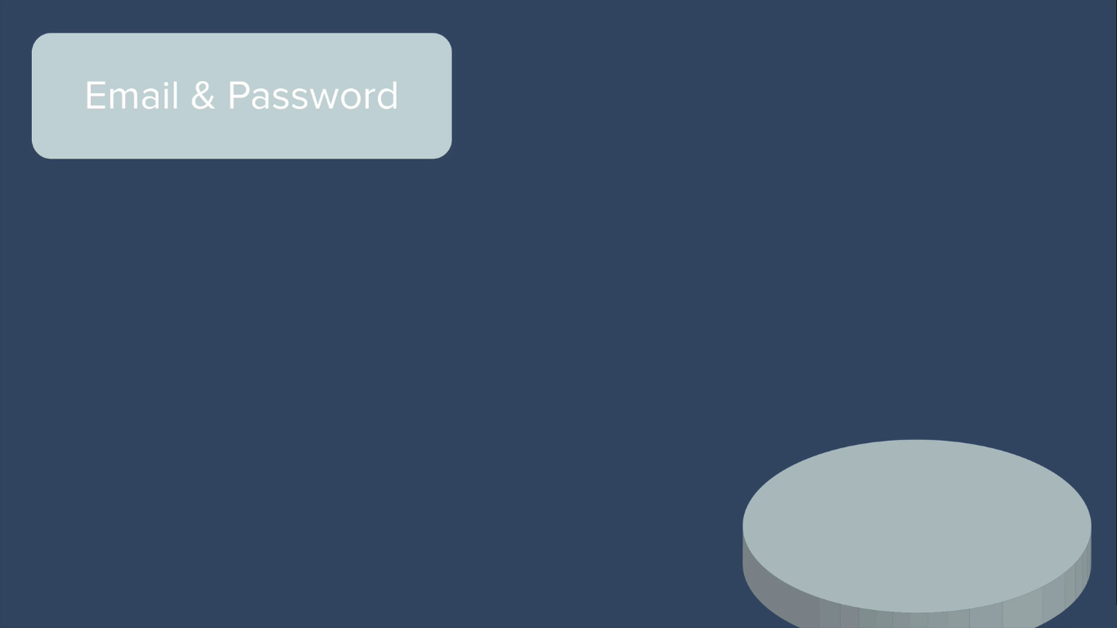

Slide 4
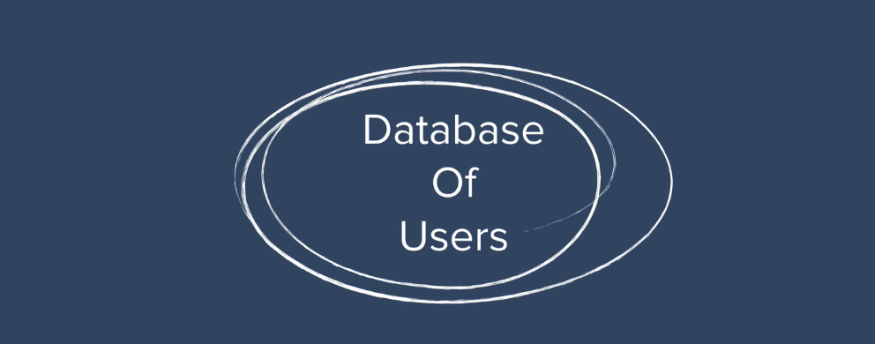

Slide 5
Install mongoose in our secrets project using npm i mongoose command.
Start mongodb server by using a command mongod at command prompt.
Then add mongoose package at app.js and connect
mongo db via connect method.

Slide 6
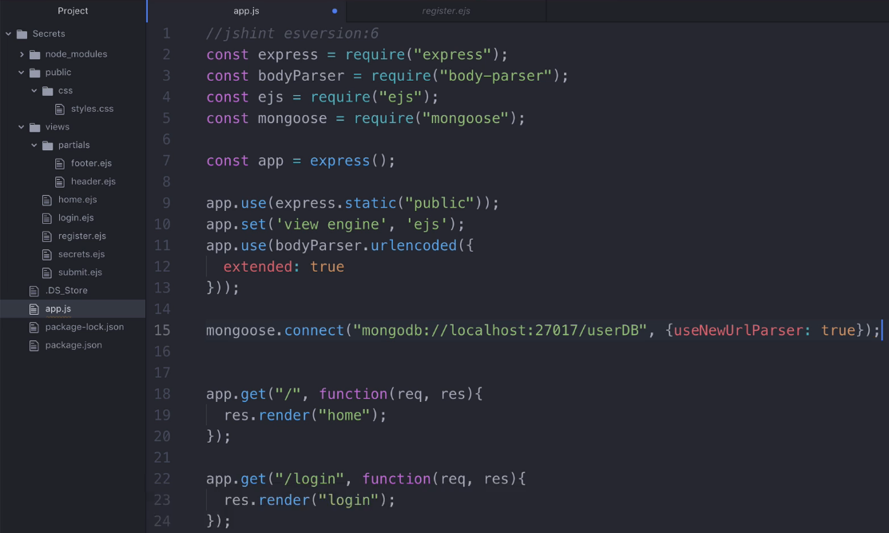
app.js file

Slide 7
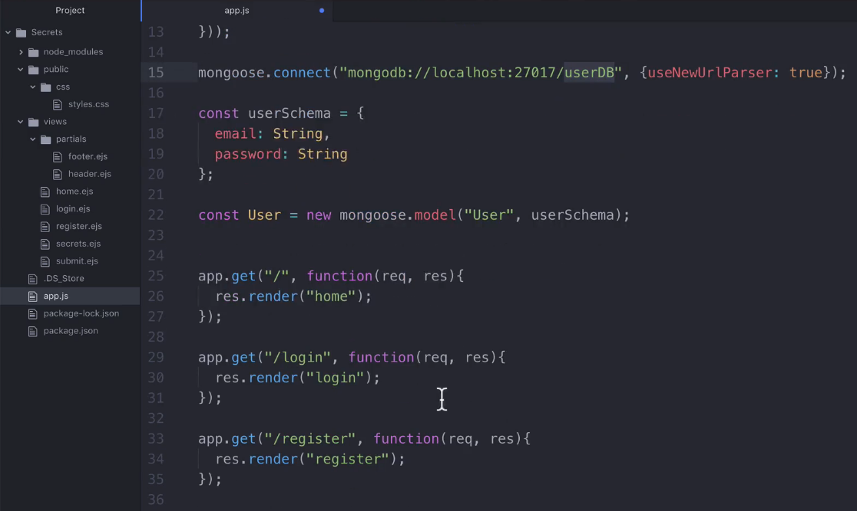
app.js file : Creating a user schema and collection.

Slide 8
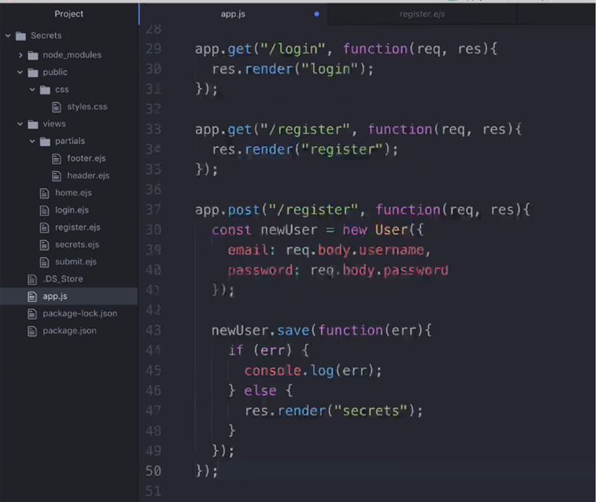
app.js file : Creating a post route register and getting username and password

Slide 9
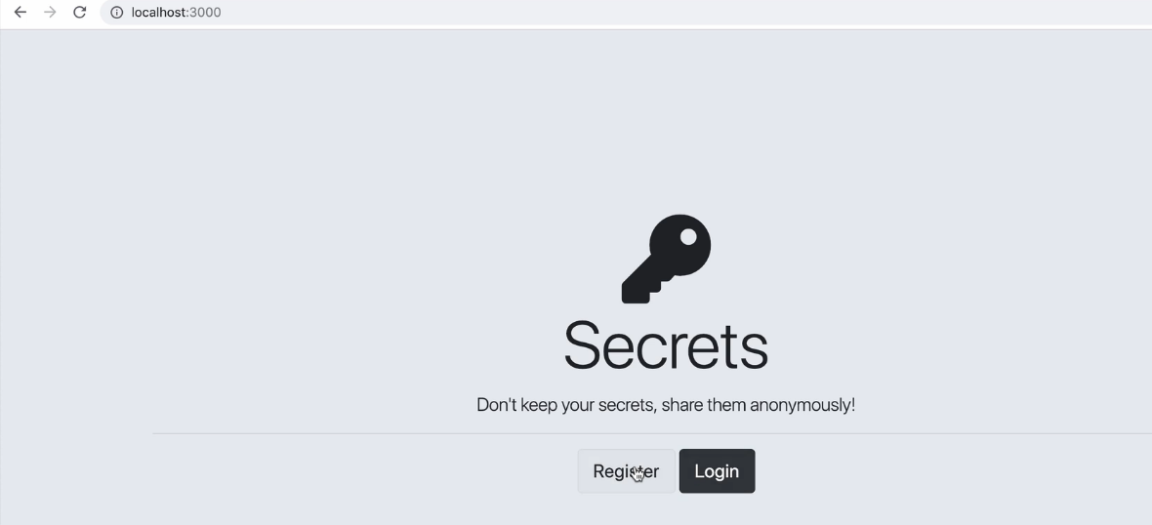
Accessing home route

Slide 10
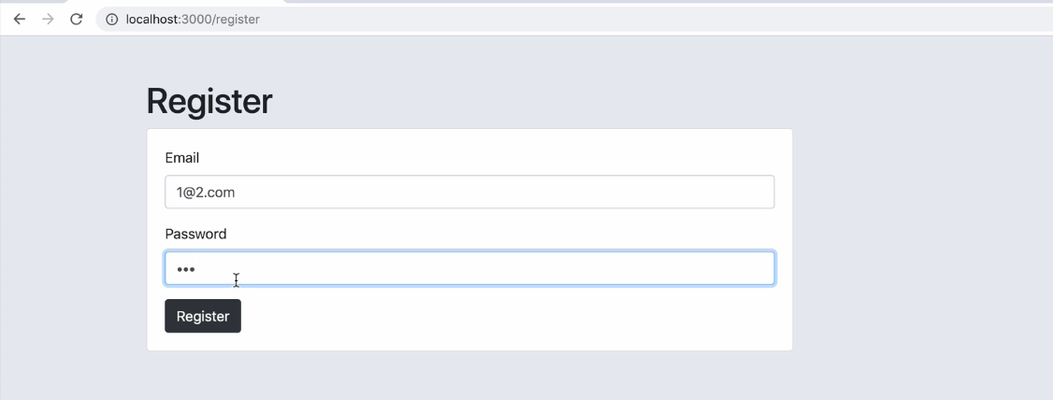
Accessing register post route: Creating new user and password

Slide 11
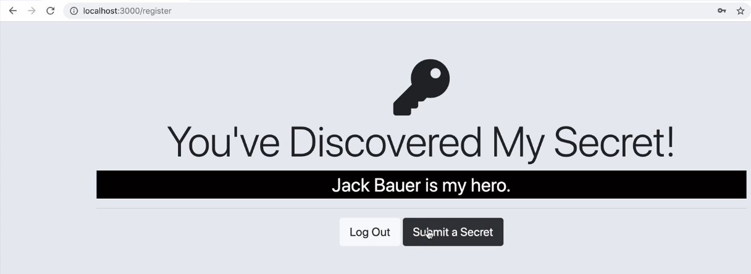
Rendering Secrets Page: After Creating new user and password

Slide 12
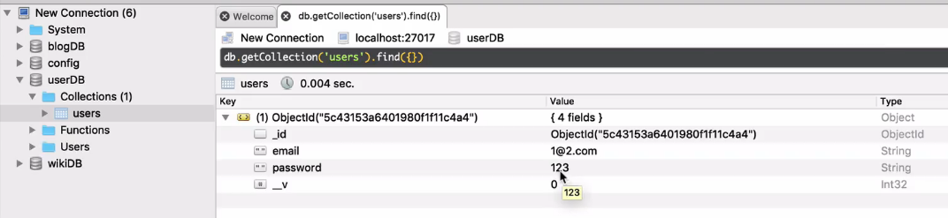
Checking at mongo DB: After Creating new user and password

Slide 13
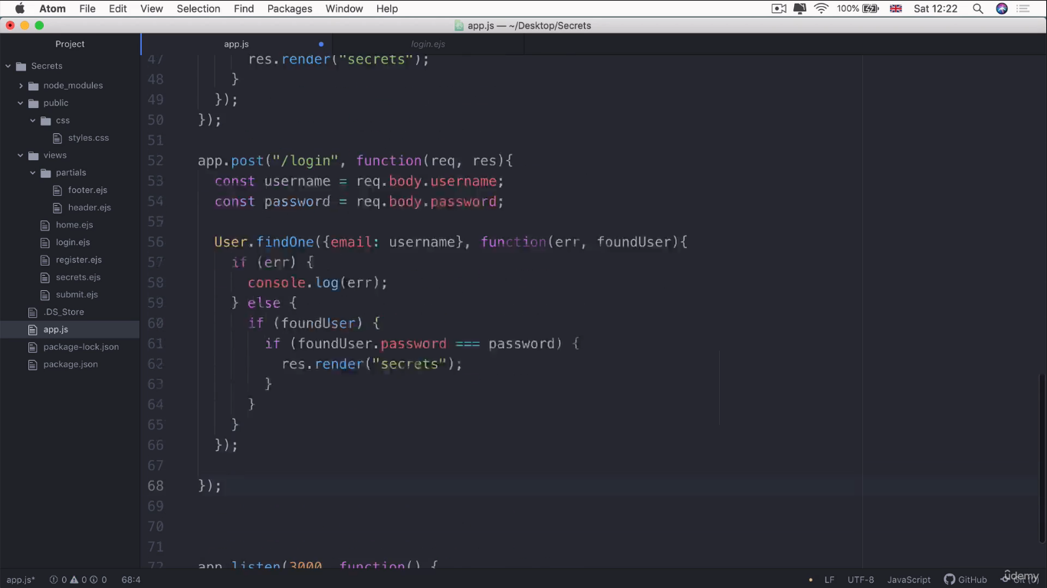
app.js file : Creating a post route login and check username and password.

Slide 14
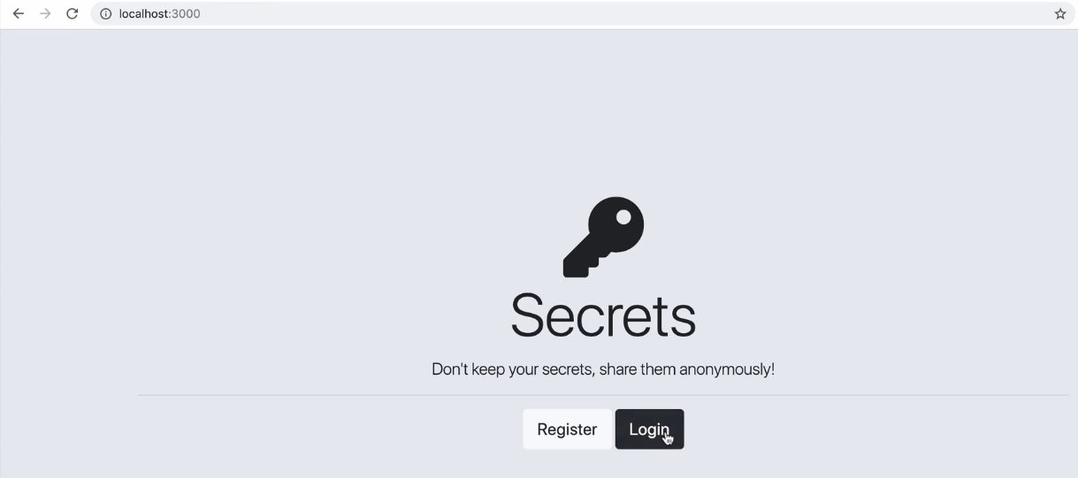
Accessing home route

Slide 15
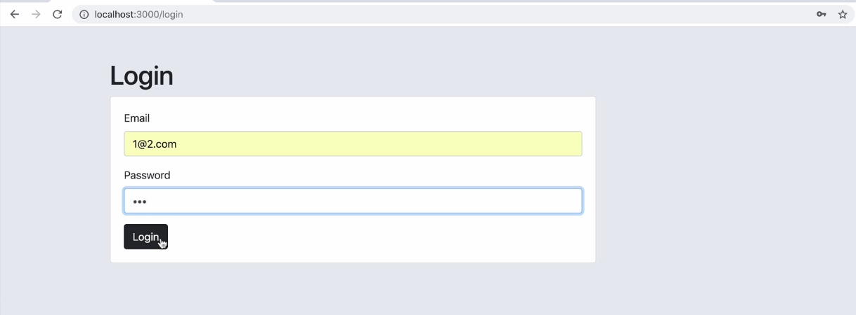
Accessing login post route: Logging with username and password

Slide 16
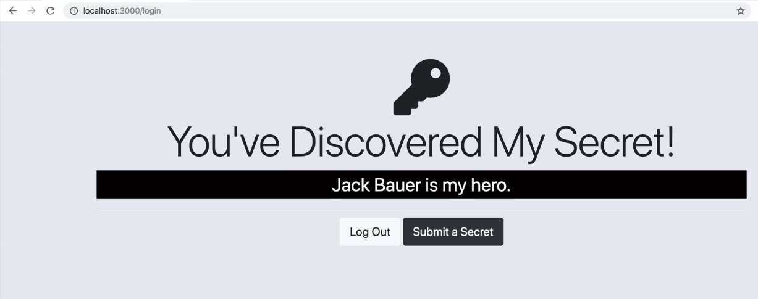
Rendering Secrets Page: After entering right user and password

Slide 17
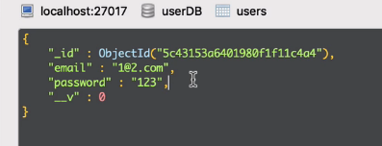
Level 1 Authentication is done by creating username & password.
But our password looks as plain text. So we have to do some
Technique to make it more secure.

Slide 18
Coding Activity:
Complete Level-1 Authentication and upload your project folder
And required screen shots via given GitHub link.

