Slide 1

GO Transit Ridership Report
SEP 2015
1 OCT 2015

Slide 2
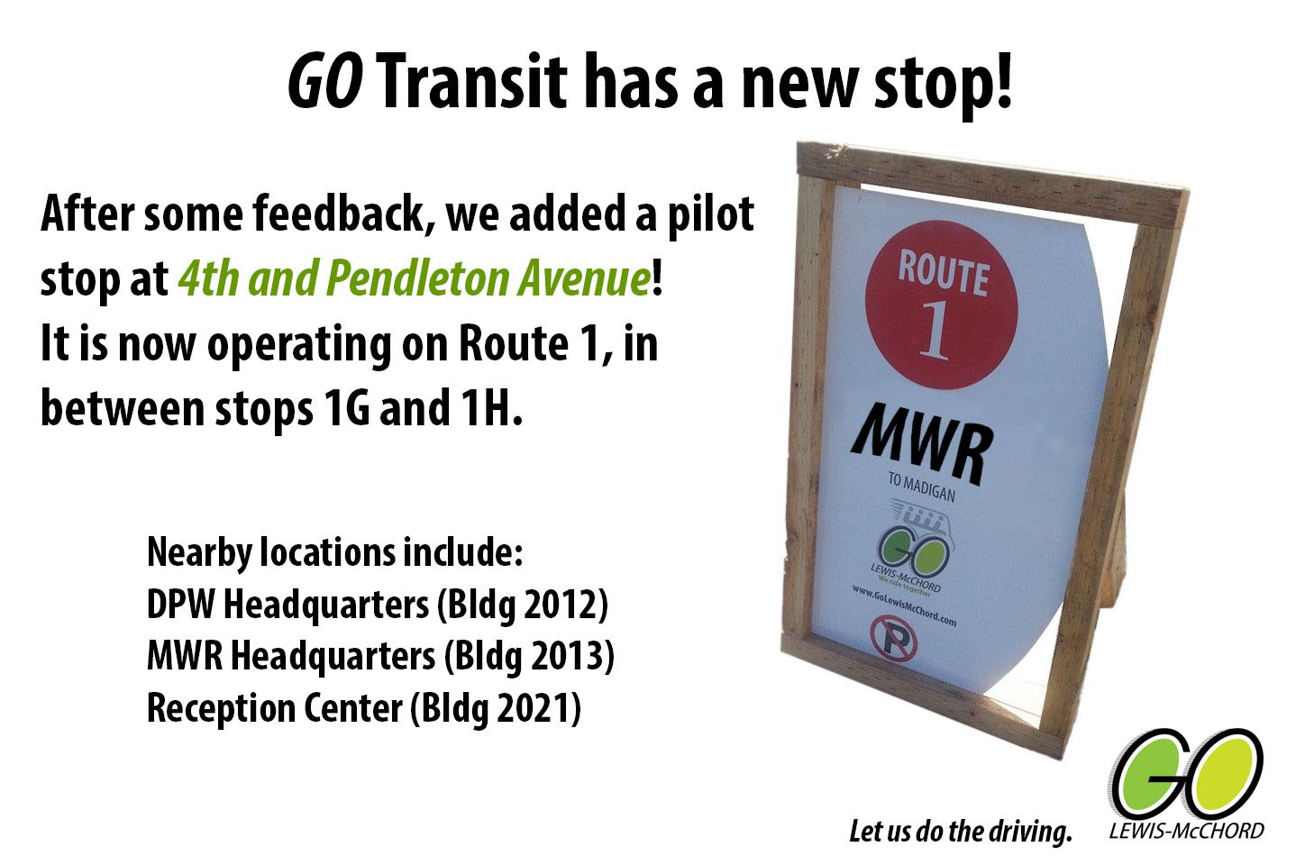
Route Updates
Added 4 new permanent stops on 28 SEP:
1S – DPW & MWR HQ (was called 4th and Pendleton)
1T – 17 FIB Barracks
1U – Hillside at Colorado
1V – Four Chaplains Chapel
Route 2 launch has been set for 2 NOV

Slide 3
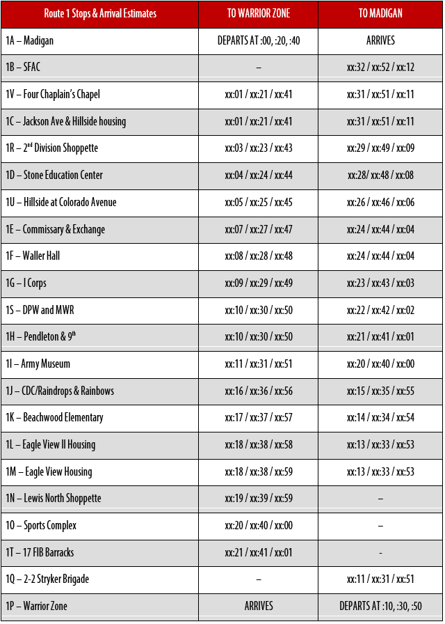
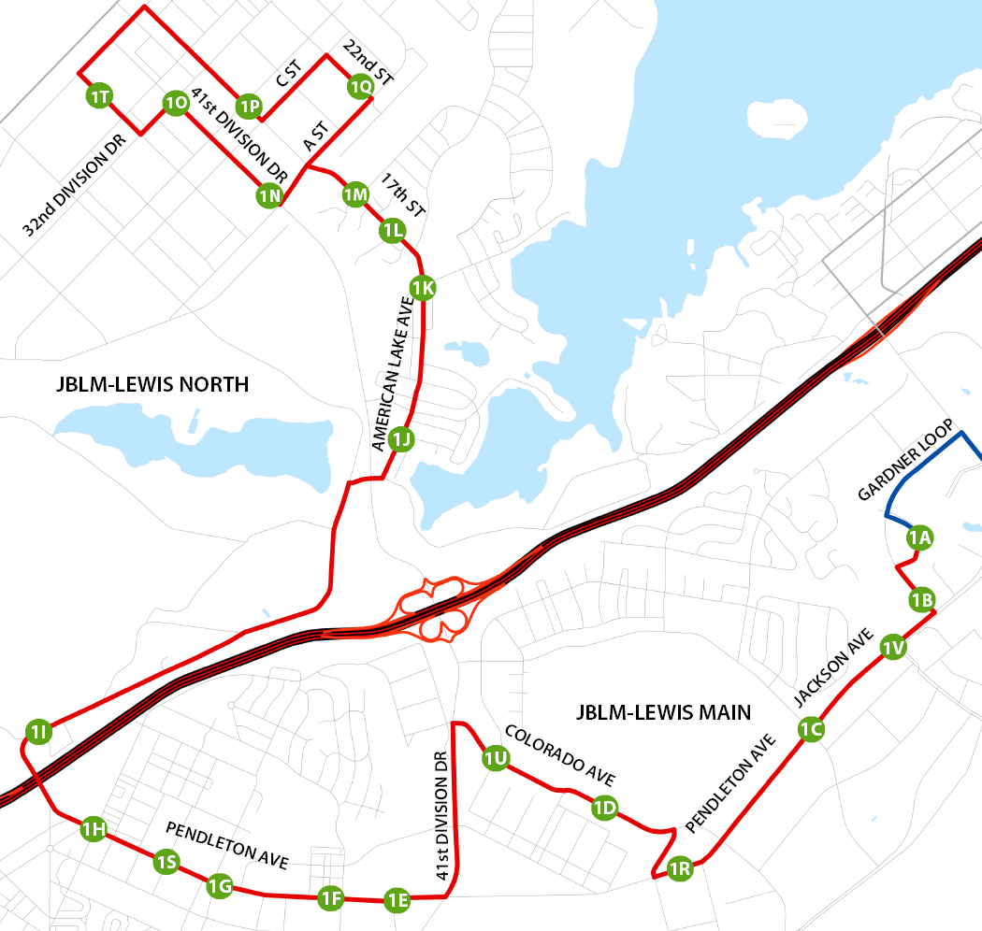
GO Transit – Route 1

Slide 4
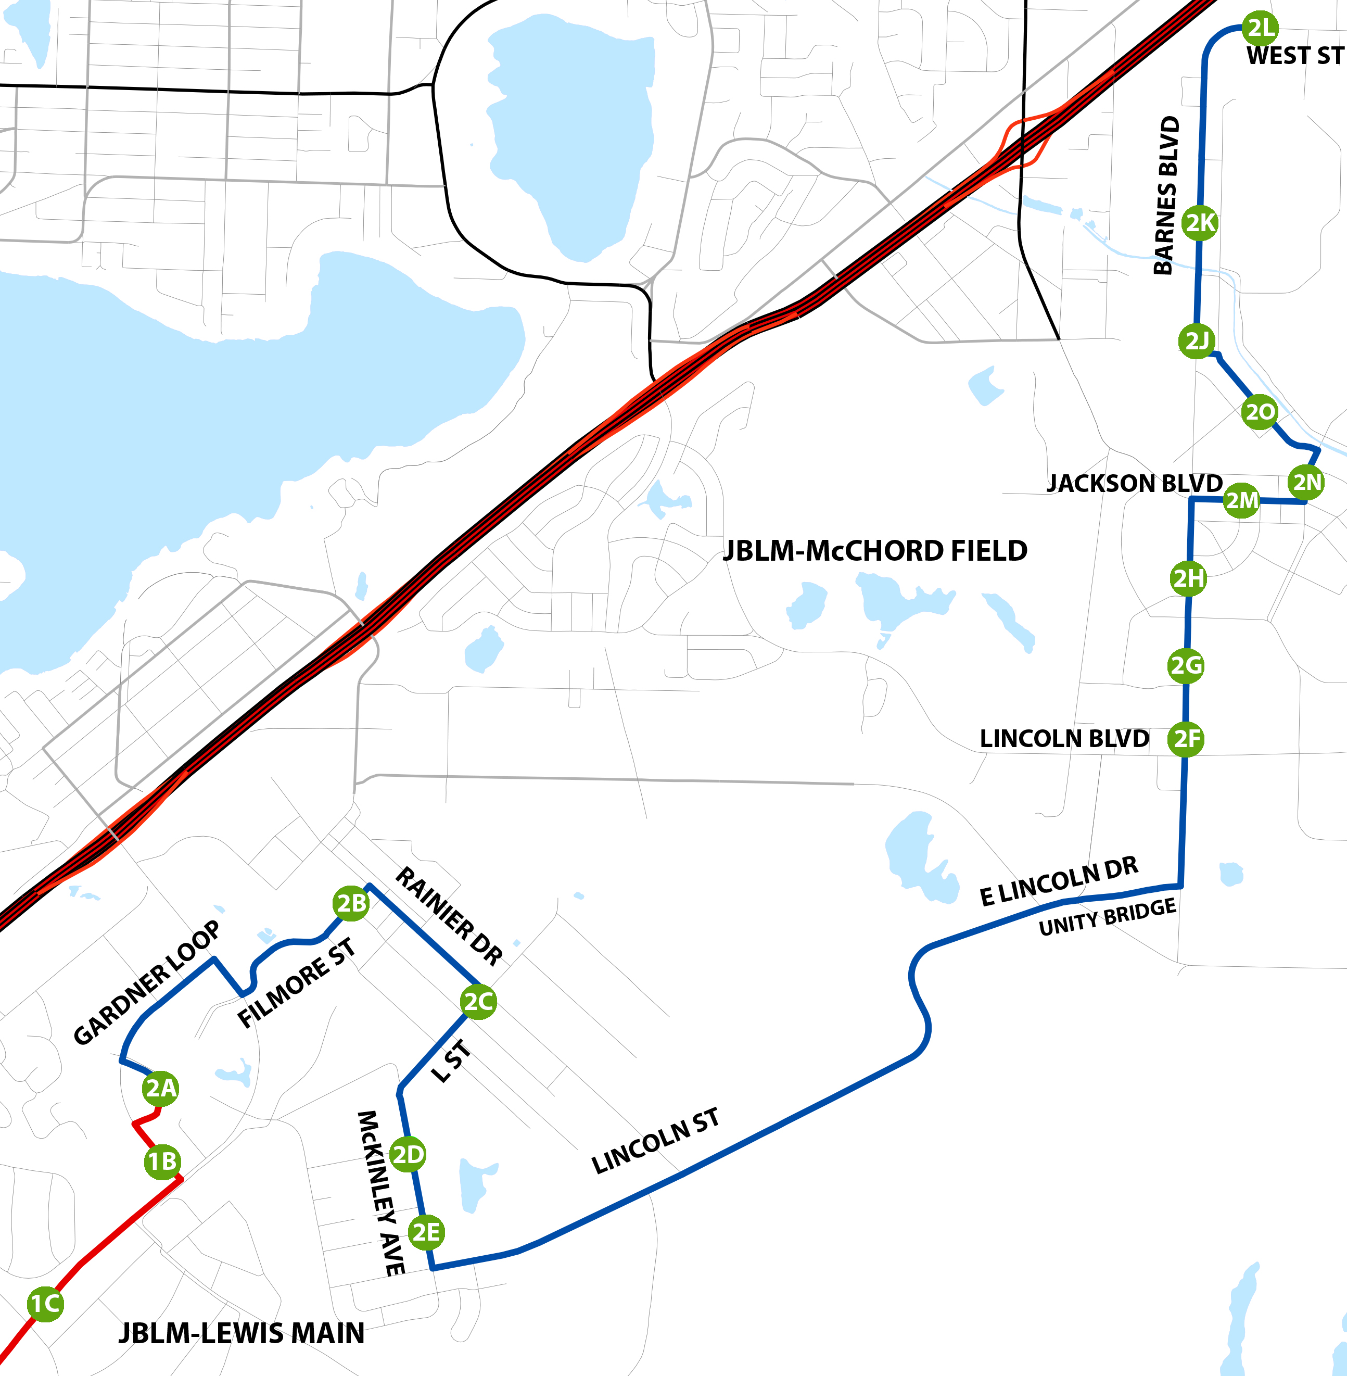
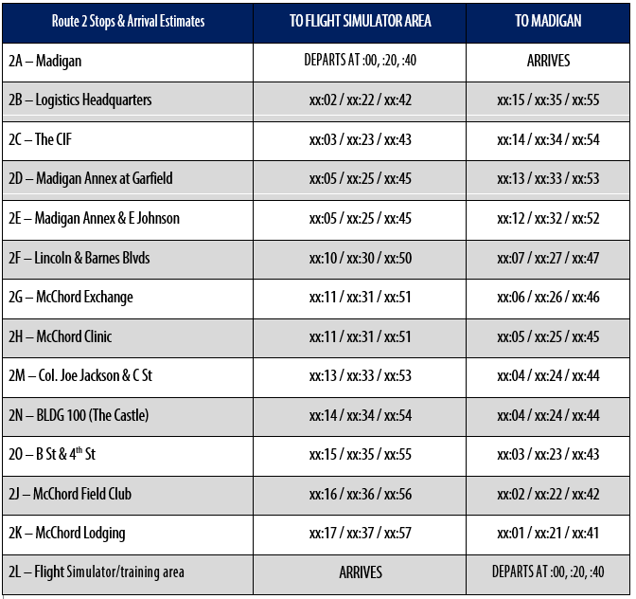
GO Transit – Route 2

Slide 5
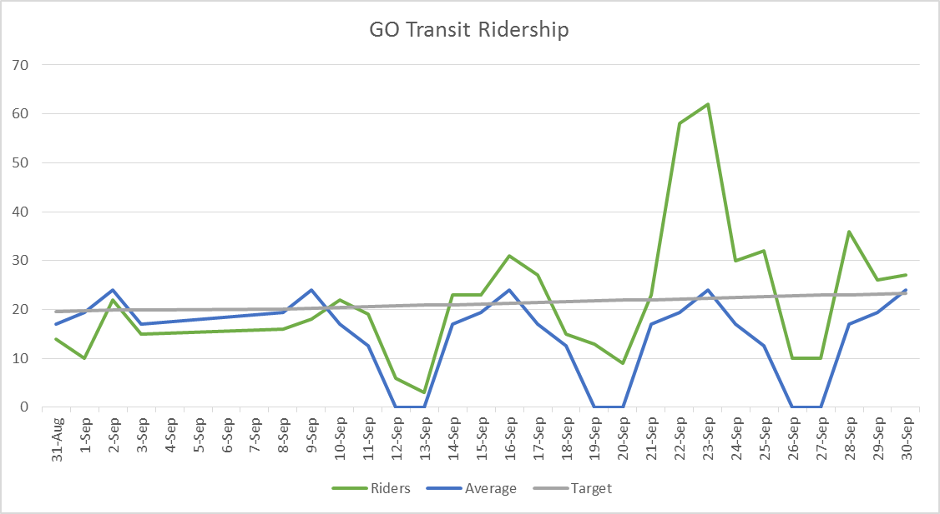
Daily Ridership
Did not operate on DONSAs (4 SEP – 7 SEP)
Highest daily record of previous shuttle on file was 33, on 22 SEP we had 58 and on 23 SEP we had 62
Typically only weekends fall below the straight-line target

Slide 6
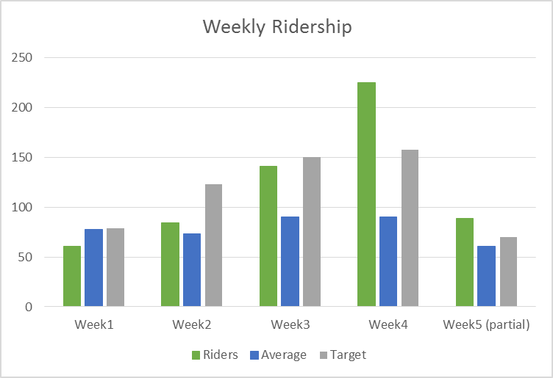
Weekly Ridership
Week 1 was underneath shuttle average
Week 2 the new system beat the average
Week 4 exceeded the target by 68 riders and the average by 135 riders (250%)
Week 5 is on track to well exceed target
Period | Riders | Average | Target
Week1 | 61 | 77.4 | 79.07
Week2 | 84 | 73 | 123.00
Week3 | 141 | 90 | 150.17
Week4 | 225 | 90 | 157.36
Week5 (partial) | 89 | 60.4 | 69.64

Slide 7
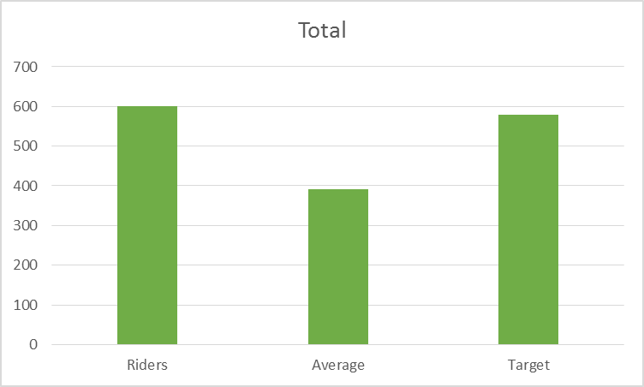
Weekly Ridership
Month ridership total was 600
Average was 391 (less than typical due to DONSAs)
SEP target was 579 based on straight-line
21 riders above straight-line target and 209 riders above the average
The beginning two weeks contained very little ridership. If the program performed as an average of week’s 3, 4, and 5 we would have had:
730 if we do not operate on DONSAs
815 if we operated on DONSAs

