Slide 1

GO Transit Ridership Report
OCT 2015
1 OCT 2015

Slide 2
Route Updates
Added 4 new stops:
1W – Rainier Inn
1X – Reception Center
2P – 373rd
2Q – PAX Terminal (requested by Chief Mazid)
Route 2 launch has been set for 9 NOV

Slide 3
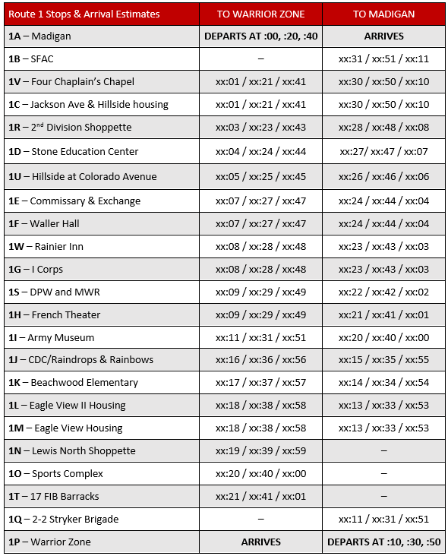
GO Transit – Route 1

Slide 4
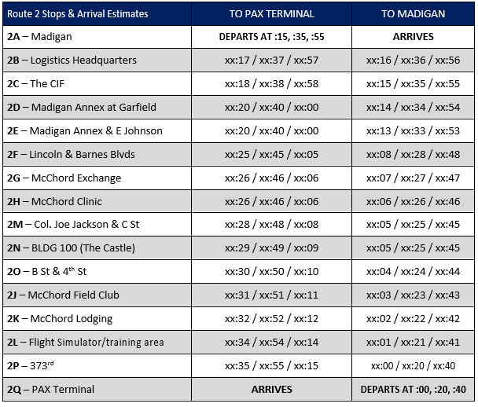
GO Transit – Route 2

Slide 5
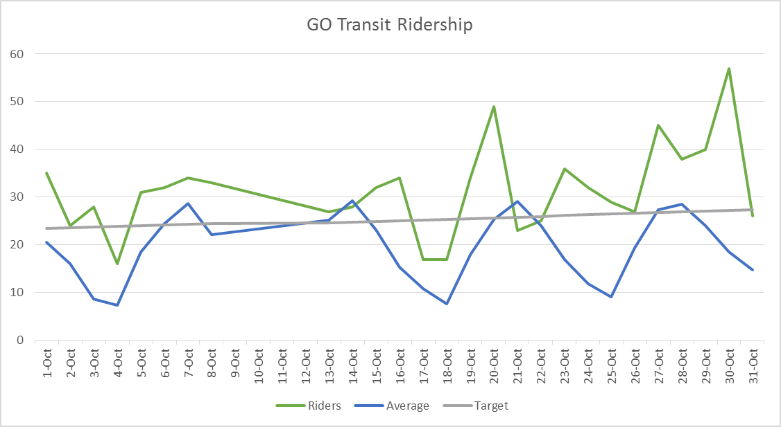
Daily Ridership
Did not operate on DONSAs (9 OCT – 12 OCT)
Typically only weekends fall below the straight-line target

Slide 6
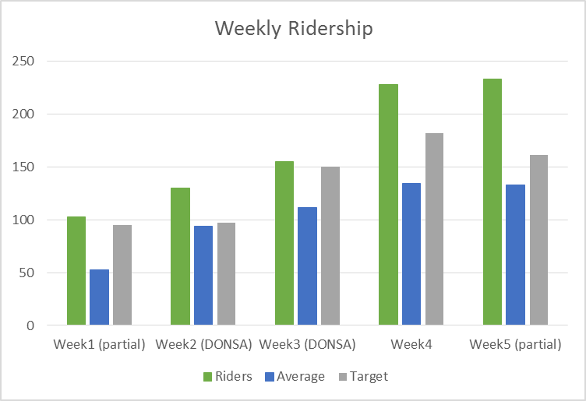
Weekly Ridership
Each week is always above the straight-line target and well above the average
The beginning of the month had stagnant ridership. Ridership increased by nearly 100 from week 3 to week 5.

Slide 7
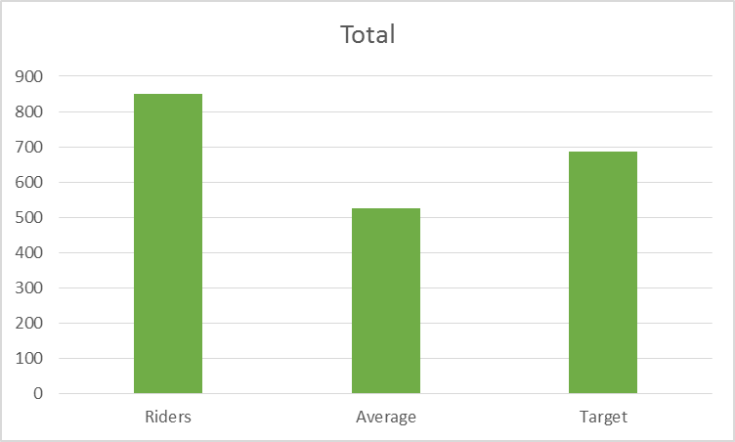
Monthly Ridership
Monthly ridership total is 849, the best shuttle/transit month on record
Average is 525.
Straight-line target is 686, ridership has exceeded this by 163.
With the launch of Route 2 in NOV we expect that NOV will bring our first 100 rider day.

