Slide 1

GO Transit Ridership Report
NOV 2015
3 DEC 2015

Slide 2
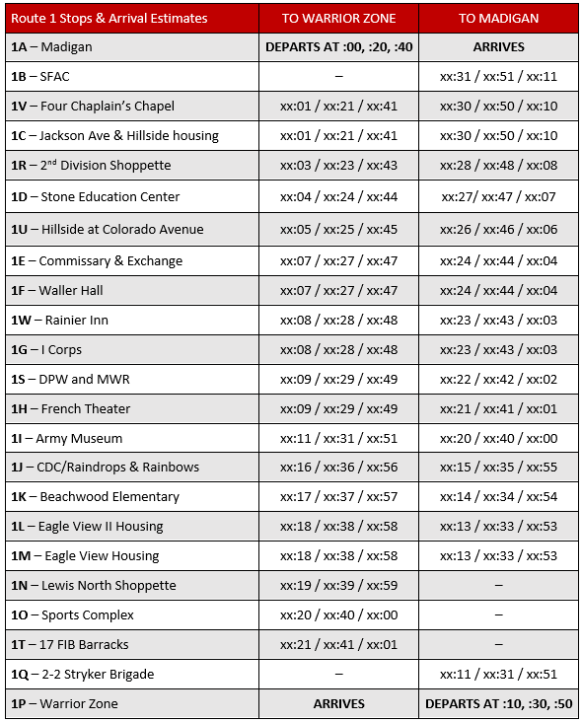
GO Transit – Route 1

Slide 3
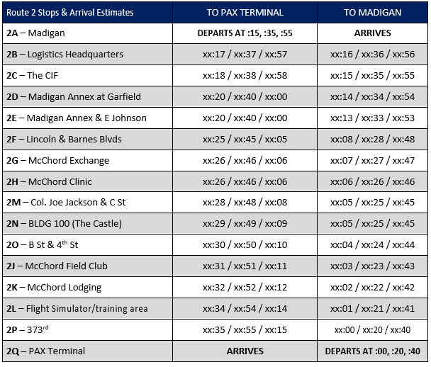
GO Transit – Route 2

Slide 4
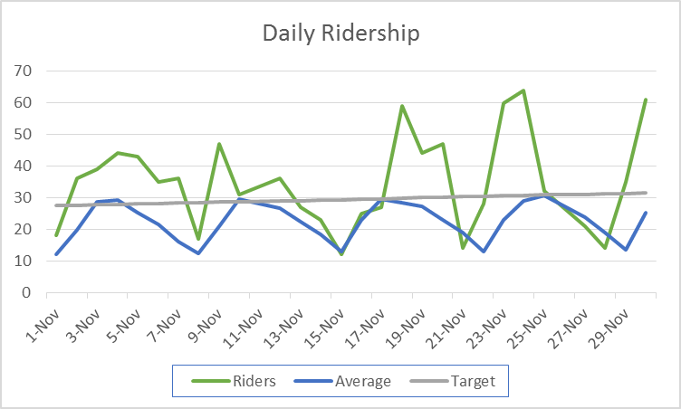
Daily Ridership
Did not operate on holidays (11 NOV & 26 NOV)
Typically only weekends fall below the straight-line target

Slide 5
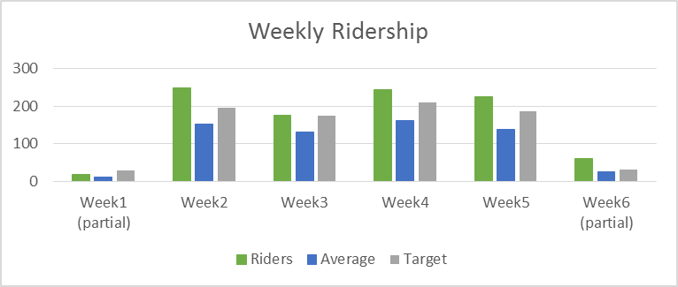
Weekly Ridership
Each week is always above the straight-line target and well above the average

Slide 6
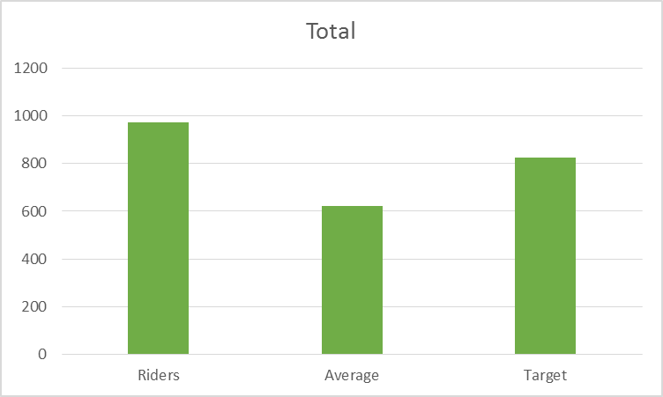
Month Ridership
Monthly ridership total is 975, our highest month on record.
Average is 622.
Straight-line target is 824, ridership exceeded this by 151.

Slide 7
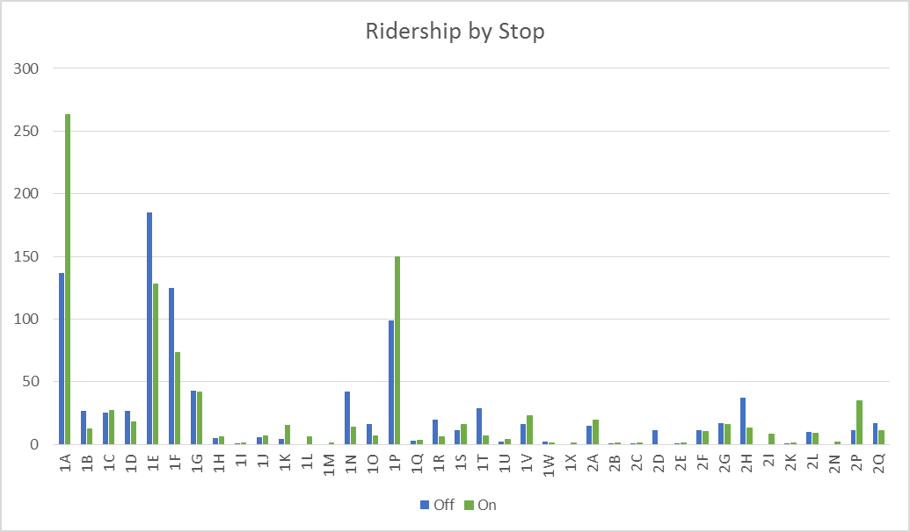
Ridership by Stop
Madigan is the best performing stop, this has not changed. Previews of DEC data suggests that 373rd may have greater performance than Madigan
Commissary/PX and I Corps have proportional increased ridership more so than other Route 1 stops.
Route 1 had 1656 arrivals/deboardings.
Route 2 had 260 arrivals/deboardings.
Route 2 started very slow but has significantly increased. Previews of DEC data show it nearing Route 1 performance.

Slide 8
Ridership by Stop Numbers
Affect is the frequency of on and off boardings for the stop against the total. For example, Madigan affects 41.75% of trips.
Normalized refers to the expected affect given the number of stops. Madigan therefore carries 17.12 times as much affect as a stop would be expected to carry.

