Slide 1

GO Transit Ridership Report
DEC 2015
5 JAN 2016

Slide 2
GO Transit – Route 2 Early Express

Slide 3
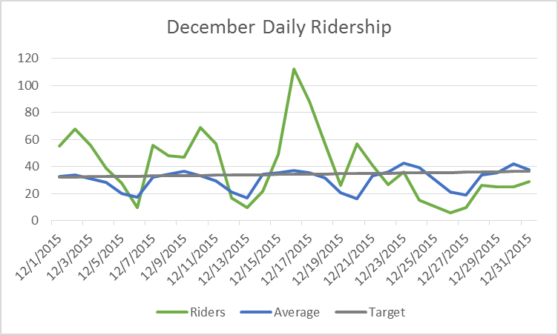
Daily Ridership
Did not operate on the holiday (DEC 25)

Slide 4
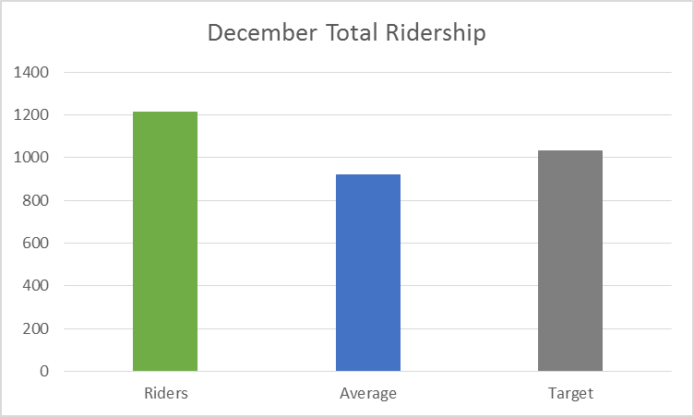
Month Ridership
Monthly ridership total is 1211, our highest month on record.
Average is 920.
Straight-line target is 1030, ridership exceeded this by 181.

Slide 5
Ridership by Stop
Effect is the frequency of on and off boardings for the stop against the total. For example, Madigan affects 31.54% of trips.
Normalized refers to the expected effect given the number of stops. Madigan therefore carries 11.99 times as much effect as a stop would be expected to carry.

