Slide 1

GO Transit Ridership Report
JAN 2016
5 JAN 2016

Slide 2
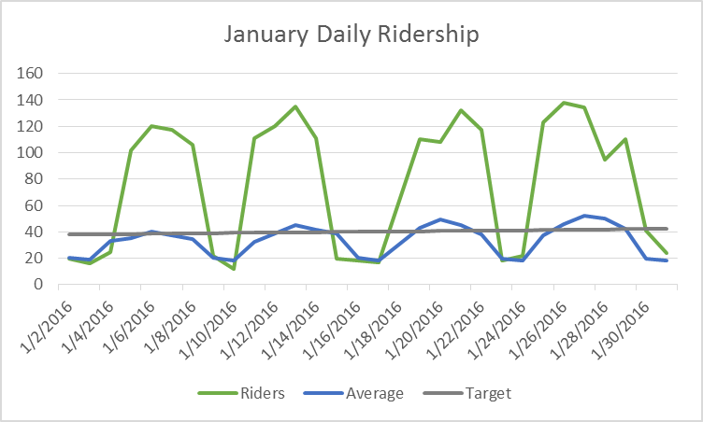
Daily Ridership
DONSAs and holidays on JAN 1, 4, 15, and 18

Slide 3
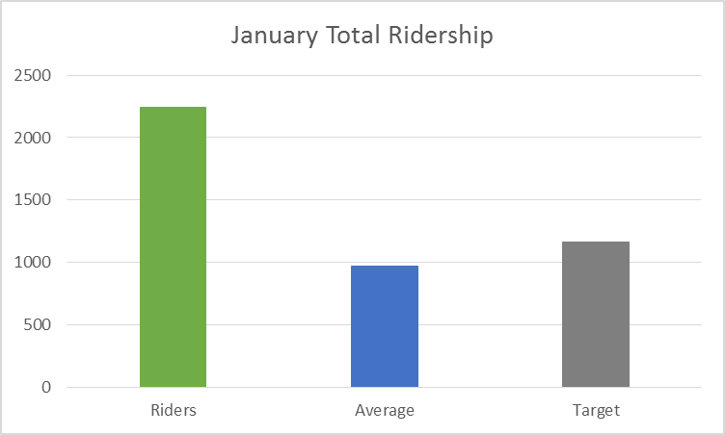
Month Ridership
Monthly ridership total is 2244, our highest month on record, nearly doubling December total.
Average is 974.
Straight-line target is 1164, ridership exceeded this by 1080.

