Slide 1


CS3904
Summer Internship - 2

Slide 2
MoodSync: Real-Time Emotion-Based Music Recommendation System Team Details 1. Gauravi Suryavamshi KS (1RVU23CSE164) 2. Aneesh Adithya SR (1RVU23CSE054) 3. Shreyas Ghanathe (1RVU23CSE445) 4. Gopika R (1RVU23CSE170) Project guide: Prof. Ritesh N

Slide 3
Problem statement
Most existing music recommendation systems rely on static user data such as listening history, genres, or manually set preferences, and do not consider the listener’s current emotional state.
This limits the effectiveness and emotional resonance of recommendations.
There is a growing need for a system that can detect emotions in real-time through facial expressions and intelligently recommend music that aligns with or enhances the user’s mood, thereby creating a more responsive and personalized listening experience.

Slide 4
Literature review
Drive link for research papers

Slide 5
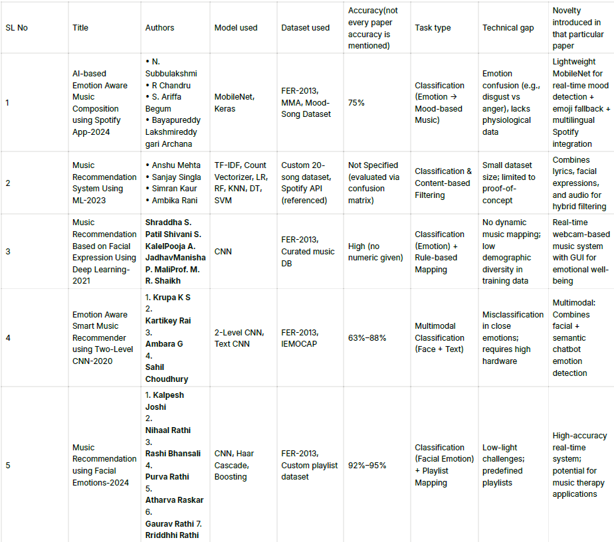
Literature review

Slide 6
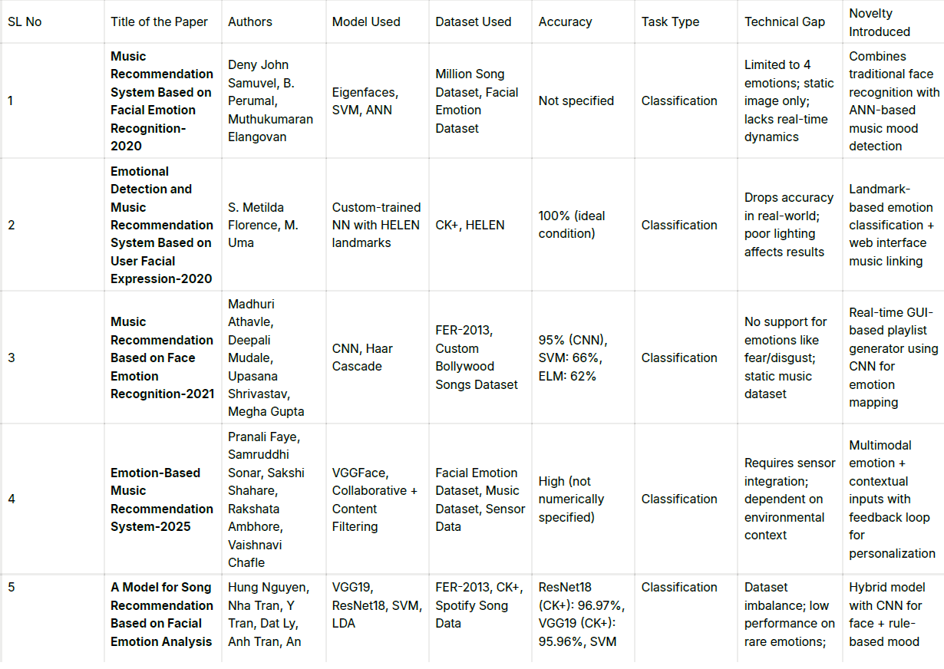
Literature review

Slide 7
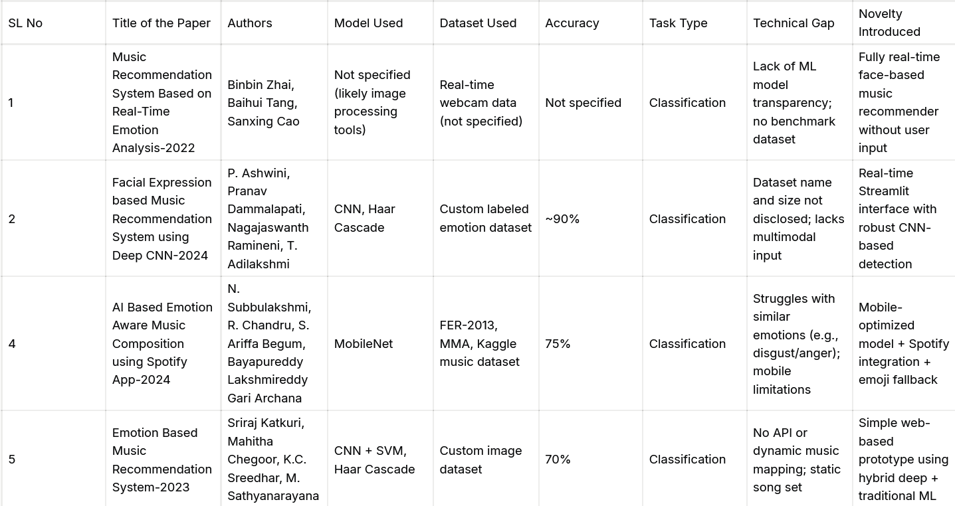
Literature review

Slide 8
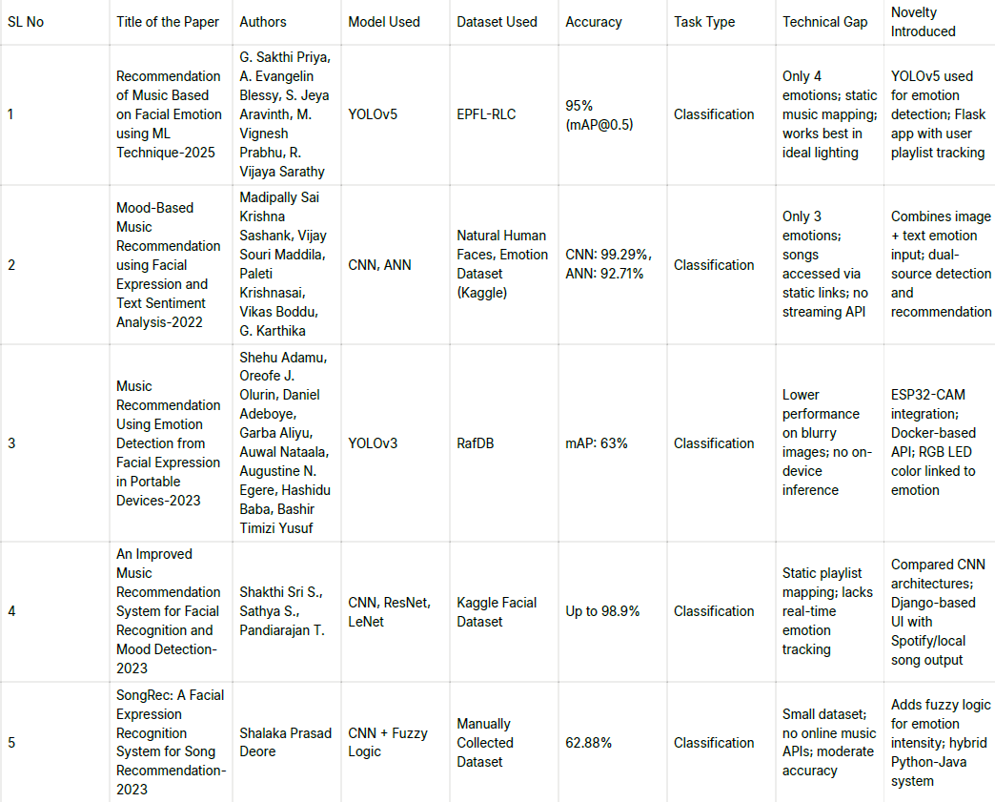
Literature review

Slide 9
Research Gap Identified
Emotions Are Oversimplified
Most systems only identify simple moods such as happy or sad—actual emotions are more nuanced.
Same Songs Every Time
The music is usually paired with moods using fixed playlists, not adjusting to the user's preference or situation.
One-Track Emotion Detection
Most models only use facial expressions. But emotions can also be detected in our voice or in our texts.
Struggles in Real Life
These systems do great in ideal conditions—but not ideal. Not so great in low light, side shots, or with live distractions.
Not For Mobile or Devices
Too heavy for phones or wearables—real-time usage isn't seamless.
No User Learning
No learning system to know what users like or don't like over time.
Can't Manage Mixed Feelings
Feelings don't always have a single dimension. Most mechanisms can't determine that someone is both happy and anxious, for instance.

Slide 10
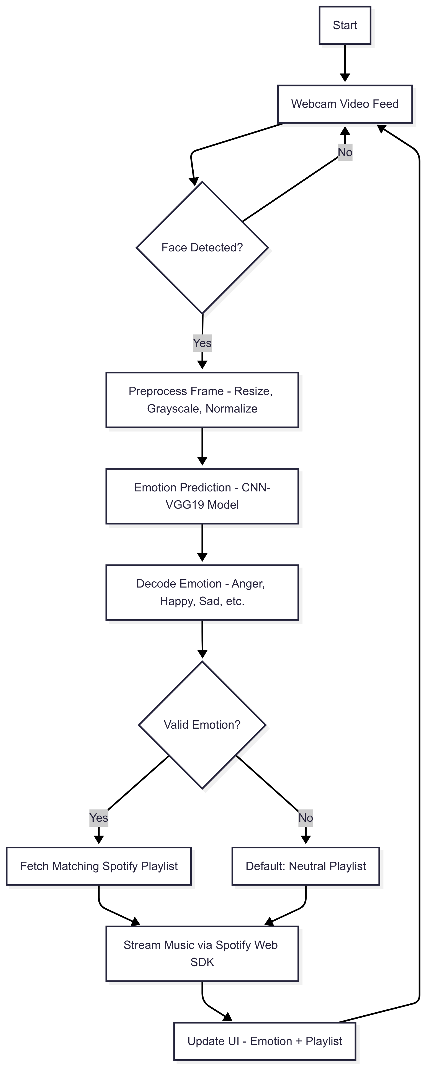
Methodology

Slide 11
Implementation
The system works by first capturing live video through a webcam using OpenCV. It detects faces in each frame with Haar Cascade, then preprocesses them (resizing to 48x48 pixels and converting to grayscale). A pre-trained VGG19 CNN model analyzes these faces to predict one of seven emotions (happy, sad, angry, etc.). Based on the detected emotion, the system fetches a matching Spotify playlist (like upbeat songs for happiness) and plays it through Spotify's API. If Spotify isn't available, it uses local backup tracks. The whole process repeats in real-time, updating results every 0.15 seconds. Built with Python, TensorFlow, and Flask, it runs smoothly on most devices.

Slide 12
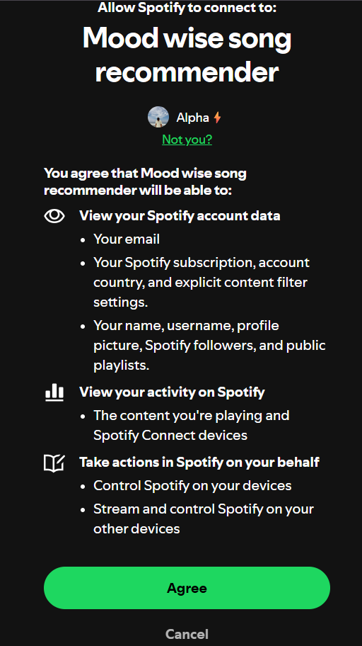
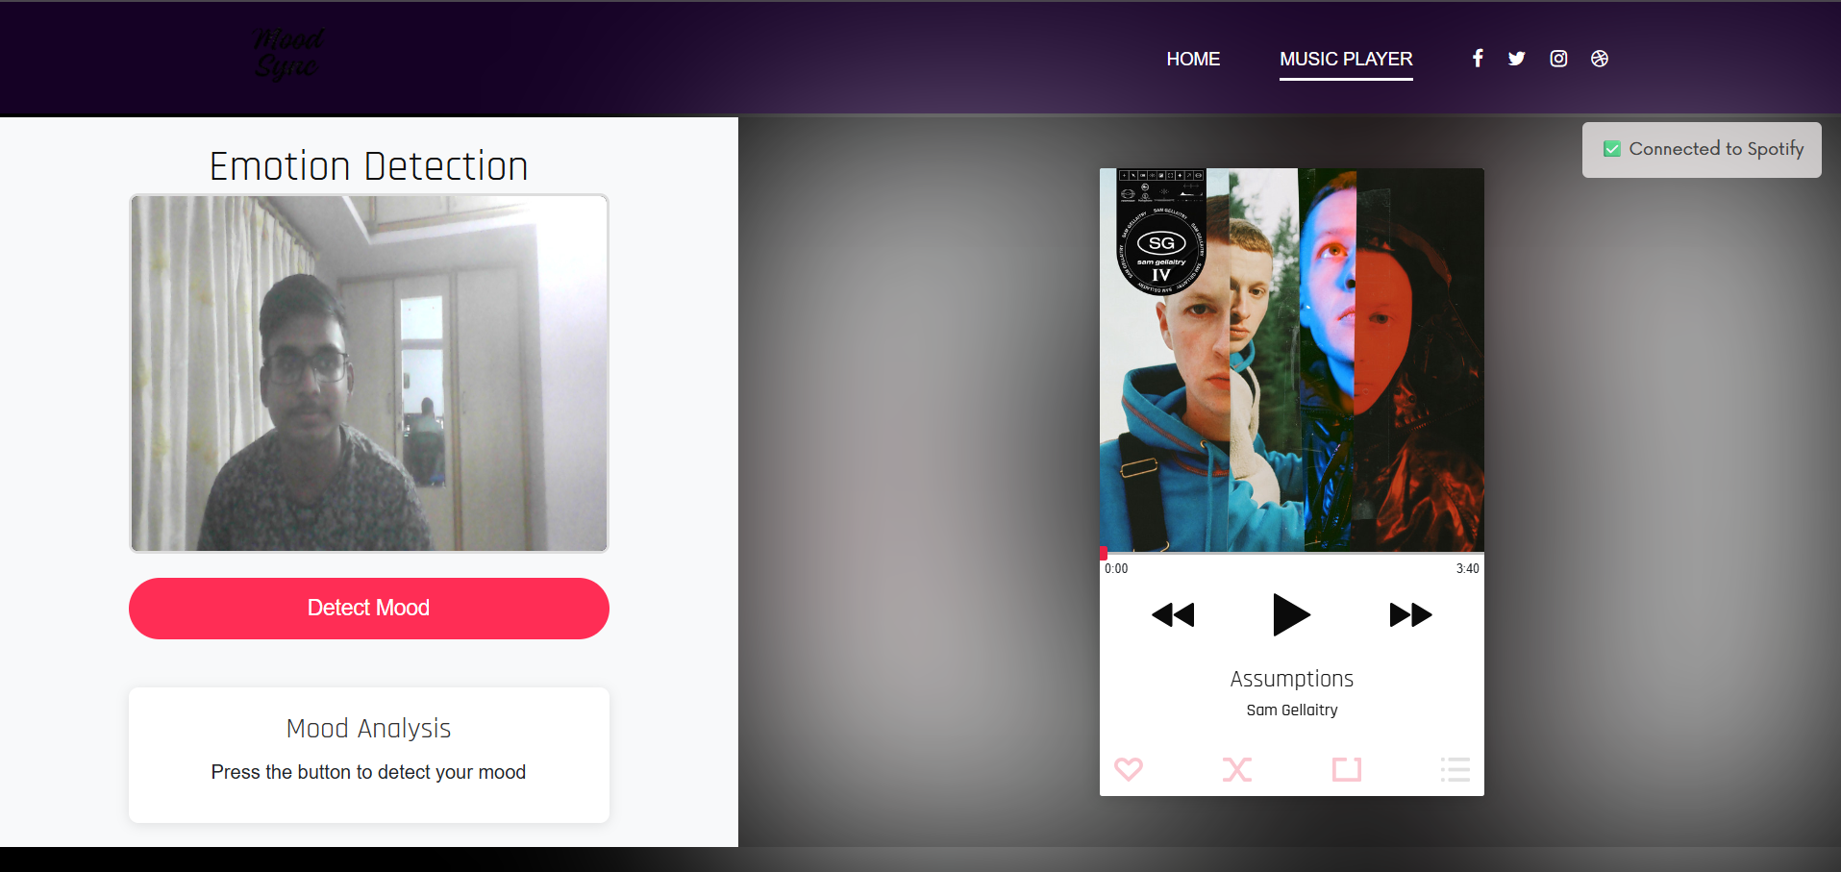
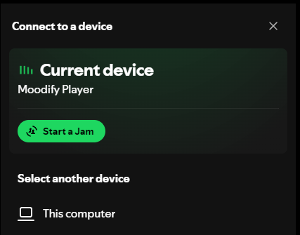
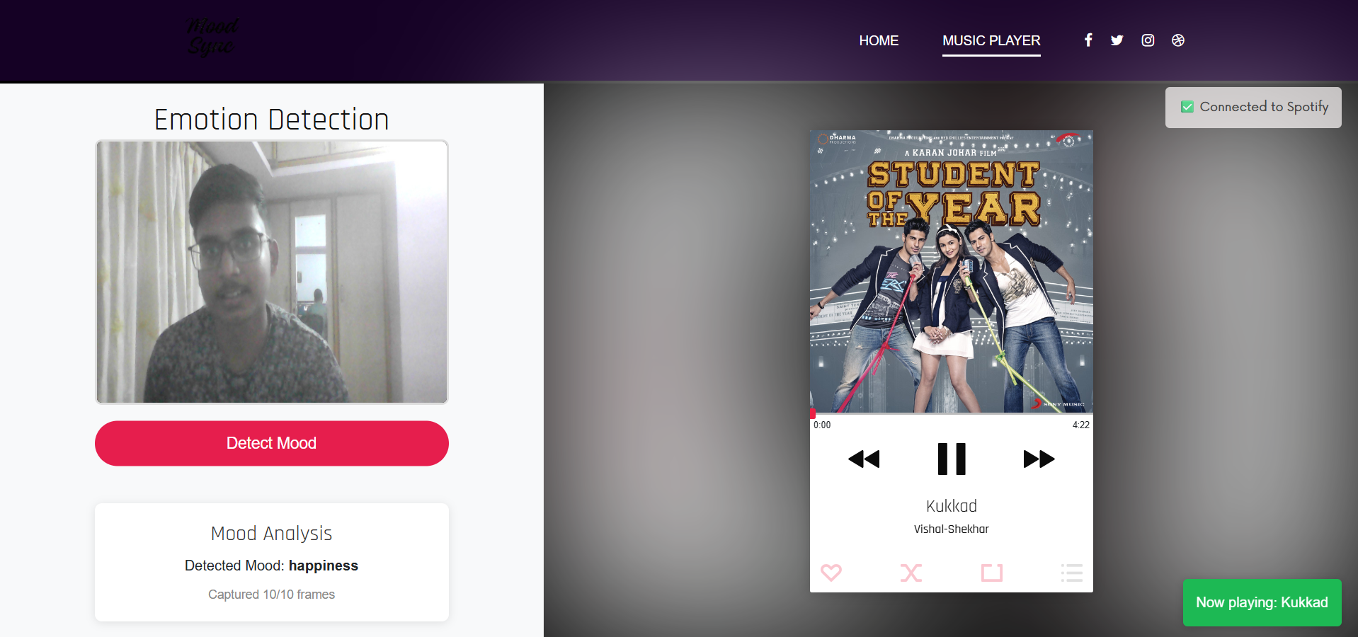
Output Screenshots

Slide 13
Future work
Multi-User Support: Allow multiple users to detect moods simultaneously.
Better UI/UX: A more polished frontend with animations and feedback.
More Emotions: Expand the CNN model to detect subtle emotions (e.g., calm, excited).
Offline Mode: Cache Spotify playlists for faster loading.

Slide 14
References
VGG19 Model Architecture Simonyan & Zisserman (2014) https://arxiv.org/abs/1409.1556 Seminal paper on VGG networks
Spotify Web API Docs Spotify Developer Documentation (2023) https://developer.spotify.com/documentation/web-api Official API reference for playlist endpoints
Haar Cascade Detection Viola & Jones (2001) https://www.cs.cmu.edu/~efros/courses/LBMV07/Papers/viola-cvpr-01.pdf Original paper on the face detection method
FER-2013 Dataset (Kaggle)
Source: Pierre-Luc Carrier and Aaron Courville (ICML 2013 Workshop)
Kaggle Link: https://www.kaggle.com/datasets/msambare/fer2013
The benchmark dataset containing 35,887 facial expression images

Slide 15
Thank you

