Slide 1
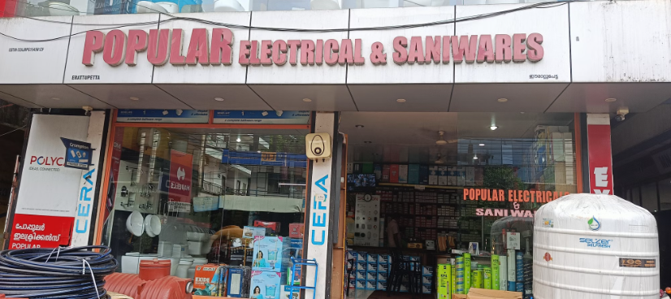
Revitalizing Sales and Inventory Management for Popular Electricals
This presentation outlines a data-driven approach to revitalize sales and inventory management for Popular Electricals, a B2C electrical retail business in Kerala. The analysis focuses on key products, customer segments, and seasonal patterns, aiming to identify trends and insights that can improve profitability and optimize inventory practices.
Created By
Gopika R
23DS3000136

Slide 2
Understanding the Business Landscape
Challenges
Objective
Popular Electricals faces declining sales, inefficient inventory management, and growing competition from online markets, impacting growth and profitability.
To leverage data analysis to provide actionable insights and optimize business operations, leading to increased profitability, improved inventory management, and sustained growth.

Slide 3

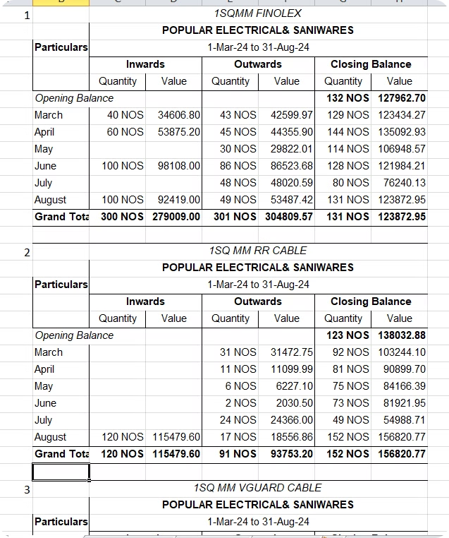
Data Analysis Methodology
Key Performance Metrics
Data Collection
Summary reports collected from Tally (March-August 2024) for 25 key products.
Sales volume, revenue, profit, cost price, and selling price calculated using Excel.
1
2
3
4
Data Cleaning and Organization
Pivot Tables and Visualization
Data structured for effective analysis.
Sales, revenue, and inventory trends identified using pivot tables and graphs.

Slide 4
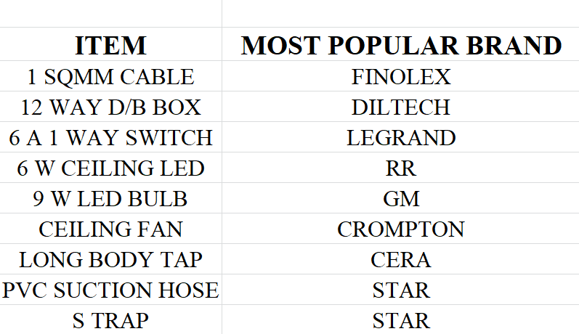
Brand Analysis
Insights
Brand popularity varies across product categories. Some brands, like V-Guard, have products but aren't best sellers in any category, indicating potential areas for growth.
Key Findings
STAR is the most popular brand for PVC suction hoses and S Traps. GM leads in 9W LED Bulbs, while CERA is the top seller for Long Body Taps. RR is the most popular in the 6W Ceiling Light category.

Slide 5

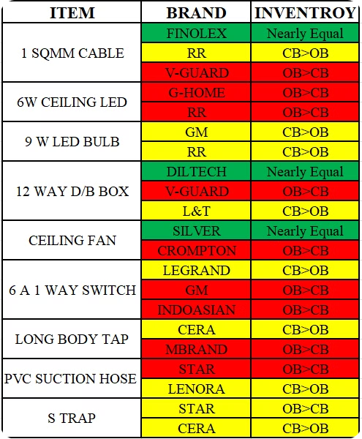
Net Inventory Movement Analysis
Opening Stock < Closing Stock
Opening Stock = Closing Stock
Indicates stock accumulation or over-purchasing, possibly due to inefficiency, overstocking, or low sales.
Represents a balance between sales and replenishment, suggesting efficient inventory management.
Opening Stock > Closing Stock
Indicates higher-than-expected sales, potentially leading to stock outs, or a need to reduce stock levels.

Slide 6

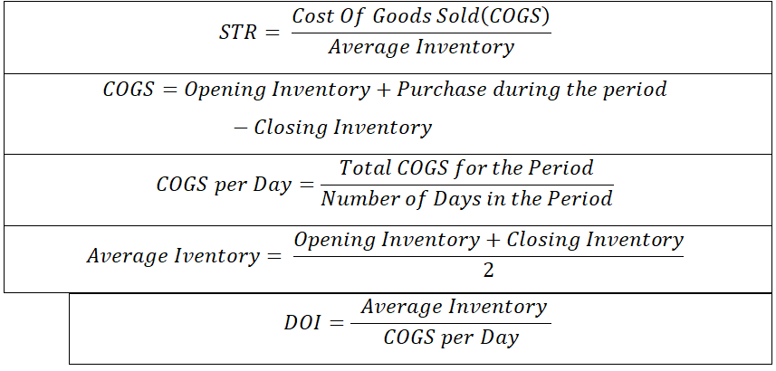
Sales vs. Stock Analysis
Stock Turnover Rate (STR)
Days of Inventory (DOI)
DOI indicates how long inventory is held, calculated as (Average Inventory / Cost of Goods Sold) x 365. A high DOI (> 120 days) suggests excess inventory and potential cash flow issues for items like decorative lighting. A low DOI (< 60 days) signifies efficient inventory management and strong cash flow for essential items like PVC pipes.
STR measures how efficiently inventory is sold, calculated as Cost of Goods Sold / Average Inventory. A high STR (> 5) for fast-moving items like wiring pipes suggests efficient inventory management. A low STR (< 2) for slower-moving items like specialized switches may indicate overstocking or inefficiencies.

Slide 7

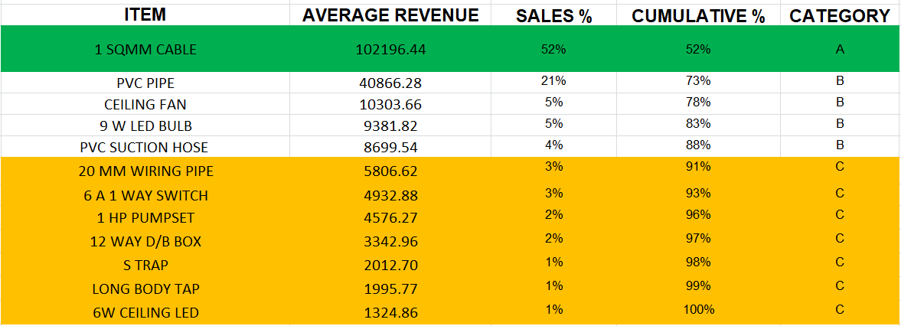
ABC Analysis
1
Category A
High-value items like 1 SQMM Cables, with infrequent sales but contributing 70-80% of total revenue.
2
Category B
Moderate-value items such as LED Bulb and Ceiling Fans with moderate sales frequency, accounting for 15-25% of the total revenue.
3
Category C
Low-value, high-volume items like 12 Way D/B Box, Long Body Tap and Ceiling LED contributing 5-10% of revenue but sold frequently.

Slide 8
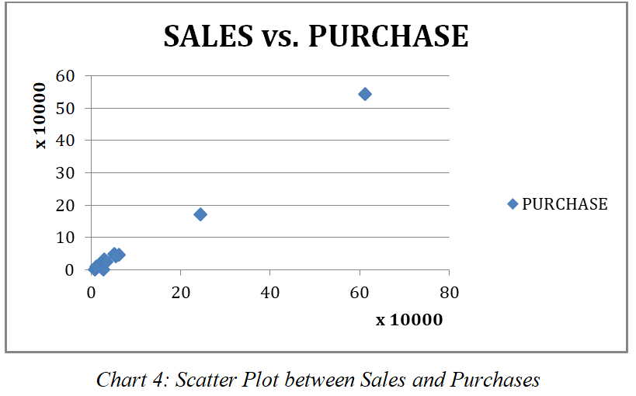
Sales and Purchase Correlation Analysis
Strong Positive Correlation
A strong correlation of 0.996 confirms that purchases closely align with sales, ensuring efficient inventory management. This minimizes the risk of overstocking or stockouts, improving overall supply chain performance.
Outliers
Products with sales significantly deviating from purchase patterns, indicating potential marketing successes, supply chain disruptions, or data anomalies.

Slide 9
Recommendations for Revitalization
Improve Visibility
1
Enhance product placement in-store and boost online presence through targeted digital campaigns to capture customer attention.
2
Collaborate with Suppliers
Explore joint marketing initiatives and negotiate favorable payment terms to improve cash flow and promotional support.
Strengthen Branding
3
Utilize consistent digital marketing strategies and active public engagement to build a strong brand identity and customer loyalty.
4
Evaluate Pricing
Conduct thorough pricing analysis, comparing against competitors to optimize pricing strategies for maximum profitability and competitiveness.
Categorize Inventory
5
Prioritize high-value (A) and moderate-value (B) items, while strategically reducing stock levels of low-value (C) items to optimize inventory efficiency.
6
Enhance Experience
Utilize analytical insights to enhance customer service and refine the purchasing process, creating a seamless and personalized shopping experience..
Understand Demand
7
Leverage past sales analysis to refine product offerings, adapt to evolving customer needs, and maximize sales opportunities.
8
Train Staff On Products
Train staff on product knowledge with a focus on data-driven insights to enhance decision-making and customer interactions.

Slide 10
THANK YOU

