Slide 1
BUSINESS INTELIGENCE
Department of Artificial intelligence and data science
Academic Year: 2024 – 2025 (Even Semester)
Register Number : 927623ABAD023, 36, 47
Name : DHARSHINI K,GOPIKAMBAL N, KAARUNYA A S
Year : II
Semester : IV
Section : A
Date : 05-03-2025

Slide 2
Navigating the Shopper’s Trail

Slide 3
INTRODUCTION
In the modern retail industry, understanding shopper behavior is crucial for optimizing sales, enhancing customer experiences, and improving business decision-making.
The Navigating Retailer Shoppers Project focuses on analyzing shopper trends, purchase patterns, and store performance using IBM Cognos Analytics, a powerful business intelligence tool.

Slide 4
ABSTRACT
Understanding Shopper Behavior – This dashboard analyzes customer journeys, tracking purchasing patterns, preferences, and interactions to optimize marketing strategies.
Data-Driven Insights – By integrating sales, customer demographics, and transaction history, IBM Cognos provides real-time analytics to enhance decision-making.
Visualization & Reporting – The dashboard presents key metrics such as sales trends, customer retention, and purchase frequency, enabling businesses to improve customer experience and increase revenue.

Slide 5
Data and Tools
Data
Data Sources Identified
Sales Transaction Data
Customer Demographics & Loyalty Data
Inventory & Stock Levels
Promotional & Discount Data
Peak Shopping Hours
Tools and Technologies Selected
IBM Cognos Analytics as the core platform

Slide 6
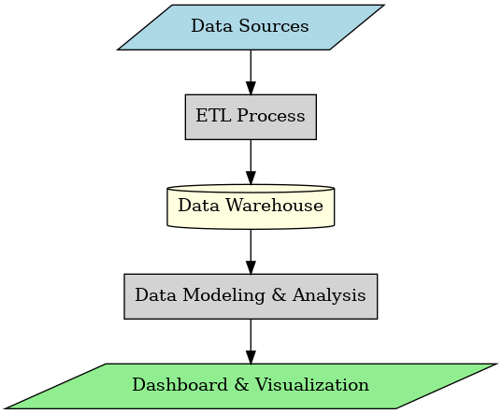
Proposed Architecture

Slide 7
Dashboard Design Plan
Key Performance Indicators (KPIs):
Total Sales & Revenue
Peak Shopping Hours
Best-Selling Products
Customer Retention & Loyalty Metrics
Inventory Turnover Rate
Types of Visualizations Planned:
Trend Line Charts for tracking sales patterns over time
Bar/Column Charts for comparing product performance
Gauge Charts for monitoring real-time key metrics
Interactive Dashboards with drill-down capabilities for deeper insights

Slide 8
Existing system
In traditional retail environments, decision-making relies on manual observations, POS (Point of Sale) data analysis, and historical sales reports. Retailers often face challenges in identifying peak shopping hours, understanding customer behavior, and optimizing product placements.
Manual Observations & POS Data Analysis
Lack of Real-Time Insights
Limited Customer Personalization
Inefficient Decision-Making
Fragmented Data Sources

Slide 9
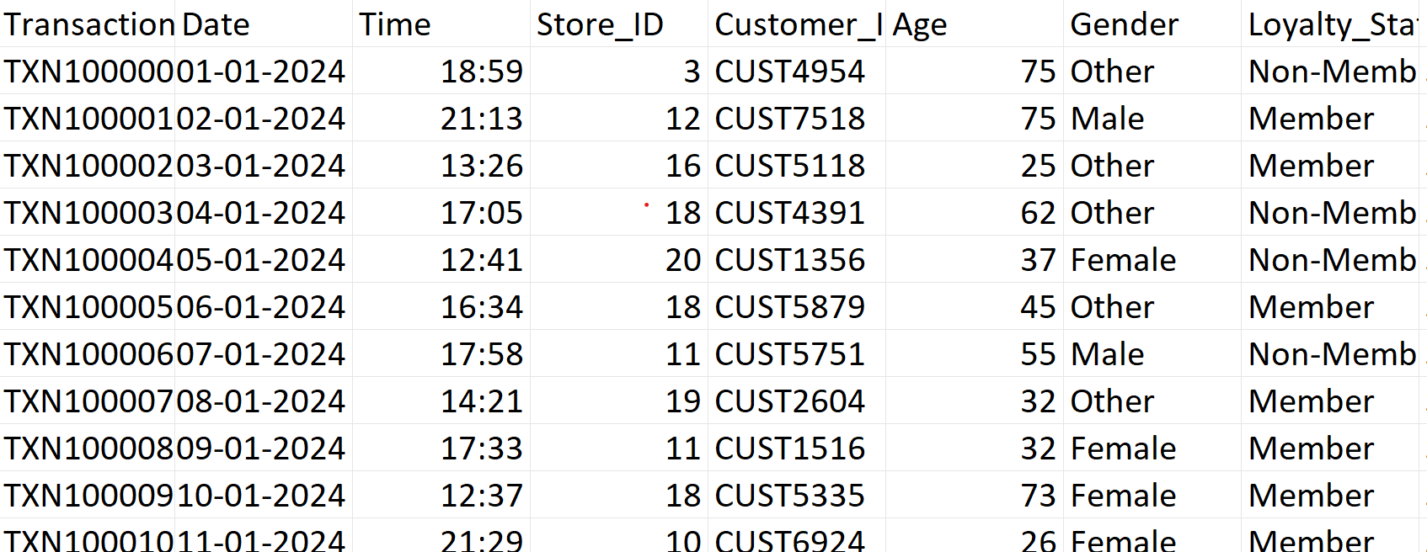
SAMPLE DATASET

Slide 10
METHODOLOGY
Data Collection
Collect shopper data from billing systems, loyalty cards, footfall counters, or online stores.
Data Preprocessing
Clean the data (remove errors, duplicates).
Organize it into useful categories like time, product, and customer type.
Data Analysis
Use tools like IBM COGNOS , Identify peak hours, popular products, loyal customers, etc.

Slide 11
METHODOLOGY
Dashboard Design
Create a user-friendly dashboard using Power BI / Tableau / Python Dash.
Include visuals like bar graphs, pie charts, and heatmaps.
Insight Generation
Extract meaningful patterns from the dashboard.
Suggest strategies based on the insights (e.g., increase staff at peak hours).
FINAL OUTPUT
Summarize findings.
Give practical suggestions to improve customer experience and sales.

Slide 12
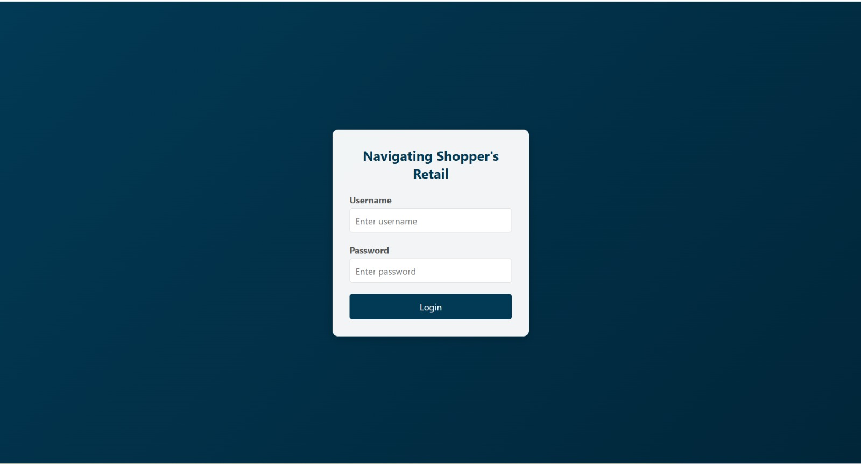
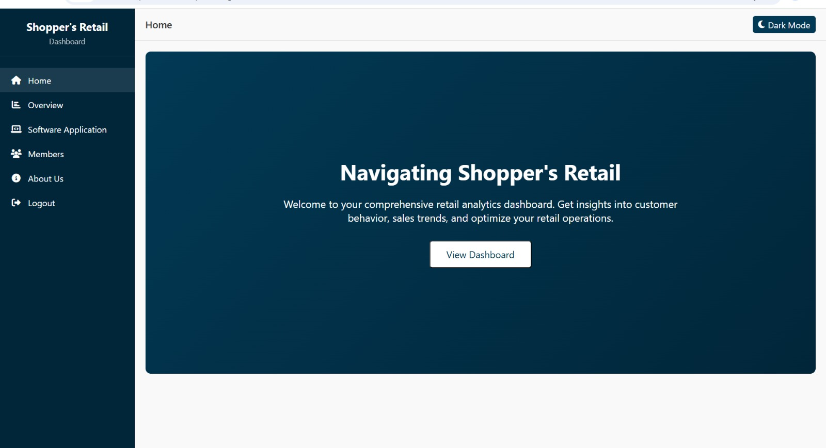
.
LOGIN PAGE
.
DASHBOARD

Slide 13
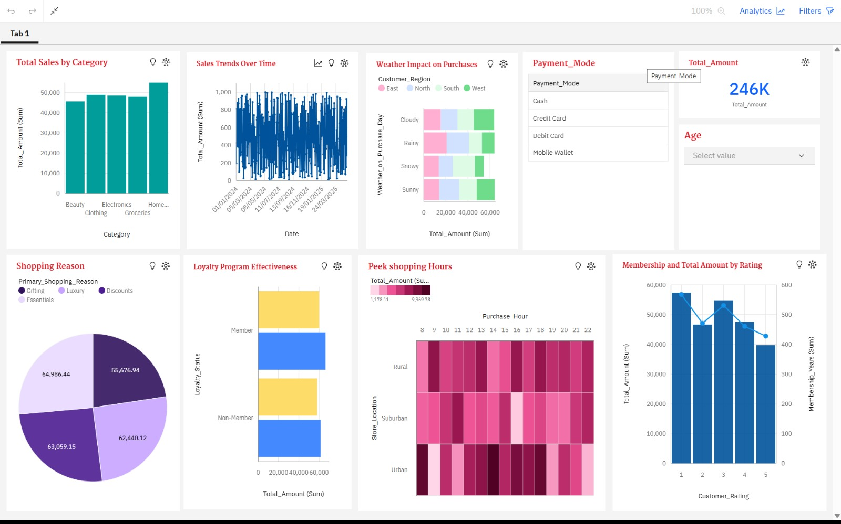
DASHBOARD
.

Slide 14
DASHBOARD DESCRIPTION
1. Total Sales by Category (Top-Left Chart)
Type: Vertical Bar Chart
Purpose: Shows the total sales amount for each product category.
Insight: Home category has the highest sales, followed by Groceries, Electronics, Clothing, and Beauty.
2. Sales Trends Over Time (Top Middle Chart)
Type: Line Chart
Purpose: Displays how sales have fluctuated over time, based on daily total amount.
Insight: Sales appear consistent across dates, with slight fluctuations—indicating regular customer activity.
3. Weather Impact on Purchases (Top Middle-Right Chart)
Type: Heatmap
Purpose: Shows how different weather conditions affect purchasing behavior across customer regions.
Insight: Some weather conditions (like Sunny ) lead to higher purchase amounts in certain regions.

Slide 15
ADAVNTAGES:
💡 Enhanced Customer Understanding
📈 Smarter Inventory Management
🤝 Improved Customer Engagement
💸 Boosted Sales & Revenue
📊 Better Decision-Making

Slide 16
Thank you

