Slide 1
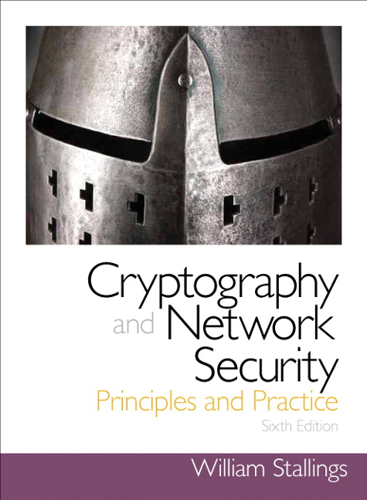
Chapter 2
Classical Encryption Techniques

Slide 2
Symmetric Encryption
The only type of encryption in use prior to the development of public-key encryption in the 1970s
Remains by far the most widely used of the two types of encryption

Slide 3
Basic Terminology
Plaintext
The original message
Ciphertext
The coded message
Enciphering or encryption
Converting plaintext to ciphertext
Deciphering or decryption
Restoring the plaintext from the ciphertext

Slide 4
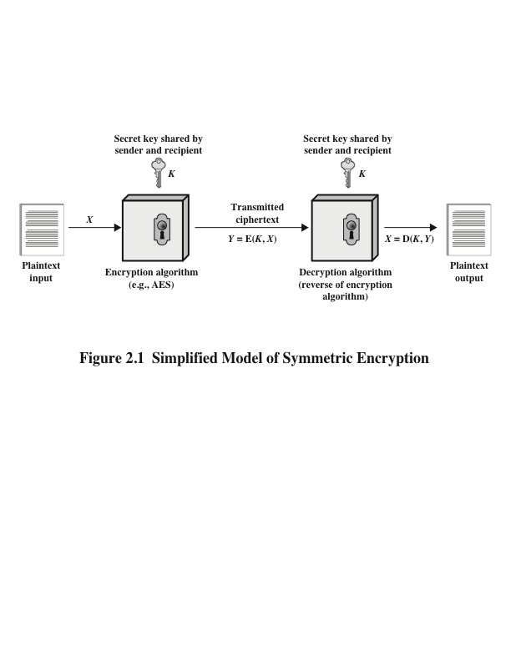
Model for symmetric encryption

Slide 5
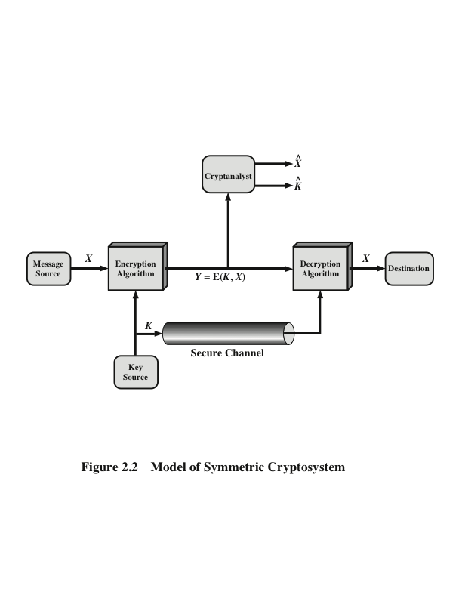
Security model for symmetric encryption

Slide 6

Security through obscurity and Kerchoffs’ assumption
Security through obscurity The secrecy of the design or implementation is the main method of providing security.
Kerchoffs’ assumption The adversary knows all details of the encryption function except the secret key

Slide 7
Cryptographic Protocols
Design features:
Two types of operations used for transforming plaintext to ciphertext
Substitution
(confusion)
Transposition
(diffusion)
Number of keys used
Symmetric single-key
Asymmetric two-keys
public encryption key
private decryption key
The way in which the plaintext is processed
Block cipher
Stream cipher

Slide 8
Cryptanalysis and Brute-Force Attack
Cryptanalysis, based on:
The nature of the algorithm plus some knowledge of the general characteristics of the plaintext
The characteristics of the algorithm to find a specific plaintext or the key being used
Brute-force attack
Attacker tries every possible key on a piece of ciphertext until an intelligible translation into plaintext is obtained
On average, half of all possible keys must be tried to achieve success

Slide 9
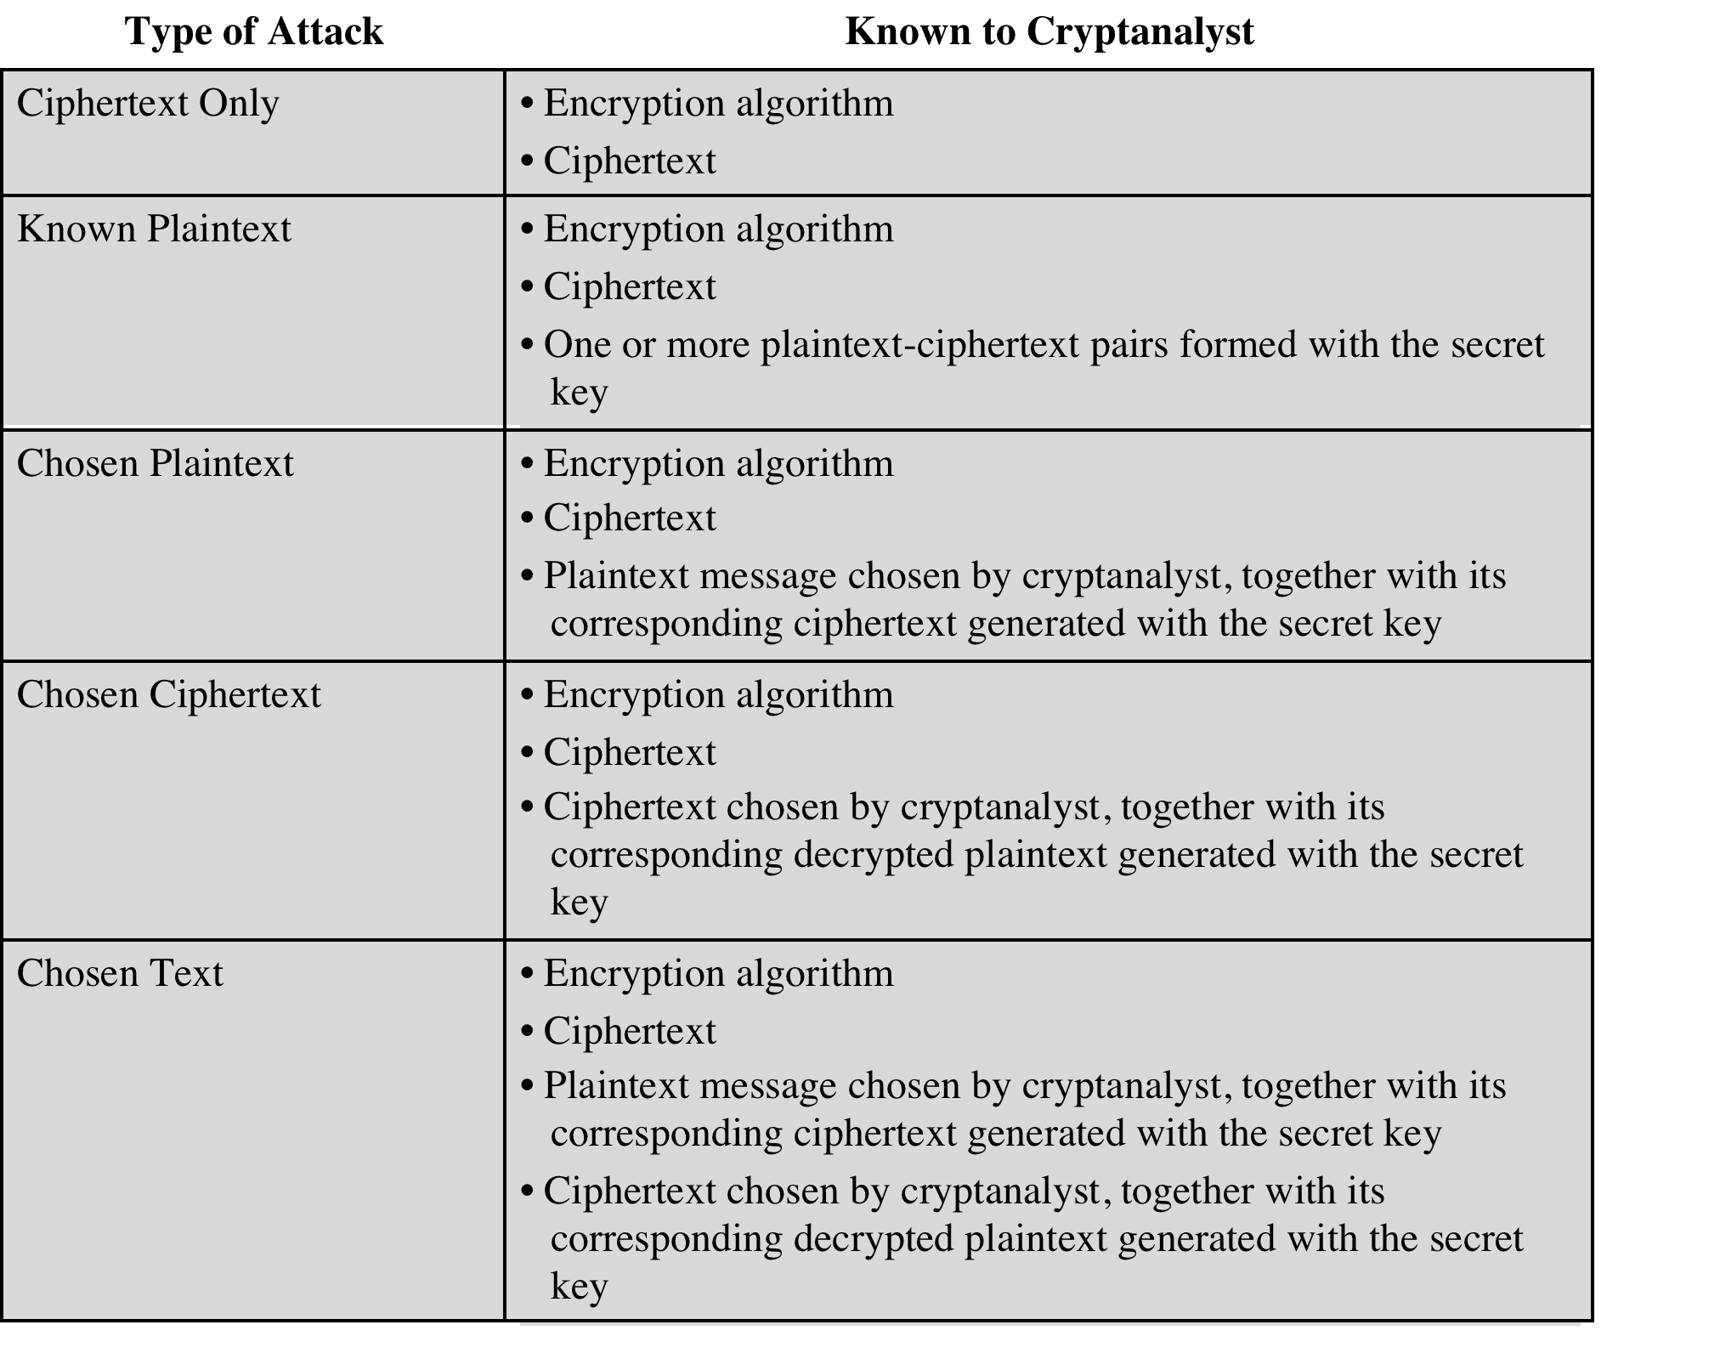

Slide 10
Security of Encryption
Unconditionally secure
No matter how much time or computational power an opponent has, it is impossible to decrypt the ciphertext
Computationally secure
The cost of breaking the cipher exceeds the value of the encrypted information
The time required to break the cipher exceeds the useful lifetime of the information

Slide 11
Brute-Force Attack
Try every possible key until an intelligible translation of the ciphertext into plaintext is obtained
On average half of all possible keys must be tried to achieve success
To supplement the brute-force approach, some degree of knowledge about the expected plaintext is needed, and some means of automatically distinguishing plaintext from garble

Slide 12
Substitution Techniques (confusion)
The letters of plaintext are replaced by other letters or numbers or symbols
The plaintext is viewed as a sequence of bits, and plaintext bit patterns are replaced with ciphertext bit patterns
Adds confusion: makes the relation between the key and the ciphertext complex

Slide 13
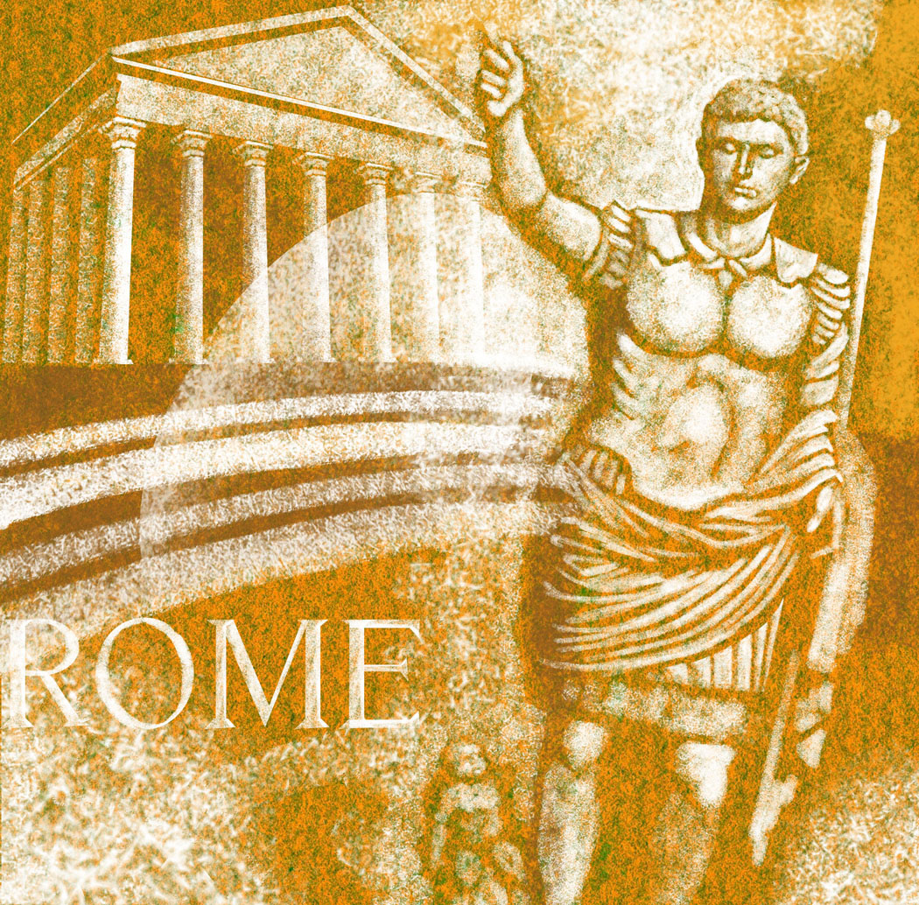
Substitution Cipher Caesar Cipher
Replacing each letter of the alphabet with the letter standing k=3 places further down the alphabet
Alphabet is wrapped around so that the letter following Z is A
For k=3,
plaintext: mee t me af t e r t h e t oga pa r t y
ciphertext: PHHW PH DIWHU WKH WRJD SDUWB

Slide 14
Caesar Cipher Algorithm
Can define transformation as:
a b c d e f g h i j k l m n o p q r s t u v w x y z
D E F G H I J K L M N O P Q R S T U V W X Y Z A B C
Mathematically give each letter a number
a b c d e f g h i j k l m n o p q r s t u v w x y z
0 1 2 3 4 5 6 7 8 9 10 11 12 13 14 15 16 17 18 19 20 21 22 23 24 25
Algorithm can be expressed as:
c = E(3, p) = (p + 3) mod 26
A shift may be of any amount, so that the general Caesar algorithm is:
C = E(k , p ) = (p + k ) mod 26
Where k takes on a value in the range 1 to 25; the decryption algorithm is simply:
p = D(k , C ) = (C - k ) mod 26

Slide 15
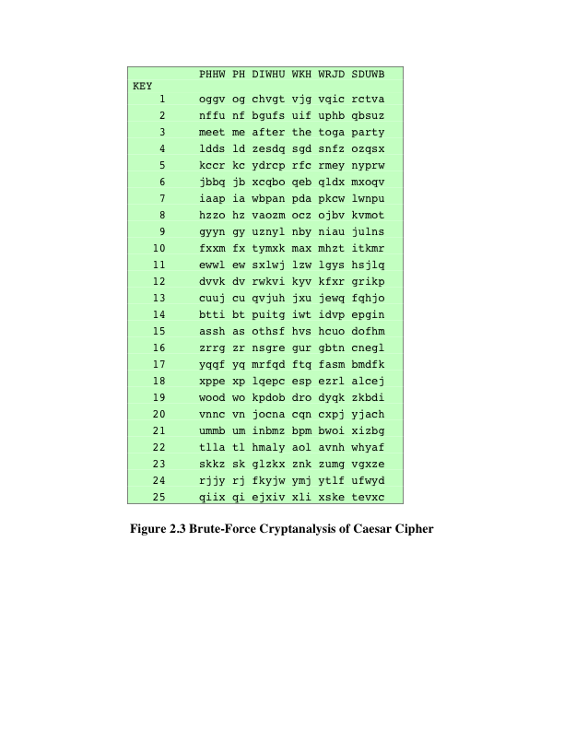
Brute-Force Cryptanalysis of Caesar Cipher

Slide 16
Monoalphabetic Cipher
Permutation of a finite set S
An ordered sequence of the elements of S , each one appearing exactly once
If the cipher can be any permutation of the 26 alphabetic characters, then there are 26! or greater than 4 x 10²⁶ possible keys
This is roughly 10 orders (5,551,115,123) of magnitude greater than the key space for DES (2⁵⁶) *
Called monoalphabetic substitution because a single cipher alphabet is used per message
* Length of the key of a permutation: $\log_{2}\left(5×2^{30}\right)+\log_{2}{2^{56}}\sim \log_{2}{2^{33}+56=}89$bits

Slide 17

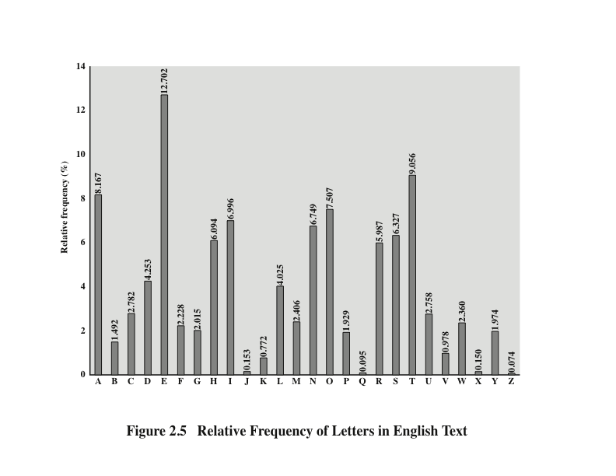
$$↤HA 1$$

Slide 18

Monoalphabetic Ciphers
Easy to break because they reflect the frequency data of the original alphabet
Countermeasure is to provide multiple substitutes (homophones) for a single letter
Digram
Two-letter combination
Most common is th
Trigram
Three-letter combination
Most frequent is the
$$↤HA 1$$

Slide 19
What you should know at this time . . .
Two factor authentication: What is needed to access CANVAS?
How many keys are used in symmetric encryption
How many keys are used in asymmetric encryption
Substitution is used to establish confusion, or is it diffusion?
[Transposition is used to establish diffusion, or is it confusion?]
Hint:
Substituting letters with Caesar’s cipher confused barbarians.
Transposing letters of a message with the Spartans scytale diffused the letters of the message.

Slide 20
Playfair Cipher
Multiple-letter encryption cipher
Treats digrams in the plaintext as single units and translates these units into ciphertext digrams
Based on the use of a 5 x 5 matrix of letters constructed using a keyword
Used as the standard field system by the British Army in World War I and the U.S. Army and other Allied forces during World War II

Slide 21
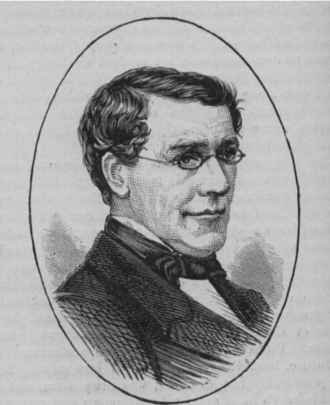
Playfair cipher
Charles Wheatstone
Fill in letters of keyword (minus duplicates) from left to right and from top to bottom, then fill in the remainder of the matrix with the remaining letters in alphabetic order.
Letters in same row: replace with letters immediately to the right
Letters in same column: replace with letters immediately below
Wrap around if necessary
Otherwise: replace with letters on same row but at other corner
If both letters in a pair are the same insert an X; if there is only one letter at the end add X.
Keyword MONARCHY:
M | O | N | A | R
C | H | Y | B | D
E | F | G | I/J | K
L | P | Q | S | T
U | V | W | X | Z
plaintext: H I D E C E V W C U Z V
ciphertext: b f c k e l w x e m u w

Slide 22
Relative occurrence frequency of letters

Slide 23
Polyalphabetic Ciphers
Polyalphabetic substitution cipher
Uses different monoalphabetic substitutions as one proceeds through the plaintext message
All these techniques have the following features in common:
A set of related monoalphabetic substitution rules is used
A key determines which particular rule is chosen for a given transformation

Slide 24
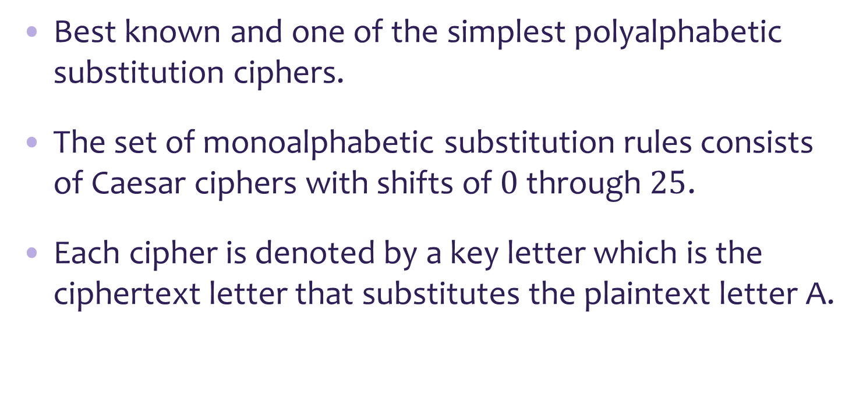
Vigenère Cipher (1918)
Best known and one of the simplest polyalphabetic substitution ciphers.
The set of monoalphabetic substitution rules consists of Caesar ciphers with shifts of $0$ through $25$.
Each cipher is denoted by a key letter which is the ciphertext letter that substitutes the plaintext letter A.

Slide 25
Example of Vigenère Cipher
The key needs to be as long as the message
Repeat the keyword
Example:
keyword D E C E P T I V E
key: D E C E P T I V E D E C E P T I V E D E C E P T I V E
plaintext: W E A R E D I S C O V E R E D S A V E Y O U R S E L F
ciphertext: z i c v t w q n g r z g v t w a v z h c q y g l m j j

Slide 26
Vigenère Autokey System
The keyword is concatenated with the plaintext itself to provide a running key
Example:
key: D E C E P T I V E W E A R E D I S C O V E R E D S A V
plaintext: W E A R E D I S C O V E R E D S A V E Y O U R S E L F
ciphertext: z i c v t w q n g k z e i i g a s x s t s l v v w l a
Even this scheme is vulnerable to cryptanalysis
Because the key and the plaintext share the same frequency distribution of letters, a statistical technique can be applied

Slide 27
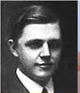
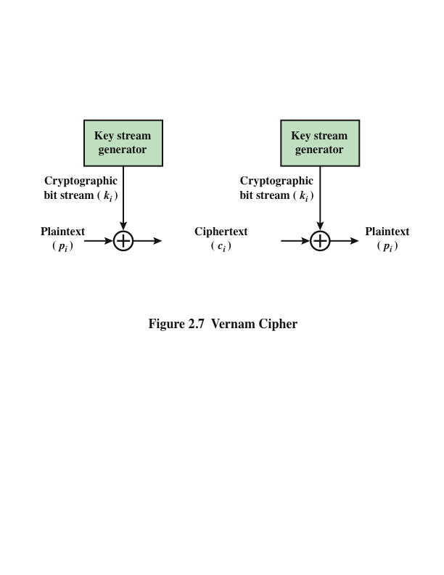
Vernam Cipher
←uses a paper tape for key→
Vernam Cipher

Slide 28
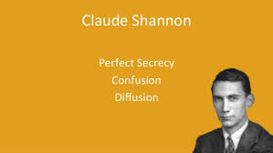
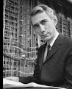
One-Time Pad
Improvement proposed by an Army Signal Corp officer, Joseph Mauborgne
Use a random key that is as long as the message so that the key need not be repeated
Key is used to encrypt and decrypt a single message and then is discarded
Each new message requires a new key of the same length as the new message
Scheme is unbreakable
Produces random output that bears no statistical relationship to the plaintext
Because the ciphertext contains no information whatsoever about the plaintext, there is simply no way to break the code

Slide 29
Perfect secrecy - Difficulties
The one-time pad offers unconditional security = perfect secrecy.
However distributing random keys that are as long as the message to be sent is a fundamental key distribution problem
Because of this, the one-time pad is of limited utility
Used primarily for low-bandwidth channels requiring very high security

Slide 30
Transposition techniques (Diffusion)
Transposition ciphers add diffusion
Spread out the bits of the message in the ciphertext.
Make the relationship between the plaintext and the ciphertext complex.

Slide 31

Rail Fence Cipher (Transposition cipher)
Plaintext is written down as a sequence of diagonals and then read off as a sequence of rows
To encipher the message . “MEET ME AFTER THE TOGA PARTY” with a Rail Fence cipher of depth 2, we would write:
M . E . M . A . T . R . H . T . G . P . R . Y
E . T . E . F . E . T . E . O . A . A . T
Encrypted message is:
m e m a t r h t g p r y e t e f e t e o a a t
M E M A T R H T
E T E F E T E O

Slide 32
Transposition Cipher with a key
A more complex transposition cipher
Write the message in a rectangle, row by row, and read the message off, column by column, but permute the order of the columns
The order of the columns then becomes the key to the algorithm
Key: 4 3 1 2 5 6 7
Plaintext: A T T A C K P
O S T P O N E
D U N T I L T
W O A M X Y Z
Ciphertext: ttnaaptmtsuoaodwcoixknlypetz

Slide 33
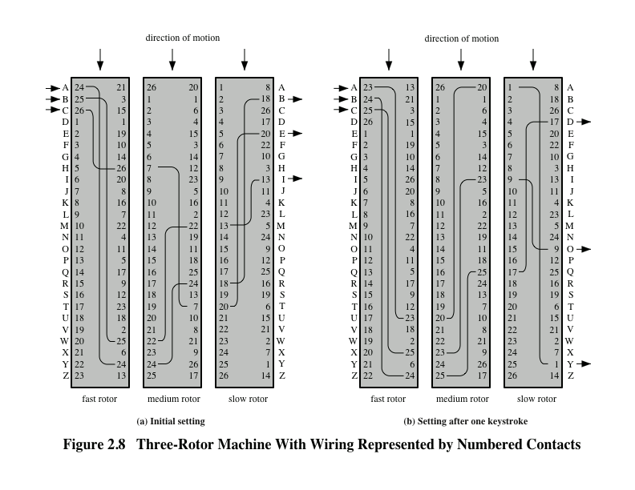
Rotor Machines - substitution ciphers
ro | period
3 | 17,567
4 | 456,978
5 | 11,881,376

Slide 34

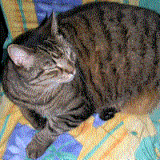
Steganography Techniques
Character marking
Selected printed letters are over-written in pencil
Markings are not visible unless the paper is held at an angle to bright light
Invisible ink
Pin punctures
Small pin punctures on selected letters are ordinarily not visible
… and much more
Image of a cat extracted from the tree --Wikipedia.

Slide 35
Summary
Symmetric Ciphers
cryptography
cryptanalysis
Transposition techniquesss
Substitution techniques
Steganography

