Slide 1

Chapter 6
Block Cipher Operation Modes

Slide 2
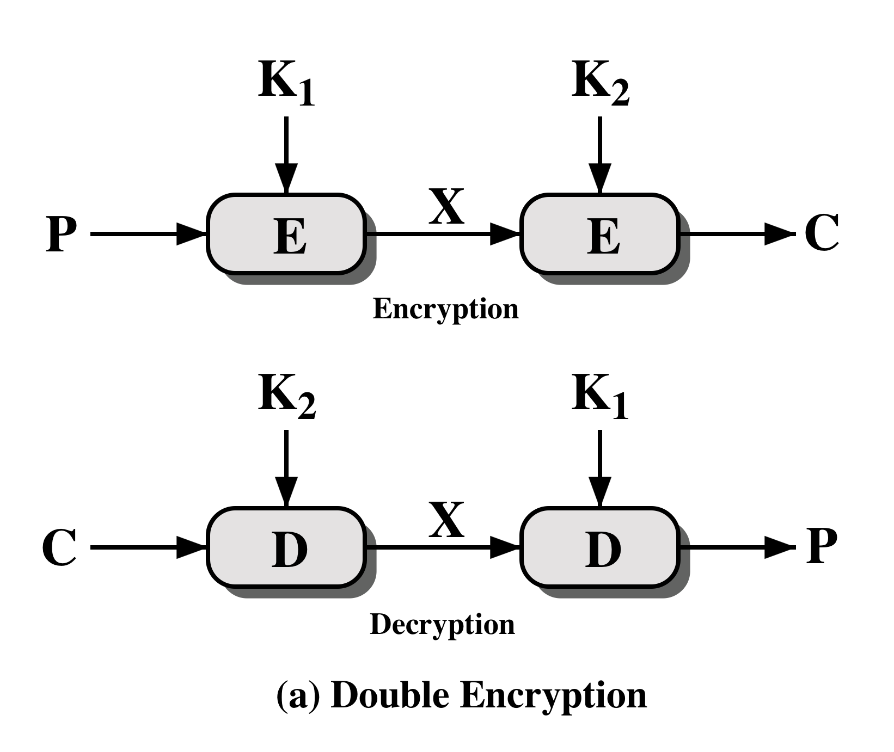
Double DES

Slide 3
Meet-in-the-Middle Attack
The use of double DES results in a mapping that is not equivalent to two single DES encryptions
The meet-in-the-middle attack algorithm defeats double DES by reducing it to single DES

Slide 4
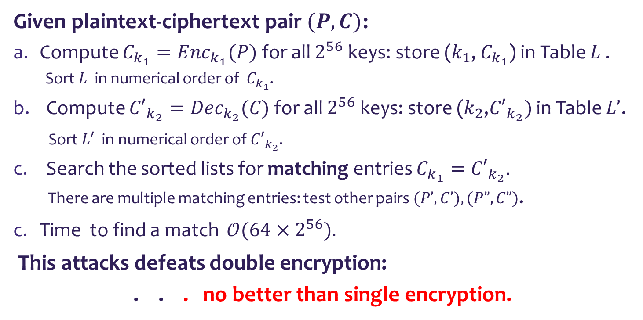



Meet-in-the-Middle Attack, 1
?
$$k_{1}$$
$$C_{k_{1}}={C′}_{k_{2}}$$
$$k_{2}$$
P
C
Given plaintext-ciphertext pair $(P,C)$:
Compute $C_{k_{1}}={Enc}_{k_{1}}(P)$ for all $2^{56}$ keys: store ($k_{1}$, $C_{k_{1}}$) in Table $L$ .
Sort $L$ in numerical order of $C_{k_{1}}$.
Compute ${C′}_{k_{2}}={Dec}_{k_{2}}(C)$ for all $2^{56}$ keys: store ($k_{2}$,${C′}_{k_{2}})$ in Table $L’$.
Sort $L′$ in numerical order of ${C′}_{k_{2}}$.
Search the sorted lists for matching entries $C_{k_{1}}={C′}_{k_{2}}.$
There are multiple matching entries: test other pairs $(P’,C’), (P”,C”)$.
Time to find a match $𝒪(64{×2}^{56}).$
This attacks defeats double encryption:
. . . no better than single encryption.

Slide 5
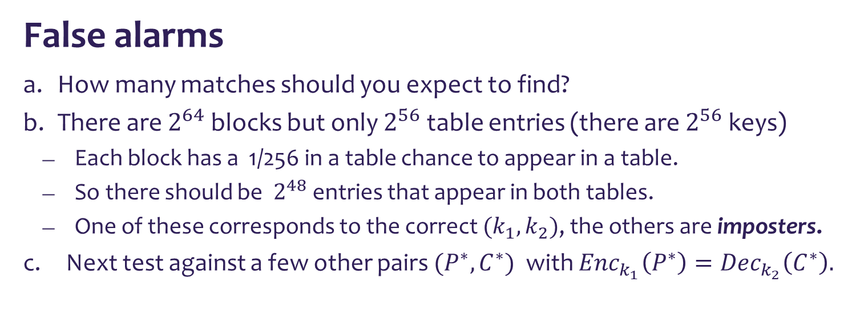
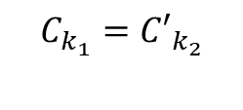


Meet-in-the-Middle Attack, 2
?
P
$$k_{1}$$
$$C_{k_{1}}={C′}_{k_{2}}$$
$$k_{2}$$
C
False alarms
How many matches should you expect to find?
There are $2^{64}$ blocks but only $2^{56}$ table entries (there are $2^{56}$keys)
Each block has a 1/256 in a table chance to appear in a table.
So there should be $2^{48}$ entries that appear in both tables.
One of these corresponds to the correct ${(k}_{1},k_{2})$, the others are imposters.
Next test against a few other pairs ${(P}^{∗},C^{∗})$ with ${Enc}_{k_{1}}\left(P^{∗}\right)={Dec}_{k_{2}}\left(C^{∗}\right).$

Slide 6

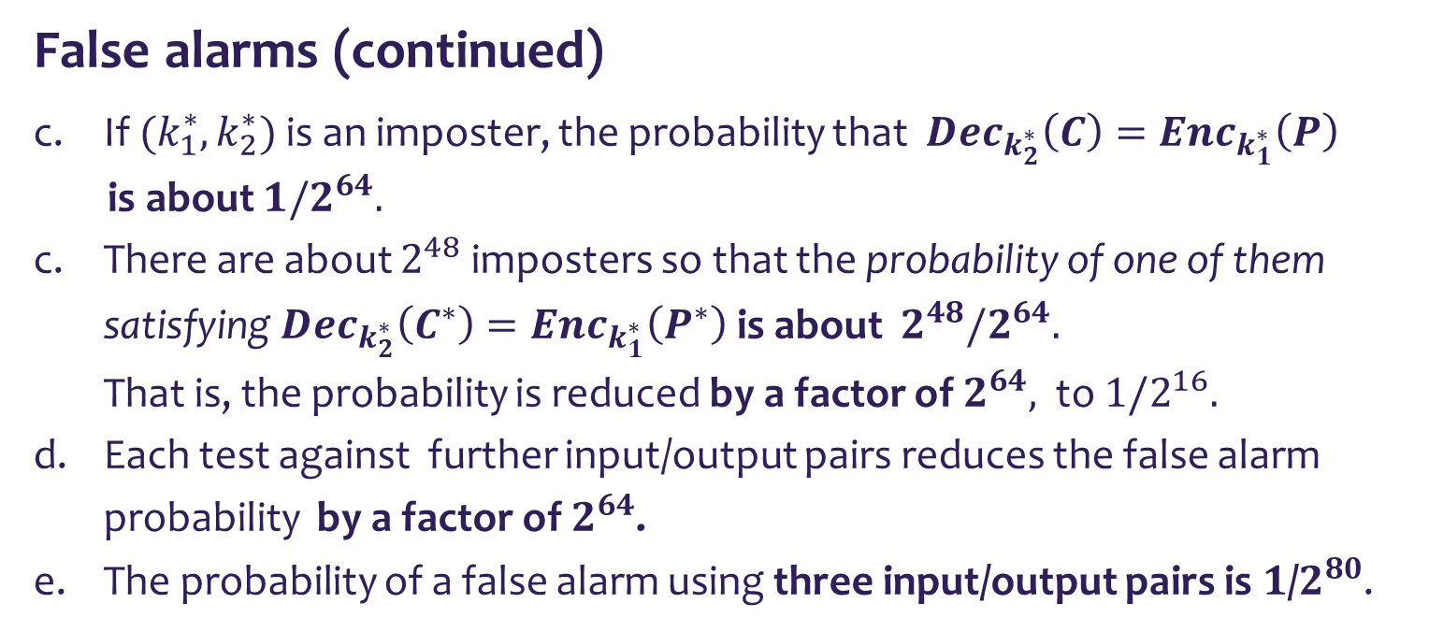


Meet-in-the-Middle Attack, 3
?
P
$$k_{1}^{∗}$$
$$C_{k_{1}}^{∗}=C_{k_{2}}^{∗′}$$
$$k_{2}^{∗}$$
C
False alarms (continued)
If $(k_{1}^{∗}, k_{2}^{∗})$ is an imposter, the probability that ${Dec}_{k_{2}^{∗}}\left(C\right)={Enc}_{k_{1}^{∗}}\left(P\right)$
is about ${1/2}^{64}.$
There are about $2^{48}$ imposters so that the probability of one of them satisfying ${Dec}_{k_{2}^{∗}}\left(C^{∗}\right)={Enc}_{k_{1}^{∗}}\left(P^{∗}\right)$ is about $2^{48}/2^{64}.$ That is, the probability is reduced by a factor of $2^{64},$ to ${1/2}^{16}.$
Each test against further input/output pairs reduces the false alarm probability by a factor of $2^{64}$.
The probability of a false alarm using three input/output pairs is $1$/$2^{80}$.

Slide 7
3DES with two & three keys
3DES with two keys is a relatively popular and has been adopted for use in the key management standards ANSI X9.17 and ISO 8732.
However it has been shown that it does not provide the 112 bit security for man-in-the middle attacks, but only ~80 bits security.
3DES with three keys in EDE mode is currently the most popular mode.

Slide 8

Multiple Encryption

Slide 9
Triple DES with Three Keys
Many researchers now feel that three-key 3DES is the preferred alternative
A number of Internet-based applications have adopted three-key 3DES including PGP and S/MIME
Three-key 3DES has an effective key length of 168 bits and is defined as:
C = E( K₃, D( K₂, E( K₁, P)))
Backward compatibility with two key 3DES is provided by putting:
K₃ = K1

Slide 10
Modes of Operation of Block Ciphers
A technique for enhancing the effect of a cryptographic algorithm or adapting the algorithm for an application
Five modes of operation have been defined by NIST
Intended to cover a wide variety of applications of encryption for which a block cipher could be used
Intended for use with any symmetric block cipher, including triple DES and AES

Slide 11
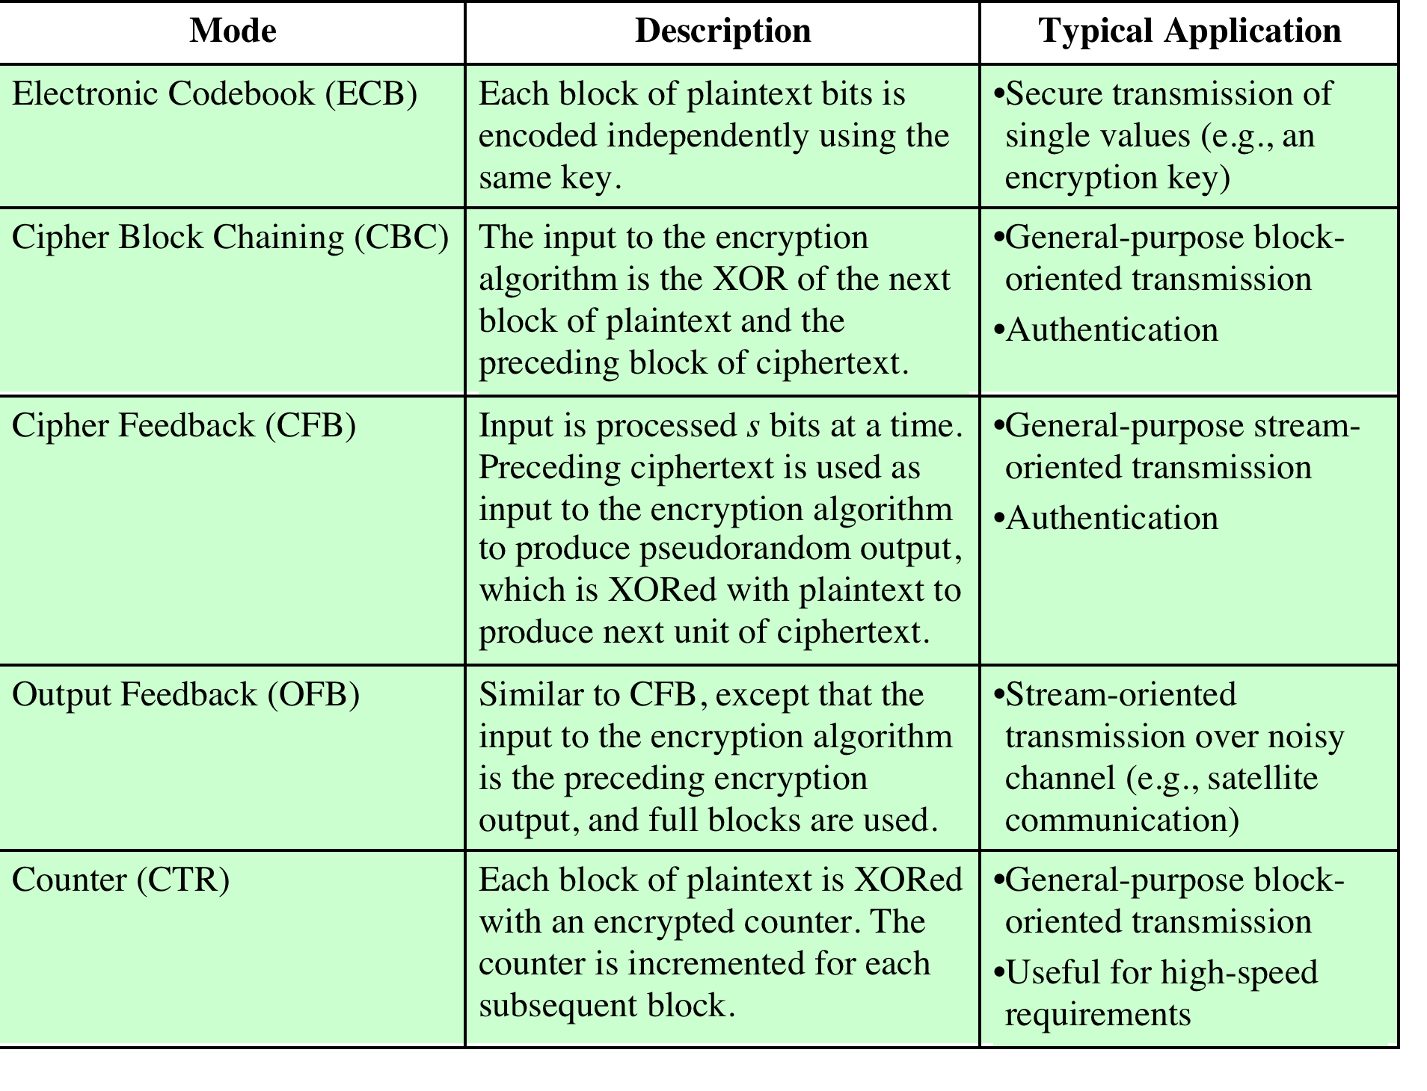

Slide 12
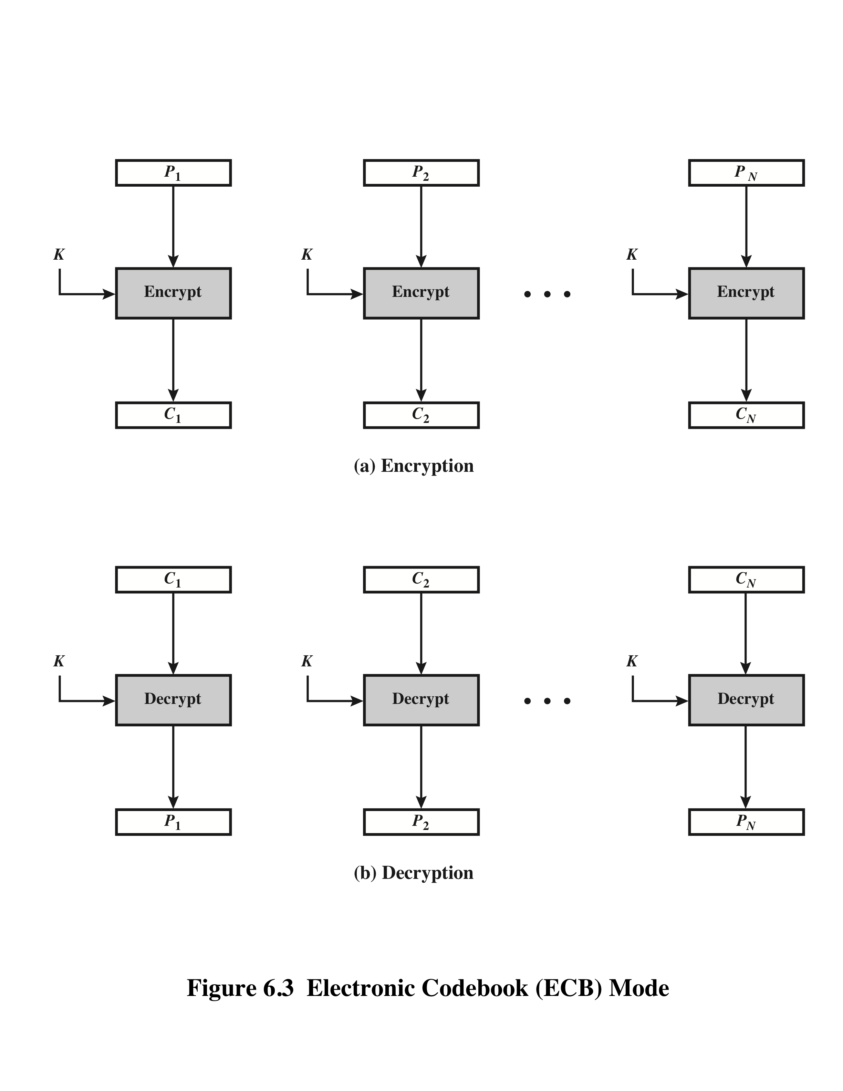
Electronic Codebook Mode (ECB)

Slide 13

Overhead
Error recovery
Error propagation
Diffusion
Security

Slide 14
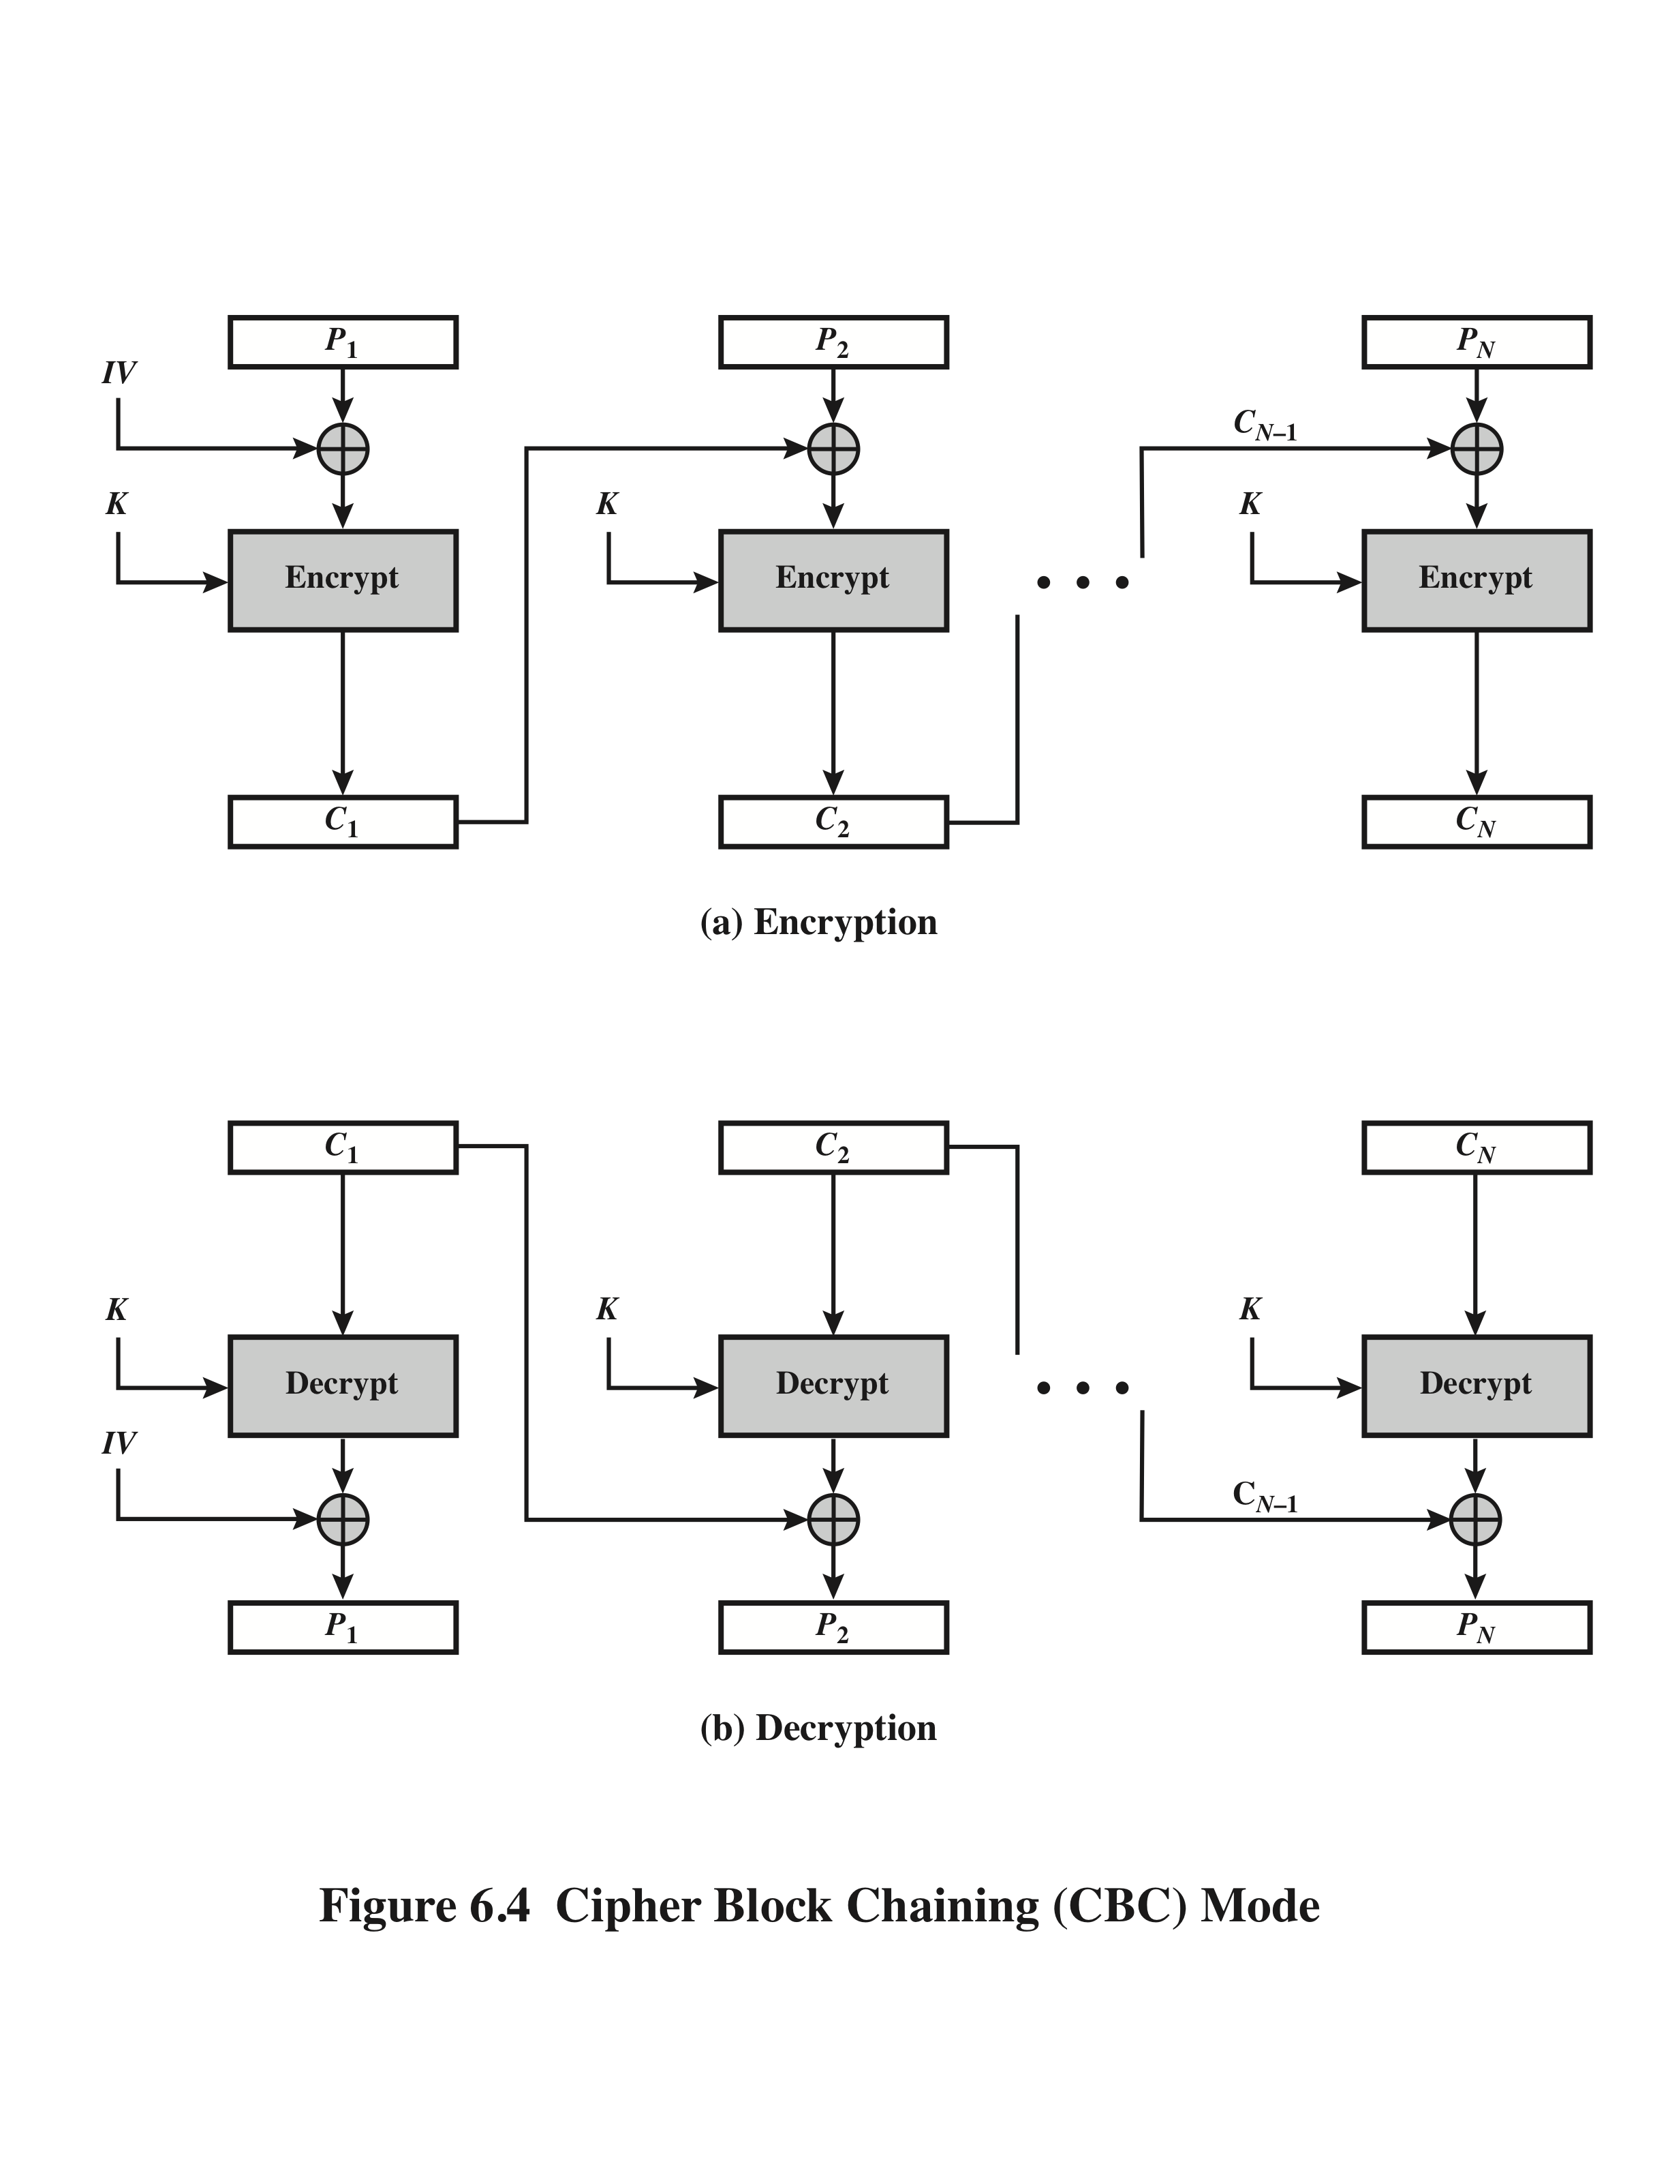
Cipher Block Chaining (CBC)
The initial vector IV
must not be predictable

Slide 15
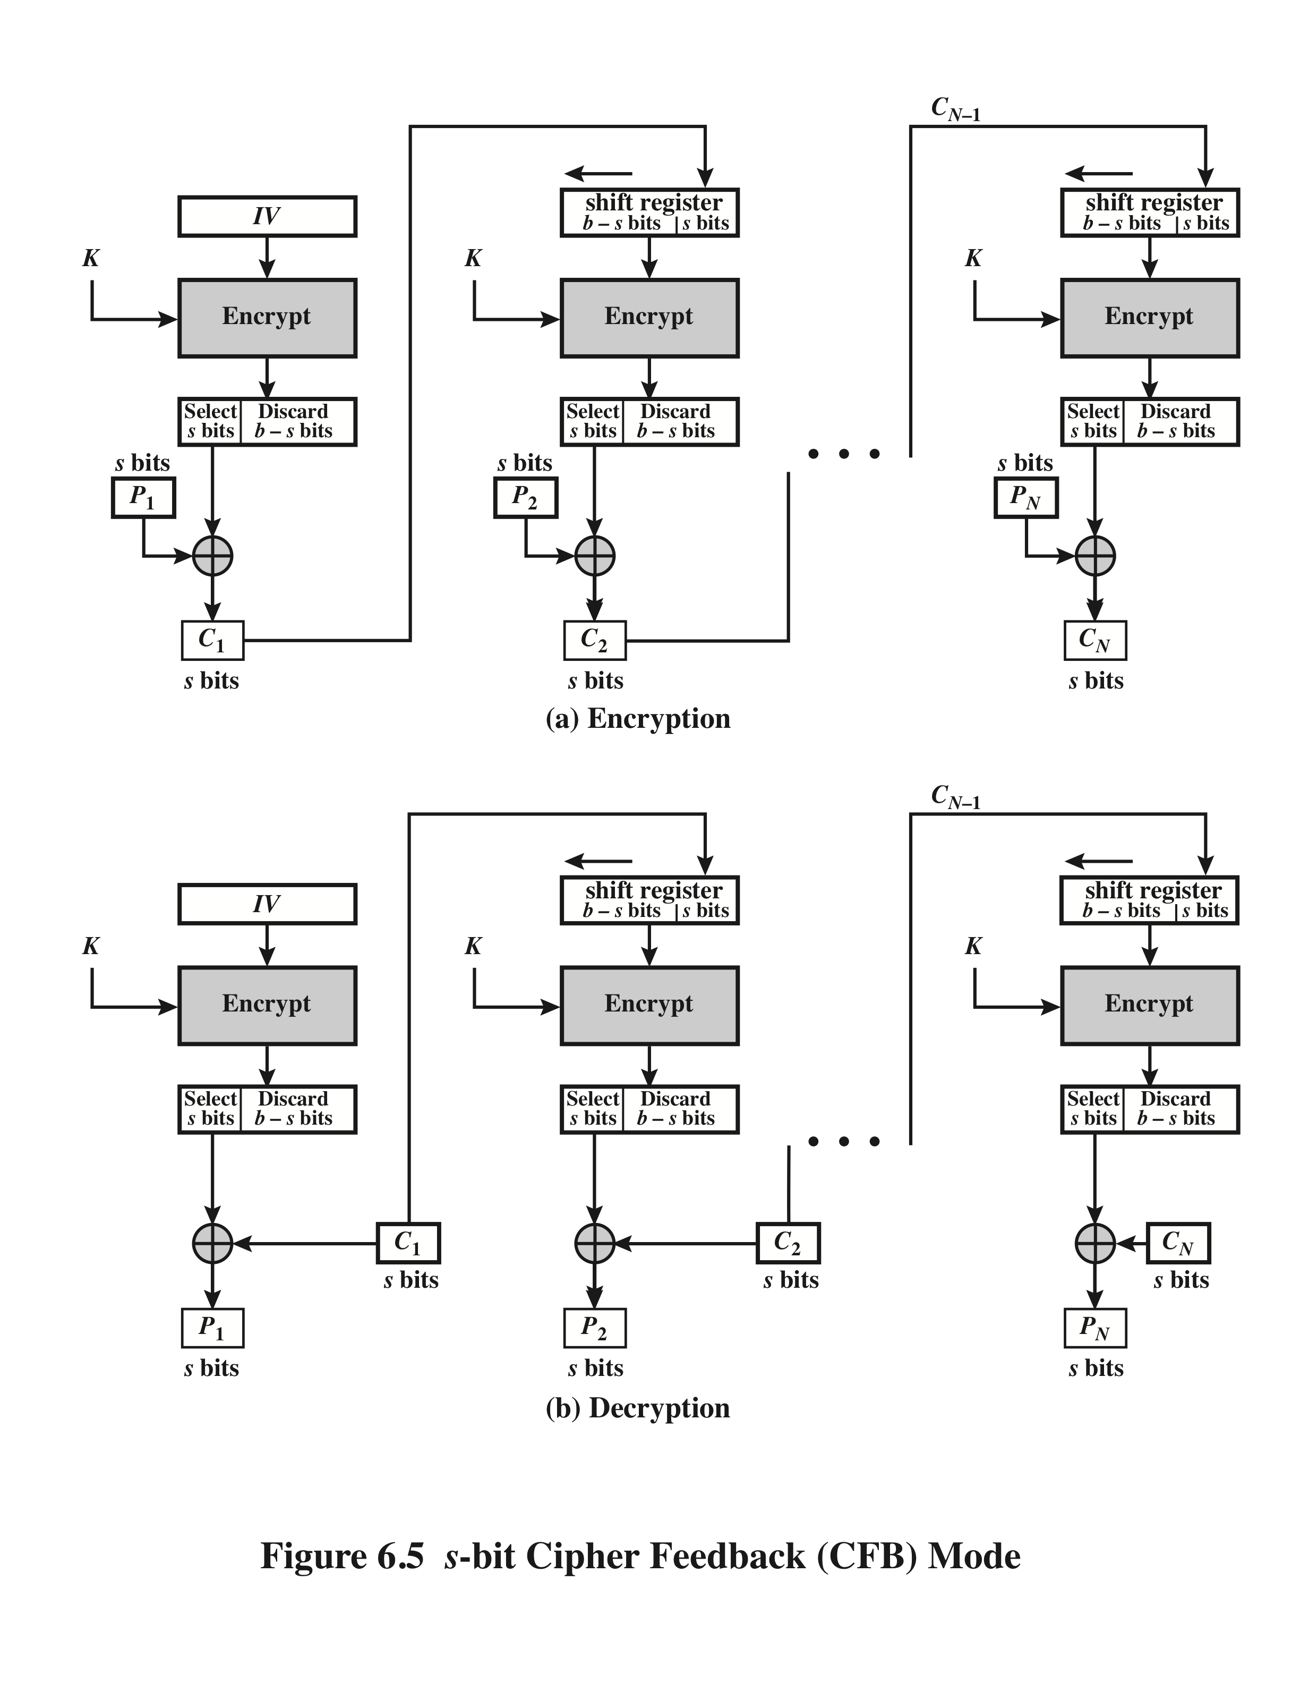
s-bit Cipher Feedback Mode (CFB)

Slide 16
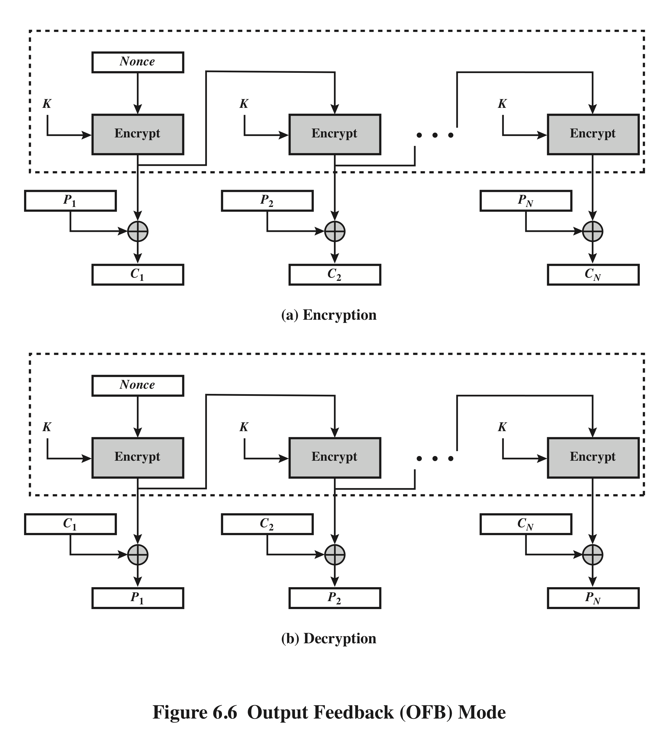
Output Feedback Mode (OFB)

Slide 17
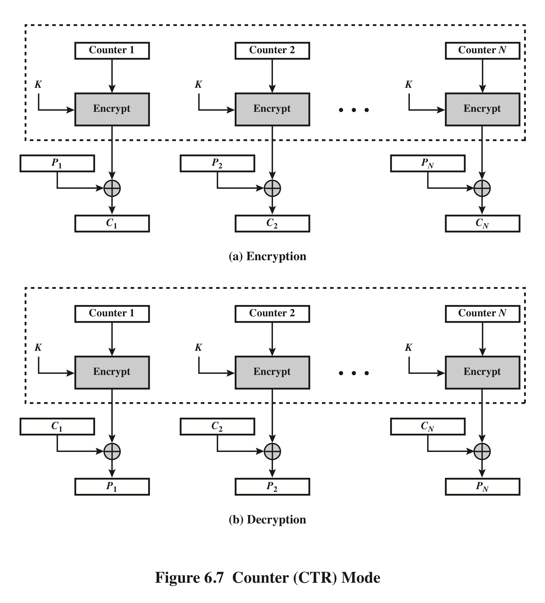
Counter Mode (CTR)

Slide 18
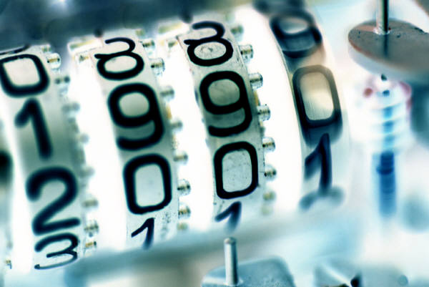
Advantages of CTR
Hardware efficiency
Software efficiency
Preprocessing
Random access
Provable security
Simplicity

Slide 19
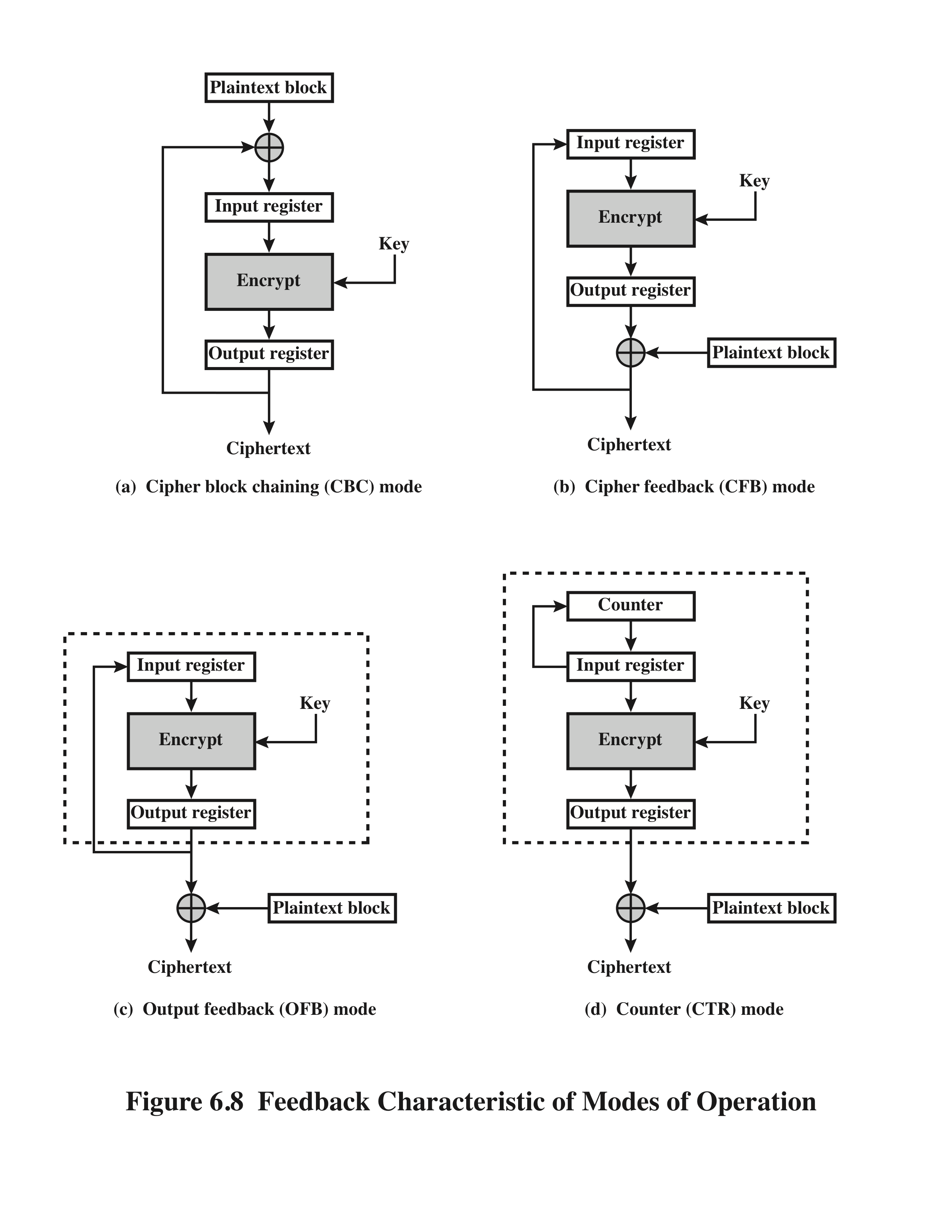
Feedback Characteristics of Modes of Operation

Slide 20
Block Chaining for Stream Ciphers
There are three modes that make it possible to convert a block cipher into a stream cipher:
Cipher feedback (CFB) mode
Output feedback (OFB) mode
Counter (CTR) mode
For AES, DES, or any block cipher, encryption is performed on a block of b bits
for DES: b = 64
for AES: b = 128

Slide 21
Summary
Multiple encryption and triple DES
Double DES
Triple DES with 2 keys
Triple DES with 3 keys
Electronic code book
Cipher block chaining mode
Cipher feedback mode
Output feedback mode
Counter mode

