Slide 1
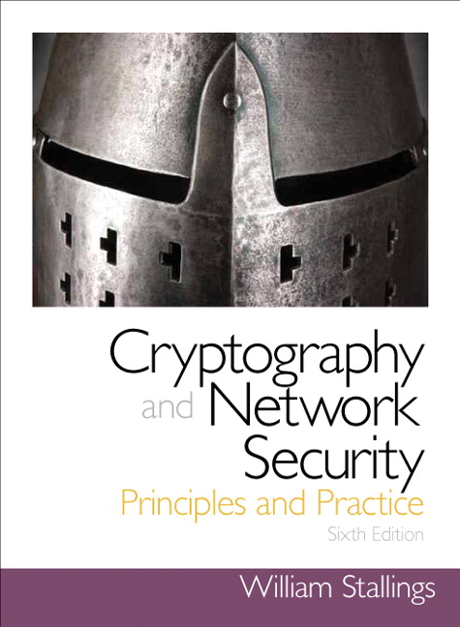
Chapter 8
More Number Theory

Slide 2
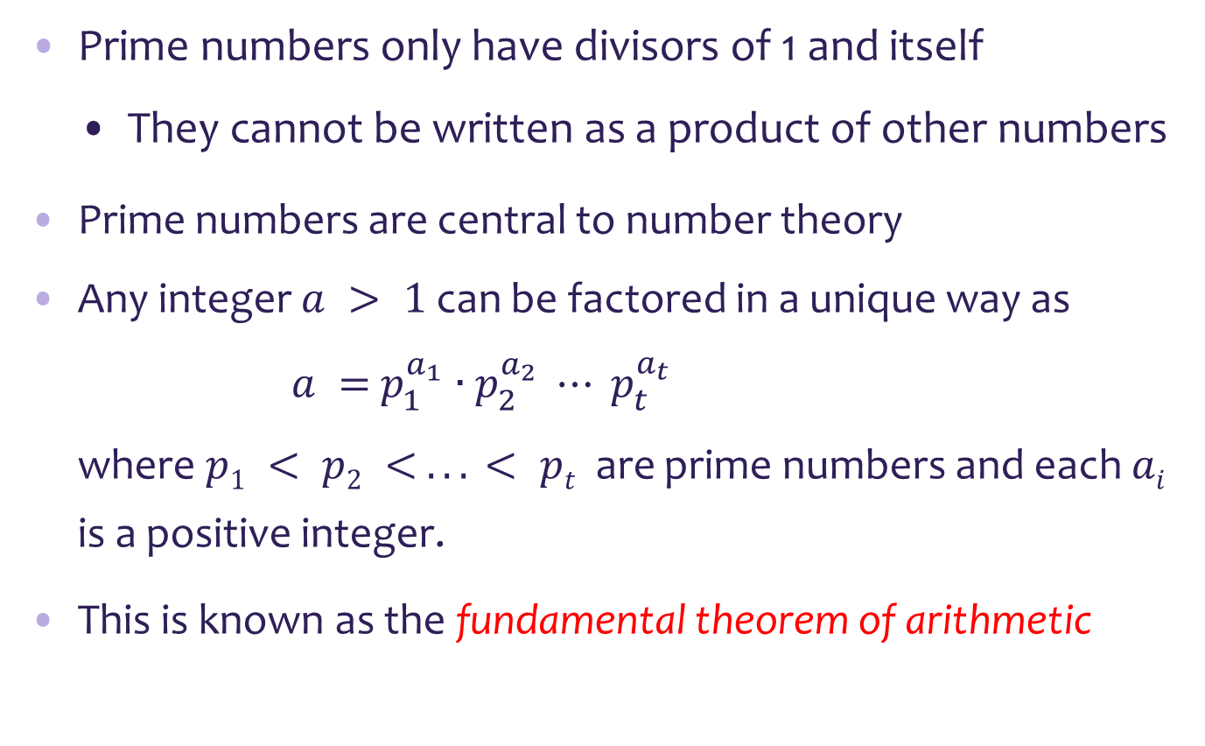
Prime Numbers
Prime numbers only have divisors of 1 and itself
They cannot be written as a product of other numbers
Prime numbers are central to number theory
Any integer $a > 1$can be factored in a unique way as
$a =$ $p_{1}^{a_{1}}∙p_{2}^{a_{2}} ⋯ p_{t}^{a_{t}}$
where $p1 < p2 < . . . < pt$are prime numbers and each $ai$ is a positive integer.
This is known as the fundamental theorem of arithmetic

Slide 3
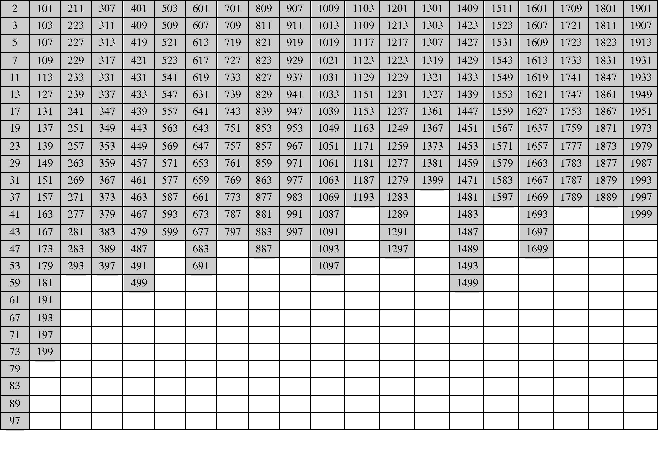
Table 8.1
Primes Under 2000

Slide 4
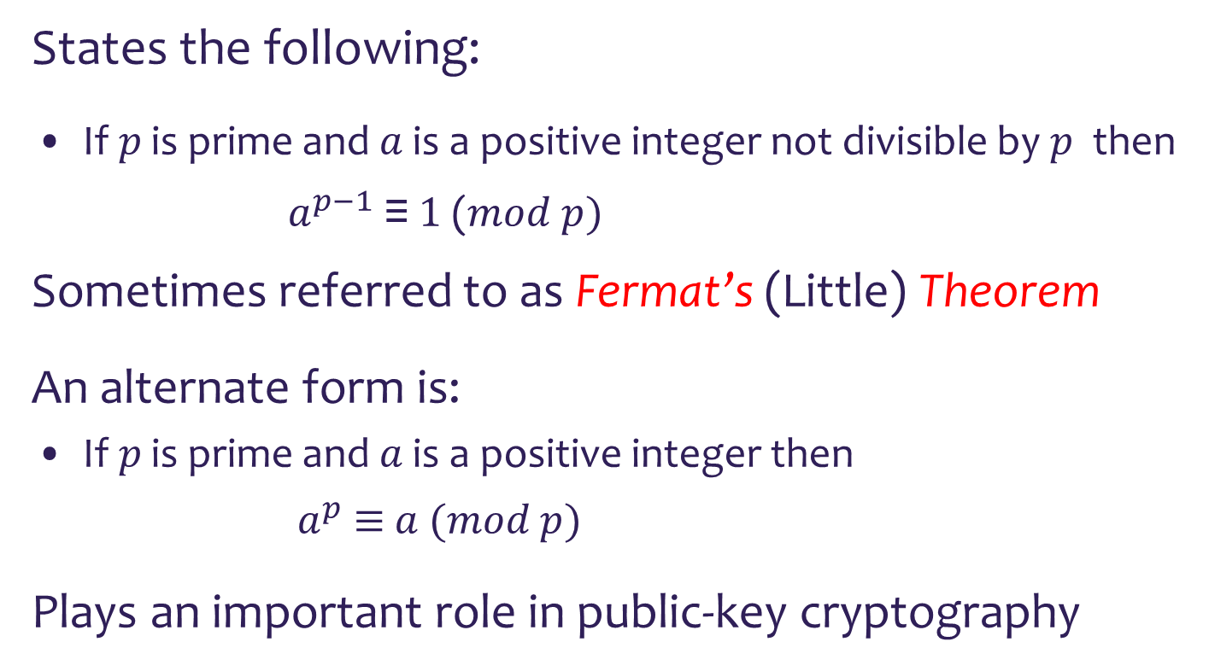
Fermat's Theorem
States the following:
If $p$ is prime and $a$ is a positive integer not divisible by $p$ then
$a^{p−1}$ ≡ $1$ ($mod p)$
Sometimes referred to as Fermat’s (Little) Theorem
An alternate form is:
If $p$ is prime and $a$ is a positive integer then
$a^{p}$ $≡$ $a$ $(mod p)$
Plays an important role in public-key cryptography

Slide 5

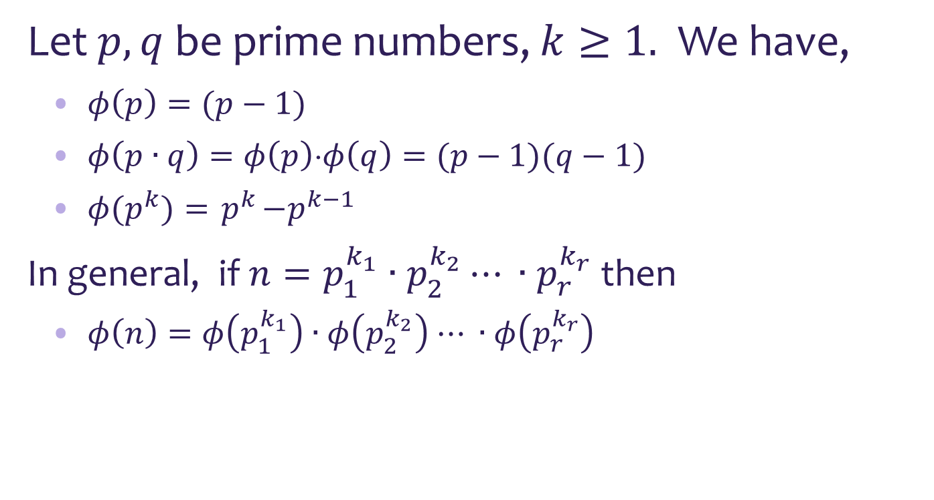
Euler's totient function $φ$
Let $p,q$be prime numbers, $k≥1.$ We have,
$φ\left(p\right)=(p−1)$
$φ\left(p∙q\right)=φ\left(p\right)⋅φ\left(q\right)=(p−1)(q−1)$
$φ{(p}^{k})={ p}^{k}−p^{k−1}$
In general, if $n=p_{1}^{k_{1}}∙p_{2}^{k_{2}}⋯ ∙p_{r}^{k_{r}}$ then
$φ\left(n\right)=φ\left(p_{1}^{k_{1}}\right)∙$ $φ\left(p_{2}^{k_{2}}\right)$ $⋯ ∙$ $φ\left(p_{r}^{k_{r}}\right)$
The totient function plays an important role in public-key cryptography.

Slide 6
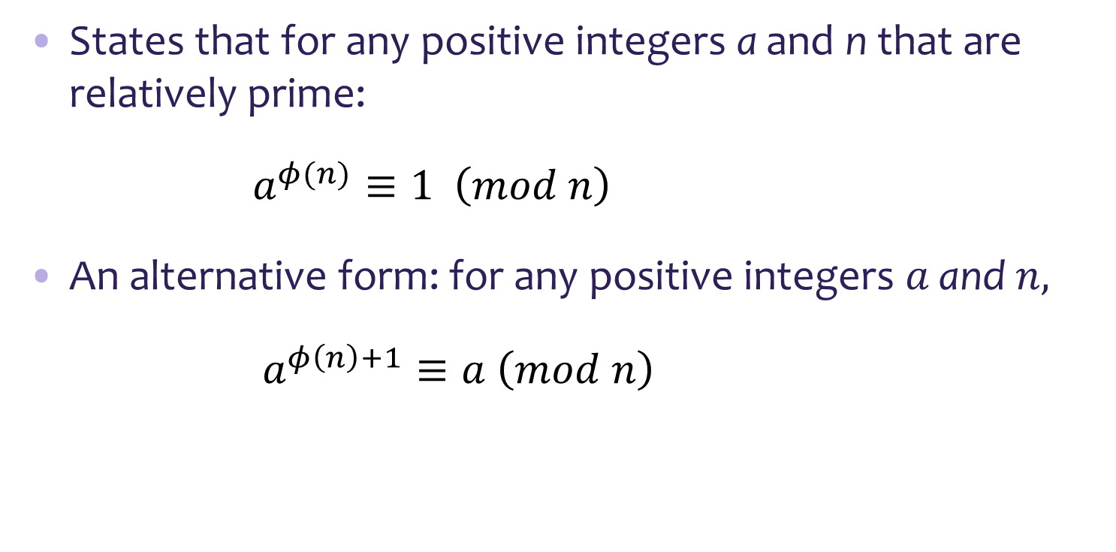
Euler's Theorem
States that for any positive integers a and n that are relatively prime:
$a^{φ(n)}≡1 \left(mod n\right)$
An alternative form: for any positive integers $a$ and $n,$
$a^{φ\left(n\right)+1}≡a \left(mod n\right)$
Plays an important role in public-key cryptography

Slide 7
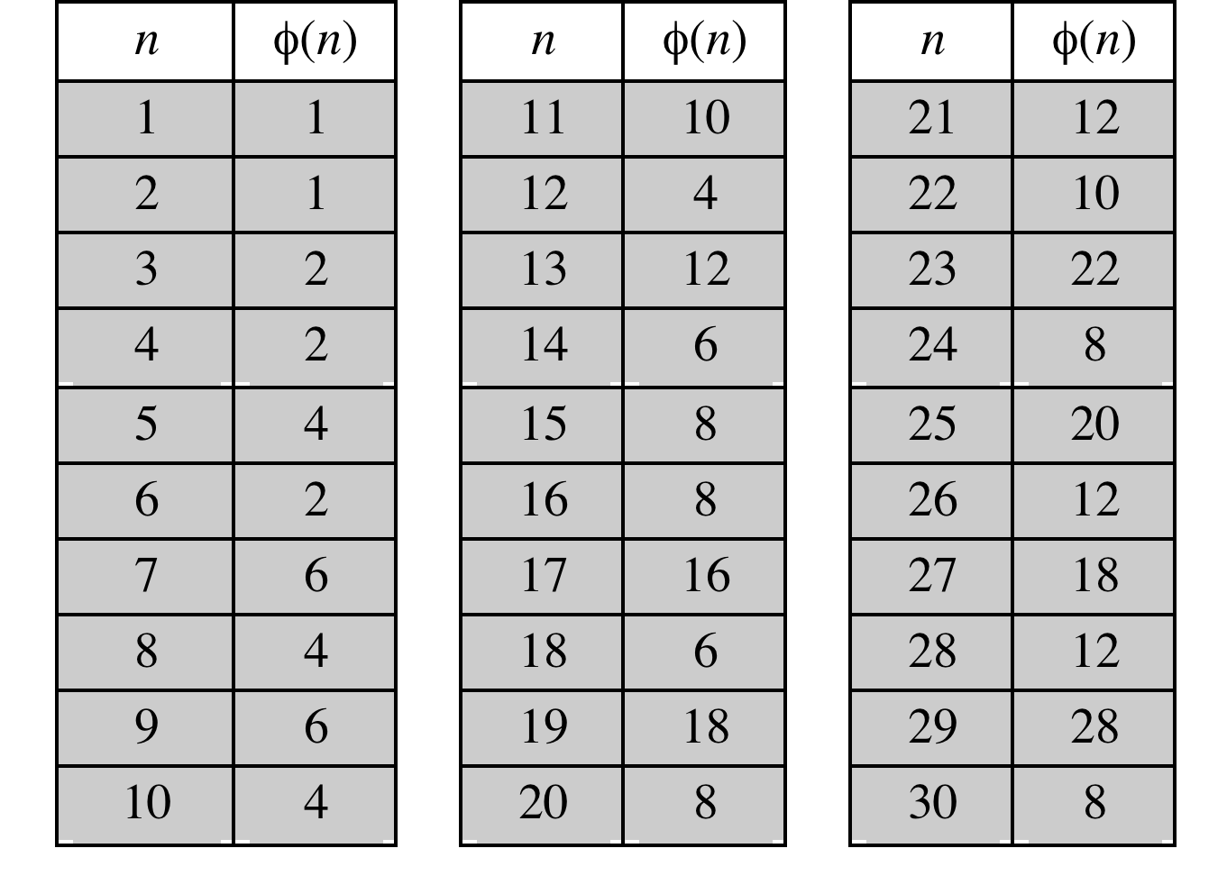
Some Values of Euler’s Totient Function ø(n)

Slide 8
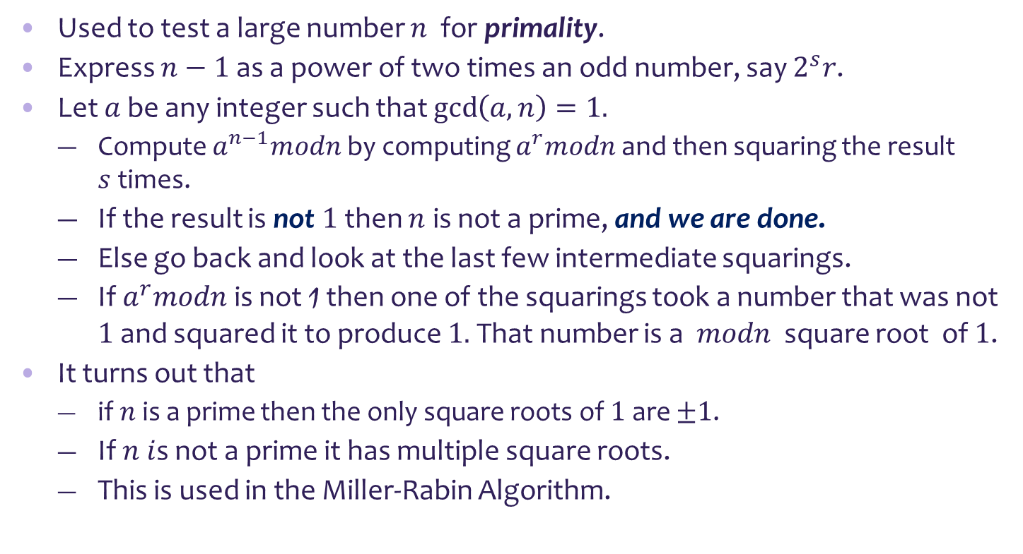
Miller-Rabin Algorithm
Used to test a large number $n$ for primality.
Express $n−1$ as a power of two times an odd number, say $2^{s}r$.
Let $a$ be any integer such that $\gcd\left(a,n\right)=1.$
Compute $a^{n−1}modn$ by computing $a^{r}modn$and then squaring the result $s$times.
If the result is not $1$ then $n$ is not a prime, and we are done.
Else go back and look at the last few intermediate squarings.
If $a^{r}modn$ is not 1 then one of the squarings took a number that was not $1$ and squared it to produce $1.$ That number is a $modn$ square root of $1$.
It turns out that
if $n$is a prime then the only square roots of $1$ are $±1$.
If $n i$s not a prime it has multiple square roots.
This is used in the Miller-Rabin Algorithm.

Slide 9
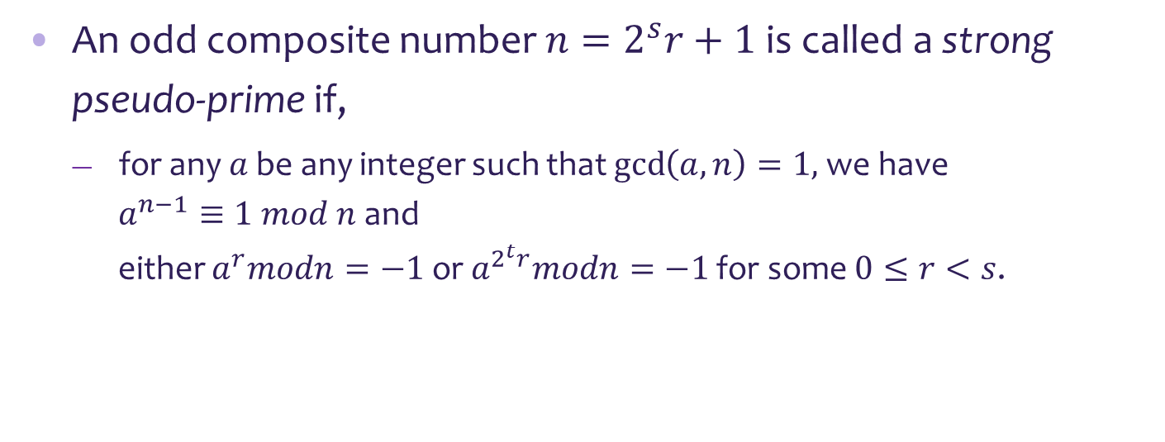
Miller-Rabin Algorithm
An odd composite number $n=2^{s}r+1$is called a strong pseudo-prime if,
for any $a$ be any integer such that $\gcd\left(a,n\right)=1,$we have
$a^{n−1}≡1 mod n$ and
either $a^{r}modn=−1$ or $a^{2^{t}r}modn=−1$ for some $0≤r<s$.
SET OF INTEGERS
STRONG
PSEDO PRIMES
PRIMES

Slide 10

Miller-Rabin Algorithm
Algorithm:
TEST: input: $n$ $( n−1=2^{s}r, r$ odd, n > 3 )
output: “composite” or “probably prime”
1.
2.
3.
4.
5.
6.
choose a random integer $a, 1<a<n−1$
choose a random integer 𝑎, 1<𝑎<𝑛−1
$x=a^{r}mod n ;$ if x$=1$then return “probably prime" ; else
𝑥=𝑎^𝑟 𝑚𝑜𝑑 𝑛 ; if x=1 then return “probably prime" ; else
repeat $s$ times
repeat 𝑠 times
y $←x^{2}mod n;$if $y=1$ and $x≠1,x≠n−1$then return “composite”
y ←𝑥^2 𝑚𝑜𝑑 𝑛; if 𝑦=1 and 𝑥≠1,𝑥≠𝑛−1 then return “composite”
$x←y$
𝑥←𝑦
return “probably prime" ;

Slide 11
Deterministic Primality Algorithm
Prior to 2002 there was no known method of efficiently proving the primality of very large numbers
All of the algorithms in use produced a probabilistic result
In 2002 Agrawal, Kayal, and Saxena developed an algorithm that efficiently determines whether a given large number is prime
Known as the AKS algorithm
Does not appear to be as efficient as the Miller-Rabin algorithm

Slide 12
Chinese Remainder Theorem (CRT)
Believed to have been discovered by the Chinese mathematician Sun-Tsu in around 100 A.D.
One of the most useful results of number theory
Says it is possible to reconstruct integers in a certain range from their residues modulo a set of pairwise relatively prime moduli
Can be stated in several ways
Provides a way to manipulate (potentially very large) numbers mod $m$ in terms of tuples of smaller numbers
Provides a way to manipulate (potentially very large) numbers mod 𝑚 in terms of tuples of smaller numbers
This can be useful when $m$ is 150 digits or more
This can be useful when 𝑚 is 150 digits or more
However, it is necessary to know beforehand the factorization of $m$
However, it is necessary to know beforehand the factorization of 𝑚

Slide 13
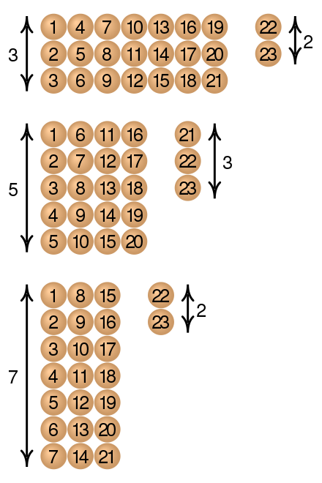

Chinese Remainder Theorem (CRC) an example
$$x≡2 \left(mod 3\right)$$
$$x≡3 (mod 5)$$
$$x≡2 \left(mod 7\right)$$
What is $x?$

Slide 14
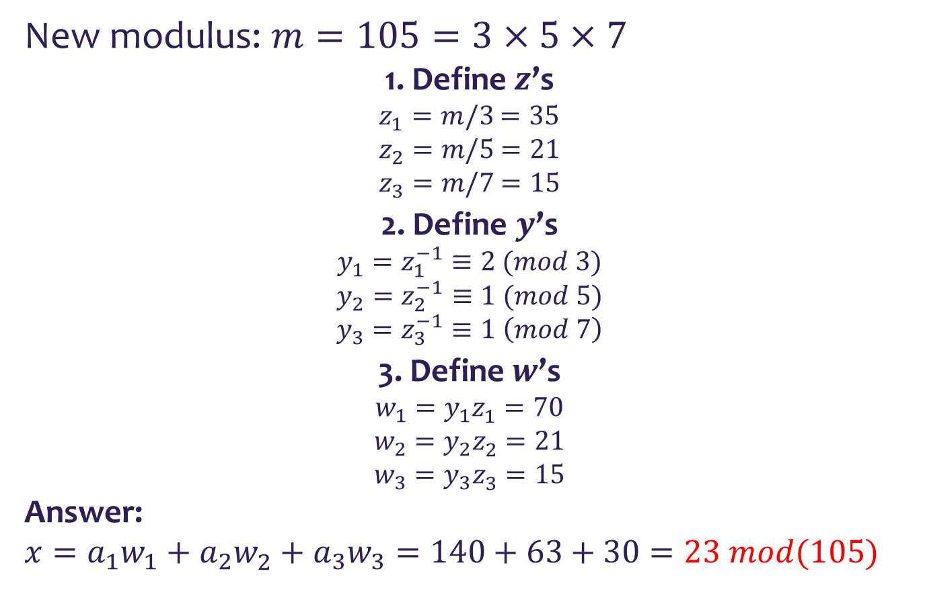
Chinese Remainder Theorem (CRC) an example
New modulus: $m=105=3×5×7$
1. Define $z$’s
$z_{1}=m/3$ $=35$
$z_{2}=m/5$ $=21$
$z_{3}=m/7$ $=15$
2. Define $y$’s
$$y_{1}=z_{1}^{−1}≡2 (mod 3)$$
$$y_{2}=z_{2}^{−1}≡1 (mod 5)$$
$$y_{3}=z_{3}^{−1}≡1 \left(mod 7\right)$$
3. Define $w$’s
$$w_{1}=y_{1}z_{1}^{}=70$$
$$w_{2}=y_{2}z_{2}^{}=21$$
$$w_{3}=y_{3}z_{3}^{}=15$$
Answer:
$$x=a_{1}w_{1}+a_{2}w_{2}^{}+a_{3}w_{3}=140+63+30=23 mod(105)$$

Slide 15
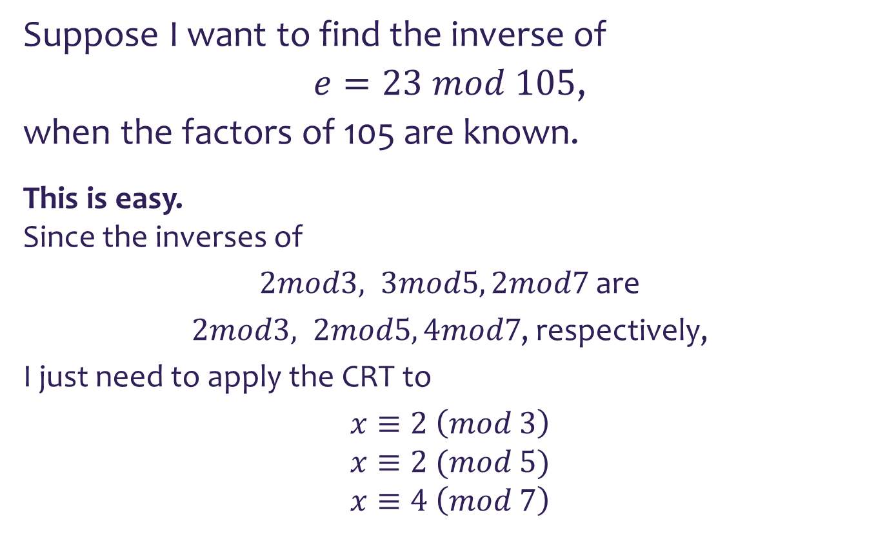
Chinese Remainder Theorem (CRC) relating to RSA
Suppose I want to find the inverse of
$e=23 mod 105$,
when the factors of 105 are known.
This is easy.
Since the inverses of
$2mod3, 3mod5, 2mod7$ are
$2mod3, 2mod5, 4mod7$, respectively,
I just need to apply the CRT to
$$x≡2 \left(mod 3\right)$$
$$x≡2 (mod 5)$$
$$x≡4 \left(mod 7\right)$$

