Slide 1

CARPENTRY FOUNDATION / INTAKE 142
Day 10 | Friday
10
November 13, 2026
Fraction operations by hand
9:00 AM–10:15 AM • Math • 75 min
Fractions in shop problems
10:30 AM–12:00 PM • Math • 90 min
Week 3 • 2 scheduled blocks • 165 teaching minutes
Estimate. Show the method. Label units. Check the result.
Textbook
Exercise Book
Numeracy Hub
Shape Canvas
Day 10 • 2026-11-13 • 01
Notes:
Today we finish the Week 3 fraction work. In the first block we add, subtract, multiply and divide fractions by hand, with no calculator, and give every answer in lowest terms. After the break we use the same four operations in shop problems: a pipe wall, a keyway, a fraction of a length, and a bar cut into three equal pieces that must be marked to the nearest sixteenth. Before calculating, decide which operation the situation needs. The calculator can confirm the arithmetic, but choosing the operation is our job.

Slide 2
DAY 10 / WEEK 3 / CLASS TIMETABLE
Today’s exact schedule
9:00 AM–10:15 AM • 75 min
10:30 AM–12:00 PM • 90 min
Fraction operations by hand
Fractions in shop problems
9:00 AM–9:05 AM
Start
5
10:30 AM–10:35 AM
Start
5
9:05 AM–9:10 AM
Recall
5
10:35 AM–10:40 AM
Recall
5
9:10 AM–9:25 AM
Teach
15
10:40 AM–10:55 AM
Teach
15
9:25 AM–9:40 AM
Together
15
10:55 AM–11:10 AM
Together
15
9:40 AM–10:00 AM
Practise
20
11:10 AM–11:45 AM
Practise
35
10:00 AM–10:10 AM
Check
10
11:45 AM–11:55 AM
Check
10
10:10 AM–10:15 AM
Wrap up
5
11:55 AM–12:00 PM
Wrap up
5
Math • Math Week 3, Lesson 5
Math • Math Week 3, Lesson 6
Break: 10:15 AM–10:30 AM • 15 minutes • excluded from teaching time
Textbook
Exercise Book
Numeracy Hub
Shape Canvas
Day 10 • 2026-11-13 • 02
Notes:
We work from 9:00 to 10:15 on the four fraction operations by hand. The scheduled break is 10:15–10:30. From 10:30 to 12:00 we use those operations in shop problems, with thirty-five minutes of practice. In each block the teaching and shared work prepare you for an independent check. Keep your paper working visible: in the first block the paper method is the answer, and the calculator only checks it afterwards.

Slide 3
W03-L05 • START • 9:00 AM–9:05 AM • 5 MIN TOTAL
Fraction operations by hand
Today’s goal: Add, subtract, multiply and divide fractions on paper without a calculator and give every answer in lowest terms.
Name one use for today’s skill.
Textbook sections 4.6–4.7 pp.97–102
Exercise Book 4D Q1–10 (p.42)
Keep your notebook, textbook and exercise book ready. Exercise 4D is done by hand.
Textbook sections 4.6–4.7 pp.97–102
Textbook
Exercise Book
Numeracy Hub
Shape Canvas
Day 10 • 2026-11-13 • 03
Notes:
START • 9:00 AM–9:05 AM • 5 MIN TOTAL — shared across this phase.
Open the textbook to pages 97–102. Today every answer starts on paper. Exercise 4D on page 42 says it plainly: no calculator. Why practise by hand when the calculator has a fraction key? Because on a job you need to know whether a calculator answer is reasonable, and you need to notice when a cut list or a sketch has a fraction that does not add up. We use one rule for adding and subtracting, and a different rule for multiplying and dividing. Keep track of which rule each question needs.

Slide 4
W03-L05 • RECALL • 9:05 AM–9:10 AM • 5 MIN TOTAL
Recall and reconnect
Say the rule for each operation: a common denominator to add or subtract, improper fractions to multiply or divide.
Try first without displayed answers.
Resources: Exercise Book 4D Q1–10 (p.42)
Textbook sections 4.6–4.7 pp.97–102
Textbook
Exercise Book
Numeracy Hub
Shape Canvas
Day 10 • 2026-11-13 • 04
Notes:
RECALL • 9:05 AM–9:10 AM • 5 MIN TOTAL — shared across this phase.
Which operations need a common denominator? Adding and subtracting, because we can only count parts of the same size together. Which operations need improper fractions first? Multiplying and dividing, so the whole number and the fraction stay together as one count. Say the rule before you write anything. If you are not sure, picture two strips: you cannot add a quarter-inch piece to a sixteenth-inch piece by counting them as two of the same thing.

Slide 5
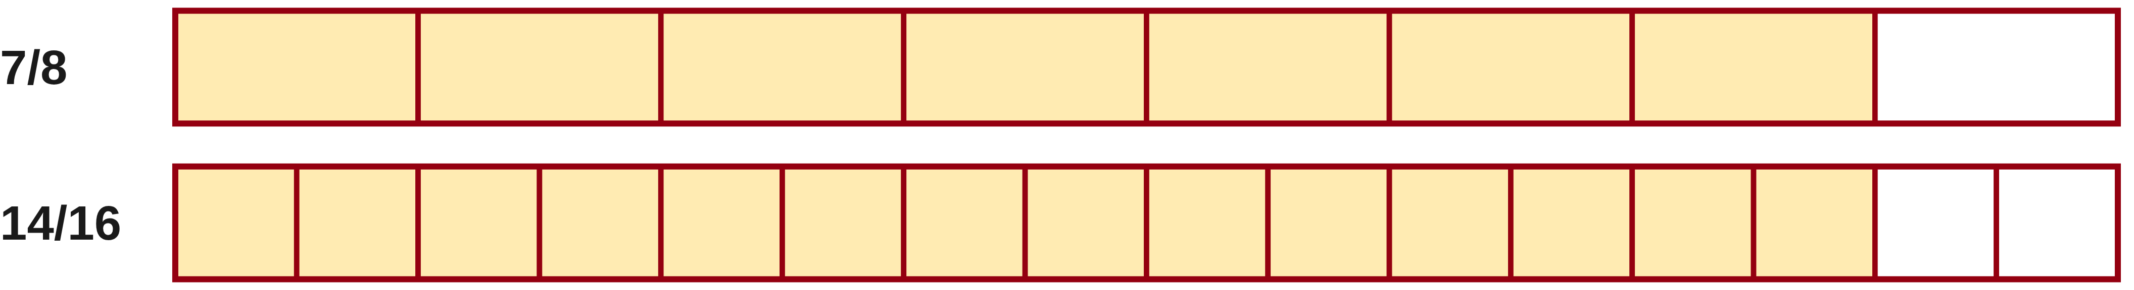
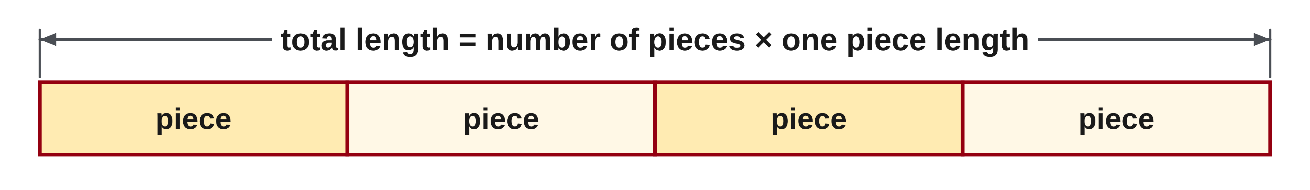
W03-L05 • TEACH • 9:10 AM–9:25 AM • 15 MIN TOTAL
Add or subtract only when the parts match
1
Find a common denominator so both fractions count same-sized parts.
2
Rewrite each fraction, then add or subtract the numerators only.
3
Carry a full set into the wholes, or borrow one whole first.
4
Write the answer in lowest terms.
Textbook sections 4.6–4.7 pp.97–102
Textbook
Exercise Book
Numeracy Hub
Shape Canvas
Day 10 • 2026-11-13 • 05
Notes:
TEACH • 9:10 AM–9:25 AM • 15 MIN TOTAL — shared across this phase.
Fractions can be added or subtracted only when they count parts of the same size. Page 97 takes five sixteenths from seven eighths: change seven eighths to fourteen sixteenths first, then take away five sixteenths to get nine sixteenths. The strips show why that is allowed: seven eighths and fourteen sixteenths cover the same length, only the size of the parts changed. With mixed numbers, add the whole numbers and the fractions separately. If the fractions come to one whole or more, carry it. When subtracting, if the top fraction is smaller, borrow one whole and write it as eighths or sixteenths. Finish in lowest terms.

Slide 6
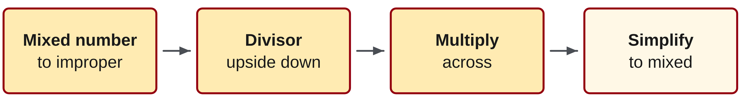
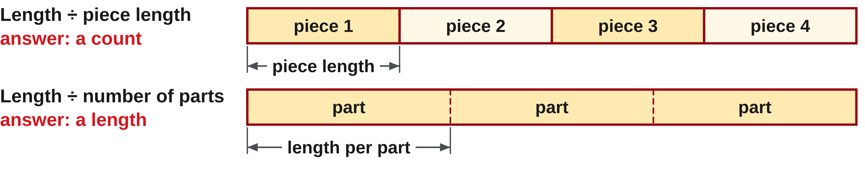
W03-L05 • TEACH • 9:10 AM–9:25 AM • 15 MIN TOTAL
Multiply and divide with improper fractions
1
Change each mixed number to an improper fraction first.
2
Multiply: numerator times numerator, denominator times denominator.
3
Divide: turn the divisor upside down, then multiply.
4
Simplify, then change back to a mixed number.
Textbook sections 4.6–4.7 pp.97–102
Textbook
Exercise Book
Numeracy Hub
Shape Canvas
Day 10 • 2026-11-13 • 06
Notes:
TEACH • 9:10 AM–9:25 AM • 15 MIN TOTAL — shared across this phase.
For multiplication and division we do not need a common denominator. Change each mixed number to an improper fraction first. To multiply, multiply the numerators and multiply the denominators. To divide, turn the number you are dividing by upside down, its reciprocal, and multiply. Then simplify and change back to a mixed number. Why does only the divisor flip? Dividing by four asks how much is in one of four shares, and multiplying by one quarter takes exactly one share. The first number is the amount being shared, so it stays as it is.

Slide 7
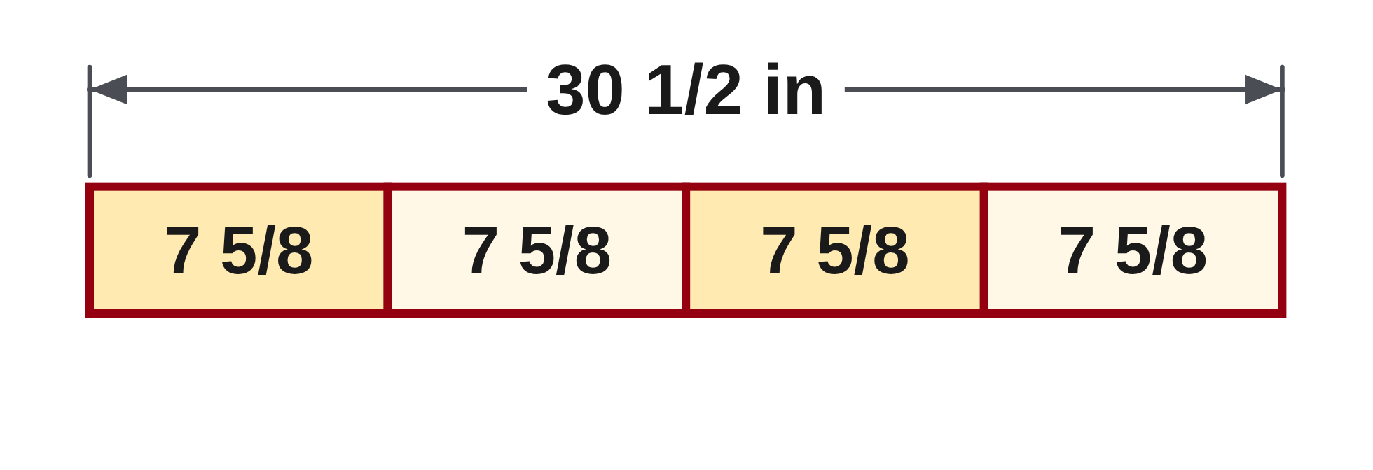
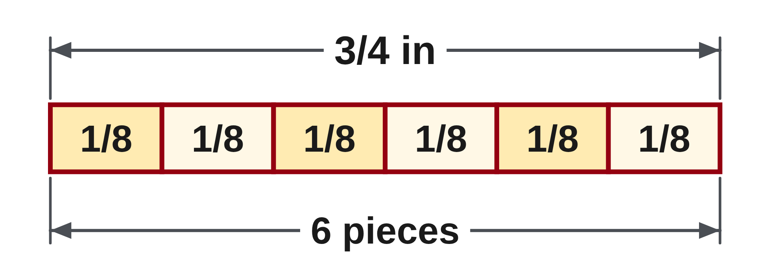
W03-L05 • TEACH • 9:10 AM–9:25 AM • 15 MIN TOTAL
Estimate first, then trust the paper method
12 3/4 + 8 5/8 + 15 1/2 = 35 + 15/8 = 36 7/8 in
30 1/2 in ÷ 4 = 61/2 × 1/4 = 61/8 = 7 5/8 in
Estimate: about 13 + 9 + 16 = 38 in, close to 36 7/8 in.
Check: 4 × 7 5/8 in = 30 1/2 in.
Both are textbook examples, pages 98 and 101.
Together: 4D questions 2 and 9 by hand. One partner names the rule, the other writes the steps.
W3 L5 • Paper first. The calculator only checks the finished working
Textbook
Exercise Book
Numeracy Hub
Shape Canvas
Day 10 • 2026-11-13 • 07
Notes:
TEACH • 9:10 AM–9:25 AM • 15 MIN TOTAL — shared across this phase.
Example 4.9 on page 98 adds three cut-list pieces: twelve and three quarters, eight and five eighths, and fifteen and a half inches. Add the whole numbers to get thirty-five. Change the fractions to eighths: six eighths, five eighths and four eighths make fifteen eighths, which is one and seven eighths. Carry the one: thirty-six and seven eighths inches. An estimate of about thirty-eight inches tells us the answer is the right size. Page 101 divides thirty and a half inches into four equal pieces: sixty-one halves times one quarter is sixty-one eighths, seven and five eighths inches. Check by multiplying back: four times seven and five eighths is thirty and a half. Paper first, then the calculator confirms.

Slide 8
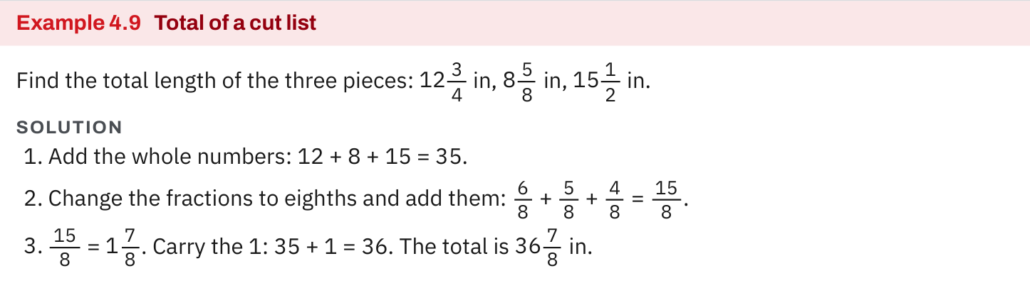
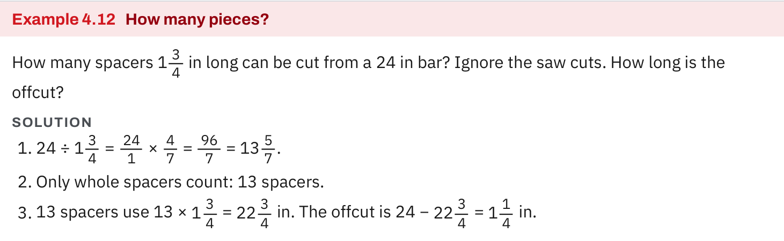
W03-L05 • TEACH • 9:10 AM–9:25 AM • 15 MIN TOTAL
Textbook | page 98
Textbook p.98 · Example 4.9: add mixed numbers, then carry the whole.
Textbook sections 4.6–4.7 pp.97–102
Textbook
Exercise Book
Numeracy Hub
Shape Canvas
Day 10 • 2026-11-13 • 08
Notes:
TEACH • 9:10 AM–9:25 AM • 15 MIN TOTAL — shared across this phase.
Example 4.9 adds a cut list of three mixed numbers. Follow the order: whole numbers first, then the fractions in eighths, then carry. Which fractions needed changing? Three quarters became six eighths and one half became four eighths, so all three count eighths. The book also shows the calculator keys, but today we finish the paper method before checking. If your paper total and the book total differ, find the step where they part company.

Slide 9
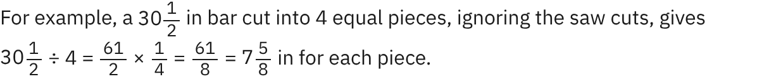
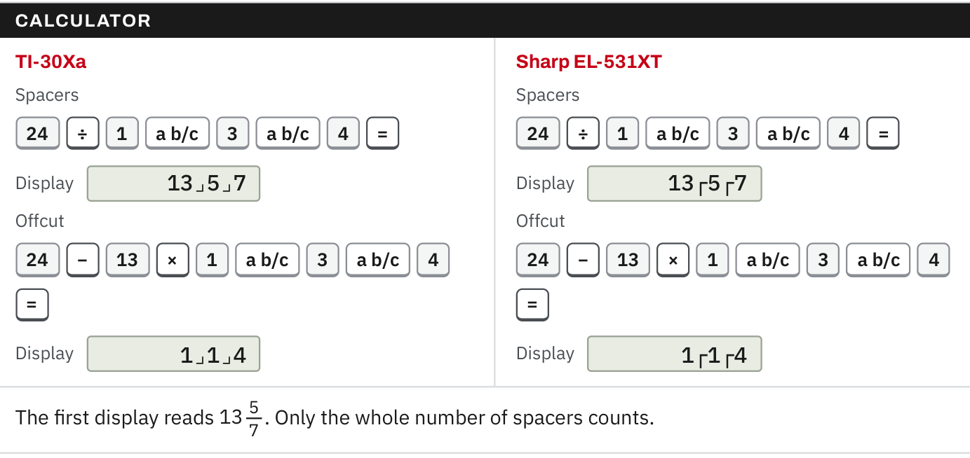
W03-L05 • TEACH • 9:10 AM–9:25 AM • 15 MIN TOTAL
Textbook | page 101
Textbook p.101 · Divide a mixed number: improper fraction, then the reciprocal.
Textbook sections 4.6–4.7 pp.97–102
Textbook
Exercise Book
Numeracy Hub
Shape Canvas
Day 10 • 2026-11-13 • 09
Notes:
TEACH • 9:10 AM–9:25 AM • 15 MIN TOTAL — shared across this phase.
Page 101 shows the division rule from page 100 at work. Thirty and a half becomes sixty-one halves. Dividing by four is the same as multiplying by one quarter, so the answer is sixty-one eighths, or seven and five eighths inches. What does the answer measure? The length of each of the four equal pieces. The book ignores the saw cuts here, so we do too. Check: four pieces of seven and five eighths inches make thirty and a half inches.

Slide 10
W03-L05 • TEACH • 9:10 AM–9:25 AM • 15 MIN TOTAL
Spot the mistake. Explain the correction.
A learner writes 2 1/2 × 1 1/2 = 2 1/4. What went wrong?
Discuss the method before checking the answer.
Wholes and fractions were multiplied separately. Use improper fractions: 5/2 × 3/2 = 15/4 = 3 3/4.
Textbook sections 4.6–4.7 pp.97–102
Textbook
Exercise Book
Numeracy Hub
Shape Canvas
Day 10 • 2026-11-13 • 10
Notes:
TEACH • 9:10 AM–9:25 AM • 15 MIN TOTAL — shared across this phase.
The learner multiplied two times one and one half times one half, then put them together: two and a quarter. That skips the cross parts, two times one half and one half times one. Change both to improper fractions: five halves times three halves is fifteen quarters, three and three quarters. An estimate warns us first: two and a half times one and a half must be more than two and a half, so two and a quarter cannot be right.

Slide 11
W03-L05 • TOGETHER • 9:25 AM–9:40 AM • 15 MIN TOTAL
Work together
Solve 4D questions 2 and 9 by hand. One partner names the rule, the other writes the steps.
Work in pairs; alternate solver and checker.
Resources: Exercise Book 4D Q1–10 (p.42)
Textbook sections 4.6–4.7 pp.97–102
Textbook
Exercise Book
Numeracy Hub
Shape Canvas
Day 10 • 2026-11-13 • 11
Notes:
TOGETHER • 9:25 AM–9:40 AM • 15 MIN TOTAL — shared across this phase.
Work 4D question 2 and question 9 by hand. Question 2 adds two mixed numbers, so the partner naming the rule should say: common denominator, then carry. Question 9 divides by a mixed number, so the rule is: improper fractions, then multiply by the reciprocal of the divisor. Swap roles between the questions. Before you compare answers, check each one with an estimate: question 2 is close to three plus two, and question 9 asks how many lengths of one and three quarters fit into ten and a half.

Slide 12

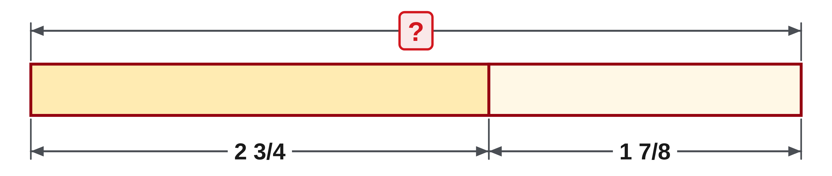
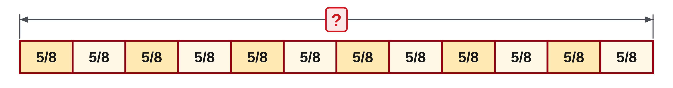
W03-L05 • TOGETHER • 9:25 AM–9:40 AM • 15 MIN TOTAL
Guided practice | 4D Q2, Q9
Work with a partner. Take turns explaining the next step.
Textbook sections 4.6–4.7 pp.97–102
Textbook
Exercise Book
Numeracy Hub
Shape Canvas
Day 10 • 2026-11-13 • 12
Notes:
TOGETHER • 9:25 AM–9:40 AM • 15 MIN TOTAL — shared across this phase.
Question 2: two and three quarters plus one and seven eighths. Write three quarters as six eighths. Add the whole numbers and the eighths separately, then carry any whole. Predict first: the answer is a little less than five. Question 9: ten and a half divided by one and three quarters. Change both to improper fractions, then multiply by the reciprocal of the divisor.
Instructor only, after the attempt: Q2: 2 + 1 = 3, 6/8 + 7/8 = 13/8 = 1 5/8, so 4 5/8. Q9: 21/2 ÷ 7/4 = 21/2 × 4/7 = 84/14 = 6. Answer Key p.17.

Slide 13
W03-L05 • TOGETHER • 9:25 AM–9:40 AM • 15 MIN TOTAL
Compare your method | 4D Q2, Q9
CHECK TOGETHER
Q2 4 5/8 Q9 6
Textbook sections 4.6–4.7 pp.97–102
Textbook
Exercise Book
Numeracy Hub
Shape Canvas
Day 10 • 2026-11-13 • 13
Notes:
TOGETHER • 9:25 AM–9:40 AM • 15 MIN TOTAL — shared across this phase.
Question 2 is four and five eighths. Two plus one is three, six eighths plus seven eighths is thirteen eighths, one and five eighths, and carrying the one gives four and five eighths. Question 9 is exactly six. Twenty-one halves times four sevenths is eighty-four fourteenths, which is six. Check by multiplying back: six times one and three quarters is ten and a half. Which question needed a common denominator? Only question 2. If you found a common denominator in question 9, the answer can still be right, but the rule does not need that extra work.

Slide 14
W03-L05 • PRACTISE • 9:40 AM–10:00 AM • 20 MIN TOTAL
Your scheduled practice
Complete 4D questions 1, 3, 4, 6, 7 and 8 on paper. Estimate first, give each answer in lowest terms, then check with the chosen calculator.
Show working and units; estimate, then check.
Resources: Exercise Book 4D Q1–10 (p.42)
Textbook sections 4.6–4.7 pp.97–102
Textbook
Exercise Book
Numeracy Hub
Shape Canvas
Day 10 • 2026-11-13 • 14
Notes:
PRACTISE • 9:40 AM–10:00 AM • 20 MIN TOTAL — shared across this phase.
Complete 4D questions 1, 3, 4, 6, 7 and 8 on paper. Say the rule before each one. Questions 1, 3 and 4 add or subtract, so they need a common denominator. Question 4 takes three and five sixteenths from seven, so borrow one whole as sixteen sixteenths. Questions 6, 7 and 8 multiply or divide, so change mixed and whole numbers to improper fractions first. Give each answer in lowest terms. Only when the page is finished, check with the calculator and mark any answer that differs.

Slide 15
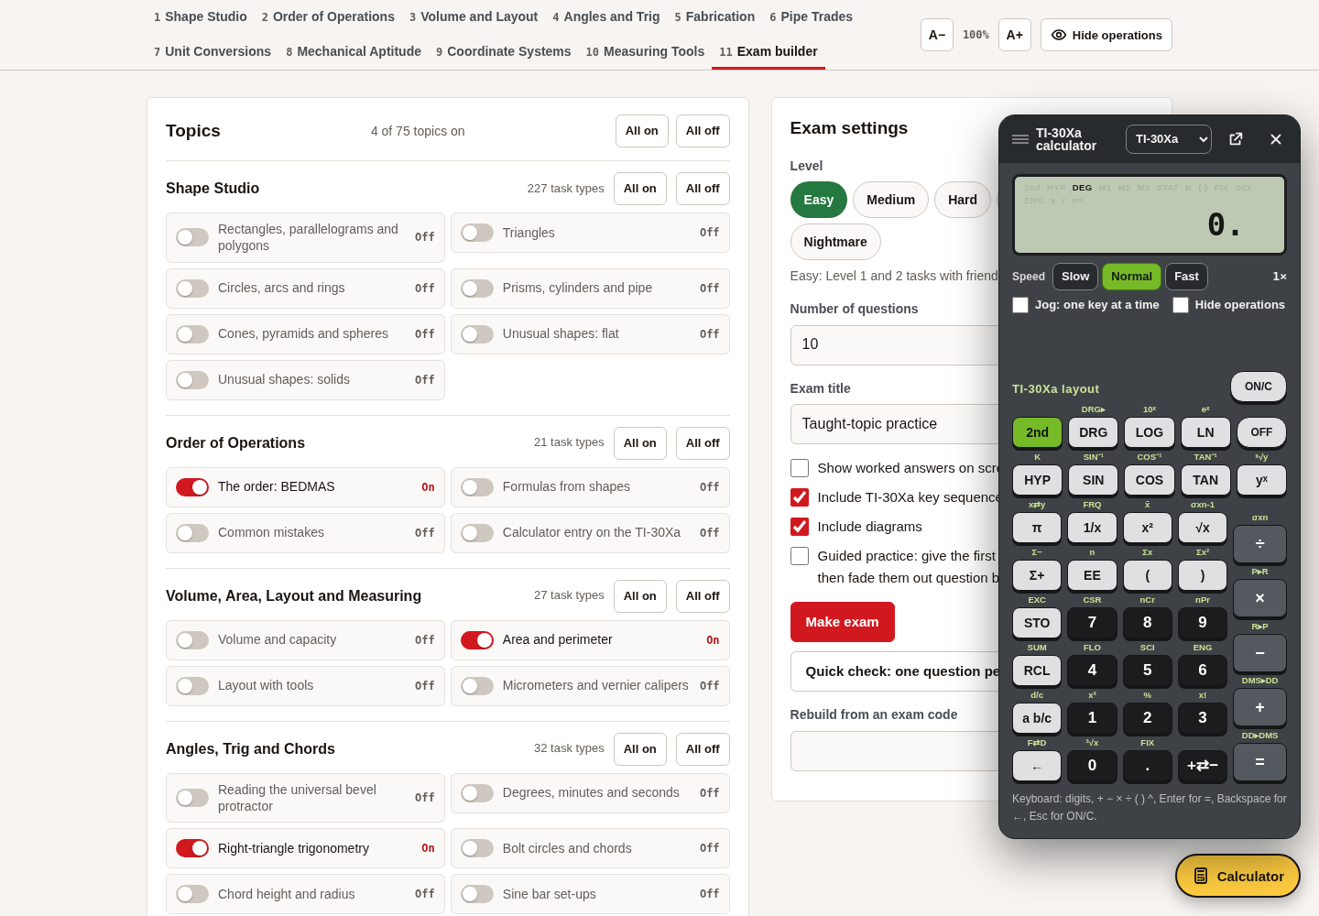

W03-L05 • PRACTISE • 9:40 AM–10:00 AM • 20 MIN TOTAL
Open Numeracy Hub
Navigation example. Use the values and units in the assigned task.
Textbook sections 4.6–4.7 pp.97–102
Textbook
Exercise Book
Numeracy Hub
Shape Canvas
Day 10 • 2026-11-13 • 15
Notes:
PRACTISE • 9:40 AM–10:00 AM • 20 MIN TOTAL — shared across this phase.
Open the calculator in Numeracy Hub and select your usual model, but only after your paper page is finished. Enter each question as written, with the fraction key, and compare the display with your paper answer. For a second look at a rule, The Basics tab has Adding and subtracting fractions and Multiplying and dividing fractions. If the display and the paper disagree, which one do you trust? Neither until you find the step that differs.

Slide 16
W03-L05 • PRACTISE • 9:40 AM–10:00 AM • 20 MIN TOTAL
Practise by hand, then check in Numeracy Hub
1
Paper first: write every step of the assigned 4D questions, with no calculator.
2
Name the rule for each question: a common denominator, or improper fractions.
3
Check afterwards: Numeracy Hub calculator, or The Basics fraction modules for a rule you missed.
Textbook sections 4.6–4.7 pp.97–102
Textbook
Exercise Book
Numeracy Hub
Shape Canvas
Day 10 • 2026-11-13 • 16
Notes:
PRACTISE • 9:40 AM–10:00 AM • 20 MIN TOTAL — shared across this phase.
Write every step of the assigned 4D questions on paper, with no calculator. Before each question, write the rule beside it: common denominator, or improper fractions. When the page is finished, check each answer with the Numeracy Hub calculator. If an answer differs, open The Basics and read Adding and subtracting fractions or Multiplying and dividing fractions, then redo that question on paper. What should you mark in your error log? The step that went wrong, not only the wrong answer.

Slide 17

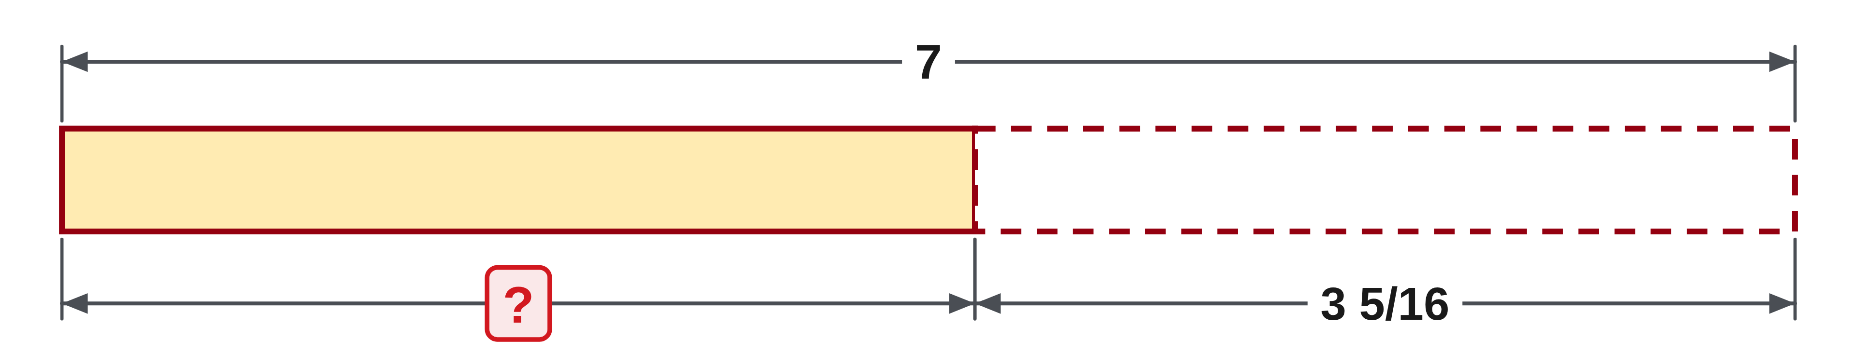
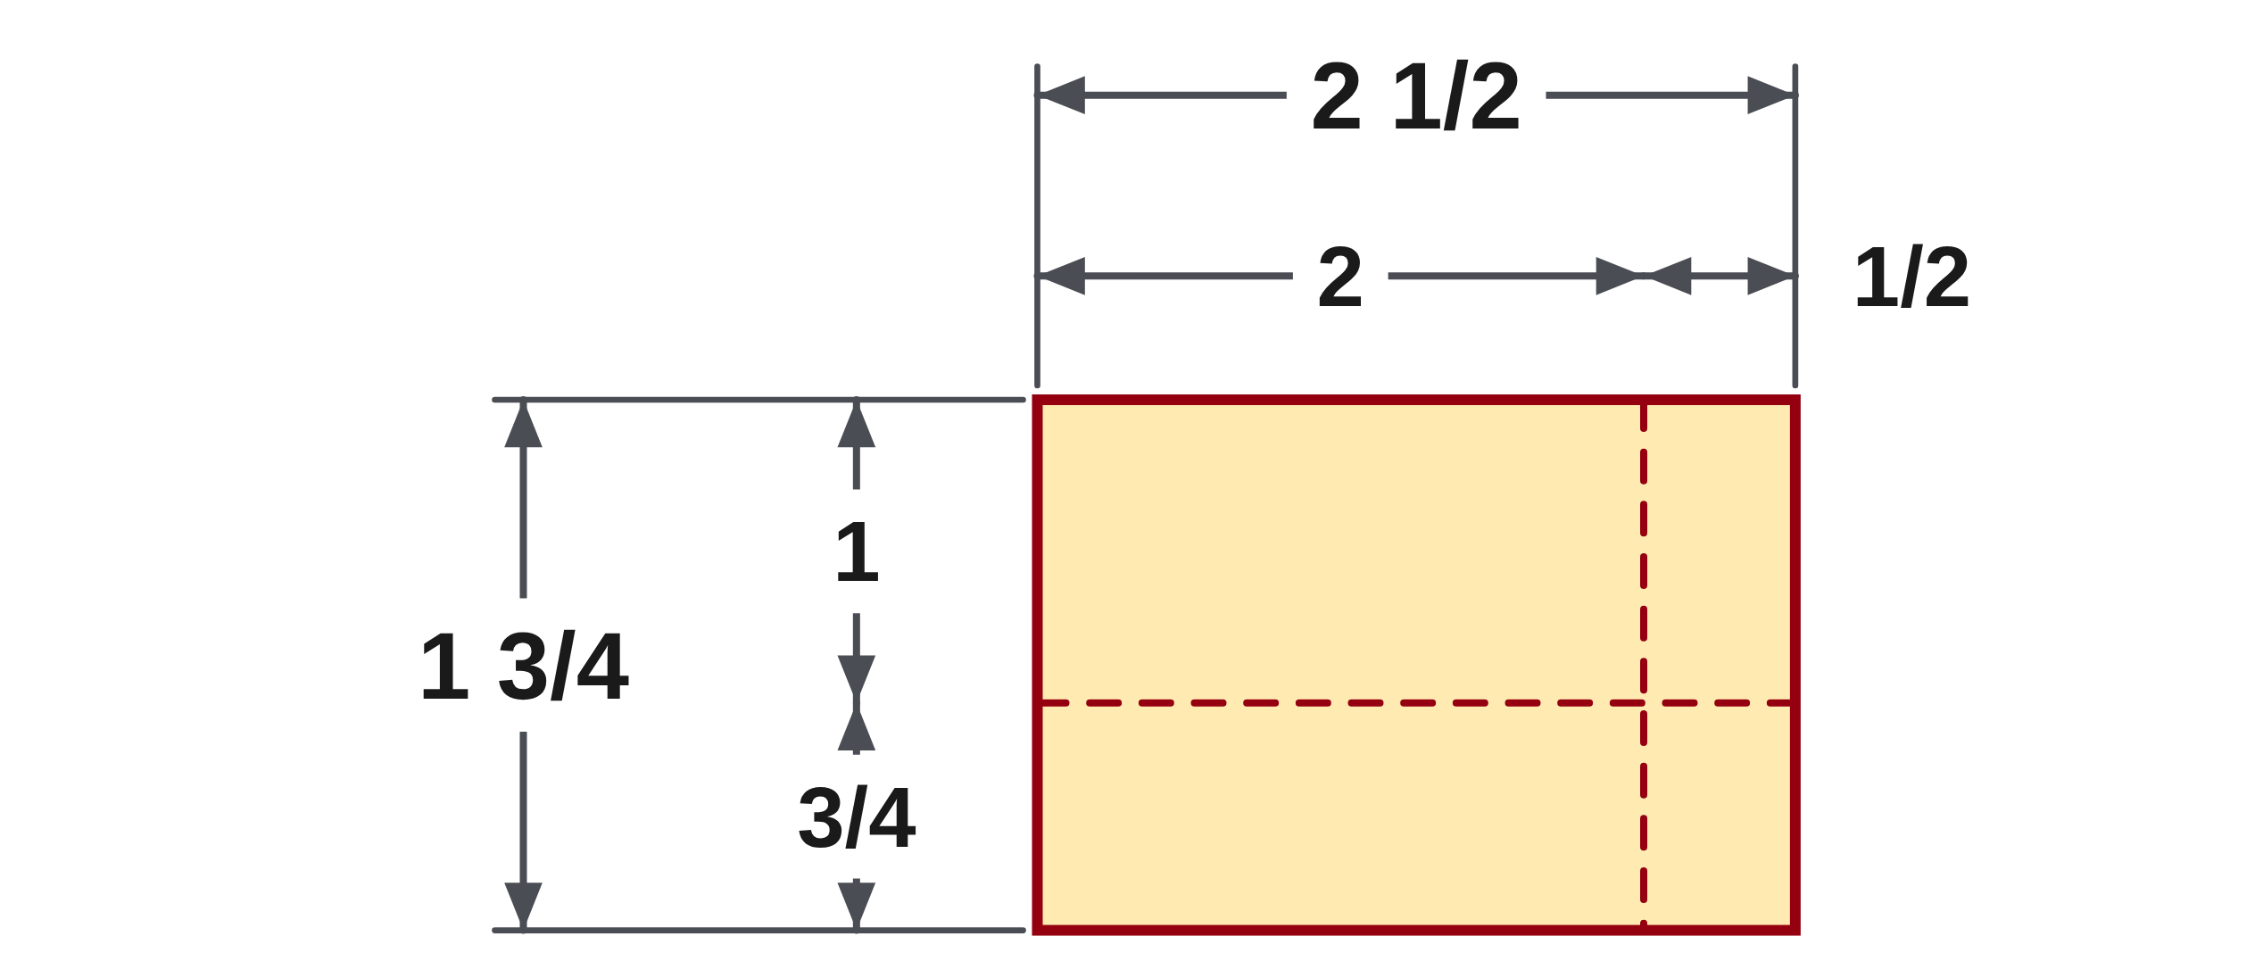
W03-L05 • PRACTISE • 9:40 AM–10:00 AM • 20 MIN TOTAL
Practise from the Exercise Book | 4D Q4
Write the operation, working and units before checking.
Textbook sections 4.6–4.7 pp.97–102
Textbook
Exercise Book
Numeracy Hub
Shape Canvas
Day 10 • 2026-11-13 • 17
Notes:
PRACTISE • 9:40 AM–10:00 AM • 20 MIN TOTAL — shared across this phase.
Seven minus three and five sixteenths. There is no fraction in seven to take five sixteenths from, so borrow one whole: seven becomes six and sixteen sixteenths. Subtract the fractions, then the whole numbers. Check by adding your answer back to three and five sixteenths.
Instructor only, after the attempt: 7 = 6 16/16. 16/16 − 5/16 = 11/16 and 6 − 3 = 3, so 3 11/16. Check: 3 11/16 + 3 5/16 = 6 16/16 = 7. Answer Key p.17.

Slide 18

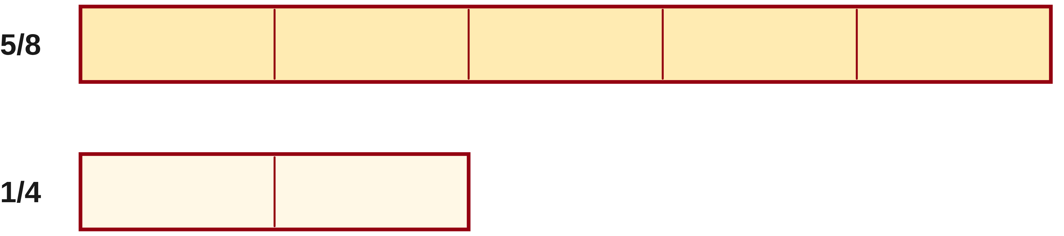
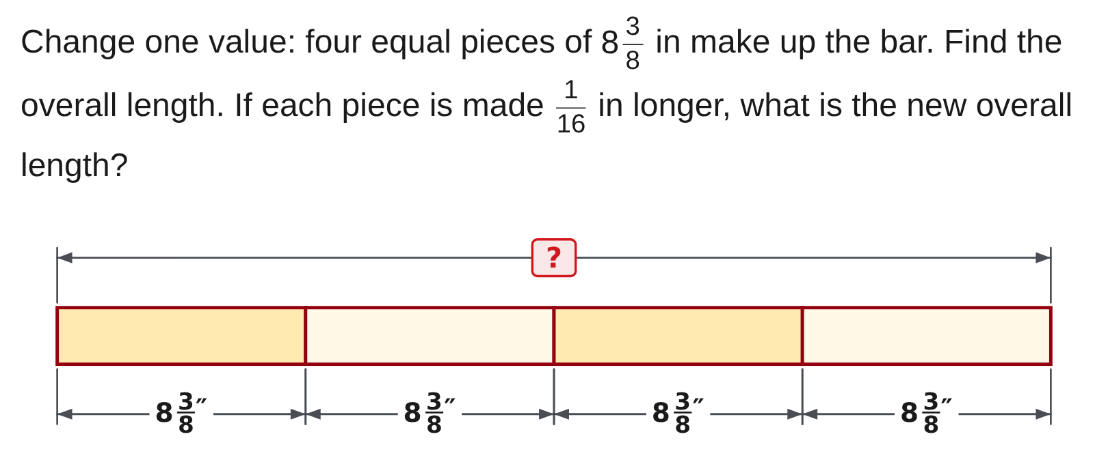
W03-L05 • PRACTISE • 9:40 AM–10:00 AM • 20 MIN TOTAL
Practise from the Exercise Book | 4D Q8
Write the operation, working and units before checking.
Textbook sections 4.6–4.7 pp.97–102
Textbook
Exercise Book
Numeracy Hub
Shape Canvas
Day 10 • 2026-11-13 • 18
Notes:
PRACTISE • 9:40 AM–10:00 AM • 20 MIN TOTAL — shared across this phase.
Five eighths divided by one quarter asks how many quarters fit into five eighths. Multiply by the reciprocal: five eighths times four over one. Predict first: two quarters make four eighths, so the answer is a little more than two.
Instructor only, after the attempt: 5/8 × 4/1 = 20/8 = 2 4/8 = 2 1/2. Answer Key p.17.

Slide 19
W03-L05 • CHECK • 10:00 AM–10:10 AM • 10 MIN TOTAL
Check independently
Complete 4D questions 5 and 10 independently, without a calculator.
Answer independently and show the method.
Resources: Exercise Book 4D Q1–10 (p.42)
Textbook sections 4.6–4.7 pp.97–102
Textbook
Exercise Book
Numeracy Hub
Shape Canvas
Day 10 • 2026-11-13 • 19
Notes:
CHECK • 10:00 AM–10:10 AM • 10 MIN TOTAL — shared across this phase.
Complete 4D questions 5 and 10 on your own, with no calculator. Question 5 multiplies two fractions. Question 10 divides a mixed number by a whole number: write the whole number over one and change the mixed number to an improper fraction before you start. Keep your working visible and give each answer in lowest terms. We will compare methods after everyone has finished.

Slide 20

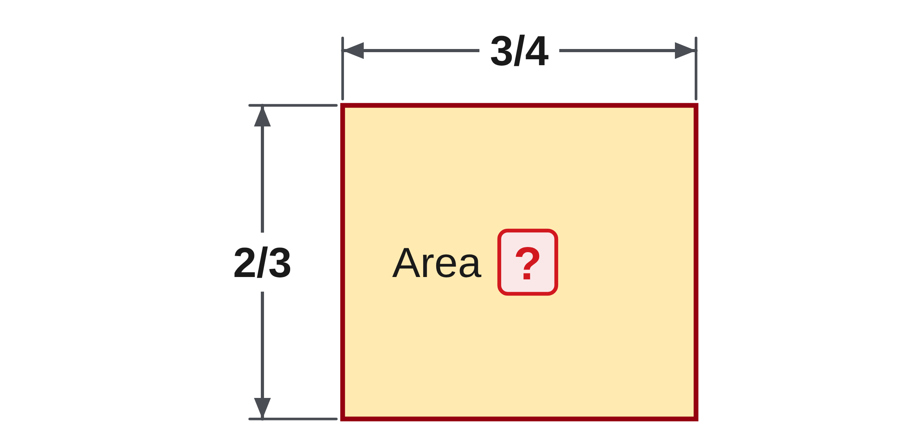
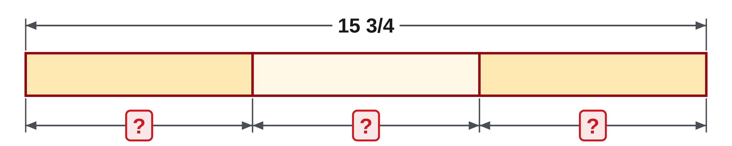
W03-L05 • CHECK • 10:00 AM–10:10 AM • 10 MIN TOTAL
Independent check | 4D Q5
Answer independently. Keep worked solutions closed.
Textbook sections 4.6–4.7 pp.97–102
Textbook
Exercise Book
Numeracy Hub
Shape Canvas
Day 10 • 2026-11-13 • 20
Notes:
CHECK • 10:00 AM–10:10 AM • 10 MIN TOTAL — shared across this phase.
Multiply three quarters by two thirds. Multiply the numerators and the denominators, then put the answer in lowest terms. Work without a calculator.
Instructor only, after the attempt: 3/4 × 2/3 = 6/12 = 1/2. Answer Key p.17.

Slide 21

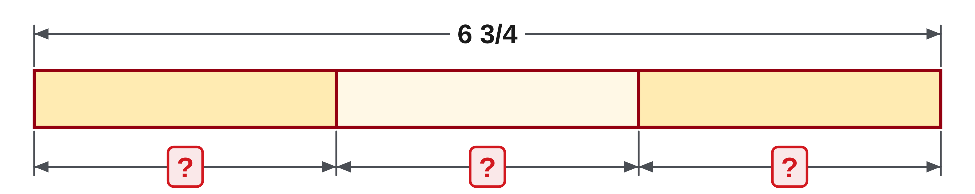
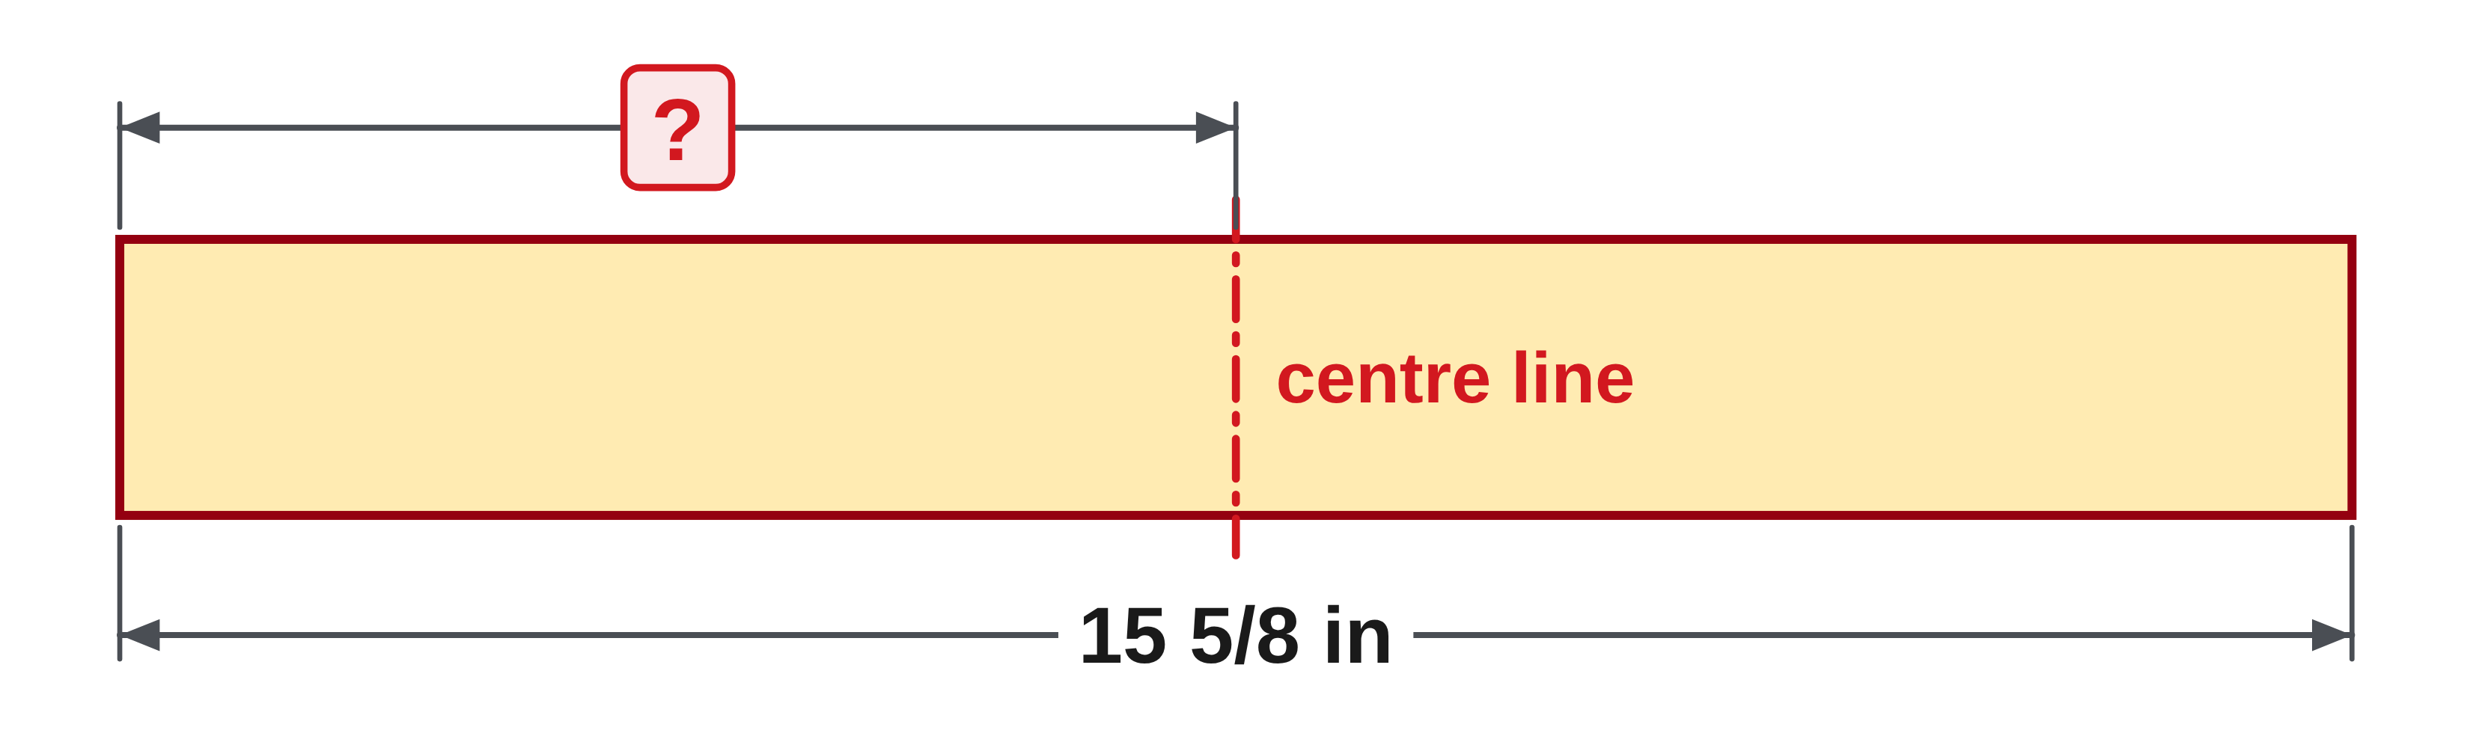
W03-L05 • CHECK • 10:00 AM–10:10 AM • 10 MIN TOTAL
Independent check | 4D Q10
Answer independently. Keep worked solutions closed.
Textbook sections 4.6–4.7 pp.97–102
Textbook
Exercise Book
Numeracy Hub
Shape Canvas
Day 10 • 2026-11-13 • 21
Notes:
CHECK • 10:00 AM–10:10 AM • 10 MIN TOTAL — shared across this phase.
Divide six and three quarters by three. Change the mixed number to an improper fraction, then multiply by the reciprocal of three. Check by multiplying your answer by three.
Instructor only, after the attempt: 6 3/4 = 27/4. 27/4 × 1/3 = 27/12 = 2 3/12 = 2 1/4. Check: 3 × 2 1/4 = 6 3/4. Answer Key p.17.

Slide 22
W03-L05 • WRAP UP • 10:10 AM–10:15 AM • 5 MIN TOTAL
Wrap up and choose the next step
Share one learning point and one skill to practise next.
Record a takeaway and next action.
Resources: Exercise Book 4D Q1–10 (p.42)
Textbook sections 4.6–4.7 pp.97–102
Textbook
Exercise Book
Numeracy Hub
Shape Canvas
Day 10 • 2026-11-13 • 22
Notes:
WRAP UP • 10:10 AM–10:15 AM • 5 MIN TOTAL — shared across this phase.
Name the rule you used most today and one question where you nearly used the wrong rule. Common denominators belong to adding and subtracting. Improper fractions and the reciprocal belong to multiplying and dividing. Did any answer need borrowing, as in question 4, or carrying, as in question 2? Record the skill that still needs practice. After the break we use the same four operations in shop problems, where the first job is choosing the operation.

Slide 23
DAY 10 • SCHEDULED BREAK
Break
10:15 AM–10:30 AM
Return ready for: Fractions in shop problems
This break is excluded from teaching minutes.
Textbook
Exercise Book
Numeracy Hub
Shape Canvas
Day 10 • 2026-11-13 • 23
Notes:
Take the scheduled break from 10:15 to 10:30. We return at 10:30 for fractions in shop problems. Keep this morning's working open: the rule you wrote beside each question is the first step in every shop problem.

Slide 24
W03-L06 • START • 10:30 AM–10:35 AM • 5 MIN TOTAL
Fractions in shop problems
Today’s goal: Choose the operation a shop problem needs, find a fraction of a length and round an equal part to the nearest 1/16 in.
Name one use for today’s skill.
Textbook sections 4.6–4.7 pp.97–102
Exercise Book 4B Q8–12 (p.38), 4C Q6–7 (p.41)
Keep your notebook, textbook, exercise book and chosen calculator ready.
Textbook sections 4.6–4.7 pp.97–102
Textbook
Exercise Book
Numeracy Hub
Shape Canvas
Day 10 • 2026-11-13 • 24
Notes:
START • 10:30 AM–10:35 AM • 5 MIN TOTAL — shared across this phase.
Open the textbook to pages 97–102 again. This block uses the same four operations, but the question no longer tells you which one to use. A pipe wall, a keyway, three quarters of a length, a bar cut into three: each needs you to read the situation first. Two ideas come from pages 100 and 101. The word of means multiply, and a length in thirds is marked on the tape by rounding to the nearest sixteenth. Which operation does three quarters of a bar need? Multiplication.

Slide 25
W03-L06 • RECALL • 10:35 AM–10:40 AM • 5 MIN TOTAL
Recall and reconnect
Say what “of” means in “3/4 of a bar”, and how many sixteenths make one whole inch.
Try first without displayed answers.
Resources: Exercise Book 4B Q8–12 (p.38), 4C Q6–7 (p.41)
Textbook sections 4.6–4.7 pp.97–102
Textbook
Exercise Book
Numeracy Hub
Shape Canvas
Day 10 • 2026-11-13 • 25
Notes:
RECALL • 10:35 AM–10:40 AM • 5 MIN TOTAL — shared across this phase.
In a word problem, of means multiply: three quarters of a bar is three quarters times the bar length. How many sixteenths make one whole inch? Sixteen. That number matters today, because a length in thirds is not on the tape. We multiply the fraction part by sixteen to find the nearest mark.

Slide 26
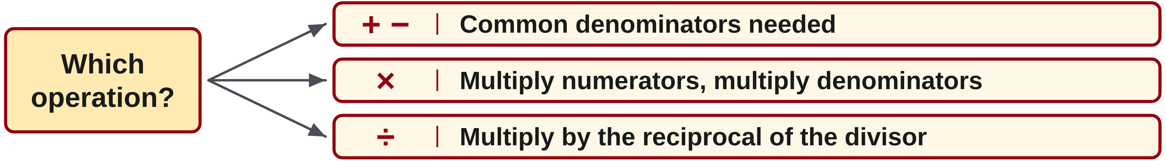
W03-L06 • TEACH • 10:40 AM–10:55 AM • 15 MIN TOTAL
Read the job to choose the operation
1
Pieces joined or plates stacked: add.
2
Material removed, or a gap left: subtract.
3
A fraction of a length, or repeated pieces: multiply.
4
A length shared into equal parts: divide.
Textbook sections 4.6–4.7 pp.97–102
Textbook
Exercise Book
Numeracy Hub
Shape Canvas
Day 10 • 2026-11-13 • 26
Notes:
TEACH • 10:40 AM–10:55 AM • 15 MIN TOTAL — shared across this phase.
Shop problems do not say add or divide. The situation does. Plates stacked or pieces joined end to end: add. Material taken away, like a pipe wall, or a gap left over: subtract. A fraction of a length, or several equal pieces: multiply. A length shared into equal parts: divide. Read the question, name the operation, then calculate. If the answer is a length that must be marked, finish by rounding to a mark that is on the tape.

Slide 27
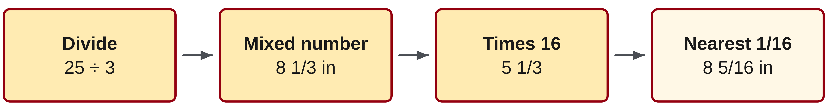
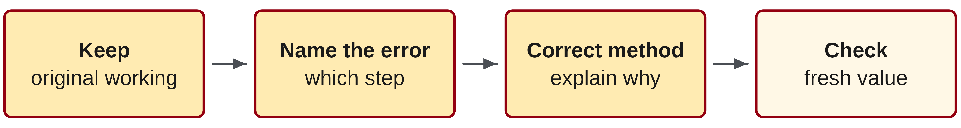
W03-L06 • TEACH • 10:40 AM–10:55 AM • 15 MIN TOTAL
Round lengths that are not on the tape
1
Divide: 25 ÷ 3 = 25/3 in.
2
Mixed number: 25/3 = 8 1/3 in.
3
Times 16: 1/3 × 16 = 5 1/3.
4
Round to whole sixteenths: mark 8 5/16 in.
Textbook sections 4.6–4.7 pp.97–102
Textbook
Exercise Book
Numeracy Hub
Shape Canvas
Day 10 • 2026-11-13 • 27
Notes:
TEACH • 10:40 AM–10:55 AM • 15 MIN TOTAL — shared across this phase.
Page 101 cuts a twenty-five inch bar into three equal pieces. Twenty-five thirds is eight and one third inches. A third is not on a tape, so multiply the fraction part by sixteen: one third times sixteen is five and one third. Round to the nearest whole number of sixteenths, five, and mark each piece at eight and five sixteenths inches. Why round only at the end? Rounding earlier would carry the error into every later step. Chapter 5 does the same job with decimal inches.

Slide 28
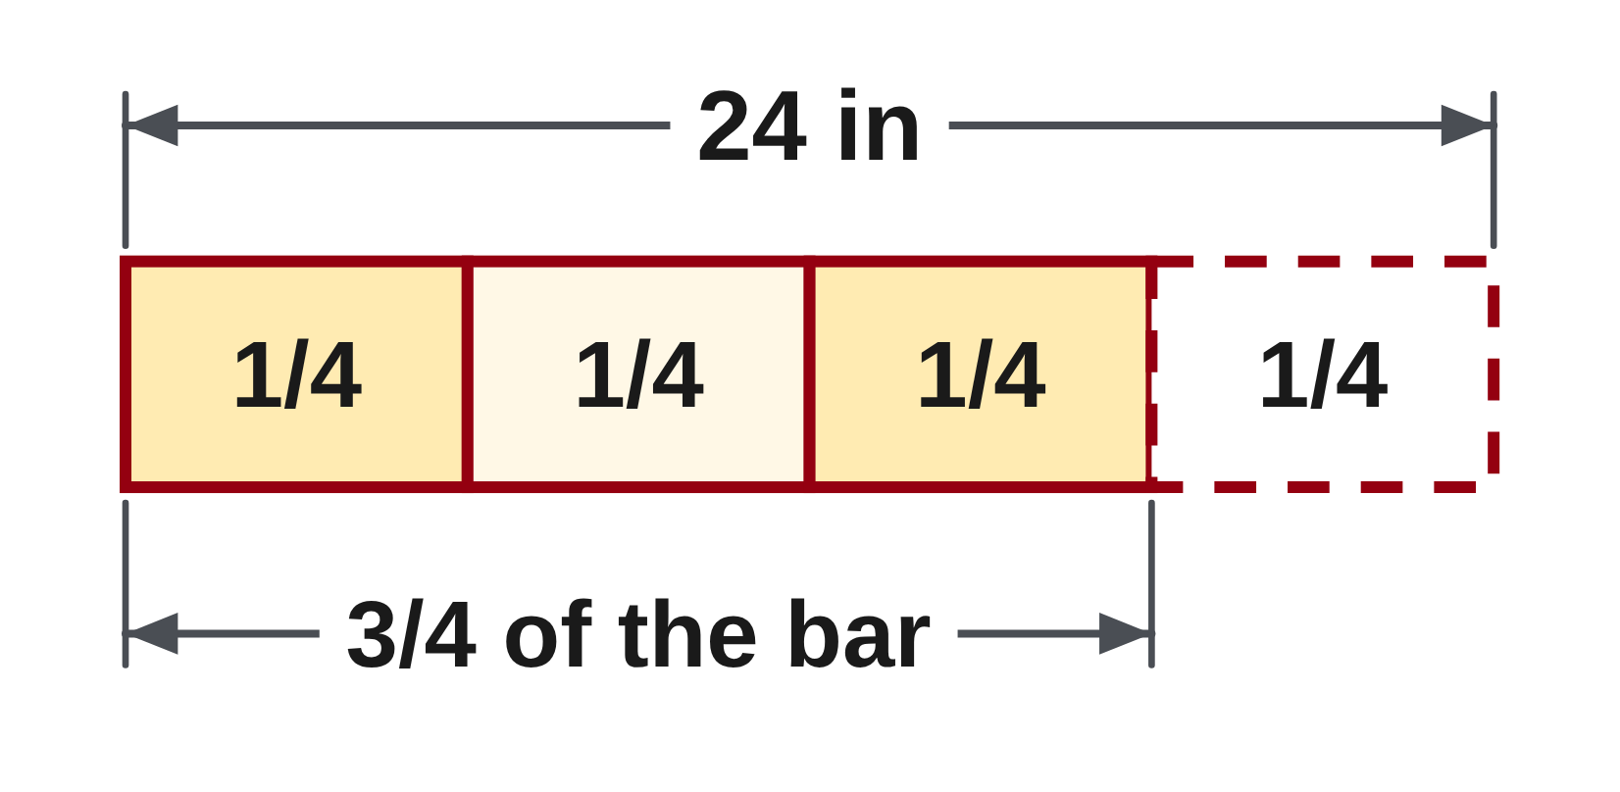
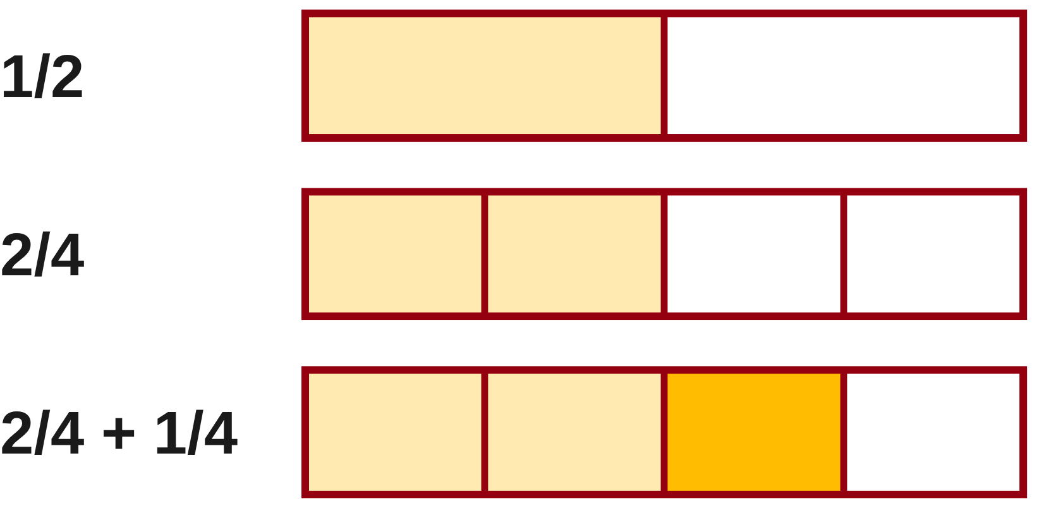
W03-L06 • TEACH • 10:40 AM–10:55 AM • 15 MIN TOTAL
“Of” means multiply, not divide
Incorrect: 3/4 of a 24 in bar = 24 ÷ 3/4 = 32 in.
A part of the bar cannot be longer than the whole bar.
Correct: 3/4 × 24 = 72/4 = 18 in
Check with a sketch: three of four equal quarters.
Each quarter of 24 in is 6 in, and 3 × 6 = 18 in.
Together: 4B questions 8 and 10 with a labelled sketch. Name the operation before calculating.
W3 L6 • Name the operation, then calculate, then round for the tape
Textbook
Exercise Book
Numeracy Hub
Shape Canvas
Day 10 • 2026-11-13 • 28
Notes:
TEACH • 10:40 AM–10:55 AM • 15 MIN TOTAL — shared across this phase.
Page 100 says that in word problems, the word of means multiply. Three quarters of a twenty-four inch bar is three quarters times twenty-four over one, seventy-two quarters, eighteen inches. The incorrect line divides instead and gets thirty-two inches, longer than the whole bar, so it cannot be a part of it. The sketch checks the product: one quarter of twenty-four inches is six inches, and three quarters is three of those, eighteen inches.

Slide 29
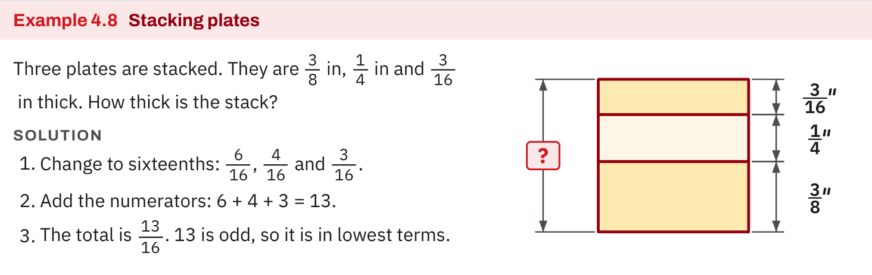
W03-L06 • TEACH • 10:40 AM–10:55 AM • 15 MIN TOTAL
Textbook | page 100
Textbook p.100 · In word problems, “of” means multiply.
Textbook sections 4.6–4.7 pp.97–102
Textbook
Exercise Book
Numeracy Hub
Shape Canvas
Day 10 • 2026-11-13 • 29
Notes:
TEACH • 10:40 AM–10:55 AM • 15 MIN TOTAL — shared across this phase.
Page 100 gives the rule in one line: in word problems, the word of means multiply. Three quarters of a twenty-four inch bar is three quarters times twenty-four over one, seventy-two quarters, which is eighteen inches. Writing the whole number over one keeps the multiplication in fraction form. Where will you meet this today? 4B question 10 takes three quarters of a 2,400 millimetre channel, and question 11 takes two thirds of a bar.

Slide 30
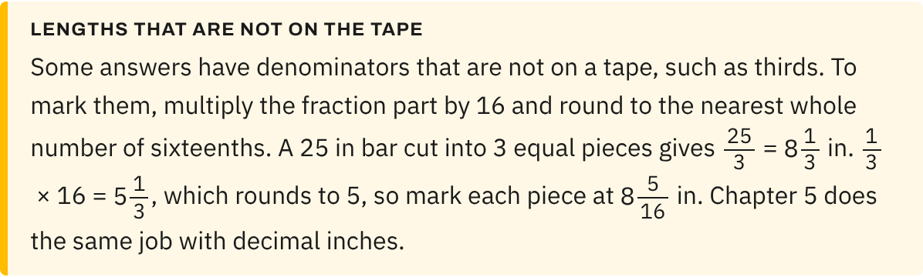
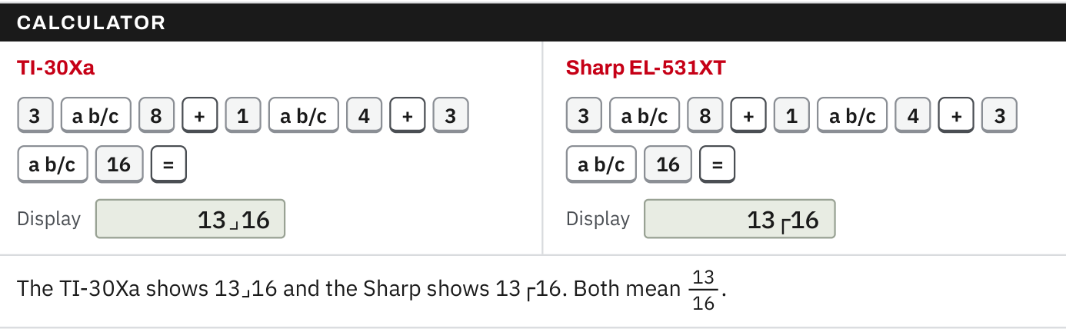
W03-L06 • TEACH • 10:40 AM–10:55 AM • 15 MIN TOTAL
Textbook | page 101
Textbook p.101 · Mark a length in thirds at the nearest sixteenth.
Textbook sections 4.6–4.7 pp.97–102
Textbook
Exercise Book
Numeracy Hub
Shape Canvas
Day 10 • 2026-11-13 • 30
Notes:
TEACH • 10:40 AM–10:55 AM • 15 MIN TOTAL — shared across this phase.
The box on page 101 answers a practical question: what do we mark when the answer has a denominator that is not on the tape? Multiply the fraction part by sixteen and round to the nearest whole number of sixteenths. Eight and one third inches becomes eight and five sixteenths, because one third times sixteen is five and one third. Keep the exact value until the last step. 4B question 12 asks for exactly this, to the nearest sixteenth.

Slide 31
W03-L06 • TEACH • 10:40 AM–10:55 AM • 15 MIN TOTAL
Spot the mistake. Explain the correction.
A 25 in bar is cut into 3 equal pieces. A learner marks each piece at 8 1/3 in. Can the tape show that mark?
Discuss the method before checking the answer.
No. Thirds are not on the tape. 1/3 × 16 = 5 1/3, so mark each piece at 8 5/16 in.
Textbook sections 4.6–4.7 pp.97–102
Textbook
Exercise Book
Numeracy Hub
Shape Canvas
Day 10 • 2026-11-13 • 31
Notes:
TEACH • 10:40 AM–10:55 AM • 15 MIN TOTAL — shared across this phase.
Eight and one third inches is the exact length, and it is correct as a number. The tape has no third marks, so it cannot be marked as written. Multiply the fraction part by sixteen: five and one third sixteenths. Round to five and mark eight and five sixteenths inches. The exact answer and the marked answer are both worth writing down: the first shows the method, the second is what you cut to.

Slide 32
W03-L06 • TOGETHER • 10:55 AM–11:10 AM • 15 MIN TOTAL
Work together
Solve 4B questions 8 and 10 with a labelled sketch. Name the operation before calculating.
Work in pairs; alternate solver and checker.
Resources: Exercise Book 4B Q8–12 (p.38), 4C Q6–7 (p.41)
Textbook sections 4.6–4.7 pp.97–102
Textbook
Exercise Book
Numeracy Hub
Shape Canvas
Day 10 • 2026-11-13 • 32
Notes:
TOGETHER • 10:55 AM–11:10 AM • 15 MIN TOTAL — shared across this phase.
Work 4B questions 8 and 10 in pairs. Sketch the pipe in question 8 as a line across its outside diameter: the line crosses the wall twice, once on each side. Which operation finds the inside diameter? Subtraction, of two wall thicknesses. Question 10 asks for three quarters of the channel length, so the word of tells you to multiply. Name the operation aloud before anyone calculates.

Slide 33
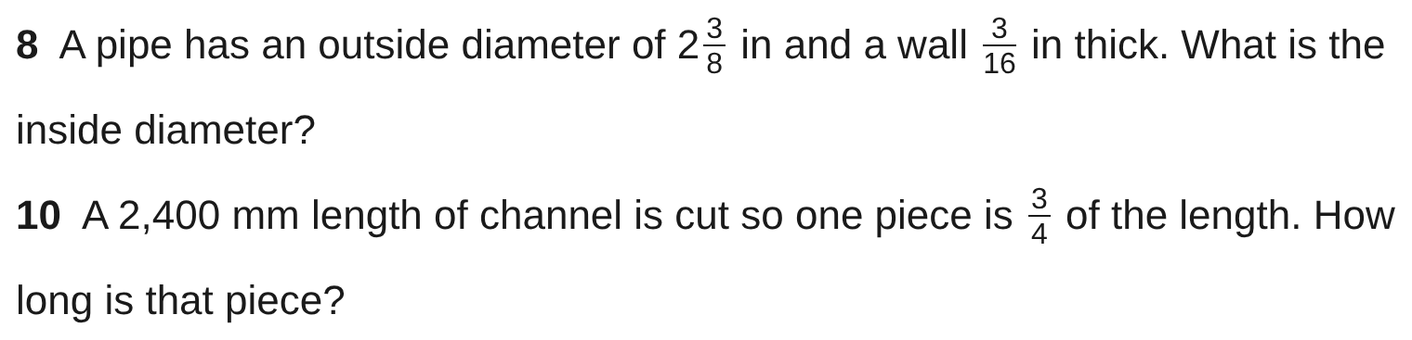
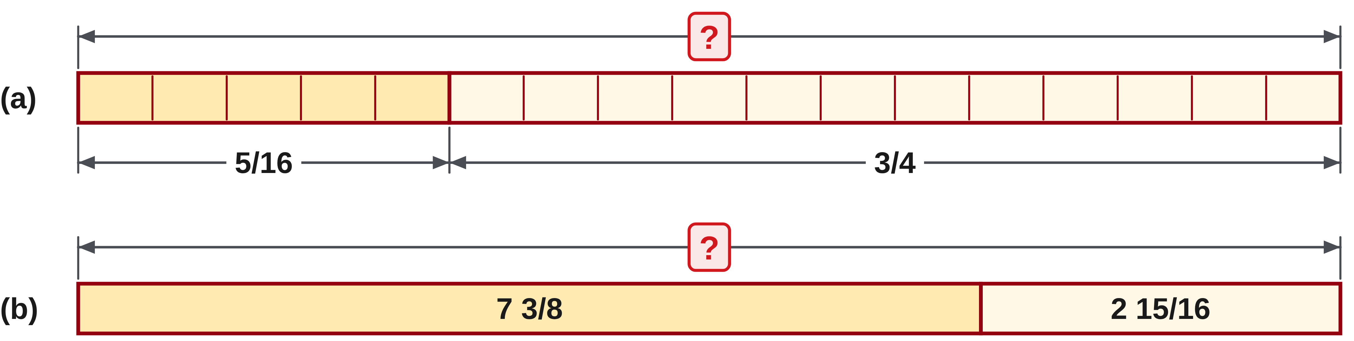
W03-L06 • TOGETHER • 10:55 AM–11:10 AM • 15 MIN TOTAL
Guided practice | 4B Q8, Q10
Work with a partner. Take turns explaining the next step.
Textbook sections 4.6–4.7 pp.97–102
Textbook
Exercise Book
Numeracy Hub
Shape Canvas
Day 10 • 2026-11-13 • 33
Notes:
TOGETHER • 10:55 AM–11:10 AM • 15 MIN TOTAL — shared across this phase.
Question 8: the outside diameter crosses the pipe wall twice. Take both wall thicknesses away from the outside diameter. Question 10: three quarters of the channel length, so multiply. Predict first: three quarters of 2,400 is less than 2,400 and more than half of it.
Instructor only, after the attempt: Q8: 2 3/8 − 2 × 3/16 = 2 3/8 − 3/8 = 2 in. Q10: 3/4 × 2,400 = 7,200/4 = 1,800 mm. Answer Key p.16.

Slide 34
W03-L06 • TOGETHER • 10:55 AM–11:10 AM • 15 MIN TOTAL
Compare your method | 4B Q8, Q10
CHECK TOGETHER
Q8 2 in Q10 1,800 mm
Textbook sections 4.6–4.7 pp.97–102
Textbook
Exercise Book
Numeracy Hub
Shape Canvas
Day 10 • 2026-11-13 • 34
Notes:
TOGETHER • 10:55 AM–11:10 AM • 15 MIN TOTAL — shared across this phase.
The inside diameter is two inches. Two walls of three sixteenths make six sixteenths, which is three eighths, and two and three eighths minus three eighths is exactly two. A common mistake takes away only one wall. The channel piece is 1,800 millimetres: three quarters times 2,400. Check it: one quarter is 600 millimetres, and three quarters is three of those. Which word told you to multiply? Of.

Slide 35
W03-L06 • PRACTISE • 11:10 AM–11:45 AM • 35 MIN TOTAL
Your scheduled practice
Complete 4B questions 9, 11 and 12, then 4C questions 6 and 7. Draw each part, name the operation and check one answer by working backwards.
Show working and units; estimate, then check.
Resources: Exercise Book 4B Q8–12 (p.38), 4C Q6–7 (p.41)
Textbook sections 4.6–4.7 pp.97–102
Textbook
Exercise Book
Numeracy Hub
Shape Canvas
Day 10 • 2026-11-13 • 35
Notes:
PRACTISE • 11:10 AM–11:45 AM • 35 MIN TOTAL — shared across this phase.
Complete 4B questions 9, 11 and 12, then 4C questions 6 and 7. Draw each part and name the operation before you calculate. Question 9 compares a key with a keyway, so the answer says whether it fits and by how much. Question 11 has two answers, one piece and the rest of the bar. Question 12 needs the nearest sixteenth, so keep the exact value until the last step. Check one answer by working backwards, for example by adding the pieces back to the whole bar.

Slide 36
W03-L06 • PRACTISE • 11:10 AM–11:45 AM • 35 MIN TOTAL
Open Shape Canvas
Navigation example. Use the values and units in the assigned task.
Textbook sections 4.6–4.7 pp.97–102
Textbook
Exercise Book
Numeracy Hub
Shape Canvas
Day 10 • 2026-11-13 • 36
Notes:
PRACTISE • 11:10 AM–11:45 AM • 35 MIN TOTAL — shared across this phase.
Open Shape Canvas and set the units to inches. Rebuild the 4C plate drawing for question 6 or 7 with its labelled dimensions, then hide the value you are asked to find. Work it on paper first. What does the drawing add? It shows which lengths join, stack or are taken away, so the operation is easier to name. Use the labels, not the size on the screen.

Slide 37
W03-L06 • PRACTISE • 11:10 AM–11:45 AM • 35 MIN TOTAL
Practise in Shape Canvas
1
Rebuild the 4C plate drawings in Shape Canvas with their labelled dimensions.
2
Hide the target value and work it on paper first.
3
Check the exact fractions with the Numeracy Hub calculator after the paper attempt.
Textbook sections 4.6–4.7 pp.97–102
Textbook
Exercise Book
Numeracy Hub
Shape Canvas
Day 10 • 2026-11-13 • 37
Notes:
PRACTISE • 11:10 AM–11:45 AM • 35 MIN TOTAL — shared across this phase.
Rebuild the plate drawings of 4C questions 6 and 7 in Shape Canvas with their labelled dimensions. Hide the value you are finding and work it on paper first. Then check the exact fraction with the Numeracy Hub calculator. If the paper and the calculator disagree, look at the drawing again: did you take away an edge distance once or twice?

Slide 38
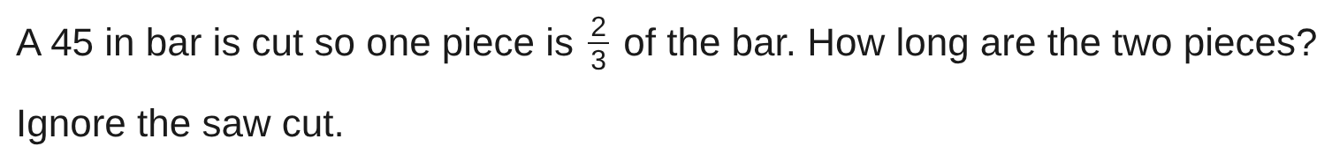
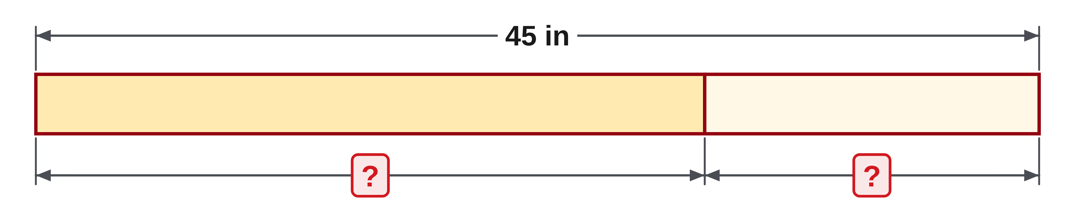
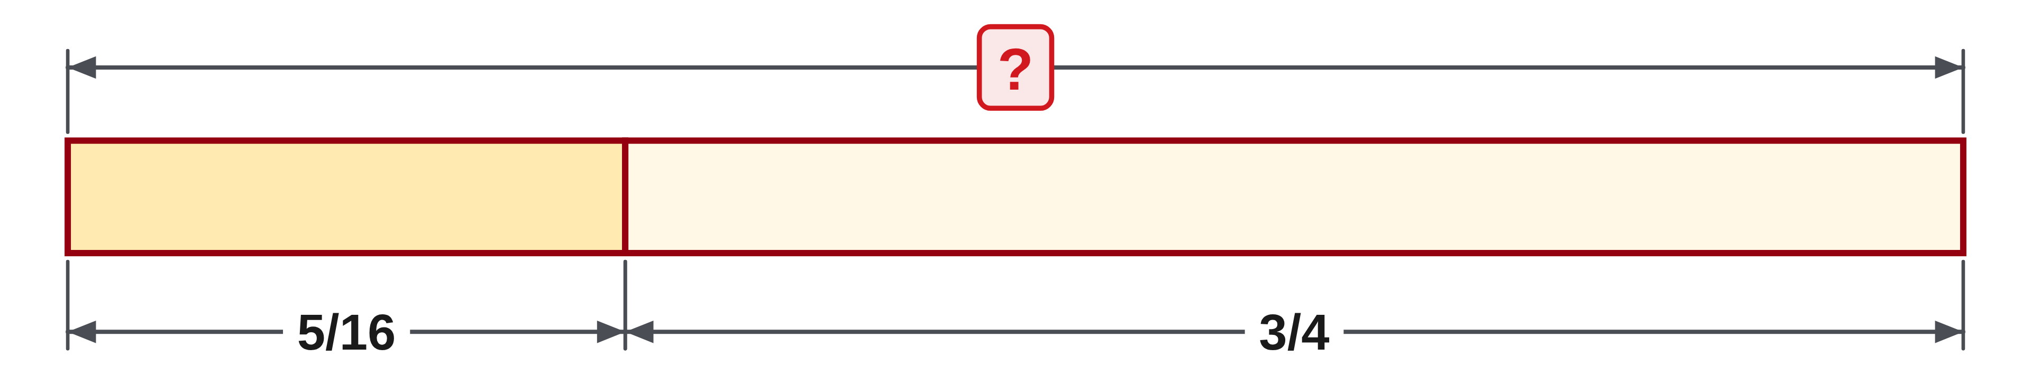
W03-L06 • PRACTISE • 11:10 AM–11:45 AM • 35 MIN TOTAL
Practise from the Exercise Book | 4B Q11
Write the operation, working and units before checking.
Textbook sections 4.6–4.7 pp.97–102
Textbook
Exercise Book
Numeracy Hub
Shape Canvas
Day 10 • 2026-11-13 • 38
Notes:
PRACTISE • 11:10 AM–11:45 AM • 35 MIN TOTAL — shared across this phase.
Two thirds of the bar means two thirds times forty-five inches. That gives one piece. The other piece is what is left of the bar, so subtract. Ignore the saw cut, as the question says. Check by adding the two pieces back to forty-five inches.
Instructor only, after the attempt: 2/3 × 45 = 90/3 = 30 in. The other piece is 45 − 30 = 15 in. Answer Key p.16.

Slide 39
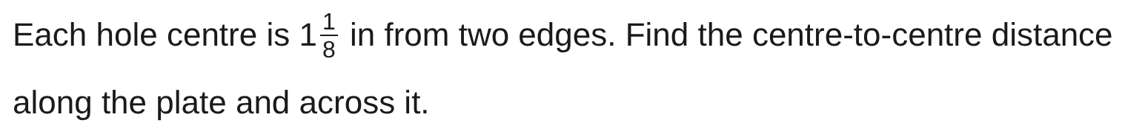
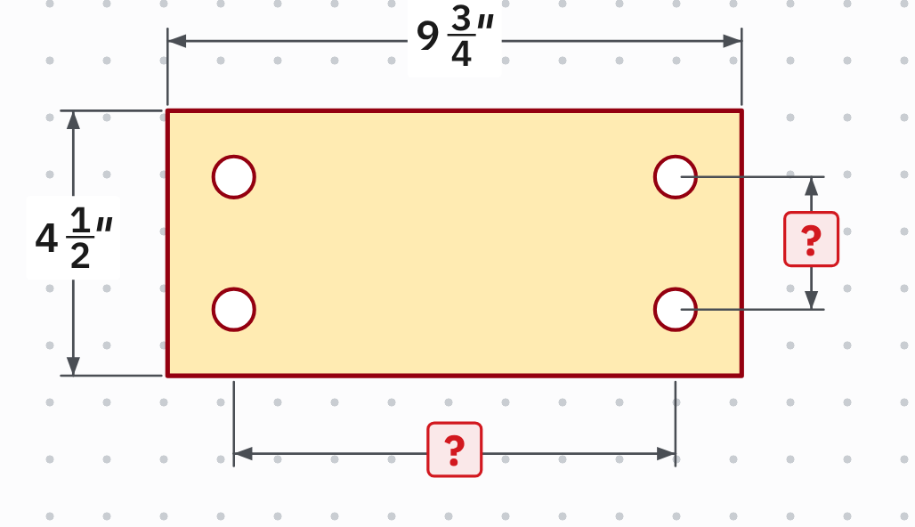
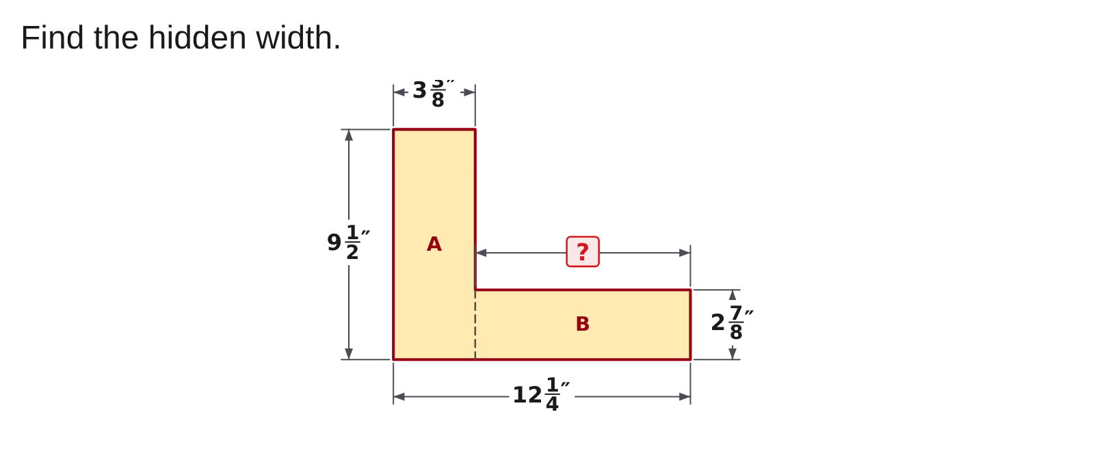
W03-L06 • PRACTISE • 11:10 AM–11:45 AM • 35 MIN TOTAL
Practise from the Exercise Book | 4C Q7
Write the operation, working and units before checking.
Textbook sections 4.6–4.7 pp.97–102
Textbook
Exercise Book
Numeracy Hub
Shape Canvas
Day 10 • 2026-11-13 • 39
Notes:
PRACTISE • 11:10 AM–11:45 AM • 35 MIN TOTAL — shared across this phase.
Each hole centre is one and one eighth inches from two edges. Along the plate, the distance between centres is the plate length less one edge distance at each end. Across the plate, it is the width less two edge distances. Which operation? Subtraction, twice. Sketch it before you calculate.
Instructor only, after the attempt: Along: 9 3/4 − 2 × 1 1/8 = 9 3/4 − 2 1/4 = 7 1/2 in. Across: 4 1/2 − 2 1/4 = 2 1/4 in. Answer Key p.17.

Slide 40
W03-L06 • CHECK • 11:45 AM–11:55 AM • 10 MIN TOTAL
Check independently
Redo 4B question 12 and 4C question 6 independently. Give each length in lowest terms with its unit.
Answer independently and show the method.
Resources: Exercise Book 4B Q8–12 (p.38), 4C Q6–7 (p.41)
Textbook sections 4.6–4.7 pp.97–102
Textbook
Exercise Book
Numeracy Hub
Shape Canvas
Day 10 • 2026-11-13 • 40
Notes:
CHECK • 11:45 AM–11:55 AM • 10 MIN TOTAL — shared across this phase.
Redo 4B question 12 and 4C question 6 on your own. Question 12 shares a length equally and asks for the nearest sixteenth, so keep the exact value until the last step. Question 6 stacks three plates. Give each length in lowest terms with its unit, and keep your working visible. We compare methods when everyone has finished.

Slide 41
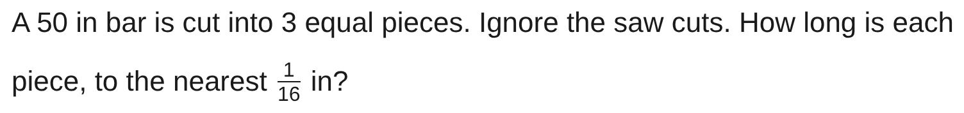
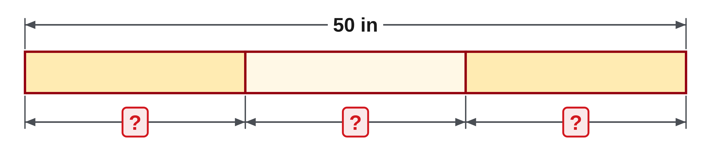
W03-L06 • CHECK • 11:45 AM–11:55 AM • 10 MIN TOTAL
Independent check | 4B Q12
Answer independently. Keep worked solutions closed.
Textbook sections 4.6–4.7 pp.97–102
Textbook
Exercise Book
Numeracy Hub
Shape Canvas
Day 10 • 2026-11-13 • 41
Notes:
CHECK • 11:45 AM–11:55 AM • 10 MIN TOTAL — shared across this phase.
A fifty inch bar is cut into three equal pieces. Find each piece as an exact fraction first, then give the length to the nearest sixteenth of an inch. Ignore the saw cuts.
Instructor only, after the attempt: 50 ÷ 3 = 50/3 = 16 2/3 in. 2/3 × 16 = 10 2/3, nearest 11 sixteenths, so 16 11/16 in. Answer Key p.16.

Slide 42
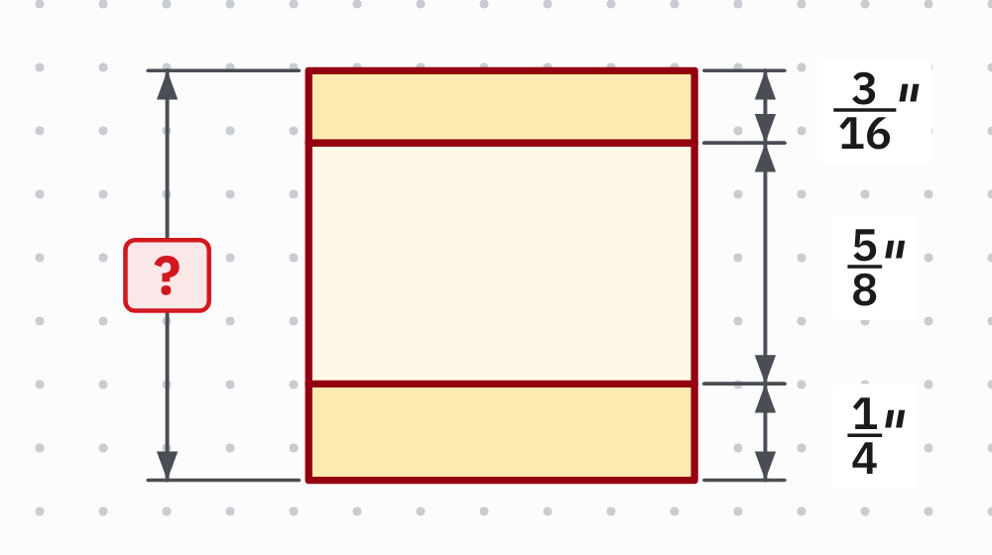
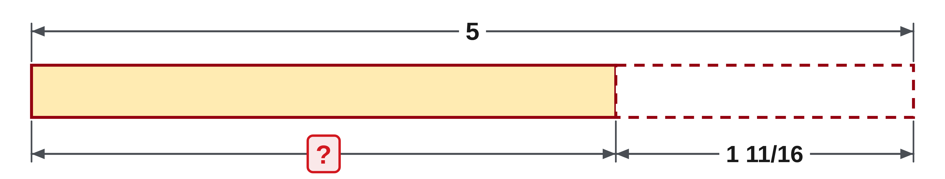
W03-L06 • CHECK • 11:45 AM–11:55 AM • 10 MIN TOTAL
Independent check | 4C Q6
Answer independently. Keep worked solutions closed.
Textbook sections 4.6–4.7 pp.97–102
Textbook
Exercise Book
Numeracy Hub
Shape Canvas
Day 10 • 2026-11-13 • 42
Notes:
CHECK • 11:45 AM–11:55 AM • 10 MIN TOTAL — shared across this phase.
Three plates are stacked. Read each thickness from the drawing, change them to the same denominator, and add. Give the answer in lowest terms with its unit.
Instructor only, after the attempt: 3/16 + 5/8 + 1/4 = 3/16 + 10/16 + 4/16 = 17/16 = 1 1/16 in. Answer Key p.17.

Slide 43
W03-L06 • WRAP UP • 11:55 AM–12:00 PM • 5 MIN TOTAL
Wrap up and choose the next step
Share one learning point and one skill to practise next.
Record a takeaway and next action.
Resources: Exercise Book 4B Q8–12 (p.38), 4C Q6–7 (p.41)
Textbook sections 4.6–4.7 pp.97–102
Textbook
Exercise Book
Numeracy Hub
Shape Canvas
Day 10 • 2026-11-13 • 43
Notes:
WRAP UP • 11:55 AM–12:00 PM • 5 MIN TOTAL — shared across this phase.
Name one shop problem today where the situation, not the question, told you the operation. A pipe wall is taken away twice. Of means multiply. A length shared into equal parts is divided, then rounded to the nearest sixteenth to be marked. Record the step that still needs practice: naming the operation, the common denominator, or the rounding to the tape. Week 4 applies these skills to cut lists and centre lines.

