Slide 1

CARPENTRY FOUNDATION / INTAKE 142
Day 23 | Friday
23
December 4, 2026
Angles, grades and carpentry slope applications
12:45 PM–2:15 PM • Math • 90 min
Week 6 • 1 scheduled block • 90 teaching minutes
Estimate. Show the method. Label units. Check the result.
Textbook
Exercise Book
Numeracy Hub
Shape Canvas
Day 23 • 2026-12-04 • 01
Notes:
Opening — within the first scheduled Start period; no additional teaching time.
Today we will describe slopes in two different ways: percentage grade and an angle in degrees. Those descriptions come from the same rise and run, but they are not interchangeable numbers. We will also use inverse trigonometry to find an angle when two sides are known. Keep a calculator ready in DEG mode and a clear triangle on your page. Our one math block runs from 12:45 to 2:15, including practice and an independent check.

Slide 2
DAY 23 / WEEK 6 / CLASS TIMETABLE
Today’s exact schedule
12:45 PM–2:15 PM • 90 min
Angles, grades and carpentry slope applications
12:45 PM–12:50 PM
Start
5
12:50 PM–12:55 PM
Recall
5
12:55 PM–1:10 PM
Teach
15
1:10 PM–1:25 PM
Together
15
1:25 PM–2:00 PM
Practise
35
2:00 PM–2:10 PM
Check
10
2:10 PM–2:15 PM
Wrap up
5
Math • Math Week 6, Lesson 9
One math block today, 12:45 PM–2:15 PM. Other scheduled program sessions remain separate.
Textbook
Exercise Book
Numeracy Hub
Shape Canvas
Day 23 • 2026-12-04 • 02
Notes:
Opening — within the first scheduled Start period; no additional teaching time.
We begin with five minutes to set up and five to recall side ratios. The teaching portion runs from 12:55 to 1:10, followed by fifteen minutes together and thirty-five minutes of practice. At 2:00 you will complete a ten-minute independent check, then we finish at 2:15. The angle and grade slides share their phase allocations. There is one math block today, so keep the full practice period for the assigned slope and angle questions.

Slide 3
W06-L09 • START • 12:45 PM–12:50 PM • 5 MIN TOTAL
Angles, grades and carpentry slope applications
Today’s goal: Find an angle from two sides and distinguish percentage grade from an angle in degrees.
Describe a prior use of the skill; identify the given and unknown quantities.
Textbook sections 13.4–13.5 pp.331–333; sections 13.7 pp.337–339 (extension)
Exercise Book 13A Q10–15 (p.128); 13B Q7–8 (p.129), Q12 (p.130). 13C Q4 (p.131), Q7 (p.132)
Keep your notebook, textbook, exercise book and chosen calculator ready.
Textbook sections 13.4–13.5 pp.331–333; sections 13.7 pp.337–339 (extension)
Textbook
Exercise Book
Numeracy Hub
Shape Canvas
Day 23 • 2026-12-04 • 03
Notes:
START • 12:45 PM–12:50 PM • 5 MIN TOTAL — shared across this phase’s slides.
A ramp drawing might describe its slope as a percentage, while a brace drawing might label an angle. We need to understand what each number means before using it. Our goal is to find angles from two known sides and to report grade and degrees separately. Read pages 331–333 with the triangle in view. What two measurements define a rise/run slope? Vertical rise and horizontal run. The sloping surface length is a different side and must not silently replace the run.

Slide 4
W06-L09 • RECALL • 12:50 PM–12:55 PM • 5 MIN TOTAL
Recall and reconnect
Discuss whether a 2% slope is the same as 2°. Retrieve the opposite/adjacent ratio.
Attempt the retrieval task independently; explain the method before checking.
Resources: Exercise Book 13A Q10–15 (p.128); 13B Q7–8 (p.129), Q12 (p.130). 13C Q4 (p.131), Q7 (p.132)
Textbook sections 13.4–13.5 pp.331–333; sections 13.7 pp.337–339 (extension)
Textbook
Exercise Book
Numeracy Hub
Shape Canvas
Day 23 • 2026-12-04 • 04
Notes:
RECALL • 12:50 PM–12:55 PM • 5 MIN TOTAL — shared across this phase’s slides.
Is a two-percent grade the same as an angle of two degrees? Take a moment to explain your first thought. A percentage compares rise with run and then expresses that ratio per hundred. An angle measures the turn from the horizontal. They describe the same triangle in different ways. Which trig ratio connects opposite and adjacent? Tangent. That ratio lets us move from rise/run to an angle, but we need inverse tangent because the angle is the quantity we do not know.

Slide 5
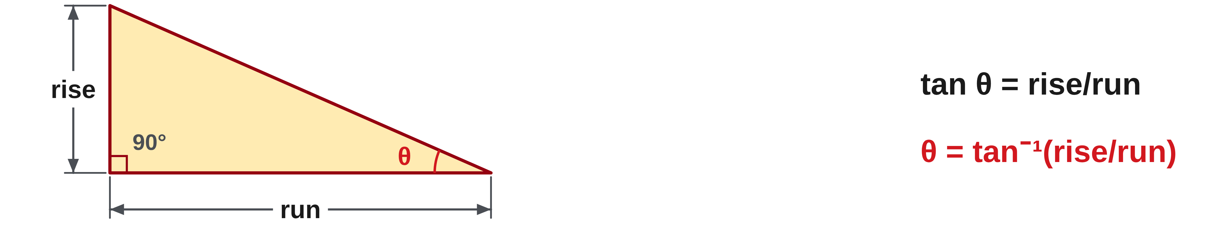
W06-L09 • TEACH • 12:55 PM–1:10 PM • 15 MIN TOTAL
Find an angle from two sides
1
For rise and run, tan θ = rise/run.
2
Use inverse tangent to recover θ from the ratio.
3
Keep the calculator in DEG mode and label the angle with °.
4
Check that the calculated angle matches the relative rise and run.
Textbook sections 13.4–13.5 pp.331–333; sections 13.7 pp.337–339 (extension)
Textbook
Exercise Book
Numeracy Hub
Shape Canvas
Day 23 • 2026-12-04 • 05
Notes:
TEACH • 12:55 PM–1:10 PM • 15 MIN TOTAL — shared across this phase’s slides.
When rise and run are known, tangent of the angle equals rise divided by run. Previously we put an angle into tangent and obtained a ratio. Now we have the ratio and want the angle that produces it, so we use inverse tangent. The key may show tan⁻¹ or require a shift function; it does not mean one divided by tangent. Check DEG mode before reading the result. If rise equals run, what angle should we expect? Forty-five degrees. That familiar case helps us judge whether our calculator is interpreting the angle correctly.

Slide 6
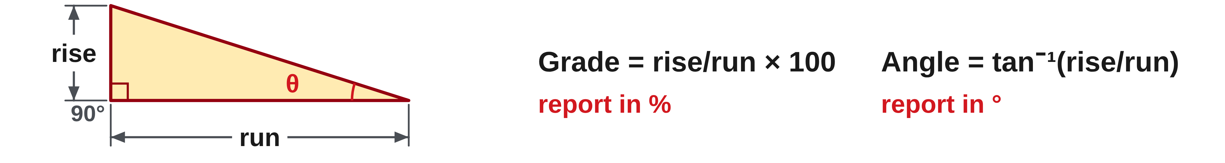
W06-L09 • TEACH • 12:55 PM–1:10 PM • 15 MIN TOTAL
Keep grade and angle separate
1
Percentage grade = rise/run × 100.
2
Angle in degrees = tan⁻¹(rise/run).
3
The same triangle gives two different descriptions of its slope.
4
Use consistent units for rise and run; label percentage and degree results separately.
Textbook sections 13.4–13.5 pp.331–333; sections 13.7 pp.337–339 (extension)
Textbook
Exercise Book
Numeracy Hub
Shape Canvas
Day 23 • 2026-12-04 • 06
Notes:
TEACH • 12:55 PM–1:10 PM • 15 MIN TOTAL — shared across this phase’s slides.
Percentage grade uses rise divided by run, multiplied by one hundred. The angle uses inverse tangent of that same rise/run ratio. The inputs are the same, but the operations and output units differ. Make the rise and run units match before dividing: millimetres over millimetres or metres over metres. The units then cancel in the ratio. Which result receives a percent sign? Grade. Which receives the degree symbol? Angle. Write both labels on your answer line so a later reader cannot mistake one slope description for the other.

Slide 7
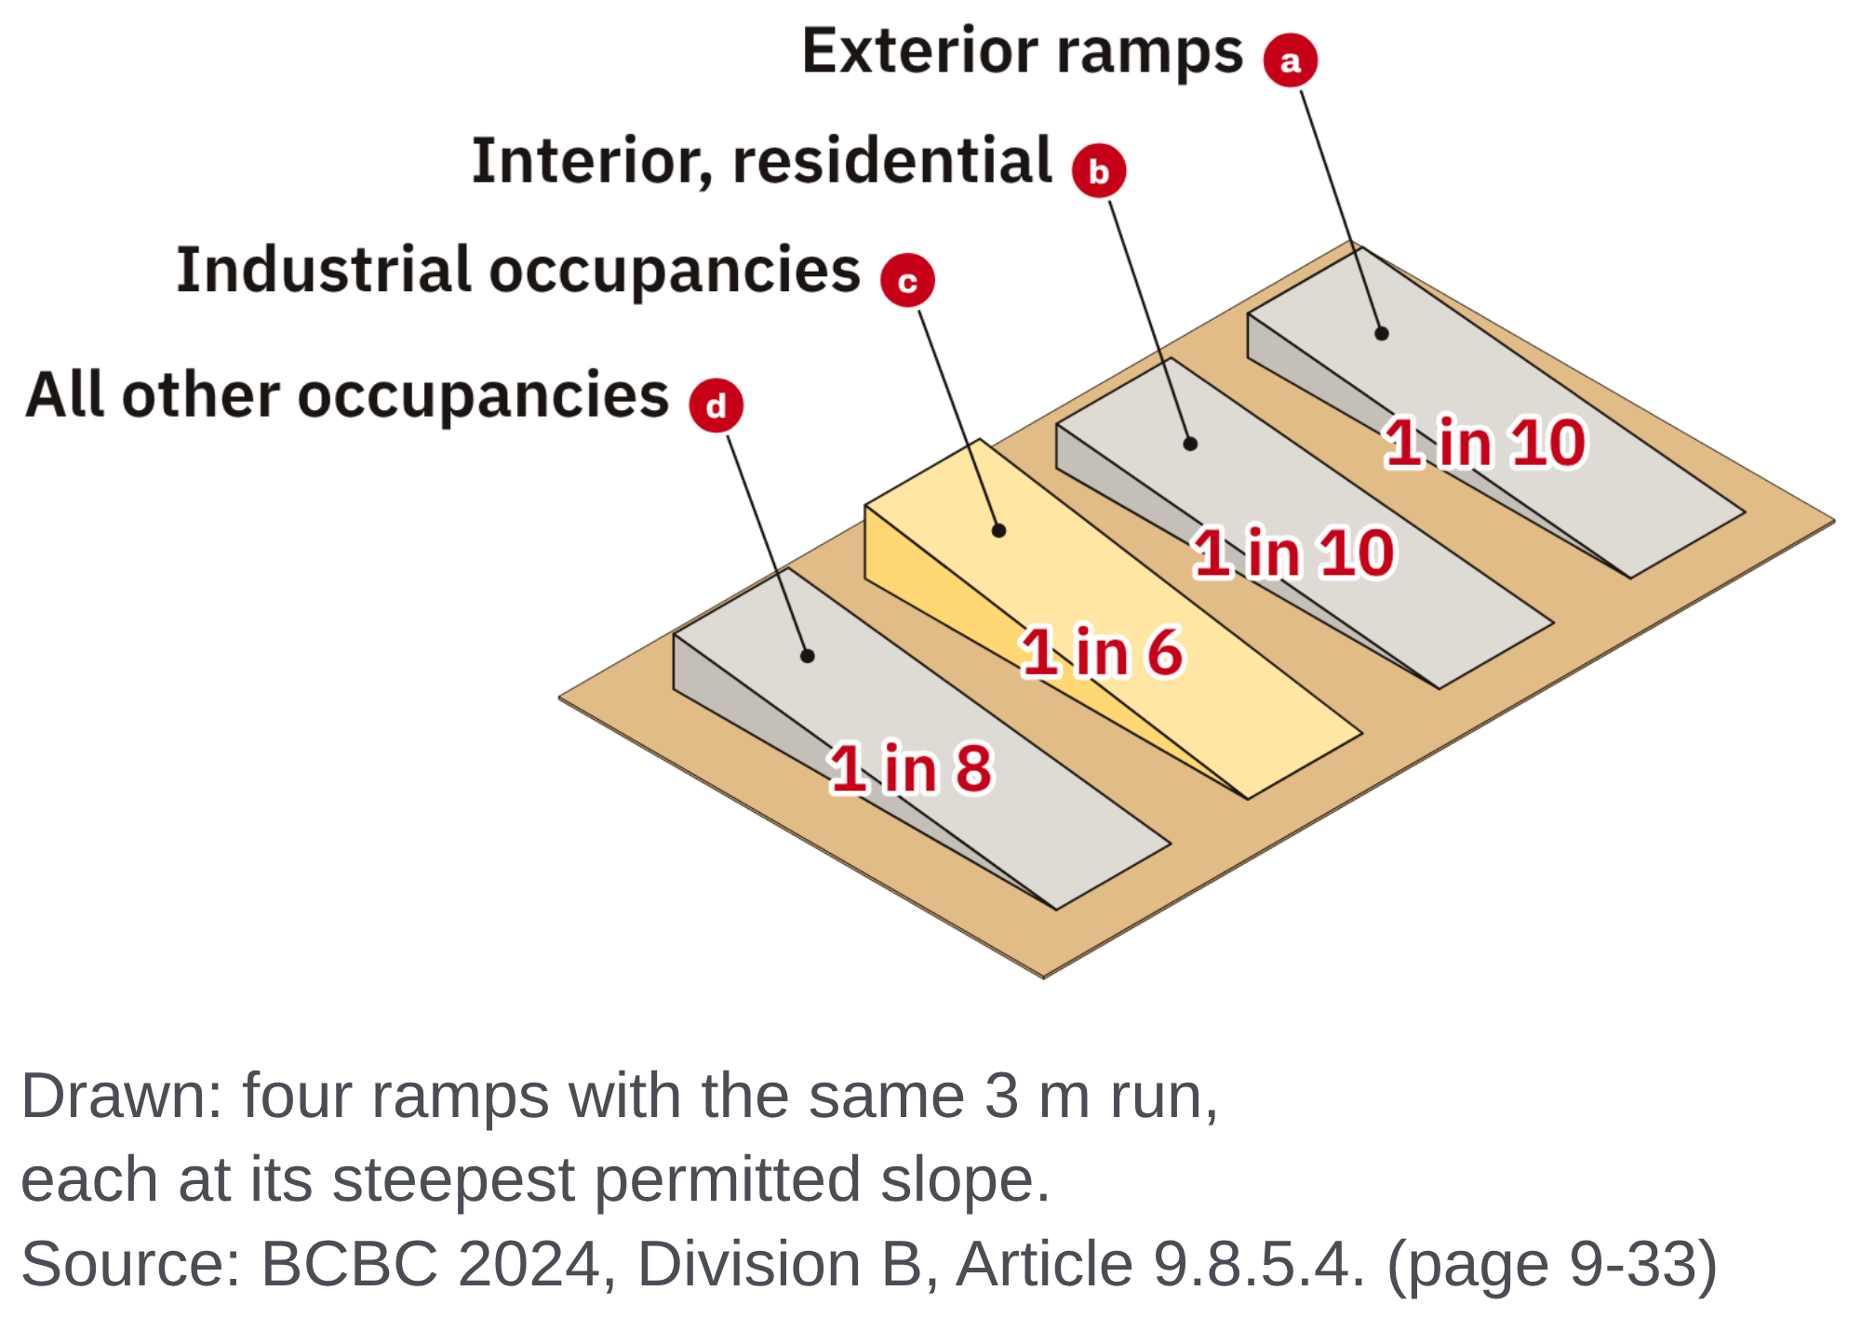
W06-L09 • TEACH • 12:55 PM–1:10 PM • 15 MIN TOTAL
One rise/run ratio, two different reports
Rise : run = 1 : 50 → rise ÷ run = 0.02
Grade = 0.02 × 100 = 2%
Angle = tan⁻¹(0.02) ≈ 1.15°
Angle example • Rise 350 mm; run 800 mm.
θ = tan⁻¹(350 ÷ 800) ≈ 23.63°.
Use the inverse-tangent function, not 1 ÷ tan. Check DEG mode.
Together • Solve 13A Q10,14–15.
Label degree answers differently from percentage answers.
Shape Canvas: show rise and run; compare with a taught Numeracy Hub task.
Textbook pp.331–333 • Numeracy Hub → Angles and Trig → Right-triangle trigonometry
Textbook
Exercise Book
Numeracy Hub
Shape Canvas
Day 23 • 2026-12-04 • 07
Notes:
TEACH • 12:55 PM–1:10 PM • 15 MIN TOTAL — shared across this phase’s slides.
For a rise-to-run ratio of one to fifty, divide one by fifty to get 0.02. Multiplying by one hundred gives a two-percent grade. Applying inverse tangent to 0.02 in degree mode gives about 1.15 degrees. These are two correct descriptions of the same slope. In the second example, 350 divided by 800 is 0.4375. Inverse tangent gives about 23.63 degrees. Why is the second angle steeper? Its rise is a much larger fraction of its run. Neither angle comes from simply moving the decimal point in the ratio.

Slide 8
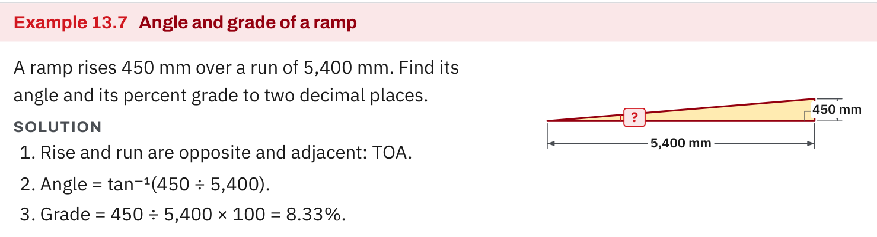
W06-L09 • TEACH • 12:55 PM–1:10 PM • 15 MIN TOTAL
Textbook | page 333
Textbook p.333 • Example 13.7 — Rise, run, angle and percentage grade
Textbook sections 13.4–13.5 pp.331–333; sections 13.7 pp.337–339 (extension)
Textbook
Exercise Book
Numeracy Hub
Shape Canvas
Day 23 • 2026-12-04 • 08
Notes:
TEACH • 12:55 PM–1:10 PM • 15 MIN TOTAL — shared across this phase’s slides.
Follow Example 13.7 on page 333 from the drawing to the rise/run ratio. Locate the horizontal run, not the sloping length. Copy the ratio first, then branch into two calculations: multiply by one hundred for percentage grade, and apply inverse tangent for degrees. What part of the working should be identical in both branches? The consistent-unit rise/run ratio. If two answers disagree with the example, inspect that shared input first. A correct function applied to a reversed run/rise ratio still describes a different angle.

Slide 9
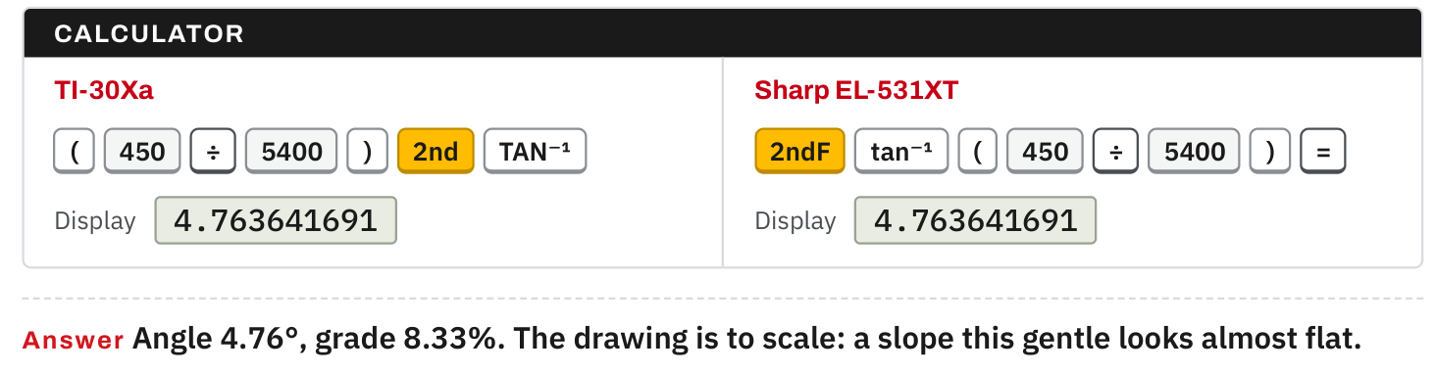
W06-L09 • TEACH • 12:55 PM–1:10 PM • 15 MIN TOTAL
Textbook | page 333
Textbook p.333 • Example 13.7 — Inverse tangent and separate degree/percent answers
Textbook sections 13.4–13.5 pp.331–333; sections 13.7 pp.337–339 (extension)
Textbook
Exercise Book
Numeracy Hub
Shape Canvas
Day 23 • 2026-12-04 • 09
Notes:
TEACH • 12:55 PM–1:10 PM • 15 MIN TOTAL — shared across this phase’s slides.
Look at the inverse-tangent step in the textbook example. The small minus-one notation names an inverse function: it asks which angle has this tangent. It is not an instruction to take a reciprocal. Keep the full ratio in the calculator until the final rounding. Now compare the two answer lines. One carries a percent sign and one a degree symbol. What would be missing if we wrote only two bare numbers? Their meanings. In carpentry communication, the label is part of the measurement, not decoration after the arithmetic.

Slide 10
W06-L09 • TEACH • 12:55 PM–1:10 PM • 15 MIN TOTAL
Spot the mistake. Explain the correction.
Does a 2% grade mean an angle of 2°?
Discuss the method before checking the answer.
No. Percent grade multiplies rise/run by 100; degrees come from inverse tangent in DEG mode.
Textbook sections 13.4–13.5 pp.331–333; sections 13.7 pp.337–339 (extension)
Textbook
Exercise Book
Numeracy Hub
Shape Canvas
Day 23 • 2026-12-04 • 10
Notes:
TEACH • 12:55 PM–1:10 PM • 15 MIN TOTAL — shared across this phase’s slides.
The claim is that two percent means two degrees. Use the definitions to test it. Two percent means a rise/run ratio of 2 divided by 100, or 0.02. The angle is inverse tangent of 0.02, about 1.15 degrees. A two-degree angle would instead have a grade of about 3.49 percent. What caused the mistaken claim? Treating two different measures as if they shared a scale. Correct it by naming the ratio first and applying the operation belonging to the requested output.

Slide 11
W06-L09 • TOGETHER • 1:10 PM–1:25 PM • 15 MIN TOTAL
Work together
Solve Exercise Book 13A Q10,14–15. Label degree answers differently from percentages.
Work in pairs, alternating solver and checker. Write a diagram, formula, units and estimate.
Resources: Exercise Book 13A Q10–15 (p.128); 13B Q7–8 (p.129), Q12 (p.130). 13C Q4 (p.131), Q7 (p.132)
Textbook sections 13.4–13.5 pp.331–333; sections 13.7 pp.337–339 (extension)
Textbook
Exercise Book
Numeracy Hub
Shape Canvas
Day 23 • 2026-12-04 • 11
Notes:
TOGETHER • 1:10 PM–1:25 PM • 15 MIN TOTAL — shared across this phase’s slides.
Work together on 13A Q10, Q14 and Q15. One partner draws and labels the triangle; the other checks the side pair and requested output. For an angle, write the appropriate inverse trig expression. For grade, write rise divided by run times one hundred. If a question requests both, keep the answer lines separate. Switch roles as you work. Explain why the symbol after the answer matters: percent and degrees cannot be exchanged even when they describe one physical slope.

Slide 12
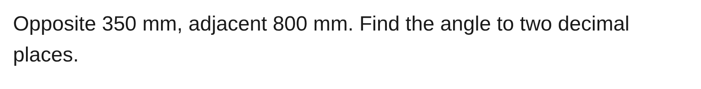
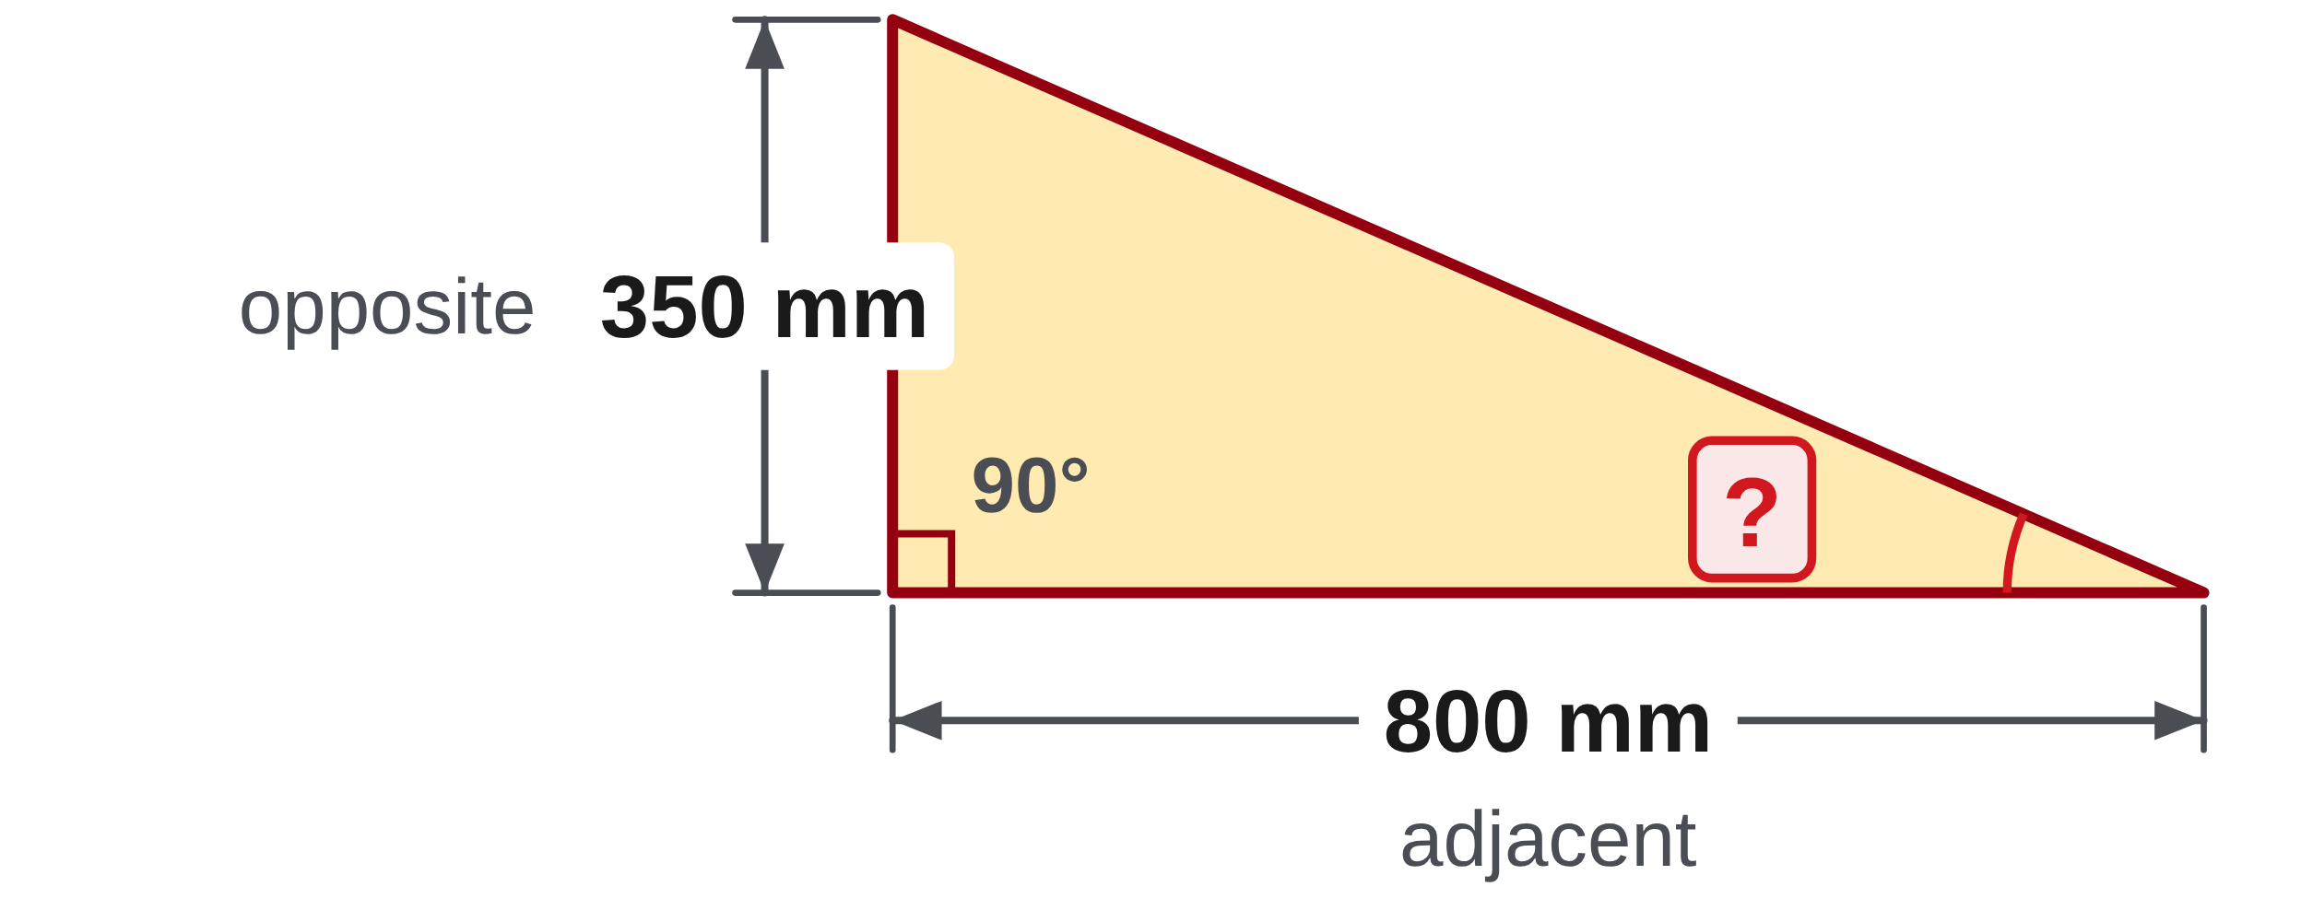
W06-L09 • TOGETHER • 1:10 PM–1:25 PM • 15 MIN TOTAL
Guided practice | 13A Q10
Work with a partner. Take turns explaining the next step.
Textbook sections 13.4–13.5 pp.331–333; sections 13.7 pp.337–339 (extension)
Textbook
Exercise Book
Numeracy Hub
Shape Canvas
Day 23 • 2026-12-04 • 12
Notes:
TOGETHER • 1:10 PM–1:25 PM • 15 MIN TOTAL — shared across this phase’s slides.
For 13A Q10, mark the opposite side as 350 millimetres and the adjacent side as 800 millimetres. Which ratio contains opposite and adjacent? Tangent. Write the ratio before using inverse tangent, then attempt the angle to two decimal places. After the attempt, compare your value with a rough judgment: the rise is less than half the run, so the angle should be well below forty-five degrees. Explain that reasonableness check to your partner before revealing the answer.
INSTRUCTOR ONLY — AFTER THE ATTEMPT: 23.63° Working: tan⁻¹(350 ÷ 800)

Slide 13
W06-L09 • TOGETHER • 1:10 PM–1:25 PM • 15 MIN TOTAL
Compare your method | 13A Q10
CHECK TOGETHER
23.63°
tan⁻¹(350 ÷ 800)
Textbook sections 13.4–13.5 pp.331–333; sections 13.7 pp.337–339 (extension)
Textbook
Exercise Book
Numeracy Hub
Shape Canvas
Day 23 • 2026-12-04 • 13
Notes:
TOGETHER • 1:10 PM–1:25 PM • 15 MIN TOTAL — shared across this phase’s slides.
The angle is inverse tangent of 350 divided by 800. The ratio is 0.4375, and inverse tangent in DEG mode gives 23.63 degrees to two decimal places. Notice that 0.4375 is a ratio, not an angle. If someone reported 43.75 percent, they found the grade instead of the requested degree measure. What would happen if the side order were reversed? We would find the other acute angle. Keep the labels visible so the calculation answers the marked angle, not a different one.
INSTRUCTOR ONLY — AFTER THE ATTEMPT: 23.63° Working: tan⁻¹(350 ÷ 800)

Slide 14
W06-L09 • PRACTISE • 1:25 PM–2:00 PM • 35 MIN TOTAL
Your scheduled practice
Complete Exercise Book 13A Q11–13 and 13B Q7; use Q12 as carpentry/truss extension. Show a Shape Canvas triangle and check the result with the Numeracy Hub. Then 13B Q8 and 13C Q4 and Q7: label each answer as a length, a percent grade or an angle in degrees.
Solve on paper first; check with tools; correct one error and explain the change.
Resources: Exercise Book 13A Q10–15 (p.128); 13B Q7–8 (p.129), Q12 (p.130). 13C Q4 (p.131), Q7 (p.132)
Textbook sections 13.4–13.5 pp.331–333; sections 13.7 pp.337–339 (extension)
Textbook
Exercise Book
Numeracy Hub
Shape Canvas
Day 23 • 2026-12-04 • 14
Notes:
PRACTISE • 1:25 PM–2:00 PM • 35 MIN TOTAL — shared across this phase’s slides.
Complete 13A Q11–13 and 13B Q7. Use 13B Q12 as the scheduled carpentry/truss extension when ready. Q11 and Q12 will require you to think about which side pair is given; do not use inverse tangent automatically for every angle. Build the assigned triangle in Shape Canvas, then compare a taught ramp or brace task in Numeracy Hub. Write the equation before opening the answer. Keep percentage and degree labels distinct wherever the task asks for both. In the fifteen added minutes, work 13B Q8, then 13C Q4 and Q7. Q8 turns a one percent grade over an eighteen metre run into a fall in millimetres. 13C Q4 and Q7 each give two sides, so the angle comes from inverse tangent. Label every answer: a length, a percent grade or an angle in degrees.

Slide 15
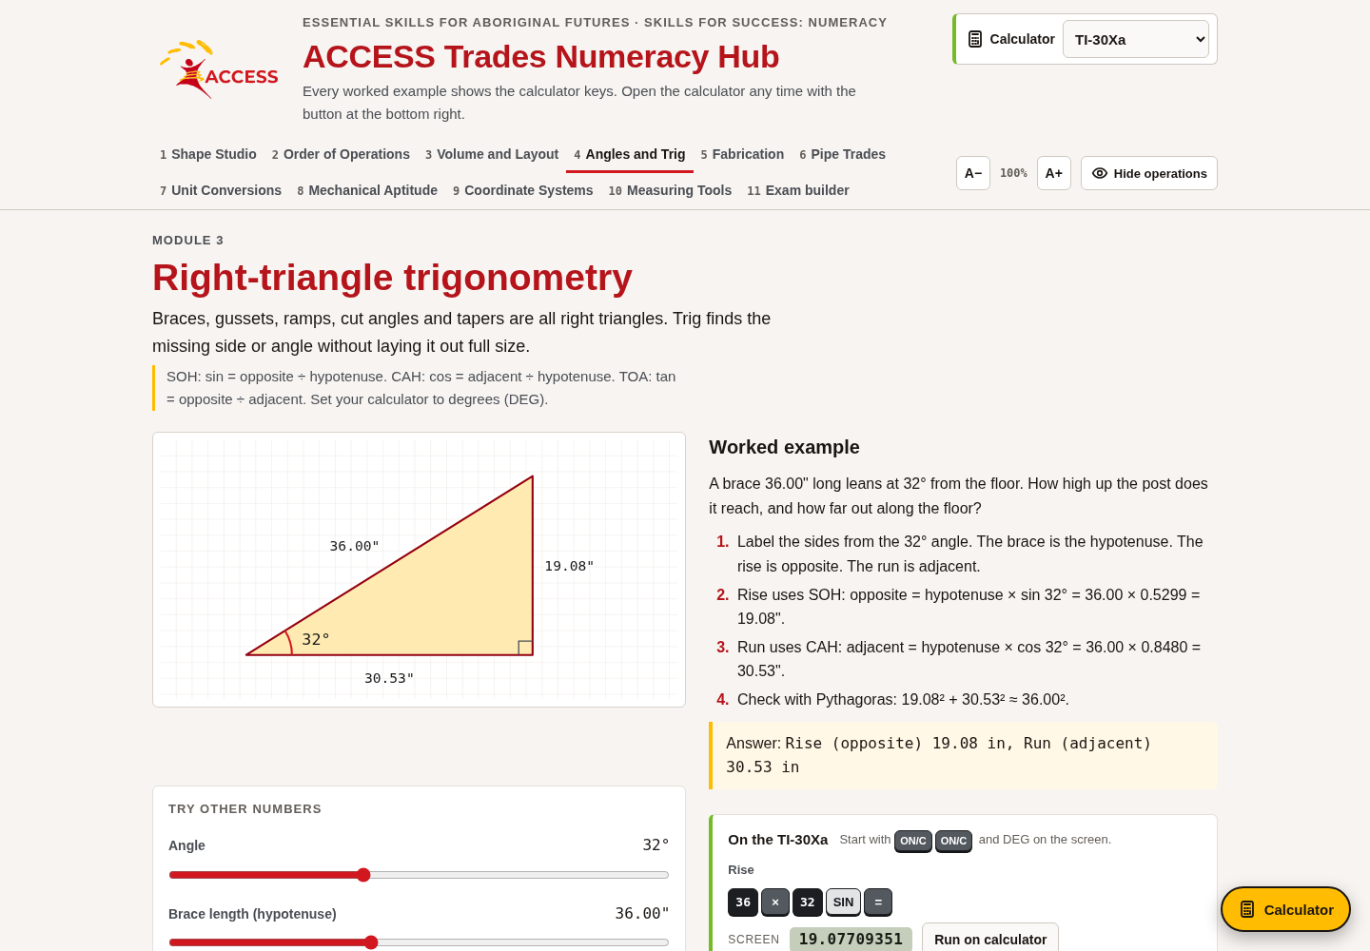
W06-L09 • PRACTISE • 1:25 PM–2:00 PM • 35 MIN TOTAL
Open Numeracy Hub
Navigation example. Use the values and units in the assigned task.
Textbook sections 13.4–13.5 pp.331–333; sections 13.7 pp.337–339 (extension)
Textbook
Exercise Book
Numeracy Hub
Shape Canvas
Day 23 • 2026-12-04 • 15
Notes:
PRACTISE • 1:25 PM–2:00 PM • 35 MIN TOTAL — shared across this phase’s slides.
Open Angles and Trig in Numeracy Hub and choose the right-triangle ramp or brace practice. Read the values on the actual task, then sketch rise, run and the marked angle. The image here shows navigation; use your task's dimensions. Which calculator setting gives the degree measure used on our drawings? DEG. Before checking the answer, write whether the unknown is a side, an angle or a grade. That decision determines the mathematical operation.

Slide 16
W06-L09 • PRACTISE • 1:25 PM–2:00 PM • 35 MIN TOTAL
Practise in Numeracy Hub and Shape Canvas
1
Build the assigned rise/run triangle in Shape Canvas and label both dimensions.
2
Calculate grade and angle separately on paper, keeping % distinct from °.
3
Check the triangle with Numeracy Hub Right-triangle trigonometry ramp/brace practice in DEG mode.
Textbook sections 13.4–13.5 pp.331–333; sections 13.7 pp.337–339 (extension)
Textbook
Exercise Book
Numeracy Hub
Shape Canvas
Day 23 • 2026-12-04 • 16
Notes:
PRACTISE • 1:25 PM–2:00 PM • 35 MIN TOTAL — shared across this phase’s slides.
Build the assigned rise/run triangle in Shape Canvas and label both dimensions with matching units. On paper, calculate the percentage grade and the angle as two separate outputs. Compare them with the Numeracy Hub task after your attempt. What should happen if the rise becomes a larger fraction of the run? Both the grade and angle increase, although their numerical values remain different. Use the picture to check the direction of change and your written equations to explain the exact values.

Slide 17
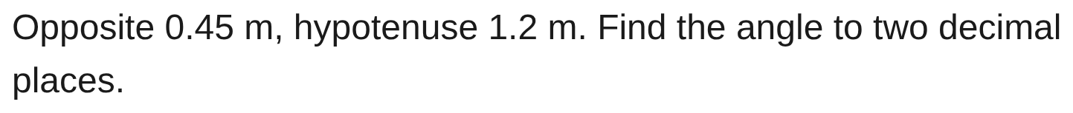
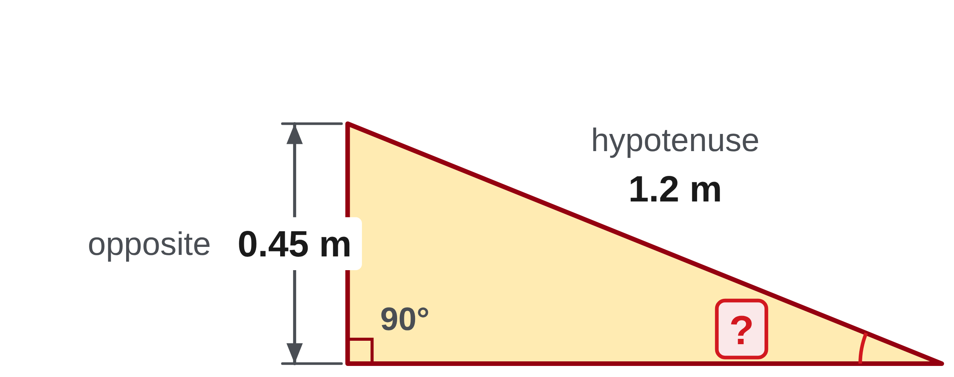
W06-L09 • PRACTISE • 1:25 PM–2:00 PM • 35 MIN TOTAL
Practise from the Exercise Book | 13A Q11
Write the operation, working and units before checking.
Textbook sections 13.4–13.5 pp.331–333; sections 13.7 pp.337–339 (extension)
Textbook
Exercise Book
Numeracy Hub
Shape Canvas
Day 23 • 2026-12-04 • 17
Notes:
PRACTISE • 1:25 PM–2:00 PM • 35 MIN TOTAL — shared across this phase’s slides.
For 13A Q11, the given pair is opposite and hypotenuse, so the angle comes from inverse sine. Attempt it first with 0.45 divided by 1.2 inside the inverse function. Both measurements are in metres, so the ratio is unitless. After your attempt, compare: the ratio is 0.375 and the angle is 22.02 degrees. Which detail ruled out tangent? The known long side is the hypotenuse, not the adjacent leg.
INSTRUCTOR ONLY — AFTER THE ATTEMPT: 22.02° Working: sin⁻¹(0.45 ÷ 1.2)

Slide 18
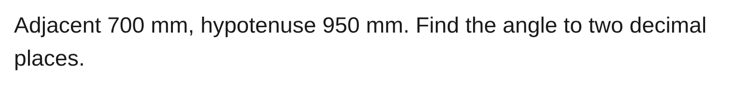
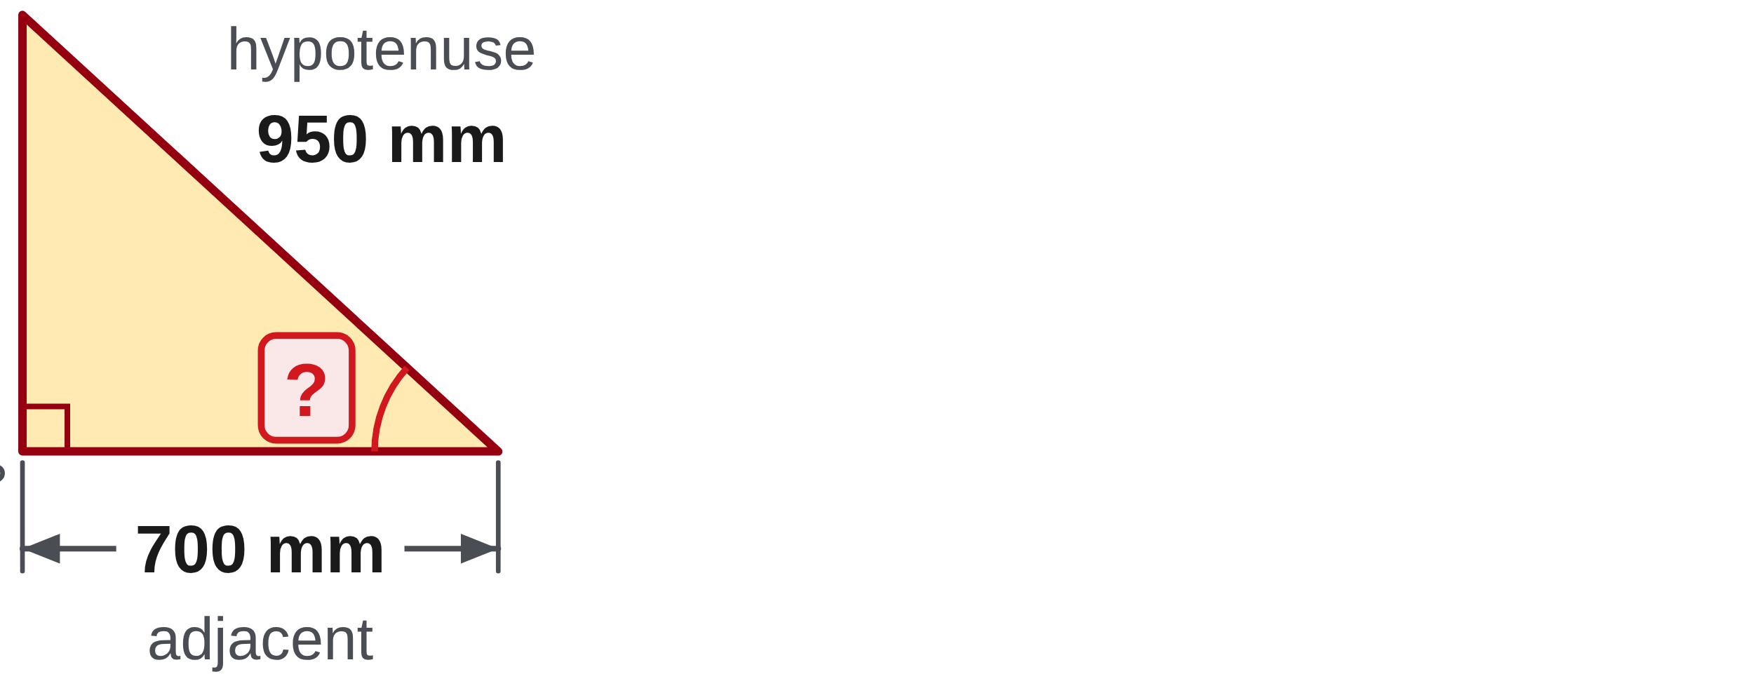
W06-L09 • PRACTISE • 1:25 PM–2:00 PM • 35 MIN TOTAL
Practise from the Exercise Book | 13A Q12
Write the operation, working and units before checking.
Textbook sections 13.4–13.5 pp.331–333; sections 13.7 pp.337–339 (extension)
Textbook
Exercise Book
Numeracy Hub
Shape Canvas
Day 23 • 2026-12-04 • 18
Notes:
PRACTISE • 1:25 PM–2:00 PM • 35 MIN TOTAL — shared across this phase’s slides.
For 13A Q12, identify adjacent as 700 millimetres and hypotenuse as 950 millimetres. Choose the inverse function matching that pair and attempt the calculation to two decimal places. After the attempt, compare your equation with cosine of the angle equals 700 divided by 950. The inverse-cosine result is 42.54 degrees. Why do we not divide 950 by 700? Cosine is adjacent over hypotenuse, and that ratio must be between zero and one for this acute angle.
INSTRUCTOR ONLY — AFTER THE ATTEMPT: 42.54° Working: cos⁻¹(700 ÷ 950)

Slide 19
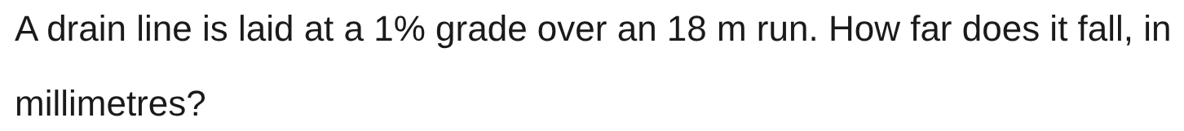
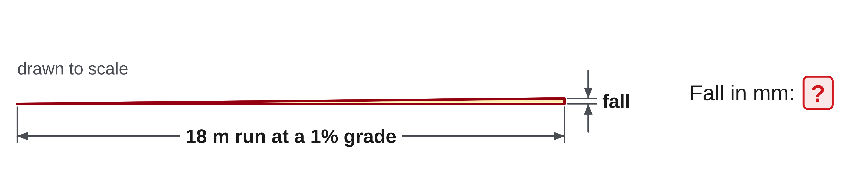
W06-L09 • PRACTISE • 1:25 PM–2:00 PM • 35 MIN TOTAL
Practise from the Exercise Book | 13B Q8
Write the operation, working and units before checking.
Textbook sections 13.4–13.5 pp.331–333; sections 13.7 pp.337–339 (extension)
Textbook
Exercise Book
Numeracy Hub
Shape Canvas
Day 23 • 2026-12-04 • 19
Notes:
PRACTISE • 1:25 PM–2:00 PM • 35 MIN TOTAL — shared across this phase’s slides.
13B Q8 gives a percent grade and a run, and asks for the fall. A grade is rise over run times one hundred, so the fall is the run times the grade over one hundred. Change eighteen metres to millimetres first, because the answer is asked in millimetres. Is a one percent grade steep? No: one millimetre of fall for every hundred millimetres of run.
INSTRUCTOR ONLY — AFTER THE ATTEMPT: 180 mm Working: 18,000 × 1 ÷ 100

Slide 20

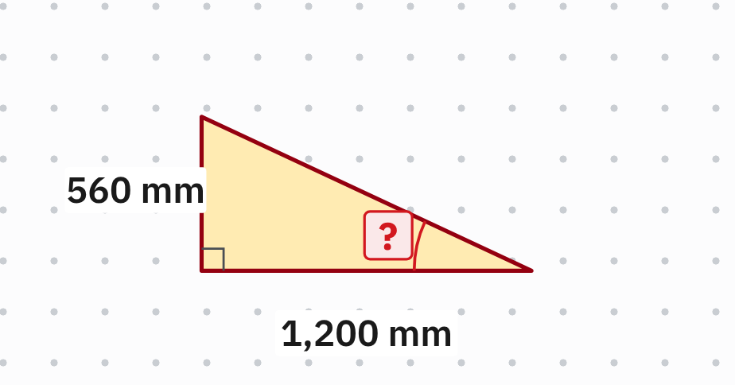
W06-L09 • PRACTISE • 1:25 PM–2:00 PM • 35 MIN TOTAL
Practise from the Exercise Book | 13C Q4
Write the operation, working and units before checking.
Textbook sections 13.4–13.5 pp.331–333; sections 13.7 pp.337–339 (extension)
Textbook
Exercise Book
Numeracy Hub
Shape Canvas
Day 23 • 2026-12-04 • 20
Notes:
PRACTISE • 1:25 PM–2:00 PM • 35 MIN TOTAL — shared across this phase’s slides.
13C Q4 marks the angle at the bottom right. The 560 millimetre side is opposite that angle and the 1,200 millimetre side is adjacent to it, so the ratio is tangent. Divide opposite by adjacent, then use inverse tangent in DEG mode. Round to two decimal places.
INSTRUCTOR ONLY — AFTER THE ATTEMPT: 25.02° Working: tan⁻¹(560 ÷ 1,200)

Slide 21
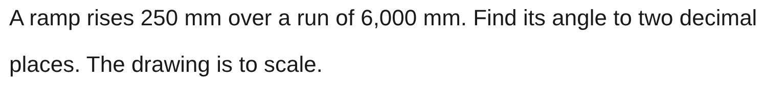
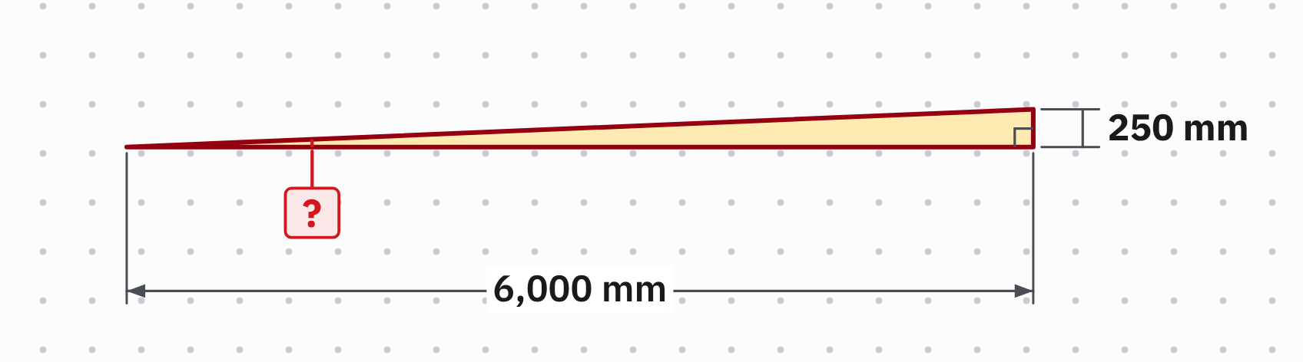
W06-L09 • PRACTISE • 1:25 PM–2:00 PM • 35 MIN TOTAL
Practise from the Exercise Book | 13C Q7
Write the operation, working and units before checking.
Textbook sections 13.4–13.5 pp.331–333; sections 13.7 pp.337–339 (extension)
Textbook
Exercise Book
Numeracy Hub
Shape Canvas
Day 23 • 2026-12-04 • 21
Notes:
PRACTISE • 1:25 PM–2:00 PM • 35 MIN TOTAL — shared across this phase’s slides.
13C Q7 is a ramp drawn to scale, so it looks almost flat. The rise and the run are the two legs, opposite and adjacent to the angle, so use inverse tangent. If the job also asked for the grade, it would be the same ratio times one hundred, a different number with a different unit.
INSTRUCTOR ONLY — AFTER THE ATTEMPT: 2.39° Working: tan⁻¹(250 ÷ 6,000)

Slide 22
W06-L09 • CHECK • 2:00 PM–2:10 PM • 10 MIN TOTAL
Check independently
Exercise Book 13A Q10 and Q14; give the grade and angle separately.
Solve without displayed answers; include working, units and final rounding.
Resources: Exercise Book 13A Q10–15 (p.128); 13B Q7–8 (p.129), Q12 (p.130). 13C Q4 (p.131), Q7 (p.132)
Textbook sections 13.4–13.5 pp.331–333; sections 13.7 pp.337–339 (extension)
Textbook
Exercise Book
Numeracy Hub
Shape Canvas
Day 23 • 2026-12-04 • 22
Notes:
CHECK • 2:00 PM–2:10 PM • 10 MIN TOTAL — shared across this phase’s slides.
Complete 13A Q10 and Q14 independently. Q10 needs a degree measure. Q14 needs both percentage grade and an angle, clearly labelled as separate answers. Keep worked answers closed and retain your ratio and calculator expression. Before submitting, check that the rise and run use matching units and that the final symbol matches the requested quantity. We will compare the methods after your attempt is complete.

Slide 23
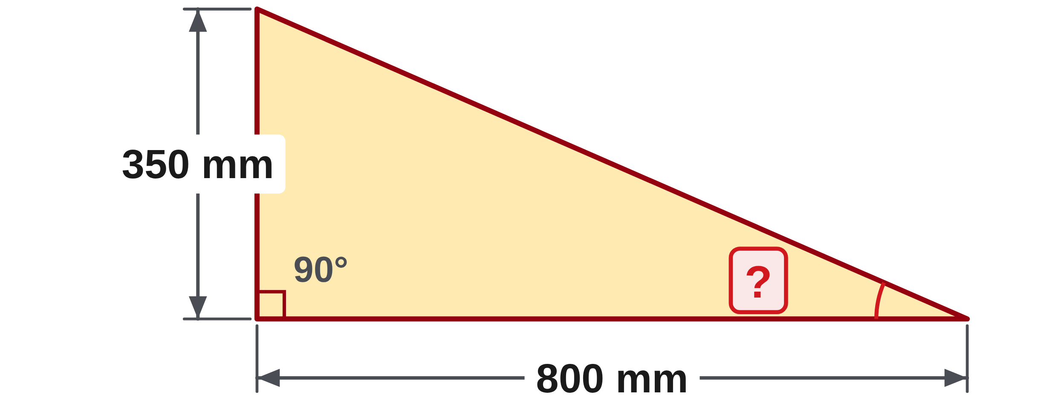
W06-L09 • CHECK • 2:00 PM–2:10 PM • 10 MIN TOTAL
Independent check | 13A Q10
Answer independently. Keep worked solutions closed.
Textbook sections 13.4–13.5 pp.331–333; sections 13.7 pp.337–339 (extension)
Textbook
Exercise Book
Numeracy Hub
Shape Canvas
Day 23 • 2026-12-04 • 23
Notes:
CHECK • 2:00 PM–2:10 PM • 10 MIN TOTAL — shared across this phase’s slides.
Read 13A Q10 and find the marked angle from the two stated sides. Show the ratio and the inverse operation you choose, then round the final degree answer to two decimal places. Keep your calculation private during the independent check.
INSTRUCTOR ONLY — AFTER THE ATTEMPT: tan θ = 350/800 = 0.4375; θ = tan⁻¹(0.4375) = 23.63°. A 43.75% response is grade rather than the requested angle.

Slide 24
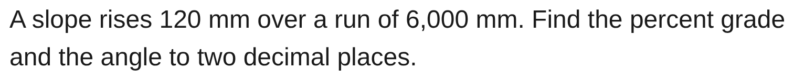
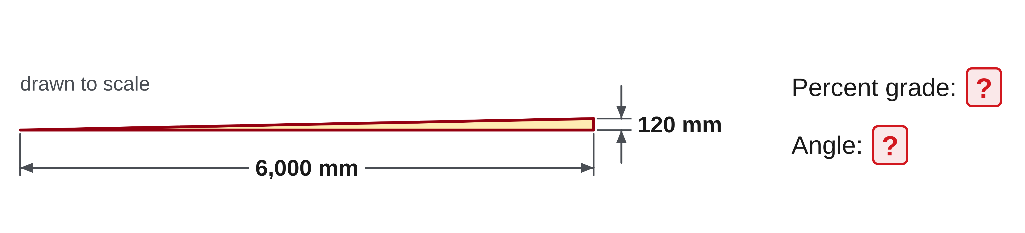
W06-L09 • CHECK • 2:00 PM–2:10 PM • 10 MIN TOTAL
Independent check | 13A Q14
Answer independently. Keep worked solutions closed.
Textbook sections 13.4–13.5 pp.331–333; sections 13.7 pp.337–339 (extension)
Textbook
Exercise Book
Numeracy Hub
Shape Canvas
Day 23 • 2026-12-04 • 24
Notes:
CHECK • 2:00 PM–2:10 PM • 10 MIN TOTAL — shared across this phase’s slides.
For 13A Q14, report the grade and the angle separately. Keep the same supplied rise and run in both calculations and show your working. Label the outputs so there is no doubt which is a percentage and which is a degree measure.
INSTRUCTOR ONLY — AFTER THE ATTEMPT: 120/6,000 = 0.02. Grade = 0.02 × 100 = 2%. Angle = tan⁻¹(0.02) ≈ 1.15°. Do not accept 2° as an equivalent angle.

Slide 25
W06-L09 • WRAP UP • 2:10 PM–2:15 PM • 5 MIN TOTAL
Wrap up and choose the next step
Ask: What changed in your understanding? Where will you use it? What should you check next time?
Name the math and one other essential skill used; record a next practice step.
Resources: Exercise Book 13A Q10–15 (p.128); 13B Q7–8 (p.129), Q12 (p.130). 13C Q4 (p.131), Q7 (p.132)
Textbook sections 13.4–13.5 pp.331–333; sections 13.7 pp.337–339 (extension)
Textbook
Exercise Book
Numeracy Hub
Shape Canvas
Day 23 • 2026-12-04 • 25
Notes:
WRAP UP • 2:10 PM–2:15 PM • 5 MIN TOTAL — shared across this phase’s slides.
Finish with one sentence explaining why two percent is not two degrees. A strong explanation mentions the shared rise/run ratio and the two different operations. Which side pair calls for inverse tangent? Opposite and adjacent. Inverse sine uses opposite and hypotenuse; inverse cosine uses adjacent and hypotenuse. Record the part that still needs practice, whether it is side labels, inverse keys or output units. Those specific notes will help you choose the right revision work later.

