Slide 1

CARPENTRY FOUNDATION / INTAKE 142
Day 03 | Monday
03
November 2, 2026
BEDMAS: choosing the correct order
12:45 PM–2:00 PM • Math • 75 min
BEDMAS in cut lists and frames
2:15 PM–3:30 PM • Math • 75 min
Week 2 • 2 scheduled blocks • 150 teaching minutes
Estimate. Show the method. Label units. Check the result.
Textbook
Exercise Book
Numeracy Hub
Shape Canvas
Day 03 • 2026-11-02 • 01
Notes:
Opening overview | 12:45 PM–12:50 PM | Within the 5-minute Start phase.
This afternoon we will make multi-step calculations unambiguous. First we will practise BEDMAS, then apply that order to cut lists and rectangular frames. The same numbers can produce different results when their grouping changes. Why does that matter when two people read a drawing or calculation? They need to agree on which quantities are combined first. Our aim is to show the order clearly enough that another person can follow and check the work.

Slide 2
DAY 03 / WEEK 2 / CLASS TIMETABLE
Today’s exact schedule
12:45 PM–2:00 PM • 75 min
2:15 PM–3:30 PM • 75 min
BEDMAS: choosing the correct order
BEDMAS in cut lists and frames
12:45 PM–12:50 PM
Start
5
2:15 PM–2:20 PM
Start
5
12:50 PM–12:55 PM
Recall
5
2:20 PM–2:25 PM
Recall
5
12:55 PM–1:10 PM
Teach
15
2:25 PM–2:40 PM
Teach
15
1:10 PM–1:25 PM
Together
15
2:40 PM–2:55 PM
Together
15
1:25 PM–1:45 PM
Practise
20
2:55 PM–3:15 PM
Practise
20
1:45 PM–1:55 PM
Check
10
3:15 PM–3:25 PM
Check
10
1:55 PM–2:00 PM
Wrap up
5
3:25 PM–3:30 PM
Wrap up
5
Math • Math Week 2, Lesson 1
Math • Math Week 2, Lesson 2
Break: 2:00 PM–2:15 PM • 15 minutes • excluded from teaching time
Textbook
Exercise Book
Numeracy Hub
Shape Canvas
Day 03 • 2026-11-02 • 02
Notes:
Opening overview | 12:45 PM–12:50 PM | Within the 5-minute Start phase.
Our first block runs from 12:45 until 2:00. After a fifteen-minute break, the second block runs from 2:15 until 3:30. Each block includes teaching, partner work, twenty minutes of practice and an independent check. Which part of the written work matters as much as the final number today? The operation order. Keep intermediate lines so a partner can see which operation you performed and why it came next.

Slide 3
W02-L01 • START • 12:45 PM–12:50 PM • 5 MIN TOTAL
BEDMAS: choosing the correct order
Today’s goal: Evaluate grouped expressions and show left-to-right order for equal-ranked operations.
Name one use for today’s skill.
Textbook Chapter 3 pp.44–51; Chapter 2 pp.31–33
Exercise Book 3A Q1–10 (p.19); 3B Q2–3 (p.21)
Keep your notebook, textbook, exercise book and chosen calculator ready.
Textbook Chapter 3 pp.44–51; Chapter 2 pp.31–33
Textbook
Exercise Book
Numeracy Hub
Shape Canvas
Day 03 • 2026-11-02 • 03
Notes:
START | 12:45 PM–12:50 PM | 5 MIN TOTAL — shared phase allocation.
BEDMAS gives us a shared way to read expressions. Our goal is to evaluate groups correctly and work left to right when operations share the same rank. Have you ever entered the same numbers as someone else but obtained a different answer? A missing bracket or a different order may explain it. Today we will point to the next operation before calculating, then rewrite the expression so the remaining work stays visible.

Slide 4
W02-L01 • RECALL • 12:50 PM–12:55 PM • 5 MIN TOTAL
Recall and reconnect
Compare Exercise Book 3A Q1 and Q4. Identify what changes when brackets are present.
Try first without displayed answers.
Resources: Exercise Book 3A Q1–10 (p.19); 3B Q2–3 (p.21)
Textbook Chapter 3 pp.44–51; Chapter 2 pp.31–33
Textbook
Exercise Book
Numeracy Hub
Shape Canvas
Day 03 • 2026-11-02 • 04
Notes:
RECALL | 12:50 PM–12:55 PM | 5 MIN TOTAL — shared phase allocation.
Compare exercise book 3A questions 1 and 4. Look for brackets before trying any arithmetic. What does a bracket tell the reader? Treat what is inside it as a group to complete first. The expressions use different numbers, so we are comparing their structure rather than claiming their answers should match. Identify which operation happens first in each, then explain the rule in words before evaluating.

Slide 5
W02-L01 • RECALL • 12:50 PM–12:55 PM • 5 MIN TOTAL
Recall from the Exercise Book | 3A Q1
Write the operation, working and units before checking.
Textbook Chapter 3 pp.44–51; Chapter 2 pp.31–33
Textbook
Exercise Book
Numeracy Hub
Shape Canvas
Day 03 • 2026-11-02 • 05
Notes:
RECALL | 12:50 PM–12:55 PM | 5 MIN TOTAL — shared phase allocation.
For 3A Q1, read 9 plus 6 times 4. Point to the operation that should be performed first. Why does the plus sign appearing earlier on the page not settle the order? Multiplication has a higher rank than addition. Try the expression, keeping the untouched 9 in the next line. After the attempt, compare your intermediate multiplication with the final sum.
INSTRUCTOR ONLY — AFTER THE ATTEMPT: 33
Working to discuss after the attempt: 6 × 4 = 24, then 9 + 24 = 33. Multiplication precedes addition.

Slide 6
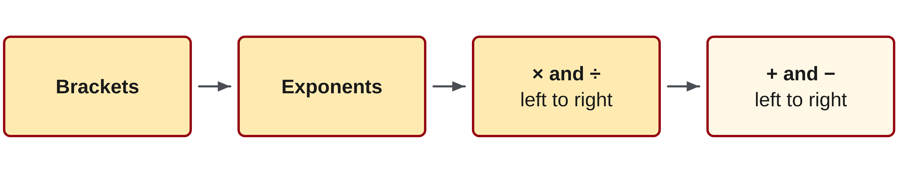
W02-L01 • TEACH • 12:55 PM–1:10 PM • 15 MIN TOTAL
Read BEDMAS as ranked operations
1
Complete the calculation inside brackets first.
2
Evaluate exponents before multiplication or division.
3
Multiplication and division share one rank: work from left to right.
4
Addition and subtraction share one rank: work from left to right.
Textbook Chapter 3 pp.44–51; Chapter 2 pp.31–33
Textbook
Exercise Book
Numeracy Hub
Shape Canvas
Day 03 • 2026-11-02 • 06
Notes:
TEACH | 12:55 PM–1:10 PM | 15 MIN TOTAL — shared phase allocation.
Read BEDMAS as four ranks, not six separate commands. Brackets come first, then exponents. Division and multiplication share a rank, so we perform them from left to right. Addition and subtraction also share a rank and follow the same left-to-right rule. Which operation goes first in 24 divided by 6 times 2? Division, because it is the leftmost operation at that shared rank. The letters are a memory aid; they do not say to hunt for every division before every multiplication. Always inspect the actual expression.

Slide 7
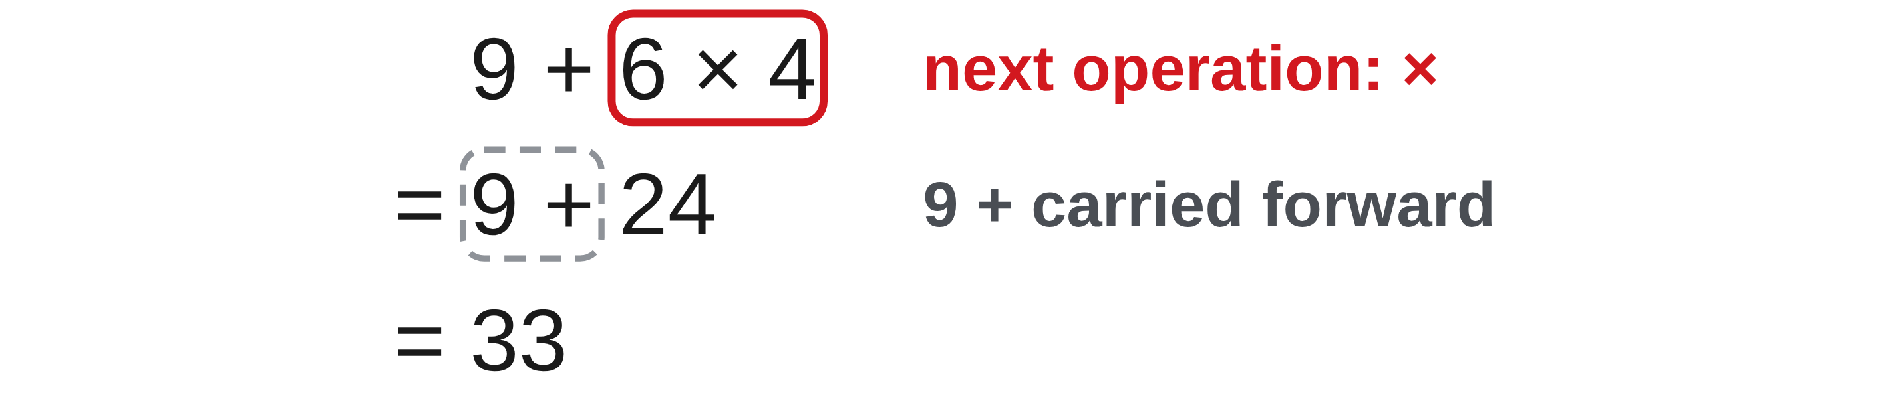
W02-L01 • TEACH • 12:55 PM–1:10 PM • 15 MIN TOTAL
Make the next operation visible
1
Copy the expression exactly, including every bracket.
2
Mark the operation you will perform next.
3
Rewrite the expression after each step; carry unchanged terms forward.
4
Match the calculator’s grouping to the written expression.
Textbook Chapter 3 pp.44–51; Chapter 2 pp.31–33
Textbook
Exercise Book
Numeracy Hub
Shape Canvas
Day 03 • 2026-11-02 • 07
Notes:
TEACH | 12:55 PM–1:10 PM | 15 MIN TOTAL — shared phase allocation.
Copy the expression exactly, including brackets and exponents. Mark the next operation, calculate that part and rewrite the whole remaining expression. Why carry the unchanged terms forward? It prevents a number from disappearing while we focus on a different part. For 9 plus 6 times 4, the next line must still include 9 plus the product. Your calculator grouping should represent the same written structure. If paper and calculator disagree, compare the first operation where their expressions differ instead of assuming the last display is automatically correct.

Slide 8
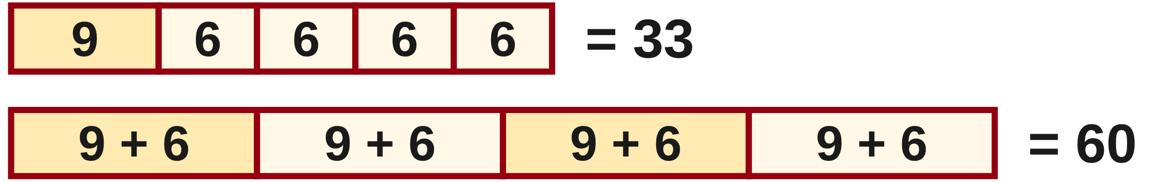
W02-L01 • TEACH • 12:55 PM–1:10 PM • 15 MIN TOTAL
Point to the next operation first
9 + 6 × 4 = 9 + 24 = 33
(9 + 6) × 4 = 15 × 4 = 60
24 ÷ 6 × 2 = 4 × 2 = 8
The last line uses left-to-right order. Do not multiply 6 × 2 first.
Together • Exercise Book 3A Q2–7.
Point to the next operation before calculating. In Numeracy Hub, select Order of Operations → The order: BEDMAS; compare Show steps with your written working.
W2 L1 • Numeracy Hub Easy practice only after the paper attempt
Textbook
Exercise Book
Numeracy Hub
Shape Canvas
Day 03 • 2026-11-02 • 08
Notes:
TEACH | 12:55 PM–1:10 PM | 15 MIN TOTAL — shared phase allocation.
Without brackets, 9 plus 6 times 4 means calculate 6 times 4 first: 24, then add 9 to get 33. With brackets around 9 plus 6, the sum is 15 and multiplying by 4 gives 60. Now read 24 divided by 6 times 2. Division and multiplication share a rank, so 24 divided by 6 gives 4, followed by 4 times 2, giving 8. What caused the first pair of answers to differ? The brackets changed the group being multiplied. The numbers themselves were unchanged.

Slide 9
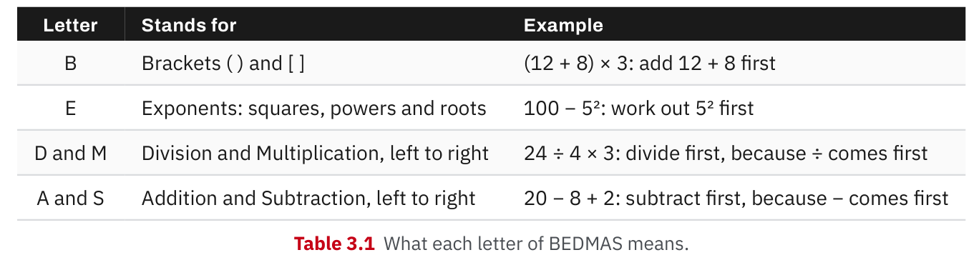
W02-L01 • TEACH • 12:55 PM–1:10 PM • 15 MIN TOTAL
Textbook | page 44
Textbook p.44 · Table 3.1: BEDMAS has four ranks, with left-to-right ties.
Textbook Chapter 3 pp.44–51; Chapter 2 pp.31–33
Textbook
Exercise Book
Numeracy Hub
Shape Canvas
Day 03 • 2026-11-02 • 09
Notes:
TEACH | 12:55 PM–1:10 PM | 15 MIN TOTAL — shared phase allocation.
Table 3.1 on page 44 organises BEDMAS into the ranks we are using. Notice that D and M occupy one row, and A and S occupy another. What does sharing a row tell us? Those operations have equal priority and are read left to right. Brackets can change the sequence by identifying a group that must be completed first. Use the table to justify an operation, not simply recite letters. If someone claims multiplication always precedes division, point them to the shared rank and then to the leftmost operation in the expression.

Slide 10
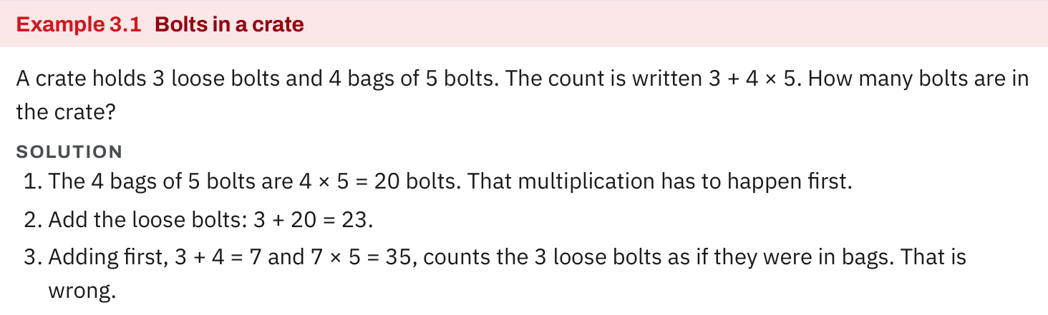
W02-L01 • TEACH • 12:55 PM–1:10 PM • 15 MIN TOTAL
Textbook | page 44
Textbook p.44 · Example 3.1: loose bolts plus equal groups.
Textbook Chapter 3 pp.44–51; Chapter 2 pp.31–33
Textbook
Exercise Book
Numeracy Hub
Shape Canvas
Day 03 • 2026-11-02 • 10
Notes:
TEACH | 12:55 PM–1:10 PM | 15 MIN TOTAL — shared phase allocation.
Example 3.1 describes three loose bolts and four bags containing five bolts each. The four bags contribute four times five, or twenty bolts. Adding the three loose bolts gives twenty-three. Why would adding three plus four before multiplying be wrong? It would treat the three loose bolts as if they were three more bags of five. The story explains the operation order: count the grouped bolts first, then include the loose ones. That same distinction appears when a carpentry task combines packaged fixings with a few spare items.

Slide 11
W02-L01 • TEACH • 12:55 PM–1:10 PM • 15 MIN TOTAL
Spot the mistake. Explain the correction.
In 24 ÷ 6 × 2, should you multiply 6 × 2 first because multiplication appears in BEDMAS?
Discuss the method before checking the answer.
No. Division and multiplication have equal rank. Work left to right: 24 ÷ 6 = 4, then 4 × 2 = 8.
Textbook Chapter 3 pp.44–51; Chapter 2 pp.31–33
Textbook
Exercise Book
Numeracy Hub
Shape Canvas
Day 03 • 2026-11-02 • 11
Notes:
TEACH | 12:55 PM–1:10 PM | 15 MIN TOTAL — shared phase allocation.
In 24 divided by 6 times 2, multiplying 6 by 2 first changes the expression's meaning. The written line has no bracket grouping those two numbers. Work left to right at the shared rank: 24 divided by 6 is 4, then 4 times 2 is 8. What expression would be needed if the intention really were to divide twenty-four by the product of six and two? We would need that product grouped in brackets. The correction is about preserving the expression we were given, not choosing an answer that seems familiar.

Slide 12
W02-L01 • TOGETHER • 1:10 PM–1:25 PM • 15 MIN TOTAL
Work together
Solve Exercise Book 3A Q2–7 with a partner. Point to the next operation before calculating.
Work in pairs; alternate solver and checker.
Resources: Exercise Book 3A Q1–10 (p.19); 3B Q2–3 (p.21)
Textbook Chapter 3 pp.44–51; Chapter 2 pp.31–33
Textbook
Exercise Book
Numeracy Hub
Shape Canvas
Day 03 • 2026-11-02 • 12
Notes:
TOGETHER | 1:10 PM–1:25 PM | 15 MIN TOTAL — shared phase allocation.
Work with a partner on 3A questions 2–7. Before each calculation, the solver points to the next operation and states the rule. The checker confirms the choice before arithmetic begins; then switch roles. What should you do when both multiplication and division appear without brackets? Read the equal-ranked operations from left to right. Keep each intermediate expression so your partner can check the reasoning rather than only compare final answers.

Slide 13
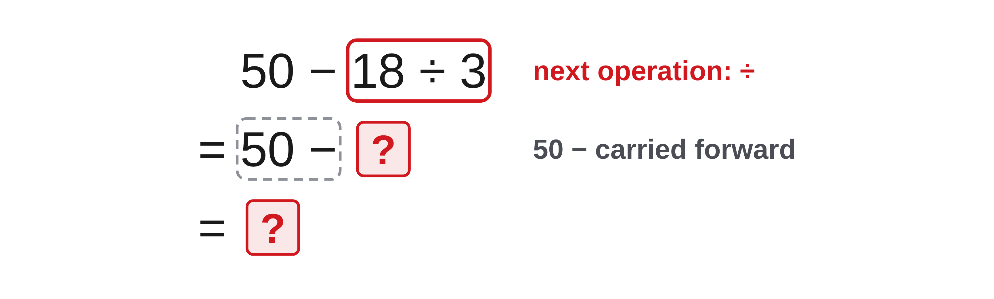
W02-L01 • TOGETHER • 1:10 PM–1:25 PM • 15 MIN TOTAL
Guided practice | 3A Q2
Work with a partner. Take turns explaining the next step.
Textbook Chapter 3 pp.44–51; Chapter 2 pp.31–33
Textbook
Exercise Book
Numeracy Hub
Shape Canvas
Day 03 • 2026-11-02 • 13
Notes:
TOGETHER | 1:10 PM–1:25 PM | 15 MIN TOTAL — shared phase allocation.
For 3A Q2, the expression is 50 minus 18 divided by 3. Which part can be replaced first without changing the expression? The division. Keep fifty and the subtraction sign in the next line while calculating that quotient. Try the arithmetic with your partner, then explain why subtracting eighteen from fifty first would answer a differently grouped question.
INSTRUCTOR ONLY — AFTER THE ATTEMPT: 44
Working to discuss after the attempt: 18 ÷ 3 = 6, then 50 − 6 = 44. Division precedes subtraction.

Slide 14
W02-L01 • TOGETHER • 1:10 PM–1:25 PM • 15 MIN TOTAL
Compare your method | 3A Q2
CHECK TOGETHER
44
Textbook Chapter 3 pp.44–51; Chapter 2 pp.31–33
Textbook
Exercise Book
Numeracy Hub
Shape Canvas
Day 03 • 2026-11-02 • 14
Notes:
TOGETHER | 1:10 PM–1:25 PM | 15 MIN TOTAL — shared phase allocation.
Eighteen divided by three is six, so the expression becomes 50 minus 6. The result is 44. What stayed unchanged when we performed the first step? The fifty and the subtraction operation. If someone got a different result, ask them to show their first intermediate line. An expression beginning with 32 divided by 3 would reveal that subtraction was performed too early. The clear written steps let us locate that error without guessing.
INSTRUCTOR ONLY — AFTER THE ATTEMPT: 44
Working to discuss after the attempt: 18 ÷ 3 = 6, then 50 − 6 = 44. Division precedes subtraction.

Slide 15
W02-L01 • PRACTISE • 1:25 PM–1:45 PM • 20 MIN TOTAL
Your scheduled practice
Complete Exercise Book 3A Q8–10 and 3B Q2–3. Try two Easy Numeracy Hub tasks; record expression, order and checked result, not only the screen answer.
Show working and units; estimate, then check.
Resources: Exercise Book 3A Q1–10 (p.19); 3B Q2–3 (p.21)
Textbook Chapter 3 pp.44–51; Chapter 2 pp.31–33
Textbook
Exercise Book
Numeracy Hub
Shape Canvas
Day 03 • 2026-11-02 • 15
Notes:
PRACTISE | 1:25 PM–1:45 PM | 20 MIN TOTAL — shared phase allocation.
Complete 3A questions 8–10 and 3B questions 2–3. Then attempt two Easy questions in Numeracy Hub. For each, keep the expression, the chosen order and the checked result. Why is a screen answer alone insufficient today? It does not show whether you understood the grouping and priority of the operations. Try each question on paper first, then compare the steps and identify any difference in order.

Slide 16
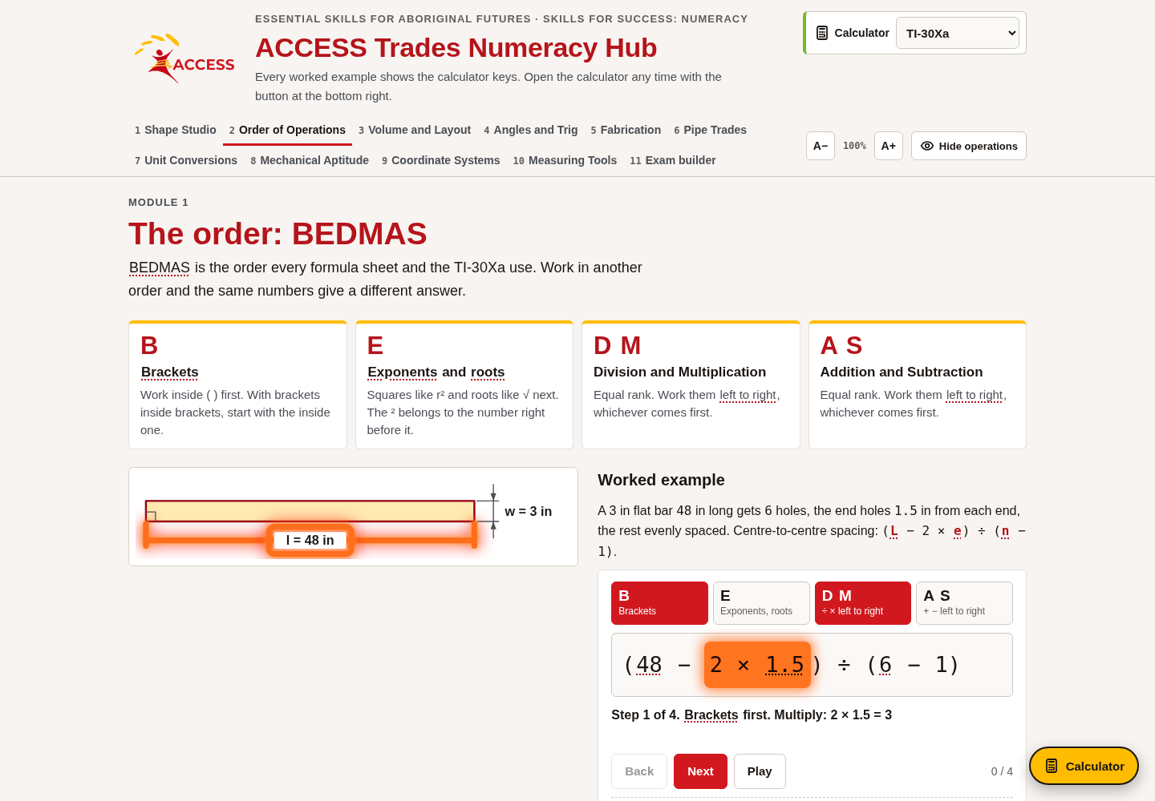
W02-L01 • PRACTISE • 1:25 PM–1:45 PM • 20 MIN TOTAL
Open Numeracy Hub
Navigation example. Use the values and units in the assigned task.
Textbook Chapter 3 pp.44–51; Chapter 2 pp.31–33
Textbook
Exercise Book
Numeracy Hub
Shape Canvas
Day 03 • 2026-11-02 • 16
Notes:
PRACTISE | 1:25 PM–1:45 PM | 20 MIN TOTAL — shared phase allocation.
Open Numeracy Hub, choose Order of Operations and then The order: BEDMAS. The screenshot helps you find the module; your task is to predict each next step before revealing it. What should you look for when comparing with Show steps? Whether the same group or operation was completed first and whether unchanged terms were carried forward. Use Next and Back to examine the exact point of disagreement, rather than skipping immediately to the final answer.

Slide 17
W02-L01 • PRACTISE • 1:25 PM–1:45 PM • 20 MIN TOTAL
Practise in Numeracy Hub
1
Supported: Open Numeracy Hub → Order of Operations → The order: BEDMAS.
2
Supported: Predict the next operation; use Show steps, Next and Back to compare with your working.
3
Independent practice: Attempt two Easy tasks on paper first; keep the expression and operation order.
Textbook Chapter 3 pp.44–51; Chapter 2 pp.31–33
Textbook
Exercise Book
Numeracy Hub
Shape Canvas
Day 03 • 2026-11-02 • 17
Notes:
PRACTISE | 1:25 PM–1:45 PM | 20 MIN TOTAL — shared phase allocation.
With The order: BEDMAS open, write the expression on paper and mark the operation you will do next. Use Show steps only after that prediction. If your line differs, go back and explain which ranking or bracket caused the difference. Then attempt two Easy tasks independently. What record should remain after you leave the screen? The original expression and a sequence that shows how its operations were performed, so the result can still be checked later.

Slide 18
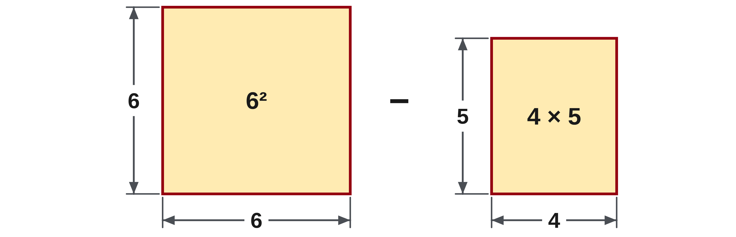
W02-L01 • PRACTISE • 1:25 PM–1:45 PM • 20 MIN TOTAL
Practise from the Exercise Book | 3A Q8
Write the operation, working and units before checking.
Textbook Chapter 3 pp.44–51; Chapter 2 pp.31–33
Textbook
Exercise Book
Numeracy Hub
Shape Canvas
Day 03 • 2026-11-02 • 18
Notes:
PRACTISE | 1:25 PM–1:45 PM | 20 MIN TOTAL — shared phase allocation.
For 3A Q8, evaluate 6 squared minus 4 times 5. Identify both the exponent and the multiplication before deciding when subtraction can happen. What does 6 squared mean? Six multiplied by itself, not six multiplied by two. Attempt the complete sequence on paper, carrying the subtraction forward until both higher-ranked parts are ready. Compare with the answer only after you have shown your own order.
INSTRUCTOR ONLY — AFTER THE ATTEMPT: 16
Working to discuss after the attempt: 6² = 36 and 4 × 5 = 20; the final subtraction is 36 − 20 = 16.

Slide 19
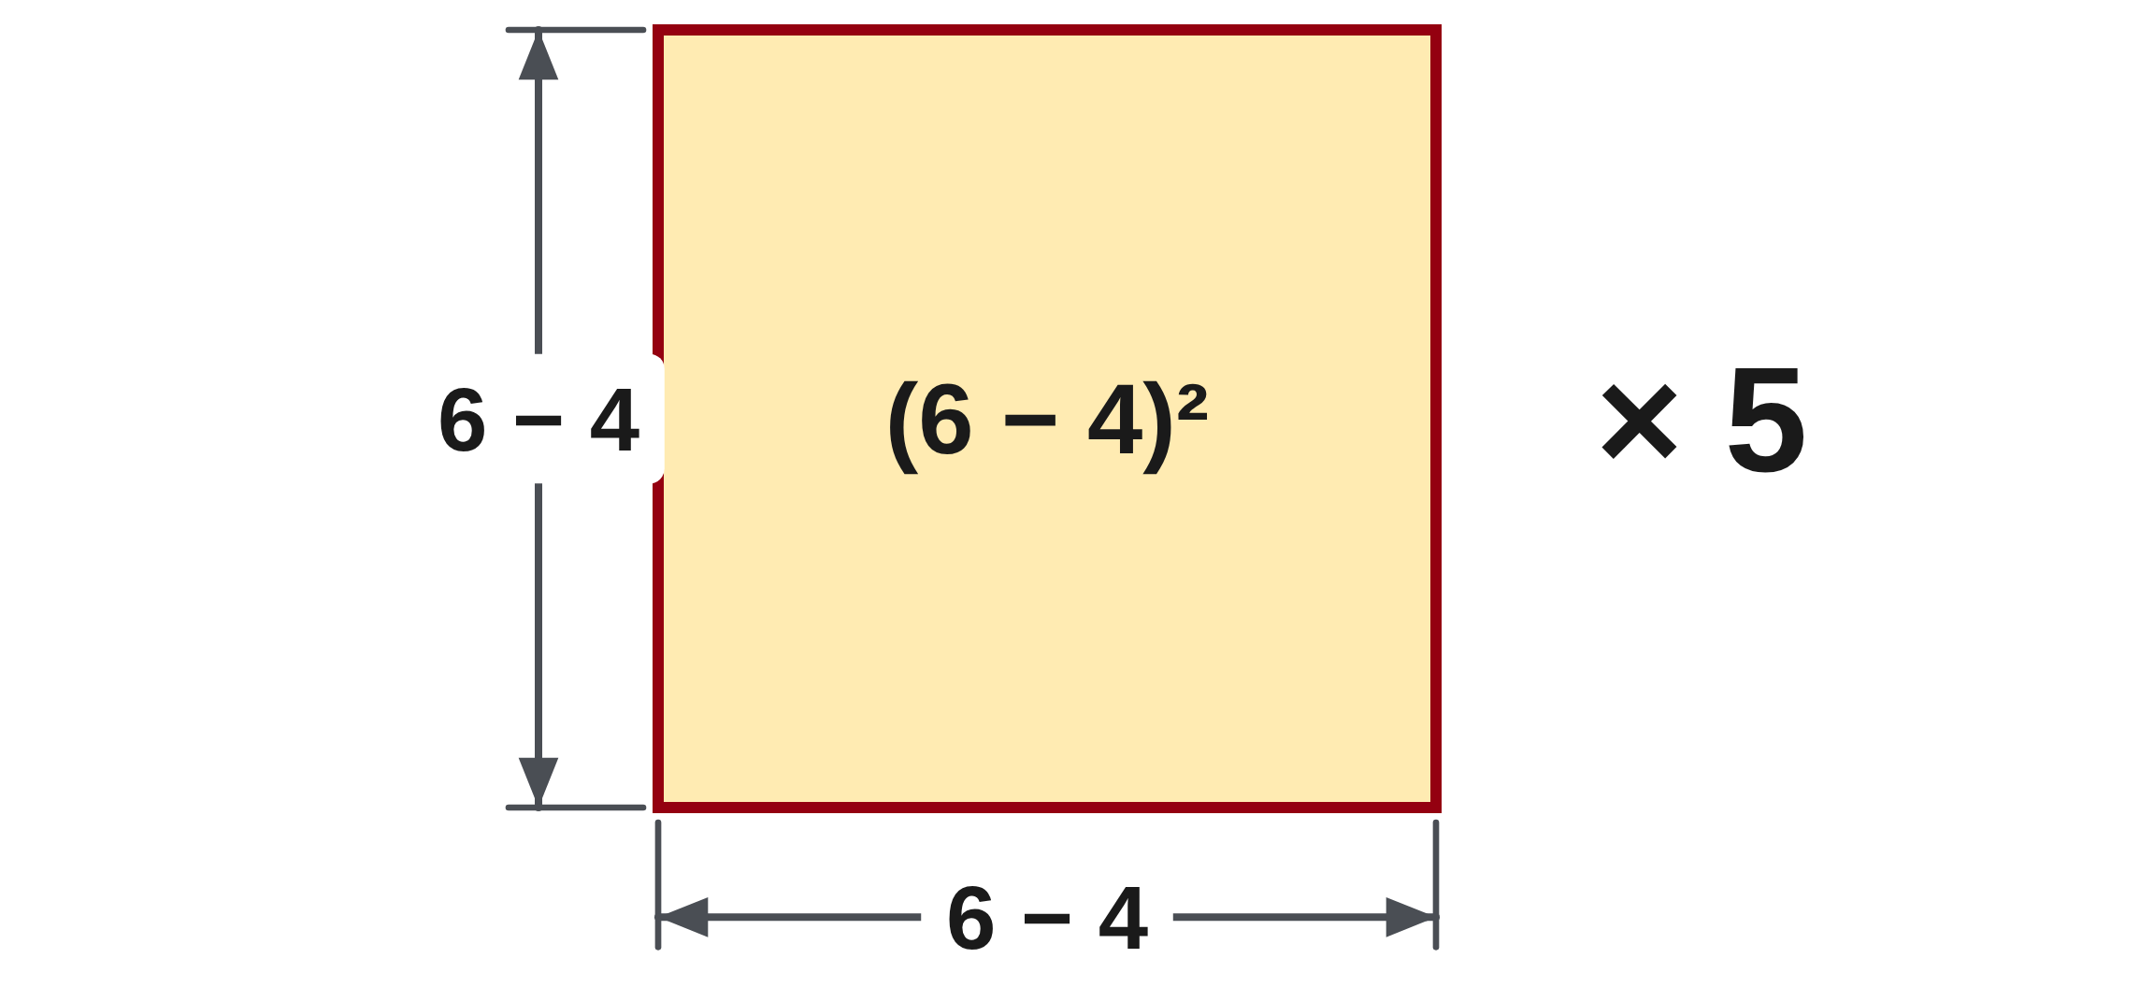
W02-L01 • PRACTISE • 1:25 PM–1:45 PM • 20 MIN TOTAL
Practise from the Exercise Book | 3A Q9
Write the operation, working and units before checking.
Textbook Chapter 3 pp.44–51; Chapter 2 pp.31–33
Textbook
Exercise Book
Numeracy Hub
Shape Canvas
Day 03 • 2026-11-02 • 19
Notes:
PRACTISE | 1:25 PM–1:45 PM | 20 MIN TOTAL — shared phase allocation.
For 3A Q9, the brackets around 6 minus 4 change the base of the square. What must be found before squaring? The result of that entire bracket. Mark the group, then work through the exponent and the final multiplication by five. After your attempt, compare this structure with the previous question. The same familiar digits do not guarantee the same operation order or answer.
INSTRUCTOR ONLY — AFTER THE ATTEMPT: 20
Working to discuss after the attempt: 6 − 4 = 2; 2² = 4; 4 × 5 = 20. The bracketed difference is the base of the square.

Slide 20
W02-L01 • CHECK • 1:45 PM–1:55 PM • 10 MIN TOTAL
Check independently
Exercise Book 3A Q8–9 without displayed solutions; mark each operation in order.
Answer independently and show the method.
Resources: Exercise Book 3A Q1–10 (p.19); 3B Q2–3 (p.21)
Textbook Chapter 3 pp.44–51; Chapter 2 pp.31–33
Textbook
Exercise Book
Numeracy Hub
Shape Canvas
Day 03 • 2026-11-02 • 20
Notes:
CHECK | 1:45 PM–1:55 PM | 10 MIN TOTAL — shared phase allocation.
Redo 3A questions 8 and 9 without displayed solutions. Number each operation so the order is visible, including the group that an exponent acts on. Which difference between the questions matters most? One has a bracketed difference as the base of a square. Keep the answer pages closed and use the expression itself to justify your next step. We will compare reasoning after both attempts.

Slide 21
W02-L01 • CHECK • 1:45 PM–1:55 PM • 10 MIN TOTAL
Independent check | 3A Q8
Answer independently. Keep worked solutions closed.
Textbook Chapter 3 pp.44–51; Chapter 2 pp.31–33
Textbook
Exercise Book
Numeracy Hub
Shape Canvas
Day 03 • 2026-11-02 • 21
Notes:
CHECK | 1:45 PM–1:55 PM | 10 MIN TOTAL — shared phase allocation.
For 3A Q8, copy 6² − 4 × 5 accurately and number the operations you will perform. Complete the attempt without referring to the worked example. Afterward, explain why subtraction waits until the square and multiplication have been evaluated. The check is about your sequence as well as the number, so keep the intermediate line rather than writing only a final answer.
INSTRUCTOR ONLY — AFTER THE ATTEMPT: 16
Working to discuss after the attempt: 6² = 36 and 4 × 5 = 20; the final subtraction is 36 − 20 = 16.

Slide 22
W02-L01 • CHECK • 1:45 PM–1:55 PM • 10 MIN TOTAL
Independent check | 3A Q9
Answer independently. Keep worked solutions closed.
Textbook Chapter 3 pp.44–51; Chapter 2 pp.31–33
Textbook
Exercise Book
Numeracy Hub
Shape Canvas
Day 03 • 2026-11-02 • 22
Notes:
CHECK | 1:45 PM–1:55 PM | 10 MIN TOTAL — shared phase allocation.
For 3A Q9, copy (6 − 4)² × 5 and identify the complete base of the square. Number the operations before evaluating them. What written feature makes subtraction the first operation here? The bracket grouping. After the attempt, compare your intermediate expression with the intended grouping and explain where the final multiplication belongs.
INSTRUCTOR ONLY — AFTER THE ATTEMPT: 20
Working to discuss after the attempt: 6 − 4 = 2; 2² = 4; 4 × 5 = 20. The bracketed difference is the base of the square.

Slide 23
W02-L01 • WRAP UP • 1:55 PM–2:00 PM • 5 MIN TOTAL
Wrap up and choose the next step
Share one learning point and one skill to practise next.
Record a takeaway and next action.
Resources: Exercise Book 3A Q1–10 (p.19); 3B Q2–3 (p.21)
Textbook Chapter 3 pp.44–51; Chapter 2 pp.31–33
Textbook
Exercise Book
Numeracy Hub
Shape Canvas
Day 03 • 2026-11-02 • 23
Notes:
WRAP UP | 1:55 PM–2:00 PM | 5 MIN TOTAL — shared phase allocation.
Tell a partner one BEDMAS rule that is easy to misread. A useful answer is that multiplication and division share a rank and must be done left to right. Point to one of your own worked lines as evidence. How do brackets affect that decision? They create a group to complete first. Record a specific habit, such as circling the next operation. After the break we will use brackets to represent actual pieces and frame sides.

Slide 24
DAY 03 • SCHEDULED BREAK
Break
2:00 PM–2:15 PM
Return ready for: BEDMAS in cut lists and frames
This break is excluded from teaching minutes.
Textbook
Exercise Book
Numeracy Hub
Shape Canvas
Day 03 • 2026-11-02 • 24
Notes:
Break | 2:00 PM–2:15 PM
We break until 2:15. Leave your BEDMAS notes open to a worked example where brackets changed the answer. When we return, we will connect that same idea to cut pieces, cutting loss and frame dimensions. What will our next expressions need to communicate? Which quantities belong together before we remove them from stock or multiply a pair of sides.

Slide 25
W02-L02 • START • 2:15 PM–2:20 PM • 5 MIN TOTAL
BEDMAS in cut lists and frames
Today’s goal: Write one correct expression for a cut list or frame and evaluate it in the right order.
Name one use for today’s skill.
Textbook Chapter 3 pp.44–51
Exercise Book 3B Q1–3 (p.21); 3C Q2–3 (p.23)
Keep your notebook, textbook, exercise book and chosen calculator ready.
Textbook Chapter 3 pp.44–51
Textbook
Exercise Book
Numeracy Hub
Shape Canvas
Day 03 • 2026-11-02 • 25
Notes:
START | 2:15 PM–2:20 PM | 5 MIN TOTAL — shared phase allocation.
Now we will write one expression that matches a cut-list or frame problem. A correct result begins with correctly grouping what the drawing counts. For a stock problem, which quantities must be removed? All specified piece lengths and any stated cutting loss. For a frame, we must count each side. Keep the sketch beside the equation so every number and multiplier has something visible to represent.

Slide 26
W02-L02 • RECALL • 2:20 PM–2:25 PM • 5 MIN TOTAL
Recall and reconnect
Compare 2 × (10 + 5) with 2 × 10 + 5. Try to explain the grouping.
Try first without displayed answers.
Resources: Exercise Book 3B Q1–3 (p.21); 3C Q2–3 (p.23)
Textbook Chapter 3 pp.44–51
Textbook
Exercise Book
Numeracy Hub
Shape Canvas
Day 03 • 2026-11-02 • 26
Notes:
RECALL | 2:20 PM–2:25 PM | 5 MIN TOTAL — shared phase allocation.
Compare 2 times the bracketed sum of 10 plus 5 with 2 times 10 plus 5. The first gives 30; the second gives 25. What is doubled in each expression? In the bracketed version, both ten and five belong to the group being doubled. Without the brackets, only ten is multiplied by two. Explain that difference before entering either expression on the calculator.

Slide 27
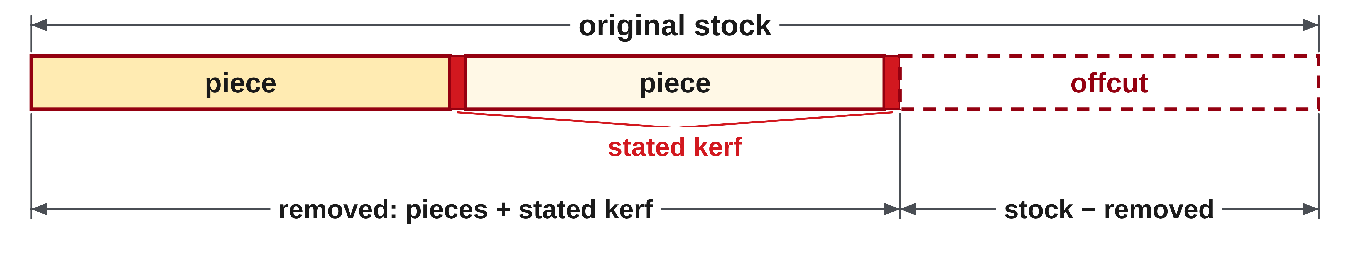
W02-L02 • TEACH • 2:25 PM–2:40 PM • 15 MIN TOTAL
Make brackets represent the drawing
1
Repeated pieces become number of pieces × length per piece.
2
Group every quantity that must be removed from the original stock.
3
Count only the cuts and kerf explicitly stated in the problem.
4
Offcut = stock − (all piece lengths + all stated cutting loss).
Textbook Chapter 3 pp.44–51
Textbook
Exercise Book
Numeracy Hub
Shape Canvas
Day 03 • 2026-11-02 • 27
Notes:
TEACH | 2:25 PM–2:40 PM | 15 MIN TOTAL — shared phase allocation.
Repeated equal pieces become a multiplication: number of pieces times length per piece. If cutting loss is stated, represent it as number of stated cuts times kerf per cut. Add all those amounts inside one group, then subtract that group from the stock. Why do the brackets matter? They make clear that every part of the used material is being removed. Count only the cuts given in the problem; do not invent a cutting arrangement or allowance. The expression should describe the particular drawing and assumptions in front of us.

Slide 28

W02-L02 • TEACH • 2:25 PM–2:40 PM • 15 MIN TOTAL
Frames count pairs of sides
1
A rectangle has two lengths and two widths.
2
Adding four sides and calculating 2 × (length + width) count the same boundary.
3
In 2 × (length + width), the 2 multiplies both dimensions.
4
Keep the sketch, expression and measurement unit attached to the same problem.
Textbook Chapter 3 pp.44–51
Textbook
Exercise Book
Numeracy Hub
Shape Canvas
Day 03 • 2026-11-02 • 28
Notes:
TEACH | 2:25 PM–2:40 PM | 15 MIN TOTAL — shared phase allocation.
A rectangle has two equal lengths and two equal widths. We can add all four sides, or add one length and one width and double that pair. Why does 2 times length plus width fail to count the same boundary when no brackets are present? It doubles the length but includes only one width. In 2 times the bracketed sum, both dimensions are doubled. Trace the four edges while you say the expression. That physical count is a useful check on whether the formula represents the whole frame.

Slide 29
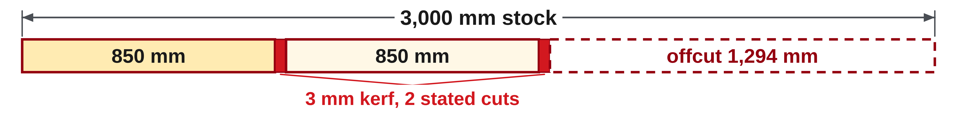
W02-L02 • TEACH • 2:25 PM–2:40 PM • 15 MIN TOTAL
Subtract the entire amount used
Classroom example: 3,000 mm stock; two 850 mm pieces;
two stated cuts, each with 3 mm kerf.
Offcut = 3,000 − (2 × 850 + 2 × 3)
= 3,000 − 1,706 = 1,294 mm
Check: 1,700 mm pieces + 6 mm kerf + 1,294 mm offcut = 3,000 mm.
Together • Exercise Book 3B Q1–2.
Underline the group before entering keys. Draw the pieces and label what each number counts.
W2 L2 • Numeracy Hub BEDMAS: Show steps after written work • Kerf is stated example data
Textbook
Exercise Book
Numeracy Hub
Shape Canvas
Day 03 • 2026-11-02 • 29
Notes:
TEACH | 2:25 PM–2:40 PM | 15 MIN TOTAL — shared phase allocation.
The stock is 3,000 mm. Two 850 mm pieces use 1,700 mm, and the two stated cuts at 3 mm each lose another 6 mm. The full amount removed is 1,706 mm, leaving 1,294 mm. Add the pieces, kerf and offcut: 1,700 plus 6 plus 1,294 restores 3,000 mm. What would happen if we added the kerf after subtracting the pieces? We would put cutting loss back into the stock. Grouping pieces and loss together prevents that sign error and connects the equation to the material account.

Slide 30
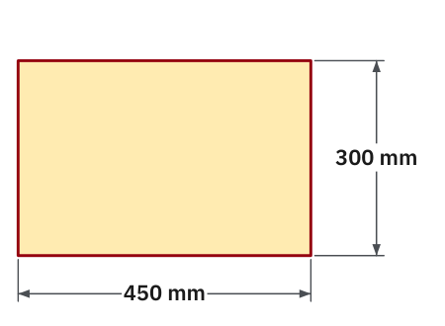
W02-L02 • TEACH • 2:25 PM–2:40 PM • 15 MIN TOTAL
Textbook | page 46
Textbook p.46 · Frame diagram: two lengths and two widths.
Textbook Chapter 3 pp.44–51
Textbook
Exercise Book
Numeracy Hub
Shape Canvas
Day 03 • 2026-11-02 • 30
Notes:
TEACH | 2:25 PM–2:40 PM | 15 MIN TOTAL — shared phase allocation.
The textbook's frame is 450 mm by 300 mm. One length and one width total 750 mm, and doubling that gives 1,500 mm around the frame. Trace the drawing to verify the same answer by adding 450, 300, 450 and 300. Which unit belongs on the result? Millimetres, because we are adding lengths around a boundary. The brackets in 2 times the sum represent a pair of sides. We are reading the labels in the diagram, not measuring the size of the projected rectangle.

Slide 31
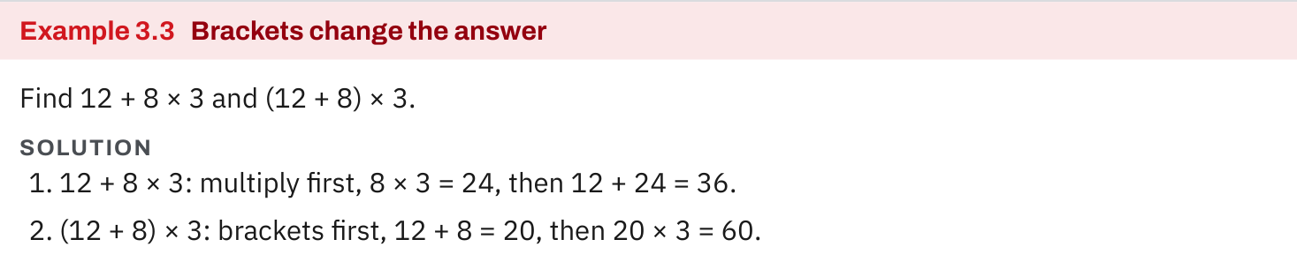
W02-L02 • TEACH • 2:25 PM–2:40 PM • 15 MIN TOTAL
Textbook | page 46
Textbook p.46 · Example 3.3: brackets change what is multiplied.
Textbook Chapter 3 pp.44–51
Textbook
Exercise Book
Numeracy Hub
Shape Canvas
Day 03 • 2026-11-02 • 31
Notes:
TEACH | 2:25 PM–2:40 PM | 15 MIN TOTAL — shared phase allocation.
Example 3.3 compares 12 plus 8 times 3 with the bracketed sum of 12 plus 8, multiplied by 3. Without brackets, 8 times 3 is 24 and the final result is 36. With brackets, 12 plus 8 is 20 and multiplying by 3 gives 60. What changed? Which quantity the multiplier acts on. This is why we cannot casually add or remove brackets while copying a formula. The grouping is mathematical information, just as a dimension label is information on a drawing.

Slide 32
W02-L02 • TEACH • 2:25 PM–2:40 PM • 15 MIN TOTAL
Spot the mistake. Explain the correction.
Does stock − pieces + kerf subtract the cutting loss?
Discuss the method before checking the answer.
No. It adds kerf back. Subtract the full group: stock − (pieces + kerf).
Textbook Chapter 3 pp.44–51
Textbook
Exercise Book
Numeracy Hub
Shape Canvas
Day 03 • 2026-11-02 • 32
Notes:
TEACH | 2:25 PM–2:40 PM | 15 MIN TOTAL — shared phase allocation.
Consider stock minus pieces plus kerf. That expression adds the kerf back after subtracting the pieces. Does sawdust increase the material remaining? No. Cutting loss must also be removed. Write stock minus the bracketed sum of pieces and kerf, or subtract each of those amounts explicitly. In our example, six millimetres of stated kerf belongs with the used material. The correction follows the meaning of the quantities: all material consumed, whether useful piece or loss, reduces the remaining stock.

Slide 33
W02-L02 • TOGETHER • 2:40 PM–2:55 PM • 15 MIN TOTAL
Work together
Solve 3B questions 1–2. Underline the group inside brackets before entering keys.
Work in pairs; alternate solver and checker.
Resources: Exercise Book 3B Q1–3 (p.21); 3C Q2–3 (p.23)
Textbook Chapter 3 pp.44–51
Textbook
Exercise Book
Numeracy Hub
Shape Canvas
Day 03 • 2026-11-02 • 33
Notes:
TOGETHER | 2:40 PM–2:55 PM | 15 MIN TOTAL — shared phase allocation.
Solve exercise book 3B questions 1 and 2 with your partner. Underline the grouped quantity before entering calculator keys. In the bolt problem, ask what is repeated and what is a single spare allowance. In the frame problem, ask which sides are counted twice. Why are those questions useful? They identify the factors and groups before arithmetic can hide a mistaken setup. Switch solver and checker roles between the questions.

Slide 34
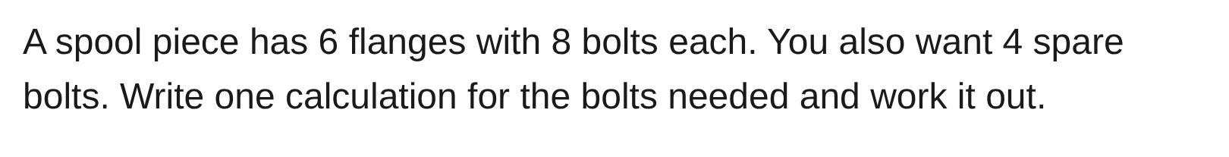
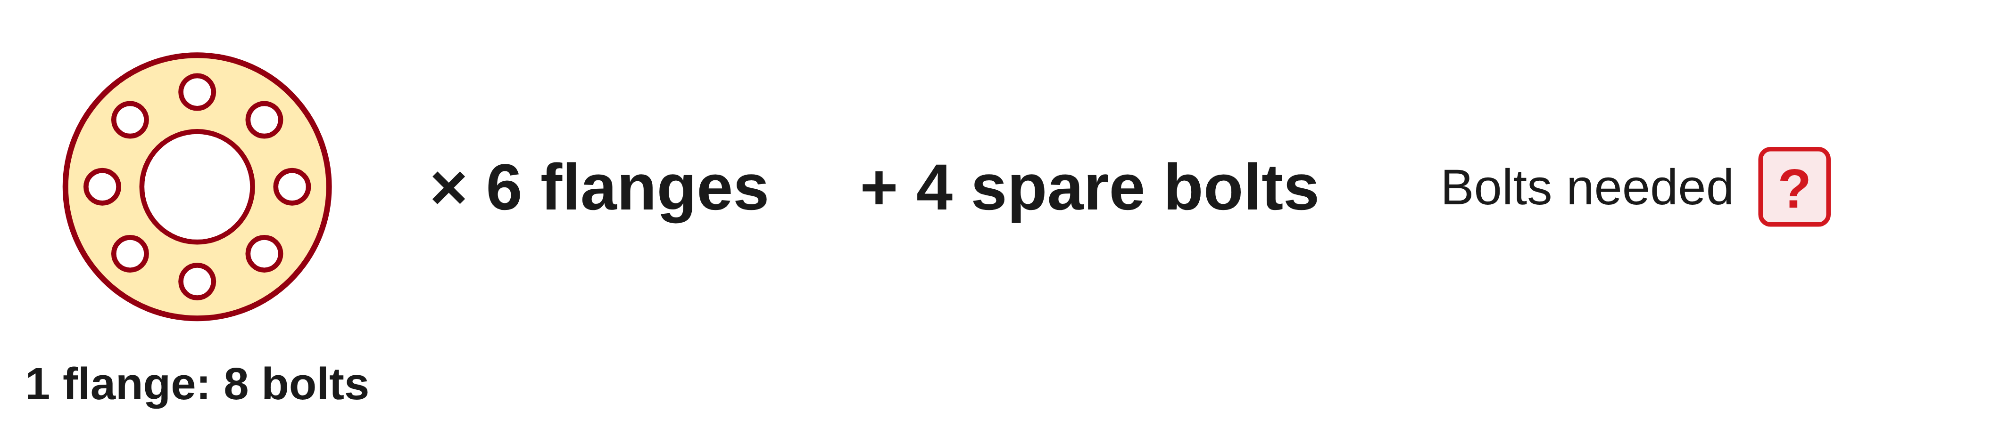
W02-L02 • TOGETHER • 2:40 PM–2:55 PM • 15 MIN TOTAL
Guided practice | 3B Q1
Work with a partner. Take turns explaining the next step.
Textbook Chapter 3 pp.44–51
Textbook
Exercise Book
Numeracy Hub
Shape Canvas
Day 03 • 2026-11-02 • 34
Notes:
TOGETHER | 2:40 PM–2:55 PM | 15 MIN TOTAL — shared phase allocation.
For 3B Q1, six flanges each need eight bolts, and four additional bolts are spares. Which quantity is repeated six times? Eight bolts per flange. Are the four spares required once or for every flange? Read the wording and build one expression that reflects it. Attempt the calculation with your partner before comparing the answer on the next slide.
INSTRUCTOR ONLY — AFTER THE ATTEMPT: 6 × 8 + 4 = 52 bolts
Working to discuss after the attempt: 6 × 8 = 48 bolts for the flanges; add the four spares once: 48 + 4 = 52 bolts.

Slide 35
W02-L02 • TOGETHER • 2:40 PM–2:55 PM • 15 MIN TOTAL
Compare your method | 3B Q1
CHECK TOGETHER
6 × 8 + 4 = 52 bolts
Textbook Chapter 3 pp.44–51
Textbook
Exercise Book
Numeracy Hub
Shape Canvas
Day 03 • 2026-11-02 • 35
Notes:
TOGETHER | 2:40 PM–2:55 PM | 15 MIN TOTAL — shared phase allocation.
The expression is 6 times 8 plus 4. The six flanges require 48 bolts, and four spares bring the total to 52. Why would 6 times the bracketed sum of 8 plus 4 overcount? It would add four spare bolts to every flange instead of adding four spares once. The written grouping has to match the story. Label the answer bolts, and point to where each number came from in the question.
INSTRUCTOR ONLY — AFTER THE ATTEMPT: 6 × 8 + 4 = 52 bolts
Working to discuss after the attempt: 6 × 8 = 48 bolts for the flanges; add the four spares once: 48 + 4 = 52 bolts.

Slide 36
W02-L02 • PRACTISE • 2:55 PM–3:15 PM • 20 MIN TOTAL
Your scheduled practice
Complete 3B question 3 and 3C questions 2–3. Draw the pieces, write one expression and compare with the Numeracy Hub steps.
Show working and units; estimate, then check.
Resources: Exercise Book 3B Q1–3 (p.21); 3C Q2–3 (p.23)
Textbook Chapter 3 pp.44–51
Textbook
Exercise Book
Numeracy Hub
Shape Canvas
Day 03 • 2026-11-02 • 36
Notes:
PRACTISE | 2:55 PM–3:15 PM | 20 MIN TOTAL — shared phase allocation.
Complete 3B Q3 and 3C questions 2 and 3. Draw or trace the pieces, write one expression and carry out the operations in order. What should be grouped in a stock problem? The complete quantity removed from the original material. Compare your reasoning with Numeracy Hub's BEDMAS steps after the paper attempt, while remembering that your assigned exercise values come from the exercise book.

Slide 37
W02-L02 • PRACTISE • 2:55 PM–3:15 PM • 20 MIN TOTAL
Open Numeracy Hub
Navigation example. Use the values and units in the assigned task.
Textbook Chapter 3 pp.44–51
Textbook
Exercise Book
Numeracy Hub
Shape Canvas
Day 03 • 2026-11-02 • 37
Notes:
PRACTISE | 2:55 PM–3:15 PM | 20 MIN TOTAL — shared phase allocation.
Open Numeracy Hub's Order of Operations section and use the BEDMAS explanation to inspect grouping. Predict a step before revealing Show steps. What is the useful connection to our cut-list work? Brackets keep a complete amount together before an outside operation acts on it. The demonstration values may differ from the assigned book problem, so compare the rule and sequence without replacing your exercise's numbers with the navigation example.

Slide 38
W02-L02 • PRACTISE • 2:55 PM–3:15 PM • 20 MIN TOTAL
Practise in Numeracy Hub
1
Supported: Draw and label the pieces or frame for the assigned question; write one expression.
2
Independent practice: Complete the paper calculation and underline the grouped quantity.
3
Independent checking: Open Numeracy Hub BEDMAS and compare Show steps with the written order.
Textbook Chapter 3 pp.44–51
Textbook
Exercise Book
Numeracy Hub
Shape Canvas
Day 03 • 2026-11-02 • 38
Notes:
PRACTISE | 2:55 PM–3:15 PM | 20 MIN TOTAL — shared phase allocation.
Start with the drawing for your assigned pieces or frame and label what every number counts. Write the expression on paper and underline the group that must stay together. Only then use Numeracy Hub to compare the operation order. If a calculator gives the expected number, what still needs checking? Whether your expression represented all the pieces or sides in the original problem. The picture and equation should tell the same story.

Slide 39
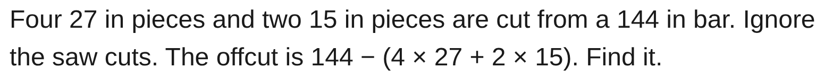
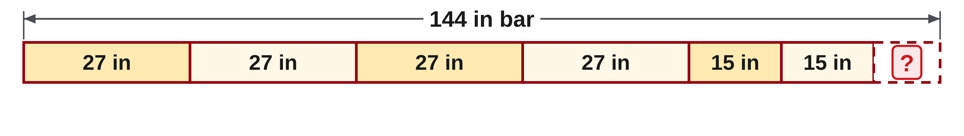
W02-L02 • PRACTISE • 2:55 PM–3:15 PM • 20 MIN TOTAL
Practise from the Exercise Book | 3B Q3
Write the operation, working and units before checking.
Textbook Chapter 3 pp.44–51
Textbook
Exercise Book
Numeracy Hub
Shape Canvas
Day 03 • 2026-11-02 • 39
Notes:
PRACTISE | 2:55 PM–3:15 PM | 20 MIN TOTAL — shared phase allocation.
For 3B Q3, four 27-inch pieces and two 15-inch pieces come from a 144-inch bar, with saw cuts ignored. Work inside the bracketed group before subtracting from the stock. Which two totals make up that group? The length of all four longer pieces and the length of both shorter pieces. Attempt the calculation, then check that pieces plus offcut reconstruct 144 inches.
INSTRUCTOR ONLY — AFTER THE ATTEMPT: 6 in 4 × 27 = 108, 2 × 15 = 30, 108 + 30 = 138, 144 − 138 = 6.
Working to discuss after the attempt: Check: 108 + 30 + 6 = 144 in, restoring the stock with saw cuts ignored.

Slide 40
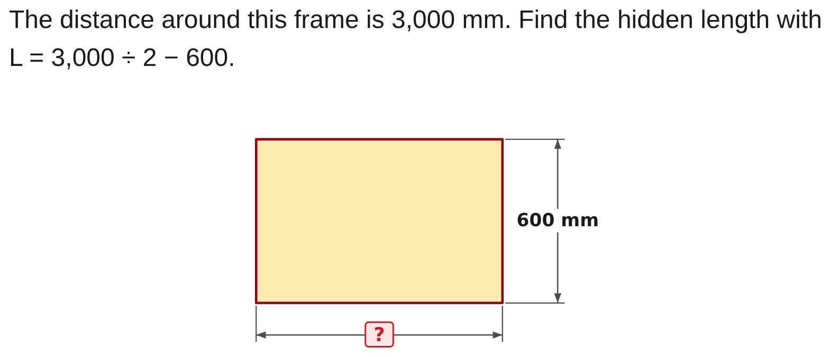
W02-L02 • PRACTISE • 2:55 PM–3:15 PM • 20 MIN TOTAL
Practise from the Exercise Book | 3C Q2
Write the operation, working and units before checking.
Textbook Chapter 3 pp.44–51
Textbook
Exercise Book
Numeracy Hub
Shape Canvas
Day 03 • 2026-11-02 • 40
Notes:
PRACTISE | 2:55 PM–3:15 PM | 20 MIN TOTAL — shared phase allocation.
For 3C Q2, the given expression is 3,000 divided by 2 minus 600. First interpret dividing the perimeter by two: it leaves one length plus one width. What does subtracting the known 600 mm then isolate? The missing length. Try the calculation and label the result in millimetres. After the attempt, substitute it into the complete rectangular perimeter to test the answer.
INSTRUCTOR ONLY — AFTER THE ATTEMPT: L = 1,500 − 600 = 900 mm
Working to discuss after the attempt: Half the perimeter is 1,500 mm, which is one length plus the 600 mm width. Subtracting gives 900 mm. Check: 2 × (900 + 600) = 3,000 mm.

Slide 41
W02-L02 • CHECK • 3:15 PM–3:25 PM • 10 MIN TOTAL
Check independently
Redo 3C questions 2–3 and explain the brackets.
Answer independently and show the method.
Resources: Exercise Book 3B Q1–3 (p.21); 3C Q2–3 (p.23)
Textbook Chapter 3 pp.44–51
Textbook
Exercise Book
Numeracy Hub
Shape Canvas
Day 03 • 2026-11-02 • 41
Notes:
CHECK | 3:15 PM–3:25 PM | 10 MIN TOTAL — shared phase allocation.
Redo 3C questions 2 and 3 independently. Explain the grouping in words and keep each intermediate line. One question works backwards from a frame perimeter; the other removes piece lengths and stated kerf from stock. What must your explanation connect? The operations and the physical quantities they represent. Keep worked solutions closed while you complete both attempts, then use a reconstruction check for each total.

Slide 42
W02-L02 • CHECK • 3:15 PM–3:25 PM • 10 MIN TOTAL
Independent check | 3C Q2
Answer independently. Keep worked solutions closed.
Textbook Chapter 3 pp.44–51
Textbook
Exercise Book
Numeracy Hub
Shape Canvas
Day 03 • 2026-11-02 • 42
Notes:
CHECK | 3:15 PM–3:25 PM | 10 MIN TOTAL — shared phase allocation.
For 3C Q2, find the hidden length from L = 3,000 ÷ 2 − 600. Show why division is performed before subtraction and keep the unit with the answer. After the attempt, explain how putting the proposed length beside the 600 mm width reconstructs half the perimeter, then doubling restores the full stated boundary. That is the relationship we are checking.
INSTRUCTOR ONLY — AFTER THE ATTEMPT: L = 1,500 − 600 = 900 mm
Working to discuss after the attempt: Half the perimeter is 1,500 mm, which is one length plus the 600 mm width. Subtracting gives 900 mm. Check: 2 × (900 + 600) = 3,000 mm.

Slide 43
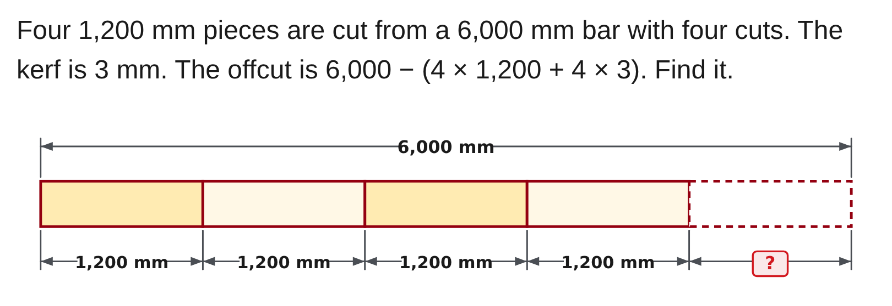
W02-L02 • CHECK • 3:15 PM–3:25 PM • 10 MIN TOTAL
Independent check | 3C Q3
Answer independently. Keep worked solutions closed.
Textbook Chapter 3 pp.44–51
Textbook
Exercise Book
Numeracy Hub
Shape Canvas
Day 03 • 2026-11-02 • 43
Notes:
CHECK | 3:15 PM–3:25 PM | 10 MIN TOTAL — shared phase allocation.
For 3C Q3, account for four 1,200 mm pieces and four cuts at 3 mm each. The stock is 6,000 mm. Write the full grouped amount removed before finding the offcut. Why is the count of cuts four here? It is explicitly stated in the question. Attempt the arithmetic, then add pieces, cutting loss and remaining stock to verify the original total.
INSTRUCTOR ONLY — AFTER THE ATTEMPT: 1,188 mm
Working to discuss after the attempt: 4 × 1,200 = 4,800 mm in pieces; 4 × 3 = 12 mm of stated kerf. 6,000 − (4,800 + 12) = 1,188 mm. Check: 4,800 + 12 + 1,188 = 6,000 mm.

Slide 44
W02-L02 • WRAP UP • 3:25 PM–3:30 PM • 5 MIN TOTAL
Wrap up and choose the next step
Share one learning point and one skill to practise next.
Record a takeaway and next action.
Resources: Exercise Book 3B Q1–3 (p.21); 3C Q2–3 (p.23)
Textbook Chapter 3 pp.44–51
Textbook
Exercise Book
Numeracy Hub
Shape Canvas
Day 03 • 2026-11-02 • 44
Notes:
WRAP UP | 3:25 PM–3:30 PM | 5 MIN TOTAL — shared phase allocation.
Choose one frame or stock problem and explain the purpose of its brackets. A useful explanation names the group: one pair of frame sides, or all material removed from stock. What check connects your final number back to the drawing? Reconstructing the complete boundary or stock total. Record a corrected expression if you changed one today. Next we will examine exactly what a square or square root acts on, using the same attention to grouping.

