Slide 1

CARPENTRY FOUNDATION / INTAKE 142
Day 11 | Tuesday
11
November 17, 2026
Decimals: place value and operations
12:45 PM–2:00 PM • Math • 75 min
Decimals, tape rounding and costs
2:15 PM–3:30 PM • Math • 75 min
Week 4 • 2 scheduled blocks • 150 teaching minutes
Estimate. Show the method. Label units. Check the result.
Textbook
Exercise Book
Numeracy Hub
Shape Canvas
Day 11 • 2026-11-17 • 01
Notes:
Timing: opening orientation within the scheduled start period.
Today we connect decimal calculations to two things you will actually do: read a precise dimension and decide what to mark or buy. From 12:45 to 2:00 we work on place value and decimal operations. After the 2:00–2:15 break, we use those results for tape rounding and costs, finishing at 3:30. A decimal point can change a cut or an order by a factor of ten. Our protection is a sensible estimate, clear units and a check.

Slide 2
DAY 11 / WEEK 4 / CLASS TIMETABLE
Today’s exact schedule
12:45 PM–2:00 PM • 75 min
2:15 PM–3:30 PM • 75 min
Decimals: place value and operations
Decimals, tape rounding and costs
12:45 PM–12:50 PM
Start
5
2:15 PM–2:20 PM
Start
5
12:50 PM–12:55 PM
Recall
5
2:20 PM–2:25 PM
Recall
5
12:55 PM–1:10 PM
Teach
15
2:25 PM–2:40 PM
Teach
15
1:10 PM–1:25 PM
Together
15
2:40 PM–2:55 PM
Together
15
1:25 PM–1:45 PM
Practise
20
2:55 PM–3:15 PM
Practise
20
1:45 PM–1:55 PM
Check
10
3:15 PM–3:25 PM
Check
10
1:55 PM–2:00 PM
Wrap up
5
3:25 PM–3:30 PM
Wrap up
5
Math • Math Week 4, Lesson 3
Math • Math Week 4, Lesson 4
Break: 2:00 PM–2:15 PM • 15 minutes • excluded from teaching time
Textbook
Exercise Book
Numeracy Hub
Shape Canvas
Day 11 • 2026-11-17 • 02
Notes:
Timing: opening orientation within the scheduled start period.
Here is our route through the afternoon. In each 75-minute block, we begin with five minutes to connect the topic and five to recall what we know. Then we have fifteen minutes of explanation, fifteen working together, twenty for practice, ten for an independent check and five to finish. The first block ends at 2:00; we restart at 2:15. Keep this distinction in mind: calculating a decimal and deciding how to round it are separate decisions.

Slide 3
W04-L03 • START • 12:45 PM–12:50 PM • 5 MIN TOTAL
Decimals: place value and operations
Today’s goal: Read metric decimal sizes and perform decimal operations with an estimated check.
Share a prior use of this skill; identify the quantity and unit.
Textbook sections 5.1–5.5 pp.76–81
Exercise Book 5A Q1–11 (pp.32–33); 5B Q1,3 (p.34)
Keep your notebook, textbook, exercise book and chosen calculator ready.
Textbook sections 5.1–5.5 pp.76–81
Textbook
Exercise Book
Numeracy Hub
Shape Canvas
Day 11 • 2026-11-17 • 03
Notes:
Timing: START | 12:45 PM–12:50 PM | 5 MIN TOTAL. Shared phase allocation across these slides.
Open the textbook to sections 5.1–5.5, pages 76–81, and have exercise book 5A and 5B ready. When you read 30.249 millimetres, each digit tells us a different-sized part of a millimetre. The number is useful because we know the unit. Where have you seen a decimal measurement on a drawing or tool? Listen for millimetres, metres or decimal inches. Today you will explain the size before relying on the calculator display.

Slide 4
W04-L03 • RECALL • 12:50 PM–12:55 PM • 5 MIN TOTAL
Recall and reconnect
Use Exercise Book 5A Q4–5 to compare decimals; ask why more digits do not always mean a larger value.
Attempt the short retrieval task independently; explain the method before seeing answers.
Resources: Exercise Book 5A Q1–11 (pp.32–33); 5B Q1,3 (p.34)
Textbook sections 5.1–5.5 pp.76–81
Textbook
Exercise Book
Numeracy Hub
Shape Canvas
Day 11 • 2026-11-17 • 04
Notes:
Timing: RECALL | 12:50 PM–12:55 PM | 5 MIN TOTAL. Shared phase allocation across these slides.
Before calculating, compare the decimals in 5A Q4–5. More written digits do not automatically mean a larger measurement. Imagine lining up the decimal points so tenths sit beneath tenths and hundredths beneath hundredths. Which is larger, 0.4 or 0.375? Keep your answer for the next slide, and explain which place first decides the comparison. You can write 0.4 as 0.400 without changing its value.

Slide 5
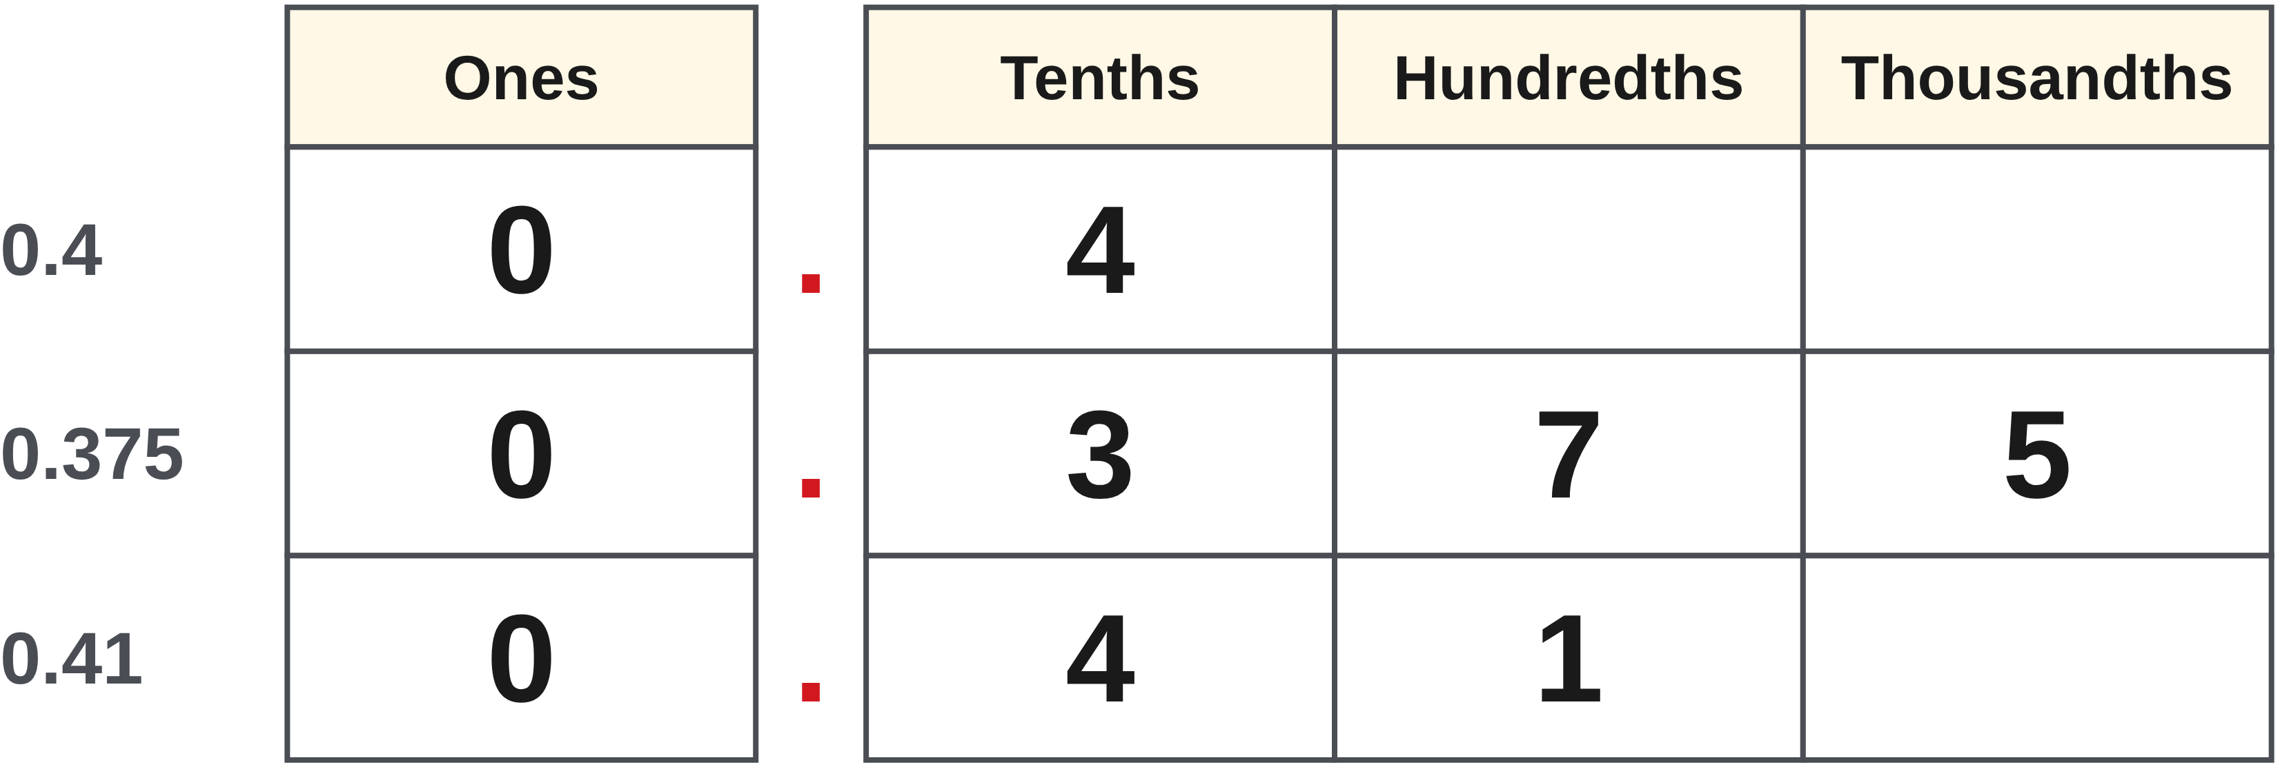
W04-L03 • RECALL • 12:50 PM–12:55 PM • 5 MIN TOTAL
Recall from the Exercise Book | 5A Q4
Write the operation, working and units before checking.
Textbook sections 5.1–5.5 pp.76–81
Textbook
Exercise Book
Numeracy Hub
Shape Canvas
Day 11 • 2026-11-17 • 05
Notes:
Timing: RECALL | 12:50 PM–12:55 PM | 5 MIN TOTAL. Shared phase allocation across these slides.
For 5A Q4, put 0.4, 0.375 and 0.41 in ascending order. Write them with three decimal places if that helps, then compare from left to right. What does the first different digit tell you? Let everyone choose an order before we discuss it.
Instructor-only, after the attempt: 0.375, 0.4, 0.41. Compare 0.375, 0.400 and 0.410. Three tenths is below four tenths; among the remaining two, zero hundredths is below one hundredth.

Slide 6
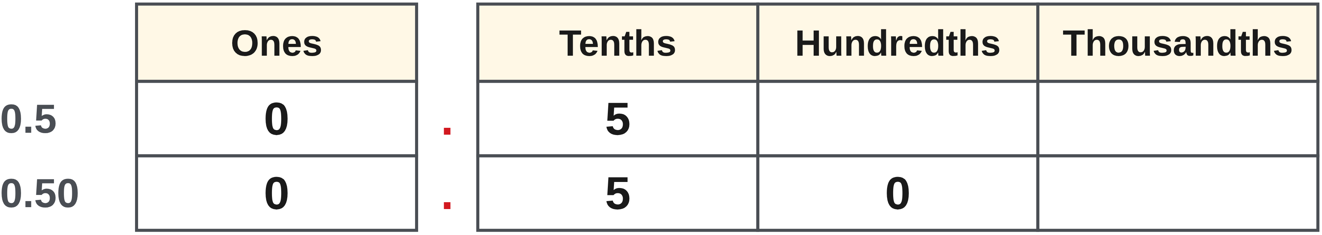
W04-L03 • TEACH • 12:55 PM–1:10 PM • 15 MIN TOTAL
Read the value of each digit
1
Decimal places name tenths, hundredths and thousandths of the unit.
2
A trailing zero changes the display, not the value: 0.5 = 0.50.
3
Compare from the largest place value to the smallest.
4
Keep the unit beside each measurement so the decimal has meaning.
Textbook sections 5.1–5.5 pp.76–81
Textbook
Exercise Book
Numeracy Hub
Shape Canvas
Day 11 • 2026-11-17 • 06
Notes:
Timing: TEACH | 12:55 PM–1:10 PM | 15 MIN TOTAL. Shared phase allocation across these slides.
A decimal is a whole unit divided into smaller equal parts. The first place after the point is tenths, then hundredths, then thousandths. In 0.5, the five means five tenths. In 0.50, it still means five tenths; the zero tells us there are no extra hundredths. Both represent the same amount. To compare values, work from the largest place toward the smallest. Which is larger, 0.50 or 0.49? It is 0.50, because five tenths exceeds four tenths. Always say the measurement unit too: half a metre and half a millimetre are very different lengths.

Slide 7
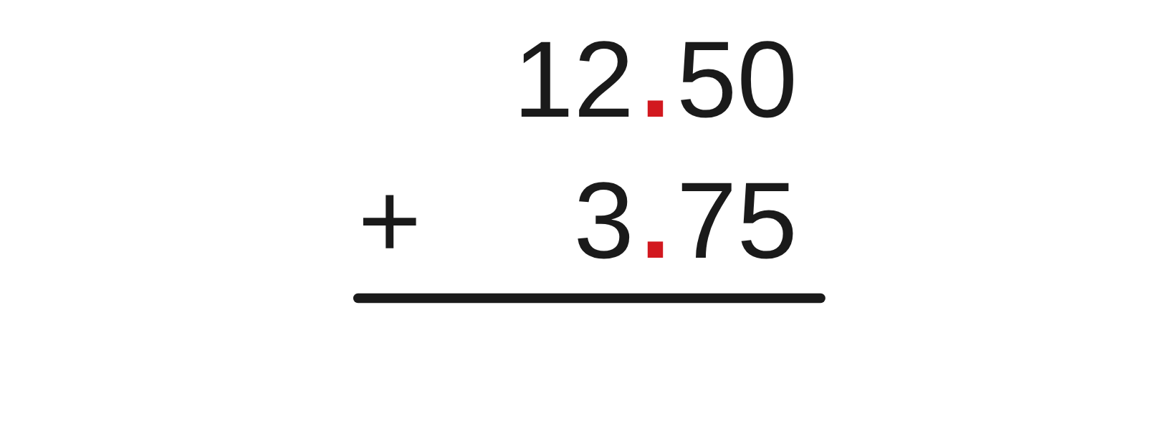
W04-L03 • TEACH • 12:55 PM–1:10 PM • 15 MIN TOTAL
Calculate and locate the decimal point
1
For addition and subtraction, line up decimal points and like places.
2
For multiplication, estimate the product before placing the decimal.
3
For division, check the answer by multiplying back.
4
Compare the final magnitude with your estimate; a tenfold error is a warning.
Textbook sections 5.1–5.5 pp.76–81
Textbook
Exercise Book
Numeracy Hub
Shape Canvas
Day 11 • 2026-11-17 • 07
Notes:
Timing: TEACH | 12:55 PM–1:10 PM | 15 MIN TOTAL. Shared phase allocation across these slides.
Our decimal point records place value, so each operation needs a check that respects place value. When adding or subtracting, put tenths with tenths and hundredths with hundredths. Multiplication needs a size estimate: three lengths of 2.4 metres must total a little more than six metres. Division can be checked by multiplication: if seven pieces are each 0.25 units, their total is 1.75 units. Which check would expose 72 as the answer to 2.4 times 3? Our estimate would: three lengths just over two metres cannot total seventy-two metres.

Slide 8
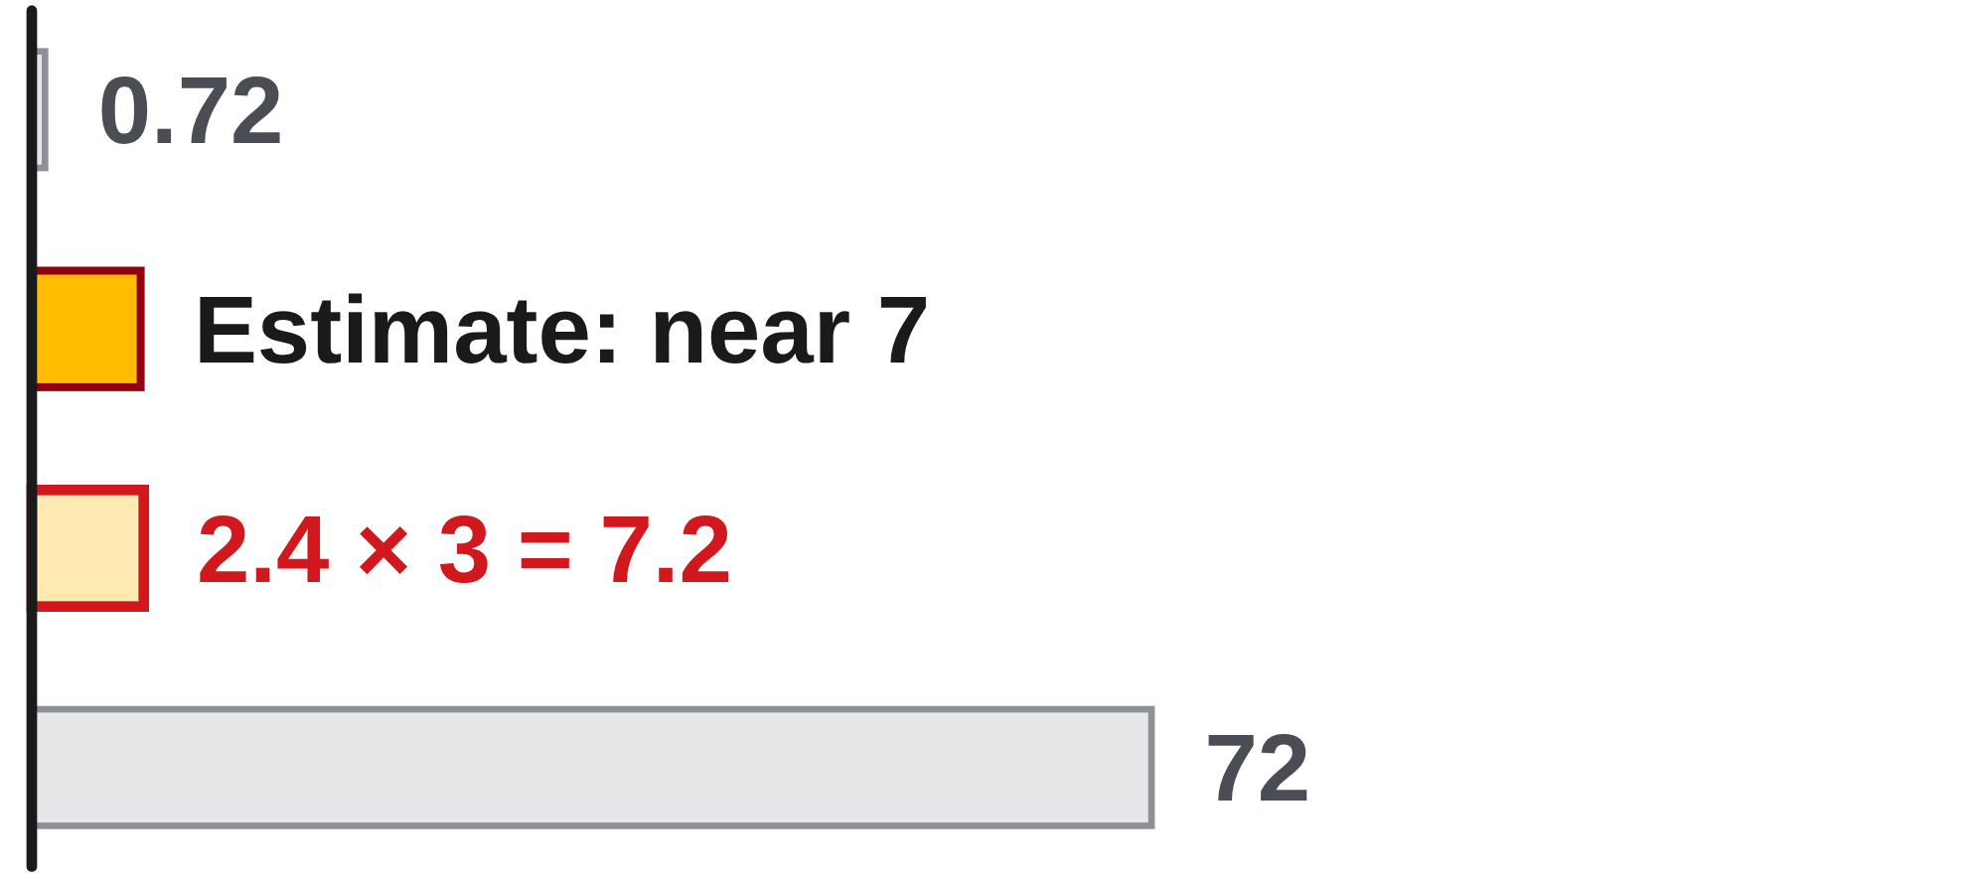
W04-L03 • TEACH • 12:55 PM–1:10 PM • 15 MIN TOTAL
Predict the size before entering keys
12.50 + 3.75 = 16.25 mm
2.4 × 3 = 7.2 m
1.75 ÷ 0.25 = 7
For 2.4 × 3, an answer near 7 is sensible—not 0.72 or 72.
For division, seven quarter-units make 1.75 units.
Together: selected 5A Q8–11 parts. Pair-check each decimal point.
Shape Canvas: enter a decimal-size rectangle in mm and explain what each digit means.
W4 L3 • Numeracy Hub Measuring Tools: metric readings • Classroom examples
Textbook
Exercise Book
Numeracy Hub
Shape Canvas
Day 11 • 2026-11-17 • 08
Notes:
Timing: TEACH | 12:55 PM–1:10 PM | 15 MIN TOTAL. Shared phase allocation across these slides.
Read these calculations with their meanings. For 12.50 plus 3.75 millimetres, align the points: fifty hundredths plus seventy-five hundredths contributes one whole and twenty-five hundredths, giving 16.25 millimetres. For three 2.4-metre lengths, double 2.4 to get 4.8, then add another 2.4: 7.2 metres. Finally, 1.75 divided by 0.25 asks how many quarter-units fit. Four quarters make one unit, and three more make 0.75, so seven fit. Why is that final answer a count rather than a length? Because we are counting equal pieces of the same-sized unit.

Slide 9
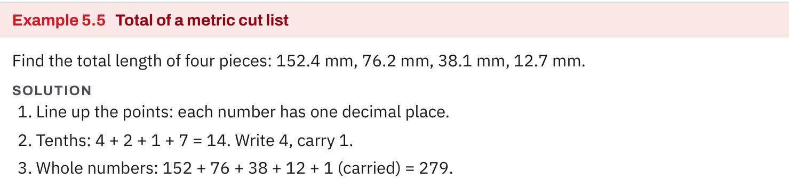
W04-L03 • TEACH • 12:55 PM–1:10 PM • 15 MIN TOTAL
Textbook | page 79
Textbook p.79 • Example 5.5 — Aligning decimal cut-list lengths
Textbook sections 5.1–5.5 pp.76–81
Textbook
Exercise Book
Numeracy Hub
Shape Canvas
Day 11 • 2026-11-17 • 09
Notes:
Timing: TEACH | 12:55 PM–1:10 PM | 15 MIN TOTAL. Shared phase allocation across these slides.
On textbook page 79, Example 5.5 totals four cut lengths: 152.4, 76.2, 38.1 and 12.7 millimetres. The tenths add to fourteen tenths. That is one whole millimetre and four tenths, so we carry one into the whole-number column. The whole numbers total 278, and the carried one makes 279.4 millimetres. What would happen if we lined up the last digits instead of the points when the decimal places differ? We could add unlike places. The method must align values, not just the appearance of the written numbers.

Slide 10
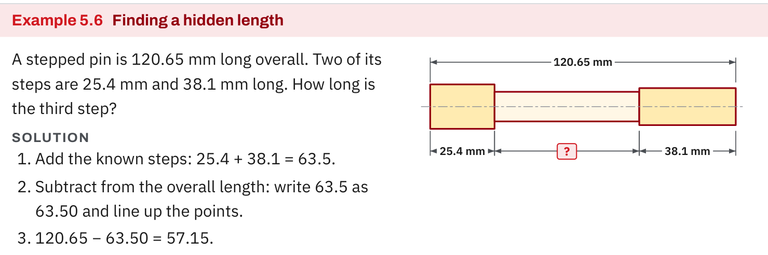
W04-L03 • TEACH • 12:55 PM–1:10 PM • 15 MIN TOTAL
Textbook | page 79
Textbook p.79 • Example 5.6 — Hidden length on a stepped pin
Textbook sections 5.1–5.5 pp.76–81
Textbook
Exercise Book
Numeracy Hub
Shape Canvas
Day 11 • 2026-11-17 • 10
Notes:
Timing: TEACH | 12:55 PM–1:10 PM | 15 MIN TOTAL. Shared phase allocation across these slides.
Example 5.6 shows the complete stepped pin as 120.65 millimetres. Two known sections measure 25.4 and 38.1 millimetres. We need the remaining section, so first combine the known lengths: 63.5 millimetres. Write that as 63.50 beneath 120.65, then subtract to get 57.15 millimetres. Why do we add the two known sections before subtracting? Together they occupy the part of the overall length that is already accounted for. Check by adding all three: 25.4 plus 38.1 plus 57.15 returns 120.65 millimetres. The drawing tells us the operation.

Slide 11
W04-L03 • TEACH • 12:55 PM–1:10 PM • 15 MIN TOTAL
Spot the mistake. Explain the correction.
Is 0.125 larger than 0.5 because it has more digits?
Discuss the method before checking the answer.
Compare equal places: 0.125 is less than 0.500. The first different digit decides.
Textbook sections 5.1–5.5 pp.76–81
Textbook
Exercise Book
Numeracy Hub
Shape Canvas
Day 11 • 2026-11-17 • 11
Notes:
Timing: TEACH | 12:55 PM–1:10 PM | 15 MIN TOTAL. Shared phase allocation across these slides.
The claim is that 0.125 is larger than 0.5 because it contains more digits. Decide whether you agree, and name the first place you compare. Rewrite 0.5 as 0.500. Now both values show thousandths, but we do not need to go that far: one tenth is less than five tenths. Therefore 0.125 is smaller. Can someone connect this to a familiar fraction? One eighth is 0.125; one half is 0.5. Extra digits describe finer parts of a unit. They do not guarantee more of that unit.

Slide 12
W04-L03 • TOGETHER • 1:10 PM–1:25 PM • 15 MIN TOTAL
Work together
Work Exercise Book 5A Q8–11 selected parts. Pair-check the position of each decimal point.
Work in pairs; alternate calculator operator and checker. Show units and an estimated answer.
Resources: Exercise Book 5A Q1–11 (pp.32–33); 5B Q1,3 (p.34)
Textbook sections 5.1–5.5 pp.76–81
Textbook
Exercise Book
Numeracy Hub
Shape Canvas
Day 11 • 2026-11-17 • 12
Notes:
Timing: TOGETHER | 1:10 PM–1:25 PM | 15 MIN TOTAL. Shared phase allocation across these slides.
We will work selected parts of 5A Q8–11 together. Before each calculator entry, the solver says the operation and an estimate; the checker watches the decimal point and unit. Start with the addition shown next. If the result differs from your estimate by ten times or one hundred times, investigate before accepting it. What must line up in addition? The decimal points, because that puts equal places together. Switch roles so both people explain a method.

Slide 13
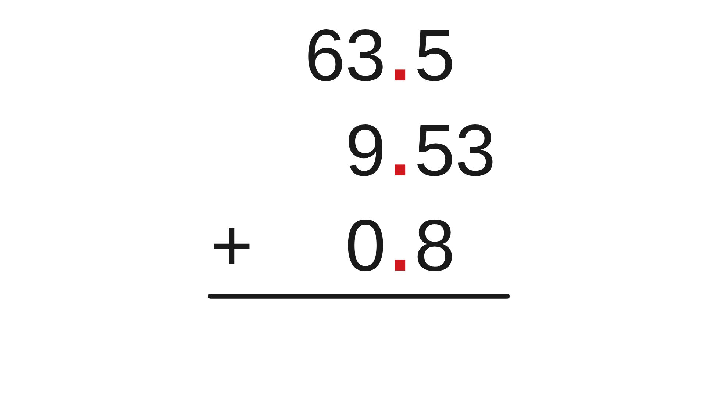
W04-L03 • TOGETHER • 1:10 PM–1:25 PM • 15 MIN TOTAL
Guided practice | 5A Q8
Work with a partner. Take turns explaining the next step.
Textbook sections 5.1–5.5 pp.76–81
Textbook
Exercise Book
Numeracy Hub
Shape Canvas
Day 11 • 2026-11-17 • 13
Notes:
Timing: TOGETHER | 1:10 PM–1:25 PM | 15 MIN TOTAL. Shared phase allocation across these slides.
In 5A Q8, add 63.5, 9.53 and 0.8. Set out the calculation with the decimal points aligned. Write 63.50 and 0.80 if you want every number to show hundredths. Estimate first: about 64 plus 10 plus 1 puts us near 75. Work with your partner before revealing the result.
Instructor-only, after the attempt: 73.83. The tenths column requires regrouping; the hundredths digit is 3. A result such as 738.3 fails the estimate.

Slide 14
W04-L03 • TOGETHER • 1:10 PM–1:25 PM • 15 MIN TOTAL
Compare your method | 5A Q8
CHECK TOGETHER
73.83
Textbook sections 5.1–5.5 pp.76–81
Textbook
Exercise Book
Numeracy Hub
Shape Canvas
Day 11 • 2026-11-17 • 14
Notes:
Timing: TOGETHER | 1:10 PM–1:25 PM | 15 MIN TOTAL. Shared phase allocation across these slides.
Our result is 73.83. Walk through it with me: 63.50 plus 9.53 equals 73.03, then adding 0.80 gives 73.83. Notice that the 0.8 adds eight tenths, not eight hundredths. Does the result agree with our estimate near 75? Yes; an estimate is a rough size check, not a second exact answer. Ask your partner to point to the hundredths column and explain why its final digit is 3.

Slide 15
W04-L03 • PRACTISE • 1:25 PM–1:45 PM • 20 MIN TOTAL
Your scheduled practice
Complete Exercise Book 5A Q1–7 plus 5B Q1,3. Display one decimal-size rectangle in Shape Canvas and explain what each digit means.
Solve on paper first; use the tool to check; correct one error with a written reason.
Resources: Exercise Book 5A Q1–11 (pp.32–33); 5B Q1,3 (p.34)
Textbook sections 5.1–5.5 pp.76–81
Textbook
Exercise Book
Numeracy Hub
Shape Canvas
Day 11 • 2026-11-17 • 15
Notes:
Timing: PRACTISE | 1:25 PM–1:45 PM | 20 MIN TOTAL. Shared phase allocation across these slides.
Now complete 5A Q1–7 and 5B Q1 and Q3. In the place-value items, name what a digit is worth. In the measurements, include the unit and the required precision. Then display one decimal-size rectangle in Shape Canvas and read its dimensions aloud. What will you write if your calculator answer looks much too large? Keep the original working, identify the misplaced decimal or incorrect entry, and write the corrected reason. That makes your notebook useful when the same issue appears again.

Slide 16

W04-L03 • PRACTISE • 1:25 PM–1:45 PM • 20 MIN TOTAL
Open Numeracy Hub
Navigation example. Use the values and units in the assigned task.
Textbook sections 5.1–5.5 pp.76–81
Textbook
Exercise Book
Numeracy Hub
Shape Canvas
Day 11 • 2026-11-17 • 16
Notes:
Timing: PRACTISE | 1:25 PM–1:45 PM | 20 MIN TOTAL. Shared phase allocation across these slides.
Open Measuring Tools in Numeracy Hub. Before revealing a metric-rule reading, locate zero, identify the distance between labelled marks and count the smaller divisions. Say the value with millimetres. What should happen to the reading when we move by one half-millimetre division? It changes by 0.5 millimetres, not five millimetres. Use the assigned task values; this image is showing where to work. Check the reading only after you have recorded your prediction.

Slide 17
W04-L03 • PRACTISE • 1:25 PM–1:45 PM • 20 MIN TOTAL
Practise in Numeracy Hub and Shape Canvas
1
Open Numeracy Hub Measuring Tools and read a metric rule before revealing its answer.
2
Enter one assigned decimal rectangle dimension in Shape Canvas using mm.
3
Read each digit and unit aloud; compare the label with your paper calculation.
Textbook sections 5.1–5.5 pp.76–81
Textbook
Exercise Book
Numeracy Hub
Shape Canvas
Day 11 • 2026-11-17 • 17
Notes:
Timing: PRACTISE | 1:25 PM–1:45 PM | 20 MIN TOTAL. Shared phase allocation across these slides.
Read a metric rule in Numeracy Hub, then enter the assigned decimal dimension in Shape Canvas using millimetres. Read the label digit by digit in place-value language: whole millimetres, tenths and hundredths where present. Does adding a trailing zero change the size of the rectangle? No; it changes how the value is written. Compare your written dimension with the label. If they disagree, check the unit as well as the number before changing the calculation.

Slide 18
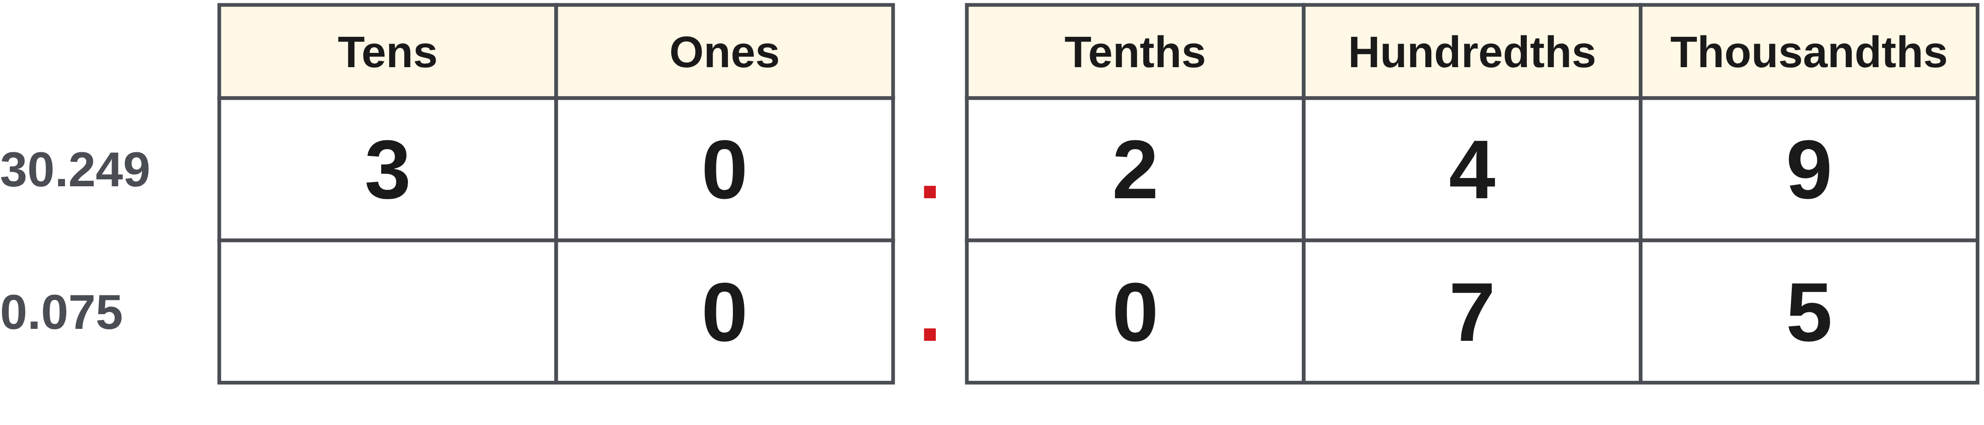
W04-L03 • PRACTISE • 1:25 PM–1:45 PM • 20 MIN TOTAL
Practise from the Exercise Book | 5A Q1
Write the operation, working and units before checking.
Textbook sections 5.1–5.5 pp.76–81
Textbook
Exercise Book
Numeracy Hub
Shape Canvas
Day 11 • 2026-11-17 • 18
Notes:
Timing: PRACTISE | 1:25 PM–1:45 PM | 20 MIN TOTAL. Shared phase allocation across these slides.
For 5A Q1, identify the value of the 4 in 30.249, then write 0.075 in words. Start by naming the first, second and third places after the decimal point. Give the value of the digit, not just its name.
Instructor-only, after the attempt: The 4 is four hundredths, or 0.04. The second number is seventy-five thousandths. The zero in the tenths place holds the position; it must not disappear from the interpretation.

Slide 19
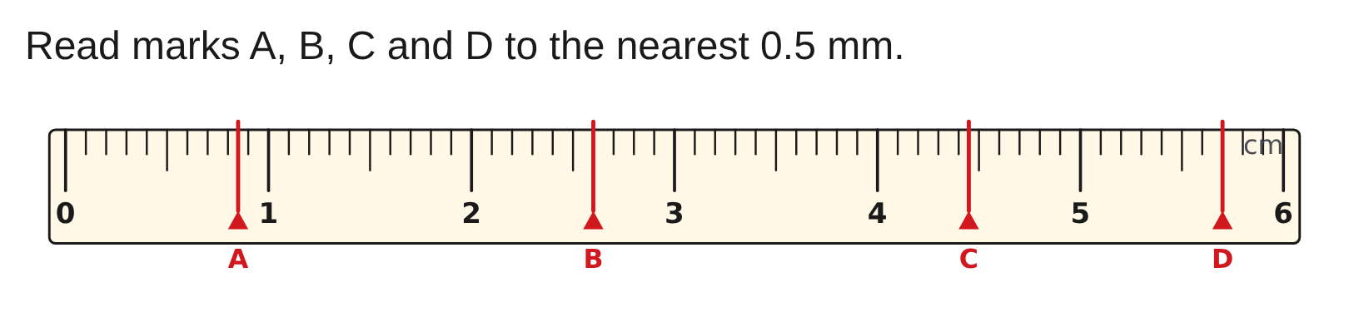
W04-L03 • PRACTISE • 1:25 PM–1:45 PM • 20 MIN TOTAL
Practise from the Exercise Book | 5A Q3
Write the operation, working and units before checking.
Textbook sections 5.1–5.5 pp.76–81
Textbook
Exercise Book
Numeracy Hub
Shape Canvas
Day 11 • 2026-11-17 • 19
Notes:
Timing: PRACTISE | 1:25 PM–1:45 PM | 20 MIN TOTAL. Shared phase allocation across these slides.
Read marks A, B, C and D to the nearest half millimetre in 5A Q3. Locate each mark relative to the labelled whole millimetres and decide whether it lands on a whole or half unit. Record all four before checking. Why do some answers end in .5 while others do not? The required graduation allows both whole and half millimetres.
Instructor-only, after the attempt: A = 8.5 mm, B = 26 mm, C = 44.5 mm, D = 57 mm.

Slide 20
W04-L03 • CHECK • 1:45 PM–1:55 PM • 10 MIN TOTAL
Check independently
Exercise Book 5A Q8 and Q10(a); include an estimate for each answer.
Solve without displayed answers; include working, units and the requested rounding.
Resources: Exercise Book 5A Q1–11 (pp.32–33); 5B Q1,3 (p.34)
Textbook sections 5.1–5.5 pp.76–81
Textbook
Exercise Book
Numeracy Hub
Shape Canvas
Day 11 • 2026-11-17 • 20
Notes:
Timing: CHECK | 1:45 PM–1:55 PM | 10 MIN TOTAL. Shared phase allocation across these slides.
Work independently on 5A Q8 and Q10(a). Include an estimate with each calculation so I can see whether you checked the decimal point. One is addition and one is multiplication; the place-value reasoning will differ. Keep the worked answers closed until you finish. What makes an estimate useful? It is quick and rough enough to do mentally, but close enough to expose an answer that is ten or one hundred times the reasonable size.

Slide 21
W04-L03 • CHECK • 1:45 PM–1:55 PM • 10 MIN TOTAL
Independent check | 5A Q8
Answer independently. Keep worked solutions closed.
Textbook sections 5.1–5.5 pp.76–81
Textbook
Exercise Book
Numeracy Hub
Shape Canvas
Day 11 • 2026-11-17 • 21
Notes:
Timing: CHECK | 1:45 PM–1:55 PM | 10 MIN TOTAL. Shared phase allocation across these slides.
Return to 5A Q8 independently: 63.5 plus 9.53 plus 0.8. Show aligned decimal points and a rough estimate. I want your method, even if you remember the result from our shared work. After recording it, check whether each addend contributed to the correct place.
Instructor-only, after the attempt: 73.83; for example, 63.50 + 9.53 = 73.03, then + 0.80 = 73.83. An estimate around 74 or 75 is reasonable.

Slide 22
W04-L03 • CHECK • 1:45 PM–1:55 PM • 10 MIN TOTAL
Independent check | 5A Q10a
Answer independently. Keep worked solutions closed.
Textbook sections 5.1–5.5 pp.76–81
Textbook
Exercise Book
Numeracy Hub
Shape Canvas
Day 11 • 2026-11-17 • 22
Notes:
Timing: CHECK | 1:45 PM–1:55 PM | 10 MIN TOTAL. Shared phase allocation across these slides.
For 5A Q10(a), multiply 0.6 by 0.4. Before calculating, decide whether taking four tenths of six tenths should give more or less than six tenths. Write the reasoning with your answer.
Instructor-only, after the attempt: 0.24. Six tenths times four tenths gives twenty-four hundredths. The product is below both factors because each factor is positive and below one; 2.4 would not pass this size check.

Slide 23
W04-L03 • WRAP UP • 1:55 PM–2:00 PM • 5 MIN TOTAL
Wrap up and choose the next step
Ask: What did you learn? Where will you use it? What will you check next time?
Name the math and one other essential skill used; write the next practice step.
Resources: Exercise Book 5A Q1–11 (pp.32–33); 5B Q1,3 (p.34)
Textbook sections 5.1–5.5 pp.76–81
Textbook
Exercise Book
Numeracy Hub
Shape Canvas
Day 11 • 2026-11-17 • 23
Notes:
Timing: WRAP UP | 1:55 PM–2:00 PM | 5 MIN TOTAL. Shared phase allocation across these slides.
Finish this block by naming one decimal check you can use at the bench or when reading a drawing. For addition, we aligned equal places. For multiplication, we predicted size. For division, we multiplied back. Which habit caught an error for you today? Write that habit beside the corrected example in your notebook. We have calculated decimal values; after the break we decide how to express them as fractions, tape marks and costs.

Slide 24
DAY 11 • SCHEDULED BREAK
Break
2:00 PM–2:15 PM
Return ready for: Decimals, tape rounding and costs
This break is excluded from teaching minutes.
Textbook
Exercise Book
Numeracy Hub
Shape Canvas
Day 11 • 2026-11-17 • 24
Notes:
Timing: scheduled break, 2:00–2:15 PM.
Take the scheduled break from 2:00 to 2:15. Leave your decimal work where you can find it. When we return, we will use fractions and decimals to choose a tape mark and calculate a purchase cost.

Slide 25
W04-L04 • START • 2:15 PM–2:20 PM • 5 MIN TOTAL
Decimals, tape rounding and costs
Today’s goal: Convert fractions and decimals, round an inch size to the requested graduation, and calculate a simple cost.
Share a prior use of this skill; identify the quantity and unit.
Textbook sections 5.6–5.7 pp.82–87
Exercise Book 5A Q12–15 (p.33); 5B Q2,4,7 (p.34)
Keep your notebook, textbook, exercise book and chosen calculator ready.
Textbook sections 5.6–5.7 pp.82–87
Textbook
Exercise Book
Numeracy Hub
Shape Canvas
Day 11 • 2026-11-17 • 25
Notes:
Timing: START | 2:15 PM–2:20 PM | 5 MIN TOTAL. Shared phase allocation across these slides.
Now the question changes from “What is the decimal?” to “How will I use this answer?” A drawing may show decimal inches, your tape may show sixteenths, and an invoice uses cents. We will move between those forms without losing precision too soon. Open textbook sections 5.6–5.7, pages 82–87. What tells us how to round? The question and the intended measurement or money unit. The calculator display alone cannot make that decision for us.

Slide 26
W04-L04 • RECALL • 2:20 PM–2:25 PM • 5 MIN TOTAL
Recall and reconnect
Share the decimal equivalents of 1/2 and 1/4. Check that a money answer and a tape answer use different rounding.
Attempt the short retrieval task independently; explain the method before seeing answers.
Resources: Exercise Book 5A Q12–15 (p.33); 5B Q2,4,7 (p.34)
Textbook sections 5.6–5.7 pp.82–87
Textbook
Exercise Book
Numeracy Hub
Shape Canvas
Day 11 • 2026-11-17 • 26
Notes:
Timing: RECALL | 2:20 PM–2:25 PM | 5 MIN TOTAL. Shared phase allocation across these slides.
What decimals match one half and one quarter? One half is 0.5 and one quarter is 0.25. Those exact equivalents are useful reference points. Now consider a money answer and a tape answer. Money may need two decimal places, while a tape mark may need a fraction of an inch. Is 0.38 inch automatically the same as three eighths? No; three eighths is exactly 0.375 inch, though 0.38 may round to that mark at a stated graduation.

Slide 27
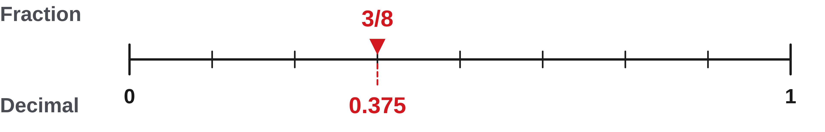
W04-L04 • TEACH • 2:25 PM–2:40 PM • 15 MIN TOTAL
Move between fractions and decimals
1
A fraction is a division: numerator ÷ denominator.
2
Keep calculator precision until the question asks for a rounded result.
3
To find the nearest sixteenth, multiply the fractional inch by 16 and round.
4
Write the rounded count over 16, then reduce; carry a whole inch if needed.
Textbook sections 5.6–5.7 pp.82–87
Textbook
Exercise Book
Numeracy Hub
Shape Canvas
Day 11 • 2026-11-17 • 27
Notes:
Timing: TEACH | 2:25 PM–2:40 PM | 15 MIN TOTAL. Shared phase allocation across these slides.
The fraction bar means division: numerator divided by denominator. Keep the calculator’s precision until the required output is clear. For a fractional inch rounded to sixteenths, multiplying by sixteen asks how many sixteenth-inch spaces that decimal contains. Round that count to the nearest whole count, place it over sixteen and simplify. What if the count rounds to sixteen? Sixteen sixteenths makes one whole inch, so carry it into the whole-number part. This is rounding to a measuring graduation; it is different from rounding a decimal to two places.

Slide 28
W04-L04 • TEACH • 2:25 PM–2:40 PM • 15 MIN TOTAL
Match the answer to its use
1
A tape result must match the requested graduation.
2
Cost = quantity × price per unit; check that the units match.
3
Round a final money amount to cents when the question requires it.
4
Use an estimate to check whether the total cost is reasonable.
Textbook sections 5.6–5.7 pp.82–87
Textbook
Exercise Book
Numeracy Hub
Shape Canvas
Day 11 • 2026-11-17 • 28
Notes:
Timing: TEACH | 2:25 PM–2:40 PM | 15 MIN TOTAL. Shared phase allocation across these slides.
The unit at the end tells us how to finish. For a tape, identify the requested graduation and give a mark that exists on that graduation. For a cost, multiply the amount purchased by the price for one matching unit. Metres times dollars per metre leaves dollars. If the question asks for cents, round the final money amount to two decimal places. Why should we estimate before keying? It can expose a quantity entered in the wrong unit or a decimal-point mistake. A precise-looking price is still wrong if the quantity and rate do not match.

Slide 29
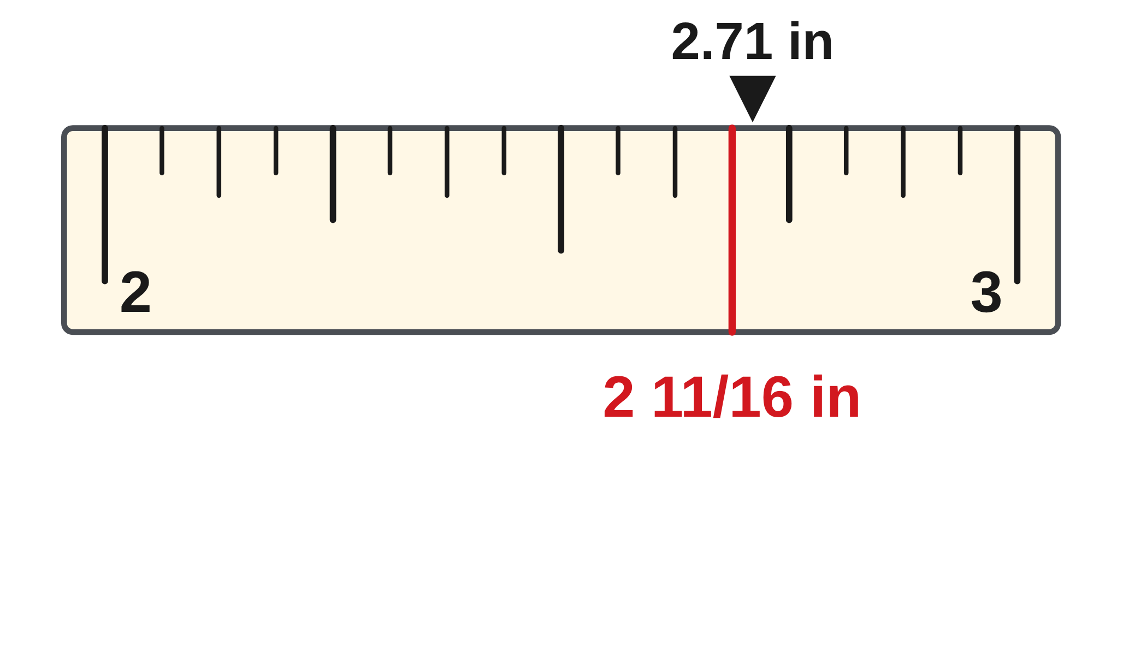
W04-L04 • TEACH • 2:25 PM–2:40 PM • 15 MIN TOTAL
Round only to the requested output
3/8 = 3 ÷ 8 = 0.375
2.71 in to nearest 1/16: 0.71 × 16 = 11.36
Nearest whole count = 11 → 2 11/16 in
Classroom cost: 4 pieces × 1.25 m × $8.40/m = $42.00.
Units show why metres cancel to leave dollars.
Together: 5A Q12–14 and 5B Q2. Explain each final rounding rule.
Compare the same fraction and decimal dimension in Shape Canvas.
W4 L4 • New classroom values • Calculator conversion is a check, not the explanation
Textbook
Exercise Book
Numeracy Hub
Shape Canvas
Day 11 • 2026-11-17 • 29
Notes:
Timing: TEACH | 2:25 PM–2:40 PM | 15 MIN TOTAL. Shared phase allocation across these slides.
Three eighths becomes 3 divided by 8, which is exactly 0.375. For 2.71 inches, keep the two whole inches and convert only 0.71 to sixteenths: 0.71 times 16 equals 11.36, so the nearest count is eleven. We mark 2 11/16 inches. For the cost example, four pieces at 1.25 metres each require five metres. Five metres at $8.40 per metre costs $42.00. Why did the metre unit disappear? The quantity’s metres cancel the “per metre” in the price, leaving dollars. These are two different final-output decisions.

Slide 30
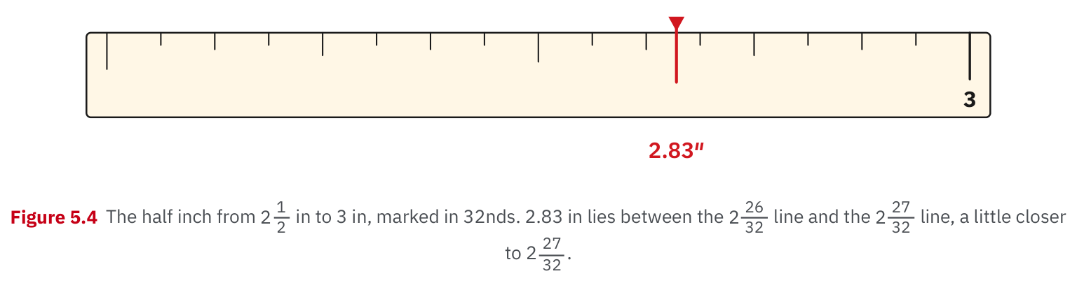
W04-L04 • TEACH • 2:25 PM–2:40 PM • 15 MIN TOTAL
Textbook | page 84
Textbook p.84 • Figure 5.4 — Locating a decimal inch on a graduated rule
Textbook sections 5.6–5.7 pp.82–87
Textbook
Exercise Book
Numeracy Hub
Shape Canvas
Day 11 • 2026-11-17 • 30
Notes:
Timing: TEACH | 2:25 PM–2:40 PM | 15 MIN TOTAL. Shared phase allocation across these slides.
Look at the textbook’s graduated rule on page 84. It shows 2.83 inches between 2 26/32 and 2 27/32. Do not judge it from the size of the projected picture; use the written values and marked graduations. The fractional part is 0.83, and 0.83 times 32 is 26.56. That is a little past halfway between counts twenty-six and twenty-seven, so it lies closer to twenty-seven. Which whole-inch number stays unchanged? The two. We are locating the remaining fraction within that inch.

Slide 31
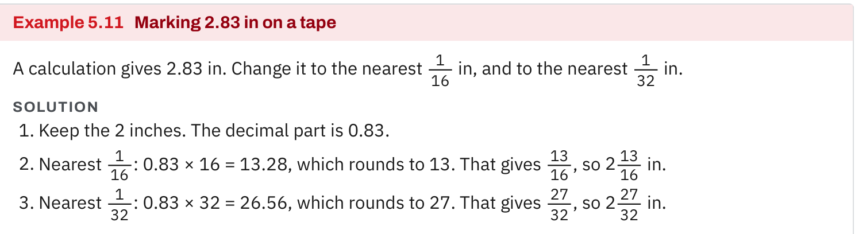
W04-L04 • TEACH • 2:25 PM–2:40 PM • 15 MIN TOTAL
Textbook | page 84
Textbook p.84 • Example 5.11 — Rounding to sixteenths and thirty-seconds
Textbook sections 5.6–5.7 pp.82–87
Textbook
Exercise Book
Numeracy Hub
Shape Canvas
Day 11 • 2026-11-17 • 31
Notes:
Timing: TEACH | 2:25 PM–2:40 PM | 15 MIN TOTAL. Shared phase allocation across these slides.
Example 5.11 uses the same 2.83-inch length but asks for two different precisions. For sixteenths, 0.83 times 16 equals 13.28, which rounds to thirteen: 2 13/16 inches. For thirty-seconds, 0.83 times 32 equals 26.56, which rounds to twenty-seven: 2 27/32 inches. Are those answers contradictory? No; they answer different graduation requests. The finer thirty-second mark lies closer to the original decimal. Keep the question’s requested precision visible beside your working so you do not accidentally report the wrong graduation for the tape.

Slide 32
W04-L04 • TEACH • 2:25 PM–2:40 PM • 15 MIN TOTAL
Spot the mistake. Explain the correction.
Can you round every intermediate decimal to two places because money uses cents?
Discuss the method before checking the answer.
No. Keep precision through the calculation; round only the final result to its requested unit.
Textbook sections 5.6–5.7 pp.82–87
Textbook
Exercise Book
Numeracy Hub
Shape Canvas
Day 11 • 2026-11-17 • 32
Notes:
Timing: TEACH | 2:25 PM–2:40 PM | 15 MIN TOTAL. Shared phase allocation across these slides.
Suppose we round every intermediate decimal to two places because money uses cents. Would that be a sound rule for a tape calculation? No. Two decimal places describe hundredths, while a tape might require sixteenths or thirty-seconds. Even a money calculation can accumulate error if we round intermediate quantities unnecessarily. Keep full working precision and round at the requested final step. What part of the problem tells you the rule? Look for words such as “nearest sixteenth” or “round to the cent.” Say that instruction before giving the answer.

Slide 33
W04-L04 • TOGETHER • 2:40 PM–2:55 PM • 15 MIN TOTAL
Work together
Work Exercise Book 5A Q12–14 and 5B Q2 in pairs. Show why each rounded answer meets the requested unit.
Work in pairs; alternate calculator operator and checker. Show units and an estimated answer.
Resources: Exercise Book 5A Q12–15 (p.33); 5B Q2,4,7 (p.34)
Textbook sections 5.6–5.7 pp.82–87
Textbook
Exercise Book
Numeracy Hub
Shape Canvas
Day 11 • 2026-11-17 • 33
Notes:
Timing: TOGETHER | 2:40 PM–2:55 PM | 15 MIN TOTAL. Shared phase allocation across these slides.
Work through 5A Q12–14 and 5B Q2 with your partner. For each item, first identify the starting form and required final form: fraction, decimal, tape mark or cost. Then explain why the conversion or rounding matches that request. The solver calculates; the checker looks for a whole-number part that might have been lost. Why is that important in a mixed number? Because converting the fractional part does not remove the whole units already present.

Slide 34
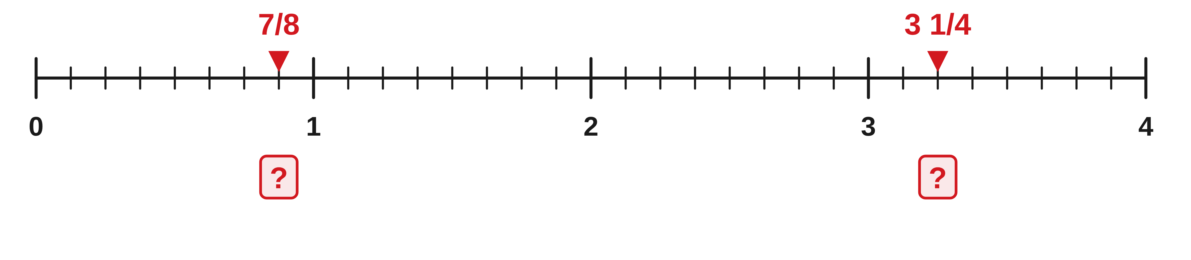
W04-L04 • TOGETHER • 2:40 PM–2:55 PM • 15 MIN TOTAL
Guided practice | 5A Q12
Work with a partner. Take turns explaining the next step.
Textbook sections 5.6–5.7 pp.82–87
Textbook
Exercise Book
Numeracy Hub
Shape Canvas
Day 11 • 2026-11-17 • 34
Notes:
Timing: TOGETHER | 2:40 PM–2:55 PM | 15 MIN TOTAL. Shared phase allocation across these slides.
In 5A Q12, change seven eighths and three and one quarter to decimals. Divide the numerator by the denominator, but keep the three whole units in the mixed number. Explain the two calculations to your partner before comparing answers.
Instructor-only, after the attempt: 7 ÷ 8 = 0.875. For 3 1/4, calculate 1 ÷ 4 = 0.25 and add 3, giving 3.25. Three divided by four would convert a different number.

Slide 35
W04-L04 • TOGETHER • 2:40 PM–2:55 PM • 15 MIN TOTAL
Compare your method | 5A Q12
CHECK TOGETHER
0.875 and 3.25
Textbook sections 5.6–5.7 pp.82–87
Textbook
Exercise Book
Numeracy Hub
Shape Canvas
Day 11 • 2026-11-17 • 35
Notes:
Timing: TOGETHER | 2:40 PM–2:55 PM | 15 MIN TOTAL. Shared phase allocation across these slides.
The two results are 0.875 and 3.25. Seven eighths is slightly below one, which checks the first result. Three and a quarter must lie between three and four, which checks the second. How can we confirm 0.875 is seven eighths? Multiply 0.875 by eight; it gives seven. Explain why 3.25 is not “three twenty-fifths.” The decimal places name hundredths, so 0.25 is twenty-five hundredths, equivalent to one quarter.

Slide 36
W04-L04 • PRACTISE • 2:55 PM–3:15 PM • 20 MIN TOTAL
Your scheduled practice
Complete Exercise Book 5A Q15, 5B Q4,7. Compare fraction and decimal entries in Shape Canvas; write a cost calculation with a reasonableness check.
Solve on paper first; use the tool to check; correct one error with a written reason.
Resources: Exercise Book 5A Q12–15 (p.33); 5B Q2,4,7 (p.34)
Textbook sections 5.6–5.7 pp.82–87
Textbook
Exercise Book
Numeracy Hub
Shape Canvas
Day 11 • 2026-11-17 • 36
Notes:
Timing: PRACTISE | 2:55 PM–3:15 PM | 20 MIN TOTAL. Shared phase allocation across these slides.
Complete 5A Q15 and 5B Q4 and Q7. For the tape questions, keep the whole inches and count the requested fractional divisions. For the cost question, show quantity times price and write a dollar total. Compare a fraction and its decimal equivalent in Shape Canvas using the same inch unit. What should stay the same? The labelled dimension and the represented length. If the two entries produce different sizes, check the conversion before blaming the drawing.

Slide 37

W04-L04 • PRACTISE • 2:55 PM–3:15 PM • 20 MIN TOTAL
Open Shape Canvas
Navigation example. Use the values and units in the assigned task.
Textbook sections 5.6–5.7 pp.82–87
Textbook
Exercise Book
Numeracy Hub
Shape Canvas
Day 11 • 2026-11-17 • 37
Notes:
Timing: PRACTISE | 2:55 PM–3:15 PM | 20 MIN TOTAL. Shared phase allocation across these slides.
In Shape Canvas, enter the assigned length first in fraction form and then in decimal form, with inches selected both times. Predict whether the shape should change before entering the second value. Equivalent values should represent the same dimension. Where can a mismatch come from? A lost whole-number part, an incorrect fraction conversion or a changed unit. Read the label back aloud and compare it with your paper calculation before continuing.

Slide 38
W04-L04 • PRACTISE • 2:55 PM–3:15 PM • 20 MIN TOTAL
Practise in Numeracy Hub and Shape Canvas
1
Use Numeracy Hub Calculator to convert an assigned fraction to a decimal.
2
In Shape Canvas, compare the same in dimension entered in fraction and decimal form.
3
Record the requested tape rounding or final cost on paper and check its units.
Textbook sections 5.6–5.7 pp.82–87
Textbook
Exercise Book
Numeracy Hub
Shape Canvas
Day 11 • 2026-11-17 • 38
Notes:
Timing: PRACTISE | 2:55 PM–3:15 PM | 20 MIN TOTAL. Shared phase allocation across these slides.
Use the Numeracy Hub calculator to check your fraction-to-decimal division. Then use the same dimension in Shape Canvas, keeping inches as the unit. The calculator checks numerical equivalence; the label lets you connect that number to a measurement. Afterward, write the final tape mark or cost required by the exercise. Why is the raw decimal display not always the final answer? A tape needs a stated graduation, and a money total needs its stated cent precision.

Slide 39
W04-L04 • PRACTISE • 2:55 PM–3:15 PM • 20 MIN TOTAL
Practise from the Exercise Book | 5A Q15
Write the operation, working and units before checking.
Textbook sections 5.6–5.7 pp.82–87
Textbook
Exercise Book
Numeracy Hub
Shape Canvas
Day 11 • 2026-11-17 • 39
Notes:
Timing: PRACTISE | 2:55 PM–3:15 PM | 20 MIN TOTAL. Shared phase allocation across these slides.
For 5A Q15, convert 0.29 inch to the nearest sixteenth. Estimate first: 0.29 is slightly above a quarter inch. Multiply by sixteen to count sixteenth-inch spaces, then round that count and simplify if possible.
Instructor-only, after the attempt: 0.29 × 16 = 4.64, so choose 5/16 inch. Four sixteenths is 0.25 and five sixteenths is 0.3125; 0.29 is closer to 0.3125.

Slide 40
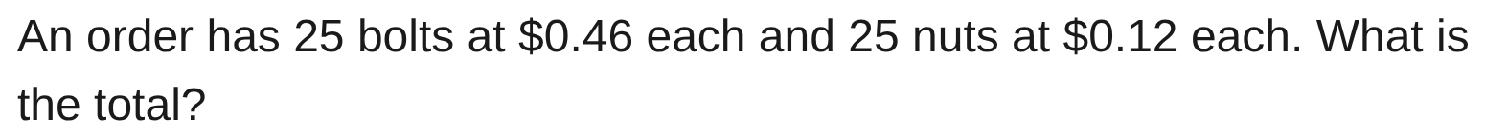
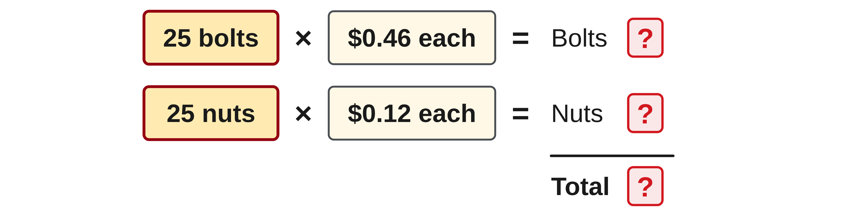
W04-L04 • PRACTISE • 2:55 PM–3:15 PM • 20 MIN TOTAL
Practise from the Exercise Book | 5B Q4
Write the operation, working and units before checking.
Textbook sections 5.6–5.7 pp.82–87
Textbook
Exercise Book
Numeracy Hub
Shape Canvas
Day 11 • 2026-11-17 • 40
Notes:
Timing: PRACTISE | 2:55 PM–3:15 PM | 20 MIN TOTAL. Shared phase allocation across these slides.
For 5B Q4, the order contains twenty-five bolts at $0.46 each and twenty-five nuts at $0.12 each. Calculate both costs or combine the price of one matching pair. Show a total in dollars and cents. Which method uses the shared quantity of twenty-five most directly?
Instructor-only, after the attempt: One bolt-and-nut pair costs $0.58; 25 × $0.58 = $14.50. Separately, $11.50 for bolts plus $3.00 for nuts gives the same total.

Slide 41
W04-L04 • CHECK • 3:15 PM–3:25 PM • 10 MIN TOTAL
Check independently
Exercise Book 5A Q13 and 5B Q7; give simplest fractions and the tape reading.
Solve without displayed answers; include working, units and the requested rounding.
Resources: Exercise Book 5A Q12–15 (p.33); 5B Q2,4,7 (p.34)
Textbook sections 5.6–5.7 pp.82–87
Textbook
Exercise Book
Numeracy Hub
Shape Canvas
Day 11 • 2026-11-17 • 41
Notes:
Timing: CHECK | 3:15 PM–3:25 PM | 10 MIN TOTAL. Shared phase allocation across these slides.
Complete 5A Q13 and 5B Q7 independently. Give the decimal conversions as fractions in lowest terms and the drawing dimension as the requested tape mark. Include enough working to show where each denominator comes from. What is different about those denominators? A decimal fraction starts from tenths, hundredths or thousandths; tape rounding starts from the requested graduation. Keep the worked solutions closed until you have recorded both answers.

Slide 42
W04-L04 • CHECK • 3:15 PM–3:25 PM • 10 MIN TOTAL
Independent check | 5A Q13
Answer independently. Keep worked solutions closed.
Textbook sections 5.6–5.7 pp.82–87
Textbook
Exercise Book
Numeracy Hub
Shape Canvas
Day 11 • 2026-11-17 • 42
Notes:
Timing: CHECK | 3:15 PM–3:25 PM | 10 MIN TOTAL. Shared phase allocation across these slides.
For 5A Q13, turn 0.875 and 0.08 into fractions in lowest terms. Read each decimal by place value, write that fraction, then divide numerator and denominator by a common factor. Do both before checking.
Instructor-only, after the attempt: 875/1000 simplifies by 125 to 7/8. The second is 8/100, which simplifies by 4 to 2/25. Do not turn 0.08 into eight tenths; the zero holds the tenths position.

Slide 43
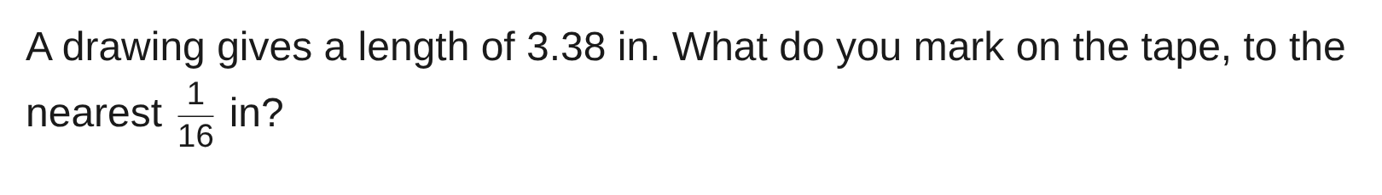
W04-L04 • CHECK • 3:15 PM–3:25 PM • 10 MIN TOTAL
Independent check | 5B Q7
Answer independently. Keep worked solutions closed.
Textbook sections 5.6–5.7 pp.82–87
Textbook
Exercise Book
Numeracy Hub
Shape Canvas
Day 11 • 2026-11-17 • 43
Notes:
Timing: CHECK | 3:15 PM–3:25 PM | 10 MIN TOTAL. Shared phase allocation across these slides.
For 5B Q7, the drawing gives 3.38 inches and the tape mark must be the nearest sixteenth. Keep the three whole inches and work with the remaining 0.38. Explain how you select the graduation before writing your final measurement.
Instructor-only, after the attempt: 0.38 × 16 = 6.08, so choose six sixteenths. Reduce 6/16 to 3/8 and restore the whole inches: 3 3/8 inches. This equals 3.375 inches, close to 3.38.

Slide 44
W04-L04 • WRAP UP • 3:25 PM–3:30 PM • 5 MIN TOTAL
Wrap up and choose the next step
Ask: What did you learn? Where will you use it? What will you check next time?
Name the math and one other essential skill used; write the next practice step.
Resources: Exercise Book 5A Q12–15 (p.33); 5B Q2,4,7 (p.34)
Textbook sections 5.6–5.7 pp.82–87
Textbook
Exercise Book
Numeracy Hub
Shape Canvas
Day 11 • 2026-11-17 • 44
Notes:
Timing: WRAP UP | 3:25 PM–3:30 PM | 5 MIN TOTAL. Shared phase allocation across these slides.
What did you check before giving a final answer today? For a fraction conversion, we checked equivalence. For a tape mark, we checked the requested graduation. For a cost, we checked quantities, rate units and cents. Choose one example from your work and say why its final form fits the job described. Write one specific reminder beside it, such as “keep the whole inches” or “round after the calculation.” That is the habit we carry into percent and ordering work.

