Slide 1

CARPENTRY FOUNDATION / INTAKE 142
Day 15 | Wednesday
15
November 25, 2026
Reading and substituting into formulas
12:45 PM–2:00 PM • Math • 75 min
Rearranging formulas and checking backwards
2:15 PM–3:30 PM • Math • 75 min
Week 5 • 2 scheduled blocks • 150 teaching minutes
Estimate. Show the method. Label units. Check the result.
Textbook
Exercise Book
Numeracy Hub
Shape Canvas
Day 15 • 2026-11-25 • 01
Notes:
Timing: opening orientation within the scheduled start period.
Today we use formulas as readable descriptions of a shape, then work backwards to find a missing dimension. From 12:45 to 2:00, we name each quantity and substitute its value. After our 2:00–2:15 break, we rearrange equations and check the result in the original formula, finishing at 3:30. The calculator can handle arithmetic, but we must choose what the symbols mean. Keep the textbook, exercise book and your written working together so every result has a clear explanation.

Slide 2
DAY 15 / WEEK 5 / CLASS TIMETABLE
Today’s exact schedule
12:45 PM–2:00 PM • 75 min
2:15 PM–3:30 PM • 75 min
Reading and substituting into formulas
Rearranging formulas and checking backwards
12:45 PM–12:50 PM
Start
5
2:15 PM–2:20 PM
Start
5
12:50 PM–12:55 PM
Recall
5
2:20 PM–2:25 PM
Recall
5
12:55 PM–1:10 PM
Teach
15
2:25 PM–2:40 PM
Teach
15
1:10 PM–1:25 PM
Together
15
2:40 PM–2:55 PM
Together
15
1:25 PM–1:45 PM
Practise
20
2:55 PM–3:15 PM
Practise
20
1:45 PM–1:55 PM
Check
10
3:15 PM–3:25 PM
Check
10
1:55 PM–2:00 PM
Wrap up
5
3:25 PM–3:30 PM
Wrap up
5
Math • Math Week 5, Lesson 3
Math • Math Week 5, Lesson 4
Break: 2:00 PM–2:15 PM • 15 minutes • excluded from teaching time
Textbook
Exercise Book
Numeracy Hub
Shape Canvas
Day 15 • 2026-11-25 • 02
Notes:
Timing: opening orientation within the scheduled start period.
The first block develops the routine: identify what is given, decide what to find, write the formula, substitute and check. The second block uses the same routine when a dimension is unknown. Both follow the displayed five, five, fifteen, fifteen, twenty, ten and five-minute phases. Our break is 2:00–2:15. What will distinguish a correct-looking number from a useful answer today? A formula that matches the requested quantity, correct units and a check that confirms the meaning.

Slide 3
W05-L03 • START • 12:45 PM–12:50 PM • 5 MIN TOTAL
Reading and substituting into formulas
Today’s goal: Name variables and substitute dimensions into a formula with correct brackets and units.
Describe a prior use of the skill; identify the given and unknown quantities.
Textbook sections 8.1–8.2 pp.124–125; formula sheet p.219
Exercise Book 8A Q1–8 (p.51); 8B Q12 (p.54)
Keep your notebook, textbook, exercise book and chosen calculator ready.
Textbook sections 8.1–8.2 pp.124–125; formula sheet p.219
Textbook
Exercise Book
Numeracy Hub
Shape Canvas
Day 15 • 2026-11-25 • 03
Notes:
Timing: START | 12:45 PM–12:50 PM | 5 MIN TOTAL. Shared phase allocation across these slides.
Open textbook sections 8.1–8.2 on pages 124–125 and keep the formula sheet on page 219 available. We will use exercise book 8A Q1–8 and 8B Q12. A letter in a formula stands for a quantity, such as the length of a rectangle. It is not an instruction to guess a number. What must we know before replacing that letter? Which measurement it represents and its unit. We will write those meanings before entering values into a calculator.

Slide 4
W05-L03 • RECALL • 12:50 PM–12:55 PM • 5 MIN TOTAL
Recall and reconnect
Identify what l and w stand for in A = l × w. Check BEDMAS using a two-step expression.
Attempt the retrieval task independently; explain the method before checking.
Resources: Exercise Book 8A Q1–8 (p.51); 8B Q12 (p.54)
Textbook sections 8.1–8.2 pp.124–125; formula sheet p.219
Textbook
Exercise Book
Numeracy Hub
Shape Canvas
Day 15 • 2026-11-25 • 04
Notes:
Timing: RECALL | 12:50 PM–12:55 PM | 5 MIN TOTAL. Shared phase allocation across these slides.
In A = l × w, what do l and w stand for? Length and width; A stands for area. Now recall the order of operations in 2 × (4 + 2). The brackets give six first, then multiplying by two gives twelve. What would happen without the brackets? Two times four plus two gives ten. The formula’s grouping matters, so when we substitute values, we must keep the same operations and brackets as the original relationship.

Slide 5
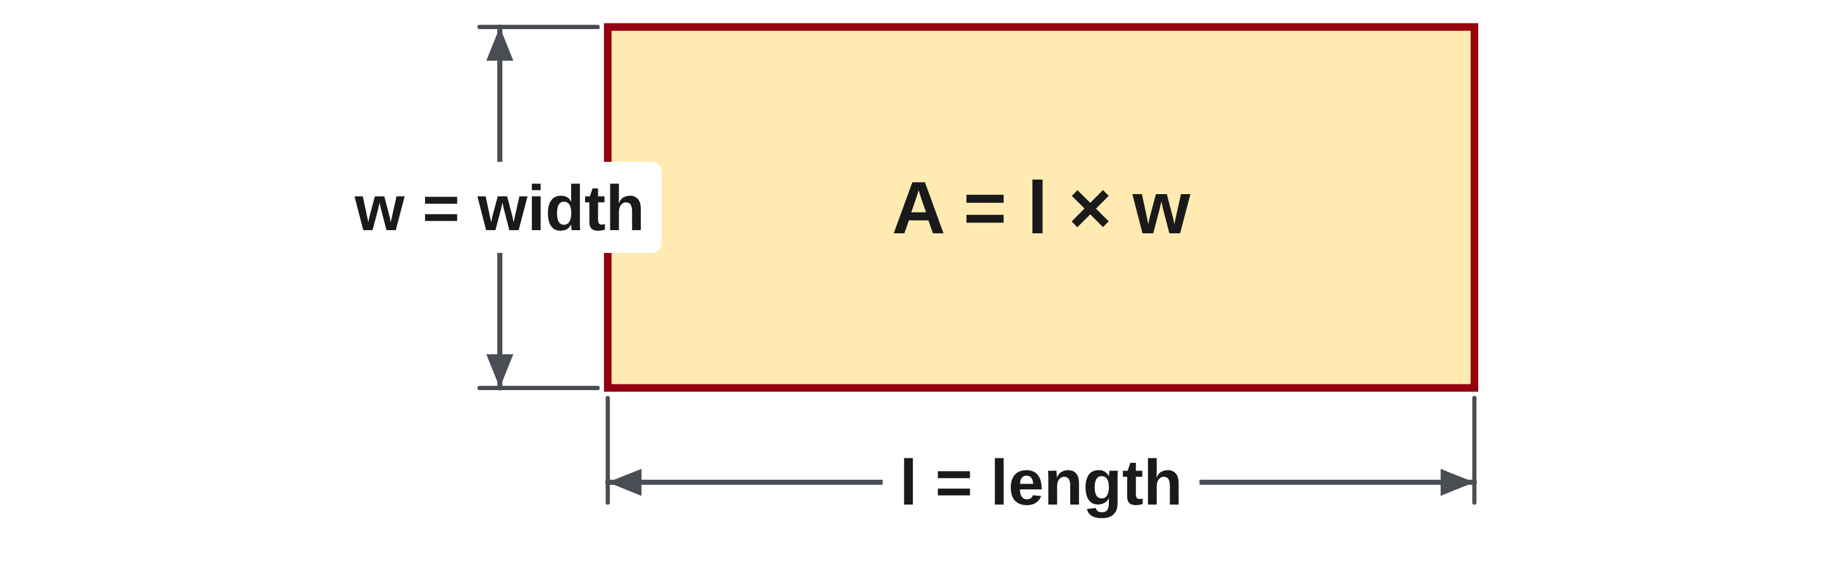
W05-L03 • TEACH • 12:55 PM–1:10 PM • 15 MIN TOTAL
Identify what each symbol means
1
List the given measurements and the quantity you need to find.
2
Match each formula letter to the correct labelled dimension.
3
Use consistent units before substituting values.
4
Keep brackets where the formula groups operations.
Textbook sections 8.1–8.2 pp.124–125; formula sheet p.219
Textbook
Exercise Book
Numeracy Hub
Shape Canvas
Day 15 • 2026-11-25 • 05
Notes:
Timing: TEACH | 12:55 PM–1:10 PM | 15 MIN TOTAL. Shared phase allocation across these slides.
Begin by listing the given measurements and the quantity requested. Then match each formula letter to a labelled dimension. In a rectangle, l is length and w is width, but the label alone does not tell us the measurement unit. Convert dimensions to consistent units before combining them. Keep the brackets when the formula groups quantities, such as length plus width in the perimeter formula. What is the risk of copying the numbers without the symbols? We can put a correct measurement in the wrong place or calculate the wrong quantity. The symbolic line is our map for the numerical line.

Slide 6
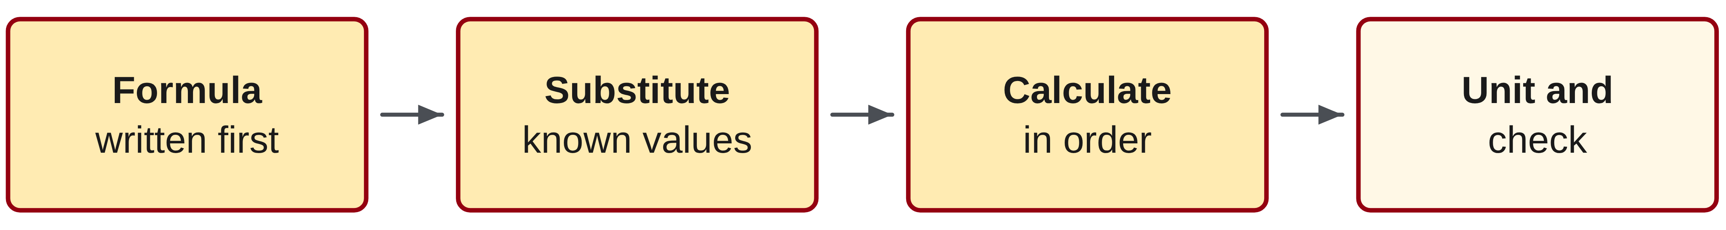
W05-L03 • TEACH • 12:55 PM–1:10 PM • 15 MIN TOTAL
Follow a formula from symbols to a result
1
Write the formula before entering the numbers.
2
Substitute the known values in the same positions.
3
Calculate in the correct order and attach the resulting unit.
4
Check both the magnitude and meaning: equal area alone does not prove a part fits.
Textbook sections 8.1–8.2 pp.124–125; formula sheet p.219
Textbook
Exercise Book
Numeracy Hub
Shape Canvas
Day 15 • 2026-11-25 • 06
Notes:
Timing: TEACH | 12:55 PM–1:10 PM | 15 MIN TOTAL. Shared phase allocation across these slides.
Write the formula first, then replace each known letter with its value in the same position. Follow the order of operations and attach the resulting unit. Multiplying two lengths produces area in square units; adding edge lengths produces perimeter in ordinary length units. After checking the arithmetic, ask what the answer tells us physically. Does an equal area prove that one rectangular part will fit exactly over another? No. Different lengths and widths can have the same product. A formula answers a particular question; we still need the actual dimensions when deciding whether a part fits.

Slide 7
W05-L03 • TEACH • 12:55 PM–1:10 PM • 15 MIN TOTAL
Match the formula to the requested quantity
Length l = 4 m
A = l × w
= 4 × 2 = 8 m²
P = 2(l + w)
= 2(4 + 2) = 12 m
Width w = 2 m
Together: 8A Q2–4 and Q7. Name each quantity before keying.
Numeracy Hub Shape Studio: compare letters, values and calculations.
W5 L3 • Classroom rectangle, not a scale drawing • Area and perimeter are different quantities
Textbook
Exercise Book
Numeracy Hub
Shape Canvas
Day 15 • 2026-11-25 • 07
Notes:
Timing: TEACH | 12:55 PM–1:10 PM | 15 MIN TOTAL. Shared phase allocation across these slides.
Our rectangle is four metres long and two metres wide. Area asks how much surface it covers: A = l × w = 4 × 2 = 8 square metres. Perimeter asks the distance around all four edges: P = 2(l + w) = 2(4 + 2) = 12 metres. Why is one answer in square metres and the other in metres? Area multiplies two lengths, while perimeter adds lengths around the boundary. Before keying, say the requested quantity aloud. The same rectangle supplies the numbers for two different questions and therefore two different formulas.

Slide 8
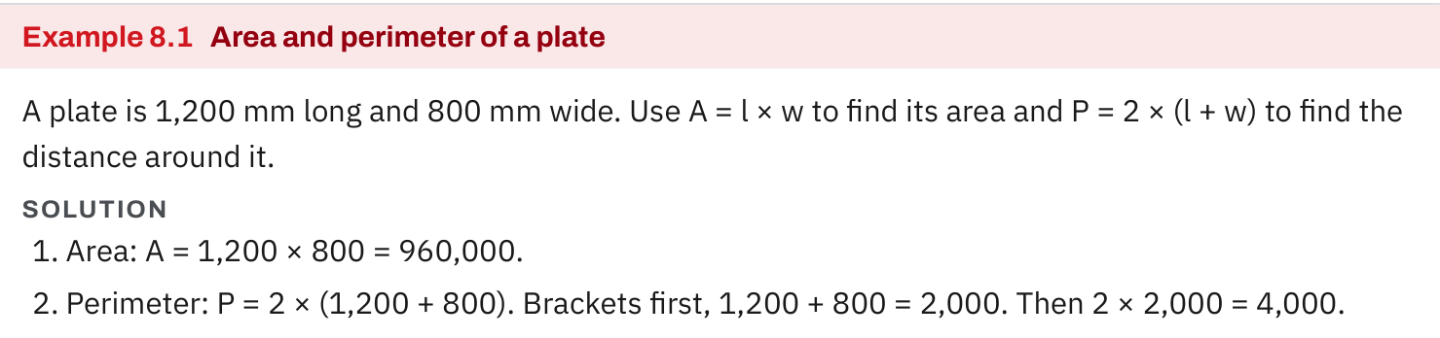
W05-L03 • TEACH • 12:55 PM–1:10 PM • 15 MIN TOTAL
Textbook | page 125
Textbook p.125 • Example 8.1 — Substitution into area and perimeter formulas
Textbook sections 8.1–8.2 pp.124–125; formula sheet p.219
Textbook
Exercise Book
Numeracy Hub
Shape Canvas
Day 15 • 2026-11-25 • 08
Notes:
Timing: TEACH | 12:55 PM–1:10 PM | 15 MIN TOTAL. Shared phase allocation across these slides.
Textbook Example 8.1 uses a plate 1200 millimetres long and 800 millimetres wide. Substitute into the area formula: A = 1200 × 800 = 960000 square millimetres. For perimeter, add one length and one width first: 1200 + 800 = 2000 millimetres, then double that to get 4000 millimetres. Why does doubling the pair count the whole boundary? A rectangle has two equal lengths and two equal widths. The numbers describe the same plate, but area counts surface coverage while perimeter counts the edge distance. Keep each quantity and unit labelled.

Slide 9
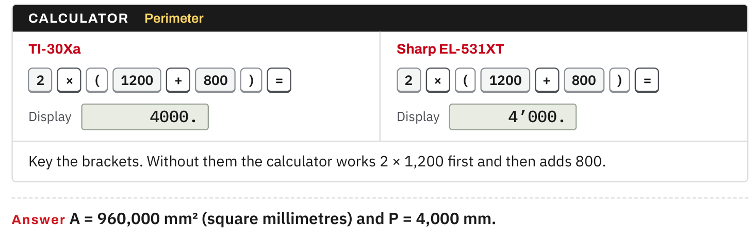
W05-L03 • TEACH • 12:55 PM–1:10 PM • 15 MIN TOTAL
Textbook | page 125
Textbook p.125 • Example 8.1 — Brackets, calculator checks and units
Textbook sections 8.1–8.2 pp.124–125; formula sheet p.219
Textbook
Exercise Book
Numeracy Hub
Shape Canvas
Day 15 • 2026-11-25 • 09
Notes:
Timing: TEACH | 12:55 PM–1:10 PM | 15 MIN TOTAL. Shared phase allocation across these slides.
The calculator line on page 125 includes brackets: 2 × (1200 + 800). Entering those brackets gives 4000 millimetres. Without them, the calculator multiplies two by 1200 first, then adds 800, producing 3200. That arithmetic is valid for a different expression, but it is not the rectangle’s perimeter. What edge lengths would be missing? The ungrouped expression counts two lengths and only one width. This physical interpretation explains why the brackets matter. Copy the formula’s structure before replacing letters with numbers, and confirm the output unit is millimetres rather than square millimetres.

Slide 10
W05-L03 • TEACH • 12:55 PM–1:10 PM • 15 MIN TOTAL
Spot the mistake. Explain the correction.
If two rectangles have the same area, must one fit exactly over the other?
Discuss the method before checking the answer.
No. Compare their length and width as well; equal products can have different dimensions.
Textbook sections 8.1–8.2 pp.124–125; formula sheet p.219
Textbook
Exercise Book
Numeracy Hub
Shape Canvas
Day 15 • 2026-11-25 • 10
Notes:
Timing: TEACH | 12:55 PM–1:10 PM | 15 MIN TOTAL. Shared phase allocation across these slides.
If two rectangles have the same area, must their dimensions match? No. Our four-by-two rectangle has area eight square metres, but an eight-by-one rectangle also has area eight square metres. One is too narrow and too long to match the other exactly. What additional information is needed to check fit? Compare length and width, including orientation and the required dimensions. The area calculation can be perfectly correct while being insufficient for a fit decision. Keep the question in view: “How much surface?” and “Will this part fit?” require different evidence.

Slide 11
W05-L03 • TOGETHER • 1:10 PM–1:25 PM • 15 MIN TOTAL
Work together
Work Exercise Book 8A Q2–4 and Q7. Name each quantity before entering calculator keys.
Work in pairs, alternating solver and checker. Write a diagram, formula, units and estimate.
Resources: Exercise Book 8A Q1–8 (p.51); 8B Q12 (p.54)
Textbook sections 8.1–8.2 pp.124–125; formula sheet p.219
Textbook
Exercise Book
Numeracy Hub
Shape Canvas
Day 15 • 2026-11-25 • 11
Notes:
Timing: TOGETHER | 1:10 PM–1:25 PM | 15 MIN TOTAL. Shared phase allocation across these slides.
Work together on 8A Q2–4 and Q7. Before using calculator keys, read each symbol aloud and say what quantity the answer will represent. Your partner checks that the substituted values occupy the right positions and that brackets are preserved. For Q2, we will first make hidden multiplication signs visible. Why does that help? It prevents adjacent letters from looking like one unfamiliar symbol and makes the order of operations easier to explain.

Slide 12
W05-L03 • TOGETHER • 1:10 PM–1:25 PM • 15 MIN TOTAL
Guided practice | 8A Q2
Work with a partner. Take turns explaining the next step.
Textbook sections 8.1–8.2 pp.124–125; formula sheet p.219
Textbook
Exercise Book
Numeracy Hub
Shape Canvas
Day 15 • 2026-11-25 • 12
Notes:
Timing: TOGETHER | 1:10 PM–1:25 PM | 15 MIN TOTAL. Shared phase allocation across these slides.
In 8A Q2, rewrite 3ab and πr² using multiplication signs. Identify which quantities are multiplied and what the exponent applies to. Explain the expansion to your partner before revealing the answer.
Instructor-only, after the attempt: 3 × a × b and π × r × r. The square applies to r only. It means r multiplied by itself, not two times r and not the entire product πr squared.

Slide 13
W05-L03 • TOGETHER • 1:10 PM–1:25 PM • 15 MIN TOTAL
Compare your method | 8A Q2
CHECK TOGETHER
3 × a × b and π × r × r
Textbook sections 8.1–8.2 pp.124–125; formula sheet p.219
Textbook
Exercise Book
Numeracy Hub
Shape Canvas
Day 15 • 2026-11-25 • 13
Notes:
Timing: TOGETHER | 1:10 PM–1:25 PM | 15 MIN TOTAL. Shared phase allocation across these slides.
The expanded forms are 3 × a × b and π × r × r. In algebra, adjacent symbols commonly imply multiplication, so 3ab includes three factors. The superscript two in r² repeats r as a factor twice. What changes if we write 2r instead? That means two times r, a different calculation. Making the signs explicit lets us substitute numbers without losing an operation. Read the second expression as “pi times radius times radius.”

Slide 14
W05-L03 • PRACTISE • 1:25 PM–1:45 PM • 20 MIN TOTAL
Your scheduled practice
Complete Exercise Book 8A Q5–6,8 and 8B Q12. Use Shape Canvas dimensions to verify substituted values; treat formula applications as introductions, not full geometry mastery.
Solve on paper first; check with tools; correct one error and explain the change.
Resources: Exercise Book 8A Q1–8 (p.51); 8B Q12 (p.54)
Textbook sections 8.1–8.2 pp.124–125; formula sheet p.219
Textbook
Exercise Book
Numeracy Hub
Shape Canvas
Day 15 • 2026-11-25 • 14
Notes:
Timing: PRACTISE | 1:25 PM–1:45 PM | 20 MIN TOTAL. Shared phase allocation across these slides.
Complete 8A Q5–6 and Q8, plus 8B Q12. These applications introduce formulas; focus on reading the symbols, substituting correctly and checking the resulting units. Use Shape Canvas dimensions to confirm the values you substituted. What should you do before trusting a matching number? Confirm that it answers the requested quantity. For a circle, distinguish the diameter used in the circumference formula from the radius used in the area formula. Keep the original formula visible above the numerical working.

Slide 15

W05-L03 • PRACTISE • 1:25 PM–1:45 PM • 20 MIN TOTAL
Open Shape Canvas
Navigation example. Use the values and units in the assigned task.
Textbook sections 8.1–8.2 pp.124–125; formula sheet p.219
Textbook
Exercise Book
Numeracy Hub
Shape Canvas
Day 15 • 2026-11-25 • 15
Notes:
Timing: PRACTISE | 1:25 PM–1:45 PM | 20 MIN TOTAL. Shared phase allocation across these slides.
Open Shape Canvas and display the assigned rectangle’s sizes and formula. Point from each written dimension to the letter it replaces in your paper formula. Which calculation describes the inside surface, and which describes the boundary? Area multiplies the two dimensions; perimeter totals the edges. Use the canvas to confirm that your labels represent the intended values, then compare the calculation. The picture helps connect letters to dimensions, but the written equation still explains how the result was obtained.

Slide 16
W05-L03 • PRACTISE • 1:25 PM–1:45 PM • 20 MIN TOTAL
Practise in Numeracy Hub and Shape Canvas
1
In Numeracy Hub Shape Studio, compare Letters and values with Calculations.
2
Create the assigned rectangle in Shape Canvas and show its sizes and formula.
3
Substitute the labelled dimensions on paper, then compare with the tool calculation.
Textbook sections 8.1–8.2 pp.124–125; formula sheet p.219
Textbook
Exercise Book
Numeracy Hub
Shape Canvas
Day 15 • 2026-11-25 • 16
Notes:
Timing: PRACTISE | 1:25 PM–1:45 PM | 20 MIN TOTAL. Shared phase allocation across these slides.
In Numeracy Hub Shape Studio, compare the Letters and values view with the Calculations view. Read a formula before revealing its substituted values. Then create the assigned rectangle in Shape Canvas and show its dimensions. What should the values in your notebook match? The corresponding labelled lengths, in consistent units. Calculate on paper first, then compare the result with the tool. If the number agrees but the unit does not, examine whether you found area or perimeter.

Slide 17
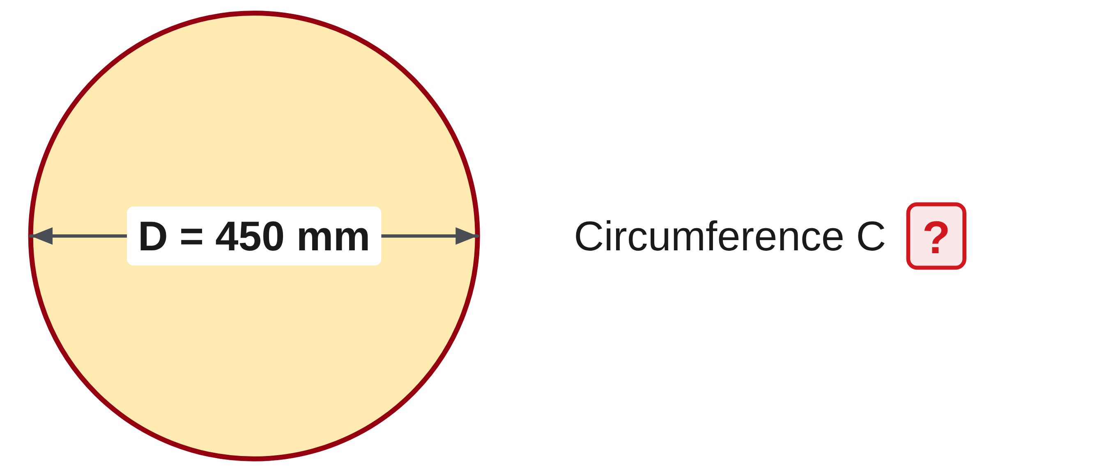
W05-L03 • PRACTISE • 1:25 PM–1:45 PM • 20 MIN TOTAL
Practise from the Exercise Book | 8A Q5
Write the operation, working and units before checking.
Textbook sections 8.1–8.2 pp.124–125; formula sheet p.219
Textbook
Exercise Book
Numeracy Hub
Shape Canvas
Day 15 • 2026-11-25 • 17
Notes:
Timing: PRACTISE | 1:25 PM–1:45 PM | 20 MIN TOTAL. Shared phase allocation across these slides.
For 8A Q5, substitute a diameter of 450 millimetres into C = π × D. Use the calculator’s pi value and round only the final result to two decimal places. Predict a circumference a little more than three diameters.
Instructor-only, after the attempt: π × 450 ≈ 1413.716694 mm, rounding to 1413.72 mm. The unit is millimetres because this is a distance around the circle. Using the radius instead would halve the required input.

Slide 18
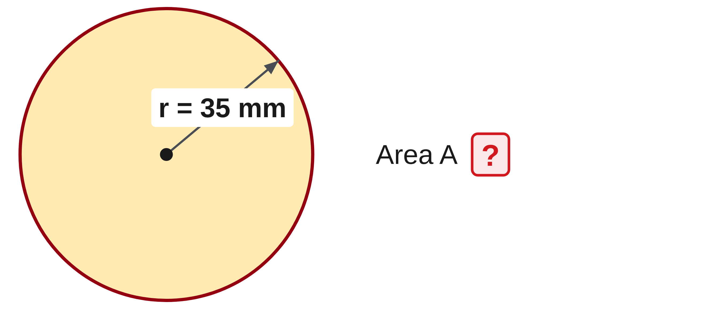
W05-L03 • PRACTISE • 1:25 PM–1:45 PM • 20 MIN TOTAL
Practise from the Exercise Book | 8A Q6
Write the operation, working and units before checking.
Textbook sections 8.1–8.2 pp.124–125; formula sheet p.219
Textbook
Exercise Book
Numeracy Hub
Shape Canvas
Day 15 • 2026-11-25 • 18
Notes:
Timing: PRACTISE | 1:25 PM–1:45 PM | 20 MIN TOTAL. Shared phase allocation across these slides.
For 8A Q6, substitute a radius of thirty-five millimetres into A = π × r². Explain what gets squared before calculating and round the final area to two decimal places.
Instructor-only, after the attempt: 35² = 1225, then π × 1225 ≈ 3848.451001, giving 3848.45 mm². Square the radius, not pi and not twice the radius. The square-millimetre unit records that two length factors were multiplied.

Slide 19
W05-L03 • CHECK • 1:45 PM–1:55 PM • 10 MIN TOTAL
Check independently
Exercise Book 8A Q3–4; label the result as area or perimeter and include units.
Solve without displayed answers; include working, units and final rounding.
Resources: Exercise Book 8A Q1–8 (p.51); 8B Q12 (p.54)
Textbook sections 8.1–8.2 pp.124–125; formula sheet p.219
Textbook
Exercise Book
Numeracy Hub
Shape Canvas
Day 15 • 2026-11-25 • 19
Notes:
Timing: CHECK | 1:45 PM–1:55 PM | 10 MIN TOTAL. Shared phase allocation across these slides.
Complete 8A Q3–4 independently. Label each result as area or perimeter and include its correct unit. Copy the formula, substitute the dimensions and show the grouped calculation. What should be visible in the perimeter work? The addition inside brackets before multiplication by two. What should be visible in the area result? A square unit. These details show the meaning of your calculation even if the arithmetic could be done mentally.

Slide 20
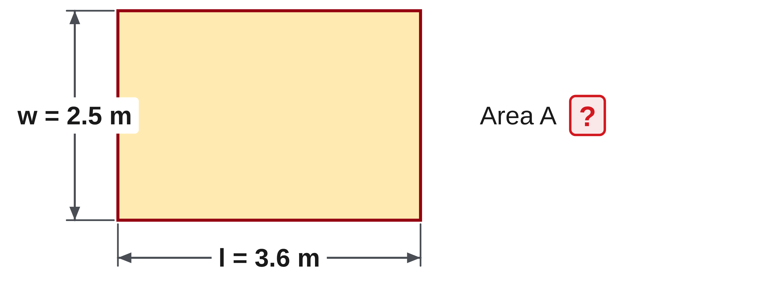
W05-L03 • CHECK • 1:45 PM–1:55 PM • 10 MIN TOTAL
Independent check | 8A Q3
Answer independently. Keep worked solutions closed.
Textbook sections 8.1–8.2 pp.124–125; formula sheet p.219
Textbook
Exercise Book
Numeracy Hub
Shape Canvas
Day 15 • 2026-11-25 • 20
Notes:
Timing: CHECK | 1:45 PM–1:55 PM | 10 MIN TOTAL. Shared phase allocation across these slides.
For 8A Q3, substitute length 3.6 metres and width 2.5 metres into A = l × w. Write the formula and numerical substitution, then decide the unit from the operation. Complete the attempt before checking.
Instructor-only, after the attempt: 3.6 × 2.5 = 9 m². One check is 3.6 × (2 + 0.5) = 7.2 + 1.8 = 9. This is surface area, so the result is square metres, not metres.

Slide 21
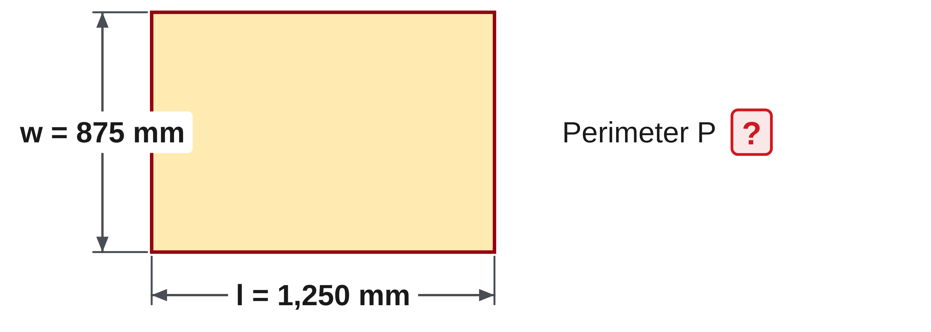
W05-L03 • CHECK • 1:45 PM–1:55 PM • 10 MIN TOTAL
Independent check | 8A Q4
Answer independently. Keep worked solutions closed.
Textbook sections 8.1–8.2 pp.124–125; formula sheet p.219
Textbook
Exercise Book
Numeracy Hub
Shape Canvas
Day 15 • 2026-11-25 • 21
Notes:
Timing: CHECK | 1:45 PM–1:55 PM | 10 MIN TOTAL. Shared phase allocation across these slides.
For 8A Q4, find P = 2 × (l + w) using length 1250 millimetres and width 875 millimetres. Preserve the brackets and show which operation you complete first. Record the perimeter unit.
Instructor-only, after the attempt: 1250 + 875 = 2125 mm; doubling gives 4250 mm. An edge-by-edge check is 1250 + 875 + 1250 + 875. Millimetres remain ordinary length units because the edges are added, not multiplied together.

Slide 22
W05-L03 • WRAP UP • 1:55 PM–2:00 PM • 5 MIN TOTAL
Wrap up and choose the next step
Ask: What changed in your understanding? Where will you use it? What should you check next time?
Name the math and one other essential skill used; record a next practice step.
Resources: Exercise Book 8A Q1–8 (p.51); 8B Q12 (p.54)
Textbook sections 8.1–8.2 pp.124–125; formula sheet p.219
Textbook
Exercise Book
Numeracy Hub
Shape Canvas
Day 15 • 2026-11-25 • 22
Notes:
Timing: WRAP UP | 1:55 PM–2:00 PM | 5 MIN TOTAL. Shared phase allocation across these slides.
Explain how you moved from a formula to a labelled answer. Which step was most important for you: naming the letters, matching units, retaining brackets or choosing area versus perimeter? Use one completed exercise as evidence. What do square units tell us? We have calculated area by multiplying lengths. After the break, we will keep this written routine but reverse the operations to find a missing dimension. The original formula will become our final check.

Slide 23
DAY 15 • SCHEDULED BREAK
Break
2:00 PM–2:15 PM
Return ready for: Rearranging formulas and checking backwards
This break is excluded from teaching minutes.
Textbook
Exercise Book
Numeracy Hub
Shape Canvas
Day 15 • 2026-11-25 • 23
Notes:
Timing: scheduled break, 2:00–2:15 PM.
Take the scheduled break from 2:00 to 2:15. When we return, we will work backwards from an area or perimeter to find an unknown dimension, then test the result in the original equation.

Slide 24
W05-L04 • START • 2:15 PM–2:20 PM • 5 MIN TOTAL
Rearranging formulas and checking backwards
Today’s goal: Rearrange one- and two-step formulas and validate a missing dimension by substitution.
Describe a prior use of the skill; identify the given and unknown quantities.
Textbook sections 8.3–8.5 pp.126–130; sections 8.7 p.134
Exercise Book 8A Q9–22 (pp.51–52), selected; 8B Q1,4 (p.53), Q15 (p.54)
Keep your notebook, textbook, exercise book and chosen calculator ready.
Textbook sections 8.3–8.5 pp.126–130; sections 8.7 p.134
Textbook
Exercise Book
Numeracy Hub
Shape Canvas
Day 15 • 2026-11-25 • 24
Notes:
Timing: START | 2:15 PM–2:20 PM | 5 MIN TOTAL. Shared phase allocation across these slides.
Suppose you know the total distance around a frame and its width, but the length is missing. A formula can help us recover that length if we undo its operations carefully. Open textbook sections 8.3–8.5, pages 126–130, and section 8.7 on page 134. What must stay true while we rearrange? Both sides must remain equal. We will use inverse operations, write each step and put the answer back into the original formula to check it.

Slide 25
W05-L04 • RECALL • 2:20 PM–2:25 PM • 5 MIN TOTAL
Recall and reconnect
Use Exercise Book 8A Q9,11. Discuss which inverse operation preserves equality.
Attempt the retrieval task independently; explain the method before checking.
Resources: Exercise Book 8A Q9–22 (pp.51–52), selected; 8B Q1,4 (p.53), Q15 (p.54)
Textbook sections 8.3–8.5 pp.126–130; sections 8.7 p.134
Textbook
Exercise Book
Numeracy Hub
Shape Canvas
Day 15 • 2026-11-25 • 25
Notes:
Timing: RECALL | 2:20 PM–2:25 PM | 5 MIN TOTAL. Shared phase allocation across these slides.
Use 8A Q9 and Q11 to recall inverse operations. Addition is undone by subtraction; multiplication is undone by division. But we must apply the same operation to both sides of the equation. Why? The equals sign states that both sides represent the same amount. Changing only one side would usually destroy that equality. In the next question, identify what has been added to the unknown and remove that amount from both sides.

Slide 26
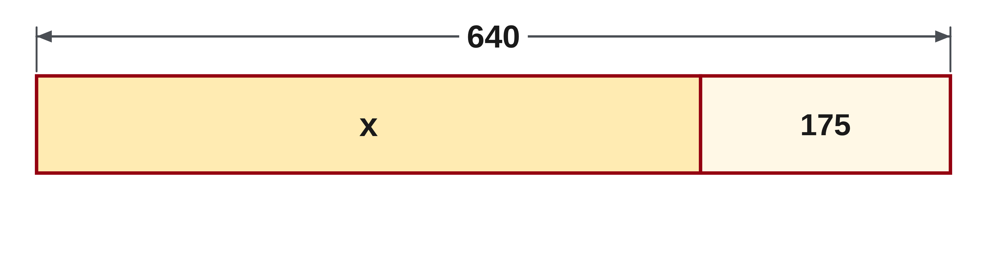
W05-L04 • RECALL • 2:20 PM–2:25 PM • 5 MIN TOTAL
Recall from the Exercise Book | 8A Q9
Write the operation, working and units before checking.
Textbook sections 8.3–8.5 pp.126–130; sections 8.7 p.134
Textbook
Exercise Book
Numeracy Hub
Shape Canvas
Day 15 • 2026-11-25 • 26
Notes:
Timing: RECALL | 2:20 PM–2:25 PM | 5 MIN TOTAL. Shared phase allocation across these slides.
For 8A Q9, solve x + 175 = 640. Name the operation attached to x, then use its inverse on both sides. Verify your value by replacing x in the original equation.
Instructor-only, after the attempt: Subtract 175 from both sides: x = 640 − 175 = 465. Check: 465 + 175 = 640. Merely changing the sign without explaining the operation hides why the rearrangement preserves equality.

Slide 27
W05-L04 • TEACH • 2:25 PM–2:40 PM • 15 MIN TOTAL
Undo operations on both sides
1
Identify the unknown before rearranging the formula.
2
Use inverse operations: add/subtract and multiply/divide.
3
Apply the same operation to both sides to preserve equality.
4
Keep the entire grouped expression together when dividing.
Textbook sections 8.3–8.5 pp.126–130; sections 8.7 p.134
Textbook
Exercise Book
Numeracy Hub
Shape Canvas
Day 15 • 2026-11-25 • 27
Notes:
Timing: TEACH | 2:25 PM–2:40 PM | 15 MIN TOTAL. Shared phase allocation across these slides.
An equation is a statement of equality. To isolate an unknown, undo operations while doing the same thing to both sides. If an amount was added, subtract it; if the unknown was multiplied by a nonzero quantity, divide by that quantity. In a grouped expression, keep the entire group together when applying an operation. Why do we undo the outside operation first in a two-step formula? It frees the inner expression without changing its internal relationship. Write the operation on both sides until the balance is clear; shortcuts are useful only when you understand what they preserve.

Slide 28
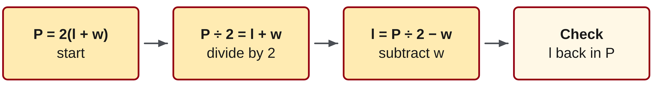
W05-L04 • TEACH • 2:25 PM–2:40 PM • 15 MIN TOTAL
Check a missing dimension backwards
1
For P = 2(l + w), divide by 2 before subtracting the known width.
2
The rearranged formula is l = P/2 − w.
3
Insert the found length into the original perimeter equation.
4
Accept the result only when the original equation balances with correct units.
Textbook sections 8.3–8.5 pp.126–130; sections 8.7 p.134
Textbook
Exercise Book
Numeracy Hub
Shape Canvas
Day 15 • 2026-11-25 • 28
Notes:
Timing: TEACH | 2:25 PM–2:40 PM | 15 MIN TOTAL. Shared phase allocation across these slides.
Start from the rectangle’s perimeter formula, P = 2(l + w). The bracketed length-plus-width pair was multiplied by two, so divide both sides by two: P/2 = l + w. Then subtract the known width from both sides, leaving l = P/2 − w. What must we do after calculating l? Substitute it into the original perimeter formula. This check is stronger than repeating the rearranged calculation because it tests whether the found length actually recreates the given perimeter. Keep the units consistent so the equality represents the same quantity on both sides.

Slide 29
W05-L04 • TEACH • 2:25 PM–2:40 PM • 15 MIN TOTAL
Balance the equation, then check
P = 2(l + w) → P ÷ 2 = l + w → l = P ÷ 2 − w
Worked example • P = 4,000 mm; w = 700 mm.
l = 4,000 ÷ 2 − 700 = 1,300 mm.
Check: 2 × (1,300 + 700) = 4,000 mm.
Spot the error • l = P − 2w gives 2,600 mm—not the length.
Substituting that answer gives 6,600 mm, not the stated perimeter.
Together • Exercise Book 8A Q15,18–19 and 8B Q1.
Say the inverse operation; keep both sides equal. Check every result
in the original formula before using the calculator or Shape Canvas.
Textbook pp.126–130,134 • Exercise Book pp.51–54 • Worked example: Exercise Book 8B Q15
Textbook
Exercise Book
Numeracy Hub
Shape Canvas
Day 15 • 2026-11-25 • 29
Notes:
Timing: TEACH | 2:25 PM–2:40 PM | 15 MIN TOTAL. Shared phase allocation across these slides.
For P = 4000 millimetres and w = 700 millimetres, halve the perimeter to get one length plus one width: 2000 millimetres. Subtract the width: 2000 − 700 = 1300 millimetres. Check the original equation: 2 × (1300 + 700) = 4000. Now try the mistaken l = P − 2w: it gives 2600, which returns a perimeter of 6600, not 4000. What does 2600 actually represent here? Both lengths together. Dividing that remaining pair by two would recover the correct single length of 1300 millimetres.

Slide 30
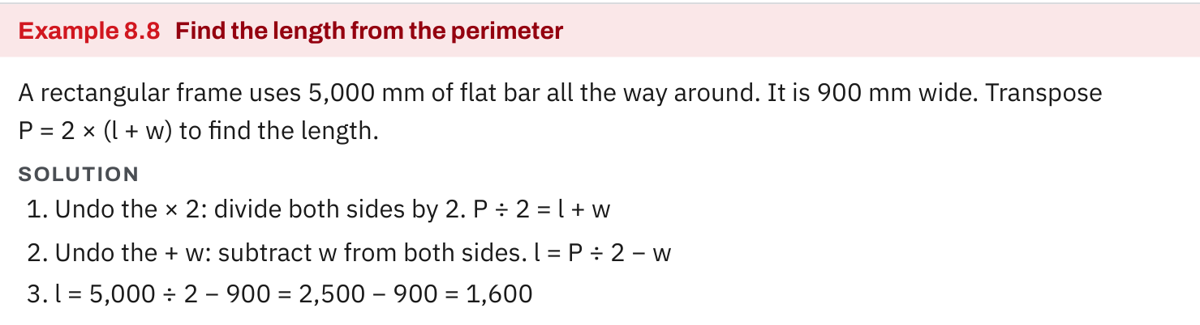
W05-L04 • TEACH • 2:25 PM–2:40 PM • 15 MIN TOTAL
Textbook | page 130
Textbook p.130 • Example 8.8 — Undo two operations to find a length
Textbook sections 8.3–8.5 pp.126–130; sections 8.7 p.134
Textbook
Exercise Book
Numeracy Hub
Shape Canvas
Day 15 • 2026-11-25 • 30
Notes:
Timing: TEACH | 2:25 PM–2:40 PM | 15 MIN TOTAL. Shared phase allocation across these slides.
Textbook Example 8.8 gives a frame with perimeter 5000 millimetres and width 900 millimetres. Divide the perimeter by two to find one length plus one width: 2500 millimetres. Subtract the width to isolate the length: 2500 − 900 = 1600 millimetres. Why is the first division by two appropriate? Opposite sides of the rectangle are equal, so the full perimeter contains two identical length-plus-width pairs. The rearranged formula expresses that geometric reasoning. State the answer as a length in millimetres, then prepare to check it using all four sides.

Slide 31
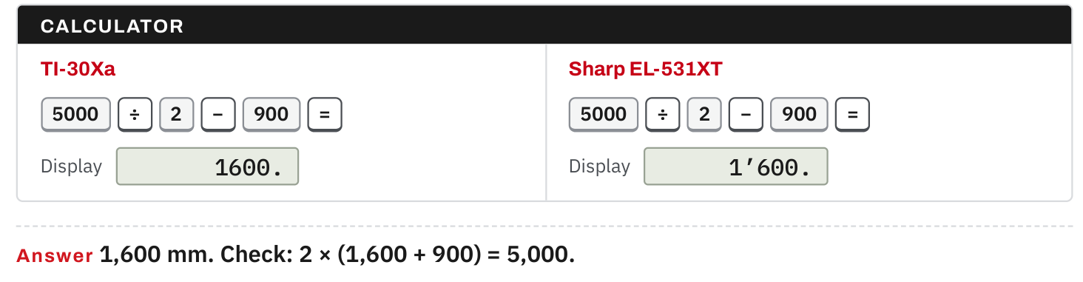
W05-L04 • TEACH • 2:25 PM–2:40 PM • 15 MIN TOTAL
Textbook | page 130
Textbook p.130 • Example 8.8 — Substitute back into the original perimeter formula
Textbook sections 8.3–8.5 pp.126–130; sections 8.7 p.134
Textbook
Exercise Book
Numeracy Hub
Shape Canvas
Day 15 • 2026-11-25 • 31
Notes:
Timing: TEACH | 2:25 PM–2:40 PM | 15 MIN TOTAL. Shared phase allocation across these slides.
Check the textbook result by returning to P = 2(l + w). Replace l with 1600 millimetres and w with 900: inside the brackets we get 2500, and doubling gives 5000 millimetres. That matches the given perimeter. What if our calculation produced 3200 millimetres for the length? Substitution would give 2 × (3200 + 900) = 8200, exposing the mismatch. The check must use the original formula and given values, not only repeat the same rearrangement. It answers whether the candidate dimension satisfies the original information.

Slide 32
W05-L04 • TEACH • 2:25 PM–2:40 PM • 15 MIN TOTAL
Spot the mistake. Explain the correction.
Why does l = P − 2w give the wrong length for a rectangle?
Discuss the method before checking the answer.
After subtracting 2w, the left side is still 2l. Divide the remaining expression by 2.
Textbook sections 8.3–8.5 pp.126–130; sections 8.7 p.134
Textbook
Exercise Book
Numeracy Hub
Shape Canvas
Day 15 • 2026-11-25 • 32
Notes:
Timing: TEACH | 2:25 PM–2:40 PM | 15 MIN TOTAL. Shared phase allocation across these slides.
Why is l = P − 2w incomplete? Expand the original perimeter equation as P = 2l + 2w. Subtracting 2w leaves P − 2w = 2l, which is still two lengths. We must divide the whole remaining expression by two to isolate one length: l = (P − 2w)/2. That simplifies to P/2 − w. Which part of the incorrect method was reasonable? Removing the two widths. The missing step was sharing what remained between the two equal lengths. Explaining that missing step is more useful than just calling the formula wrong.

Slide 33
W05-L04 • TOGETHER • 2:40 PM–2:55 PM • 15 MIN TOTAL
Work together
Complete Exercise Book 8A Q15,18–19 and Exercise Book 8B Q1 as a group. Explain the inverse step.
Work in pairs, alternating solver and checker. Write a diagram, formula, units and estimate.
Resources: Exercise Book 8A Q9–22 (pp.51–52), selected; 8B Q1,4 (p.53), Q15 (p.54)
Textbook sections 8.3–8.5 pp.126–130; sections 8.7 p.134
Textbook
Exercise Book
Numeracy Hub
Shape Canvas
Day 15 • 2026-11-25 • 33
Notes:
Timing: TOGETHER | 2:40 PM–2:55 PM | 15 MIN TOTAL. Shared phase allocation across these slides.
Work together on 8A Q15, Q18–19 and 8B Q1. Identify the unknown, say the inverse operation and apply it to both sides before entering numbers. After solving, substitute into the original relationship. What should your partner check? That the operation affects the entire required expression and that the original equality is recovered. Begin by isolating length in the area formula on the next slide; it needs one inverse step rather than the perimeter formula’s two.

Slide 34
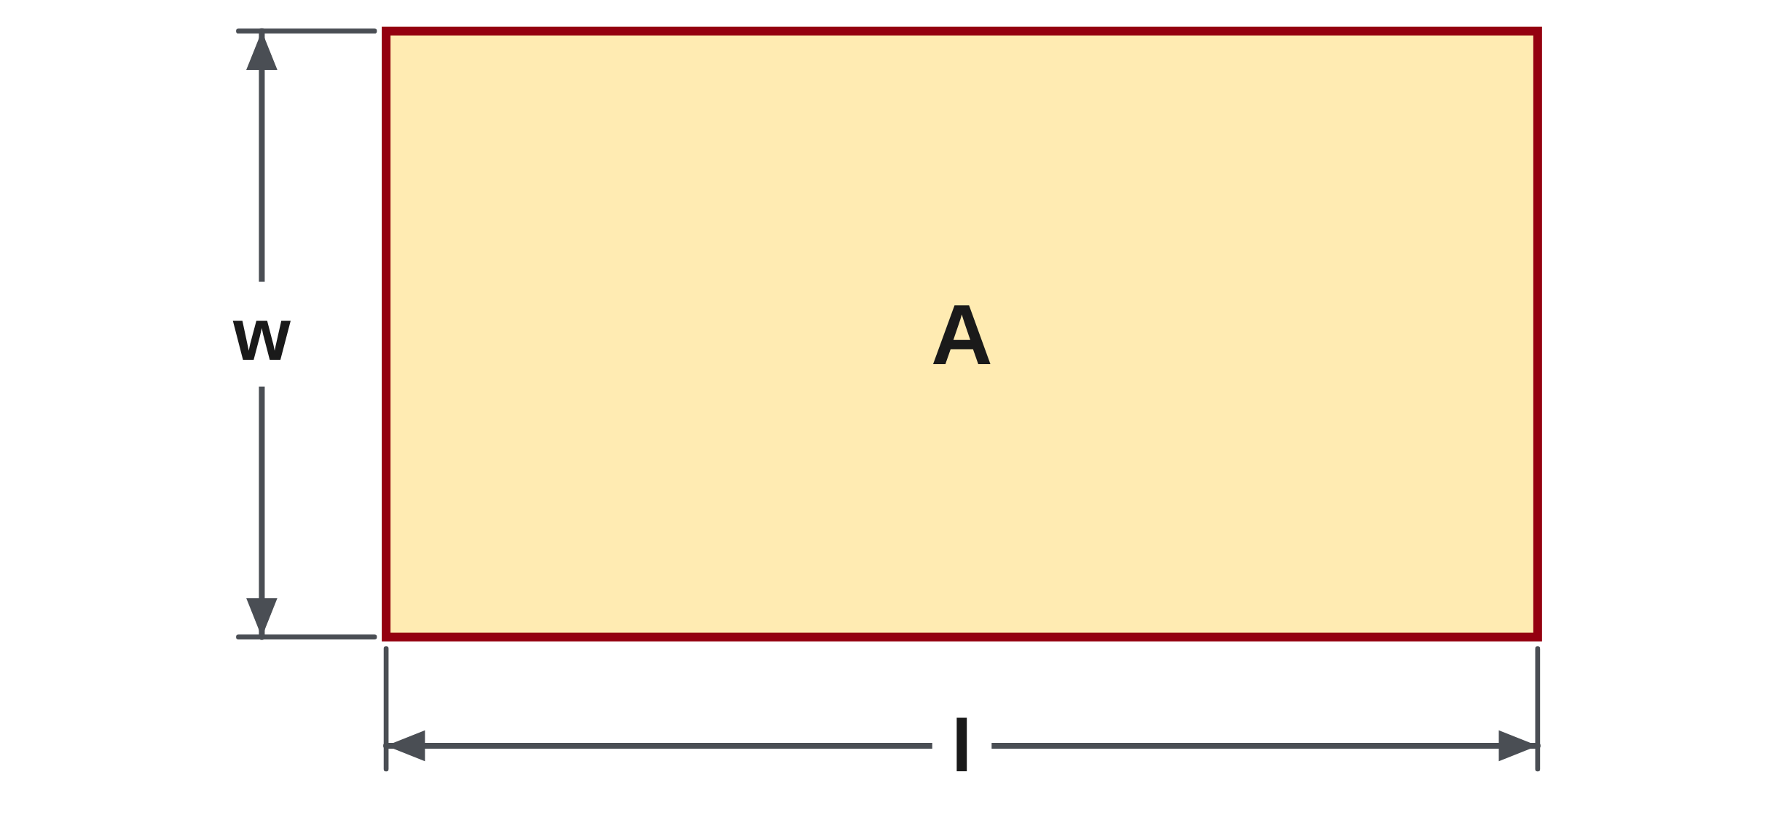
W05-L04 • TOGETHER • 2:40 PM–2:55 PM • 15 MIN TOTAL
Guided practice | 8A Q15
Work with a partner. Take turns explaining the next step.
Textbook sections 8.3–8.5 pp.126–130; sections 8.7 p.134
Textbook
Exercise Book
Numeracy Hub
Shape Canvas
Day 15 • 2026-11-25 • 34
Notes:
Timing: TOGETHER | 2:40 PM–2:55 PM | 15 MIN TOTAL. Shared phase allocation across these slides.
For 8A Q15, make l the subject of A = l × w. Which operation currently connects l to w, and what inverse operation isolates l? Write the step on both sides before simplifying.
Instructor-only, after the attempt: Divide both sides by w, giving l = A ÷ w, with w nonzero. For an actual rectangle the width is positive. Area divided by width leaves a length, matching the requested quantity.

Slide 35
W05-L04 • TOGETHER • 2:40 PM–2:55 PM • 15 MIN TOTAL
Compare your method | 8A Q15
CHECK TOGETHER
l = A ÷ w
Textbook sections 8.3–8.5 pp.126–130; sections 8.7 p.134
Textbook
Exercise Book
Numeracy Hub
Shape Canvas
Day 15 • 2026-11-25 • 35
Notes:
Timing: TOGETHER | 2:40 PM–2:55 PM | 15 MIN TOTAL. Shared phase allocation across these slides.
Our rearrangement is l = A ÷ w. The original formula multiplied length by width; dividing both sides by width undoes that multiplication. Why does the unit also make sense? Square metres divided by metres leaves metres, a length. To check the rearrangement, multiply the resulting length by the same width and recover the original area. This is the same balance principle as solving a simple multiplication equation, now written with quantities rather than specific numbers.

Slide 36
W05-L04 • PRACTISE • 2:55 PM–3:15 PM • 20 MIN TOTAL
Your scheduled practice
Solve selected Exercise Book 8A Q12–14,16–17,20–22 and Exercise Book 8B Q4,15. Check every result in the original equation; use tools after the written rearrangement.
Solve on paper first; check with tools; correct one error and explain the change.
Resources: Exercise Book 8A Q9–22 (pp.51–52), selected; 8B Q1,4 (p.53), Q15 (p.54)
Textbook sections 8.3–8.5 pp.126–130; sections 8.7 p.134
Textbook
Exercise Book
Numeracy Hub
Shape Canvas
Day 15 • 2026-11-25 • 36
Notes:
Timing: PRACTISE | 2:55 PM–3:15 PM | 20 MIN TOTAL. Shared phase allocation across these slides.
Complete selected 8A Q12–14, Q16–17 and Q20–22, plus 8B Q4 and Q15. For each, keep the original equation visible, rearrange on paper and substitute your result back. Use the tools after that written explanation. What should you investigate if the original equation does not balance? A missing inverse step, an operation applied to only part of a group, an arithmetic error or inconsistent units. Keep the failed check and correction so you can explain why the revised answer works.

Slide 37
W05-L04 • PRACTISE • 2:55 PM–3:15 PM • 20 MIN TOTAL
Open Shape Canvas
Navigation example. Use the values and units in the assigned task.
Textbook sections 8.3–8.5 pp.126–130; sections 8.7 p.134
Textbook
Exercise Book
Numeracy Hub
Shape Canvas
Day 15 • 2026-11-25 • 37
Notes:
Timing: PRACTISE | 2:55 PM–3:15 PM | 20 MIN TOTAL. Shared phase allocation across these slides.
Use the rectangle in Shape Canvas to connect the known area or perimeter with one missing dimension. Identify which quantity is provided before selecting a formula. An area problem divides by the known width; a perimeter problem first accounts for two length-width pairs. What should the canvas help you verify? That your found length, combined with the given width, reproduces the stated quantity. Write that check on paper as well so the explanation does not depend on reading a screen result.

Slide 38
W05-L04 • PRACTISE • 2:55 PM–3:15 PM • 20 MIN TOTAL
Practise in Numeracy Hub and Shape Canvas
1
Use a Shape Canvas rectangle with known area or perimeter and one unknown dimension.
2
Rearrange the original formula and solve the missing dimension on paper.
3
Use Numeracy Hub Calculator to substitute back into the original formula and check equality.
Textbook sections 8.3–8.5 pp.126–130; sections 8.7 p.134
Textbook
Exercise Book
Numeracy Hub
Shape Canvas
Day 15 • 2026-11-25 • 38
Notes:
Timing: PRACTISE | 2:55 PM–3:15 PM | 20 MIN TOTAL. Shared phase allocation across these slides.
Start with the given area or perimeter and one known rectangle dimension. Rearrange the matching formula on paper and solve for the missing dimension. Then use Numeracy Hub Calculator to put the value back into the original formula. What must match at the end? The original area or perimeter, including its unit. A plausible-looking rectangle alone is not enough. Read the label for the known quantity and show the equality that confirms your unknown dimension satisfies it.

Slide 39
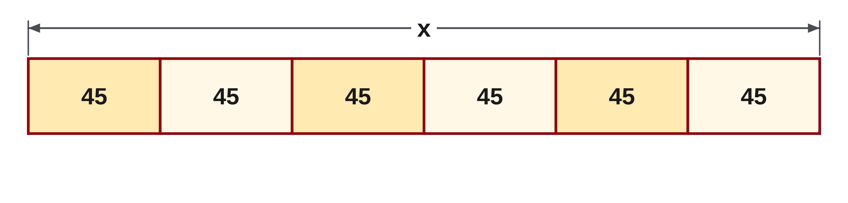
W05-L04 • PRACTISE • 2:55 PM–3:15 PM • 20 MIN TOTAL
Practise from the Exercise Book | 8A Q12
Write the operation, working and units before checking.
Textbook sections 8.3–8.5 pp.126–130; sections 8.7 p.134
Textbook
Exercise Book
Numeracy Hub
Shape Canvas
Day 15 • 2026-11-25 • 39
Notes:
Timing: PRACTISE | 2:55 PM–3:15 PM | 20 MIN TOTAL. Shared phase allocation across these slides.
For 8A Q12, solve x ÷ 6 = 45. Identify the inverse of division by six and apply it to both sides. Check by substituting your result into the original division statement.
Instructor-only, after the attempt: Multiply both sides by six: x = 45 × 6 = 270. The check is 270 ÷ 6 = 45. Dividing forty-five by six again would make the value smaller and would not undo the original operation.

Slide 40
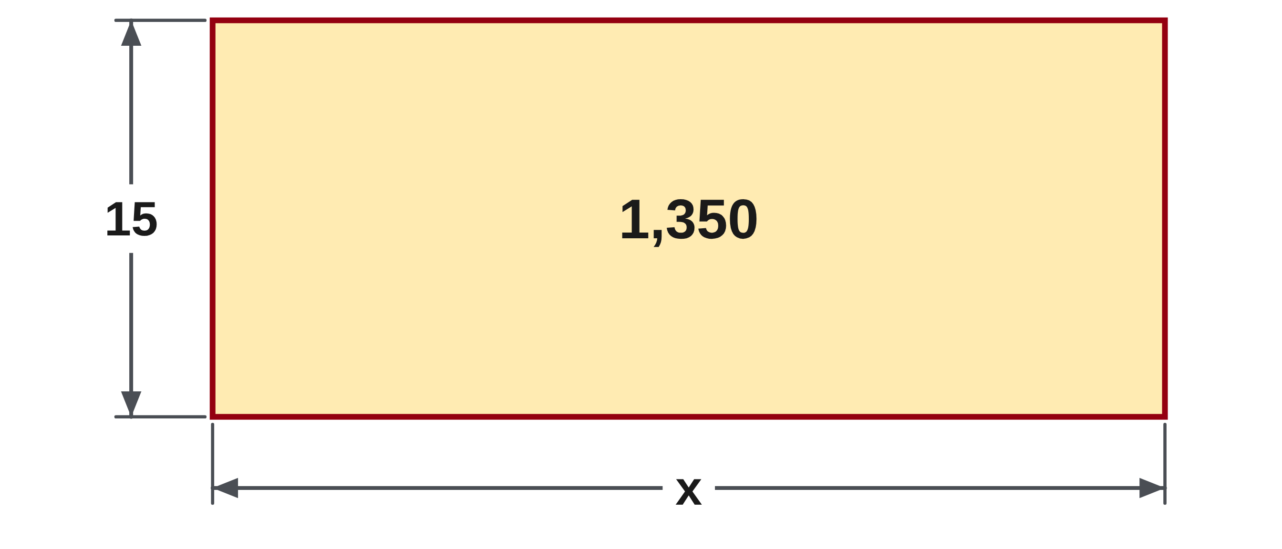
W05-L04 • PRACTISE • 2:55 PM–3:15 PM • 20 MIN TOTAL
Practise from the Exercise Book | 8A Q13
Write the operation, working and units before checking.
Textbook sections 8.3–8.5 pp.126–130; sections 8.7 p.134
Textbook
Exercise Book
Numeracy Hub
Shape Canvas
Day 15 • 2026-11-25 • 40
Notes:
Timing: PRACTISE | 2:55 PM–3:15 PM | 20 MIN TOTAL. Shared phase allocation across these slides.
For 8A Q13, solve 15 × x = 1350. Ask how many equal groups of fifteen make 1350, then use the inverse operation on both sides. Show the multiplication check after solving.
Instructor-only, after the attempt: x = 1350 ÷ 15 = 90. Check: 15 × 90 = 1350. Since 15 × 100 = 1500, an answer somewhat below one hundred is a reasonable size estimate.

Slide 41
W05-L04 • CHECK • 3:15 PM–3:25 PM • 10 MIN TOTAL
Check independently
Exercise Book 8B Q4 and Q15; show the substitution check, not just the answer.
Solve without displayed answers; include working, units and final rounding.
Resources: Exercise Book 8A Q9–22 (pp.51–52), selected; 8B Q1,4 (p.53), Q15 (p.54)
Textbook sections 8.3–8.5 pp.126–130; sections 8.7 p.134
Textbook
Exercise Book
Numeracy Hub
Shape Canvas
Day 15 • 2026-11-25 • 41
Notes:
Timing: CHECK | 3:15 PM–3:25 PM | 10 MIN TOTAL. Shared phase allocation across these slides.
Complete 8B Q4 and Q15 independently. Show the missing length and a substitution check for Q4. For Q15, calculate the mistaken answer, demonstrate why it fails the original equation, then give and check the correction. What evidence proves a rearrangement error? The proposed dimension cannot recreate the stated perimeter when substituted back. Keep the original equation visible; an answer without that check does not yet show the reasoning requested here.

Slide 42
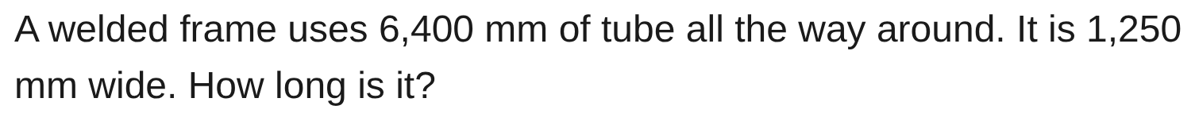
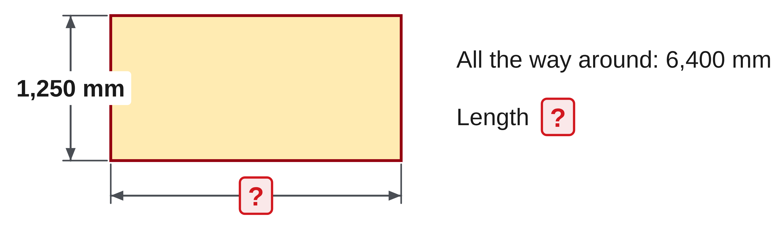
W05-L04 • CHECK • 3:15 PM–3:25 PM • 10 MIN TOTAL
Independent check | 8B Q4
Answer independently. Keep worked solutions closed.
Textbook sections 8.3–8.5 pp.126–130; sections 8.7 p.134
Textbook
Exercise Book
Numeracy Hub
Shape Canvas
Day 15 • 2026-11-25 • 42
Notes:
Timing: CHECK | 3:15 PM–3:25 PM | 10 MIN TOTAL. Shared phase allocation across these slides.
For 8B Q4, the rectangular frame uses 6400 millimetres of tube around its boundary and is 1250 millimetres wide. Find its length and show the check in the original perimeter formula.
Instructor-only, after the attempt: l = 6400/2 − 1250 = 3200 − 1250 = 1950 mm. Check: 2 × (1950 + 1250) = 6400 mm. Subtracting the two widths without halving the remaining amount would give two lengths, not one.

Slide 43
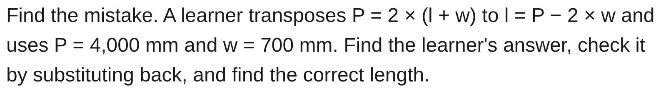
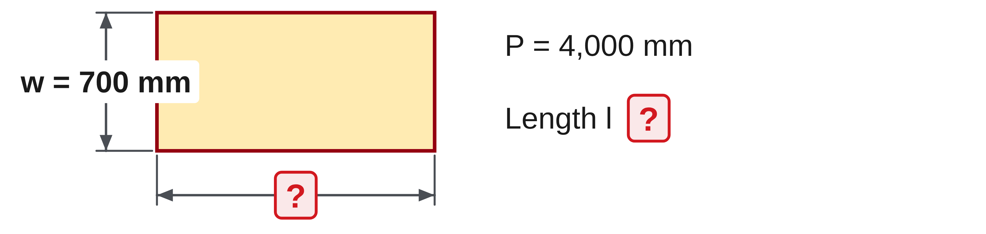
W05-L04 • CHECK • 3:15 PM–3:25 PM • 10 MIN TOTAL
Independent check | 8B Q15
Answer independently. Keep worked solutions closed.
Textbook sections 8.3–8.5 pp.126–130; sections 8.7 p.134
Textbook
Exercise Book
Numeracy Hub
Shape Canvas
Day 15 • 2026-11-25 • 43
Notes:
Timing: CHECK | 3:15 PM–3:25 PM | 10 MIN TOTAL. Shared phase allocation across these slides.
In 8B Q15, evaluate the learner’s l = P − 2w using P = 4000 millimetres and w = 700 millimetres. Test it in the original equation, then correct the method. Show all three stages before comparing.
Instructor-only, after the attempt: The learner gets 2600 mm. Substituting gives 2 × (2600 + 700) = 6600 mm, which fails. Correctly, l = 4000/2 − 700 = 1300 mm; 2 × (1300 + 700) = 4000 mm. The mistaken value counts both lengths together.

Slide 44
W05-L04 • WRAP UP • 3:25 PM–3:30 PM • 5 MIN TOTAL
Wrap up and choose the next step
Ask: What changed in your understanding? Where will you use it? What should you check next time?
Name the math and one other essential skill used; record a next practice step.
Resources: Exercise Book 8A Q9–22 (pp.51–52), selected; 8B Q1,4 (p.53), Q15 (p.54)
Textbook sections 8.3–8.5 pp.126–130; sections 8.7 p.134
Textbook
Exercise Book
Numeracy Hub
Shape Canvas
Day 15 • 2026-11-25 • 44
Notes:
Timing: WRAP UP | 3:25 PM–3:30 PM | 5 MIN TOTAL. Shared phase allocation across these slides.
Explain why a substitution check is valuable even when your algebra looks tidy. It asks whether the found dimension actually recreates the information in the original problem. Which inverse operation did you use today, and what did it undo? Use one exercise to answer precisely. Keep one corrected equation in your notebook with its successful check. Before moving into squares and square roots, make sure the one- and two-step balance routines are clear: preserve equality, isolate the unknown, then verify the original relationship.

