Slide 1

CARPENTRY FOUNDATION / INTAKE 142
Day 21 | Thursday
21
December 3, 2026
Checking square, diagonals and layout
12:45 PM–2:00 PM • Math • 75 min
SOH CAH TOA and missing sides
2:15 PM–3:30 PM • Math • 75 min
Week 6 • 2 scheduled blocks • 150 teaching minutes
Estimate. Show the method. Label units. Check the result.
Textbook
Exercise Book
Numeracy Hub
Shape Canvas
Day 21 • 2026-12-03 • 01
Notes:
Opening — within the first scheduled Start period; no additional teaching time.
Today we will use triangles for two practical decisions: whether a frame is square, and how to find a side we cannot measure directly. Before the break we compare measured diagonals with calculated targets. After the break we connect an angle and a known side using sine, cosine or tangent. Keep your drawings and units visible: the calculator will help with arithmetic, but the drawing tells us which calculation belongs to the job.

Slide 2
DAY 21 / WEEK 6 / CLASS TIMETABLE
Today’s exact schedule
12:45 PM–2:00 PM • 75 min
2:15 PM–3:30 PM • 75 min
Checking square, diagonals and layout
SOH CAH TOA and missing sides
12:45 PM–12:50 PM
Start
5
2:15 PM–2:20 PM
Start
5
12:50 PM–12:55 PM
Recall
5
2:20 PM–2:25 PM
Recall
5
12:55 PM–1:10 PM
Teach
15
2:25 PM–2:40 PM
Teach
15
1:10 PM–1:25 PM
Together
15
2:40 PM–2:55 PM
Together
15
1:25 PM–1:45 PM
Practise
20
2:55 PM–3:15 PM
Practise
20
1:45 PM–1:55 PM
Check
10
3:15 PM–3:25 PM
Check
10
1:55 PM–2:00 PM
Wrap up
5
3:25 PM–3:30 PM
Wrap up
5
Math • Math Week 6, Lesson 7
Math • Math Week 6, Lesson 8
Break: 2:00 PM–2:15 PM • 15 minutes • excluded from teaching time
Textbook
Exercise Book
Numeracy Hub
Shape Canvas
Day 21 • 2026-12-03 • 02
Notes:
Opening — within the first scheduled Start period; no additional teaching time.
Our first block runs from 12:45 to 2:00. We have five minutes to reconnect with square checks, fifteen minutes for explanations, fifteen together, twenty for practice and ten for an independent check before wrapping up. We return at 2:15 for missing-side trigonometry and finish at 3:30. Notice that several slides belong to one timed phase. The displayed time is the total for that activity, so we keep our explanations focused and protect your practice time.

Slide 3
W06-L07 • START • 12:45 PM–12:50 PM • 5 MIN TOTAL
Checking square, diagonals and layout
Today’s goal: Apply a scaled 3–4–5 triangle and compare diagonals to diagnose an out-of-square frame.
Describe a prior use of the skill; identify the given and unknown quantities.
Textbook sections 12.5–12.6 pp.194–196
Exercise Book 12A Q17–18 (p.76); 12B Q4–5,7 (pp.77–78)
Keep your notebook, textbook, exercise book and chosen calculator ready.
Textbook sections 12.5–12.6 pp.194–196
Textbook
Exercise Book
Numeracy Hub
Shape Canvas
Day 21 • 2026-12-03 • 03
Notes:
START • 12:45 PM–12:50 PM • 5 MIN TOTAL — shared across this phase’s slides.
Imagine that we have assembled a rectangular frame. Its side lengths can be correct while its corners are still out of square. Today we need evidence about both the lengths and the angles. We will use the textbook, pages 194–196, and the drawing questions in 12A and 12B. What extra measurement crosses the frame and helps us check its shape? A diagonal. By the end, you should be able to state the target diagonal and explain which way the frame needs to move.

Slide 4
W06-L07 • RECALL • 12:50 PM–12:55 PM • 5 MIN TOTAL
Recall and reconnect
Discuss which three lengths make a scaled 3–4–5 triangle and why both diagonals matter.
Attempt the retrieval task independently; explain the method before checking.
Resources: Exercise Book 12A Q17–18 (p.76); 12B Q4–5,7 (pp.77–78)
Textbook sections 12.5–12.6 pp.194–196
Textbook
Exercise Book
Numeracy Hub
Shape Canvas
Day 21 • 2026-12-03 • 04
Notes:
RECALL • 12:50 PM–12:55 PM • 5 MIN TOTAL — shared across this phase’s slides.
Think back to a 3–4–5 triangle. If the first two sides become 6 and 8, what must the third side become? Ten, because every side doubles. Now imagine taking only one diagonal of a frame. Does that tell us what the other diagonal measures? No. We compare both diagonals with each other and with the target calculated from the side lengths. Explain that distinction to a neighbour: a measurement is evidence only when we know what we are comparing it with.

Slide 5
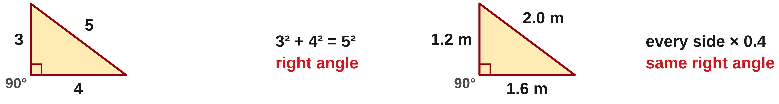
W06-L07 • TEACH • 12:55 PM–1:10 PM • 15 MIN TOTAL
Use a scaled 3–4–5 triangle
1
3² + 4² = 5², so a 3–4–5 triangle has a right angle.
2
Multiply all three sides by the same factor to scale the check.
3
Measure the diagonal between the two marked side lengths.
4
Compare with the expected diagonal before deciding how to adjust the corner.
Textbook sections 12.5–12.6 pp.194–196
Textbook
Exercise Book
Numeracy Hub
Shape Canvas
Day 21 • 2026-12-03 • 05
Notes:
TEACH • 12:55 PM–1:10 PM • 15 MIN TOTAL — shared across this phase’s slides.
The reason the 3–4–5 check works is the right-triangle relationship. Three squared is nine; four squared is sixteen; together they make twenty-five, which is five squared. Scaling preserves that relationship only when all three sides use the same factor. For our smaller check, multiply each side by 0.4: the lengths become 1.2, 1.6 and 2 metres. Mark the two leg lengths first and measure between the marks. What length tells us that the included corner is square? Two metres. The target comes from the triangle, not from guessing what looks straight.

Slide 6
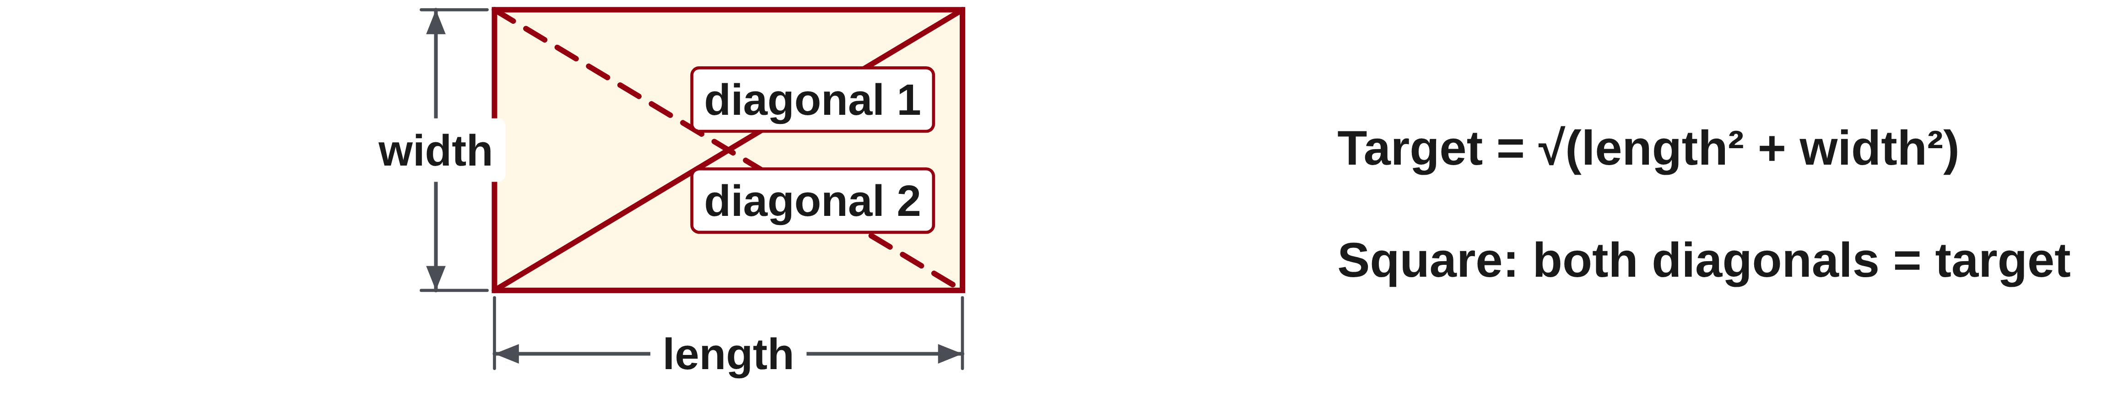
W06-L07 • TEACH • 12:55 PM–1:10 PM • 15 MIN TOTAL
Check the complete frame
1
Calculate the expected diagonal from the stated side lengths.
2
Compare both measured diagonals with the target and with each other.
3
Use the book diagram to identify an open or closed corner.
4
Recheck dimensions and diagonals after the indicated correction.
Textbook sections 12.5–12.6 pp.194–196
Textbook
Exercise Book
Numeracy Hub
Shape Canvas
Day 21 • 2026-12-03 • 06
Notes:
TEACH • 12:55 PM–1:10 PM • 15 MIN TOTAL — shared across this phase’s slides.
A complete frame needs a complete check. We first confirm the intended side lengths, then calculate the diagonal that those sides would produce at a right angle. We measure both actual diagonals between corresponding corners. If one is longer and the other shorter than the target, the frame has skewed. Bringing the ends of the longer diagonal closer together changes its shape toward square. Why do we measure the sides again after moving the corners? Because an adjustment can disturb more than one measurement. We want the intended dimensions and the right shape together.

Slide 7
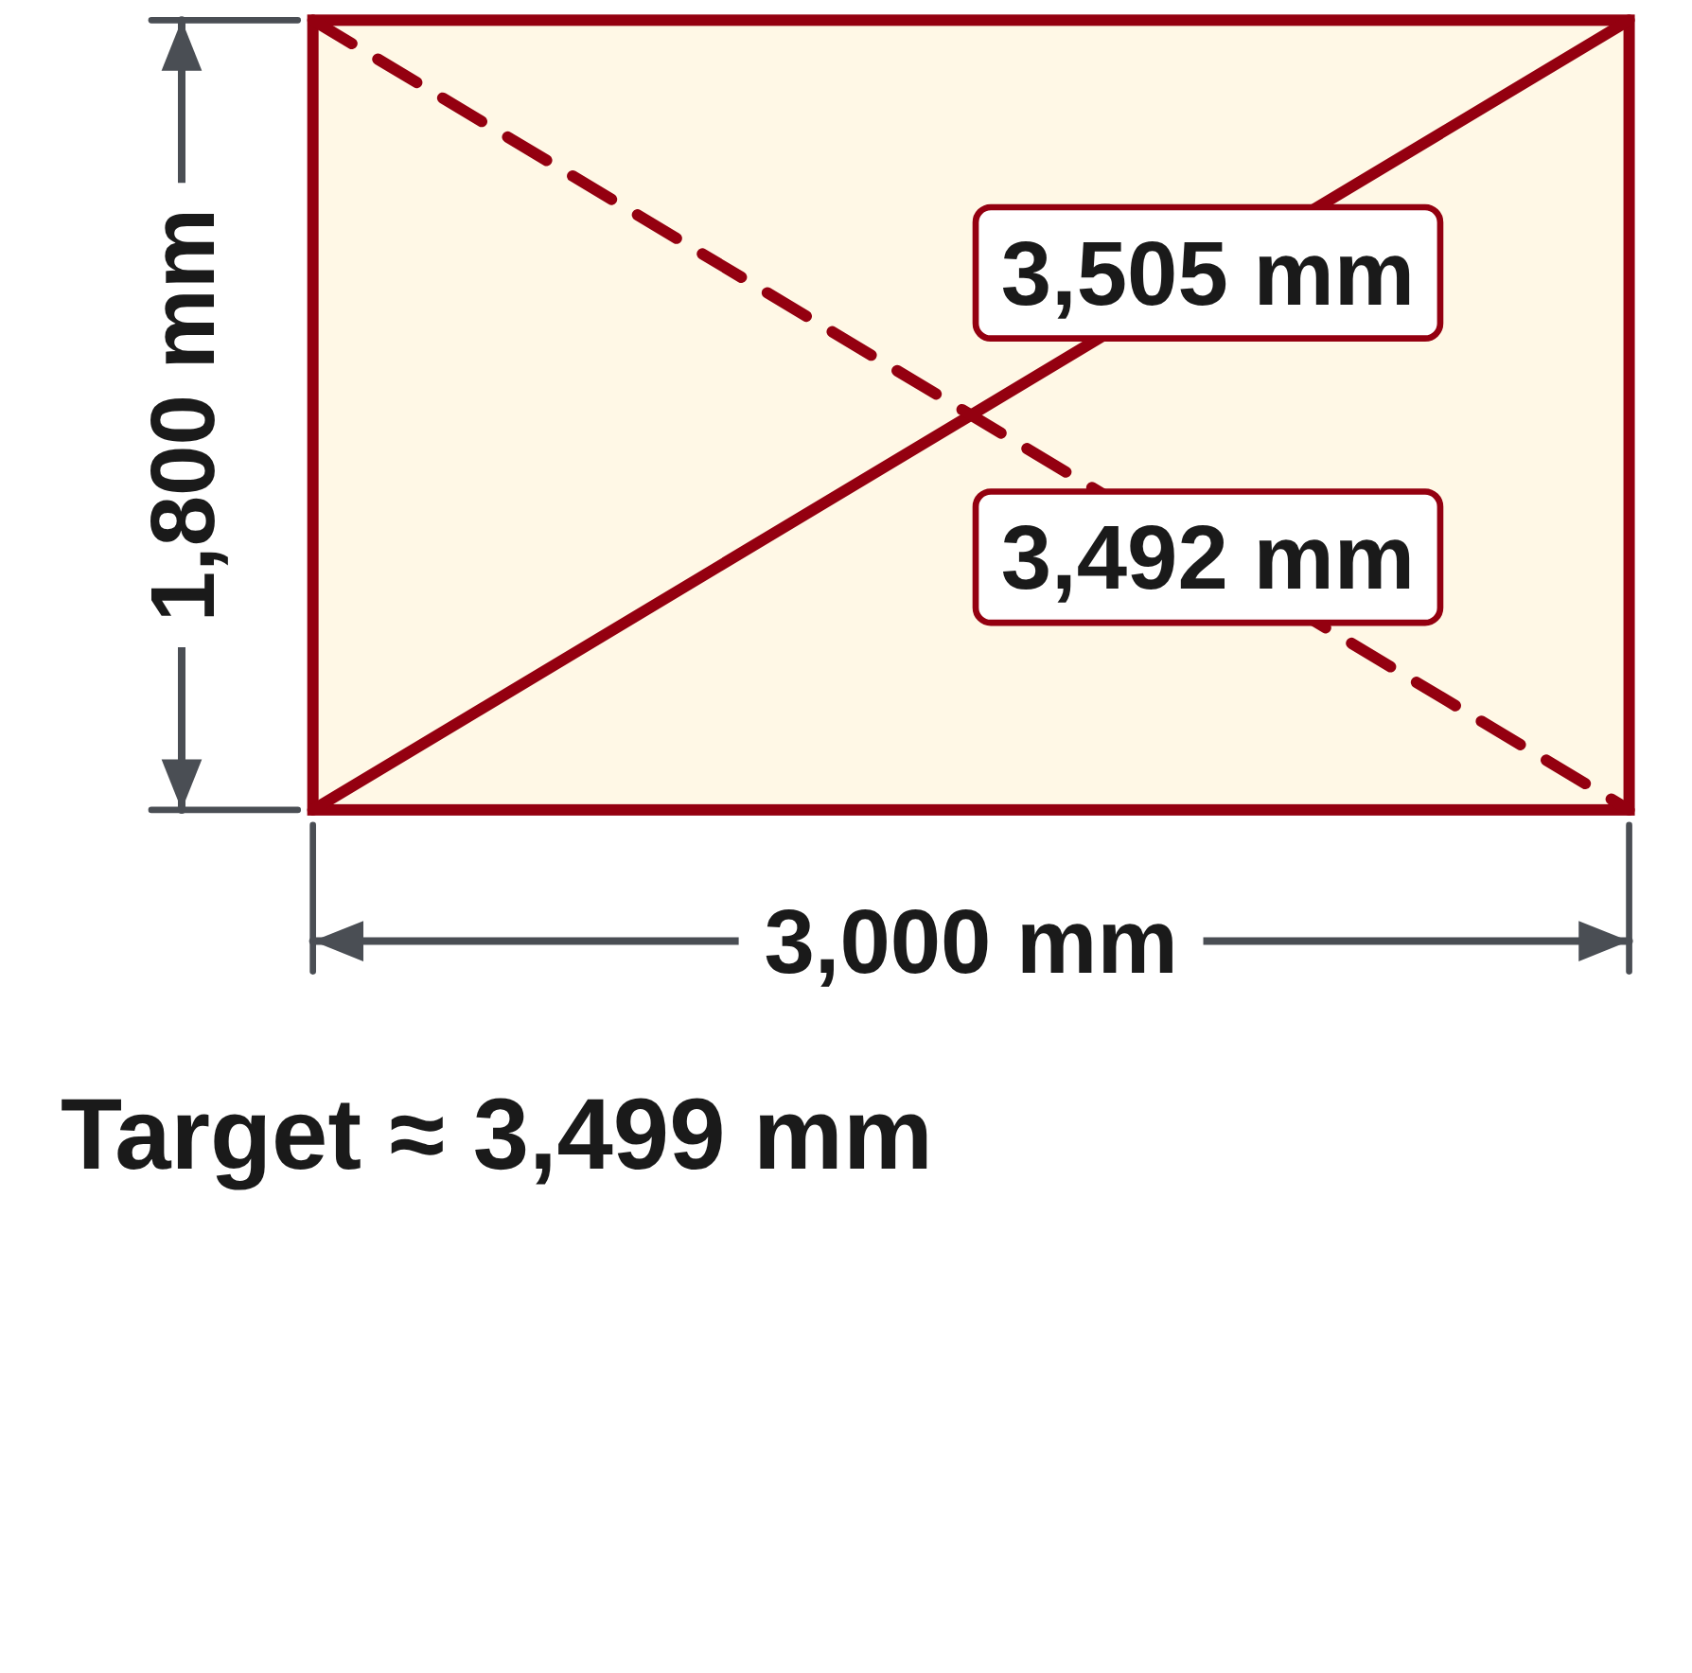
W06-L07 • TEACH • 12:55 PM–1:10 PM • 15 MIN TOTAL
Use a target triangle and target diagonal
Scaled 3–4–5 • 1.2 m, 1.6 m and 2.0 m.
1.2² + 1.6² = 4 = 2². With the two legs held at their target lengths,
a 1.998 m diagonal is shorter than target: the corner is closed.
Rectangle example • 3,000 mm × 1,800 mm.
Target diagonal = √(3,000² + 1,800²) ≈ 3,499 mm.
For the book’s 3,505 / 3,492 mm readings, bring the ends of the longer
diagonal closer together, then recheck dimensions and both diagonals.
Together • Mark a paper or clear-floor triangle using the book dimensions.
Rotate measurer and checker roles. Use tape/chalk only—no cutting or power tools.
Exercise Book 12B Q4–5 pp.77–78 • Shape Canvas rectangle/diagonal and right triangle • Classroom layout activity
Textbook
Exercise Book
Numeracy Hub
Shape Canvas
Day 21 • 2026-12-03 • 07
Notes:
TEACH • 12:55 PM–1:10 PM • 15 MIN TOTAL — shared across this phase’s slides.
For the first example, square 1.2 and 1.6, giving 1.44 and 2.56. Their sum is 4, so the square root gives a 2-metre target. The actual 1.998 metres is 2 millimetres short. With those leg marks held in place, the corner is closed, meaning less than ninety degrees. For the rectangular frame, calculate the square root of 3,000 squared plus 1,800 squared. We get about 3,499 millimetres. Which diagonal needs to shorten? The 3,505-millimetre one. Bring its endpoints toward each other, then remeasure both diagonals and sides.

Slide 8
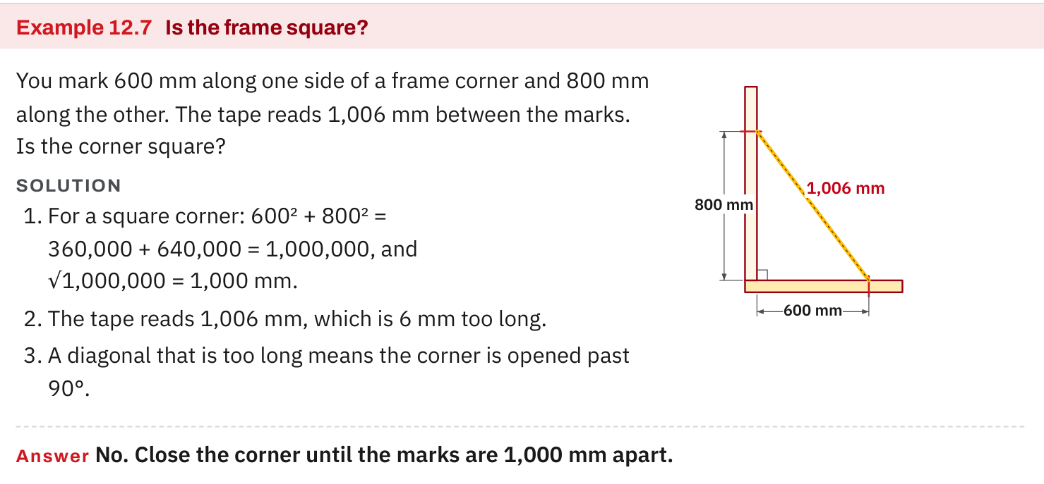
W06-L07 • TEACH • 12:55 PM–1:10 PM • 15 MIN TOTAL
Textbook | page 195
Textbook p.195 • Example 12.7 — Compare a measured diagonal with the square target
Textbook sections 12.5–12.6 pp.194–196
Textbook
Exercise Book
Numeracy Hub
Shape Canvas
Day 21 • 2026-12-03 • 08
Notes:
TEACH • 12:55 PM–1:10 PM • 15 MIN TOTAL — shared across this phase’s slides.
On page 195, follow the comparison in Example 12.7. Separate the intended triangle from the reading on the tape. The intended lengths establish the square target; the observed length tells us how the actual corner differs. A shorter cross measurement closes the included angle when the two leg lengths stay fixed. A longer cross measurement opens it. What must stay fixed for that comparison to make sense? The marked distances along the two sides. If a mark has moved, repeat the measurement before deciding that the corner itself is wrong.

Slide 9
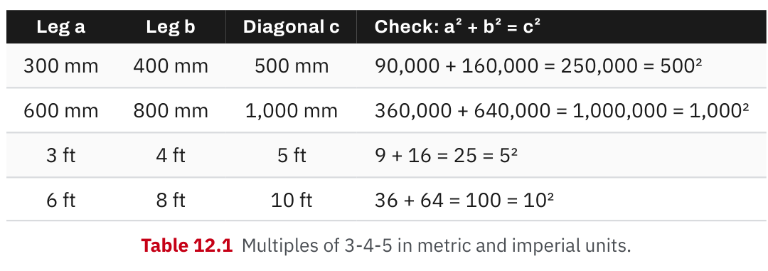
W06-L07 • TEACH • 12:55 PM–1:10 PM • 15 MIN TOTAL
Textbook | page 195
Textbook p.195 • Table 12.1 — Scaled 3–4–5 checks
Textbook sections 12.5–12.6 pp.194–196
Textbook
Exercise Book
Numeracy Hub
Shape Canvas
Day 21 • 2026-12-03 • 09
Notes:
TEACH • 12:55 PM–1:10 PM • 15 MIN TOTAL — shared across this phase’s slides.
This table gives several sizes of the same 3–4–5 relationship. Read across a row as one complete set; do not borrow a side from another row. The practical choice is a triangle that fits the space and lets you measure clearly. For our 1.2, 1.6 and 2-metre set, divide each value by its original 3, 4 or 5. All three give 0.4. What does that common number confirm? The three lengths share one scale factor. A tape reading that matches only two values does not complete the square check.

Slide 10
W06-L07 • TEACH • 12:55 PM–1:10 PM • 15 MIN TOTAL
Spot the mistake. Explain the correction.
A triangle uses 3, 4 and 10 units. Is it a scaled 3–4–5 check?
Discuss the method before checking the answer.
No. The same scale factor must apply to all three lengths, not just the diagonal.
Textbook sections 12.5–12.6 pp.194–196
Textbook
Exercise Book
Numeracy Hub
Shape Canvas
Day 21 • 2026-12-03 • 10
Notes:
TEACH • 12:55 PM–1:10 PM • 15 MIN TOTAL — shared across this phase’s slides.
The proposed lengths are 3, 4 and 10 units. Before calculating, look at the scale factors: 3 stayed 3, 4 stayed 4, but 5 doubled to 10. That cannot preserve the triangle's shape. There is an even quicker problem here: 3 plus 4 is only 7, so those two shorter lengths cannot reach across a length of 10 to make a triangle. What would the valid doubled set be? Six, eight and ten. The lesson is to scale the whole relationship, not just the measurement we want to change.

Slide 11
W06-L07 • TOGETHER • 1:10 PM–1:25 PM • 15 MIN TOTAL
Work together
In pairs, mark a paper or clear-floor triangle using the book dimensions. Rotate measurer/checker roles; no cutting or power tools.
Work in pairs, alternating solver and checker. Write a diagram, formula, units and estimate.
Resources: Exercise Book 12A Q17–18 (p.76); 12B Q4–5,7 (pp.77–78)
Textbook sections 12.5–12.6 pp.194–196
Textbook
Exercise Book
Numeracy Hub
Shape Canvas
Day 21 • 2026-12-03 • 11
Notes:
TOGETHER • 1:10 PM–1:25 PM • 15 MIN TOTAL — shared across this phase’s slides.
With your partner, mark the textbook triangle on paper or the clear floor using tape and chalk. One person identifies the two leg marks and predicts the cross measurement; the other measures and checks. Then swap roles. Keep the two marked leg lengths unchanged while comparing the diagonal with its target. Say whether the corner is open, closed or square, and point to the measurement supporting your decision. We are modelling a layout check here; there is no cutting or power-tool work in this activity.

Slide 12
W06-L07 • PRACTISE • 1:25 PM–1:45 PM • 20 MIN TOTAL
Your scheduled practice
Solve Exercise Book 12B Q5,7 and 12A Q17–18. Compare theoretical diagonals to given readings; annotate the adjustment on a sketch.
Solve on paper first; check with tools; correct one error and explain the change.
Resources: Exercise Book 12A Q17–18 (p.76); 12B Q4–5,7 (pp.77–78)
Textbook sections 12.5–12.6 pp.194–196
Textbook
Exercise Book
Numeracy Hub
Shape Canvas
Day 21 • 2026-12-03 • 12
Notes:
PRACTISE • 1:25 PM–1:45 PM • 20 MIN TOTAL — shared across this phase’s slides.
Work through 12B Q5 and Q7, then 12A Q17–18. Before pressing square root, identify which lengths are the legs and make their units consistent. In the frame question, your answer must include the direction of correction, not only a diagonal length. In the gate question, the final answer needs feet and inches to the nearest sixteenth. Use your drawing to check whether the diagonal is longer than either leg, then compare your calculated target with the supplied reading.

Slide 13

W06-L07 • PRACTISE • 1:25 PM–1:45 PM • 20 MIN TOTAL
Open Numeracy Hub
Navigation example. Use the values and units in the assigned task.
Textbook sections 12.5–12.6 pp.194–196
Textbook
Exercise Book
Numeracy Hub
Shape Canvas
Day 21 • 2026-12-03 • 13
Notes:
PRACTISE • 1:25 PM–1:45 PM • 20 MIN TOTAL — shared across this phase’s slides.
Open Measuring Tools in Numeracy Hub and find the square-check activity. Keep your written target beside the screen. The tool is useful because it lets us compare the meaning of the measurements, not just produce another decimal. Point to the side marks and then to the diagonal. Which measurement would change if the corner opened while the leg marks stayed fixed? The distance between those marks would increase. Use that observation to explain your paper answer before checking it.

Slide 14
W06-L07 • PRACTISE • 1:25 PM–1:45 PM • 20 MIN TOTAL
Practise in Numeracy Hub and Shape Canvas
1
Use a Shape Canvas right triangle for the scaled 3–4–5 check and a rectangle for diagonals.
2
Mark the book dimensions on paper or a clear classroom floor with tape and chalk.
3
Compare target and measured lengths, using Numeracy Hub Measuring Tools square checks to review.
Textbook sections 12.5–12.6 pp.194–196
Textbook
Exercise Book
Numeracy Hub
Shape Canvas
Day 21 • 2026-12-03 • 14
Notes:
PRACTISE • 1:25 PM–1:45 PM • 20 MIN TOTAL — shared across this phase’s slides.
In Shape Canvas, use a right triangle to show the scaled 3–4–5 relationship and a rectangle to compare diagonals. Match the dimensions to the assigned problem. On your paper or floor model, label the target and actual measurements separately so they cannot be confused. Then use Numeracy Hub's square check as a second representation. If the displays disagree, check the units and dimensions first. Which three values belong together in the smaller square check? 1.2 metres, 1.6 metres and 2 metres.

Slide 15
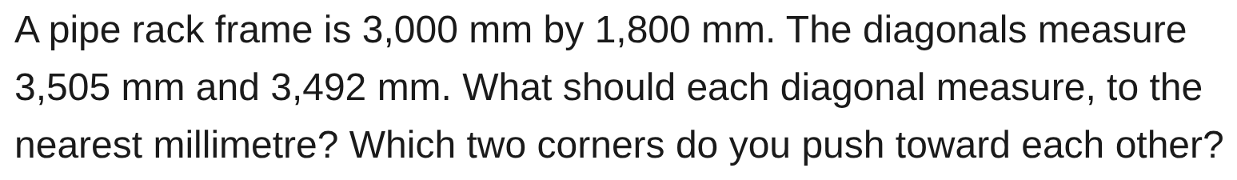
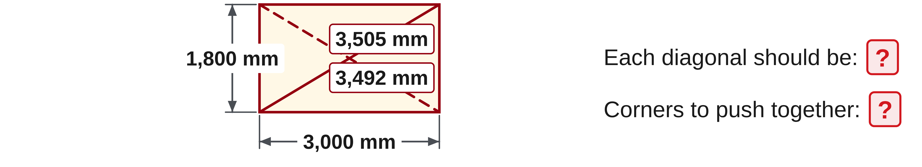
W06-L07 • PRACTISE • 1:25 PM–1:45 PM • 20 MIN TOTAL
Practise from the Exercise Book | 12B Q5
Write the operation, working and units before checking.
Textbook sections 12.5–12.6 pp.194–196
Textbook
Exercise Book
Numeracy Hub
Shape Canvas
Day 21 • 2026-12-03 • 15
Notes:
PRACTISE • 1:25 PM–1:45 PM • 20 MIN TOTAL — shared across this phase’s slides.
For 12B Q5, sketch the frame and draw both measured diagonals before choosing a correction. Calculate the target independently, then label the endpoints of the longer reading. After you attempt it, we can compare: 3,000 squared plus 1,800 squared is 12,240,000; its square root is about 3,498.57 millimetres. Rounding gives 3,499 millimetres. The corners at the ends of the 3,505-millimetre diagonal need to move toward each other. Rechecking both diagonals is part of the solution.
INSTRUCTOR ONLY — AFTER THE ATTEMPT: 3,499 mm each (3,498.57 mm). Push the two corners at the ends of the 3,505 mm diagonal. Working: √(3,000² + 1,800²) = √12,240,000

Slide 16
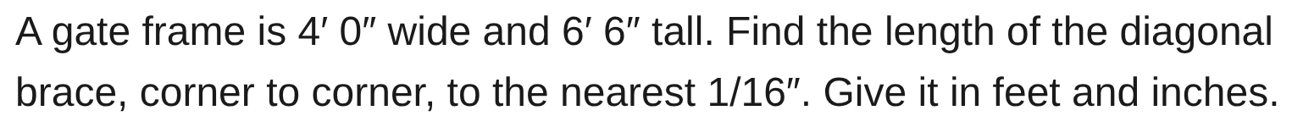
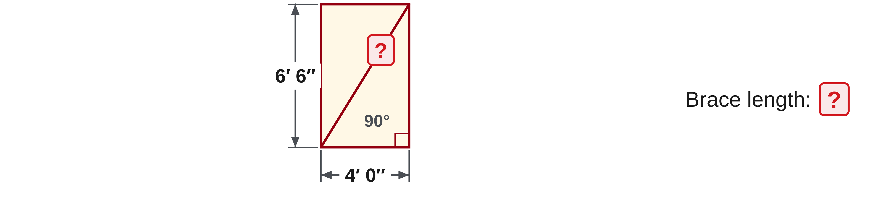
W06-L07 • PRACTISE • 1:25 PM–1:45 PM • 20 MIN TOTAL
Practise from the Exercise Book | 12B Q7
Write the operation, working and units before checking.
Textbook sections 12.5–12.6 pp.194–196
Textbook
Exercise Book
Numeracy Hub
Shape Canvas
Day 21 • 2026-12-03 • 16
Notes:
PRACTISE • 1:25 PM–1:45 PM • 20 MIN TOTAL — shared across this phase’s slides.
For 12B Q7, do not combine feet and inches inside the squared expression. Convert the width to 48 inches and the height to 78 inches first. After your attempt, compare the diagonal calculation: the square root of 48 squared plus 78 squared is about 91.586 inches. To round to a sixteenth, compare the decimal part with sixteenths; the nearest is nine sixteenths. What remains after removing seven feet, or 84 inches? Seven and nine sixteenths inches.
INSTRUCTOR ONLY — AFTER THE ATTEMPT: 91 9/16″, which is 7′ 7 9/16″ Working: 48″ and 78″: √(2,304 + 6,084) = √8,388 = 91.586″

Slide 17
W06-L07 • CHECK • 1:45 PM–1:55 PM • 10 MIN TOTAL
Check independently
Exercise Book 12B Q4 and Q5; state target lengths and the direction of correction.
Solve without displayed answers; include working, units and final rounding.
Resources: Exercise Book 12A Q17–18 (p.76); 12B Q4–5,7 (pp.77–78)
Textbook sections 12.5–12.6 pp.194–196
Textbook
Exercise Book
Numeracy Hub
Shape Canvas
Day 21 • 2026-12-03 • 17
Notes:
CHECK • 1:45 PM–1:55 PM • 10 MIN TOTAL — shared across this phase’s slides.
Now complete 12B Q4 and Q5 independently. Give the target measurement and explain the adjustment, using a labelled sketch if it helps. Keep worked answers closed. I am looking for the distinction between a measured diagonal and its theoretical target, and between describing an error and correcting it. When you have finished, check the units and the requested rounding before submitting. We will discuss the answers only after you have made your own attempt.

Slide 18
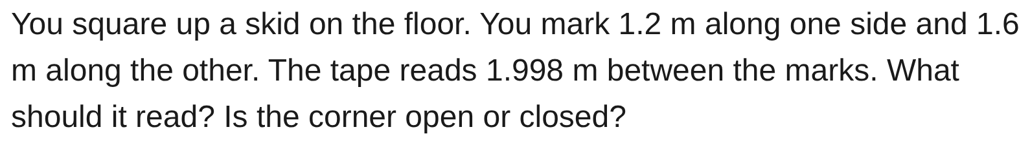
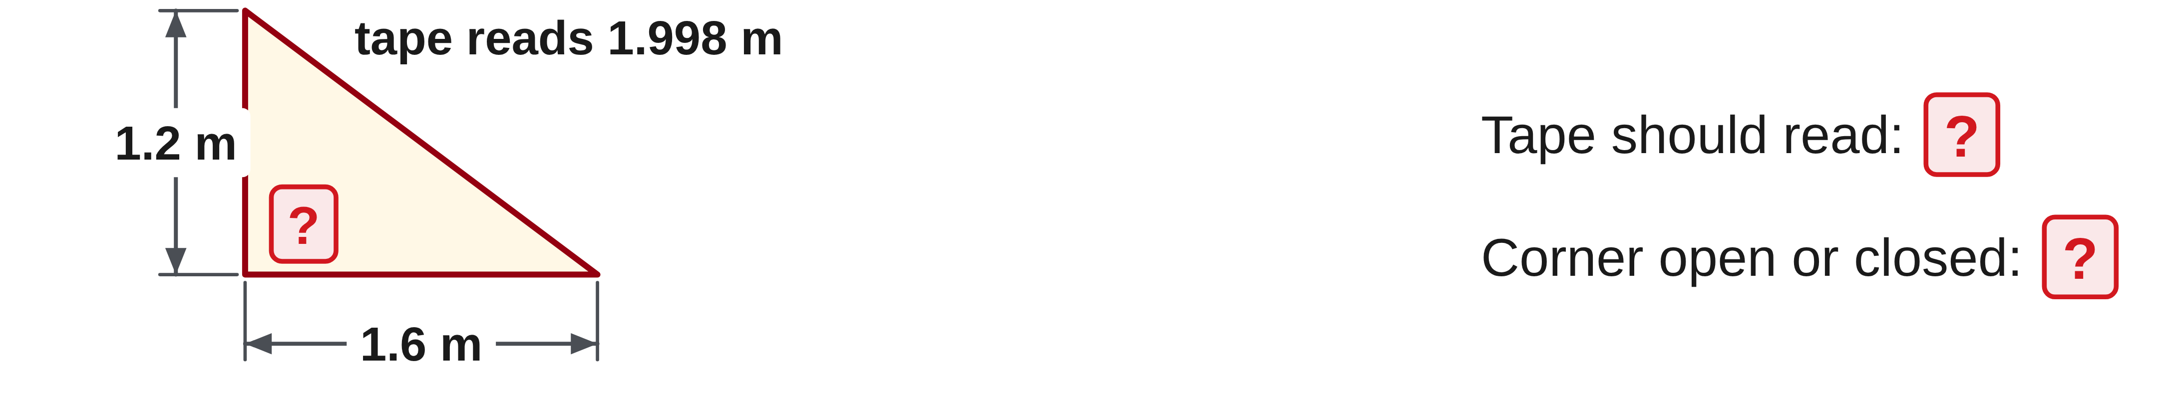
W06-L07 • CHECK • 1:45 PM–1:55 PM • 10 MIN TOTAL
Independent check | 12B Q4
Answer independently. Keep worked solutions closed.
Textbook sections 12.5–12.6 pp.194–196
Textbook
Exercise Book
Numeracy Hub
Shape Canvas
Day 21 • 2026-12-03 • 18
Notes:
CHECK • 1:45 PM–1:55 PM • 10 MIN TOTAL — shared across this phase’s slides.
Read 12B Q4 and show how you establish the target between the two marks. Then state whether the observed reading describes an open or closed corner. Include the unit with your target. Keep your reasoning on the page rather than calling it out so everyone can complete the check independently.
INSTRUCTOR ONLY — AFTER THE ATTEMPT: 1.2² + 1.6² = 4; √4 = 2 m. The actual 1.998 m is 0.002 m short, so the fixed-leg corner is closed, below 90°.

Slide 19
W06-L07 • CHECK • 1:45 PM–1:55 PM • 10 MIN TOTAL
Independent check | 12B Q5
Answer independently. Keep worked solutions closed.
Textbook sections 12.5–12.6 pp.194–196
Textbook
Exercise Book
Numeracy Hub
Shape Canvas
Day 21 • 2026-12-03 • 19
Notes:
CHECK • 1:45 PM–1:55 PM • 10 MIN TOTAL — shared across this phase’s slides.
For 12B Q5, record the target for each diagonal to the nearest millimetre. On your sketch, identify the two corners you would bring together. An arrow on the correct diagonal makes your explanation clear. Complete the calculation independently; keep the intermediate value until the last rounding step.
INSTRUCTOR ONLY — AFTER THE ATTEMPT: √(3,000² + 1,800²) = √12,240,000 ≈ 3,498.57 mm, or 3,499 mm. Push together the corners at the ends of the 3,505 mm diagonal, then recheck.

Slide 20
W06-L07 • WRAP UP • 1:55 PM–2:00 PM • 5 MIN TOTAL
Wrap up and choose the next step
Ask: What changed in your understanding? Where will you use it? What should you check next time?
Name the math and one other essential skill used; record a next practice step.
Resources: Exercise Book 12A Q17–18 (p.76); 12B Q4–5,7 (pp.77–78)
Textbook sections 12.5–12.6 pp.194–196
Textbook
Exercise Book
Numeracy Hub
Shape Canvas
Day 21 • 2026-12-03 • 20
Notes:
WRAP UP • 1:55 PM–2:00 PM • 5 MIN TOTAL — shared across this phase’s slides.
Finish this sentence in your notebook: “Before I adjust a frame, I compare…” A complete answer names the side lengths, both diagonals and the calculated target. What did the square root tell us today? It returned a length from the sum of two squared lengths. After the break, we will use a known angle and side to find another side. Keep the right angle and the longest-side idea ready; those are the starting points for trigonometry.

Slide 21
DAY 21 • SCHEDULED BREAK
Break
2:00 PM–2:15 PM
Return ready for: SOH CAH TOA and missing sides
This break is excluded from teaching minutes.
Textbook
Exercise Book
Numeracy Hub
Shape Canvas
Day 21 • 2026-12-03 • 21
Notes:
Scheduled break — resume at the time shown.
Take the scheduled break now. We restart at 2:15 with SOH CAH TOA and missing sides. Leave your square-check work where you can find it, and bring your calculator back ready to check its angle setting. Our next diagrams are still right triangles, but we will use an angle and one known side instead of two known sides.

Slide 22
W06-L08 • START • 2:15 PM–2:20 PM • 5 MIN TOTAL
SOH CAH TOA and missing sides
Today’s goal: Name sides relative to a marked angle and select sine, cosine or tangent to find a missing side.
Describe a prior use of the skill; identify the given and unknown quantities.
Textbook sections 13.1–13.3 pp.202–206; sections 2.10 pp.37–38
Exercise Book 13A Q1–8 (pp.81–82); 13C Q1–2 (p.85)
Keep your notebook, textbook, exercise book and chosen calculator ready.
Textbook sections 13.1–13.3 pp.202–206; sections 2.10 pp.37–38
Textbook
Exercise Book
Numeracy Hub
Shape Canvas
Day 21 • 2026-12-03 • 22
Notes:
START • 2:15 PM–2:20 PM • 5 MIN TOTAL — shared across this phase’s slides.
A brace may give us an angle and a length while the height is unknown. Pythagoras alone needs two side lengths, so we need another relationship. Sine, cosine and tangent connect an angle with a pair of sides in a right triangle. Today the important first move is naming those sides from the marked angle. We will use pages 202–206 and 13A Q1–8, then the assigned 13C applications when ready. Check that your calculator is in degrees.

Slide 23
W06-L08 • RECALL • 2:20 PM–2:25 PM • 5 MIN TOTAL
Recall and reconnect
Check hypotenuse identification; compare opposite and adjacent when the marked angle changes.
Attempt the retrieval task independently; explain the method before checking.
Resources: Exercise Book 13A Q1–8 (pp.81–82); 13C Q1–2 (p.85)
Textbook sections 13.1–13.3 pp.202–206; sections 2.10 pp.37–38
Textbook
Exercise Book
Numeracy Hub
Shape Canvas
Day 21 • 2026-12-03 • 23
Notes:
RECALL • 2:20 PM–2:25 PM • 5 MIN TOTAL — shared across this phase’s slides.
Point to the right angle in the triangle. The side across from it is the hypotenuse, regardless of how the drawing is rotated. Now point to the marked acute angle. The side across from that angle is opposite; the remaining leg touching it is adjacent. If we move our attention to the other acute angle, what changes? Opposite and adjacent swap. What stays the same? The hypotenuse. Side names come from relationships in the triangle, not from the top or bottom of the page.

Slide 24
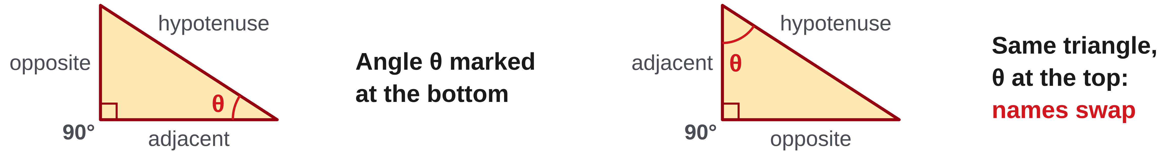
W06-L08 • TEACH • 2:25 PM–2:40 PM • 15 MIN TOTAL
Name sides from the chosen angle
1
The hypotenuse is always opposite the right angle.
2
The opposite side faces the marked angle.
3
The adjacent side touches the marked angle and is not the hypotenuse.
4
Changing the marked angle swaps opposite and adjacent.
Textbook sections 13.1–13.3 pp.202–206; sections 2.10 pp.37–38
Textbook
Exercise Book
Numeracy Hub
Shape Canvas
Day 21 • 2026-12-03 • 24
Notes:
TEACH • 2:25 PM–2:40 PM • 15 MIN TOTAL — shared across this phase’s slides.
Start every trig drawing with the right-angle marker. Across from it is the hypotenuse, the longest side. Next circle the angle used by the problem. The leg facing that angle is opposite. The other leg touches the angle and is adjacent. There are two sides touching the angle, but we have already named one as the hypotenuse, so adjacent means the remaining leg. What happens if the page turns sideways? None of the labels change. What happens if the reference angle changes to the other acute angle? The two leg labels swap.

Slide 25
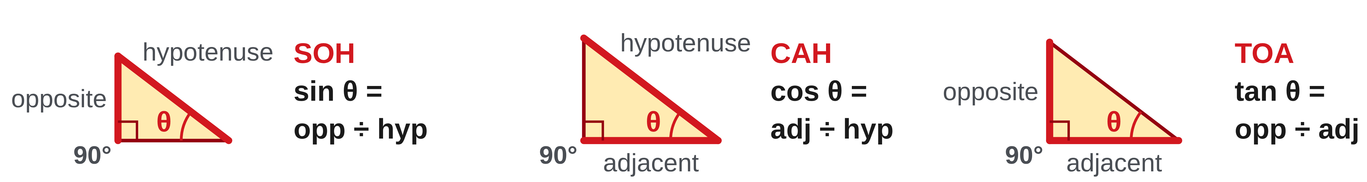
W06-L08 • TEACH • 2:25 PM–2:40 PM • 15 MIN TOTAL
Choose the ratio for the two sides
1
SOH: sin θ = opposite/hypotenuse.
2
CAH: cos θ = adjacent/hypotenuse.
3
TOA: tan θ = opposite/adjacent.
4
Choose the known and wanted sides, rearrange, and use calculator DEG mode.
Textbook sections 13.1–13.3 pp.202–206; sections 2.10 pp.37–38
Textbook
Exercise Book
Numeracy Hub
Shape Canvas
Day 21 • 2026-12-03 • 25
Notes:
TEACH • 2:25 PM–2:40 PM • 15 MIN TOTAL — shared across this phase’s slides.
SOH means sine equals opposite divided by hypotenuse. CAH means cosine equals adjacent divided by hypotenuse. TOA means tangent equals opposite divided by adjacent. We choose between them by asking which pair contains our known side and wanted side. If we know the hypotenuse and want the opposite side, which ratio contains both? Sine. Write that equation before rearranging it. Multiplying both sides by the hypotenuse isolates the opposite length. Check DEG mode before calculating: the degree sign in the drawing must agree with the calculator's interpretation of the angle.

Slide 26
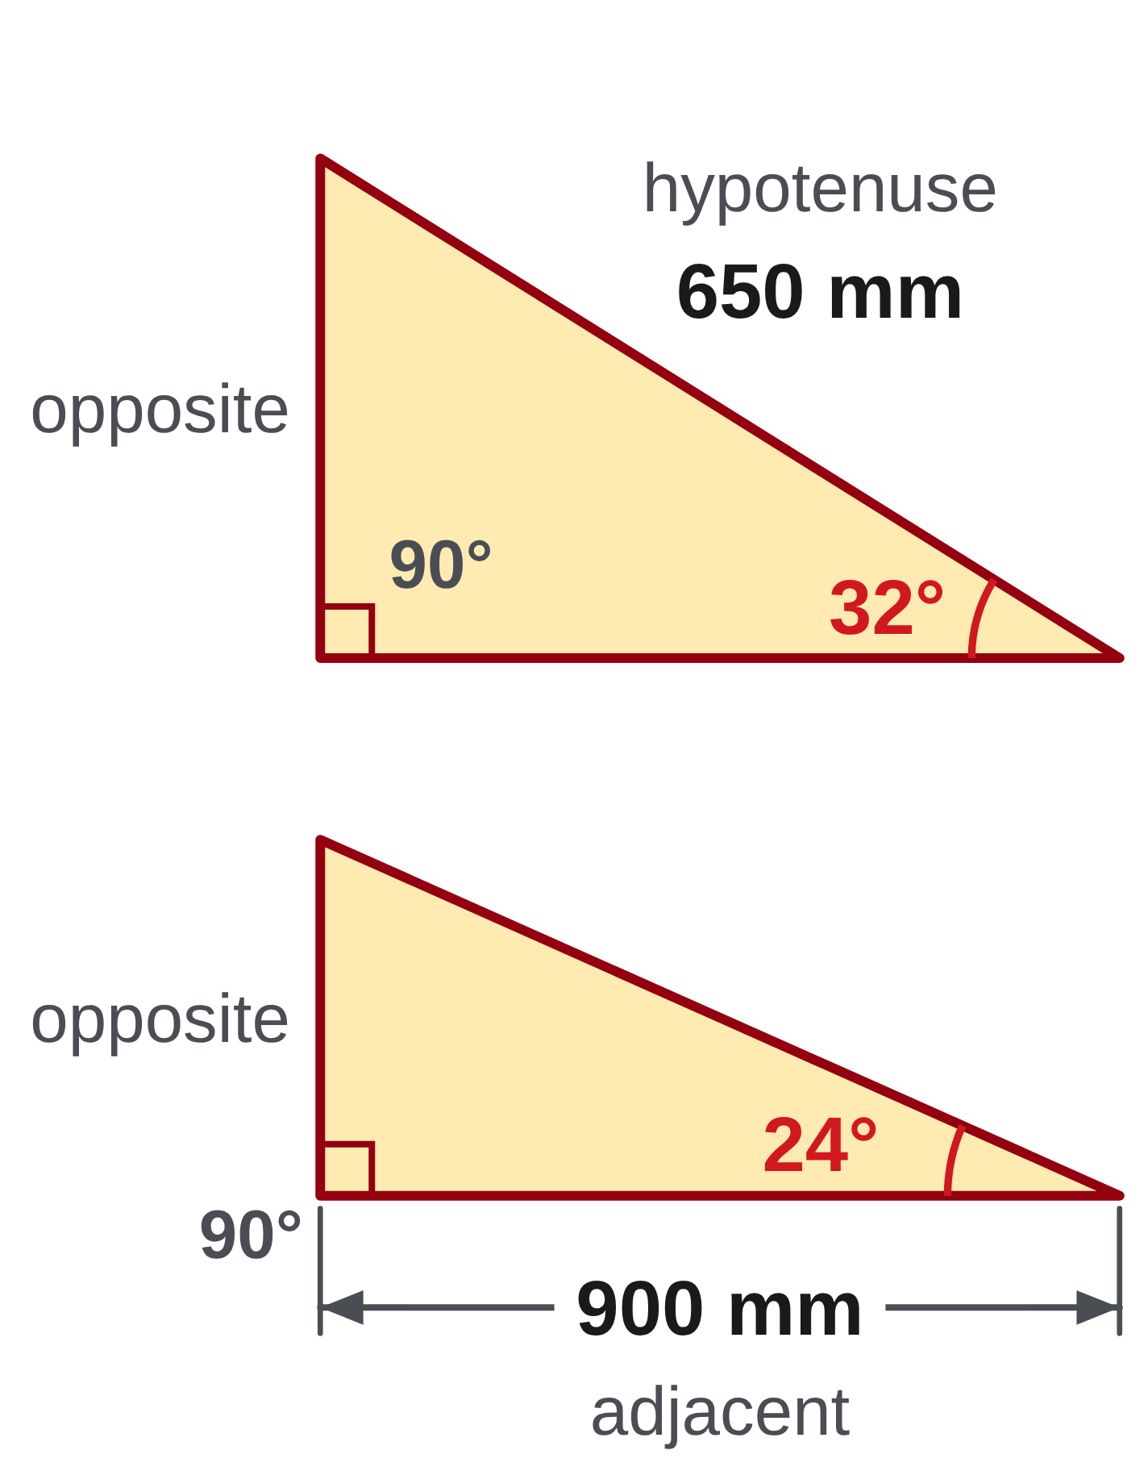
W06-L08 • TEACH • 2:25 PM–2:40 PM • 15 MIN TOTAL
Label two sides before choosing the ratio
Known hypotenuse 650 mm; angle 32°; find the opposite side.
sin 32° = opposite ÷ 650 → opposite = 650 × sin 32° ≈ 344.45 mm.
Known adjacent side 900 mm; angle 24°; find the opposite side.
tan 24° = opposite ÷ 900 → opposite = 900 × tan 24° ≈ 400.71 mm.
Calculator check • Use DEG, not RAD. Follow the selected model’s
trig key order. Sketch the angle and side labels before entering keys.
Together • Work 13A Q1–5. Say the two relevant side names aloud.
Choose the ratio, rearrange it, then calculate. Check the result against the sketch.
Exercise Book 13A pp.81–82 • Numeracy Hub → Angles and Trig → Module 3 • Shape Canvas right triangle
Textbook
Exercise Book
Numeracy Hub
Shape Canvas
Day 21 • 2026-12-03 • 26
Notes:
TEACH • 2:25 PM–2:40 PM • 15 MIN TOTAL — shared across this phase’s slides.
In the first example we know the hypotenuse, 650 millimetres, and want the opposite side. Sine connects them: sin 32° equals opposite divided by 650. Multiply by 650, giving 650 times sin 32°, about 344.45 millimetres. In the second example we know the adjacent side, 900 millimetres, so tangent is the correct ratio. Opposite equals 900 times tan 24°, about 400.71 millimetres. Why did the function change? The known side changed. Both answers are lengths; the ratio itself has no length unit.

Slide 27
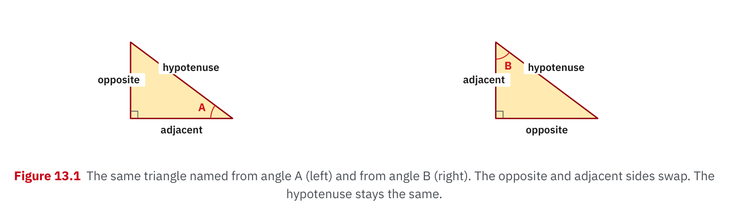
W06-L08 • TEACH • 2:25 PM–2:40 PM • 15 MIN TOTAL
Textbook | page 202
Textbook p.202 • Figure 13.1 — Opposite and adjacent depend on the marked angle
Textbook sections 13.1–13.3 pp.202–206; sections 2.10 pp.37–38
Textbook
Exercise Book
Numeracy Hub
Shape Canvas
Day 21 • 2026-12-03 • 27
Notes:
TEACH • 2:25 PM–2:40 PM • 15 MIN TOTAL — shared across this phase’s slides.
Use Figure 13.1 on page 202 to trace the side names from the marked angle. First locate the hypotenuse across from the right angle; then point across the triangle from the chosen angle to find opposite. Adjacent is the remaining leg beside that angle. Ask your partner to name the same sides using the other acute angle. What should they exchange? Opposite and adjacent. This small labelling step prevents a large calculation error: a calculator can evaluate the wrong trig ratio perfectly, so it cannot decide the correct labels for us.

Slide 28
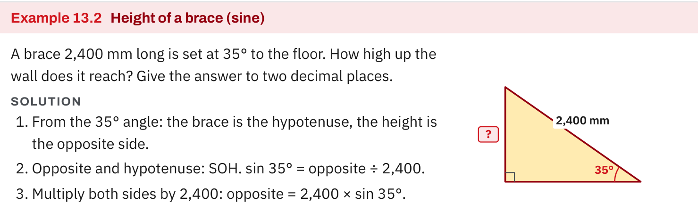
W06-L08 • TEACH • 2:25 PM–2:40 PM • 15 MIN TOTAL
Textbook | page 205
Textbook p.205 • Example 13.2 — Sine and the height of a brace
Textbook sections 13.1–13.3 pp.202–206; sections 2.10 pp.37–38
Textbook
Exercise Book
Numeracy Hub
Shape Canvas
Day 21 • 2026-12-03 • 28
Notes:
TEACH • 2:25 PM–2:40 PM • 15 MIN TOTAL — shared across this phase’s slides.
In the brace example on page 205, the sloping brace is the hypotenuse and the vertical rise is opposite the angle measured from the horizontal. That is why the example uses sine. Follow the written equation from ratio to isolated height rather than starting with the key sequence. What must be true about the height compared with the sloping brace? It must be shorter. If your answer is longer, stop and inspect the ratio, the rearrangement and DEG mode. A drawing provides a useful reasonableness check before we trust the decimal.

Slide 29
W06-L08 • TEACH • 2:25 PM–2:40 PM • 15 MIN TOTAL
Spot the mistake. Explain the correction.
Does the side drawn at the bottom always count as adjacent?
Discuss the method before checking the answer.
No. Adjacent is defined relative to the marked angle; first identify the hypotenuse and that angle.
Textbook sections 13.1–13.3 pp.202–206; sections 2.10 pp.37–38
Textbook
Exercise Book
Numeracy Hub
Shape Canvas
Day 21 • 2026-12-03 • 29
Notes:
TEACH • 2:25 PM–2:40 PM • 15 MIN TOTAL — shared across this phase’s slides.
The side at the bottom of the page is not automatically adjacent. Adjacent is a relationship to the chosen angle. Imagine turning the triangle through a quarter turn: the same side is now at the edge of the page, but it still touches the same angle. We identify the hypotenuse first because it also touches an acute angle and must not be mistaken for the adjacent leg. Which two things do you mark before writing SOH CAH TOA? The right angle and the reference angle. Page position never replaces those markings.

Slide 30
W06-L08 • TOGETHER • 2:40 PM–2:55 PM • 15 MIN TOTAL
Work together
Work Exercise Book 13A Q1–5; say the two relevant sides before choosing a ratio.
Work in pairs, alternating solver and checker. Write a diagram, formula, units and estimate.
Resources: Exercise Book 13A Q1–8 (pp.81–82); 13C Q1–2 (p.85)
Textbook sections 13.1–13.3 pp.202–206; sections 2.10 pp.37–38
Textbook
Exercise Book
Numeracy Hub
Shape Canvas
Day 21 • 2026-12-03 • 30
Notes:
TOGETHER • 2:40 PM–2:55 PM • 15 MIN TOTAL — shared across this phase’s slides.
Work with your partner on 13A Q1–5. Before any keys, say two side names aloud: the side you know and the side you need. Your partner checks those labels against the marked angle, then asks which ratio contains both. Write the equation and rearrange it before calculating. Switch roles for the next question. If your numerical answers differ, compare the labelled diagrams first, then the equations, then the calculator entries. That order usually finds the real cause fastest.

Slide 31
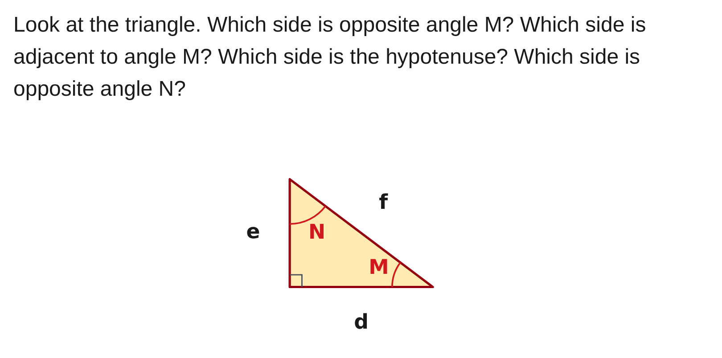
W06-L08 • TOGETHER • 2:40 PM–2:55 PM • 15 MIN TOTAL
Guided practice | 13A Q1
Work with a partner. Take turns explaining the next step.
Textbook sections 13.1–13.3 pp.202–206; sections 2.10 pp.37–38
Textbook
Exercise Book
Numeracy Hub
Shape Canvas
Day 21 • 2026-12-03 • 31
Notes:
TOGETHER • 2:40 PM–2:55 PM • 15 MIN TOTAL — shared across this phase’s slides.
Look at 13A Q1 and use angle M first. Point across from M to identify the opposite side, then locate the hypotenuse across from the right angle. The remaining leg is adjacent to M. Only after those three labels are settled should you change your reference to N. Try naming all four requested sides with your partner before revealing the comparison. Which side keeps its name when the reference changes? The hypotenuse.
INSTRUCTOR ONLY — AFTER THE ATTEMPT: Opposite M: e. Adjacent to M: d. Hypotenuse: f. Opposite N: d.

Slide 32
W06-L08 • TOGETHER • 2:40 PM–2:55 PM • 15 MIN TOTAL
Compare your method | 13A Q1
CHECK TOGETHER
Opposite M: e. Adjacent to M: d. Hypotenuse: f. Opposite N: d.
Textbook sections 13.1–13.3 pp.202–206; sections 2.10 pp.37–38
Textbook
Exercise Book
Numeracy Hub
Shape Canvas
Day 21 • 2026-12-03 • 32
Notes:
TOGETHER • 2:40 PM–2:55 PM • 15 MIN TOTAL — shared across this phase’s slides.
For angle M, e is opposite and d is adjacent. Side f is the hypotenuse because it lies across from the right angle. When we use angle N, d becomes opposite. Notice that the triangle itself did not change; our reference changed. If you had chosen the bottom edge automatically, this is where the error would appear. Explain to your partner why f stays the hypotenuse while d changes its role. Then carry that labelling habit into the remaining guided questions.
INSTRUCTOR ONLY — AFTER THE ATTEMPT: Opposite M: e. Adjacent to M: d. Hypotenuse: f. Opposite N: d.

Slide 33
W06-L08 • PRACTISE • 2:55 PM–3:15 PM • 20 MIN TOTAL
Your scheduled practice
Complete Exercise Book 13A Q6–8 and 13C Q1–2 as ready. Use one Easy Numeracy Hub task and compare with the drawn triangle.
Solve on paper first; check with tools; correct one error and explain the change.
Resources: Exercise Book 13A Q1–8 (pp.81–82); 13C Q1–2 (p.85)
Textbook sections 13.1–13.3 pp.202–206; sections 2.10 pp.37–38
Textbook
Exercise Book
Numeracy Hub
Shape Canvas
Day 21 • 2026-12-03 • 33
Notes:
PRACTISE • 2:55 PM–3:15 PM • 20 MIN TOTAL — shared across this phase’s slides.
Continue with 13A Q6–8, and move to 13C Q1–2 when ready. Keep a labelled triangle beside each equation. In Numeracy Hub, use one Easy right-triangle task and compare its drawing with your paper method. Do not use a remembered sequence of buttons as a substitute for choosing the ratio. Before each answer, ask whether a leg should be shorter than the hypotenuse and whether the direction of the calculation matches the unknown in the drawing.

Slide 34

W06-L08 • PRACTISE • 2:55 PM–3:15 PM • 20 MIN TOTAL
Open Numeracy Hub
Navigation example. Use the values and units in the assigned task.
Textbook sections 13.1–13.3 pp.202–206; sections 2.10 pp.37–38
Textbook
Exercise Book
Numeracy Hub
Shape Canvas
Day 21 • 2026-12-03 • 34
Notes:
PRACTISE • 2:55 PM–3:15 PM • 20 MIN TOTAL — shared across this phase’s slides.
Open Angles and Trig in Numeracy Hub, then Module 3 for right-triangle trigonometry. Select the scheduled Easy task and read its own values; the navigation image is not a new set of dimensions. Keep the answer hidden until your labelled sketch and equation are written. Which setting must match an angle carrying the degree symbol? DEG. When you check the result, compare the chosen ratio and the interpretation of the diagram as well as the final number.

Slide 35
W06-L08 • PRACTISE • 2:55 PM–3:15 PM • 20 MIN TOTAL
Practise in Numeracy Hub and Shape Canvas
1
Set the calculator to DEG and label the sides of a right triangle in Shape Canvas.
2
Hide one side; write the selected ratio and solve on paper.
3
Try the scheduled Easy Right-triangle trigonometry task in Numeracy Hub and compare diagrams.
Textbook sections 13.1–13.3 pp.202–206; sections 2.10 pp.37–38
Textbook
Exercise Book
Numeracy Hub
Shape Canvas
Day 21 • 2026-12-03 • 35
Notes:
PRACTISE • 2:55 PM–3:15 PM • 20 MIN TOTAL — shared across this phase’s slides.
In Shape Canvas, label the reference angle and the opposite, adjacent and hypotenuse sides. Hide the side you are solving for, but retain the known side and angle from the task. Write your ratio on paper, rearrange, and calculate in degrees. Then compare with the Easy task in Numeracy Hub. What should match between the paper and tool diagrams? The reference angle and the identities of the known and unknown sides. The drawings do not have to sit in the same orientation to represent the same relationship.

Slide 36
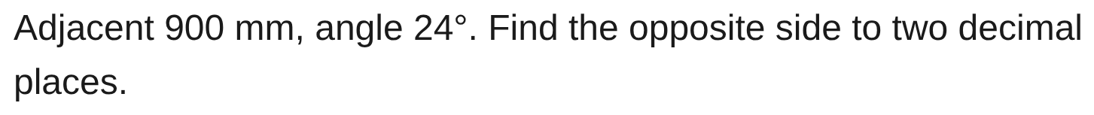
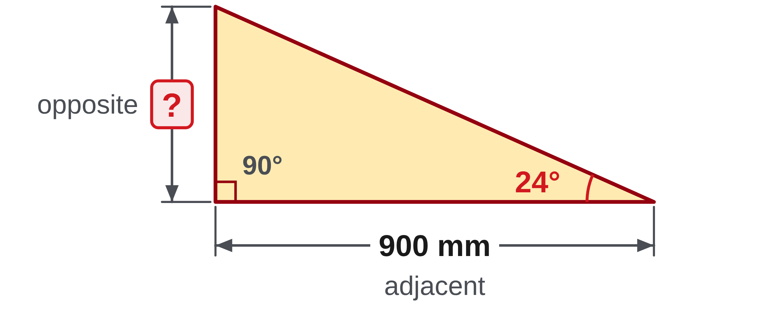
W06-L08 • PRACTISE • 2:55 PM–3:15 PM • 20 MIN TOTAL
Practise from the Exercise Book | 13A Q6
Write the operation, working and units before checking.
Textbook sections 13.1–13.3 pp.202–206; sections 2.10 pp.37–38
Textbook
Exercise Book
Numeracy Hub
Shape Canvas
Day 21 • 2026-12-03 • 36
Notes:
PRACTISE • 2:55 PM–3:15 PM • 20 MIN TOTAL — shared across this phase’s slides.
For 13A Q6, label 900 millimetres as adjacent to 24 degrees and mark the opposite side as unknown. Choose the ratio containing those two legs and attempt the calculation. After the attempt, explain why tangent fits: tan 24° equals opposite divided by 900. Multiplying by 900 gives about 400.71 millimetres. Because 24 degrees is below 45 degrees, the opposite leg should be shorter than the adjacent leg. Does your result pass that comparison?
INSTRUCTOR ONLY — AFTER THE ATTEMPT: 400.71 mm Working: 900 × tan 24°

Slide 37
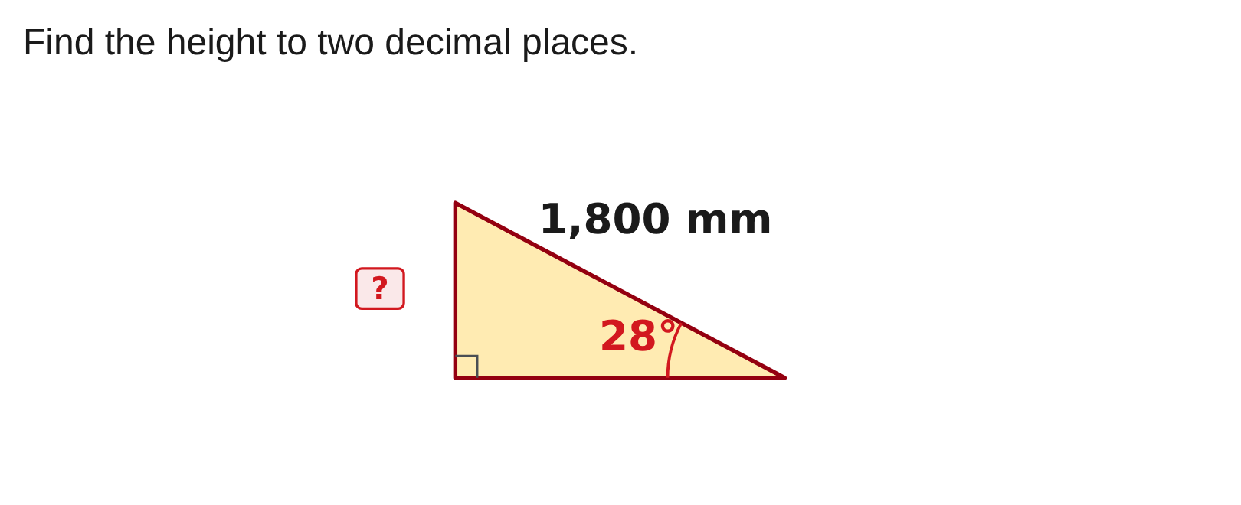
W06-L08 • PRACTISE • 2:55 PM–3:15 PM • 20 MIN TOTAL
Practise from the Exercise Book | 13C Q1
Write the operation, working and units before checking.
Textbook sections 13.1–13.3 pp.202–206; sections 2.10 pp.37–38
Textbook
Exercise Book
Numeracy Hub
Shape Canvas
Day 21 • 2026-12-03 • 37
Notes:
PRACTISE • 2:55 PM–3:15 PM • 20 MIN TOTAL — shared across this phase’s slides.
For 13C Q1, read the height question from its diagram and copy the given dimension and angle onto your own triangle. Name the height relative to the marked angle before choosing a ratio. Keep full calculator precision until the requested two-decimal-place answer. After your attempt, compare the height with the sloping length shown: a height cannot exceed the hypotenuse. The answer for this diagram is 845.05 millimetres. Explain the ratio you used, not just the matching number.
INSTRUCTOR ONLY — AFTER THE ATTEMPT: 845.05 mm

Slide 38
W06-L08 • CHECK • 3:15 PM–3:25 PM • 10 MIN TOTAL
Check independently
Exercise Book 13A Q4 and Q6; label the sides and chosen ratio.
Solve without displayed answers; include working, units and final rounding.
Resources: Exercise Book 13A Q1–8 (pp.81–82); 13C Q1–2 (p.85)
Textbook sections 13.1–13.3 pp.202–206; sections 2.10 pp.37–38
Textbook
Exercise Book
Numeracy Hub
Shape Canvas
Day 21 • 2026-12-03 • 38
Notes:
CHECK • 3:15 PM–3:25 PM • 10 MIN TOTAL — shared across this phase’s slides.
Complete 13A Q4 and Q6 independently. Each response needs the side labels and selected ratio, followed by working and a final length to two decimal places. Keep solution displays closed. Your diagram should make it clear why one question uses a different trig function from the other. When you finish, inspect DEG mode and the size of each length against the triangle. We will compare answers after you have submitted your own method.

Slide 39
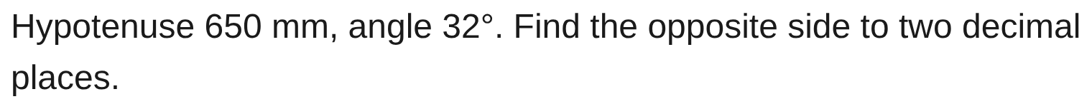
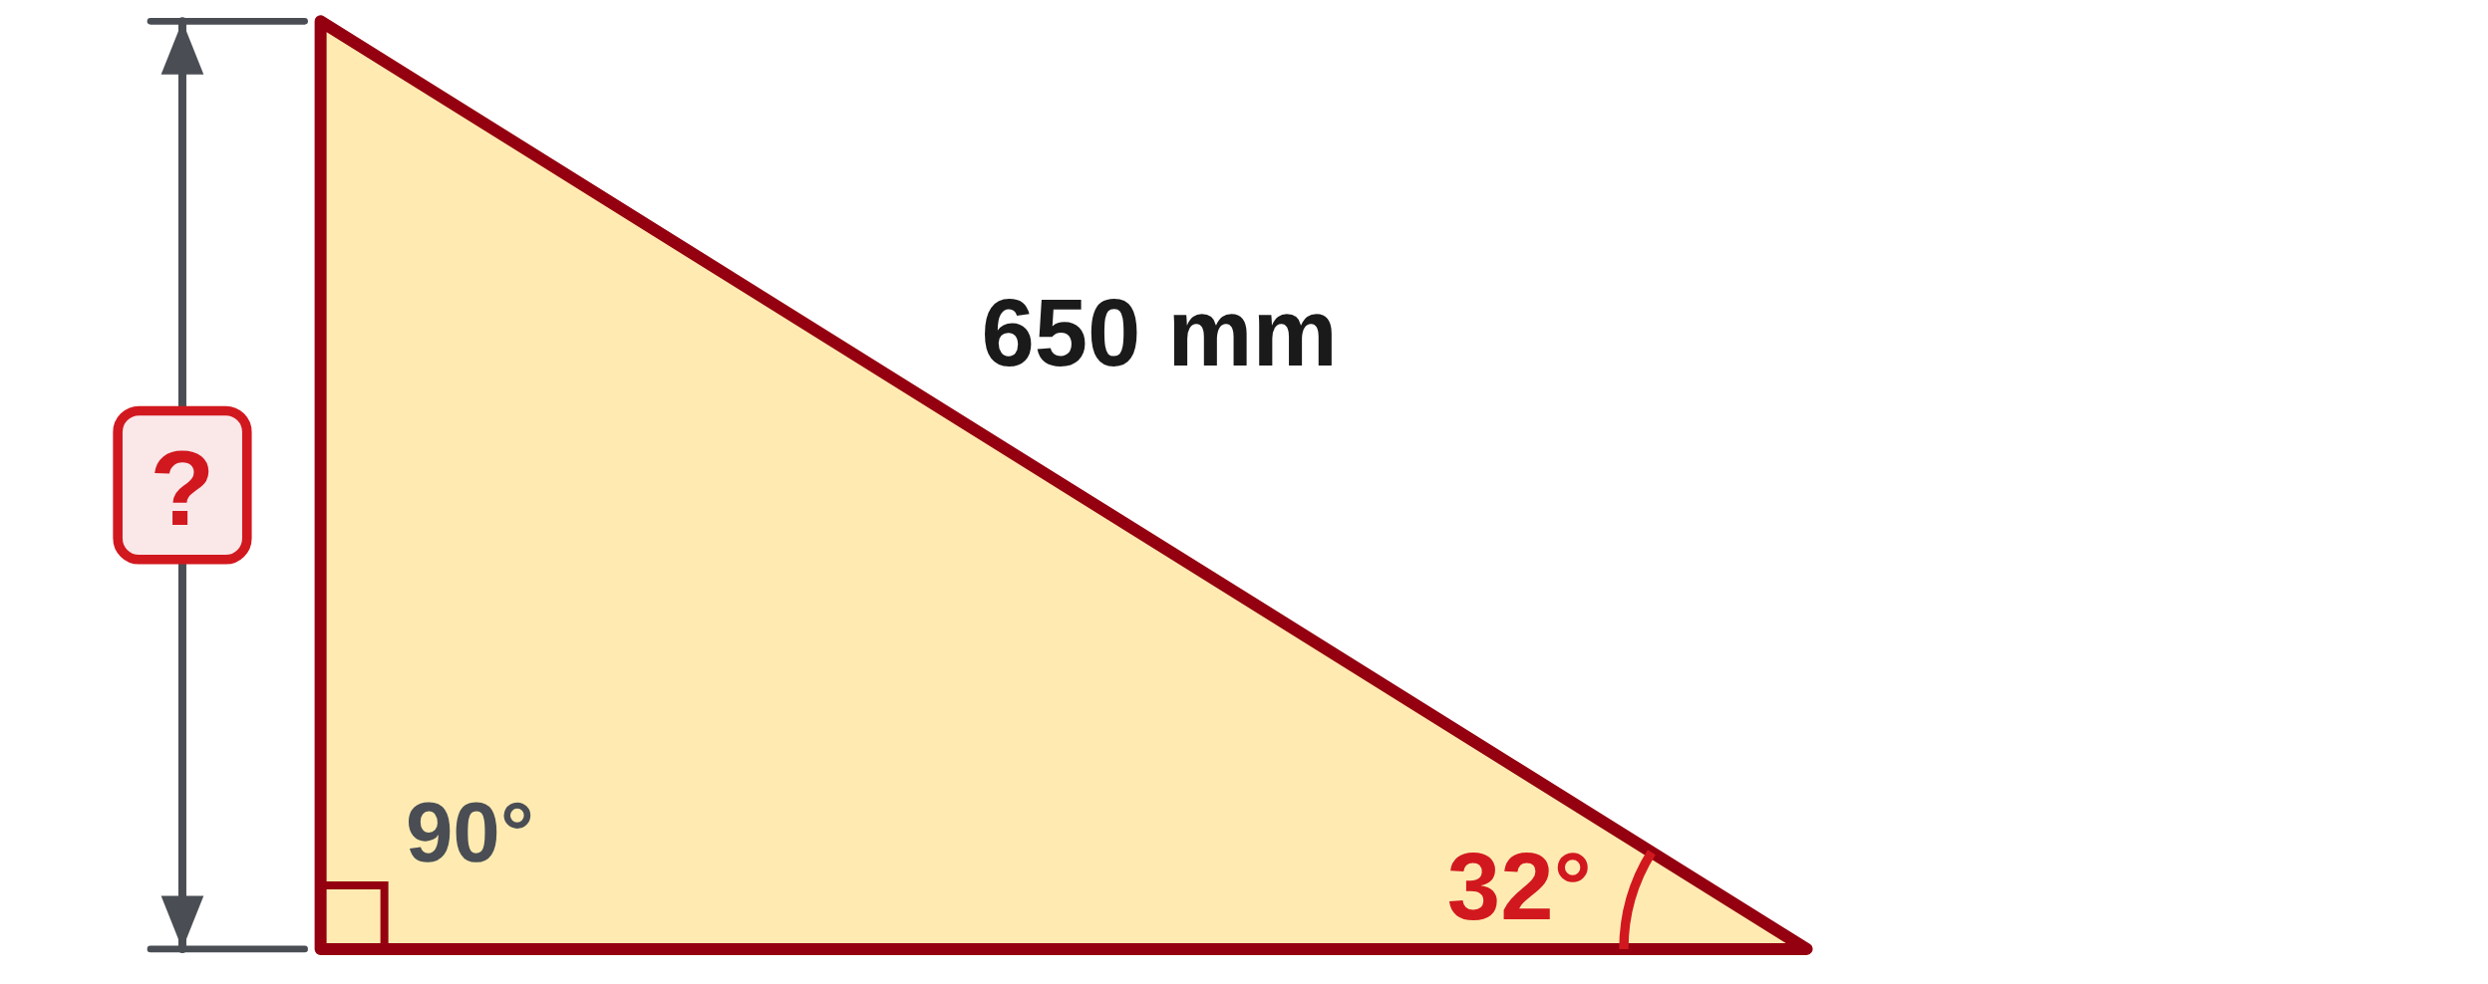
W06-L08 • CHECK • 3:15 PM–3:25 PM • 10 MIN TOTAL
Independent check | 13A Q4
Answer independently. Keep worked solutions closed.
Textbook sections 13.1–13.3 pp.202–206; sections 2.10 pp.37–38
Textbook
Exercise Book
Numeracy Hub
Shape Canvas
Day 21 • 2026-12-03 • 39
Notes:
CHECK • 3:15 PM–3:25 PM • 10 MIN TOTAL — shared across this phase’s slides.
For 13A Q4, find the opposite side from the stated hypotenuse and angle. Write your chosen ratio before entering the calculation, then give the length to two decimal places. Keep your method private during the check so the next person's work remains independent.
INSTRUCTOR ONLY — AFTER THE ATTEMPT: sin 32° = opposite/650, so opposite = 650 × sin 32° = 344.45 mm. The result is less than 650 mm, consistent with a leg being shorter than the hypotenuse.

Slide 40
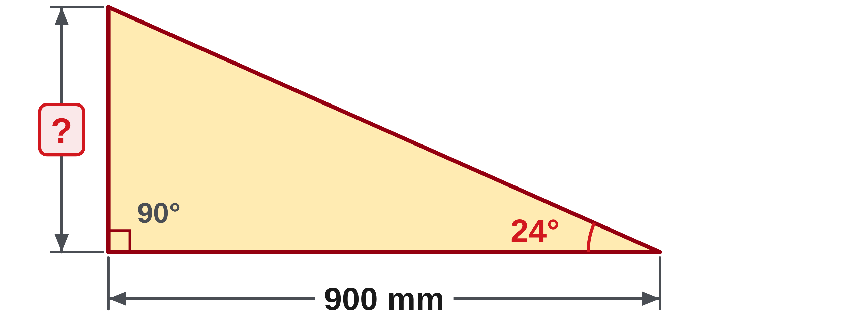
W06-L08 • CHECK • 3:15 PM–3:25 PM • 10 MIN TOTAL
Independent check | 13A Q6
Answer independently. Keep worked solutions closed.
Textbook sections 13.1–13.3 pp.202–206; sections 2.10 pp.37–38
Textbook
Exercise Book
Numeracy Hub
Shape Canvas
Day 21 • 2026-12-03 • 40
Notes:
CHECK • 3:15 PM–3:25 PM • 10 MIN TOTAL — shared across this phase’s slides.
For 13A Q6, use the adjacent side and marked angle to find the opposite side. Label the two relevant sides and show the equation that connects them. Round only the final result to two decimal places. Do not call out your function or answer while others are working.
INSTRUCTOR ONLY — AFTER THE ATTEMPT: tan 24° = opposite/900, so opposite = 900 × tan 24° = 400.71 mm. An answer based on sine used the wrong side pair.

Slide 41
W06-L08 • WRAP UP • 3:25 PM–3:30 PM • 5 MIN TOTAL
Wrap up and choose the next step
Ask: What changed in your understanding? Where will you use it? What should you check next time?
Name the math and one other essential skill used; record a next practice step.
Resources: Exercise Book 13A Q1–8 (pp.81–82); 13C Q1–2 (p.85)
Textbook sections 13.1–13.3 pp.202–206; sections 2.10 pp.37–38
Textbook
Exercise Book
Numeracy Hub
Shape Canvas
Day 21 • 2026-12-03 • 41
Notes:
WRAP UP • 3:25 PM–3:30 PM • 5 MIN TOTAL — shared across this phase’s slides.
What is the first decision in a trig problem? Naming the sides relative to the marked angle. What comes next? Choosing the ratio that contains the known and wanted sides. Write one reminder from today's work beside a corrected question: perhaps “mark the angle,” “exclude the hypotenuse when naming adjacent,” or “check DEG.” Our next step will reverse this process and find an angle from two sides. Keep today's ratio equations; we will use them again.

