Slide 1

CARPENTRY FOUNDATION / INTAKE 142
Day 24 | Thursday
24
December 10, 2026
Skill clinics: practise your priority topic
9:00 AM–10:15 AM • Math • 75 min
Mixed-topic calculation practice
10:30 AM–12:00 PM • Calculation Practice • 90 min
Week 7 • 2 scheduled blocks • 165 teaching minutes
Estimate. Show the method. Label units. Check the result.
Textbook
Exercise Book
Numeracy Hub
Shape Canvas
Day 24 • 2026-12-10 • 01
Notes:
Opening — within the first scheduled Start period; no additional teaching time.
Today begins with a clinic chosen from the evidence in your own work. Some of you will focus on fractions and decimals, others on conversions and formulas, and others on right triangles. After the break, everyone moves to mixed practice using taught topics. The aim is to repair a method and then show that you can choose it independently. Keep your earlier feedback and written attempts available so the improvement is visible, not just remembered.

Slide 2
DAY 24 / WEEK 7 / CLASS TIMETABLE
Today’s exact schedule
9:00 AM–10:15 AM • 75 min
10:30 AM–12:00 PM • 90 min
Skill clinics: practise your priority topic
Mixed-topic calculation practice
9:00 AM–9:05 AM
Start
5
10:30 AM–10:35 AM
Start
5
9:05 AM–9:10 AM
Recall
5
10:35 AM–10:40 AM
Recall
5
9:10 AM–9:25 AM
Teach
15
10:40 AM–10:55 AM
Teach
15
9:25 AM–9:40 AM
Together
15
10:55 AM–11:10 AM
Together
15
9:40 AM–10:00 AM
Practise
20
11:10 AM–11:45 AM
Practise
35
10:00 AM–10:10 AM
Check
10
11:45 AM–11:55 AM
Check
10
10:10 AM–10:15 AM
Wrap up
5
11:55 AM–12:00 PM
Wrap up
5
Math • Math Week 7, Lesson 3
Calculation Practice • Math Week 7, Lesson 4
Break: 10:15 AM–10:30 AM • 15 minutes • excluded from teaching time
Textbook
Exercise Book
Numeracy Hub
Shape Canvas
Day 24 • 2026-12-10 • 02
Notes:
Opening — within the first scheduled Start period; no additional teaching time.
The clinic runs from 9:00 to 10:15, with twenty minutes of practice and a ten-minute pathway check. We break until 10:30. The second block continues to noon and includes thirty-five minutes for the mixed set, followed by an independent retry and reflection. Those longer practice minutes are for using the methods, not extra lecturing. Keep the original and corrected working together so we can use the check to decide what still needs attention.

Slide 3
W07-L03 • START • 9:00 AM–9:05 AM • 5 MIN TOTAL
Skill clinics: practise your priority topic
Today’s goal: Repair a documented error and explain a corrected method independently.
Identify one target skill and the checking habit to use today.
Textbook Chapter 4–5 pp.56–87; Chapter 7–8 pp.108–134; Chapter 12–13 pp.188–209, selected
Path A: 4A Q14–17 p.26; 5A Q12–15 p.33. B: 7A Q11–14 pp.45–46; 8C Q1–2 p.55. C: 12C Q1–2 p.79; 13A Q6,10 p.82.
Keep your notebook, textbook, exercise book and chosen calculator ready.
Textbook Chapter 4–5 pp.56–87; Chapter 7–8 pp.108–134; Chapter 12–13 pp.188–209, selected
Textbook
Exercise Book
Numeracy Hub
Shape Canvas
Day 24 • 2026-12-10 • 03
Notes:
START • 9:00 AM–9:05 AM • 5 MIN TOTAL — shared across this phase’s slides.
Choose one error you can point to in your earlier work. It might be regrouping a fraction, converting in the wrong direction or selecting a triangle ratio. Today we will repair that specific step. What makes a useful target different from “get better at math”? A useful target names the operation that failed and the check that could catch it. We will use the assigned pathway questions and the relevant textbook pages to make that improvement concrete.

Slide 4
W07-L03 • RECALL • 9:05 AM–9:10 AM • 5 MIN TOTAL
Recall and reconnect
Use each learner’s Week 6 exits and capstone work to choose one pathway. Do not assume all learners need trig extension.
Review previous feedback and attempt the retrieval prompt without displayed solutions.
Resources: Path A: 4A Q14–17 p.26; 5A Q12–15 p.33. B: 7A Q11–14 pp.45–46; 8C Q1–2 p.55. C: 12C Q1–2 p.79; 13A Q6,10 p.82.
Textbook Chapter 4–5 pp.56–87; Chapter 7–8 pp.108–134; Chapter 12–13 pp.188–209, selected
Textbook
Exercise Book
Numeracy Hub
Shape Canvas
Day 24 • 2026-12-10 • 04
Notes:
RECALL • 9:05 AM–9:10 AM • 5 MIN TOTAL — shared across this phase’s slides.
Open your Week 6 exits and applied drawing work. Find a place where the method became uncertain, not simply a low score. Which pathway matches the evidence: A for fractions and decimals, B for conversions and formulas, or C for right triangles and trig? Choose with me if you are unsure. Not everyone needs a trig extension. The best use of this block is the skill that will improve your own next independent solution.

Slide 5
W07-L03 • TEACH • 9:10 AM–9:25 AM • 15 MIN TOTAL
Choose the pathway your work shows you need
1
Use Week 6 exits and the applied drawing work to identify the error you need to repair.
2
Path A uses fractions and decimals: 4A Q14–17 and 5A Q12–15. Explain regrouping, conversion or the tape-reading error in your selected work.
3
Path B uses conversions and formulas: 7A Q11–14 and 8C Q1–2. Show the conversion direction or missing-dimension method.
4
Path C uses right triangles and trig: 12C Q1–2 and 13A Q6,10. Use this pathway when the evidence and taught content call for it; not everyone needs trig extension.
Textbook Chapter 4–5 pp.56–87; Chapter 7–8 pp.108–134; Chapter 12–13 pp.188–209, selected
Textbook
Exercise Book
Numeracy Hub
Shape Canvas
Day 24 • 2026-12-10 • 05
Notes:
TEACH • 9:10 AM–9:25 AM • 15 MIN TOTAL — shared across this phase’s slides.
Path A works with fractional and decimal quantities, including regrouping and equivalent forms. Path B checks conversion factors, direction and rearranging a relationship to find a missing dimension. Path C starts with the right triangle and side labels before selecting Pythagoras or a trig ratio. Choose from your actual work, not from which title sounds most advanced. What evidence would support Path B? An inch-to-millimetre conversion done in reverse, or an area problem solved without isolating the missing width. Naming the error gives us a clear reason for the pathway.

Slide 6
W07-L03 • TEACH • 9:10 AM–9:25 AM • 15 MIN TOTAL
A correction needs an explanation and a retry
1
Keep the original working so the point where the method failed remains visible.
2
Beside the corrected method, explain what changed and how your chosen check detects the original error.
3
Partners explain the first two selected questions; continue the scheduled four-question practice in your chosen pathway.
4
Keep tool answers hidden until after the written attempt. Use the scheduled independent pathway check to show that you can avoid the error yourself.
Textbook Chapter 4–5 pp.56–87; Chapter 7–8 pp.108–134; Chapter 12–13 pp.188–209, selected
Textbook
Exercise Book
Numeracy Hub
Shape Canvas
Day 24 • 2026-12-10 • 06
Notes:
TEACH • 9:10 AM–9:25 AM • 15 MIN TOTAL — shared across this phase’s slides.
Keep the original line of working visible. Beside it, write the corrected line and explain why the change is necessary. For a regrouping error, the explanation should say that one whole was exchanged for fractional parts without changing the quantity. For a conversion error, it should identify the direction and units of the factor. What tells us the repair is secure? A later independent attempt using the same idea. Matching an answer after looking at the tool is useful feedback, but it does not yet show that you can choose the method yourself.

Slide 7
W07-L03 • TEACH • 9:10 AM–9:25 AM • 15 MIN TOTAL
Choose one pathway and explain the method
A • FRACTIONS AND DECIMALS
4A Q14–17 p.26; 5A Q12–15 p.33.
Tools: Numeracy Hub Calculator and tape-reading practice.
B • CONVERSIONS AND FORMULAS
7A Q11–14 pp.45–46; 8C Q1–2 p.55.
Tools: Unit Conversions and a Shape Canvas rectangle.
C • RIGHT TRIANGLES AND TRIG
12C Q1–2 p.79; 13A Q6,10 p.82.
Tools: Angles and Trig Module 3 and a Shape Canvas right triangle.
Instructor models one common pathway error. Partners solve the first two selected questions and explain the correction.
Exercise Book practice pathways • Tool answers stay hidden until the paper attempt
Textbook
Exercise Book
Numeracy Hub
Shape Canvas
Day 24 • 2026-12-10 • 07
Notes:
TEACH • 9:10 AM–9:25 AM • 15 MIN TOTAL — shared across this phase’s slides.
Use only the pathway assigned from your evidence. In A, work with 4A Q14–17 and 5A Q12–15, using the calculator and tape practice after the written attempt. In B, use 7A Q11–14 and 8C Q1–2 with Unit Conversions and a rectangle. In C, use 12C Q1–2 and 13A Q6 and Q10 with a right triangle. What should a partner hear from you before any answer? The step you are repairing and why that operation applies. The tools check that reasoning; they do not choose your pathway.

Slide 8
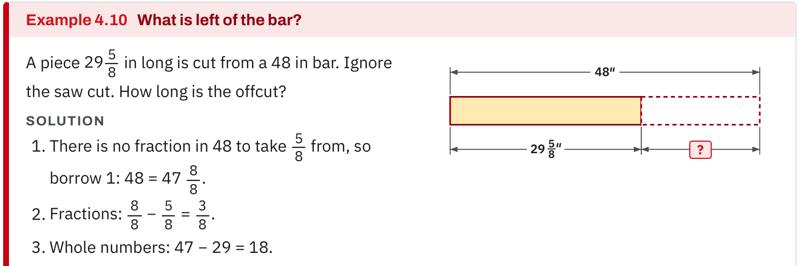
W07-L03 • TEACH • 9:10 AM–9:25 AM • 15 MIN TOTAL
Textbook | page 66
Path A only: regroup a whole number before subtracting fractional lengths.
Textbook Chapter 4–5 pp.56–87; Chapter 7–8 pp.108–134; Chapter 12–13 pp.188–209, selected
Textbook
Exercise Book
Numeracy Hub
Shape Canvas
Day 24 • 2026-12-10 • 08
Notes:
TEACH • 9:10 AM–9:25 AM • 15 MIN TOTAL — shared across this phase’s slides.
Path A, look at the regrouping example on page 66. When the fraction being removed is larger than the fractional part available, exchange one whole for the common denominator's number of parts. The total quantity stays equal even though its written form changes. For example, one whole equals eight eighths; that is why eighths can be added to the fractional part while the whole-number part decreases by one. What would be wrong with adding the fractional parts without reducing the whole number? You would increase the original quantity instead of rewriting it.

Slide 9
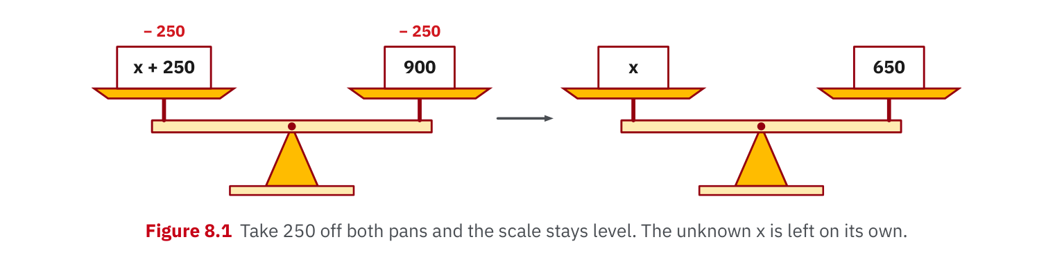
W07-L03 • TEACH • 9:10 AM–9:25 AM • 15 MIN TOTAL
Textbook | page 127
Path B only: the same inverse operation keeps both sides equal.
Textbook Chapter 4–5 pp.56–87; Chapter 7–8 pp.108–134; Chapter 12–13 pp.188–209, selected
Textbook
Exercise Book
Numeracy Hub
Shape Canvas
Day 24 • 2026-12-10 • 09
Notes:
TEACH • 9:10 AM–9:25 AM • 15 MIN TOTAL — shared across this phase’s slides.
Path B, page 127 shows an equation as a balance. To isolate a missing dimension, undo the operation connecting it to the known values, and do that equally on both sides. For a rectangle, area equals length times width, so dividing both sides by the known length leaves width. What check returns us to the original statement? Multiply the proposed width by the length and see whether it recreates the area. This substitution checks the relationship, which is stronger evidence than simply repeating the same calculator division.

Slide 10
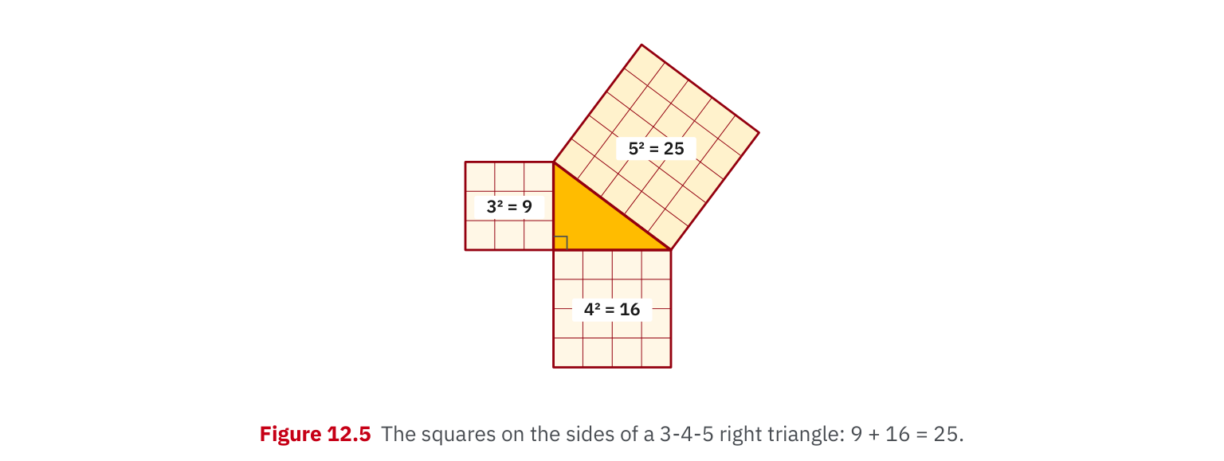
W07-L03 • TEACH • 9:10 AM–9:25 AM • 15 MIN TOTAL
Textbook | page 192
Path C only: revisit the right-triangle relationship before solving.
Textbook Chapter 4–5 pp.56–87; Chapter 7–8 pp.108–134; Chapter 12–13 pp.188–209, selected
Textbook
Exercise Book
Numeracy Hub
Shape Canvas
Day 24 • 2026-12-10 • 10
Notes:
TEACH • 9:10 AM–9:25 AM • 15 MIN TOTAL — shared across this phase’s slides.
Path C, revisit the right-triangle relationship on page 192 before choosing a calculation. The hypotenuse is across from the right angle and is the longest side. If it is unknown and both legs are given, add their squares and take a square root. If a leg is unknown, subtract the known leg's square from the hypotenuse's square first. What common error does the diagram prevent? Adding the squares when the unknown is a leg. Side labels determine the structure of the equation before any keys are pressed.

Slide 11
W07-L03 • TEACH • 9:10 AM–9:25 AM • 15 MIN TOTAL
Spot the mistake. Explain the correction.
Your corrected page now matches the tool answer, but the original error has been erased. Does that show which part of your method improved?
Discuss the method before checking the answer.
Retain before-and-after working, identify the incorrect step and explain the repair. Matching a displayed answer does not replace the scheduled independent pathway check.
Textbook Chapter 4–5 pp.56–87; Chapter 7–8 pp.108–134; Chapter 12–13 pp.188–209, selected
Textbook
Exercise Book
Numeracy Hub
Shape Canvas
Day 24 • 2026-12-10 • 11
Notes:
TEACH • 9:10 AM–9:25 AM • 15 MIN TOTAL — shared across this phase’s slides.
A corrected page that matches the tool answer can still hide how the learner got there. If the original method is erased, we lose the evidence of what changed. Keep the wrong step legible, add the repair beside it and explain the reason. What would count as a meaningful explanation for a conversion? “I multiplied by 25.4 because each inch contains 25.4 millimetres,” rather than “I changed the answer.” The independent pathway check then shows whether that repaired reasoning can be used without the displayed solution.

Slide 12
W07-L03 • TOGETHER • 9:25 AM–9:40 AM • 15 MIN TOTAL
Work together
Partners work the first two selected pathway questions and explain the correction in their own words.
Explain the method and check directions; work with a partner only where permitted.
Resources: Path A: 4A Q14–17 p.26; 5A Q12–15 p.33. B: 7A Q11–14 pp.45–46; 8C Q1–2 p.55. C: 12C Q1–2 p.79; 13A Q6,10 p.82.
Textbook Chapter 4–5 pp.56–87; Chapter 7–8 pp.108–134; Chapter 12–13 pp.188–209, selected
Textbook
Exercise Book
Numeracy Hub
Shape Canvas
Day 24 • 2026-12-10 • 12
Notes:
TOGETHER • 9:25 AM–9:40 AM • 15 MIN TOTAL — shared across this phase’s slides.
With your partner, attempt the first two selected questions in your assigned pathway. The solver explains the vulnerable step; the checker asks why it preserves the quantity or relationship. Swap roles for the next question. Keep answer displays closed until the attempt exists on paper. If you disagree, compare the exact step rather than debating whose final number looks familiar. Your before-and-after record should make the cause of the original error easy to see.

Slide 13
W07-L03 • PRACTISE • 9:40 AM–10:00 AM • 20 MIN TOTAL
Your scheduled practice
Complete four questions in the selected pathway, then one from another pathway if ready. Keep a before/after solution showing what changed; tool answers remain hidden until the attempt.
Keep numbered written solutions and units. Use tools only under the conditions stated for this block.
Resources: Path A: 4A Q14–17 p.26; 5A Q12–15 p.33. B: 7A Q11–14 pp.45–46; 8C Q1–2 p.55. C: 12C Q1–2 p.79; 13A Q6,10 p.82.
Textbook Chapter 4–5 pp.56–87; Chapter 7–8 pp.108–134; Chapter 12–13 pp.188–209, selected
Textbook
Exercise Book
Numeracy Hub
Shape Canvas
Day 24 • 2026-12-10 • 13
Notes:
PRACTISE • 9:40 AM–10:00 AM • 20 MIN TOTAL — shared across this phase’s slides.
Complete four questions in your selected pathway, then one from another pathway if ready. Keep the original working and the repaired version together. Before opening a tool answer, identify the check you intend to use: addition back, reverse conversion, substitution or a triangle-size check. Which one would catch your earlier error most directly? Use that check and write what it tells you. The independent check at 10:00 will use your pathway, so focus on the method you need to carry forward.

Slide 14

W07-L03 • PRACTISE • 9:40 AM–10:00 AM • 20 MIN TOTAL
Open Numeracy Hub
Choose only your assigned pathway. Trigonometry is for Path C.
Textbook Chapter 4–5 pp.56–87; Chapter 7–8 pp.108–134; Chapter 12–13 pp.188–209, selected
Textbook
Exercise Book
Numeracy Hub
Shape Canvas
Day 24 • 2026-12-10 • 14
Notes:
PRACTISE • 9:40 AM–10:00 AM • 20 MIN TOTAL — shared across this phase’s slides.
Open the Numeracy Hub area that matches your pathway. A uses Calculator and tape practice; B uses Unit Conversions; C uses Angles and Trig, Module 3. Do not switch to trig simply because it appears on the screen. Keep your selected exercise beside the tool and retain its values and units. What should come before revealing a result? Your own written method. That first attempt lets the feedback tell us something useful about your reasoning.

Slide 15
W07-L03 • PRACTISE • 9:40 AM–10:00 AM • 20 MIN TOTAL
Practise in Numeracy Hub and Shape Canvas
1
Choose the tool for your selected pathway only: A—Numeracy Hub Calculator and tape practice; B—Unit Conversions and a Shape Canvas rectangle; C—Angles and Trig Module 3 and a Shape Canvas right triangle.
2
Complete the selected source-book work on paper first, with units and a visible method. Leave tool answers hidden during the attempt.
3
Use the pathway tool to check the attempt and explain the correction beside the original working. Retain that record for the scheduled independent pathway check.
Textbook Chapter 4–5 pp.56–87; Chapter 7–8 pp.108–134; Chapter 12–13 pp.188–209, selected
Textbook
Exercise Book
Numeracy Hub
Shape Canvas
Day 24 • 2026-12-10 • 15
Notes:
PRACTISE • 9:40 AM–10:00 AM • 20 MIN TOTAL — shared across this phase’s slides.
For A, check the written fraction or decimal result using Calculator or tape practice. For B, compare the unit conversion or rebuild the missing-dimension rectangle in Shape Canvas. For C, label the right triangle and use Module 3 after your paper attempt. Explain any difference between the tool and your work beside the original line. If the numerical results match, still identify the check: matching digits alone does not explain why the method works.

Slide 16
W07-L03 • PRACTISE • 9:40 AM–10:00 AM • 20 MIN TOTAL
Practise from the Exercise Book | 4A Q14a
Use only the question for your selected skill pathway.
Textbook Chapter 4–5 pp.56–87; Chapter 7–8 pp.108–134; Chapter 12–13 pp.188–209, selected
Textbook
Exercise Book
Numeracy Hub
Shape Canvas
Day 24 • 2026-12-10 • 16
Notes:
PRACTISE • 9:40 AM–10:00 AM • 20 MIN TOTAL — shared across this phase’s slides.
Path A, attempt 4A Q14(a). The denominators are different, so think about equivalent parts before combining the numerators. After your attempt, compare three quarters with twelve sixteenths. Five sixteenths plus twelve sixteenths gives seventeen sixteenths, or one and one sixteenth. What stayed the same during the conversion? The size of three quarters. We changed its name to match the parts being added, not its value.
INSTRUCTOR ONLY — AFTER THE ATTEMPT: (a) 1 1/16

Slide 17
W07-L03 • PRACTISE • 9:40 AM–10:00 AM • 20 MIN TOTAL
Practise from the Exercise Book | 5A Q12
Use only the question for your selected skill pathway.
Textbook Chapter 4–5 pp.56–87; Chapter 7–8 pp.108–134; Chapter 12–13 pp.188–209, selected
Textbook
Exercise Book
Numeracy Hub
Shape Canvas
Day 24 • 2026-12-10 • 17
Notes:
PRACTISE • 9:40 AM–10:00 AM • 20 MIN TOTAL — shared across this phase’s slides.
Path A, convert both numbers in 5A Q12. A fraction becomes a decimal by dividing numerator by denominator; retain the whole part of a mixed number. After your attempt, seven divided by eight gives 0.875, while three and one quarter becomes 3 plus 0.25, or 3.25. Which error would produce 0.25 for the second number? Dropping the three wholes. Check each decimal against the size of the original quantity before using a tool.
INSTRUCTOR ONLY — AFTER THE ATTEMPT: 0.875 and 3.25

Slide 18
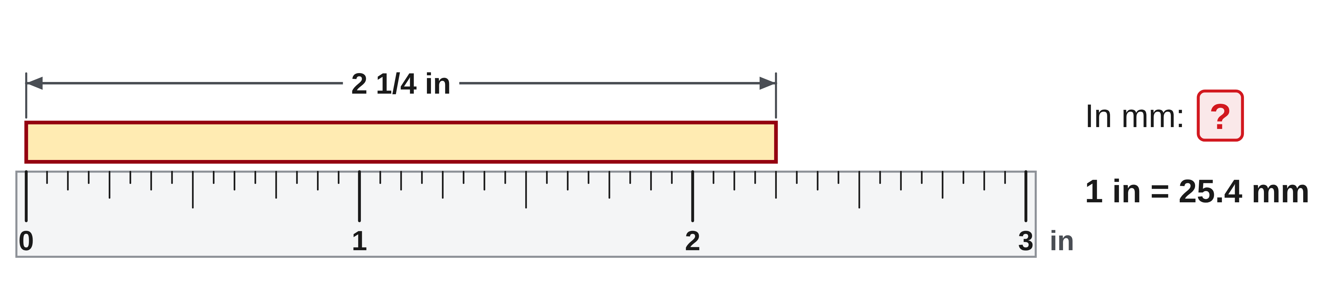
W07-L03 • PRACTISE • 9:40 AM–10:00 AM • 20 MIN TOTAL
Practise from the Exercise Book | 7A Q12
Use only the question for your selected skill pathway.
Textbook Chapter 4–5 pp.56–87; Chapter 7–8 pp.108–134; Chapter 12–13 pp.188–209, selected
Textbook
Exercise Book
Numeracy Hub
Shape Canvas
Day 24 • 2026-12-10 • 18
Notes:
PRACTISE • 9:40 AM–10:00 AM • 20 MIN TOTAL — shared across this phase’s slides.
Path B, attempt 7A Q12 by converting the whole mixed number into inches as a decimal, then applying the inch-to-millimetre factor. After the attempt, compare: two and one quarter is 2.25, and 2.25 times 25.4 is 57.15 millimetres. Why should the numerical value grow? A millimetre is a smaller unit than an inch. Reverse division by 25.4 should recover 2.25 inches, providing a useful check on the conversion direction.
INSTRUCTOR ONLY — AFTER THE ATTEMPT: 57.15 mm

Slide 19
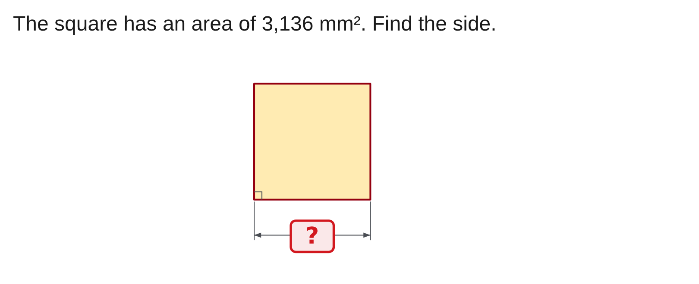
W07-L03 • PRACTISE • 9:40 AM–10:00 AM • 20 MIN TOTAL
Practise from the Exercise Book | 8C Q2
Use only the question for your selected skill pathway.
Textbook Chapter 4–5 pp.56–87; Chapter 7–8 pp.108–134; Chapter 12–13 pp.188–209, selected
Textbook
Exercise Book
Numeracy Hub
Shape Canvas
Day 24 • 2026-12-10 • 19
Notes:
PRACTISE • 9:40 AM–10:00 AM • 20 MIN TOTAL — shared across this phase’s slides.
Path B, read 8C Q2 carefully: the shape is a square and its area is 3,136 square millimetres. Attempt the missing side before checking. A square's area is side times itself, so the reverse operation is square root. After your attempt, 56 times 56 recreates 3,136. What unit belongs to the side? Millimetres, because the unknown is a length. Dividing area by four would confuse area with the four-edge perimeter.
INSTRUCTOR ONLY — AFTER THE ATTEMPT: 56 mm

Slide 20
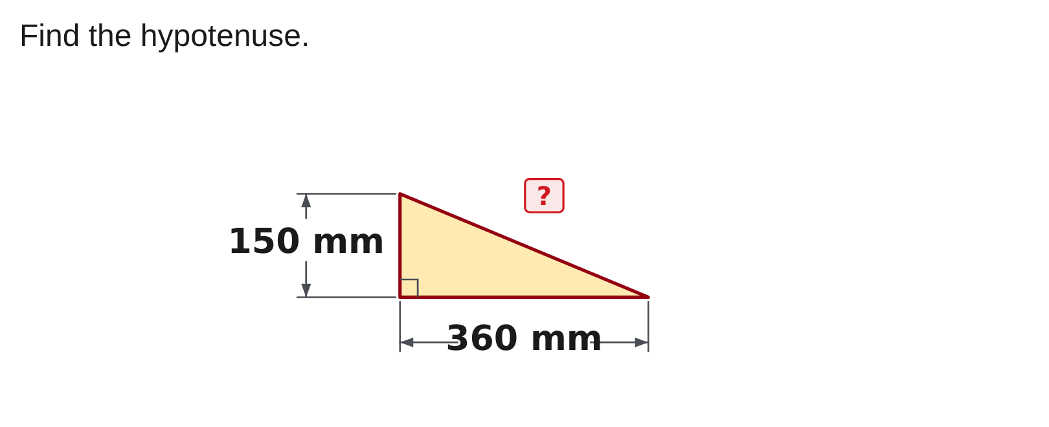
W07-L03 • PRACTISE • 9:40 AM–10:00 AM • 20 MIN TOTAL
Practise from the Exercise Book | 12C Q1
Use only the question for your selected skill pathway.
Textbook Chapter 4–5 pp.56–87; Chapter 7–8 pp.108–134; Chapter 12–13 pp.188–209, selected
Textbook
Exercise Book
Numeracy Hub
Shape Canvas
Day 24 • 2026-12-10 • 20
Notes:
PRACTISE • 9:40 AM–10:00 AM • 20 MIN TOTAL — shared across this phase’s slides.
Path C, locate the right angle in 12C Q1 and identify the hypotenuse across from it. Use the two leg dimensions in the diagram and attempt the squared relationship before checking. The answer is 390 millimetres. Your explanation should show why the squares are added and why the square root returns a length. What size check must the result pass? The hypotenuse must exceed either leg. A matching number without the diagram's side relationships is incomplete evidence.
INSTRUCTOR ONLY — AFTER THE ATTEMPT: 390 mm

Slide 21
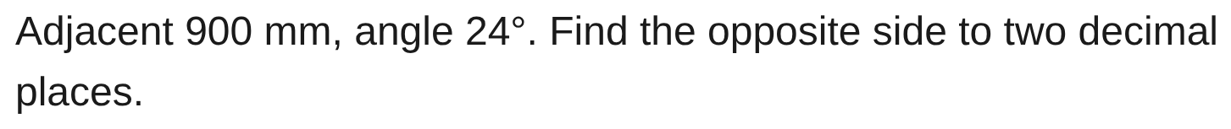
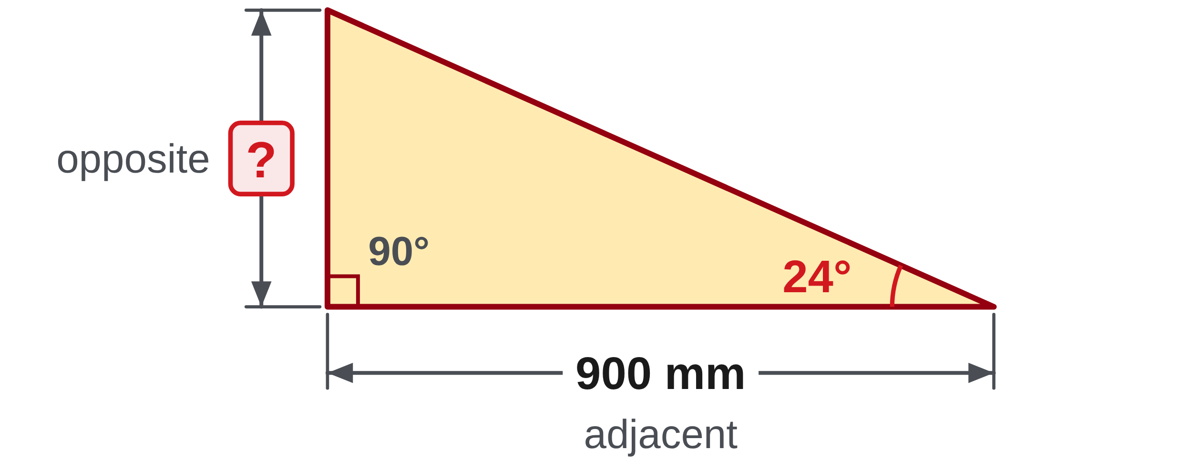
W07-L03 • PRACTISE • 9:40 AM–10:00 AM • 20 MIN TOTAL
Practise from the Exercise Book | 13A Q6
Use only the question for your selected skill pathway.
Textbook Chapter 4–5 pp.56–87; Chapter 7–8 pp.108–134; Chapter 12–13 pp.188–209, selected
Textbook
Exercise Book
Numeracy Hub
Shape Canvas
Day 24 • 2026-12-10 • 21
Notes:
PRACTISE • 9:40 AM–10:00 AM • 20 MIN TOTAL — shared across this phase’s slides.
Path C, attempt 13A Q6 with 900 millimetres adjacent to the marked 24-degree angle. Name the requested opposite side before choosing the ratio. After your attempt, tangent connects those two legs: opposite equals 900 times tan 24°, giving 400.71 millimetres. Why does a result shorter than 900 make sense? The angle is less than forty-five degrees. If your result differs, compare the side labels and DEG setting before repeating the calculator entry.
INSTRUCTOR ONLY — AFTER THE ATTEMPT: 400.71 mm Working: 900 × tan 24°

Slide 22
W07-L03 • CHECK • 10:00 AM–10:10 AM • 10 MIN TOTAL
Check independently
Use Path A: 4A Q14(b); B: 7A Q11; or C: 13A Q10. Explain the error avoided.
Submit work and demonstrate the checking strategy; identify a remaining difficulty.
Resources: Path A: 4A Q14–17 p.26; 5A Q12–15 p.33. B: 7A Q11–14 pp.45–46; 8C Q1–2 p.55. C: 12C Q1–2 p.79; 13A Q6,10 p.82.
Textbook Chapter 4–5 pp.56–87; Chapter 7–8 pp.108–134; Chapter 12–13 pp.188–209, selected
Textbook
Exercise Book
Numeracy Hub
Shape Canvas
Day 24 • 2026-12-10 • 22
Notes:
CHECK • 10:00 AM–10:10 AM • 10 MIN TOTAL — shared across this phase’s slides.
Complete only the check for your selected pathway: A uses 4A Q14(b), B uses 7A Q11, and C uses 13A Q10. Work independently and explain the error you avoided. Keep the earlier correction available as evidence after the check, but do not copy a solution into this attempt. I am looking for the same repaired idea used deliberately in the new response. Submit the method and a checking strategy with the final answer.

Slide 23
W07-L03 • CHECK • 10:00 AM–10:10 AM • 10 MIN TOTAL
Independent check | 4A Q14b
Use only the question for your selected skill pathway.
Textbook Chapter 4–5 pp.56–87; Chapter 7–8 pp.108–134; Chapter 12–13 pp.188–209, selected
Textbook
Exercise Book
Numeracy Hub
Shape Canvas
Day 24 • 2026-12-10 • 23
Notes:
CHECK • 10:00 AM–10:10 AM • 10 MIN TOTAL — shared across this phase’s slides.
Path A, complete 4A Q14(b) independently. Show how you combine the mixed numbers and express the final quantity. Include one sentence explaining the fraction error you avoided. Keep your answer private until the check finishes.
INSTRUCTOR ONLY — AFTER THE ATTEMPT: 3/8 = 6/16. Fraction sum 6/16 + 15/16 = 21/16 = 1 5/16. Whole parts 7 + 2 plus the regrouped whole give 10 5/16.

Slide 24
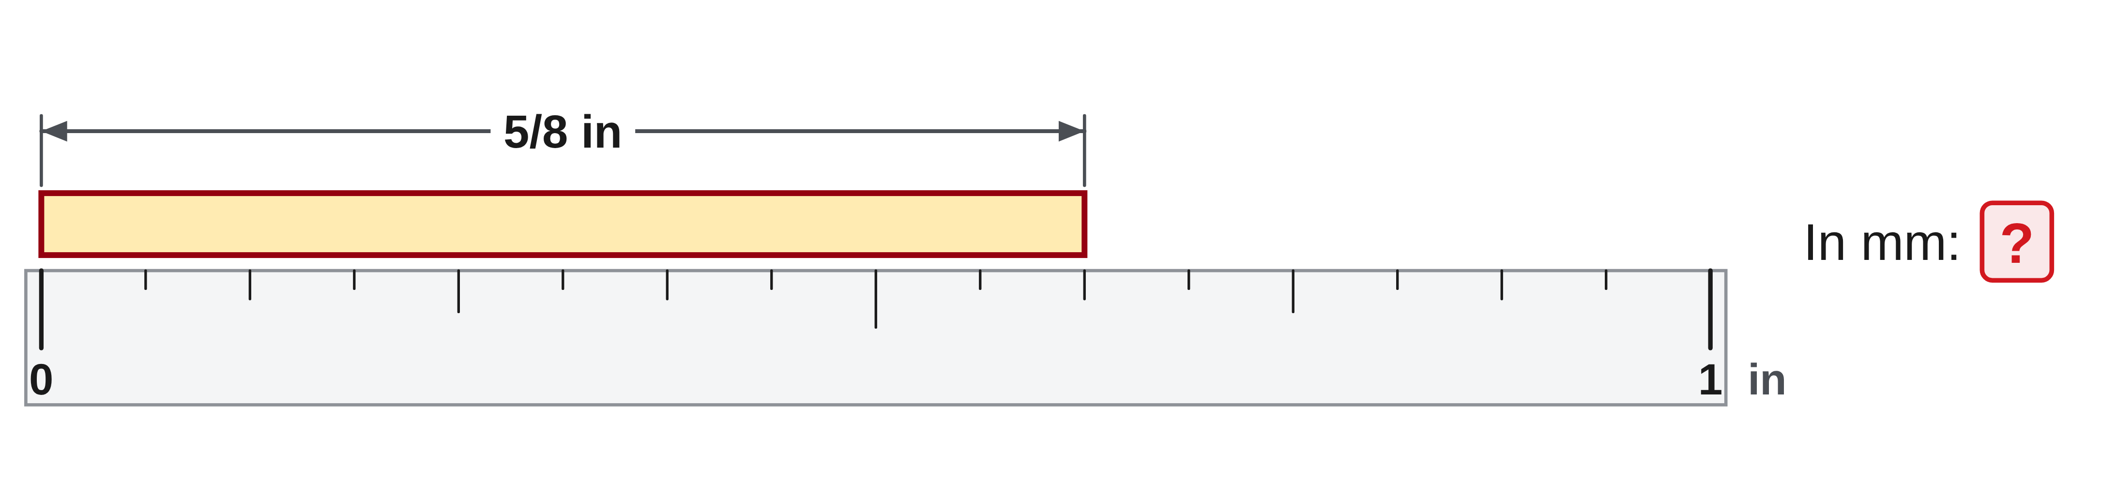
W07-L03 • CHECK • 10:00 AM–10:10 AM • 10 MIN TOTAL
Independent check | 7A Q11
Use only the question for your selected skill pathway.
Textbook Chapter 4–5 pp.56–87; Chapter 7–8 pp.108–134; Chapter 12–13 pp.188–209, selected
Textbook
Exercise Book
Numeracy Hub
Shape Canvas
Day 24 • 2026-12-10 • 24
Notes:
CHECK • 10:00 AM–10:10 AM • 10 MIN TOTAL — shared across this phase’s slides.
Path B, complete 7A Q11 independently. Record the starting unit, target unit and factor used so the conversion direction is clear. Explain how you would check the result in reverse. Do not reveal your answer while other pathways are still working.
INSTRUCTOR ONLY — AFTER THE ATTEMPT: 5/8 in = 0.625 in; 0.625 × 25.4 = 15.875 mm. Reverse division by 25.4 recovers 0.625 in. Look for the factor and unit reasoning.

Slide 25
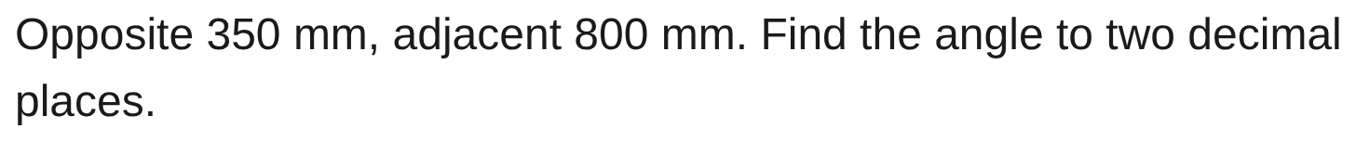
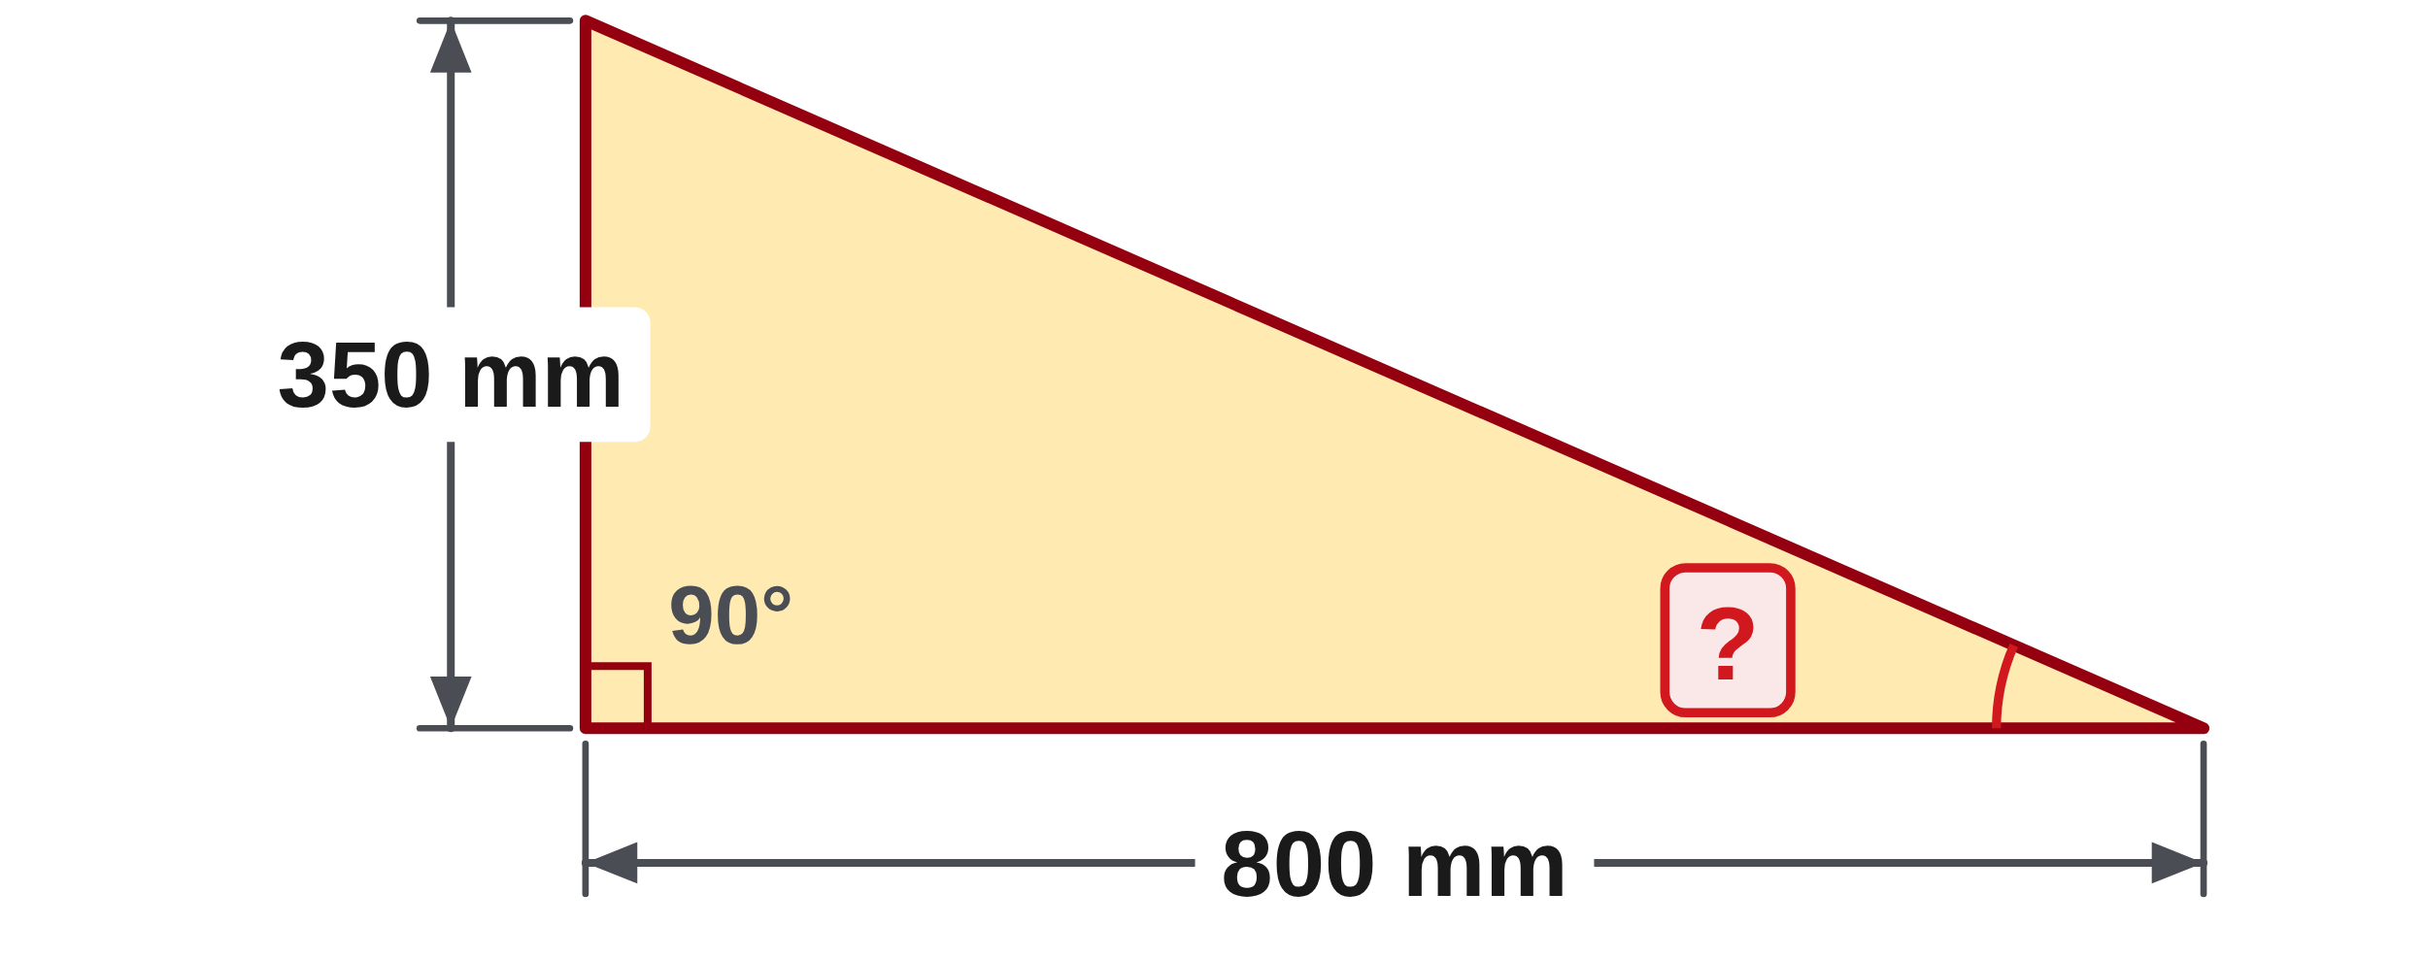
W07-L03 • CHECK • 10:00 AM–10:10 AM • 10 MIN TOTAL
Independent check | 13A Q10
Use only the question for your selected skill pathway.
Textbook Chapter 4–5 pp.56–87; Chapter 7–8 pp.108–134; Chapter 12–13 pp.188–209, selected
Textbook
Exercise Book
Numeracy Hub
Shape Canvas
Day 24 • 2026-12-10 • 25
Notes:
CHECK • 10:00 AM–10:10 AM • 10 MIN TOTAL — shared across this phase’s slides.
Path C, complete 13A Q10 independently. Label the stated sides relative to the marked angle and show the inverse function you select. Include the final rounding and a reasonableness check. Keep your method on the page until collection.
INSTRUCTOR ONLY — AFTER THE ATTEMPT: θ = tan⁻¹(350/800) = tan⁻¹(0.4375) ≈ 23.63°. The rise is less than the run, so an angle below 45° is consistent. A degree result requires DEG mode.

Slide 26
W07-L03 • WRAP UP • 10:10 AM–10:15 AM • 5 MIN TOTAL
Wrap up and choose the next step
Identify what improved, what needs another attempt and which resource will support the next step.
Name the math and another essential skill used; record a concrete follow-up action.
Resources: Path A: 4A Q14–17 p.26; 5A Q12–15 p.33. B: 7A Q11–14 pp.45–46; 8C Q1–2 p.55. C: 12C Q1–2 p.79; 13A Q6,10 p.82.
Textbook Chapter 4–5 pp.56–87; Chapter 7–8 pp.108–134; Chapter 12–13 pp.188–209, selected
Textbook
Exercise Book
Numeracy Hub
Shape Canvas
Day 24 • 2026-12-10 • 26
Notes:
WRAP UP • 10:10 AM–10:15 AM • 5 MIN TOTAL — shared across this phase’s slides.
Compare your original error with the independent pathway response. What can you now explain without looking at the tool? Name the precise improvement: regrouping, conversion direction, isolating a dimension or choosing the triangle relationship. If the error reappeared, keep that evidence and identify the step needing another attempt. After the break, mixed practice will ask you to recognize which method belongs to a fresh question, so bring your checking strategy with you.

Slide 27
DAY 24 • SCHEDULED BREAK
Break
10:15 AM–10:30 AM
Return ready for: Mixed-topic calculation practice
This break is excluded from teaching minutes.
Textbook
Exercise Book
Numeracy Hub
Shape Canvas
Day 24 • 2026-12-10 • 27
Notes:
Scheduled break — resume at the time shown.
Take the scheduled break and return at 10:30. Keep the pathway correction and independent check together. Our next block mixes taught topics, so you will use the same checking habits while deciding which method a question needs. Bring your calculator and the textbook formula and conversion pages back ready for use.

Slide 28
W07-L04 • START • 10:30 AM–10:35 AM • 5 MIN TOTAL
Mixed-topic calculation practice
Today’s goal: Apply taught methods to fresh practice, retain working and use feedback to choose a revision priority.
Identify one target skill and the checking habit to use today.
Textbook formula sheet p.219; conversion factors pp.220–221; relevant chapters as needed
Paper fallback: 3A Q8–9 p.19; 6B Q2 p.41; 7A Q11 p.45; 8C Q1–2 p.55; 10A Q5–6 p.63; 12C Q1–2 p.79.
Keep your notebook, textbook, exercise book and chosen calculator ready.
Textbook formula sheet p.219; conversion factors pp.220–221; relevant chapters as needed
Textbook
Exercise Book
Numeracy Hub
Shape Canvas
Day 24 • 2026-12-10 • 28
Notes:
START • 10:30 AM–10:35 AM • 5 MIN TOTAL — shared across this phase’s slides.
The next block is formative mixed practice. We will use a previewed ten-question set in Numeracy Hub or the exact ten paper fallback items shown in the plan. Your written method matters as much as the result because it tells us what to revise next. Keep the formula sheet on page 219 and conversion factors on pages 220–221 available. This practice gives feedback about taught skills; it is not an institutional pass-or-fail test.

Slide 29
W07-L04 • RECALL • 10:35 AM–10:40 AM • 5 MIN TOTAL
Recall and reconnect
Try to choose one personal error to watch for and identify their calculator model.
Review previous feedback and attempt the retrieval prompt without displayed solutions.
Resources: Paper fallback: 3A Q8–9 p.19; 6B Q2 p.41; 7A Q11 p.45; 8C Q1–2 p.55; 10A Q5–6 p.63; 12C Q1–2 p.79.
Textbook formula sheet p.219; conversion factors pp.220–221; relevant chapters as needed
Textbook
Exercise Book
Numeracy Hub
Shape Canvas
Day 24 • 2026-12-10 • 29
Notes:
RECALL • 10:35 AM–10:40 AM • 5 MIN TOTAL — shared across this phase’s slides.
Before we begin, choose one personal error to watch for. Write a short reminder such as “keep brackets,” “state the conversion direction” or “label the unknown before selecting a formula.” Identify your calculator model so you know the key order and, where needed, the angle setting. What should a check do? Test the part of your method most likely to fail. A reminder tied to an actual past error is more useful than a general instruction to be careful.

Slide 30
W07-L04 • TEACH • 10:40 AM–10:55 AM • 15 MIN TOTAL
Make the generated set reproducible
1
Start with All off and enable only taught order, conversion, area/perimeter, volume or right-triangle topics.
2
Use Easy, 10 questions, diagrams on and calculator keys on; keep worked answers off during the attempt.
3
Retain the exam code before use. The instructor previews the set and removes untaught or trade-specific material.
4
Use the previewed ten-question set or the exact ten paper fallback items. This is formative practice, not an institutional pass/fail test.
Textbook formula sheet p.219; conversion factors pp.220–221; relevant chapters as needed
Textbook
Exercise Book
Numeracy Hub
Shape Canvas
Day 24 • 2026-12-10 • 30
Notes:
TEACH • 10:40 AM–10:55 AM • 15 MIN TOTAL — shared across this phase’s slides.
In Exam builder, start with All off and enable only the taught topics selected for this practice: order of operations, conversions, area or perimeter, volume, or right triangles. Use Easy and ten questions, with diagrams and calculator keys on and worked answers off. Save the code before beginning so the exact set can be checked later. I will preview the questions and remove material outside our taught scope. Why save the code? Generated values can change, and feedback is meaningful only when the answer belongs to the question you actually attempted.

Slide 31
W07-L04 • TEACH • 10:40 AM–10:55 AM • 15 MIN TOTAL
Record the method before checking the result
1
Start each response with the question number or saved code so the working can be matched to its prompt.
2
Write the formula or operation, then working, units and the requested final rounding.
3
Include an estimate or second-method check; a calculator display alone does not explain your method.
4
After completion, check and correct. The scheduled independent retry uses new numbers for one missed type from the same taught-topic settings.
Textbook formula sheet p.219; conversion factors pp.220–221; relevant chapters as needed
Textbook
Exercise Book
Numeracy Hub
Shape Canvas
Day 24 • 2026-12-10 • 31
Notes:
TEACH • 10:40 AM–10:55 AM • 15 MIN TOTAL — shared across this phase’s slides.
For each response, begin with the question number or saved code. Then write the operation or formula, substitute the values, keep units visible and round at the requested final step. Add an estimate or another check that tests your method. What is missing from a calculator display alone? The reason that those numbers and that operation answer the question. After the set is complete, we will compare and correct. The later independent retry will use new numbers for one missed type, so understanding the method matters more than remembering today's answer.

Slide 32
W07-L04 • TEACH • 10:40 AM–10:55 AM • 15 MIN TOTAL
Keep a reproducible ten-question record
Demonstrate reading a question, saving its code and using requested rounding.
Work one separate example together; keep practice-set answers hidden.
PAPER FALLBACK • ITEMS 1–5
1. 3A Q8 — p.19
2. 3A Q9 — p.19
3. 6B Q2 — p.41
4. 7A Q11 — p.45
5. 8C Q1 — p.55
PAPER FALLBACK • ITEMS 6–10
6. 8C Q2 — p.55
7. 10A Q5 — p.63
8. 10A Q6 — p.63
9. 12C Q1 — p.79
10. 12C Q2 — p.79
Response format • Question number/code → formula or operation → working
→ units and final rounding → estimate or second-method check.
Exercise Book required for full numbered questions • Use the assigned paper questions if needed
Textbook
Exercise Book
Numeracy Hub
Shape Canvas
Day 24 • 2026-12-10 • 32
Notes:
TEACH • 10:40 AM–10:55 AM • 15 MIN TOTAL — shared across this phase’s slides.
This slide fixes the paper fallback order so your working can be matched to the prompts. Items one and two are 3A Q8 and Q9; then come 6B Q2, 7A Q11 and 8C Q1. The second half is 8C Q2, 10A Q5 and Q6, then 12C Q1 and Q2. Use the exercise book for the complete questions and diagrams. What should you write above each response? Its item number and book reference. That simple record lets us compare the correct prompt, your original attempt and the later correction without confusion.

Slide 33
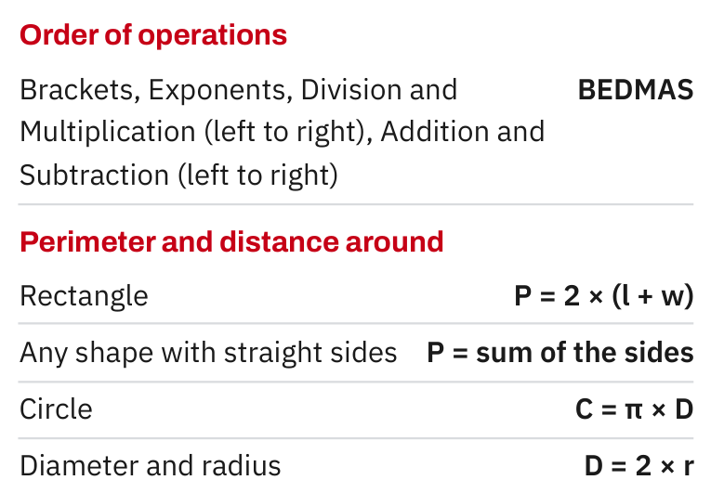
W07-L04 • TEACH • 10:40 AM–10:55 AM • 15 MIN TOTAL
Textbook | page 219
Use only formulas for the topics selected in today’s practice set.
Textbook formula sheet p.219; conversion factors pp.220–221; relevant chapters as needed
Textbook
Exercise Book
Numeracy Hub
Shape Canvas
Day 24 • 2026-12-10 • 33
Notes:
TEACH • 10:40 AM–10:55 AM • 15 MIN TOTAL — shared across this phase’s slides.
The formula sheet on page 219 is a reference, not a menu to try at random. Read the unknown in the question first. Boundary points toward perimeter; coverage points toward area; space inside a prism points toward volume. Identify the drawing and dimensions, then choose the relevant formula from the taught topics selected today. What determines whether the answer needs square units? The quantity is an area. Copying a formula without checking what it measures can produce tidy arithmetic that answers a different question.

Slide 34
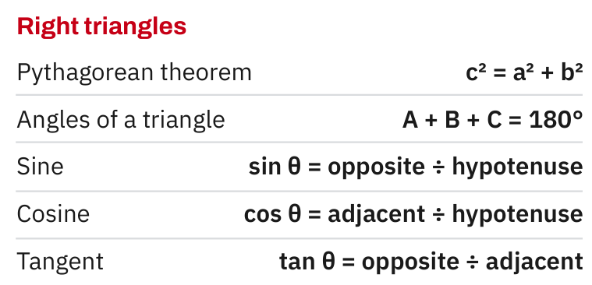
W07-L04 • TEACH • 10:40 AM–10:55 AM • 15 MIN TOTAL
Textbook | page 219
Right-triangle references apply only when those taught topics are selected.
Textbook formula sheet p.219; conversion factors pp.220–221; relevant chapters as needed
Textbook
Exercise Book
Numeracy Hub
Shape Canvas
Day 24 • 2026-12-10 • 34
Notes:
TEACH • 10:40 AM–10:55 AM • 15 MIN TOTAL — shared across this phase’s slides.
Use the right-triangle section of the formula sheet only when the selected practice actually calls for a taught triangle method. First locate the right angle. With two sides, Pythagoras may find the third; with an angle and a side, a trig ratio may be appropriate. The side names must match the marked angle. What distinguishes the hypotenuse from either leg? It lies across from the right angle. That fact remains true if the drawing is rotated, and it tells you how to place the known lengths in the relationship.

Slide 35
W07-L04 • TEACH • 10:40 AM–10:55 AM • 15 MIN TOTAL
Spot the mistake. Explain the correction.
You reveal worked answers while you are still completing the set, then copy the method. Can the record show which method you chose independently?
Discuss the method before checking the answer.
Keep worked answers hidden until the whole attempt is complete. Then use Check my answers, reveal worked answers for corrections, and retain the code/results so the attempt and correction can be distinguished.
Textbook formula sheet p.219; conversion factors pp.220–221; relevant chapters as needed
Textbook
Exercise Book
Numeracy Hub
Shape Canvas
Day 24 • 2026-12-10 • 35
Notes:
TEACH • 10:40 AM–10:55 AM • 15 MIN TOTAL — shared across this phase’s slides.
If worked answers appear while you are still choosing a method, the record no longer shows what you could do independently. Keep them hidden until the whole attempt is complete. Then use Check my answers, reveal the worked solutions and compare each step with your own. What should remain visible after correcting? Both the initial method and the explanation of the change. The purpose is useful feedback, so we need an honest record of the point where your reasoning changed, not a page that looks perfect after copying.

Slide 36
W07-L04 • TOGETHER • 10:55 AM–11:10 AM • 15 MIN TOTAL
Work together
Work one separate demonstration question; state the formula and units before keys. Keep assessment/practice answers hidden.
Explain the method and check directions; work with a partner only where permitted.
Resources: Paper fallback: 3A Q8–9 p.19; 6B Q2 p.41; 7A Q11 p.45; 8C Q1–2 p.55; 10A Q5–6 p.63; 12C Q1–2 p.79.
Textbook formula sheet p.219; conversion factors pp.220–221; relevant chapters as needed
Textbook
Exercise Book
Numeracy Hub
Shape Canvas
Day 24 • 2026-12-10 • 36
Notes:
TOGETHER • 10:55 AM–11:10 AM • 15 MIN TOTAL — shared across this phase’s slides.
Let's practise the response format with a separate example before the set. Imagine a rectangle three metres by two metres and find its perimeter. We write P = 2(l + w), then P = 2(3 + 2) = 10 metres. A second check adds the four edges: 3 + 2 + 3 + 2 = 10. Which parts made that response complete? A named quantity, formula, substitution, unit and check. Keep this demonstration separate from the ten assigned practice questions.

Slide 37
W07-L04 • PRACTISE • 11:10 AM–11:45 AM • 35 MIN TOTAL
Your scheduled practice
Complete the previewed 10-question Numeracy Hub set, or the ten paper fallback questions. Keep written methods. Use Check my answers only after completion; reveal worked answers for correction and save the code/results manually.
Keep numbered written solutions and units. Use tools only under the conditions stated for this block.
Resources: Paper fallback: 3A Q8–9 p.19; 6B Q2 p.41; 7A Q11 p.45; 8C Q1–2 p.55; 10A Q5–6 p.63; 12C Q1–2 p.79.
Textbook formula sheet p.219; conversion factors pp.220–221; relevant chapters as needed
Textbook
Exercise Book
Numeracy Hub
Shape Canvas
Day 24 • 2026-12-10 • 37
Notes:
PRACTISE • 11:10 AM–11:45 AM • 35 MIN TOTAL — shared across this phase’s slides.
Complete the previewed ten-question Numeracy Hub set or the exact ten paper fallback questions. Keep numbered methods and units on paper. Use Check my answers only after all ten have been attempted; then reveal worked answers for corrections and save the code and results manually. If you become stuck, record where rather than replacing the attempt with a copied solution. The later retry will focus on one missed type, so the written evidence helps us choose useful feedback.

Slide 38
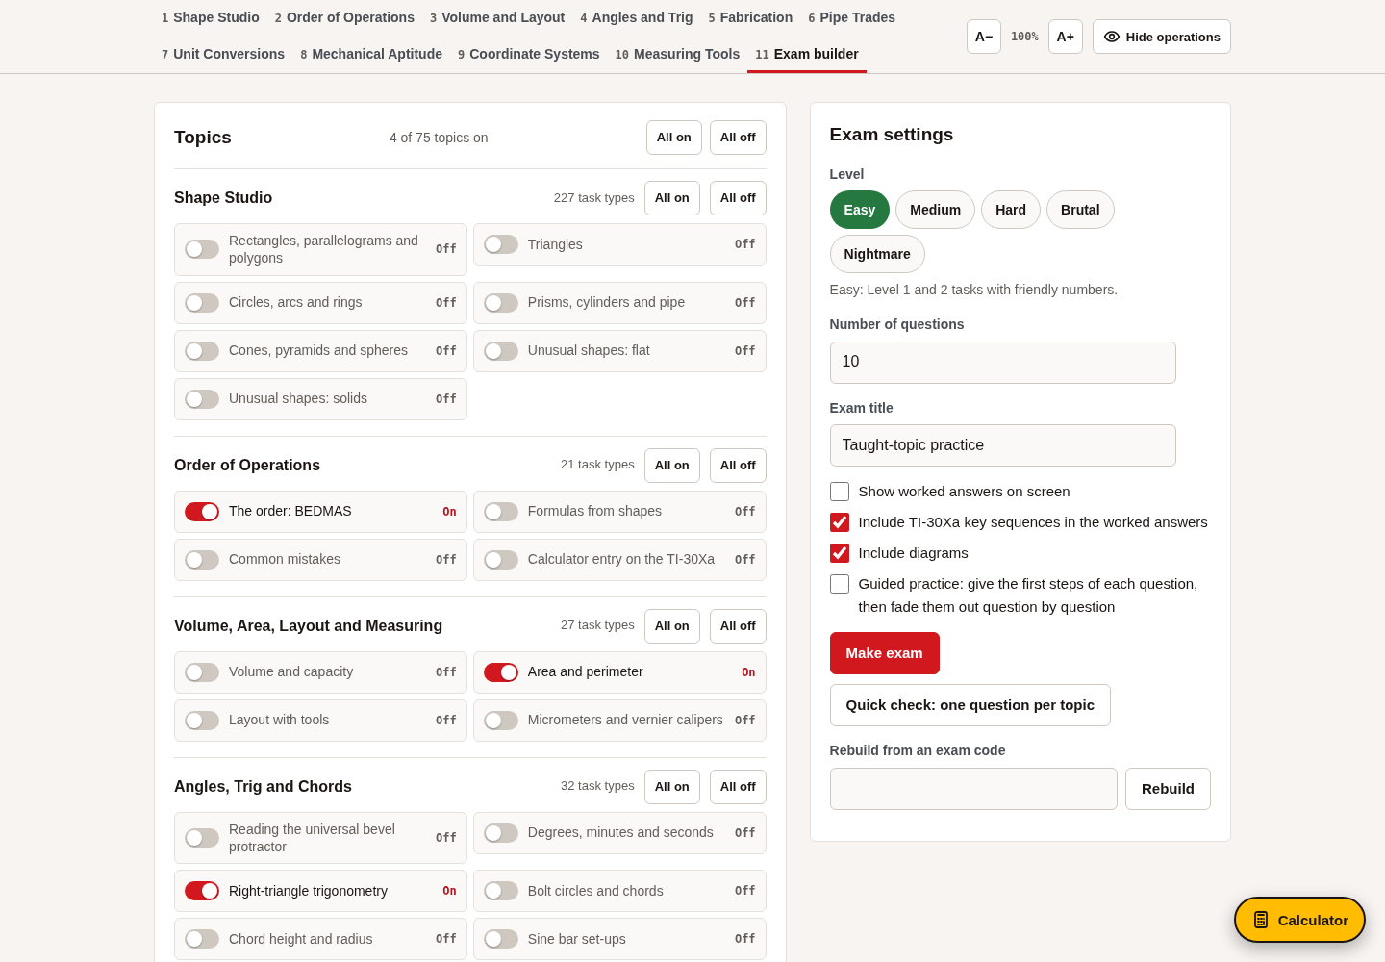
W07-L04 • PRACTISE • 11:10 AM–11:45 AM • 35 MIN TOTAL
Open Numeracy Hub
Navigation example. Use the values and units in the assigned task.
Textbook formula sheet p.219; conversion factors pp.220–221; relevant chapters as needed
Textbook
Exercise Book
Numeracy Hub
Shape Canvas
Day 24 • 2026-12-10 • 38
Notes:
PRACTISE • 11:10 AM–11:45 AM • 35 MIN TOTAL — shared across this phase’s slides.
Open the previewed Numeracy Hub set and verify its saved code before starting. Confirm that worked answers are off and that the selected topics match what we have taught. The navigation image is not the source of your question values; your own generated set is. What belongs on your paper beside the number? The code or reference that connects the working to its prompt. Retain that record when you check, because a regenerated question may have different values and a different answer.

Slide 39
W07-L04 • PRACTISE • 11:10 AM–11:45 AM • 35 MIN TOTAL
Practise in Numeracy Hub
1
Configure Numeracy Hub Exam builder: All off; only the scheduled taught topics; Easy; 10 questions; diagrams and calculator keys on; worked answers off. Save the code and use the instructor-previewed set.
2
Complete the ten questions with numbered written methods and units. Use the exact scheduled paper fallback if the generated set is not used.
3
After completion, use Check my answers and then worked answers for corrections; save code/results manually. For the scheduled check, explain one correction and independently retry one missed type with new numbers from the same settings.
Textbook formula sheet p.219; conversion factors pp.220–221; relevant chapters as needed
Textbook
Exercise Book
Numeracy Hub
Shape Canvas
Day 24 • 2026-12-10 • 39
Notes:
PRACTISE • 11:10 AM–11:45 AM • 35 MIN TOTAL — shared across this phase’s slides.
Use Easy with ten questions, diagrams and calculator keys on, and worked answers off. Complete the written attempt before pressing Check my answers. Then compare the saved set's solutions with your work and explain one correction. For the independent check later, we will use new numbers of one missed type from the same taught-topic settings. Which answer key applies to a generated question? The one tied to its saved code. The fixed paper answers apply only to the printed fallback items.

Slide 40
W07-L04 • PRACTISE • 11:10 AM–11:45 AM • 35 MIN TOTAL
Paper fallback 1 of 10 | 3A Q8
Write the operation, working and units before checking.
Textbook formula sheet p.219; conversion factors pp.220–221; relevant chapters as needed
Textbook
Exercise Book
Numeracy Hub
Shape Canvas
Day 24 • 2026-12-10 • 40
Notes:
PRACTISE • 11:10 AM–11:45 AM • 35 MIN TOTAL — shared across this phase’s slides.
Paper item one is 3A Q8: six squared minus four times five. Write each stage of the order of operations on a new line and retain the expression until the whole set is finished. Keep this answer private during the attempt.
INSTRUCTOR ONLY — AFTER THE WHOLE SET: 6² = 36 and 4 × 5 = 20; 36 − 20 = 16. Explain that exponent and multiplication precede the subtraction; left-to-right subtraction at the start changes the expression.

Slide 41
W07-L04 • PRACTISE • 11:10 AM–11:45 AM • 35 MIN TOTAL
Paper fallback 2 of 10 | 3A Q9
Write the operation, working and units before checking.
Textbook formula sheet p.219; conversion factors pp.220–221; relevant chapters as needed
Textbook
Exercise Book
Numeracy Hub
Shape Canvas
Day 24 • 2026-12-10 • 41
Notes:
PRACTISE • 11:10 AM–11:45 AM • 35 MIN TOTAL — shared across this phase’s slides.
Paper item two is 3A Q9. Notice that the expression has brackets around six minus four. Copy those brackets before starting and show how the expression changes at each step. Keep the attempt independent until all ten items are complete.
INSTRUCTOR ONLY — AFTER THE WHOLE SET: (6 − 4)² × 5 = 2² × 5 = 4 × 5 = 20. The brackets change the first operation, which explains why this result differs from item one despite similar numbers.

Slide 42
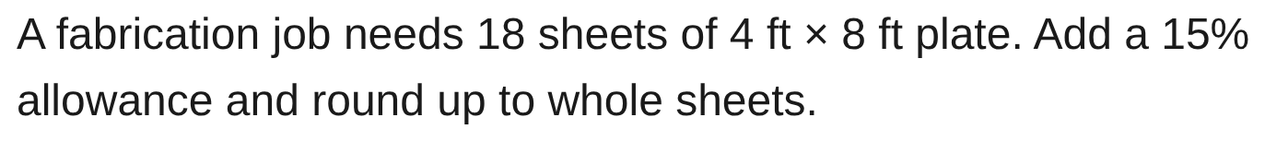
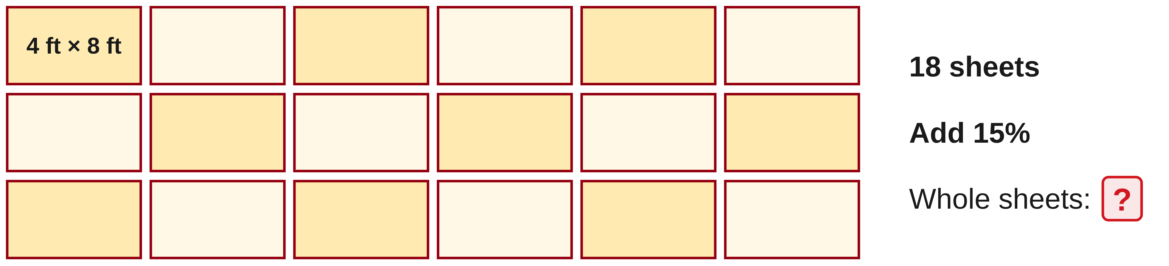
W07-L04 • PRACTISE • 11:10 AM–11:45 AM • 35 MIN TOTAL
Paper fallback 3 of 10 | 6B Q2
Write the operation, working and units before checking.
Textbook formula sheet p.219; conversion factors pp.220–221; relevant chapters as needed
Textbook
Exercise Book
Numeracy Hub
Shape Canvas
Day 24 • 2026-12-10 • 42
Notes:
PRACTISE • 11:10 AM–11:45 AM • 35 MIN TOTAL — shared across this phase’s slides.
Paper item three is 6B Q2. Record the original sheet requirement, stated allowance and final whole-sheet purchase. Keep the unrounded total in your working so the reason for the last rounding step is visible. Complete the attempt before checking.
INSTRUCTOR ONLY — AFTER THE WHOLE SET: 18 × 1.15 = 20.7 sheets, so order 21 whole sheets. The original 18 remains the base; 15% adds 2.7 sheets. Ordering 20 would fall short of the stated allowance quantity.

Slide 43
W07-L04 • PRACTISE • 11:10 AM–11:45 AM • 35 MIN TOTAL
Paper fallback 4 of 10 | 7A Q11
Write the operation, working and units before checking.
Textbook formula sheet p.219; conversion factors pp.220–221; relevant chapters as needed
Textbook
Exercise Book
Numeracy Hub
Shape Canvas
Day 24 • 2026-12-10 • 43
Notes:
PRACTISE • 11:10 AM–11:45 AM • 35 MIN TOTAL — shared across this phase’s slides.
Paper item four is 7A Q11. Show the starting measurement and target unit along with your conversion operation. Keep enough working to explain the direction of the factor. Do not open the answer until the entire set is complete.
INSTRUCTOR ONLY — AFTER THE WHOLE SET: 5/8 = 0.625; 0.625 × 25.4 = 15.875 mm. The factor is 25.4 millimetres per inch. Reverse division by 25.4 recovers the original fractional-inch quantity.

Slide 44

W07-L04 • PRACTISE • 11:10 AM–11:45 AM • 35 MIN TOTAL
Paper fallback 5 of 10 | 8C Q1
Write the operation, working and units before checking.
Textbook formula sheet p.219; conversion factors pp.220–221; relevant chapters as needed
Textbook
Exercise Book
Numeracy Hub
Shape Canvas
Day 24 • 2026-12-10 • 44
Notes:
PRACTISE • 11:10 AM–11:45 AM • 35 MIN TOTAL — shared across this phase’s slides.
Paper item five is 8C Q1. Read the given dimension from the rectangle's diagram and identify the missing width. Record the relationship you use and label the resulting unit. Retain your own first attempt until the ten-question set is finished.
INSTRUCTOR ONLY — AFTER THE WHOLE SET: Width = area ÷ length = 4,800 cm² ÷ 80 cm = 60 cm. Substitution gives 80 × 60 = 4,800 cm². The requested width is a length, not an area.

Slide 45
W07-L04 • PRACTISE • 11:10 AM–11:45 AM • 35 MIN TOTAL
Paper fallback 6 of 10 | 8C Q2
Write the operation, working and units before checking.
Textbook formula sheet p.219; conversion factors pp.220–221; relevant chapters as needed
Textbook
Exercise Book
Numeracy Hub
Shape Canvas
Day 24 • 2026-12-10 • 45
Notes:
PRACTISE • 11:10 AM–11:45 AM • 35 MIN TOTAL — shared across this phase’s slides.
Paper item six is 8C Q2. The given quantity is the square's area. Identify what must be recovered and show the relationship between that unknown and the stated area. Keep your working visible before any tool check.
INSTRUCTOR ONLY — AFTER THE WHOLE SET: Side = √3,136 = 56 mm. Squaring 56 gives 3,136 mm² again. Dividing the area by four would confuse a square's four edges with the relationship defining its area.

Slide 46
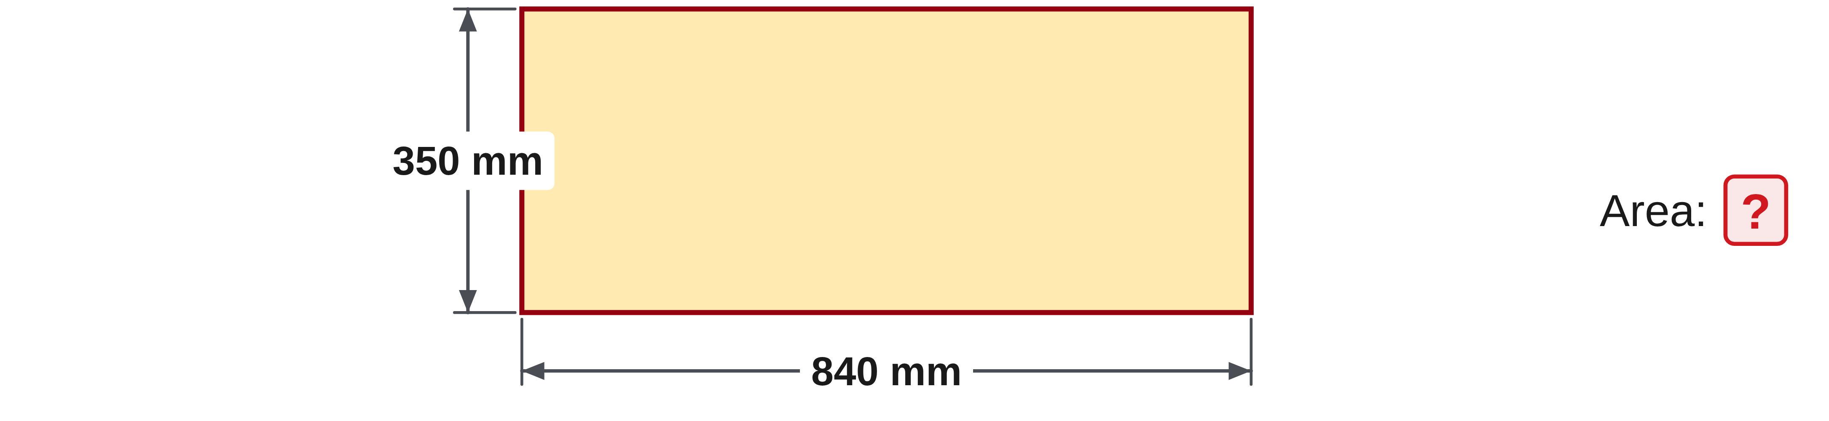
W07-L04 • PRACTISE • 11:10 AM–11:45 AM • 35 MIN TOTAL
Paper fallback 7 of 10 | 10A Q5
Write the operation, working and units before checking.
Textbook formula sheet p.219; conversion factors pp.220–221; relevant chapters as needed
Textbook
Exercise Book
Numeracy Hub
Shape Canvas
Day 24 • 2026-12-10 • 46
Notes:
PRACTISE • 11:10 AM–11:45 AM • 35 MIN TOTAL — shared across this phase’s slides.
Paper item seven is 10A Q5. Copy the rectangle's two dimensions and the requested quantity before calculating. Include the unit with the final result, and keep your answer private until the complete set has been attempted.
INSTRUCTOR ONLY — AFTER THE WHOLE SET: A = 840 × 350 = 294,000 mm². Multiplying two lengths gives square units. A perimeter calculation would add the edge lengths and answer a different question.

Slide 47

W07-L04 • PRACTISE • 11:10 AM–11:45 AM • 35 MIN TOTAL
Paper fallback 8 of 10 | 10A Q6
Write the operation, working and units before checking.
Textbook formula sheet p.219; conversion factors pp.220–221; relevant chapters as needed
Textbook
Exercise Book
Numeracy Hub
Shape Canvas
Day 24 • 2026-12-10 • 47
Notes:
PRACTISE • 11:10 AM–11:45 AM • 35 MIN TOTAL — shared across this phase’s slides.
Paper item eight is 10A Q6. Record the square's side length and show the operation that produces its area. Keep the precision required by the given measurement; do not replace the first attempt after seeing a tool answer.
INSTRUCTOR ONLY — AFTER THE WHOLE SET: A = 1.6 × 1.6 = 2.56 m². Four times 1.6 would give perimeter, 6.4 m, rather than area. The diagram's requested quantity determines the operation and unit.

Slide 48
W07-L04 • PRACTISE • 11:10 AM–11:45 AM • 35 MIN TOTAL
Paper fallback 9 of 10 | 12C Q1
Write the operation, working and units before checking.
Textbook formula sheet p.219; conversion factors pp.220–221; relevant chapters as needed
Textbook
Exercise Book
Numeracy Hub
Shape Canvas
Day 24 • 2026-12-10 • 48
Notes:
PRACTISE • 11:10 AM–11:45 AM • 35 MIN TOTAL — shared across this phase’s slides.
Paper item nine is 12C Q1. Read both known side lengths from the diagram and label the unknown hypotenuse. Show the right-triangle relationship and all working, then keep the response for the end-of-set comparison.
INSTRUCTOR ONLY — AFTER THE WHOLE SET: The hypotenuse is 390 mm. Check that the learner adds the squares of the two diagram legs and then takes the square root. The result must be longer than either leg and expressed as a length.

Slide 49
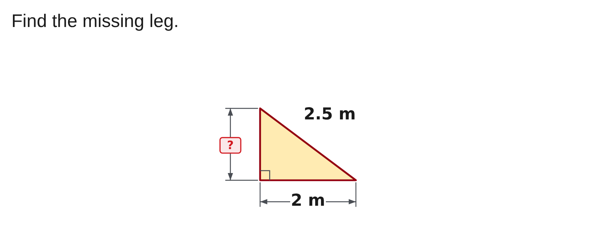
W07-L04 • PRACTISE • 11:10 AM–11:45 AM • 35 MIN TOTAL
Paper fallback 10 of 10 | 12C Q2
Write the operation, working and units before checking.
Textbook formula sheet p.219; conversion factors pp.220–221; relevant chapters as needed
Textbook
Exercise Book
Numeracy Hub
Shape Canvas
Day 24 • 2026-12-10 • 49
Notes:
PRACTISE • 11:10 AM–11:45 AM • 35 MIN TOTAL — shared across this phase’s slides.
Paper item ten is 12C Q2. Identify the missing leg and distinguish it from the hypotenuse before writing the equation. Keep the diagram's units consistent and retain your full method for comparison after this last attempt.
INSTRUCTOR ONLY — AFTER THE WHOLE SET: The missing leg is 1.5 m. Rearrange c² = a² + b² to subtract the known leg's square from the hypotenuse's square, then take the square root. The unknown leg must be shorter than the hypotenuse.

Slide 50
W07-L04 • CHECK • 11:45 AM–11:55 AM • 10 MIN TOTAL
Check independently
Explain one corrected item and independently redo one missed type using new numbers from the same tool settings.
Submit work and demonstrate the checking strategy; identify a remaining difficulty.
Resources: Paper fallback: 3A Q8–9 p.19; 6B Q2 p.41; 7A Q11 p.45; 8C Q1–2 p.55; 10A Q5–6 p.63; 12C Q1–2 p.79.
Textbook formula sheet p.219; conversion factors pp.220–221; relevant chapters as needed
Textbook
Exercise Book
Numeracy Hub
Shape Canvas
Day 24 • 2026-12-10 • 50
Notes:
CHECK • 11:45 AM–11:55 AM • 10 MIN TOTAL — shared across this phase’s slides.
Choose one corrected item and explain where your first method failed. Then attempt a fresh question of that same missed type using new numbers from the taught-topic settings. Keep the retry independent, with worked answers off. The goal is to show that the correction changed your decision-making. For a generated retry, retain its code and compare only with its own saved worked answer. A memorized result from the original question will not demonstrate the repaired method.

Slide 51
W07-L04 • WRAP UP • 11:55 AM–12:00 PM • 5 MIN TOTAL
Wrap up and choose the next step
Identify what improved, what needs another attempt and which resource will support the next step.
Name the math and another essential skill used; record a concrete follow-up action.
Resources: Paper fallback: 3A Q8–9 p.19; 6B Q2 p.41; 7A Q11 p.45; 8C Q1–2 p.55; 10A Q5–6 p.63; 12C Q1–2 p.79.
Textbook formula sheet p.219; conversion factors pp.220–221; relevant chapters as needed
Textbook
Exercise Book
Numeracy Hub
Shape Canvas
Day 24 • 2026-12-10 • 51
Notes:
WRAP UP • 11:55 AM–12:00 PM • 5 MIN TOTAL — shared across this phase’s slides.
Record two revision priorities from today's evidence. Name the step, not just the chapter: for example, “convert the whole mixed number before multiplying” or “subtract squared lengths when a leg is missing.” Include the book reference and tool module that support each priority. What did the independent retry reveal? Whether you can apply the corrected method to new values. Keep the original set, corrections and retry together so the next review starts from evidence rather than guesswork.

