Slide 1

CARPENTRY FOUNDATION / INTAKE 142
Day 25 | Monday
25
December 14, 2026
Review: numbers, units and formulas
9:00 AM–10:15 AM • Math Review • 75 min
Review: geometry and job problems
10:30 AM–12:00 PM • Math Review • 90 min
Week 8 • 2 scheduled blocks • 165 teaching minutes
Estimate. Show the method. Label units. Check the result.
Textbook
Exercise Book
Numeracy Hub
Shape Canvas
Day 25 • 2026-12-14 • 01
Notes:
Opening — within the first scheduled Start period; no additional teaching time.
Today is a review of choosing methods, first for numbers, units and formulas, then for geometry and job problems. Start with the two priorities you identified last week. We will use stations and worked explanations to strengthen those decisions before another independent check. The aim is not to race through familiar answers. It is to explain why an operation fits the unknown and how you would detect an error in your own result.

Slide 2
DAY 25 / WEEK 8 / CLASS TIMETABLE
Today’s exact schedule
9:00 AM–10:15 AM • 75 min
10:30 AM–12:00 PM • 90 min
Review: numbers, units and formulas
Review: geometry and job problems
9:00 AM–9:05 AM
Start
5
10:30 AM–10:35 AM
Start
5
9:05 AM–9:10 AM
Recall
5
10:35 AM–10:40 AM
Recall
5
9:10 AM–9:25 AM
Teach
15
10:40 AM–10:55 AM
Teach
15
9:25 AM–9:40 AM
Together
15
10:55 AM–11:10 AM
Together
15
9:40 AM–10:00 AM
Practise
20
11:10 AM–11:45 AM
Practise
35
10:00 AM–10:10 AM
Check
10
11:45 AM–11:55 AM
Check
10
10:10 AM–10:15 AM
Wrap up
5
11:55 AM–12:00 PM
Wrap up
5
Math Review • Math Week 8, Lesson 1
Math Review • Math Week 8, Lesson 2
Break: 10:15 AM–10:30 AM • 15 minutes • excluded from teaching time
Textbook
Exercise Book
Numeracy Hub
Shape Canvas
Day 25 • 2026-12-14 • 02
Notes:
Opening — within the first scheduled Start period; no additional teaching time.
The first review block runs from 9:00 to 10:15, including twenty minutes for station practice and a ten-minute independent check. We break until 10:30, then review geometry and job problems until noon. The second block has thirty-five minutes of practice because the applications need time for drawings and working. Keep the scheduled phases together: the slides within one phase share its minutes, leaving enough time for your actual problem solving.

Slide 3
W08-L01 • START • 9:00 AM–9:05 AM • 5 MIN TOTAL
Review: numbers, units and formulas
Today’s goal: Retrieve core methods across the course and explain when each method is appropriate.
Identify one target skill and the checking habit to use today.
Textbook Chapter 1–8, selected; formula sheet p.219; conversion factors pp.220–221
Stations: 1B Q3 p.8; 4A Q14(a),15(a) p.26; 5A Q12–13 p.33; 6A Q19 p.40; 7A Q11–12 p.45; 8C Q1–2 p.55.
Keep your notebook, textbook, exercise book and chosen calculator ready.
Textbook Chapter 1–8, selected; formula sheet p.219; conversion factors pp.220–221
Textbook
Exercise Book
Numeracy Hub
Shape Canvas
Day 25 • 2026-12-14 • 03
Notes:
START • 9:00 AM–9:05 AM • 5 MIN TOTAL — shared across this phase’s slides.
Open your two revision priorities from last week. Today the number, fraction, conversion and formula stations give you a chance to test those methods again. Keep the formula sheet on page 219 and conversion factors on pages 220–221 available. What should you decide before entering calculator keys? The operation or relationship that fits the question. By the end of this block, you should be able to justify that decision and demonstrate a check on the result.

Slide 4
W08-L01 • RECALL • 9:05 AM–9:10 AM • 5 MIN TOTAL
Recall and reconnect
Use learners’ two priorities from Week 7. Ask each to identify a useful checking strategy.
Review previous feedback and attempt the retrieval prompt without displayed solutions.
Resources: Stations: 1B Q3 p.8; 4A Q14(a),15(a) p.26; 5A Q12–13 p.33; 6A Q19 p.40; 7A Q11–12 p.45; 8C Q1–2 p.55.
Textbook Chapter 1–8, selected; formula sheet p.219; conversion factors pp.220–221
Textbook
Exercise Book
Numeracy Hub
Shape Canvas
Day 25 • 2026-12-14 • 04
Notes:
RECALL • 9:05 AM–9:10 AM • 5 MIN TOTAL — shared across this phase’s slides.
Choose one checking strategy for each of your two priorities. If fractions were difficult, adding back can test a subtraction. If conversion direction was difficult, a reverse conversion can recover the starting quantity. If a missing dimension caused trouble, substitute it into the original formula. Which check would expose your specific earlier mistake? Explain that choice to a neighbour. We are not just repeating calculations today; we are using evidence to make the next attempt more reliable.

Slide 5
W08-L01 • TEACH • 9:10 AM–9:25 AM • 15 MIN TOTAL
Choose the method before the keys
1
At the number station, explain the operation choice and any rounding needed for a whole purchase unit.
2
At the fraction/decimal station, show the regrouping or conversion that keeps the quantity unchanged.
3
At the conversion/scale station, record the factor, its direction and both units.
4
At the formulas station, find the missing dimension and substitute it back into the original relationship.
Textbook Chapter 1–8, selected; formula sheet p.219; conversion factors pp.220–221
Textbook
Exercise Book
Numeracy Hub
Shape Canvas
Day 25 • 2026-12-14 • 05
Notes:
TEACH • 9:10 AM–9:25 AM • 15 MIN TOTAL — shared across this phase’s slides.
At the number station, distinguish the total required from the number of whole purchase units. At fractions and decimals, preserve the quantity while changing its form or regrouping it. At conversion and scale, identify the starting and target units and choose the correct direction. At formulas, isolate the missing dimension and substitute it back. What connects these stations? In each case, the meaning of the quantity controls the operation. The calculator can perform arithmetic, but it cannot decide whether the question asks for bolts, boxes, millimetres, a drawing length or a width.

Slide 6
W08-L01 • TEACH • 9:10 AM–9:25 AM • 15 MIN TOTAL
Let your error log guide the review
1
Begin with the two revision priorities from Week 7 and select a checking strategy for each.
2
Look for the step behind the error: regrouping, a wrong factor, a wrong denominator or missing brackets.
3
Use the selected Textbook chapters, formula sheet p.219 and conversion factors pp.220–221 to explain why the method applies.
4
Keep written working and record whether the solution was independent, tool-checked or completed with a prompt.
Textbook Chapter 1–8, selected; formula sheet p.219; conversion factors pp.220–221
Textbook
Exercise Book
Numeracy Hub
Shape Canvas
Day 25 • 2026-12-14 • 06
Notes:
TEACH • 9:10 AM–9:25 AM • 15 MIN TOTAL — shared across this phase’s slides.
An error log is useful when it identifies a step you can change. “Wrong answer” tells us little; “I divided the inches by 25.4” tells us to revisit conversion direction. Missing brackets, an incorrect common denominator and a lost whole number are different errors with different repairs. Use the relevant textbook explanation to name why the repair works. What should you record about support? Whether you solved independently, checked afterward with a tool or needed a prompt. That distinction helps us choose the next practice rather than treating every matching answer as equal evidence.

Slide 7
W08-L01 • TEACH • 9:10 AM–9:25 AM • 15 MIN TOTAL
Rotate through four method stations
1 • NUMBER DECISIONS
1B Q3 p.8.
Explain operation choice and
whole-purchase-unit rounding.
2 • FRACTIONS / DECIMALS
4A Q14(a),15(a) p.26;
5A Q12–13 p.33.
Explain regrouping or conversion.
3 • CONVERSION / SCALE
6A Q19 p.40;
7A Q11–12 p.45.
Show factor, direction and units.
4 • FORMULAS
8C Q1–2 p.55.
Find the missing dimension,
then substitute it back.
Instructor: model one error from the logs. Partners explain one method at each stop.
Tools after paper: Calculator, Unit Conversions, or a Shape Canvas missing-dimension rectangle.
Exercise Book practice stations • No displayed answers during first attempts
Textbook
Exercise Book
Numeracy Hub
Shape Canvas
Day 25 • 2026-12-14 • 07
Notes:
TEACH • 9:10 AM–9:25 AM • 15 MIN TOTAL — shared across this phase’s slides.
Our four stations use the listed exercise-book questions. The number station uses 1B Q3. Fractions and decimals use 4A Q14(a) and Q15(a), plus 5A Q12–13. Conversion and scale use 6A Q19 and 7A Q11–12. Formulas use 8C Q1–2. Start with your highest-need topics during practice, while using the paired rotation to hear an explanation at each station. What must your partner hear? Why the selected method applies and how the answer can be checked. Keep displayed answers hidden during the first attempt so that explanation belongs to you.

Slide 8
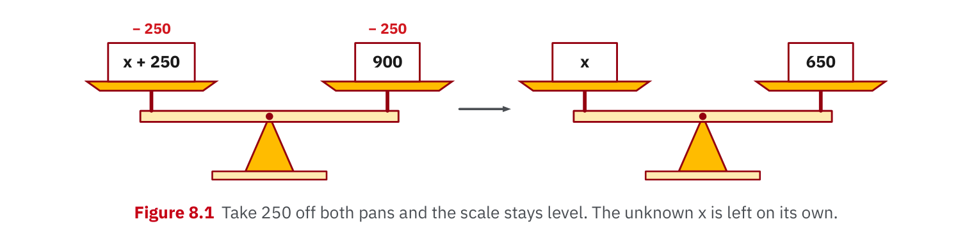
W08-L01 • TEACH • 9:10 AM–9:25 AM • 15 MIN TOTAL
Textbook | page 127
Figure 8.1: inverse operations preserve equality.
Textbook Chapter 1–8, selected; formula sheet p.219; conversion factors pp.220–221
Textbook
Exercise Book
Numeracy Hub
Shape Canvas
Day 25 • 2026-12-14 • 08
Notes:
TEACH • 9:10 AM–9:25 AM • 15 MIN TOTAL — shared across this phase’s slides.
Figure 8.1 on page 127 represents equality as a balance. If we divide one side of an equation, we divide the other side by the same nonzero quantity to preserve equality. This is the reasoning behind finding width from area and length. Starting with A = l × w, dividing both sides by l leaves A/l = w. Why is this more than a rule to move symbols? We are keeping two equal quantities equal while isolating the unknown. Substitution afterward checks that our proposed value still satisfies the original relationship.

Slide 9
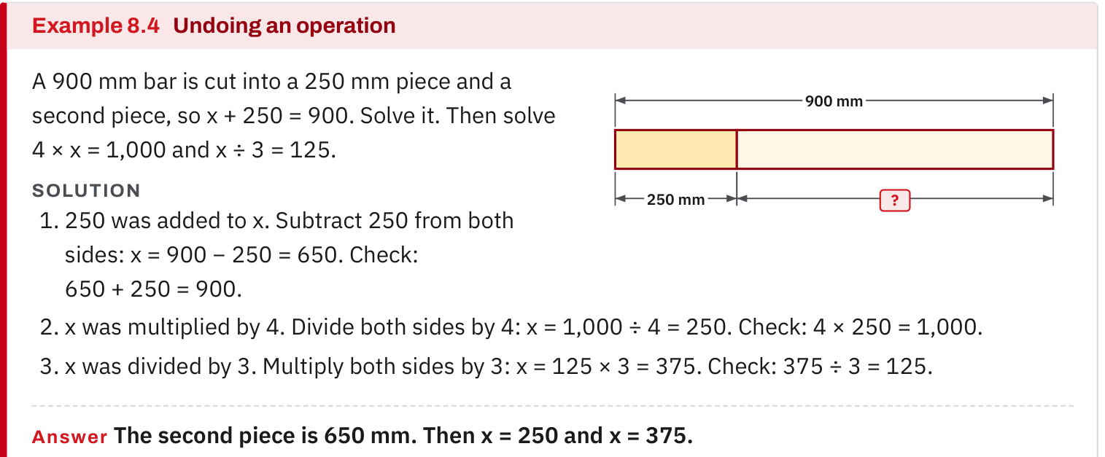
W08-L01 • TEACH • 9:10 AM–9:25 AM • 15 MIN TOTAL
Textbook | page 127
Example 8.4: name the operation, undo it, then substitute back.
Textbook Chapter 1–8, selected; formula sheet p.219; conversion factors pp.220–221
Textbook
Exercise Book
Numeracy Hub
Shape Canvas
Day 25 • 2026-12-14 • 09
Notes:
TEACH • 9:10 AM–9:25 AM • 15 MIN TOTAL — shared across this phase’s slides.
In Example 8.4, identify the operation acting on the unknown, then undo it using the inverse operation. Do not jump straight to a remembered final formula. Read the equation as a statement about quantities and follow the balance at each line. What comes after solving? Substitute the result back into the original equation. If the original values are not reproduced, inspect the rearrangement before trying random calculator entries. This check is especially useful when a problem gives area but asks for a length, because the units also reveal whether the operation makes sense.

Slide 10
W08-L01 • TEACH • 9:10 AM–9:25 AM • 15 MIN TOTAL
Spot the mistake. Explain the correction.
A conversion response says “multiply by the factor” but omits the starting and target units. What still needs to be justified?
Discuss the method before checking the answer.
Name both units and show why the chosen factor and direction produce the requested unit. Check the result with Unit Conversions after the paper attempt; retain the factor and working.
Textbook Chapter 1–8, selected; formula sheet p.219; conversion factors pp.220–221
Textbook
Exercise Book
Numeracy Hub
Shape Canvas
Day 25 • 2026-12-14 • 10
Notes:
TEACH • 9:10 AM–9:25 AM • 15 MIN TOTAL — shared across this phase’s slides.
“Multiply by the factor” is incomplete without the units and direction. A factor that converts inches to millimetres is used differently when converting millimetres to inches. Name the starting unit and requested unit, then explain how the factor changes one into the other. What size clue can help? Moving from a larger unit to a smaller unit normally increases the numerical count for the same length. After the paper attempt, use Unit Conversions to compare. Keep the factor and working so the tool result does not replace the explanation.

Slide 11
W08-L01 • TOGETHER • 9:25 AM–9:40 AM • 15 MIN TOTAL
Work together
Pairs rotate through number, fraction/decimal, conversion and formula stations; explain one solution aloud at each stop.
Explain the method and check directions; work with a partner only where permitted.
Resources: Stations: 1B Q3 p.8; 4A Q14(a),15(a) p.26; 5A Q12–13 p.33; 6A Q19 p.40; 7A Q11–12 p.45; 8C Q1–2 p.55.
Textbook Chapter 1–8, selected; formula sheet p.219; conversion factors pp.220–221
Textbook
Exercise Book
Numeracy Hub
Shape Canvas
Day 25 • 2026-12-14 • 11
Notes:
TOGETHER • 9:25 AM–9:40 AM • 15 MIN TOTAL — shared across this phase’s slides.
Rotate through the four stations with your partner. At each stop, one person explains a solution while the other asks a checking question. Then swap roles. At the number station, ask whether the quantity can be purchased fractionally. At conversions, ask which unit cancels. At formulas, ask whether substitution recreates the given value. Keep the discussion tied to the listed questions and retain the working. A clear spoken explanation should make the next written attempt easier to choose independently.

Slide 12
W08-L01 • PRACTISE • 9:40 AM–10:00 AM • 20 MIN TOTAL
Your scheduled practice
Complete the listed station questions; start with the two highest-need topics. Keep written working and note whether a tool or prompt was required.
Keep numbered written solutions and units. Use tools only under the conditions stated for this block.
Resources: Stations: 1B Q3 p.8; 4A Q14(a),15(a) p.26; 5A Q12–13 p.33; 6A Q19 p.40; 7A Q11–12 p.45; 8C Q1–2 p.55.
Textbook Chapter 1–8, selected; formula sheet p.219; conversion factors pp.220–221
Textbook
Exercise Book
Numeracy Hub
Shape Canvas
Day 25 • 2026-12-14 • 12
Notes:
PRACTISE • 9:40 AM–10:00 AM • 20 MIN TOTAL — shared across this phase’s slides.
Complete the listed station questions, beginning with your two highest-need topics. Keep each reference above its working and note whether the response was independent, checked with a tool afterward or completed with a prompt. Those labels help us interpret progress accurately. Before checking a final number, inspect the vulnerable step from your error log. Which line could show the same old mistake? Test that line using the strategy you selected at the start of the block.

Slide 13
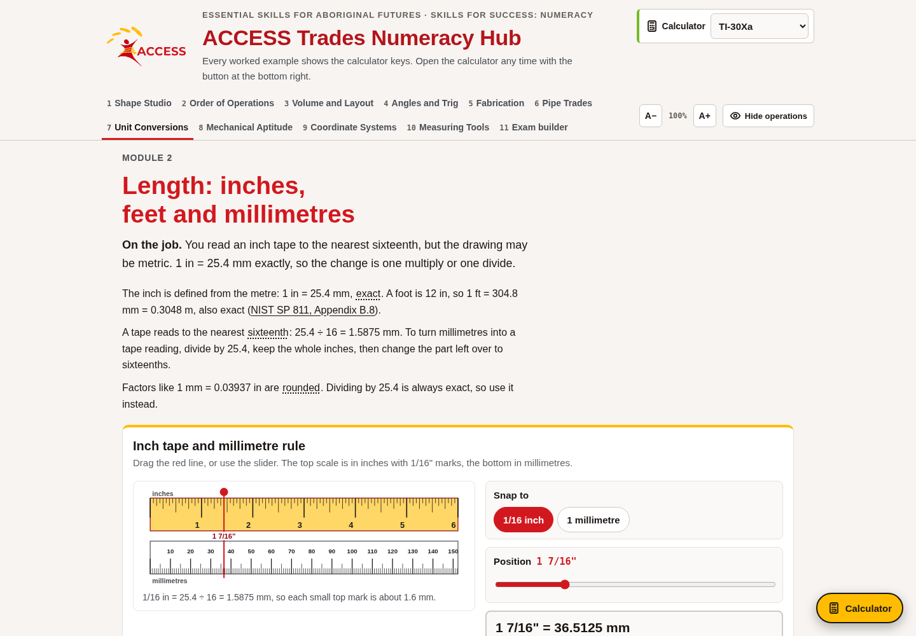
W08-L01 • PRACTISE • 9:40 AM–10:00 AM • 20 MIN TOTAL
Open Numeracy Hub
Navigation example. Use the values and units in the assigned task.
Textbook Chapter 1–8, selected; formula sheet p.219; conversion factors pp.220–221
Textbook
Exercise Book
Numeracy Hub
Shape Canvas
Day 25 • 2026-12-14 • 13
Notes:
PRACTISE • 9:40 AM–10:00 AM • 20 MIN TOTAL — shared across this phase’s slides.
Open Numeracy Hub Calculator for the number checks or Unit Conversions for the length station. Keep the exercise-book values and units beside the screen. Your first attempt stays on paper; the tool then helps you compare the result and locate any difference. What would you do if the tool gives a different value? Check the entered quantity, units and direction against your written method before replacing the answer. A mismatch is information to investigate, not a reason to erase the evidence.

Slide 14
W08-L01 • PRACTISE • 9:40 AM–10:00 AM • 20 MIN TOTAL
Practise in Numeracy Hub and Shape Canvas
1
At the relevant stations, write the selected book solution first and state the method and units.
2
Use Numeracy Hub Calculator for number checks or Unit Conversions for length practice; at the formulas station, use the scheduled Shape Canvas rectangle with one missing dimension.
3
Compare the tool check with your working, and substitute the missing dimension back where relevant. Mark whether each solution was independent, tool-checked or prompted.
Textbook Chapter 1–8, selected; formula sheet p.219; conversion factors pp.220–221
Textbook
Exercise Book
Numeracy Hub
Shape Canvas
Day 25 • 2026-12-14 • 14
Notes:
PRACTISE • 9:40 AM–10:00 AM • 20 MIN TOTAL — shared across this phase’s slides.
At the formula station, build the assigned rectangle in Shape Canvas and identify the missing dimension. Solve it on paper, then substitute the result into the area relationship. At the other stations, use Calculator or Unit Conversions after your written attempt. Mark how much support each answer needed. Why keep that distinction? A solution you can explain independently tells us something different from one reached after a hint, and both help plan the next step when recorded honestly.

Slide 15
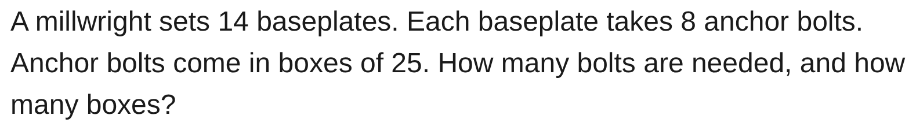
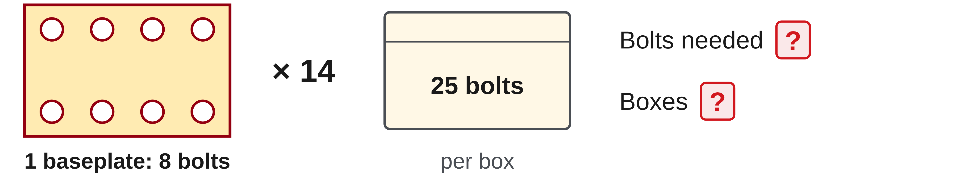
W08-L01 • PRACTISE • 9:40 AM–10:00 AM • 20 MIN TOTAL
Practise from the Exercise Book | 1B Q3
Write the operation, working and units before checking.
Textbook Chapter 1–8, selected; formula sheet p.219; conversion factors pp.220–221
Textbook
Exercise Book
Numeracy Hub
Shape Canvas
Day 25 • 2026-12-14 • 15
Notes:
PRACTISE • 9:40 AM–10:00 AM • 20 MIN TOTAL — shared across this phase’s slides.
For 1B Q3, separate the bolt requirement from the box order. Attempt both quantities before checking. After your attempt, fourteen baseplates times eight bolts gives 112 bolts. Dividing by twenty-five per box gives 4.48 boxes, so five boxes are needed. Why not four? Four boxes contain only one hundred bolts. Check that five boxes supply 125, enough for the stated requirement. The arithmetic and purchasing decision belong on separate lines so the rounding is justified.
INSTRUCTOR ONLY — AFTER THE ATTEMPT: 112 bolts, 5 boxes Working: 14 × 8 = 112. 112 ÷ 25 = 4.48, round up to 5 boxes.

Slide 16

W08-L01 • PRACTISE • 9:40 AM–10:00 AM • 20 MIN TOTAL
Practise from the Exercise Book | 8C Q1
Write the operation, working and units before checking.
Textbook Chapter 1–8, selected; formula sheet p.219; conversion factors pp.220–221
Textbook
Exercise Book
Numeracy Hub
Shape Canvas
Day 25 • 2026-12-14 • 16
Notes:
PRACTISE • 9:40 AM–10:00 AM • 20 MIN TOTAL — shared across this phase’s slides.
For 8C Q1, use the rectangle's given length and area to find its width. Attempt the inverse relationship before checking. After the attempt, divide 4,800 square centimetres by the shown 80-centimetre length to obtain 60 centimetres. Multiplying 80 by 60 recreates 4,800 square centimetres. What happened to the square unit during division? Dividing area by a length leaves a length. That unit reasoning helps confirm that the operation is finding the requested width.
INSTRUCTOR ONLY — AFTER THE ATTEMPT: 60 cm

Slide 17
W08-L01 • CHECK • 10:00 AM–10:10 AM • 10 MIN TOTAL
Check independently
Exercise Book 6A Q19, 7A Q11 and 8C Q2; identify the appropriate method for each.
Submit work and demonstrate the checking strategy; identify a remaining difficulty.
Resources: Stations: 1B Q3 p.8; 4A Q14(a),15(a) p.26; 5A Q12–13 p.33; 6A Q19 p.40; 7A Q11–12 p.45; 8C Q1–2 p.55.
Textbook Chapter 1–8, selected; formula sheet p.219; conversion factors pp.220–221
Textbook
Exercise Book
Numeracy Hub
Shape Canvas
Day 25 • 2026-12-14 • 17
Notes:
CHECK • 10:00 AM–10:10 AM • 10 MIN TOTAL — shared across this phase’s slides.
Complete 6A Q19, 7A Q11 and 8C Q2 independently. Each question uses a different decision: scale, unit conversion or a missing dimension. Identify the method before calculating, then include working and an appropriate check. Keep worked solutions closed until you have finished. I am looking for evidence that you can recognize the relationship from the question, not just repeat a sequence used by the previous station.

Slide 18
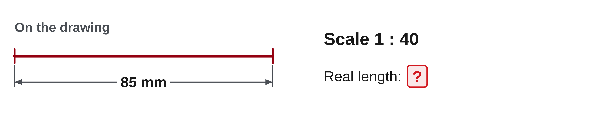
W08-L01 • CHECK • 10:00 AM–10:10 AM • 10 MIN TOTAL
Independent check | 6A Q19
Answer independently. Keep worked solutions closed.
Textbook Chapter 1–8, selected; formula sheet p.219; conversion factors pp.220–221
Textbook
Exercise Book
Numeracy Hub
Shape Canvas
Day 25 • 2026-12-14 • 18
Notes:
CHECK • 10:00 AM–10:10 AM • 10 MIN TOTAL — shared across this phase’s slides.
In 6A Q19, use the stated drawing scale to find the real length. Show the relationship between the drawing measurement and actual measurement, including the unit. Keep the response independent and record a check of the direction.
INSTRUCTOR ONLY — AFTER THE ATTEMPT: 1:40 means each drawing unit represents 40 real units. Real length = 85 × 40 = 3,400 mm. Dividing 3,400 by 40 recovers the 85 mm drawing length.

Slide 19
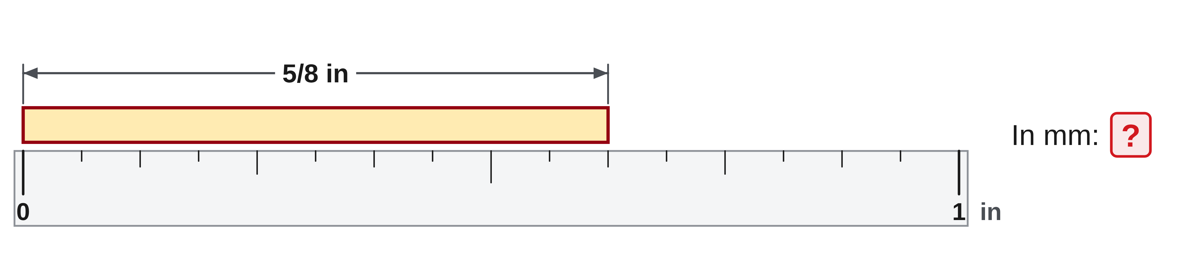
W08-L01 • CHECK • 10:00 AM–10:10 AM • 10 MIN TOTAL
Independent check | 7A Q11
Answer independently. Keep worked solutions closed.
Textbook Chapter 1–8, selected; formula sheet p.219; conversion factors pp.220–221
Textbook
Exercise Book
Numeracy Hub
Shape Canvas
Day 25 • 2026-12-14 • 19
Notes:
CHECK • 10:00 AM–10:10 AM • 10 MIN TOTAL — shared across this phase’s slides.
Complete 7A Q11 with the starting and target units visible. Write the factor or relationship that converts the fractional-inch measurement, then show how you would check it. Keep your numerical answer private until collection.
INSTRUCTOR ONLY — AFTER THE ATTEMPT: 5/8 = 0.625 in. Multiplying by 25.4 mm per inch gives 15.875 mm. The reverse calculation, 15.875/25.4, returns 0.625 in. Check that the student converted the entire quantity and used the correct direction.

Slide 20
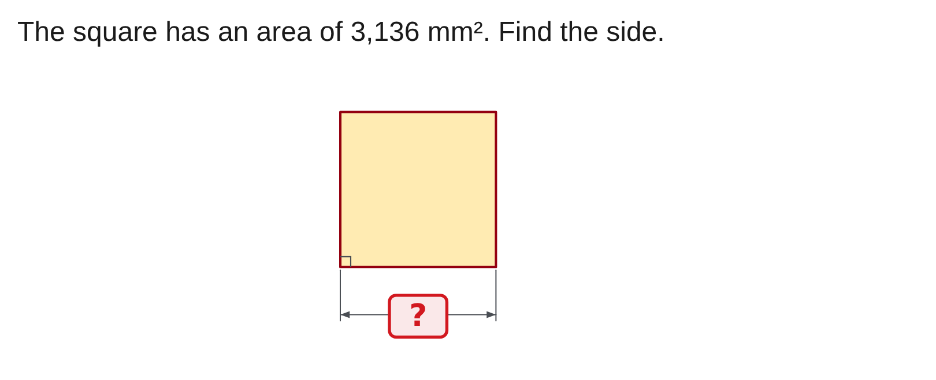
W08-L01 • CHECK • 10:00 AM–10:10 AM • 10 MIN TOTAL
Independent check | 8C Q2
Answer independently. Keep worked solutions closed.
Textbook Chapter 1–8, selected; formula sheet p.219; conversion factors pp.220–221
Textbook
Exercise Book
Numeracy Hub
Shape Canvas
Day 25 • 2026-12-14 • 20
Notes:
CHECK • 10:00 AM–10:10 AM • 10 MIN TOTAL — shared across this phase’s slides.
For 8C Q2, find the square's side from its given area. Record the relationship and your inverse operation, then check the proposed length against the original area. Include the appropriate unit in the final answer.
INSTRUCTOR ONLY — AFTER THE ATTEMPT: Side = √3,136 = 56 mm. Check: 56 × 56 = 3,136 mm². The result is a length; dividing by four would use a perimeter idea on an area quantity.

Slide 21
W08-L01 • WRAP UP • 10:10 AM–10:15 AM • 5 MIN TOTAL
Wrap up and choose the next step
Identify what improved, what needs another attempt and which resource will support the next step.
Name the math and another essential skill used; record a concrete follow-up action.
Resources: Stations: 1B Q3 p.8; 4A Q14(a),15(a) p.26; 5A Q12–13 p.33; 6A Q19 p.40; 7A Q11–12 p.45; 8C Q1–2 p.55.
Textbook Chapter 1–8, selected; formula sheet p.219; conversion factors pp.220–221
Textbook
Exercise Book
Numeracy Hub
Shape Canvas
Day 25 • 2026-12-14 • 21
Notes:
WRAP UP • 10:10 AM–10:15 AM • 5 MIN TOTAL — shared across this phase’s slides.
Which of the three check questions required you to reverse a relationship? In different ways, all three asked you to connect a known measurement to another representation or quantity. Name the method you can now justify most clearly, and the step that still needs attention. Keep the relevant question and checking strategy in your notes. After the break, we will apply that same habit of identifying the unknown to perimeter, area, volume and triangles.

Slide 22
DAY 25 • SCHEDULED BREAK
Break
10:15 AM–10:30 AM
Return ready for: Review: geometry and job problems
This break is excluded from teaching minutes.
Textbook
Exercise Book
Numeracy Hub
Shape Canvas
Day 25 • 2026-12-14 • 22
Notes:
Scheduled break — resume at the time shown.
Take the scheduled break and return at 10:30. Keep your calculator, textbook formula sheet and error notes ready. The next review block focuses on geometry and job problems. We will use the drawing and the requested unit to decide which calculation belongs, then test whether the answer makes physical sense.

Slide 23
W08-L02 • START • 10:30 AM–10:35 AM • 5 MIN TOTAL
Review: geometry and job problems
Today’s goal: Select perimeter, area, volume or triangle methods from a drawing and report the correct unit.
Identify one target skill and the checking habit to use today.
Textbook Chapter 9–13 pp.140–214, selected; formula sheet p.219
Exercise Book 9A Q1,8 p.57; 10B Q1,11 pp.65–66; 11A Q7,19 pp.69–70; 12B Q3 p.77; 13A Q6,14 p.82.
Keep your notebook, textbook, exercise book and chosen calculator ready.
Textbook Chapter 9–13 pp.140–214, selected; formula sheet p.219
Textbook
Exercise Book
Numeracy Hub
Shape Canvas
Day 25 • 2026-12-14 • 23
Notes:
START • 10:30 AM–10:35 AM • 5 MIN TOTAL — shared across this phase’s slides.
For this geometry review, begin with the unknown rather than the formula. Are we measuring an outside boundary, covering a surface, filling space or finding a triangle side? The answer to that question determines the method and unit. We will use selected work from chapters 9–13, the formula sheet on page 219 and the listed exercises. What should you draw before entering numbers? A labelled sketch that separates the given dimensions from the quantity you are trying to find.

Slide 24
W08-L02 • RECALL • 10:35 AM–10:40 AM • 5 MIN TOTAL
Recall and reconnect
Display three drawings and ask which result uses mm, mm² or mm³; retrieve DEG mode for trig.
Review previous feedback and attempt the retrieval prompt without displayed solutions.
Resources: Exercise Book 9A Q1,8 p.57; 10B Q1,11 pp.65–66; 11A Q7,19 pp.69–70; 12B Q3 p.77; 13A Q6,14 p.82.
Textbook Chapter 9–13 pp.140–214, selected; formula sheet p.219
Textbook
Exercise Book
Numeracy Hub
Shape Canvas
Day 25 • 2026-12-14 • 24
Notes:
RECALL • 10:35 AM–10:40 AM • 5 MIN TOTAL — shared across this phase’s slides.
Compare a rectangle, a rectangular prism and a right triangle. A boundary or side length may use millimetres; surface coverage uses square millimetres; volume uses cubic millimetres. Which picture needs three dimensions for its volume? The prism. Which triangle setting must agree with degree-marked angles? DEG. These quick decisions can detect an error before arithmetic begins. If the requested unit and your formula disagree, stop and reconsider the quantity rather than trying to repair only the label afterward.

Slide 25
W08-L02 • TEACH • 10:40 AM–10:55 AM • 15 MIN TOTAL
Match the drawing to the requested quantity
1
Outside boundary is perimeter: add edges, or use 2(l + w) for a rectangle. Report a length unit such as mm or m.
2
Surface coverage is area: use the appropriate area formula and subtract openings where stated. Report square units.
3
Space or capacity is volume: base area × height for a prism. Report the requested cubic or capacity unit.
4
A right-triangle side uses Pythagoras or the selected trig ratio. The side answer is a length; confirm DEG mode for trig.
Textbook Chapter 9–13 pp.140–214, selected; formula sheet p.219
Textbook
Exercise Book
Numeracy Hub
Shape Canvas
Day 25 • 2026-12-14 • 25
Notes:
TEACH • 10:40 AM–10:55 AM • 15 MIN TOTAL — shared across this phase’s slides.
Perimeter follows the outside edge, so it adds lengths. Area covers a surface, so it uses square units and subtracts openings when the problem says material is removed. Volume measures space; for a prism it is base area times height and uses cubic units. A right-triangle side remains a length even when its calculation uses squared values or trig ratios. What first question sorts these methods? “What quantity is being asked for?” The same rectangle may appear in a perimeter problem, an area problem or the base of a volume problem, so the shape alone is not enough.

Slide 26
W08-L02 • TEACH • 10:40 AM–10:55 AM • 15 MIN TOTAL
Use the drawing to check the calculation
1
Identify the unknown before selecting the formula, and label all given dimensions on the appropriate drawing.
2
Keep each stated cut and kerf with its own problem; include the stated kerf in the paired work on 12B Q3.
3
Reject an answer whose unit does not match the quantity or whose magnitude does not fit the drawing.
4
For the scheduled fresh Hub question, explain why the formula applies and retain the question/code for checking.
Textbook Chapter 9–13 pp.140–214, selected; formula sheet p.219
Textbook
Exercise Book
Numeracy Hub
Shape Canvas
Day 25 • 2026-12-14 • 26
Notes:
TEACH • 10:40 AM–10:55 AM • 15 MIN TOTAL — shared across this phase’s slides.
Annotate the dimensions that belong to the problem you are solving. A kerf stated in 12B Q3 belongs with that cutting calculation; it should not be imported into an unrelated no-waste floor problem. Check the magnitude against the drawing as well as the unit. A hypotenuse shorter than a leg or an opening larger than the entire plate should make you stop. What should you retain from a fresh Numeracy Hub question? Its prompt or code, the written method and your reason for choosing the formula. That record makes the later check meaningful.

Slide 27
W08-L02 • TEACH • 10:40 AM–10:55 AM • 15 MIN TOTAL
Match the quantity, formula and unit
Find | Method example | Result unit
Outside boundary | Add edges; rectangle 2(l + w) | mm or m
Surface coverage | Area; subtract openings | mm² or m²
Space / capacity | Base area × height | mm³, m³ or L
Right-triangle side | Pythagoras or selected trig ratio | mm or m
Together • Work 10B Q1 and 12B Q3 in pairs.
Annotate every dimension and include stated kerf. Explain why the method
matches the unknown; reject an unreasonable unit or magnitude.
Exercise Book pp.65,77 • Shape Canvas rectangle, prism and right triangle • Formula sheet p.219
Textbook
Exercise Book
Numeracy Hub
Shape Canvas
Day 25 • 2026-12-14 • 27
Notes:
TEACH • 10:40 AM–10:55 AM • 15 MIN TOTAL — shared across this phase’s slides.
Use the requested quantity to connect each drawing, formula and unit. A rectangle's boundary uses an edge-sum formula and length units. Its surface uses an area formula and square units. A prism extends base area through a height, producing cubic units. For the paired work, 10B Q1 is a no-waste floor coverage problem, while 12B Q3 includes its stated cutting details. What would go wrong if we used one question's assumptions in the other? We would solve a different problem. Read the conditions as carefully as the numbers.

Slide 28
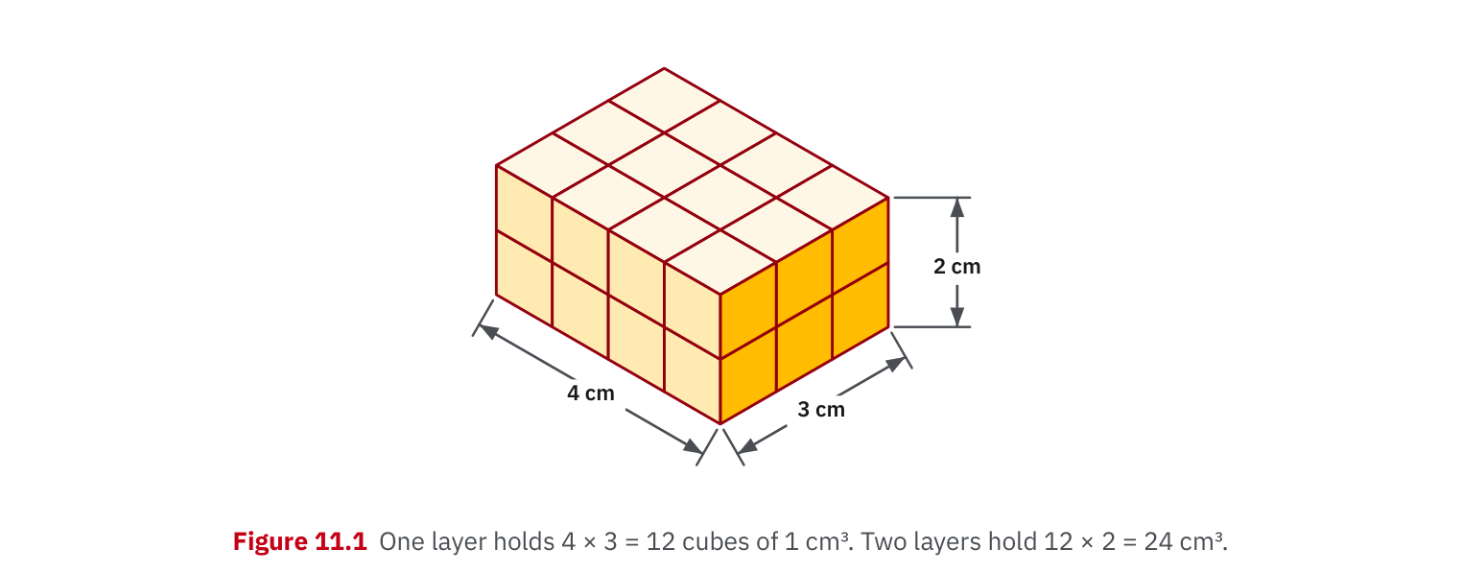
W08-L02 • TEACH • 10:40 AM–10:55 AM • 15 MIN TOTAL
Textbook | page 172
Figure 11.1: volume counts unit cubes in three directions.
Textbook Chapter 9–13 pp.140–214, selected; formula sheet p.219
Textbook
Exercise Book
Numeracy Hub
Shape Canvas
Day 25 • 2026-12-14 • 28
Notes:
TEACH • 10:40 AM–10:55 AM • 15 MIN TOTAL — shared across this phase’s slides.
Figure 11.1 on page 172 builds volume from unit cubes. A row counts one direction, a layer adds a second, and stacked layers add the third. That is why length times width times height produces cubic units. What does multiplying the base area by height count? The same-sized area repeated through the prism's depth. Keep the three directions conceptually separate even if two dimensions happen to match. A number with square units describes only the base surface, not the space occupied by all the stacked layers.

Slide 29
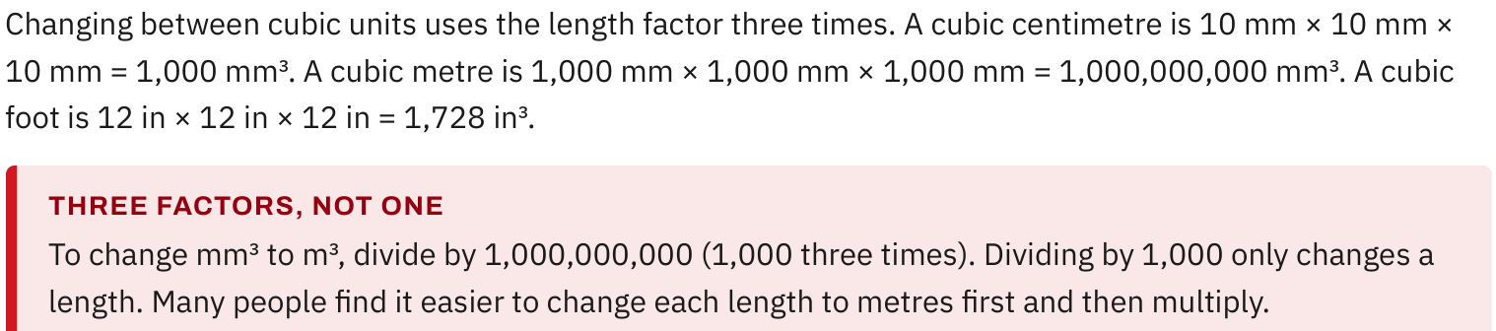
W08-L02 • TEACH • 10:40 AM–10:55 AM • 15 MIN TOTAL
Textbook | page 172
Cubic conversions use the length factor three times.
Textbook Chapter 9–13 pp.140–214, selected; formula sheet p.219
Textbook
Exercise Book
Numeracy Hub
Shape Canvas
Day 25 • 2026-12-14 • 29
Notes:
TEACH • 10:40 AM–10:55 AM • 15 MIN TOTAL — shared across this phase’s slides.
Cubic conversion applies the length conversion in three directions. One metre contains one thousand millimetres, so a cubic metre contains one thousand times one thousand times one thousand cubic millimetres: one billion. What happens if you divide cubic millimetres by only one thousand? You apply a length conversion to a volume and get the wrong scale. An alternative is to convert each of the three dimensions into metres first, then multiply. Both approaches must give the same cubic-metre volume when the units are handled consistently.

Slide 30
W08-L02 • TEACH • 10:40 AM–10:55 AM • 15 MIN TOTAL
Spot the mistake. Explain the correction.
A surface-coverage calculation is labelled mm³. What does that unit suggest, and what should you recheck?
Discuss the method before checking the answer.
Cubic units describe volume. Recheck the requested quantity and formula: surface coverage needs an area calculation and square units; a correct-looking number with the wrong unit is not a complete result.
Textbook Chapter 9–13 pp.140–214, selected; formula sheet p.219
Textbook
Exercise Book
Numeracy Hub
Shape Canvas
Day 25 • 2026-12-14 • 30
Notes:
TEACH • 10:40 AM–10:55 AM • 15 MIN TOTAL — shared across this phase’s slides.
The answer is labelled cubic millimetres, but the question asked for surface coverage. Cubic units describe volume, so the label signals that either the formula or the interpretation may be wrong. Do not simply cross out the exponent and assume the number is fine. Check whether you multiplied two relevant dimensions for area or accidentally included a third. What unit should surface coverage use? Square units. A correct-looking number and a wrong unit are a reason to inspect the method together, because the unit tells us what the calculation actually measured.

Slide 31
W08-L02 • TOGETHER • 10:55 AM–11:10 AM • 15 MIN TOTAL
Work together
Work Exercise Book 10B Q1 and 12B Q3 in pairs. Annotate all dimensions and explicitly include stated kerf.
Explain the method and check directions; work with a partner only where permitted.
Resources: Exercise Book 9A Q1,8 p.57; 10B Q1,11 pp.65–66; 11A Q7,19 pp.69–70; 12B Q3 p.77; 13A Q6,14 p.82.
Textbook Chapter 9–13 pp.140–214, selected; formula sheet p.219
Textbook
Exercise Book
Numeracy Hub
Shape Canvas
Day 25 • 2026-12-14 • 31
Notes:
TOGETHER • 10:55 AM–11:10 AM • 15 MIN TOTAL — shared across this phase’s slides.
Work 10B Q1 and 12B Q3 with your partner. Annotate every dimension before selecting the relationship. In the floor question, retain the stated no-waste condition. In the cutting question, include its stated kerf. One partner explains why the formula matches the unknown; the other checks whether the result's unit and size fit the drawing. Then swap roles. If the arithmetic differs, compare assumptions and diagrams before repeating keys, because those determine which numbers belong in the equation.

Slide 32
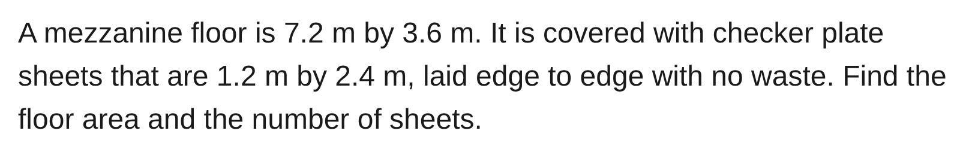
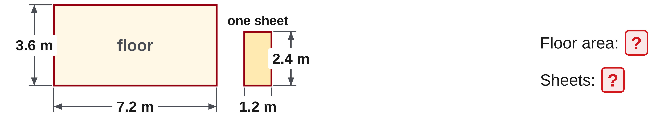
W08-L02 • TOGETHER • 10:55 AM–11:10 AM • 15 MIN TOTAL
Guided practice | 10B Q1
Work with a partner. Take turns explaining the next step.
Textbook Chapter 9–13 pp.140–214, selected; formula sheet p.219
Textbook
Exercise Book
Numeracy Hub
Shape Canvas
Day 25 • 2026-12-14 • 32
Notes:
TOGETHER • 10:55 AM–11:10 AM • 15 MIN TOTAL — shared across this phase’s slides.
For 10B Q1, calculate the floor area and one-sheet area, then use them to find the no-waste count. Attempt the question with your partner before checking. Read the exact condition: the checker plate sheets are laid edge to edge with no waste. Do we automatically add the ten-percent allowance from our earlier classroom adaptation? No. That allowance belonged to a different stated task. This question's answer follows its own dimensions and no-waste condition.
INSTRUCTOR ONLY — AFTER THE ATTEMPT: 25.92 m², 9 sheets Working: 7.2 × 3.6 = 25.92 m², one sheet = 2.88 m², 25.92 ÷ 2.88 = 9

Slide 33
W08-L02 • TOGETHER • 10:55 AM–11:10 AM • 15 MIN TOTAL
Compare your method | 10B Q1
CHECK TOGETHER
25.92 m², 9 sheets
7.2 × 3.6 = 25.92 m², one sheet = 2.88 m², 25.92 ÷ 2.88 = 9
Textbook Chapter 9–13 pp.140–214, selected; formula sheet p.219
Textbook
Exercise Book
Numeracy Hub
Shape Canvas
Day 25 • 2026-12-14 • 33
Notes:
TOGETHER • 10:55 AM–11:10 AM • 15 MIN TOTAL — shared across this phase’s slides.
The floor area is 7.2 times 3.6, or 25.92 square metres. One sheet covers 1.2 times 2.4, or 2.88 square metres. Division gives nine sheets. Check the layout: three lengths of 2.4 span 7.2 metres, and three widths of 1.2 span 3.6 metres. Why does the answer remain nine here? The question explicitly says no waste. We do not add an unstated allowance just because another lesson used one. Conditions are part of the mathematics.
INSTRUCTOR ONLY — AFTER THE ATTEMPT: 25.92 m², 9 sheets Working: 7.2 × 3.6 = 25.92 m², one sheet = 2.88 m², 25.92 ÷ 2.88 = 9

Slide 34
W08-L02 • PRACTISE • 11:10 AM–11:45 AM • 35 MIN TOTAL
Your scheduled practice
Solve the remaining listed exercises, prioritizing documented needs. Finish with one fresh Numeracy Hub question; explain why that formula applies and keep its question/code for checking.
Keep numbered written solutions and units. Use tools only under the conditions stated for this block.
Resources: Exercise Book 9A Q1,8 p.57; 10B Q1,11 pp.65–66; 11A Q7,19 pp.69–70; 12B Q3 p.77; 13A Q6,14 p.82.
Textbook Chapter 9–13 pp.140–214, selected; formula sheet p.219
Textbook
Exercise Book
Numeracy Hub
Shape Canvas
Day 25 • 2026-12-14 • 34
Notes:
PRACTISE • 11:10 AM–11:45 AM • 35 MIN TOTAL — shared across this phase’s slides.
Complete the remaining listed exercises, prioritizing the needs shown in your work. Finish with one Easy Numeracy Hub question in a taught topic and keep its question or code. Before calculating, write why the formula applies. For example, a plate with a hole requires net area, while a box's missing height requires reversing volume divided by base area. The specific explanation makes it easier to see whether a wrong answer came from interpretation, arithmetic, units or calculator entry.

Slide 35

W08-L02 • PRACTISE • 11:10 AM–11:45 AM • 35 MIN TOTAL
Open Numeracy Hub
Navigation example. Use the values and units in the assigned task.
Textbook Chapter 9–13 pp.140–214, selected; formula sheet p.219
Textbook
Exercise Book
Numeracy Hub
Shape Canvas
Day 25 • 2026-12-14 • 35
Notes:
PRACTISE • 11:10 AM–11:45 AM • 35 MIN TOTAL — shared across this phase’s slides.
Open Volume and Layout or Angles and Trig in Numeracy Hub, choosing the taught topic that matches your documented need. Use one Easy question after the assigned paper work. Copy its values and retain the code so the answer can be checked against the right prompt. What must you write before revealing the solution? The unknown, selected formula and unit. The tool supplies feedback, while your written reasoning shows the decision you made independently.

Slide 36
W08-L02 • PRACTISE • 11:10 AM–11:45 AM • 35 MIN TOTAL
Practise in Numeracy Hub and Shape Canvas
1
In Shape Canvas, compare the scheduled rectangle, rectangular prism and right triangle. Label the given dimensions and identify the unknown for the relevant written problem.
2
After the listed paper work, use Numeracy Hub Volume and Layout or Angles and Trig for one Easy task in a taught topic, chosen to match the documented need.
3
Keep the question/code, written formula, diagram and units. Explain why the method applies and use the drawing to reject an unreasonable unit or magnitude.
Textbook Chapter 9–13 pp.140–214, selected; formula sheet p.219
Textbook
Exercise Book
Numeracy Hub
Shape Canvas
Day 25 • 2026-12-14 • 36
Notes:
PRACTISE • 11:10 AM–11:45 AM • 35 MIN TOTAL — shared across this phase’s slides.
In Shape Canvas, compare the rectangle, prism and right triangle using the dimensions relevant to your problem. Mark the unknown so the picture tells us what the calculation should return. After the paper work, use one Easy Numeracy Hub task from the matching taught module. Keep the diagram, formula, unit and question code together. If the result seems unreasonable, point to the drawing feature that contradicts it: a leg too long, an area too large or a volume unit where a length was requested.

Slide 37
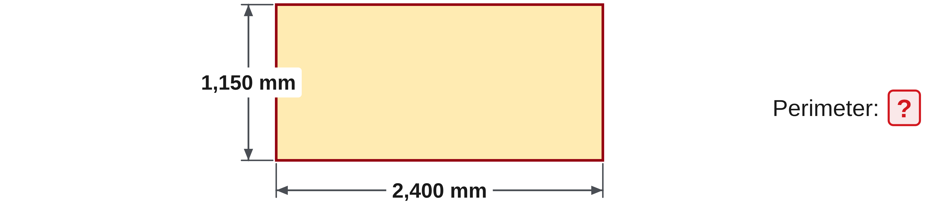
W08-L02 • PRACTISE • 11:10 AM–11:45 AM • 35 MIN TOTAL
Practise from the Exercise Book | 9A Q1
Write the operation, working and units before checking.
Textbook Chapter 9–13 pp.140–214, selected; formula sheet p.219
Textbook
Exercise Book
Numeracy Hub
Shape Canvas
Day 25 • 2026-12-14 • 37
Notes:
PRACTISE • 11:10 AM–11:45 AM • 35 MIN TOTAL — shared across this phase’s slides.
Attempt 9A Q1 by tracing the entire rectangle boundary. After your attempt, compare two equivalent calculations: 2 times the sum of 2,400 and 1,150, or 2,400 plus 1,150 plus 2,400 plus 1,150. Both give 7,100 millimetres. What would 3,550 millimetres represent? Only one length and one width, halfway around. A quick boundary trace makes that missing-half error visible without needing a second calculator entry.
INSTRUCTOR ONLY — AFTER THE ATTEMPT: 7,100 mm

Slide 38
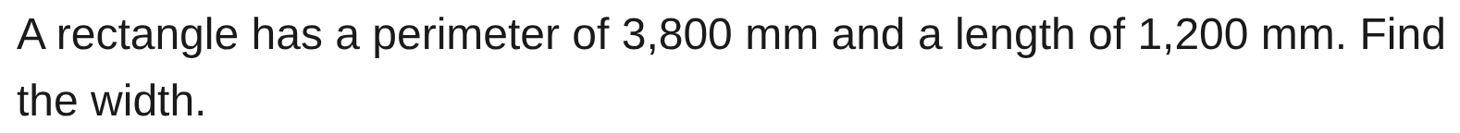
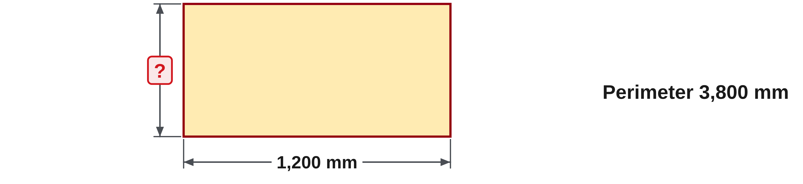
W08-L02 • PRACTISE • 11:10 AM–11:45 AM • 35 MIN TOTAL
Practise from the Exercise Book | 9A Q8
Write the operation, working and units before checking.
Textbook Chapter 9–13 pp.140–214, selected; formula sheet p.219
Textbook
Exercise Book
Numeracy Hub
Shape Canvas
Day 25 • 2026-12-14 • 38
Notes:
PRACTISE • 11:10 AM–11:45 AM • 35 MIN TOTAL — shared across this phase’s slides.
For 9A Q8, the full perimeter is 3,800 millimetres and each long edge is 1,200. Attempt the missing width first. Afterward, halve the perimeter to get length plus width: 1,900 millimetres. Subtract the length, 1,200, leaving a 700-millimetre width. Check by tracing all four edges: 1,200 plus 700 plus 1,200 plus 700 equals 3,800. Why not subtract only one long edge from the full perimeter? The remaining distance would still include three edges, not one width.
INSTRUCTOR ONLY — AFTER THE ATTEMPT: 700 mm

Slide 39
W08-L02 • CHECK • 11:45 AM–11:55 AM • 10 MIN TOTAL
Check independently
Exercise Book 10B Q11, 11A Q19 and 13A Q14, with diagrams and units.
Submit work and demonstrate the checking strategy; identify a remaining difficulty.
Resources: Exercise Book 9A Q1,8 p.57; 10B Q1,11 pp.65–66; 11A Q7,19 pp.69–70; 12B Q3 p.77; 13A Q6,14 p.82.
Textbook Chapter 9–13 pp.140–214, selected; formula sheet p.219
Textbook
Exercise Book
Numeracy Hub
Shape Canvas
Day 25 • 2026-12-14 • 39
Notes:
CHECK • 11:45 AM–11:55 AM • 10 MIN TOTAL — shared across this phase’s slides.
Complete 10B Q11, 11A Q19 and 13A Q14 independently, with diagrams and units. These questions ask for different quantities, so name the unknown before selecting the formula. Keep the solution displays closed and retain working through the final requested rounding. Your drawing should help explain which dimensions belong together and what the answer measures. Submit your own method before comparing results with the class.

Slide 40
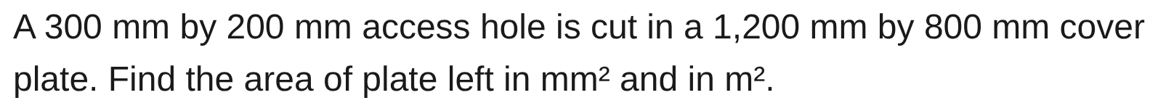
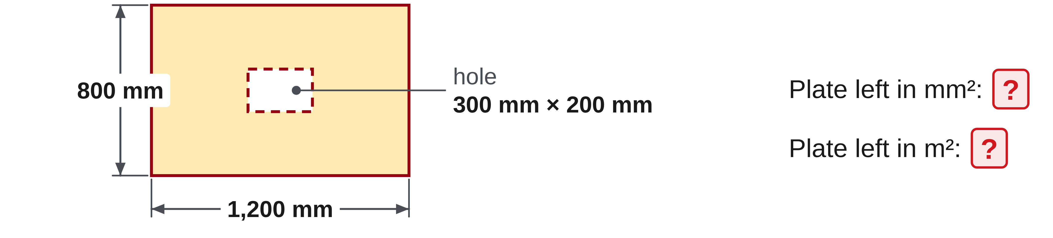
W08-L02 • CHECK • 11:45 AM–11:55 AM • 10 MIN TOTAL
Independent check | 10B Q11
Answer independently. Keep worked solutions closed.
Textbook Chapter 9–13 pp.140–214, selected; formula sheet p.219
Textbook
Exercise Book
Numeracy Hub
Shape Canvas
Day 25 • 2026-12-14 • 40
Notes:
CHECK • 11:45 AM–11:55 AM • 10 MIN TOTAL — shared across this phase’s slides.
For 10B Q11, show the plate and opening on a labelled sketch, then find the area left in both requested units. Retain the conversion working so the relationship between the two answers is clear. Keep the check independent until collection.
INSTRUCTOR ONLY — AFTER THE ATTEMPT: Outer area 1,200 × 800 = 960,000 mm²; opening 300 × 200 = 60,000 mm²; remaining 900,000 mm². Divide by 1,000,000 to obtain 0.9 m². The opening is subtracted once.

Slide 41
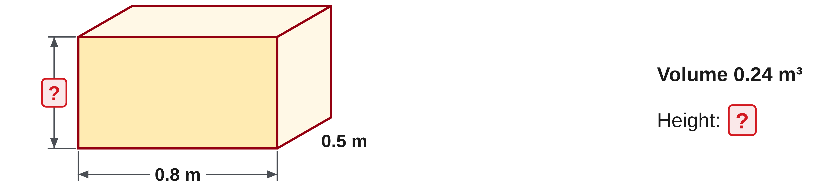
W08-L02 • CHECK • 11:45 AM–11:55 AM • 10 MIN TOTAL
Independent check | 11A Q19
Answer independently. Keep worked solutions closed.
Textbook Chapter 9–13 pp.140–214, selected; formula sheet p.219
Textbook
Exercise Book
Numeracy Hub
Shape Canvas
Day 25 • 2026-12-14 • 41
Notes:
CHECK • 11:45 AM–11:55 AM • 10 MIN TOTAL — shared across this phase’s slides.
For 11A Q19, identify the unknown height and the given base dimensions. Show the volume relationship, your rearrangement and a substitution check. Include the length unit with the answer rather than carrying the volume unit into the unknown.
INSTRUCTOR ONLY — AFTER THE ATTEMPT: Base area = 0.8 × 0.5 = 0.4 m²; height = 0.24/0.4 = 0.6 m. Check: 0.8 × 0.5 × 0.6 = 0.24 m³. Dividing volume by base area returns a length.

Slide 42
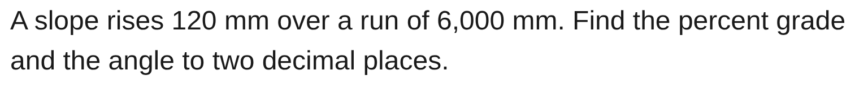
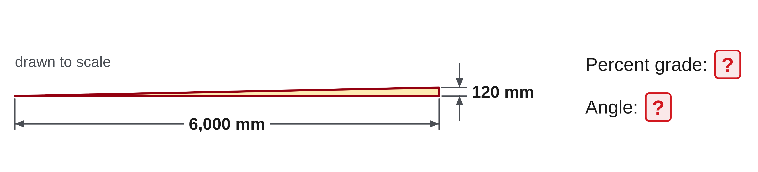
W08-L02 • CHECK • 11:45 AM–11:55 AM • 10 MIN TOTAL
Independent check | 13A Q14
Answer independently. Keep worked solutions closed.
Textbook Chapter 9–13 pp.140–214, selected; formula sheet p.219
Textbook
Exercise Book
Numeracy Hub
Shape Canvas
Day 25 • 2026-12-14 • 42
Notes:
CHECK • 11:45 AM–11:55 AM • 10 MIN TOTAL — shared across this phase’s slides.
For 13A Q14, calculate percentage grade and angle as separate outputs. Retain the stated rise and run and label both answers clearly. Keep the method independent and show the final requested rounding.
INSTRUCTOR ONLY — AFTER THE ATTEMPT: rise/run = 120/6,000 = 0.02. Grade = 2%; angle = tan⁻¹(0.02) ≈ 1.15° in DEG mode. A 2° result incorrectly treats percent grade and degree angle as the same scale.

Slide 43
W08-L02 • WRAP UP • 11:55 AM–12:00 PM • 5 MIN TOTAL
Wrap up and choose the next step
Identify what improved, what needs another attempt and which resource will support the next step.
Name the math and another essential skill used; record a concrete follow-up action.
Resources: Exercise Book 9A Q1,8 p.57; 10B Q1,11 pp.65–66; 11A Q7,19 pp.69–70; 12B Q3 p.77; 13A Q6,14 p.82.
Textbook Chapter 9–13 pp.140–214, selected; formula sheet p.219
Textbook
Exercise Book
Numeracy Hub
Shape Canvas
Day 25 • 2026-12-14 • 43
Notes:
WRAP UP • 11:55 AM–12:00 PM • 5 MIN TOTAL — shared across this phase’s slides.
Choose the geometry decision that is now clearest to you: boundary, coverage, volume, triangle side or slope. Explain the unit that belongs to it and one check that would expose an error. Then record the method you still need to review before the readiness check. Use a precise reference and action, such as reworking a net-area question while keeping square-unit conversion visible. Your drawings and error notes are useful evidence; keep them with the corrected working.

