Slide 1

CARPENTRY FOUNDATION / INTAKE 142
Day 26 | Wednesday
26
December 16, 2026
Readiness check: 12 core questions
9:00 AM–10:15 AM • Math Review • 75 min
Corrections and a personal practice plan
10:30 AM–12:00 PM • Math Review • 90 min
Week 8 • 2 scheduled blocks • 165 teaching minutes
Estimate. Show the method. Label units. Check the result.
Textbook
Exercise Book
Numeracy Hub
Shape Canvas
Day 26 • 2026-12-16 • 01
Notes:
Opening — within the first scheduled Start period; no additional teaching time.
Today begins with a twelve-question readiness check on the core work we have taught. Its purpose is to identify what you can do independently and what still needs support. After the break, we will use that evidence to correct methods and plan continued practice. This is formative classroom feedback, not an official KPU entry examination or an institutional pass standard. Keep your chosen calculator and the permitted formula and conversion pages ready.

Slide 2
DAY 26 / WEEK 8 / CLASS TIMETABLE
Today’s exact schedule
9:00 AM–10:15 AM • 75 min
10:30 AM–12:00 PM • 90 min
Readiness check: 12 core questions
Corrections and a personal practice plan
9:00 AM–9:05 AM
Start
5
10:30 AM–10:35 AM
Start
5
9:05 AM–9:10 AM
Recall
5
10:35 AM–10:40 AM
Recall
5
9:10 AM–9:15 AM
Teach
5
10:40 AM–10:55 AM
Teach
15
9:15 AM–9:20 AM
Directions
5
10:55 AM–11:10 AM
Together
15
9:20 AM–10:00 AM
Independent check
40
11:10 AM–11:45 AM
Practise
35
10:00 AM–10:10 AM
Collect & reflect
10
11:45 AM–11:55 AM
Check
10
10:10 AM–10:15 AM
Wrap up
5
11:55 AM–12:00 PM
Wrap up
5
Math Review • Math Week 8, Lesson 3
Math Review • Math Week 8, Lesson 4
Break: 10:15 AM–10:30 AM • 15 minutes • excluded from teaching time
Textbook
Exercise Book
Numeracy Hub
Shape Canvas
Day 26 • 2026-12-16 • 02
Notes:
Opening — within the first scheduled Start period; no additional teaching time.
The first block runs from 9:00 to 10:15. We use five minutes to start, five to confirm access and materials, five for a separate response-format example and five for directions. The independent check is exactly 9:20 to 10:00, followed by ten minutes to collect and reflect and five to wrap up. After the 10:15–10:30 break, corrections and planning continue to noon. The readiness block has its own timing; we do not replace it with the usual fifteen-minute teaching phase.

Slide 3
W08-L03 • START • 9:00 AM–9:05 AM • 5 MIN TOTAL
Readiness check: 12 core questions
Today’s goal: Demonstrate independent calculation, units, working and checking across the core course skills.
Identify one target skill and the checking habit to use today.
Textbook formula sheet p.219; conversion factors pp.220–221 permitted for this proposed formative check
Set in order: 4A Q14(a) p.26; 5A Q12 first value p.33; 6B Q2 p.41; 6A Q19 p.40; 7A Q11 p.45; 8C Q1 p.55; 9A Q1 p.57; 10B Q11 p.66; 11A Q7 p.69; 12A Q10 p.76; 13A Q6,14 p.82.
Keep your notebook, textbook, exercise book and chosen calculator ready.
Textbook formula sheet p.219; conversion factors pp.220–221 permitted for this proposed formative check
Textbook
Exercise Book
Numeracy Hub
Shape Canvas
Day 26 • 2026-12-16 • 03
Notes:
START • 9:00 AM–9:05 AM • 5 MIN TOTAL — shared across this phase’s slides.
The twelve questions are listed in a fixed order. Number your response page from one to twelve so each method can be matched to its prompt. You may use your chosen calculator, the textbook formula sheet on page 219 and conversion factors on pages 220–221 under these stated conditions. Keep your own working for every item. The evidence will help us choose useful corrections afterward, so an honest record of an uncertain attempt is more helpful than a copied answer.

Slide 4
W08-L03 • RECALL • 9:05 AM–9:10 AM • 5 MIN TOTAL
Recall and reconnect
Confirm access needs, calculator model and permitted formula/conversion sheets. Explain this is not an official KPU entry exam or pass standard.
Review previous feedback and attempt the retrieval prompt without displayed solutions.
Resources: Set in order: 4A Q14(a) p.26; 5A Q12 first value p.33; 6B Q2 p.41; 6A Q19 p.40; 7A Q11 p.45; 8C Q1 p.55; 9A Q1 p.57; 10B Q11 p.66; 11A Q7 p.69; 12A Q10 p.76; 13A Q6,14 p.82.
Textbook formula sheet p.219; conversion factors pp.220–221 permitted for this proposed formative check
Textbook
Exercise Book
Numeracy Hub
Shape Canvas
Day 26 • 2026-12-16 • 04
Notes:
RECALL • 9:05 AM–9:10 AM • 5 MIN TOTAL — shared across this phase’s slides.
Before we begin, confirm that you can read the questions and access the permitted pages and your chosen calculator. Tell me now if a direction or access arrangement needs clarification. During the check, any assistance will be recorded separately. If a skill has not yet been taught, mark it “not yet taught” rather than guessing at a readiness judgment. The purpose is to understand the taught skills you can currently demonstrate, not to apply an official entry-exam pass mark.

Slide 5
W08-L03 • TEACH • 9:10 AM–9:15 AM • 5 MIN TOTAL
Set up the independent response record
1
Prepare a numbered 1–12 response page in the exact order of the listed book questions.
2
For each response, retain a diagram where useful, the formula, units, calculation and final check.
3
Use the scheduled five-minute response example to see this format; it is a different example, not a scored item.
4
During Directions, clarify wording and rounding only. Do not solve readiness items together.
Textbook formula sheet p.219; conversion factors pp.220–221 permitted for this proposed formative check
Textbook
Exercise Book
Numeracy Hub
Shape Canvas
Day 26 • 2026-12-16 • 05
Notes:
TEACH • 9:10 AM–9:15 AM • 5 MIN TOTAL — shared across this phase’s slides.
Prepare one numbered space for each of the twelve responses. Where useful, include a labelled sketch, then the formula or operation, calculation, unit and final check. In this five-minute example period we will use a different, unscored problem solely to demonstrate that record. We will not work through any of the twelve scored items together. What should the numbering let us do afterward? Match each solution to the exact prompt and distinguish an attempted method from an unanswered or not-yet-taught item.

Slide 6
W08-L03 • TEACH • 9:10 AM–9:15 AM • 5 MIN TOTAL
Keep the readiness attempt independent
1
Use the chosen calculator, Textbook formula sheet p.219 and conversion factors pp.220–221 under the stated conditions.
2
Keep Numeracy Hub worked answers and Shape Canvas answer displays closed; do not use tool hints or partner solutions.
3
Attempt all taught core items in the scheduled independent period. Any assistance is recorded separately; deferred skills are marked not yet taught.
4
Submit your working and identify two uncertain items during Collect & reflect. This is formative feedback, not an official KPU entry exam or institutional pass standard.
Textbook formula sheet p.219; conversion factors pp.220–221 permitted for this proposed formative check
Textbook
Exercise Book
Numeracy Hub
Shape Canvas
Day 26 • 2026-12-16 • 06
Notes:
TEACH • 9:10 AM–9:15 AM • 5 MIN TOTAL — shared across this phase’s slides.
The attempt must show your own method. Use the chosen calculator and permitted formula and conversion pages; keep Numeracy Hub worked answers and Shape Canvas answer displays closed. Do not use tool hints or partner solutions. If help is needed, it will be recorded separately so the result is interpreted fairly. What should you do when a skill was deferred and not taught? Mark it “not yet taught.” At collection, you will identify two uncertain items and describe the difficulty. That reflection supports the next block without changing what happened during the independent attempt.

Slide 7
W08-L03 • TEACH • 9:10 AM–9:15 AM • 5 MIN TOTAL
Unscored example: show a complete response
P = 2 × (3 + 2)
P = 10 m
2 m
Check: 3 + 2 + 3 + 2 = 10 m
3 m
Record a labelled sketch, formula, substitution, answer, units and check.
Textbook formula sheet p.219; conversion factors pp.220–221 permitted for this proposed formative check
Textbook
Exercise Book
Numeracy Hub
Shape Canvas
Day 26 • 2026-12-16 • 07
Notes:
TEACH • 9:10 AM–9:15 AM • 5 MIN TOTAL — shared across this phase’s slides.
Here is our separate, unscored example: a rectangle three metres long and two metres wide. I label the sketch and write P = 2(l + w). Substituting gives P = 2(3 + 2) = 10 metres. I then check by adding the four edges: 3 + 2 + 3 + 2 = 10 metres. What makes this a complete response? The diagram, formula, substituted values, calculation, unit and check. We are demonstrating the format only; none of the twelve readiness answers is being worked here.

Slide 8
W08-L03 • DIRECTIONS • 9:15 AM–9:20 AM • 5 MIN TOTAL
Directions for the readiness check
Clarify directions and rounding without solving any scored item. Learners set up a numbered 1–12 response page.
Set up a numbered response page. Clarify directions only; do not work with a partner on test items.
Resources: Set in order: 4A Q14(a) p.26; 5A Q12 first value p.33; 6B Q2 p.41; 6A Q19 p.40; 7A Q11 p.45; 8C Q1 p.55; 9A Q1 p.57; 10B Q11 p.66; 11A Q7 p.69; 12A Q10 p.76; 13A Q6,14 p.82.
Textbook formula sheet p.219; conversion factors pp.220–221 permitted for this proposed formative check
Textbook
Exercise Book
Numeracy Hub
Shape Canvas
Day 26 • 2026-12-16 • 08
Notes:
DIRECTIONS • 9:15 AM–9:20 AM • 5 MIN TOTAL — shared across this phase’s slides.
The twelve book references must stay in the listed order. For item two, use only the first value in 5A Q12. Read each prompt for its requested units and rounding. You may ask about wording or directions now, but we will not solve a scored item together. Number the page one through twelve and keep all working. During the forty-minute check, work independently under the stated conditions. If assistance occurs, it will be recorded separately rather than treated as an independent solution.

Slide 9
W08-L03 • INDEPENDENT CHECK • 9:20 AM–10:00 AM • 40 MIN TOTAL
Independent readiness check
Complete the twelve listed questions independently in 40 minutes. Try to attempt all core items; record help separately. If a skill was deferred, mark it not yet taught rather than assigning a false readiness judgement.
Keep numbered written solutions and units. Use tools only under the conditions stated for this block.
Resources: Set in order: 4A Q14(a) p.26; 5A Q12 first value p.33; 6B Q2 p.41; 6A Q19 p.40; 7A Q11 p.45; 8C Q1 p.55; 9A Q1 p.57; 10B Q11 p.66; 11A Q7 p.69; 12A Q10 p.76; 13A Q6,14 p.82.
Textbook formula sheet p.219; conversion factors pp.220–221 permitted for this proposed formative check
Textbook
Exercise Book
Numeracy Hub
Shape Canvas
Day 26 • 2026-12-16 • 09
Notes:
INDEPENDENT CHECK • 9:20 AM–10:00 AM • 40 MIN TOTAL — shared across this phase’s slides.
The independent check begins at 9:20 and ends at 10:00. Work through the twelve listed questions on your numbered response page. Attempt the taught core items and keep your method, units and final answers visible. Keep worked solutions, tool hints and partner answers closed. If a skill was not taught, mark it accordingly; if help is required, it will be recorded separately. I will clarify procedural wording without coaching a solution. Continue at your own pace within the forty-minute period.

Slide 10
W08-L03 • INDEPENDENT CHECK • 9:20 AM–10:00 AM • 40 MIN TOTAL
Readiness question 1 of 12 | 4A Q14a
Independent readiness check. Record all working on your numbered response page.
Textbook formula sheet p.219; conversion factors pp.220–221 permitted for this proposed formative check
Textbook
Exercise Book
Numeracy Hub
Shape Canvas
Day 26 • 2026-12-16 • 10
Notes:
INDEPENDENT CHECK • 9:20 AM–10:00 AM • 40 MIN TOTAL — shared across this phase’s slides.
Item one is 4A Q14(a): add five sixteenths and three quarters. Record your complete response beside number one. Work independently and keep the method on your page; I will not discuss the calculation during the check.
INSTRUCTOR ONLY — AFTER COLLECTION, NOT TO BE READ OR USED AS COACHING DURING THE CHECK: 3/4 = 12/16; 5/16 + 12/16 = 17/16 = 1 1/16. Check for equivalent fractions and correct conversion of the improper fraction. Accept equivalent exact form if appropriate to the stated directions.

Slide 11
W08-L03 • INDEPENDENT CHECK • 9:20 AM–10:00 AM • 40 MIN TOTAL
Readiness question 2 of 12 | 5A Q12 — first value
Independent readiness check. Record all working on your numbered response page.
Textbook formula sheet p.219; conversion factors pp.220–221 permitted for this proposed formative check
Textbook
Exercise Book
Numeracy Hub
Shape Canvas
Day 26 • 2026-12-16 • 11
Notes:
INDEPENDENT CHECK • 9:20 AM–10:00 AM • 40 MIN TOTAL — shared across this phase’s slides.
Item two is the first value only from 5A Q12: change seven eighths to a decimal. Do not include the second value from the full exercise-book question. Put the response beside number two and continue independently under the same conditions.
INSTRUCTOR ONLY — AFTER COLLECTION, NOT TO BE READ OR USED AS COACHING DURING THE CHECK: 7 ÷ 8 = 0.875. The selected item contains only 7/8; 3 1/4 is not part of this readiness item. Check that the decimal represents a quantity below one.

Slide 12
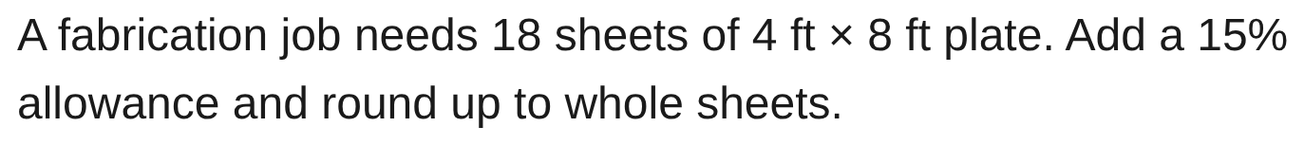
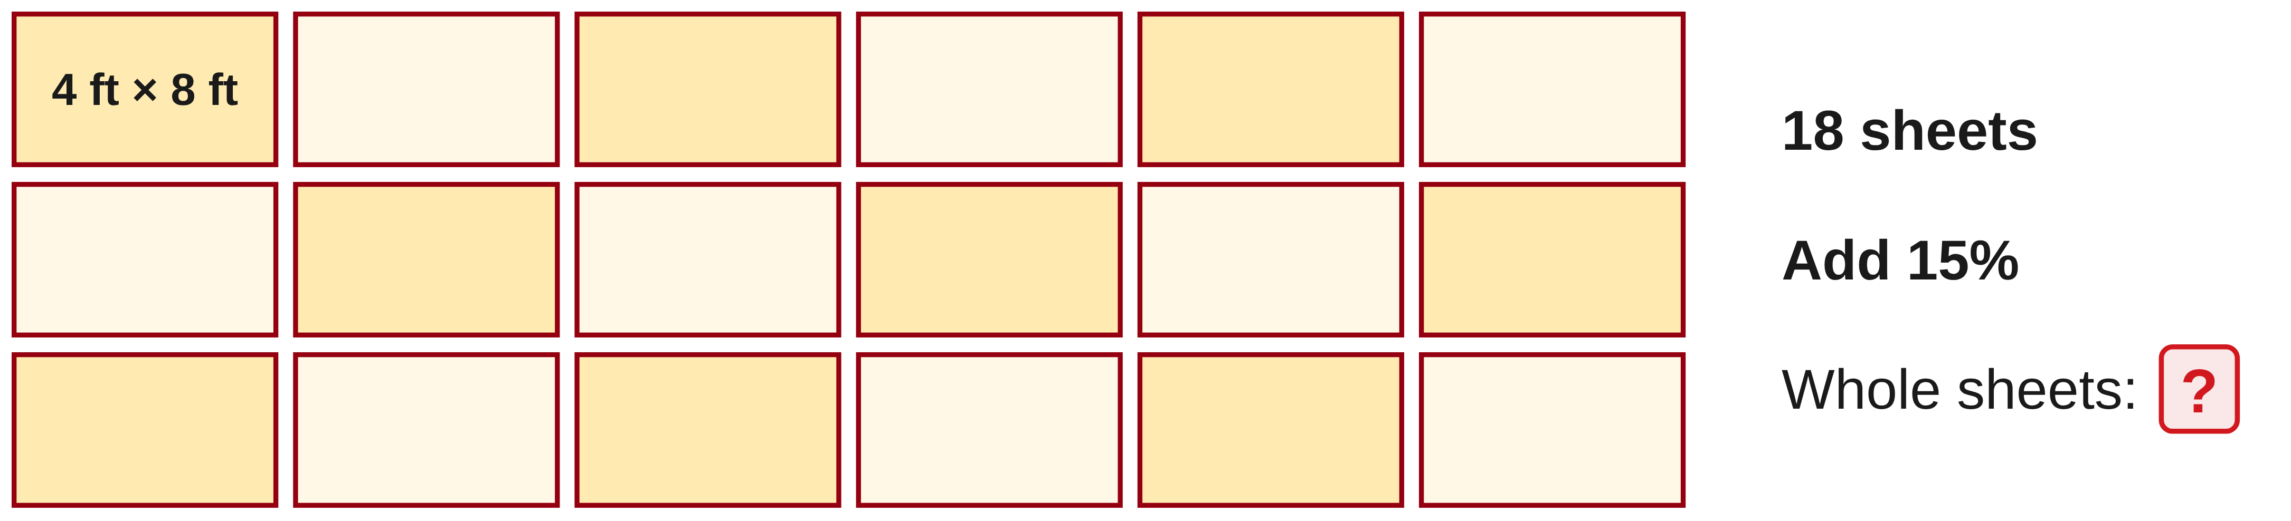
W08-L03 • INDEPENDENT CHECK • 9:20 AM–10:00 AM • 40 MIN TOTAL
Readiness question 3 of 12 | 6B Q2
Independent readiness check. Record all working on your numbered response page.
Textbook formula sheet p.219; conversion factors pp.220–221 permitted for this proposed formative check
Textbook
Exercise Book
Numeracy Hub
Shape Canvas
Day 26 • 2026-12-16 • 12
Notes:
INDEPENDENT CHECK • 9:20 AM–10:00 AM • 40 MIN TOTAL — shared across this phase’s slides.
Item three is 6B Q2. A fabrication job needs eighteen sheets of four-foot by eight-foot plate. Add the stated fifteen-percent allowance and report the whole-sheet order. Record your own working beside number three; do not consult a worked solution.
INSTRUCTOR ONLY — AFTER COLLECTION, NOT TO BE READ OR USED AS COACHING DURING THE CHECK: 18 × 1.15 = 20.7 sheets; round up to 21 whole sheets. Equivalently, allowance is 18 × 0.15 = 2.7, then 18 + 2.7 = 20.7. Check the allowance is added to the base.

Slide 13
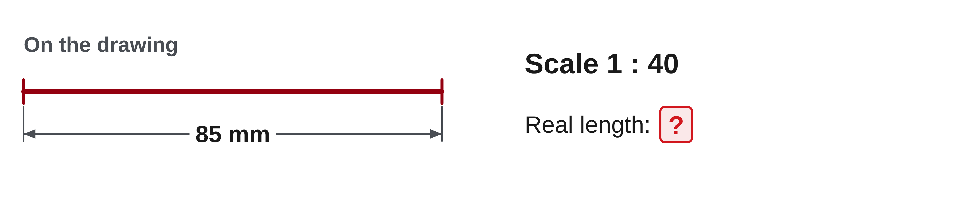
W08-L03 • INDEPENDENT CHECK • 9:20 AM–10:00 AM • 40 MIN TOTAL
Readiness question 4 of 12 | 6A Q19
Independent readiness check. Record all working on your numbered response page.
Textbook formula sheet p.219; conversion factors pp.220–221 permitted for this proposed formative check
Textbook
Exercise Book
Numeracy Hub
Shape Canvas
Day 26 • 2026-12-16 • 13
Notes:
INDEPENDENT CHECK • 9:20 AM–10:00 AM • 40 MIN TOTAL — shared across this phase’s slides.
Item four is 6A Q19. The scale is one to forty and the line on the drawing measures eighty-five millimetres. Find the real length and place your response beside number four. Continue independently, retaining the calculation and unit.
INSTRUCTOR ONLY — AFTER COLLECTION, NOT TO BE READ OR USED AS COACHING DURING THE CHECK: Actual length = 85 × 40 = 3,400 mm, equivalent to 3.4 m. The ratio means one drawing unit represents forty real units. Reverse division by forty checks the 85 mm drawing length.

Slide 14
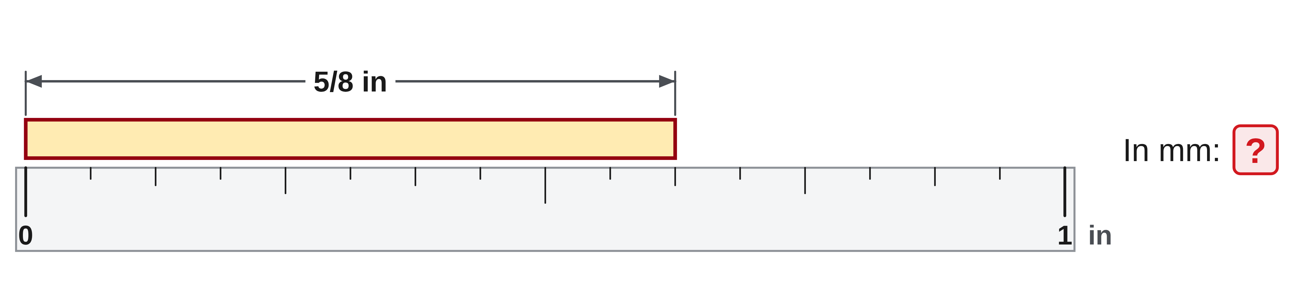
W08-L03 • INDEPENDENT CHECK • 9:20 AM–10:00 AM • 40 MIN TOTAL
Readiness question 5 of 12 | 7A Q11
Independent readiness check. Record all working on your numbered response page.
Textbook formula sheet p.219; conversion factors pp.220–221 permitted for this proposed formative check
Textbook
Exercise Book
Numeracy Hub
Shape Canvas
Day 26 • 2026-12-16 • 14
Notes:
INDEPENDENT CHECK • 9:20 AM–10:00 AM • 40 MIN TOTAL — shared across this phase’s slides.
Item five is 7A Q11: convert five eighths of an inch to millimetres. Record the conversion on your numbered response page. Use only the permitted materials and keep your result private while others are working.
INSTRUCTOR ONLY — AFTER COLLECTION, NOT TO BE READ OR USED AS COACHING DURING THE CHECK: 5/8 = 0.625 in; 0.625 × 25.4 = 15.875 mm. Check factor direction and inclusion of the starting and target units. Reverse conversion recovers 0.625 in. Do not supply the factor orally during the attempt.

Slide 15

W08-L03 • INDEPENDENT CHECK • 9:20 AM–10:00 AM • 40 MIN TOTAL
Readiness question 6 of 12 | 8C Q1
Independent readiness check. Record all working on your numbered response page.
Textbook formula sheet p.219; conversion factors pp.220–221 permitted for this proposed formative check
Textbook
Exercise Book
Numeracy Hub
Shape Canvas
Day 26 • 2026-12-16 • 15
Notes:
INDEPENDENT CHECK • 9:20 AM–10:00 AM • 40 MIN TOTAL — shared across this phase’s slides.
Item six is 8C Q1. Use the given rectangle diagram and its area of 4,800 square centimetres to find the width. Keep the diagram information with your working beside number six. The calculation remains independent.
INSTRUCTOR ONLY — AFTER COLLECTION, NOT TO BE READ OR USED AS COACHING DURING THE CHECK: With the diagram's 80 cm length, width = 4,800/80 = 60 cm. Substitution gives 80 × 60 = 4,800 cm². Check that the response is a length and that the stated diagram dimension is used.

Slide 16
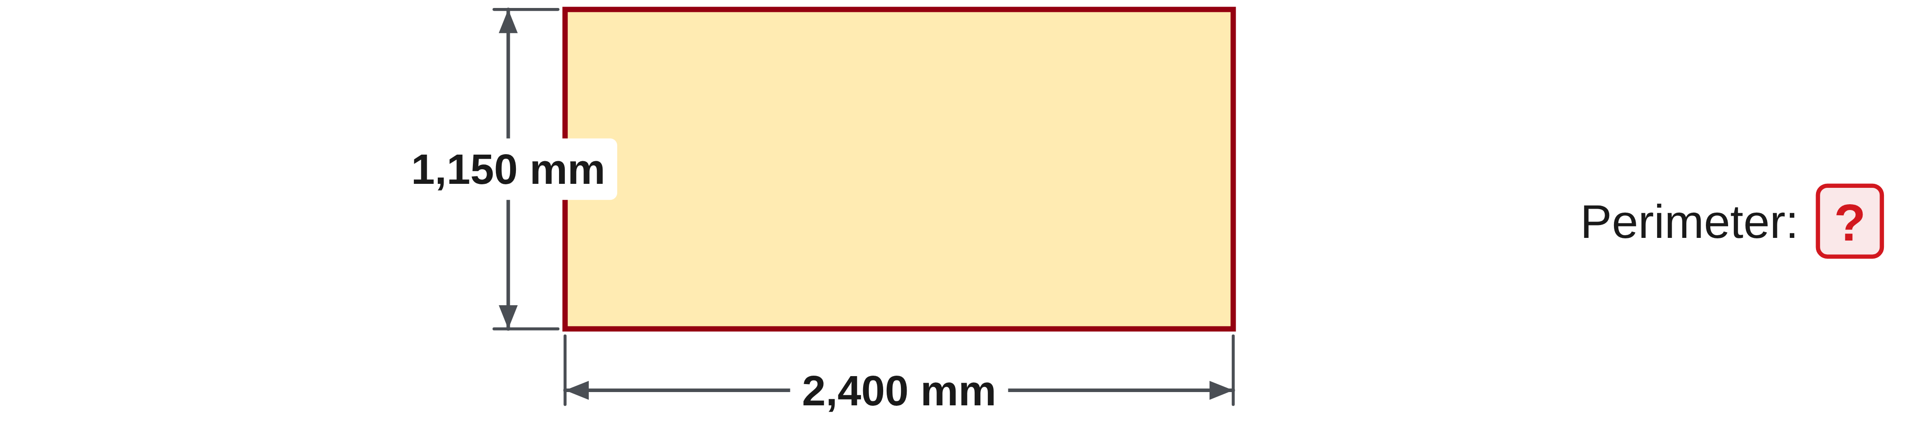
W08-L03 • INDEPENDENT CHECK • 9:20 AM–10:00 AM • 40 MIN TOTAL
Readiness question 7 of 12 | 9A Q1
Independent readiness check. Record all working on your numbered response page.
Textbook formula sheet p.219; conversion factors pp.220–221 permitted for this proposed formative check
Textbook
Exercise Book
Numeracy Hub
Shape Canvas
Day 26 • 2026-12-16 • 16
Notes:
INDEPENDENT CHECK • 9:20 AM–10:00 AM • 40 MIN TOTAL — shared across this phase’s slides.
Item seven is 9A Q1. Find the perimeter of the rectangle that measures 2,400 millimetres by 1,150 millimetres. Place your own working and answer beside number seven. Keep solution discussions until after the work has been collected.
INSTRUCTOR ONLY — AFTER COLLECTION, NOT TO BE READ OR USED AS COACHING DURING THE CHECK: P = 2(2,400 + 1,150) = 2 × 3,550 = 7,100 mm. Adding all four sides gives the same result. An answer of 3,550 mm counts only half the boundary.

Slide 17
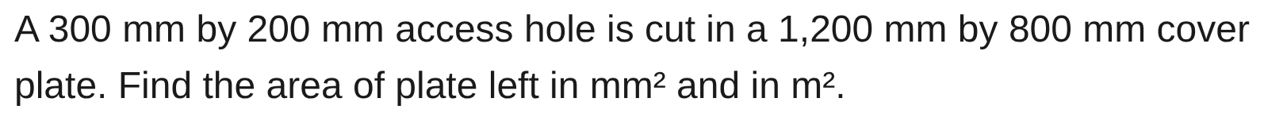
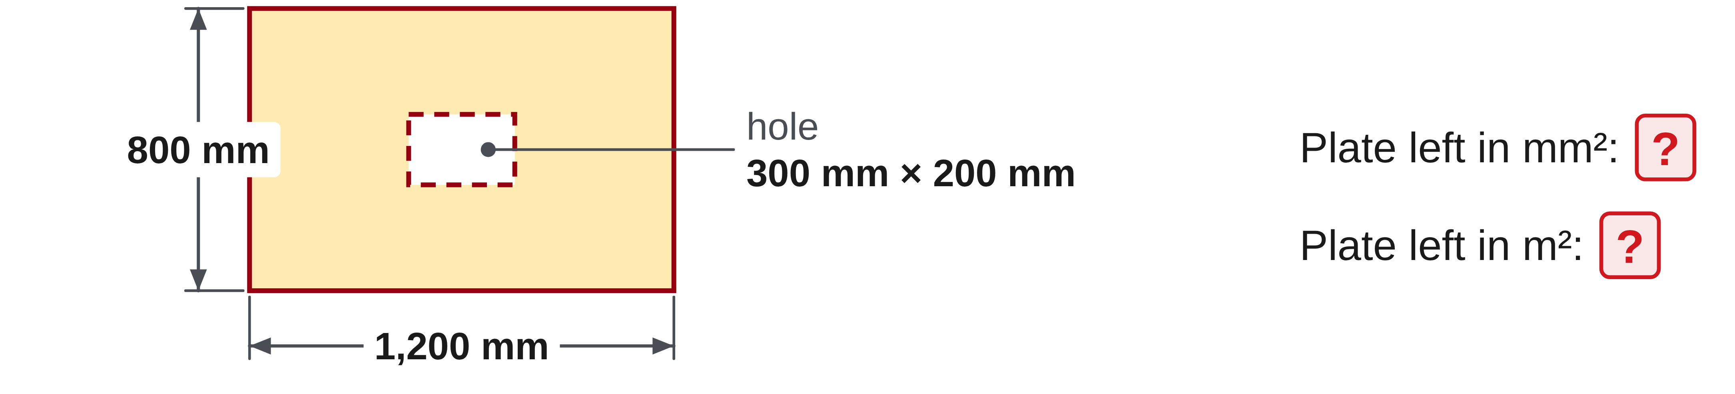
W08-L03 • INDEPENDENT CHECK • 9:20 AM–10:00 AM • 40 MIN TOTAL
Readiness question 8 of 12 | 10B Q11
Independent readiness check. Record all working on your numbered response page.
Textbook formula sheet p.219; conversion factors pp.220–221 permitted for this proposed formative check
Textbook
Exercise Book
Numeracy Hub
Shape Canvas
Day 26 • 2026-12-16 • 17
Notes:
INDEPENDENT CHECK • 9:20 AM–10:00 AM • 40 MIN TOTAL — shared across this phase’s slides.
Item eight is 10B Q11. The prompt gives a 300 by 200-millimetre hole in a 1,200 by 800-millimetre plate. Find the area left in both requested units: square millimetres and square metres. Record the complete response beside number eight.
INSTRUCTOR ONLY — AFTER COLLECTION, NOT TO BE READ OR USED AS COACHING DURING THE CHECK: Outer area 960,000 mm² minus opening 60,000 mm² gives 900,000 mm². Dividing by 1,000,000 gives 0.9 m². Check that the opening is removed once and the area conversion uses the squared length factor.

Slide 18
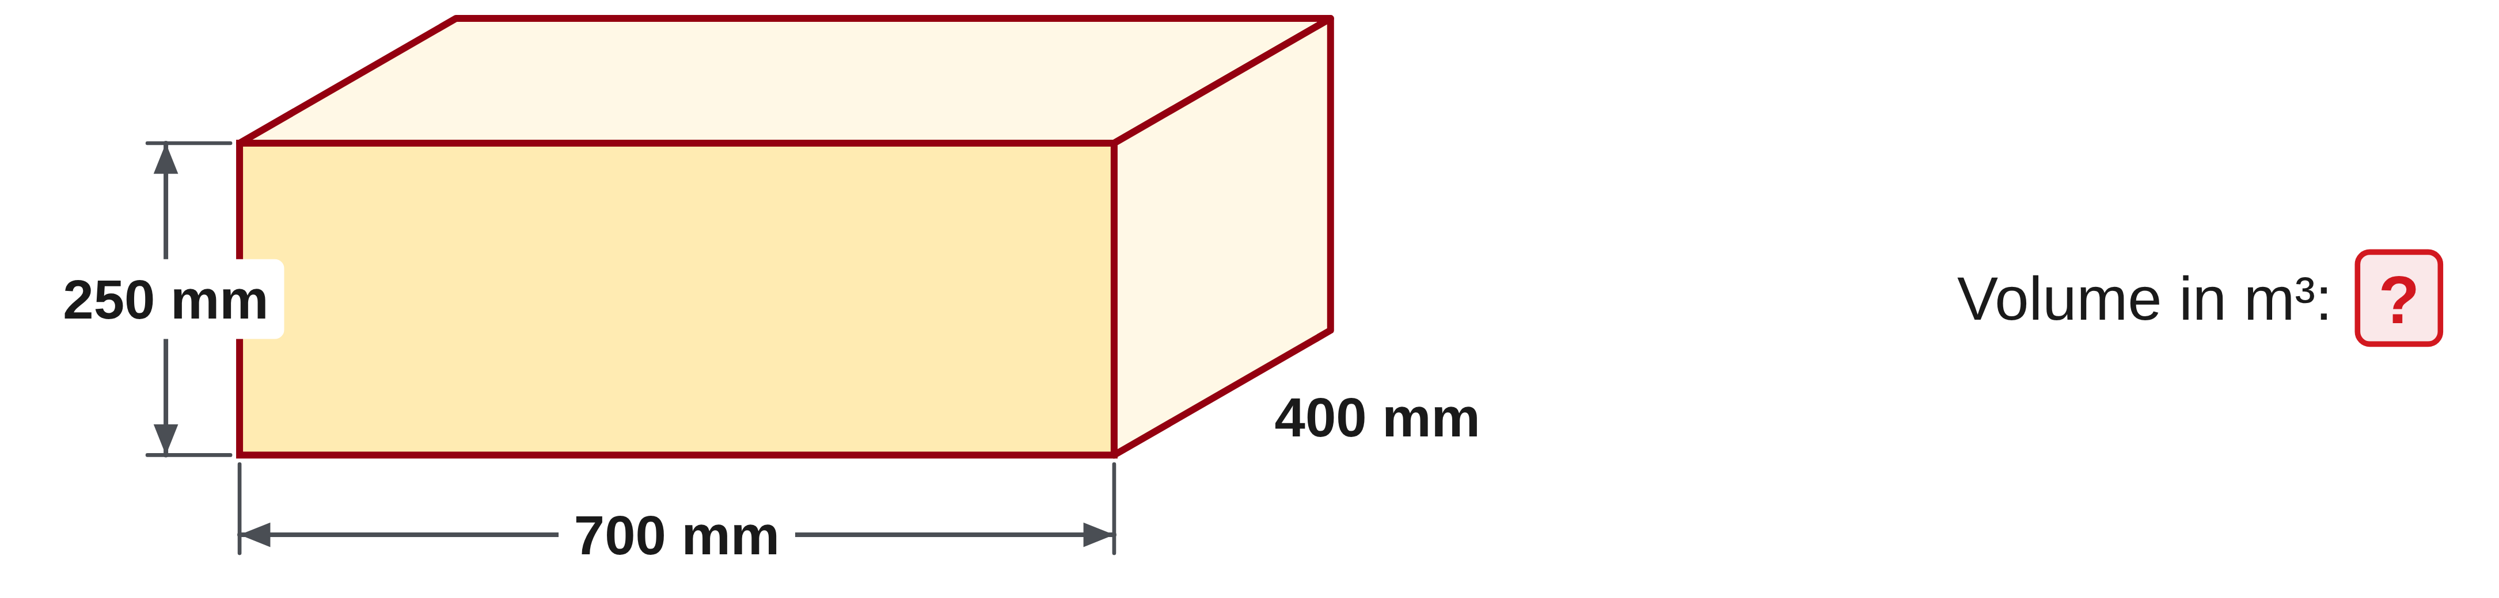
W08-L03 • INDEPENDENT CHECK • 9:20 AM–10:00 AM • 40 MIN TOTAL
Readiness question 9 of 12 | 11A Q7
Independent readiness check. Record all working on your numbered response page.
Textbook formula sheet p.219; conversion factors pp.220–221 permitted for this proposed formative check
Textbook
Exercise Book
Numeracy Hub
Shape Canvas
Day 26 • 2026-12-16 • 18
Notes:
INDEPENDENT CHECK • 9:20 AM–10:00 AM • 40 MIN TOTAL — shared across this phase’s slides.
Item nine is 11A Q7. The box measures 700 millimetres by 400 millimetres by 250 millimetres. Find the volume in cubic metres and keep the working beside number nine. Continue without consulting any worked-answer display.
INSTRUCTOR ONLY — AFTER COLLECTION, NOT TO BE READ OR USED AS COACHING DURING THE CHECK: Convert dimensions to 0.7 m, 0.4 m and 0.25 m; product = 0.07 m³. Alternatively, 70,000,000 mm³ divided by 1,000,000,000 equals 0.07 m³. Check cubic rather than linear conversion.

Slide 19
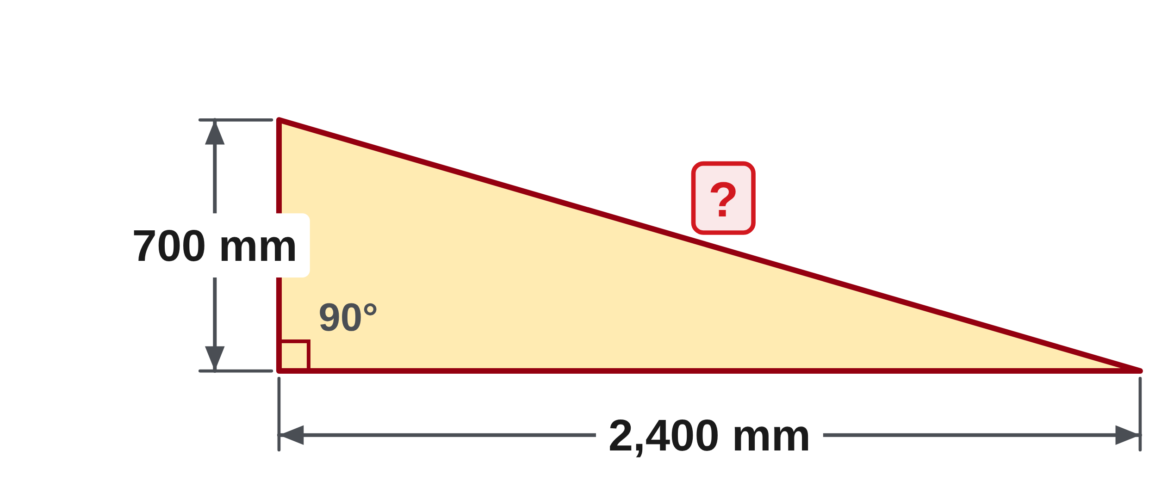
W08-L03 • INDEPENDENT CHECK • 9:20 AM–10:00 AM • 40 MIN TOTAL
Readiness question 10 of 12 | 12A Q10
Independent readiness check. Record all working on your numbered response page.
Textbook formula sheet p.219; conversion factors pp.220–221 permitted for this proposed formative check
Textbook
Exercise Book
Numeracy Hub
Shape Canvas
Day 26 • 2026-12-16 • 19
Notes:
INDEPENDENT CHECK • 9:20 AM–10:00 AM • 40 MIN TOTAL — shared across this phase’s slides.
Item ten is 12A Q10. The two legs are 700 millimetres and 2,400 millimetres. Find the hypotenuse and record your method beside number ten. Keep the response independent; we will review the reasoning after collection.
INSTRUCTOR ONLY — AFTER COLLECTION, NOT TO BE READ OR USED AS COACHING DURING THE CHECK: c = √(700² + 2,400²) = √(490,000 + 5,760,000) = √6,250,000 = 2,500 mm. The hypotenuse exceeds both legs. Check that the final square root is included.

Slide 20
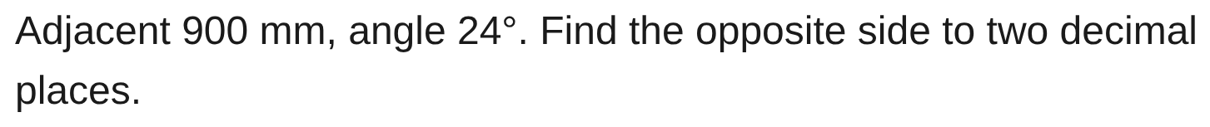
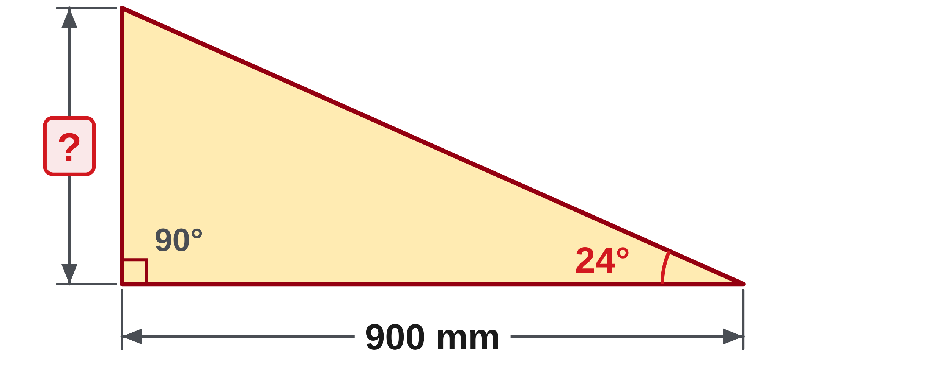
W08-L03 • INDEPENDENT CHECK • 9:20 AM–10:00 AM • 40 MIN TOTAL
Readiness question 11 of 12 | 13A Q6
Independent readiness check. Record all working on your numbered response page.
Textbook formula sheet p.219; conversion factors pp.220–221 permitted for this proposed formative check
Textbook
Exercise Book
Numeracy Hub
Shape Canvas
Day 26 • 2026-12-16 • 20
Notes:
INDEPENDENT CHECK • 9:20 AM–10:00 AM • 40 MIN TOTAL — shared across this phase’s slides.
Item eleven is 13A Q6. The adjacent side is 900 millimetres and the marked angle is 24 degrees. Find the opposite side to two decimal places. Record the full response beside number eleven and keep all reasoning on the page.
INSTRUCTOR ONLY — AFTER COLLECTION, NOT TO BE READ OR USED AS COACHING DURING THE CHECK: tan 24° = opposite/900; opposite = 900 × tan 24° ≈ 400.71 mm in DEG mode. Check the selected side pair and final rounding. Do not name the function during the attempt.

Slide 21
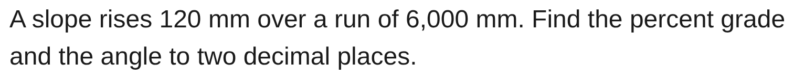
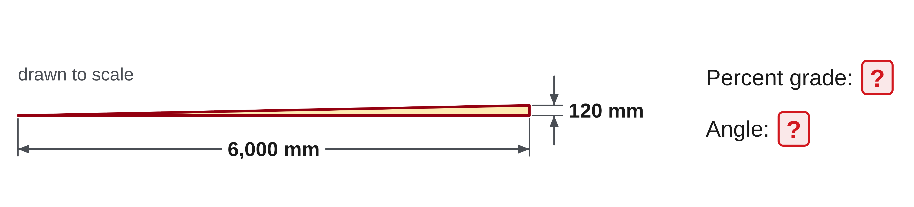
W08-L03 • INDEPENDENT CHECK • 9:20 AM–10:00 AM • 40 MIN TOTAL
Readiness question 12 of 12 | 13A Q14
Independent readiness check. Record all working on your numbered response page.
Textbook formula sheet p.219; conversion factors pp.220–221 permitted for this proposed formative check
Textbook
Exercise Book
Numeracy Hub
Shape Canvas
Day 26 • 2026-12-16 • 21
Notes:
INDEPENDENT CHECK • 9:20 AM–10:00 AM • 40 MIN TOTAL — shared across this phase’s slides.
Item twelve is 13A Q14. The slope rises 120 millimetres over a run of 6,000 millimetres. Report percentage grade and angle to the requested precision as separate answers. Complete your own working beside number twelve, then review your response page within the remaining time.
INSTRUCTOR ONLY — AFTER COLLECTION, NOT TO BE READ OR USED AS COACHING DURING THE CHECK: Ratio 120/6,000 = 0.02. Grade = 0.02 × 100 = 2%; angle = tan⁻¹(0.02) ≈ 1.15° in DEG mode. The percent and degree results describe the same slope on different scales.

Slide 22
W08-L03 • COLLECT & REFLECT • 10:00 AM–10:10 AM • 10 MIN TOTAL
Collect and reflect
Submit your work and identify two items you were uncertain about. Describe whether the difficulty involved the concept, operation, calculator entry or units.
Submit work and demonstrate the checking strategy; identify a remaining difficulty.
Resources: Set in order: 4A Q14(a) p.26; 5A Q12 first value p.33; 6B Q2 p.41; 6A Q19 p.40; 7A Q11 p.45; 8C Q1 p.55; 9A Q1 p.57; 10B Q11 p.66; 11A Q7 p.69; 12A Q10 p.76; 13A Q6,14 p.82.
Textbook formula sheet p.219; conversion factors pp.220–221 permitted for this proposed formative check
Textbook
Exercise Book
Numeracy Hub
Shape Canvas
Day 26 • 2026-12-16 • 22
Notes:
COLLECT & REFLECT • 10:00 AM–10:10 AM • 10 MIN TOTAL — shared across this phase’s slides.
The independent period is finished. Please stop working and submit the response page before we discuss solutions. On your reflection, identify two items you felt uncertain about. Describe the difficulty as precisely as you can: understanding the quantity, choosing an operation, calculator entry or units. You do not need to announce a score or compare with a neighbour. That description will help us choose the correction work after the break while preserving the independent attempt as it was completed.

Slide 23
W08-L03 • WRAP UP • 10:10 AM–10:15 AM • 5 MIN TOTAL
Wrap up and choose the next step
Identify what improved, what needs another attempt and which resource will support the next step.
Name the math and another essential skill used; record a concrete follow-up action.
Resources: Set in order: 4A Q14(a) p.26; 5A Q12 first value p.33; 6B Q2 p.41; 6A Q19 p.40; 7A Q11 p.45; 8C Q1 p.55; 9A Q1 p.57; 10B Q11 p.66; 11A Q7 p.69; 12A Q10 p.76; 13A Q6,14 p.82.
Textbook formula sheet p.219; conversion factors pp.220–221 permitted for this proposed formative check
Textbook
Exercise Book
Numeracy Hub
Shape Canvas
Day 26 • 2026-12-16 • 23
Notes:
WRAP UP • 10:10 AM–10:15 AM • 5 MIN TOTAL — shared across this phase’s slides.
The readiness check gives us evidence for the next learning step. A missed item is most useful when we understand the cause, and a correct item is strongest when the method is clear. Keep your reflection on the two uncertain questions. After the break, we will choose corrections and fresh questions that match your actual needs. We will not treat a not-yet-taught skill as a failed independent skill or turn this classroom check into an official entry-exam judgment.

Slide 24
DAY 26 • SCHEDULED BREAK
Break
10:15 AM–10:30 AM
Return ready for: Corrections and a personal practice plan
This break is excluded from teaching minutes.
Textbook
Exercise Book
Numeracy Hub
Shape Canvas
Day 26 • 2026-12-16 • 24
Notes:
Scheduled break — resume at the time shown.
Take the scheduled break and return at 10:30. When we resume, your work will be returned privately and we will focus on methods to improve. Bring your textbook and calculator back ready. The next block includes corrections, fresh independent attempts and a personal plan for two priority skills.

Slide 25
W08-L04 • START • 10:30 AM–10:35 AM • 5 MIN TOTAL
Corrections and a personal practice plan
Today’s goal: Correct a demonstrated error, solve a fresh problem of the same type and plan continued practice.
Identify one target skill and the checking habit to use today.
Textbook relevant chapters from readiness errors; formula sheet p.219; glossary pp.222–225
Choose missed types from the readiness set. Fresh checks: 4A Q15(b) p.26; 7A Q12 p.45; 10A Q6 p.63; 12A Q12 p.76; 13A Q10 p.82.
Keep your notebook, textbook, exercise book and chosen calculator ready.
Textbook relevant chapters from readiness errors; formula sheet p.219; glossary pp.222–225
Textbook
Exercise Book
Numeracy Hub
Shape Canvas
Day 26 • 2026-12-16 • 25
Notes:
START • 10:30 AM–10:35 AM • 5 MIN TOTAL — shared across this phase’s slides.
The next block turns the readiness evidence into useful practice. Choose two errors to understand, not simply two answers to replace. We will keep the original method, explain where it failed, work a correction and try fresh values. The textbook chapter, formula sheet and glossary can help make the explanation precise. What will show that the repair worked? A new response in the same skill that you can complete and check independently.

Slide 26
W08-L04 • RECALL • 10:35 AM–10:40 AM • 5 MIN TOTAL
Recall and reconnect
Return the readiness work privately; ask each learner to choose two errors to understand rather than only counting a score.
Review previous feedback and attempt the retrieval prompt without displayed solutions.
Resources: Choose missed types from the readiness set. Fresh checks: 4A Q15(b) p.26; 7A Q12 p.45; 10A Q6 p.63; 12A Q12 p.76; 13A Q10 p.82.
Textbook relevant chapters from readiness errors; formula sheet p.219; glossary pp.222–225
Textbook
Exercise Book
Numeracy Hub
Shape Canvas
Day 26 • 2026-12-16 • 26
Notes:
RECALL • 10:35 AM–10:40 AM • 5 MIN TOTAL — shared across this phase’s slides.
Look privately at your returned work and choose two priorities. A correct final number with unclear reasoning can still deserve attention; a clear method with one arithmetic slip needs a different repair from a wrong formula. Name the step that caused the difficulty. What would help you distinguish those cases? The original working. Keep it visible, and select the relevant fresh checks from the list so the next attempt tests the same skill without repeating a memorized answer.

Slide 27
W08-L04 • TEACH • 10:40 AM–10:55 AM • 15 MIN TOTAL
Explain the step that failed
1
Use your private readiness feedback to choose two errors to understand, rather than only counting a score.
2
Keep the correction record in order: original method → why it failed → corrected working → independent retry.
3
Use the relevant Textbook chapter, formula sheet p.219 and glossary pp.222–225 to make the explanation precise.
4
Include a diagram and units where relevant. Pair-check one correction, then use the scheduled fresh checks to show the method independently.
Textbook relevant chapters from readiness errors; formula sheet p.219; glossary pp.222–225
Textbook
Exercise Book
Numeracy Hub
Shape Canvas
Day 26 • 2026-12-16 • 27
Notes:
TEACH • 10:40 AM–10:55 AM • 15 MIN TOTAL — shared across this phase’s slides.
Organize each correction in four parts: original method, reason it failed, corrected working and independent retry. Use mathematical words that identify the issue. For example, “I used a linear conversion factor for an area” is more informative than “I moved the decimal wrong.” The relevant textbook chapter and glossary can help you name the relationship. What should a diagram contribute? It should identify the given dimensions, unknown and units that justify the method. Then a partner can check one correction before you attempt fresh work independently.

Slide 28
W08-L04 • TEACH • 10:40 AM–10:55 AM • 15 MIN TOTAL
Match the fresh attempt to the repaired skill
1
Choose from the listed fresh checks according to the skills shown by your readiness errors; they are not a new requirement to complete every topic.
2
A fresh problem of the same type tests the method without relying on a remembered answer.
3
If the five-question Hub set is used, select only taught weak topics and keep worked answers off until after the attempt.
4
Your practice plan names two skills, exact book pages, tool modules and a concrete next practice step.
Textbook relevant chapters from readiness errors; formula sheet p.219; glossary pp.222–225
Textbook
Exercise Book
Numeracy Hub
Shape Canvas
Day 26 • 2026-12-16 • 28
Notes:
TEACH • 10:40 AM–10:55 AM • 15 MIN TOTAL — shared across this phase’s slides.
Select fresh questions that match the two priority skills shown by your readiness work. The list includes fraction subtraction, conversion, area, Pythagoras and an angle question; it is not a requirement to complete every topic. New values test whether the method transfers beyond a remembered answer. If a five-question Numeracy Hub set is appropriate, use only taught weak topics and keep worked answers off until the attempt is complete. What belongs in the practice plan afterward? Two precise skills, exact book pages, tool modules and a next action you can actually carry out.

Slide 29
W08-L04 • TEACH • 10:40 AM–10:55 AM • 15 MIN TOTAL
Explain why the first method failed
Possible demonstration A • Regroup before subtraction.
5 1/4 − 2 3/8 = 4 10/8 − 2 3/8 = 2 7/8.
Check: 2 7/8 + 2 3/8 = 5 1/4. Explain why the whole was regrouped.
Possible demonstration B • Convert the entire mixed number.
1 3/4 in = 1.75 in; 1.75 × 25.4 = 44.45 mm.
Check: 44.45 ÷ 25.4 = 1.75 in—not 1.34 in.
Instructor • Choose the two most common actual errors; use different numbers.
Together • Pair-check one correction while the instructor supports
the highest-need group. Require a diagram and units where relevant.
These are fresh classroom demonstrations, not the independent retry questions.
Relevant Textbook chapters selected from readiness errors • Explain the change, do not copy an answer
Textbook
Exercise Book
Numeracy Hub
Shape Canvas
Day 26 • 2026-12-16 • 29
Notes:
TEACH • 10:40 AM–10:55 AM • 15 MIN TOTAL — shared across this phase’s slides.
For the first demonstration, five and one quarter minus two and three eighths needs common parts. One quarter is two eighths; regrouping one whole changes five and two eighths into four and ten eighths. Subtracting gives two and seven eighths. Adding back two and three eighths returns five and one quarter. For the conversion demonstration, one and three quarters is 1.75 inches, not 1.34. Multiplying 1.75 by 25.4 gives 44.45 millimetres. Which step preserves the original quantity in each example? Rewriting it in equivalent fractional or decimal form before operating.

Slide 30
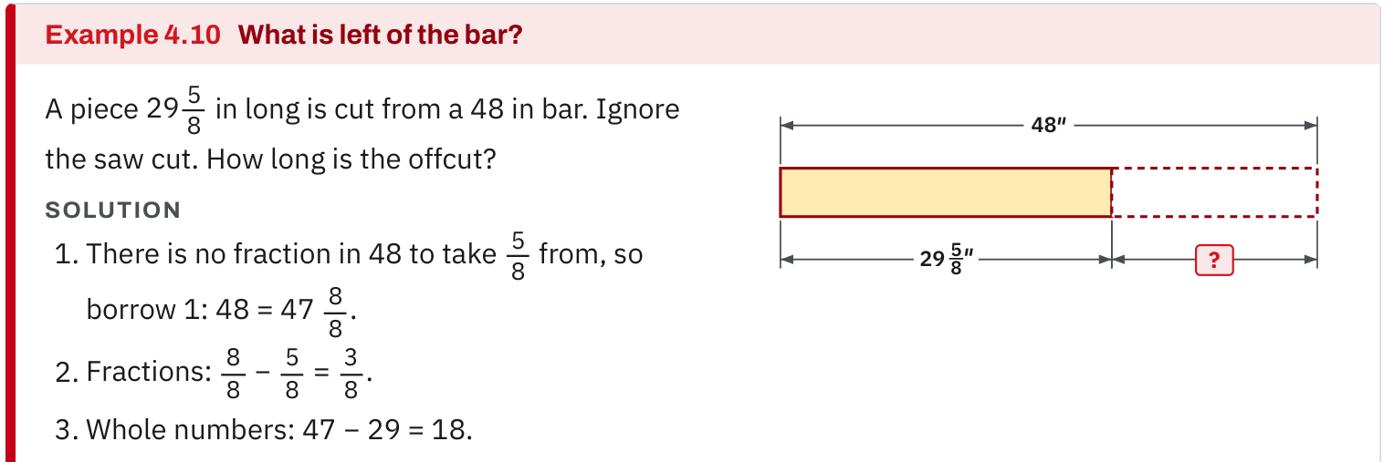
W08-L04 • TEACH • 10:40 AM–10:55 AM • 15 MIN TOTAL
Textbook | page 66
Use for a fraction priority: regrouping and an offcut diagram.
Textbook relevant chapters from readiness errors; formula sheet p.219; glossary pp.222–225
Textbook
Exercise Book
Numeracy Hub
Shape Canvas
Day 26 • 2026-12-16 • 30
Notes:
TEACH • 10:40 AM–10:55 AM • 15 MIN TOTAL — shared across this phase’s slides.
If fractions are your priority, use the regrouping explanation and offcut diagram on page 66. A length can be partitioned differently without changing its total. When the fractional part is too small for the subtraction, exchange one whole for a full denominator's worth of fractional parts. What must happen to the whole-number part? It decreases by one. What must happen to the fractional part? It gains an equivalent whole. Keeping both changes visible prevents the common error of adding fractional pieces without preserving the original total.

Slide 31
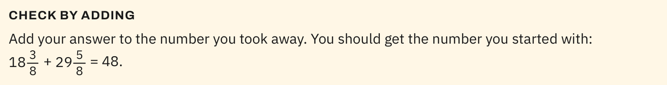
W08-L04 • TEACH • 10:40 AM–10:55 AM • 15 MIN TOTAL
Textbook | page 66
Use for a fraction priority: verify subtraction by adding back.
Textbook relevant chapters from readiness errors; formula sheet p.219; glossary pp.222–225
Textbook
Exercise Book
Numeracy Hub
Shape Canvas
Day 26 • 2026-12-16 • 31
Notes:
TEACH • 10:40 AM–10:55 AM • 15 MIN TOTAL — shared across this phase’s slides.
Now use the same page to check subtraction by adding back. The remaining length plus the removed length should reproduce the original length when no other loss is stated. In our demonstration, two and seven eighths plus two and three eighths gives four and ten eighths, which is five and one quarter. What does that confirm? The regrouping and subtraction preserved the quantity. If a different problem states kerf or another loss, that stated loss also belongs in the check. Use the conditions of the actual question rather than importing assumptions from another example.

Slide 32
W08-L04 • TEACH • 10:40 AM–10:55 AM • 15 MIN TOTAL
Spot the mistake. Explain the correction.
A correction replaces the wrong result with the answer-key result and says “I understand.” What evidence is missing?
Discuss the method before checking the answer.
Explain why the original method failed, retain corrected working, and complete a fresh question in the priority skill independently with a checking strategy. The new attempt provides evidence that the method has improved.
Textbook relevant chapters from readiness errors; formula sheet p.219; glossary pp.222–225
Textbook
Exercise Book
Numeracy Hub
Shape Canvas
Day 26 • 2026-12-16 • 32
Notes:
TEACH • 10:40 AM–10:55 AM • 15 MIN TOTAL — shared across this phase’s slides.
Replacing a wrong result with the answer-key number does not tell us which idea changed. A useful correction explains the failed step and keeps the repaired working visible. Then a fresh independent response shows whether you can apply the idea without the answer in front of you. What evidence would support a repaired conversion? The starting unit, factor direction, resulting unit and a successful reverse check. A sentence saying “I understand” is a claim; the new method and check give us something concrete to examine together.

Slide 33
W08-L04 • TOGETHER • 10:55 AM–11:10 AM • 15 MIN TOTAL
Work together
Learners pair-check one correction while the instructor supports the highest-need group. Require a diagram and units where relevant.
Explain the method and check directions; work with a partner only where permitted.
Resources: Choose missed types from the readiness set. Fresh checks: 4A Q15(b) p.26; 7A Q12 p.45; 10A Q6 p.63; 12A Q12 p.76; 13A Q10 p.82.
Textbook relevant chapters from readiness errors; formula sheet p.219; glossary pp.222–225
Textbook
Exercise Book
Numeracy Hub
Shape Canvas
Day 26 • 2026-12-16 • 33
Notes:
TOGETHER • 10:55 AM–11:10 AM • 15 MIN TOTAL — shared across this phase’s slides.
Pair-check one correction while I work with the group needing the most support. Explain the original error without hiding it, then walk your partner through the repaired method. The checker asks whether the units, diagram and relationship agree and whether the proposed checking strategy would catch the old mistake. Keep this paired correction separate from the fresh independent check. Helping someone explain a method now is useful; doing their later attempt for them would hide what still needs practice.

Slide 34
W08-L04 • PRACTISE • 11:10 AM–11:45 AM • 35 MIN TOTAL
Your scheduled practice
Correct missed items, then solve fresh checks matching the same skills. Create a five-question Numeracy Hub set if appropriate; keep its code. Write a personal plan naming two skills, book pages and tool modules for continued study.
Keep numbered written solutions and units. Use tools only under the conditions stated for this block.
Resources: Choose missed types from the readiness set. Fresh checks: 4A Q15(b) p.26; 7A Q12 p.45; 10A Q6 p.63; 12A Q12 p.76; 13A Q10 p.82.
Textbook relevant chapters from readiness errors; formula sheet p.219; glossary pp.222–225
Textbook
Exercise Book
Numeracy Hub
Shape Canvas
Day 26 • 2026-12-16 • 34
Notes:
PRACTISE • 11:10 AM–11:45 AM • 35 MIN TOTAL — shared across this phase’s slides.
Correct the missed items in your two priority skills, then use the matching fresh questions from the list. If appropriate, create an Easy five-question Numeracy Hub set using only the taught weak topics and retain its code. Keep worked answers off until the attempt is complete. Write a personal plan naming the two skills, exact book pages and tool modules you will use next. A plan should tell you what to do when you reopen it, not merely say “study more.”

Slide 35
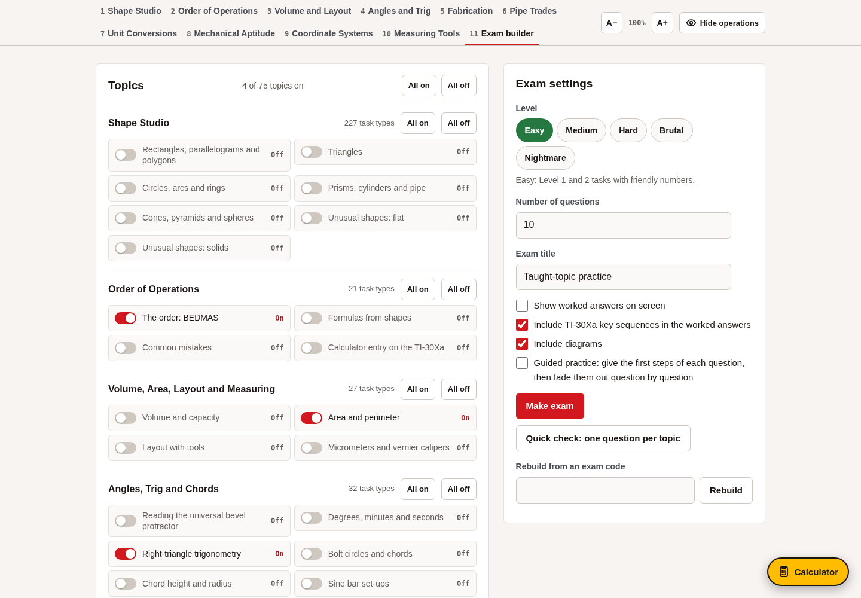
W08-L04 • PRACTISE • 11:10 AM–11:45 AM • 35 MIN TOTAL
Open Numeracy Hub
Navigation example. Use the values and units in the assigned task.
Textbook relevant chapters from readiness errors; formula sheet p.219; glossary pp.222–225
Textbook
Exercise Book
Numeracy Hub
Shape Canvas
Day 26 • 2026-12-16 • 35
Notes:
PRACTISE • 11:10 AM–11:45 AM • 35 MIN TOTAL — shared across this phase’s slides.
Open Numeracy Hub only for the taught weak topics selected from your feedback. If using Exam builder, choose Easy and five questions, save the code and leave worked answers off. The numbers in a generated task belong to that saved question, so retain the prompt or code with your method. What will you compare after the attempt? Your steps with the worked solution for that exact set. A different generated set cannot serve as its answer key.

Slide 36
W08-L04 • PRACTISE • 11:10 AM–11:45 AM • 35 MIN TOTAL
Practise in Numeracy Hub and Shape Canvas
1
After the written attempt, use Shape Canvas to rebuild one missed diagram and connect its labels to the corrected method and units.
2
If appropriate during the scheduled practice, create a Numeracy Hub Exam builder set with only taught weak topics: Easy, 5 questions, worked answers off. Retain its code and written attempts.
3
Reveal worked answers only after the attempt to support corrections. Keep the code, corrected work and the two-skill plan with exact book pages and tool modules.
Textbook relevant chapters from readiness errors; formula sheet p.219; glossary pp.222–225
Textbook
Exercise Book
Numeracy Hub
Shape Canvas
Day 26 • 2026-12-16 • 36
Notes:
PRACTISE • 11:10 AM–11:45 AM • 35 MIN TOTAL — shared across this phase’s slides.
Use Shape Canvas to rebuild one missed diagram after the written attempt, connecting each label to the corrected equation and unit. If a short Numeracy Hub set is appropriate, retain the code and complete the five written responses before revealing answers. Then explain corrections alongside the original work. Which record should remain together at the end? The code, first attempts, corrected methods and your two-skill practice plan. Together they show both the evidence and the next action.

Slide 37
W08-L04 • PRACTISE • 11:10 AM–11:45 AM • 35 MIN TOTAL
Practise from the Exercise Book | 4A Q15b
Choose only fresh questions matching your two priority skills.
Textbook relevant chapters from readiness errors; formula sheet p.219; glossary pp.222–225
Textbook
Exercise Book
Numeracy Hub
Shape Canvas
Day 26 • 2026-12-16 • 37
Notes:
PRACTISE • 11:10 AM–11:45 AM • 35 MIN TOTAL — shared across this phase’s slides.
If fraction subtraction matches your priority, attempt 4A Q15(b) independently before looking at its solution. Keep the equivalent fractions and any regrouping visible. Once the fresh attempt has been completed and collected for checking, compare the repaired method with the earlier error; do not reveal the answer while someone is using this as their independent retry.
INSTRUCTOR ONLY — AFTER THE INDEPENDENT ATTEMPT: 9 1/8 − 4 3/4 = 8 9/8 − 4 6/8 = 4 3/8. Adding 4 3/8 to 4 3/4 returns 9 1/8.

Slide 38
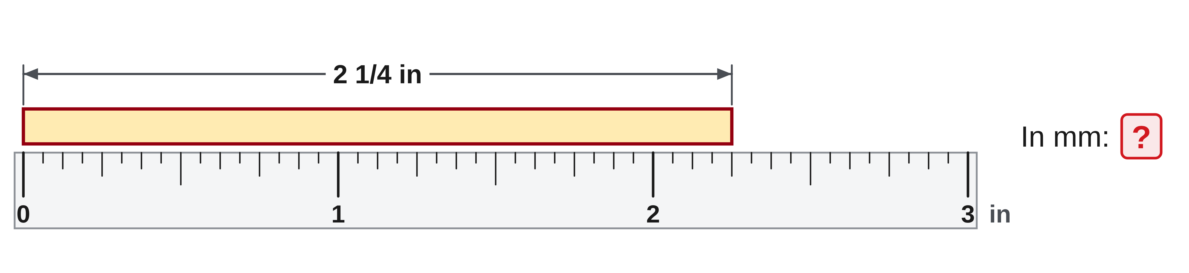
W08-L04 • PRACTISE • 11:10 AM–11:45 AM • 35 MIN TOTAL
Practise from the Exercise Book | 7A Q12
Choose only fresh questions matching your two priority skills.
Textbook relevant chapters from readiness errors; formula sheet p.219; glossary pp.222–225
Textbook
Exercise Book
Numeracy Hub
Shape Canvas
Day 26 • 2026-12-16 • 38
Notes:
PRACTISE • 11:10 AM–11:45 AM • 35 MIN TOTAL — shared across this phase’s slides.
If conversion matches your priority, attempt 7A Q12 with the entire mixed-number quantity included. Keep the starting and target units visible and show your check. Retain the independent attempt before using feedback; do not discuss the numerical result while others are using this as their fresh check.
INSTRUCTOR ONLY — AFTER THE INDEPENDENT ATTEMPT: 2 1/4 in = 2.25 in; 2.25 × 25.4 = 57.15 mm. The reverse check, 57.15/25.4, returns 2.25 in. The quarter must become 0.25, not digits appended to the whole.

Slide 39
W08-L04 • CHECK • 11:45 AM–11:55 AM • 10 MIN TOTAL
Check independently
Independently complete one fresh question in each priority skill and explain the checking strategy.
Submit work and demonstrate the checking strategy; identify a remaining difficulty.
Resources: Choose missed types from the readiness set. Fresh checks: 4A Q15(b) p.26; 7A Q12 p.45; 10A Q6 p.63; 12A Q12 p.76; 13A Q10 p.82.
Textbook relevant chapters from readiness errors; formula sheet p.219; glossary pp.222–225
Textbook
Exercise Book
Numeracy Hub
Shape Canvas
Day 26 • 2026-12-16 • 39
Notes:
CHECK • 11:45 AM–11:55 AM • 10 MIN TOTAL — shared across this phase’s slides.
Independently complete one fresh question in each of your two priority skills and explain the checking strategy. Use the selected items from the listed fresh checks. Keep worked answers closed during the attempt, and record any assistance separately. A successful response shows the repaired method on new values rather than a copied correction.
INSTRUCTOR ONLY — AFTER THE ATTEMPT: Fresh checks are 4A Q15(b) = 4 3/8; 7A Q12 = 57.15 mm; 10A Q6 = 2.56 m²; 12A Q12 = 1,500 mm; 13A Q10 = 23.63°. Use only the matching assigned items. Generated alternatives require their own saved-code worked answers.

Slide 40
W08-L04 • WRAP UP • 11:55 AM–12:00 PM • 5 MIN TOTAL
Wrap up and choose the next step
Identify what improved, what needs another attempt and which resource will support the next step.
Name the math and another essential skill used; record a concrete follow-up action.
Resources: Choose missed types from the readiness set. Fresh checks: 4A Q15(b) p.26; 7A Q12 p.45; 10A Q6 p.63; 12A Q12 p.76; 13A Q10 p.82.
Textbook relevant chapters from readiness errors; formula sheet p.219; glossary pp.222–225
Textbook
Exercise Book
Numeracy Hub
Shape Canvas
Day 26 • 2026-12-16 • 40
Notes:
WRAP UP • 11:55 AM–12:00 PM • 5 MIN TOTAL — shared across this phase’s slides.
Finish by naming your two priority skills and the exact resources for the next attempt. Include a book page, a tool module where useful and a concrete action such as “rework the missing-dimension question and substitute my answer back.” What evidence from today shows improvement? Point to a corrected explanation and a fresh independent response. If a step still needs support, write that honestly in the plan. Keep the work together so continued practice begins with a clear method and a useful check.

